Slide 1
B

Slide 2
01.03.2021
L.O. To be able to tell the time on a 24-hour clock.
Go to Times Tables Rock Stars to warm up your number brain before you start your maths activity.
Subject: Maths

Slide 3
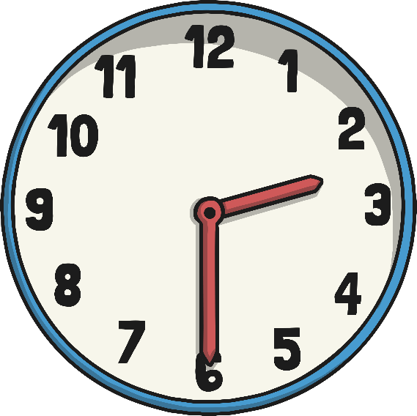
The 24 Hour Day
A day has 24 hours. A clock has 12 hours.
This means each time will happen twice every day.
half past 2 in the morning
half past 2 in the afternoon

Slide 4
a.m. and p.m.
We have to use a way to write these times differently. One way is to use a.m. and p.m.
a.m. (ante meridiem – before noon)
p.m. (post meridiem – after noon)
2:30 a.m.
2:30 p.m.

Slide 5
The 24 Hour Clock
Another way is to use a 24 hour clock.
This means the hours after 12 noon are converted to 13:00 to 23:00.
2:30
14:30
A 4 digit format is used. 2 digits for the hour, a colon (:) and 2 for the minutes.

Slide 6
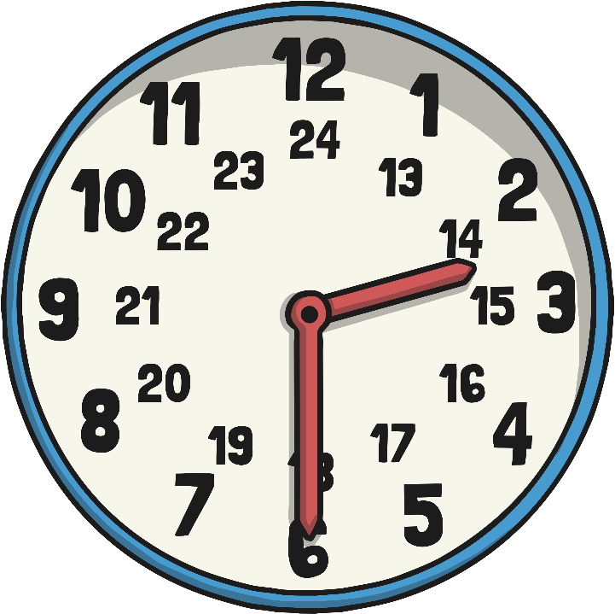
24 Hour Hours
This clock and table show the corresponding hours on a 24 hour clock.
0:00 = 12:00 AM | 12:00 = 12:00 PM
01:00 = 1:00 AM | 13:00 = 1:00 PM
02:00 = 2:00 AM | 14:00 = 2:00 PM
03:00 = 3:00 AM | 15:00 = 3:00 PM
04:00 = 4:00 AM | 16:00 = 4:00 PM
05:00 = 5:00 AM | 17:00 = 5:00 PM
06:00 = 6:00 AM | 18:00 = 6:00 PM
07:00 = 7:00 AM | 19:00 = 7:00 PM
08:00 = 8:00 AM | 20:00 = 8:00 PM
09:00 = 9:00 AM | 21:00 = 9:00 PM
10:00 = 10:00 AM | 22:00 = 10:00 PM
11:00 = 11:00 AM | 23:00 = 11:00 PM
Midnight is referred to as 00:00

Slide 7
24 Hour Time in the Morning
To convert between 12 and 24 hour time in the morning change the format.
6:00 a.m.
06:00
becomes
10:30
10:30 a.m.
becomes
The hours stay the same.

Slide 8
24 Hour Time in the Afternoon
To convert between 12 and 24 hour time in the afternoon add or subtract 12 hours and change the format.
6:00 p.m. becomes 18:00
22:30 becomes 10:30 p.m.

Slide 9
Have a try at converting 12 to 24 hour
Remember:
To convert between 12 and 24 hour time in the afternoon add or subtract 12 hours and change the format
To convert between 12 and 24 hour time in the morning change the format but the hours stay the same.
12 hour time
24 hour time
2:45 a.m.
10:20 a.m.
1:55 p.m.
3:05 p.m.

Slide 10
How did you do?
12 hour time
24 hour time
2:45 a.m.
02:45
10:20 a.m.
10:20
1:55 p.m.
13:55
3:05 p.m.
15:05

Slide 11
Convert 24 to 12 hour
Convert these times to 12 hour time
24 hour time
12 hour time
03:15
11:15
14:45
16:20

Slide 12
How did you do?
Convert these times to 12 hour time
24 hour time
12 hour time
03:15
3:15 a.m.
11:15
11:15 a.m.
14:45
2:45 p.m.
16:20
4:20 p.m.

Slide 13
Match the times to the correct clock
9 o’clock in the morning
Half past 3 in the afternoon
25 past 7 in the morning
Half 11 in the evening
20 past six in the morning
Quarter to 9 in the evening
20:45
07:25
23:30
09:00
15:30
06:20

Slide 14
Complete the sentences
Quarter to two in the __________ Quarter past three in the afternoon
Twenty past elven in the __________ Twenty-five to six in the evening
Ten to four in the __________ Twenty to 9 in the morning

Slide 15
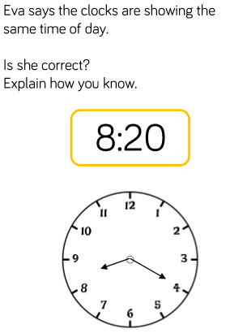
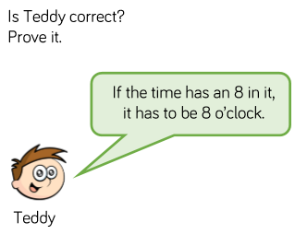
Complete the challenges

Slide 16
02.03.2021
L.O. To be able to find a duration of time
Go to Times Tables Rock Stars to warm up your number brain before you start your maths activity.
Subject: Maths

Slide 17
Pre-recorded Teaching
Access the online teaching video below that will support you to complete the work in this lesson. This video will act as a support but all of the work can still be successfully understood & completed using paper-based versions of this pack. If you need further support to understand / complete work then please contact school via e-mail or telephone.
Play Video
You can also copy and paste this link if you would prefer:
https://classroom.thenational.academy/lessons/calculating-and-comparing-intervals-of-time-6gw3jc?activity=video&step=1

Slide 18
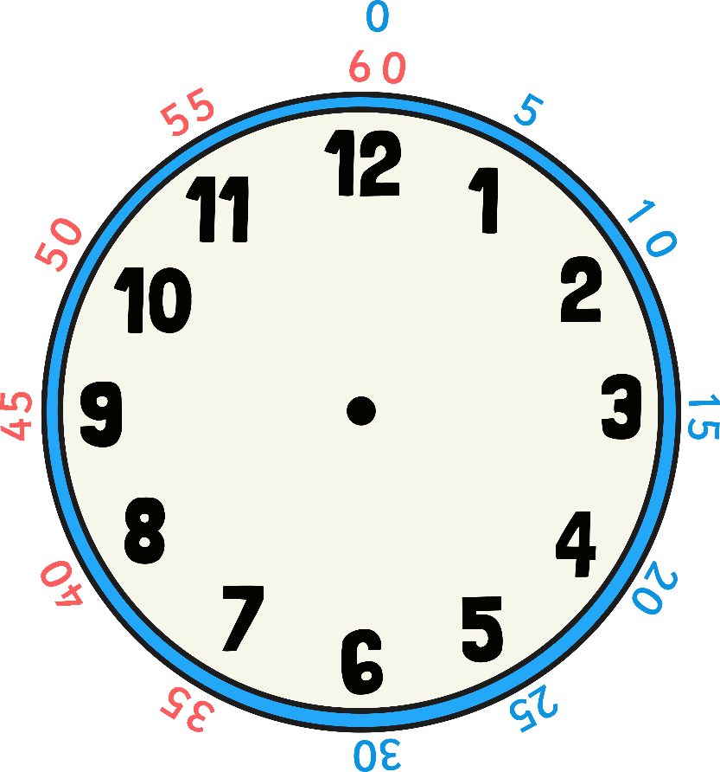
When we find durations of time we need to look at the start time and count on until we get to the end time.
This is the start time of a movie
This is the end time of a movie
+ 2 hours
+ 5 minutes
2 hours + 5 minutes = 2 hours and 5 minutes
The total duration of the movie is 2 hours and 5 minutes.
01:20
03:20
03:25

Slide 19
Durations of time – How long is the bus journey?
I get on the bus at this time.
I arrive at school at this time.
+ 1 hour
+ 30 minutes
1 hour + 30 minutes = 1 hour and 30 minutes.
The total journey time is 1 hour and 30 minutes.
07:30
08:30
09:00

Slide 20
Duration of time on a digital clock.
A tennis match starts at this time.
1
9
3
4
A tennis match ends at this time.
1
6
2
5
+ 3 hours
+ 5 minutes
+ 4 minutes
16:25
19:25
19:30
19:34
3 hours + 5 minutes + 4 minutes = 3 hours and 9 minutes
The total time is 3 hours and 9 minutes

Slide 21
Duration of time on a digital clock.
A concert starts at this time.
2
2
5
5
It ends at this time.
1
8
3
0
+ 4 hours
+ 5 minutes
+ 5 minutes
+ 5 minutes
+ 5 minutes
+ 5 minutes
18:30
22:30
22:35
22:40
22:45
22:50
22:55
4 hours + 5 + 5+ 5 + 5 +5 = 4 hours and 25 minutes
The duration of the concert is 4 hours and 25 minutes.

Slide 22
Complete the table
TV Programme | Start Time | Finish Time | Duration
The football show | 12:00 | 14:22
An adventure | 10:40 | 12:44
+ 2 hours
+ 20 minutes
+ 22 minutes
12:00
+ 2 hours
+ 40 minutes
+ 44 minutes
10:40

Slide 23
How did you do?
TV Programme | Start Time | Finish Time | Duration
The football show | 12:00 | 14:22 | 2hours and 22 minutes
An adventure | 10:40 | 12:44 | 2 hours and 4 minutes

Slide 24
Complete the table – you can use a number line to help you
TV Programme | Start Time | Finish Time | Duration
Pals | 06:30 | 08:30
Dennis the explorer | 15:15 | 16:45
The football show | 12:00 | 13:32
An adventure | 10:40 | 12:40
Bob and Bill | 16:40 | 17:15
The twisters | 11:30 | 14:30

Slide 25
Complete the questions
Example:
Rosie started running at 7:20 a.m. and stopped at 8:45 a.m.
How many minutes dud she run for?
For these questions you will need to work out how many hours and minutes first.
So we know that she ran for 1 full hour and 25 minutes.
We know 60 minutes are in 1 hour so it would be 60+45=105
So Rosie ran for 105 minutes.

Slide 26
Complete the questions.
Tommy started running at 09:10 and finished at 10:25. How many minutes did he run for?
Amy started running at 13:50 and finished at 16:55. How many minutes did she run for?
Tony started running at 14:30 and finished at 16:35. How many minutes did he run for?
Jodie started running at 16:45 and finished at 18:45. How many minutes did she run for?

Slide 27
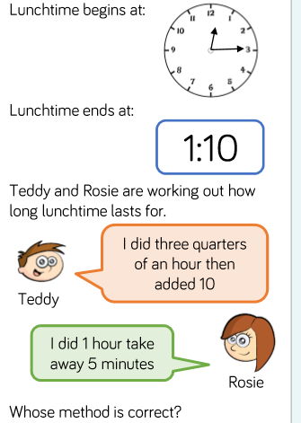
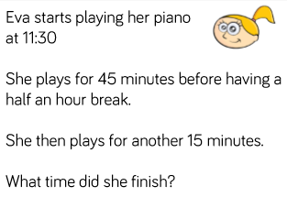
Complete the challenges

Slide 28
03.03.2021
L.O. To be able to compare durations of time
Go to Times Tables Rock Stars to warm up your number brain before you start your maths activity.
Subject: Maths

Slide 29
Pre-recorded Teaching
Access the online teaching video below that will support you to complete the work in this lesson. This video will act as a support but all of the work can still be successfully understood & completed using paper-based versions of this pack. If you need further support to understand / complete work then please contact school via e-mail or telephone.
Play Video
You can also copy and paste this link if you would prefer:
https://classroom.thenational.academy/lessons/calculating-and-comparing-intervals-of-time-6gw3jc?activity=video&step=1

Slide 30
Put these in order from the longest time to the shortest
Space Wars
2 hours and 35 mins
The Tiger King
2 hours and 20 mins
Revengers
1 hour and 50 mins
Wonder Girl
1 hour and 45 mins
Spider Boy
1 hour and 30 mins
Pet Adventure
2 hours and 15 mins

Slide 31
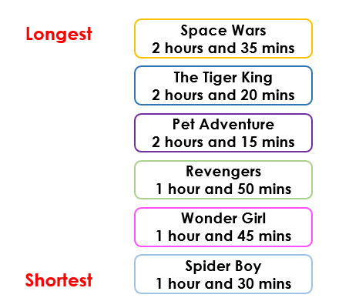
How did you do?

Slide 32
When we compare durations of time we first need to know the lengths of time we are comparing
Which train takes the longest?
Destination | Train departs | Train arrives
London | 08:45 | 11:35
Leeds | 10:05 | 10:33
The first thing we need to do is work out the length of time the London train takes.
We can use a number line to help us.
+ 15 minutes
+ 2 hours
+ 35 minutes
15 minutes + 35 minutes = 50 minutes
2 hours + 50 minutes = 2 hours and 50 minutes
08:45
09:00
11:00
11:35

Slide 33
When we compare durations of time we first need to know the lengths of time we are comparing
Which train takes the longest?
+
Destination | Train departs | Train arrives
London | 08:45 | 11:35
Leeds | 10:05 | 10:33
The next thing we need to do is work out how long the Leeds journey is.
+ 25 minutes
+ 3 minutes
25 minutes + 3 minutes = 28 minutes
You could also do this in smaller jumps of 5 to make it easier.
10:05
10:30
10:33

Slide 34
Which journey time took the longest?
Destination | Train departs | Train arrives
London | 08:45 | 11:35
Leeds | 10:05 | 10:33
The London journey took 2 hours and 50 minutes
The Leeds journey too 28 minutes
Therefore the London journey was the longest.

Slide 35
Comparing durations
Which journey takes the longest?
Destination | Bus departs | Bus arrives
Wheatley Hill | 12:33 | 13:44
Trimdon | 14:45 | 15:15
First we need to work out how long the Wheatley Hill journey takes.
1 hour + 7 minutes + 4 minutes = 1 hour and 11 minutes
+ 1 hour
+ 7 minutes
+ 4minutes
12:33
13:33
13:40
13:44

Slide 36
Comparing durations
Which journey takes the longest?
Destination | Bus departs | Bus arrives
Wheatley Hill | 12:33 | 13:44
Trimdon | 14:45 | 15:15
Next we need to work out how long the Trimdon journey takes.
15 minutes + 15 minutes = 30 minutes
+ 15 minutes
+ 15 minutes
14:45
15:00
15:15

Slide 37
Which journey took the longest?
Destination | Bus departs | Bus arrives
Wheatley Hill | 12:33 | 13:44
Trimdon | 14:45 | 15:15
The Wheatley hill journey took 1 hour and 11 minutes
The Trimdon journey took 30 minutes
Therefore the Wheatley Hill journey took the longest

Slide 38
Which football match lasted the longest?
Football team | Start time | End time
Newcastle | 11:40 | 13:55
Sunderland | 12:30 | 14:13
First work out the time for the Newcastle match and fill in the blanks
+ 1 hour
+ 1 hour
+ 15 minutes
1 hour + 1 hour + 15 minutes =
11:40
13:55

Slide 39
Which football match lasted the longest?
Football team | Start time | End time
Newcastle | 11:40 | 13:55
Sunderland | 12:30 | 14:13
Next work out the time for the Sunderland match and fill in the blanks
+ 1 hour
+ 30 minutes
+ 13 minutes
1 hour + 30 minutes + 13 minutes =
12:30
14:13

Slide 40
Which football match took the longest?
Football team | Start time | End time
Newcastle | 11:40 | 13:55
Sunderland | 12:30 | 14:13
The Newcastle match lasted 1 hour and 15 minutes
The Sunderland match lasted 1 hour and 43 minutes
The Sunderland match took the longest

Slide 41
Complete the questions
Use the symbols <, > and = to compare the following durations
02:00 p.m. – 6:00 p.m. 08:00 a.m. – 15:00 p.m.
07:30 a.m. – 09:30 a.m. 11:40 a.m. – 05:40 p.m.
06:30 a.m. – 05:00 p.m. 03:30 p.m. – 05:00 a.m.
05:45 p.m. – 08:50 p.m. 12:15 a.m. – 10:00 a.m.
04:15 a.m. – 10:30 a.m. 07:30 a.m. – 11:45 a.m.

Slide 42
Complete the questions
Destination | Plane departs | Plane arrives
America | 11:40 | 15:35
Spain | 09:21 | 14:20
Germany | 17:50 | 19:45
Which journey took the least amount of time?
Which journey was the longest?
How long was the journey to Spain?

Slide 43
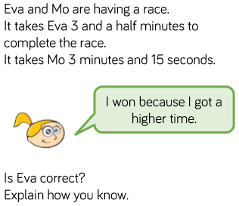
Complete the challenge

Slide 44
04.03.2021
L.O. To be able to find start and end times
Go to Times Tables Rock Stars to warm up your number brain before you start your maths activity.
Subject: Maths

Slide 45
When we work out the start and end times we can use a number line to help
An English lesson started at 12:05 and lasted 35 minutes. What was the end time?
The first thing to do is put the start time on a number line and then make jumps
+ 5 minutes
+ 5 minutes
+ 5 minutes
+ 5 minutes
+ 5 minutes
+ 5 minutes
+ 5 minutes
12:05
12:10
12:15
12:20
12:25
12:30
12:35
12:40
12:05+35= 12:40
Or you could do it in bigger jumps
+ 25 minutes
+ 10 minutes
The end time is 12:40
12:05
12:30
12:40

Slide 46
A maths lesson started at 13:05 and lasted 1 hour and 15 minutes. What time did it finish?
The first thing to do is put the start time on the number line and make jumps
+ 1 hour
+ 15 minutes
The end time is 14:20
13:05
14:05
14:20

Slide 47
When working out the start time follow the same method and count backwards.
A film finished at 11:35 and lasted 1 hour and 20 minutes. What time did it start?
The first thing to do is put the end time and do jumps until you count back 1 hour and 20 minutes
-1 hour
- 5 minutes
- 15 minutes
11:35 – 1 hour and 20 minutes = 10:15
11:35
10:35
10:30
10:15
The start time is 10:15

Slide 48
Fill in the gaps to work out the answer
Gymnastics starts at 11:15 and last 2 hours and 10 minutes. What is the end time?
+ 1hour
+ 1 hour
+ 10 minutes
11:15
11:15 + 1 hour + 1 hour + 10 minutes = ________
The end time is _________

Slide 49
Fill in the gaps to work out the answer
Gymnastics starts at 11:15 and last 2 hours and 10 minutes. What is the end time?
+ 1hour
+ 1 hour
+ 10 minutes
11:15
12:15
13:15
13:25
11:15 + 1 hour + 1 hour + 10 minutes = 13:25
The end time is 13:25

Slide 50
Fill in the gaps to work out the answer
Football ends at 12:15 and lasted 1 hour and 7 minutes. What was the start time?
- 1 hour
- 5 minutes
- 2 minutes
12:15
12:15 – 1 hour – 5 minutes – 2 minutes = ________
The start time is _________

Slide 51
Fill in the gaps to work out the answer
Football ends at 12:15 and lasted 1 hour and 7 minutes. What was the start time?
- 1 hour
- 5 minutes
- 2 minutes
12:15
11:15
11:10
11:08
12:15 – 1 hour – 5 minutes – 2 minutes = 11:08
The start time is 11:08

Slide 52
Complete the questions
Breakfast club starts at 07:30 and lasts 1 hour and 20 minutes. What time does it end?
P.E starts at 13:05 and lasts 55 minutes. What time does it end?
After school club starts at 15:10 and last 1 hour and 20 minutes. What time does it end?
Mr Jones finished breakfast at 08:15. He was eating for 35 minutes. What time did he start breakfast?
Amy arrived at her grandmas at 11:05. The bus journey took 40 minute. What time did she get on the bus?
Jessica finished watching Toy Story at 14:20. The movie lasted 1 hour and 25 minutes. What time did the movie start?

Slide 53
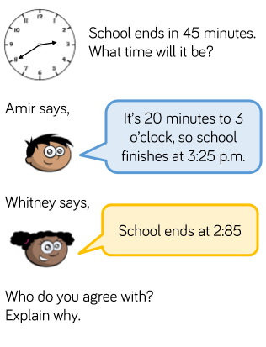
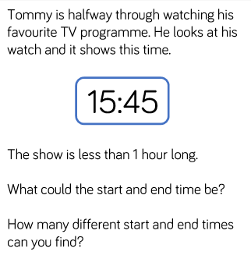
Complete the challenges

