Slide 2
22.6.2021
L.O. To be able to use mentally add and subtract numbers
Go to Times Tables Rock Stars to warm up your number brain before you start your maths activity.
Subject: Maths

Slide 3
When you add 10s mentally you need to look at the tens column
Thousands | Hundreds | Tens | Ones
4 | 6 | 7 | 2
 |  | 1 | 0
+
six hundred and seventy two add ten is four six hundred and eighty two

Slide 4
When you add 10s mentally you need to look at the tens column
528+2 tens= 548
241 + 3 tens = 271
524 + 5 tens = 574
Note that because we are not exchanging in this lesson today that only the tens column changes

Slide 5
When you subtract 10s mentally you need to look at the tens column
528 - 2 tens= 508
241 - 3 tens = 211
574 - 5 tens = 524
Note that because we are not exchanging in this lesson today that only the tens column changes

Slide 6
When you add 100s mentally you need to look at the hundreds column
Thousands | Hundreds | Tens | Ones
4 | 6 | 7 | 2
 | 2 | 0 | 0
six hundred and seventy two add two hundred is four thousand, eight hundred and seventy two

Slide 7
When you add 100s mentally you need to look at the hundreds column
562 + 3 hundreds = 862
254 + 6 hundreds = 854
358 + 4 hundreds = 758
Note that because we are not exchanging in this lesson today that only the hundreds column changes

Slide 8
When you subtract 100s mentally you need to look at the hundreds column
562 - 3 hundreds = 262
254 - 1 hundred = 154
958 - 4 hundreds = 558
Note that because we are not exchanging in this lesson today that only the hundreds column changes

Slide 9
Complete the calculations mentally
Six hundred and twenty two add 2 tens =
Eight hundred and eleven add 3 tens =
Two hundred and fifty three subtract 4 tens =
Four hundred and twenty five add 4 hundreds =
Six hundred and forty five subtract 4 hundreds =
Six hundred eighteen subtract 1 thousands =
Three hundred and ninety three subtract 3 tens =
Eight hundred and sixty two subtract 4 hundreds =

Slide 10
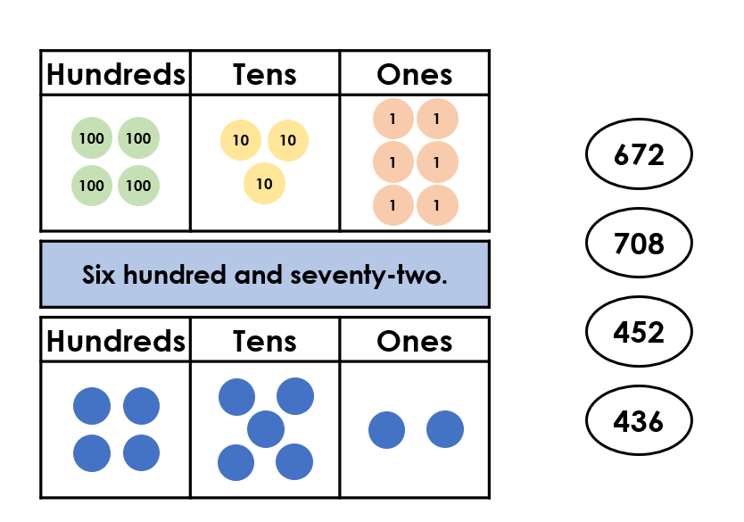
Find the odd one out by matching the numbers

Slide 11
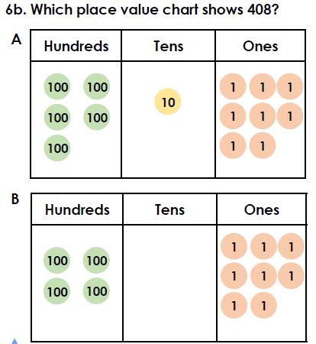
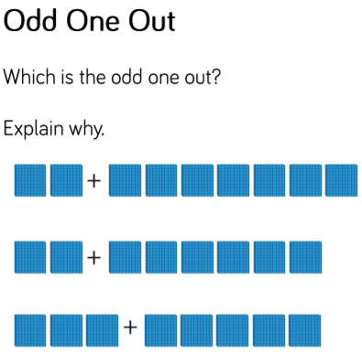
Complete the challenges

Slide 12
22.6.2021
L.O. To be able to use column addition to add numbers
Go to Times Tables Rock Stars to warm up your number brain before you start your maths activity.
Subject: Maths

Slide 13
Pre-recorded Teaching
Access the online teaching video below that will support you to complete the work in this lesson. This video will act as a support but all of the work can still be successfully understood & completed using paper-based versions of this pack. If you need further support to understand / complete work then please contact school via e-mail or telephone.
Play Video
You can also copy and paste this link if you would prefer:
https://classroom.thenational.academy/lessons/adding-using-the-column-method-when-multiple-columns-require-regrouping-cmwpcr

Slide 14
Lets warm our brains up first! Can you work out the answers to the questions in your head?
75+5=
62+8=
91+9=
14+6=
33+7=

Slide 15
How did you do?
75+5=80
62+8=70
91+9=100
14+6=20
33+7=40

Slide 16
When we use column addition we always start with the 1s column
Thousands | Hundreds | Tens | Ones
263+331=
+

Slide 17
When we use column addition we always start with the 1s column
Thousands | Hundreds | Tens | Ones
263+331=594
+
5 9 4

Slide 18
Can you use the place value counters in the grid to work out the answer and write the calculation? Remember to start with the ones
+

Slide 19
How did you do?
H T O
2 4 2
2 1 3
4 5 5
+
+
242+213=455

Slide 20
Remember to always set out the numbers correctly in column addition
H T O
7 2 1
2 3 5
H T O
7 2 1
2 3 5
9 5 6
+
H T O
4 2 1
3 4 8
H T O
4 2 1
3 4 8
7 6 9
+

Slide 21
Often column addition involves exchanging numbers
In the ones column 5+7=12
We therefore need to exchange 10 ones into 1 ten
1
2
Remember to add the extra 10

Slide 22
Once you have exchanged you can continue to complete the sum
1
5 7
2

Slide 23
Have a try at this calculation – you will need to exchange in the ones column.
506
245
+

Slide 24
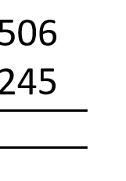
Have a try at this calculation – you will need to exchange in the ones column.
There are now 11 ones so we need to exchange 10 ones for one ten and then add them together – remember to add the one you have exchanged also
506
245
+
+
1
7 5 1

Slide 25
Use the column addition method to solve the calculations. Questions 4 to 10 involve exchanges
421+436=
225+412=
520+410=
205+206=
258+351=
874+135=
108+356=
289+422=
511+199=
259+458=

Slide 26
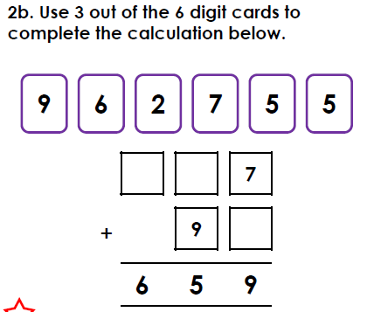
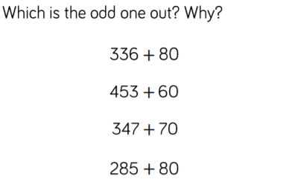
Complete the challenges.

Slide 27
23.6.2021
L.O. To be able to use column subtraction
Go to Times Tables Rock Stars to warm up your number brain before you start your maths activity.
Subject: Maths

Slide 28
Pre-recorded Teaching
Access the online teaching video below that will support you to complete the work in this lesson. This video will act as a support but all of the work can still be successfully understood & completed using paper-based versions of this pack. If you need further support to understand / complete work then please contact school via e-mail or telephone.
Play Video
You can also copy and paste this link if you would prefer:
https://classroom.thenational.academy/lessons/subtracting-using-the-column-method-when-multiple-columns-require-regrouping-6xh34c

Slide 29
Lets warm our brains up first! Can you work out the answers to the questions in your head?
75-5=
68-8=
91-7=
14-12=
33-9=

Slide 30
How did you do?
75-5=70
68-8=60
91-7=84
14-12=2
33-9=24

Slide 31
When we use column subtraction we always start with the 1s column
Thousands | Hundreds | Tens | Ones
263- 131=
-

Slide 32
When we use column subtraction we always start with the 1s column
Thousands | Hundreds | Tens | Ones
263- 131= 132
-
1 3 2

Slide 33
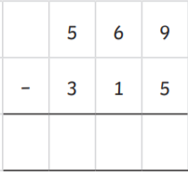
Starting with the 1s column work out the calculation

Slide 34
How did you do?
3 0 1 3
2 5 4

Slide 35
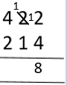
Sometimes when we subtract we need to exchange. Look carefully at the ones. There aren’t enough ones to subtract from so we need to exchange 1 ten for 10 ones. So instead of 2-4 it changes to 12-4
-
-
-
2 0 8
Can 4 ones be taken away from 2 ones?
It can’t so we need to exchange 1 ten for 10 ones.
The rest of the calculation can now be completed.
Always remember that you cannot subtract a lager number from a smaller number. You need to exchange!

Slide 36
Have a try of this calculation using the same method. You will need to exchange in the ones column.
823
204
-

Slide 37
Have a try of this calculation using the same method. You will need to exchange in the ones column.
1
823
204
823
204
1
6 1 9
You can’t subtract 4 from 3 to you need to exchange 1 ten for 10 ones.

Slide 38
Complete the calculations using column subtraction. Questions 4 to 10 involve exchanges
561-240=
584-234=
266-155=
442-314=
698-339=
652=523=
478-259=
614-233=
287-192=
302-111=

Slide 39
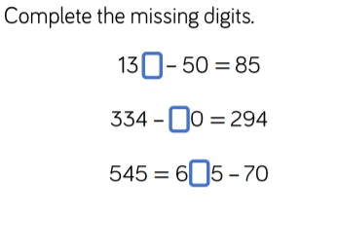
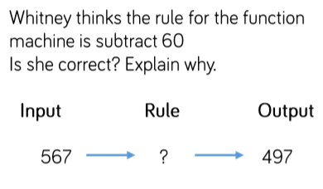
Complete the challenges

Slide 40
24.6.2021
L.O. To be able to solve problems involving addition and subtraction.
Go to Times Tables Rock Stars to warm up your number brain before you start your maths activity.
Subject: Maths

Slide 41
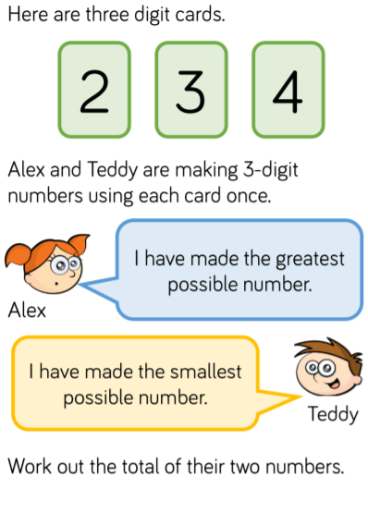
When we have problems to solve in maths it’s important to break down the question
The first thing we need to do is identify what number Alex has made and what number Teddy has made

Slide 42
When we have problems to solve in maths it’s important to break down the question
Alex has made 432
Teddy has made 234

Slide 43
When we have problems to solve in maths it’s important to break down the question
Next we need to add those numbers together using column addition
4 3 2
+ 2 3 4
6 6 6

Slide 44
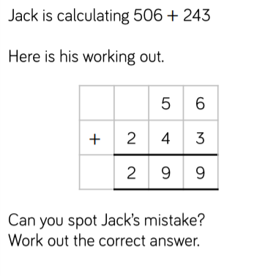
When we have problems to solve in maths it’s important to break down the question
The first thing we need to do here is work out the calculation

Slide 45
When we have problems to solve in maths it’s important to break down the question
5 0 6
2 4 3
7 4 9
Next we need to look at what Jack did to identify where he went wrong

Slide 46
When we have problems to solve in maths it’s important to break down the question
5 0 6
2 4 3
7 4 9
Jack hasn’t used zero as a place value holder in the tens column. The correct answer is 749

Slide 47
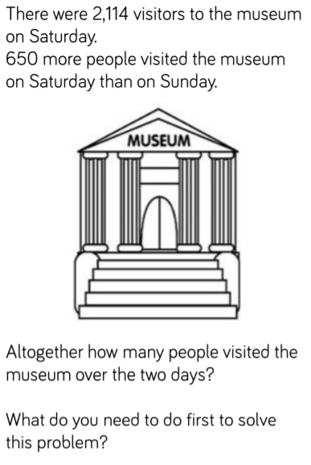
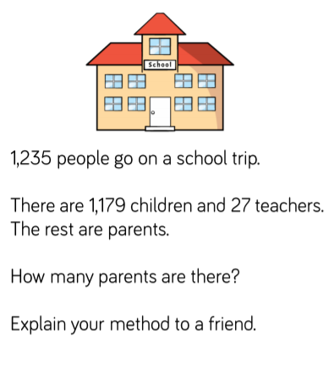
Can you use the method of breaking down the question to solve the problems

Slide 48
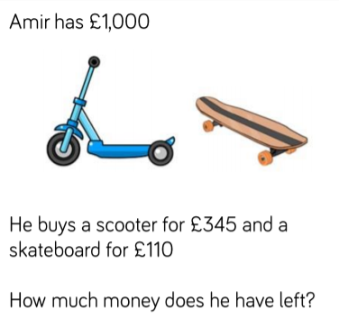
Can you use the method of breaking down the question to solve the problems

Slide 49
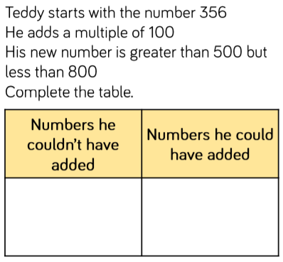
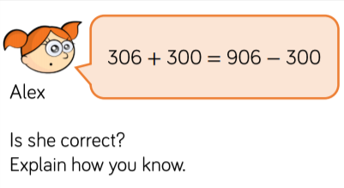
Can you use the method of breaking down the question to solve the problems

Slide 50
28.6.2021
L.O. To be able to count in multiples
Go to Times Tables Rock Stars to warm up your number brain before you start your maths activity.
Subject: Maths

Slide 51
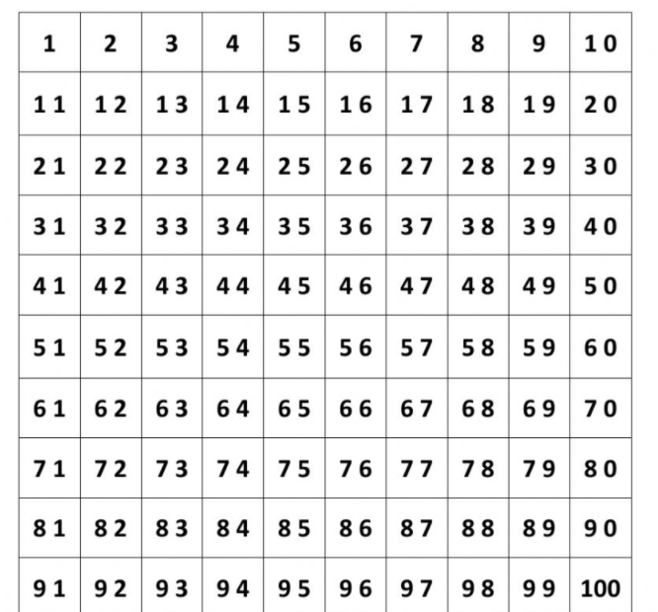
When we count in multiples we need to start at zero and count in equal steps
Use the number square and colour in all the multiples of 4.
Can you do the same using a different colour to identify the multiples of 8?

Slide 52
Complete the number sequences by counting on in jumps of 8 or 4.
1. ______ 8 12 _______ ________
2. 8 ______ _______ 20 ______
3. _______ _______ 60 _______ _______
4. 24 _______ 16 ______ ______ ______
5. 48 ________ 32 ______ ______ ______
6. 96 ______ 80 ______ ______ ______
7. 72 ______ ______ 48 _______
8. 48 ______ 40______ _______
9. 72 ______ 56 ______ ______ ______
10. 88 ______ 72 ______ ______ ______
Tip: Count on or back from the last number. Use the number square on the last page to help.
Subject: Maths

Slide 53
Can you use your knowledge of counting in multiples to complete the calculations
6 x _____ = 48 6. _____x _____ = 80
5 x _____ = 20 7. _____x _____ = 48
7 x _____ = 56 8. _____x _____ = 96
9 x _____ = 36 9. _____x _____ = 28
2 x _____ = 16 10. _____x _____ = 64

