Slide 1
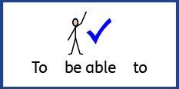
Date: Monday 28th June 2021
L.O: To be able to write using subordinate conjunctions.
Subject: English
Word of the week: Memorable

Slide 2
Date: Monday 28th June.
What Work? | L.O: To be able to write using conjunctions.
How Much Work?
My work is Finished when...
Next?

Slide 3
What is a conjunction?
A conjunction links two or more words, phrases or clauses together.
There are two main types of conjunctions we use within sentences.
Do you know what they both are?
co-ordinating conjunctions (e.g. and) link two main clauses together as an equal pair to create a compound sentence. We usually remember these words using the acronym ‘FANBOYS’.
subordinating conjunctions (e.g. when) introduce a subordinate clause. These are the ones we are going to look at today...

Slide 4
Can you spot the subordinate clause and the subordinating conjunction in this sentence?
The eager pupils sped into school when the bell rang.

Slide 5
Can you think of any other subordinating conjunctions?
subordinating conjunctions
Delete me to find out more!!
Delete me to find out more!!
Delete me to find out more!!
Delete me to find out more!!
Delete me to find out more!!
If
Since
As
When
Although
While
After
Before
Until
Because
Delete me to find out more!!
Delete me to find out more!!
Delete me to find out more!!
Delete me to find out more!!
Delete me to find out more!!

Slide 6
Can you spot the subordinating conjunctions in this piece of text? Where have they been used in these sentences?
Subordinating Conjunction Hunt
As he walked closer, Cleo could see the crocodilius in the cave entrance. The beast was hurriedly eating the remains of its last unlucky victim because it was ravenous. Cleo examined its bright red eyes, huge smoking nostrils and razor-sharp teeth while the beast was occupied. Although Cleo was standing quite a distance away, the terrible stench of the gruesome beast was still making him feel nauseous. Cleo took a deep breath before he tiptoed bravely forward. It was time for battle.
As he walked closer, Cleo could see the crocodilius in the cave entrance. The beast was hurriedly eating the remains of its last unlucky victim because it was ravenous. Cleo examined its bright red eyes, huge smoking nostrils and razor-sharp teeth while the beast was occupied. Although Cleo was standing quite a distance away, the terrible stench of the gruesome beast was still making him feel nauseous. Cleo took a deep breath before he tiptoed bravely forward. It was time for battle.

Slide 7
My Scaffolding
The soldiers were tired _________ they had walked for days.
The war began _______ Germany invaded Poland.
Evacuees were sent to the countryside _______ it was safer there.
Anne Frank hid in the secret annex _______ the war began.
as when after because

Slide 8
Can you now choose 5 subordinate conjunctions from below and write your own 5 sentences using subordinate conjunctions about anything you are interested in.
if since as when although while after before until because

Slide 9
Date: Tuesday 29th June 2021
L.O: To be able to write sentences using subordinate clauses.
Subject: English
Word of the week: Memorable

Slide 10
Date: Tuesday 29th June.
What Work? | L.O: To be able to write sentences using subordinate clauses.
How Much Work?
My work is Finished when...
Next?

Slide 11
What is a clause?
A clause is a group of words that
includes a subject and a verb.
There are two types of clauses,
independent clauses and subordinate clauses.
The independent clause makes sense on its own because it is a complete thought.
For example:
Germany were in the war.
The war was terrifying.
A subordinate clause supports the independent clause. The opening words of subordinate clauses show that they are dependent on the independent clause.
For example:
which began with poland.
because there were bombs going off.

Slide 12
The Subordinate Clause
A subordinate clause can come at various points in a sentence.
You might use one at the front of a sentence.
For example, a fronted adverbial can be a type of subordinate clause:
Like a bullet speeding through the air, the solider ran into the trenches.
You might want to use one at the end of the sentence:
Anne frank hid in a secret annex because there was a war.
Sometimes they even come in the middle of sentences:
The soldiers, who were at war, hoped to go home for Christmas.

Slide 13
So, if I start a sentence …….
The evacuees moved to the country …..
What extra information can we add to make a subordinate clause?

Slide 14
Some possible subordinate clauses …….
The evacuees moved to the country …..
…. to make sure they were safe whilst there was a war.
…. because they lived in a town which might be bombed.

Slide 15
Re-read the information research sheet on Anne Frank then use it to help you add subordinate clauses to your scaffolding sheet.

Slide 16
My Scaffolding.
Anne Frank lived in a secret Annex ________________
____________________________________________.
She hid there for a long time _____________________ ____________________________________________.
Just before the end of the war she was found ________
____________________________________________.
Anne died of a disease called Typhus ______________
____________________________________________.
Anne’s story made me feel _______________________
_____________________________________________.

Slide 17
Date: Wednesday 30th June 2021
L.O: To be able to write sentences using time openers.
Subject: English
Word of the week: Memorable

Slide 18
Date: Wednesday 30th June.
What Work? | L.O: To be able to write sentences using time openers.
How Much Work?
My work is Finished when...
Next?

Slide 19
Time Openers
Time openers are words that join phrases or sentences together to help us understand when something is happening.
Words such as before, after, next, just then, shortly, afterwards, last, eventually, firstly, secondly, and thirdly, are all-time words.
They are also known as fronted adverbials.
After a time opener, we use a comma.

Slide 20
Using time openers
As soon as I woke up, I felt scared remembering that we were at war.
Firstly, I woke up my parents then we unpacked our belongings in our new home.

Slide 21
My Scaffolding.
____________ leaving we made sure we had only packed the essentials and our gas masks.
_____________ we arrived, we met the people who’s house we would be hiding out in.
____________ we heard a loud, frightening noise outside. _______ we realised the war had started.
before after next just then shortly suddenly

Slide 22
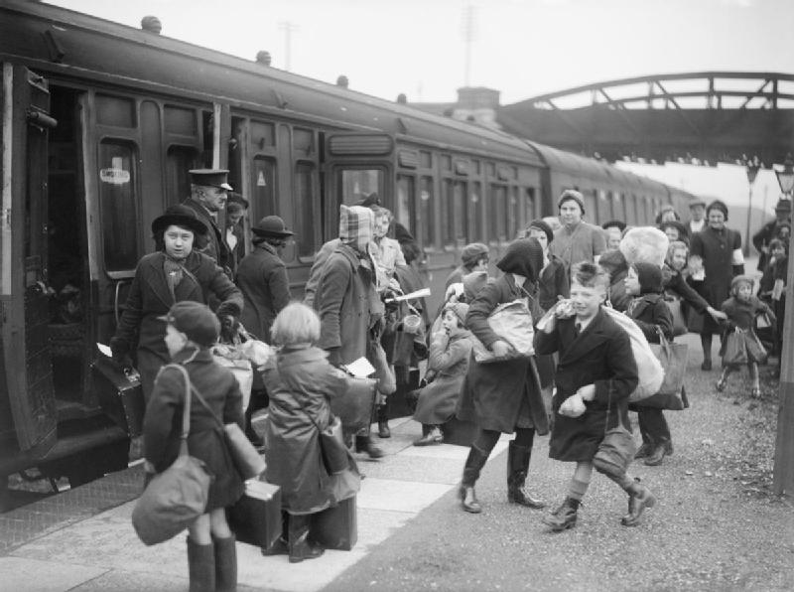
Use the five time openers below to create your own sentences about the war using the picture to help:
before after next just then shortly afterwards

Slide 23
Date: Thursday 1st July 2021
L.O: To be able to write using first person pronouns.
Subject: English
Word of the week: Memorable

Slide 24
Date: Thursday 1st July 2021.
What Work? | L.O: To be able to write using first person pronouns.
How Much Work?
My work is Finished when...
Next?

Slide 25
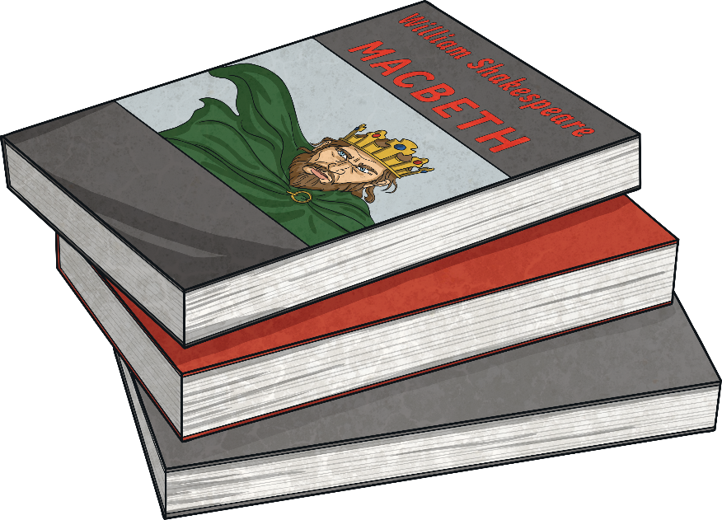
Point of View
When writing recounts the events can be told from different points of view.
It can be written in the first, second or third person. Can you guess which one is which below?
I was going to the funfair today. I was so excited!
Have you ever wondered what life would be like as a superhero?
The boys ran from the house screaming. Riley was terrified.

Slide 26
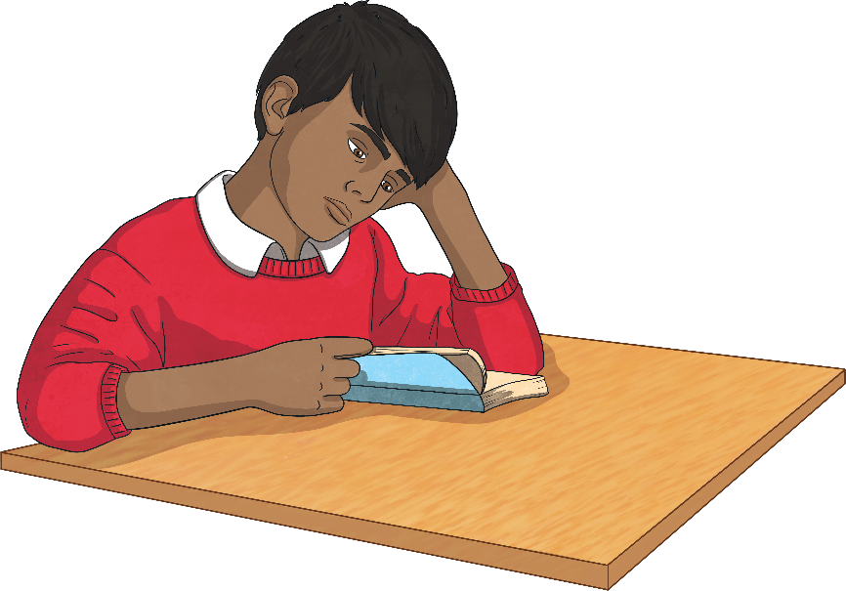
First Person
If writing a recount in the first person, we write about ourselves.
Other pronouns used in the first person:
my
me
mine
we
our
ours
us
Describe how you feel and what you are doing or have done.
Use the pronoun ‘I’
For example:
Last year, I went to Spain with my family. I loved it!

Slide 27
Second Person
If writing in the second person, talk to the reader directly.
Other pronouns used in the second person:
your
yours
Use the pronoun ‘you’.
The second person is used a lot non-fiction as well as in fiction texts.
For example:
Before you begin, make sure that you have all of the tools listed above.

Slide 28
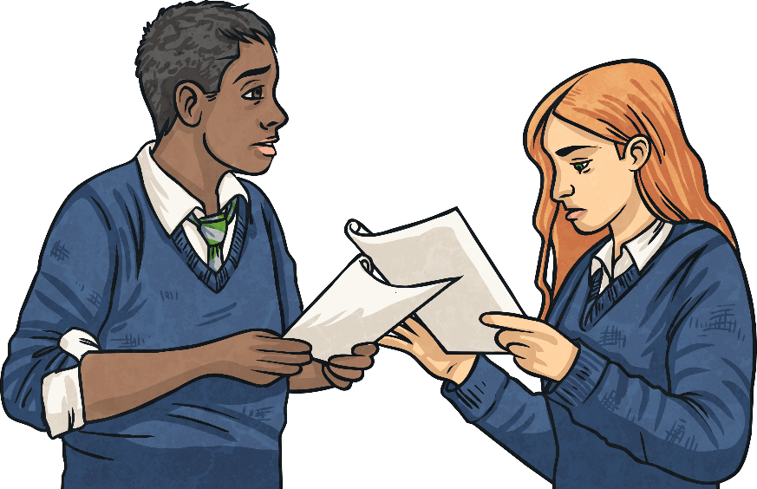
Third Person
If you are writing in the third person, you write about other people or characters.
Other pronouns used in the third person:
her/hers
his
theirs
You use the character’s name or pronouns such as ‘he’, ‘she’ and ‘they’.
For example:
Michelle sped off at top speed and was soon in first place. She couldn’t believe that she was going to win!

Slide 29
First, Second or Third Person?
Decide if the following sentences are in the first, second or third person.
Sophie was going to the cinema to meet her friends.
Third person
I couldn’t believe what I was seeing – it was incredible!
First person
“Where shall we go now?” wondered Tim and Holly as they sat in their car.
Third person
Do you believe in ghosts? Well after reading this story, you will!
Second person
As I walked into my new school, my stomach churned and my hands began to shake.
First person
Are you an early bird or are you a night owl?
Second person

Slide 30
My Scaffolding using the first person
When at war ______ felt scared, always thinking of ____ family at home.
The other soldiers and I heard ______ first explosion on a wet rainy Monday morning.
When at war _____ families often sent ______ letters and pictures.
Our I My Us

Slide 31
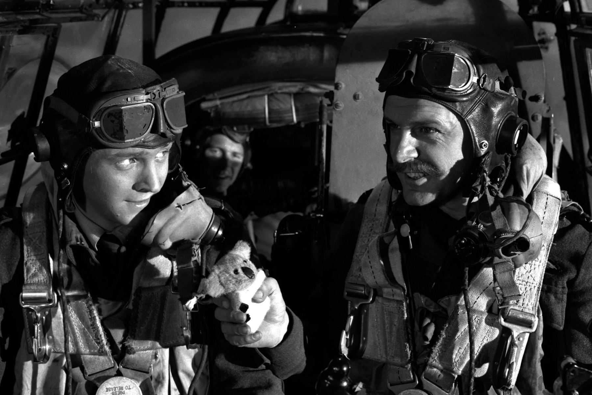
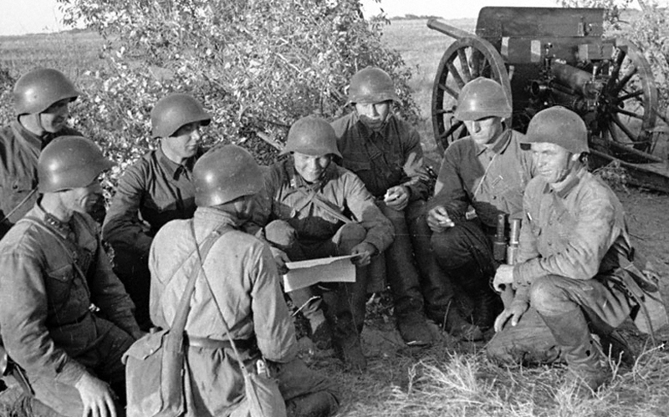
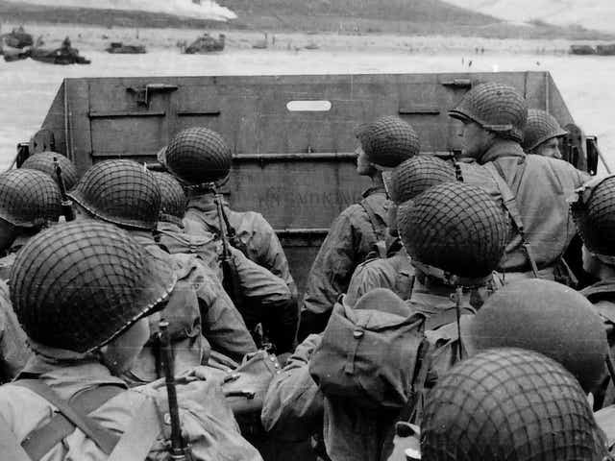
Now choose five of the personal pronouns and write a sentence using each one imagining you are a solider at war.
my
me
mine
we
our
ours
us

Slide 32
Date: Friday 2nd July 2021
L.O: To be able to write sentences using full stops and capital letters.
Subject: English Intervention
Word of the week: Memorable

Slide 33
Date: Friday 2nd July 2021
What Work? | L.O: To be able to write sentences using full stops and capital letters.
How Much Work?
My work is Finished when...
Next?

Slide 34
My Scaffolding – add full stops and capital letters.
a hundred years might seem like a very long time ago, but it isn’t really
your great-great grandparents were around then, and they would have lived through, and maybe even taken part in, this terrible conflict
lots of history books have been written on World War 1 facts and why it started but it all boils down to the fact that Europe had split into two large families of countries The Allies — the british empire, france, belgium, russia and later, the USA — were in one family
and the central powers of germany, austria, hungary, bulgaria and turkey were in the other.
on 4 August 1914, germany invaded belgium, and so, standing by its promise to stick up for belgium, britain declared war on germany
the world was at war…

Slide 35
Using the fact sheet can you now write 5 sentences about the war using capital letters and full stops. https://www.natgeokids.com/uk/discover/history/general-history/first-world-war/

