Slide 1


Subject: English
Base 1

Slide 2


Date: Monday 1st March 2021
L.O. To be able to create an argument.
Subject: English

Slide 3

Pre-recorded Teaching
Access the online teaching video below that will support you to complete the work in this lesson. This video will act as a support but all of the work can still be successfully understood & completed using paper-based versions of this pack. If you need further support to understand / complete work then please contact school via e-mail or telephone.
Play Video
You can also copy and paste this link if you would prefer:
https://classroom.thenational.academy/lessons/to-explore-arguments-for-and-against-6xk3ge?from_query=arguments

Slide 4
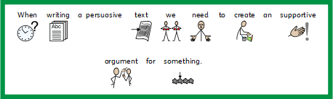
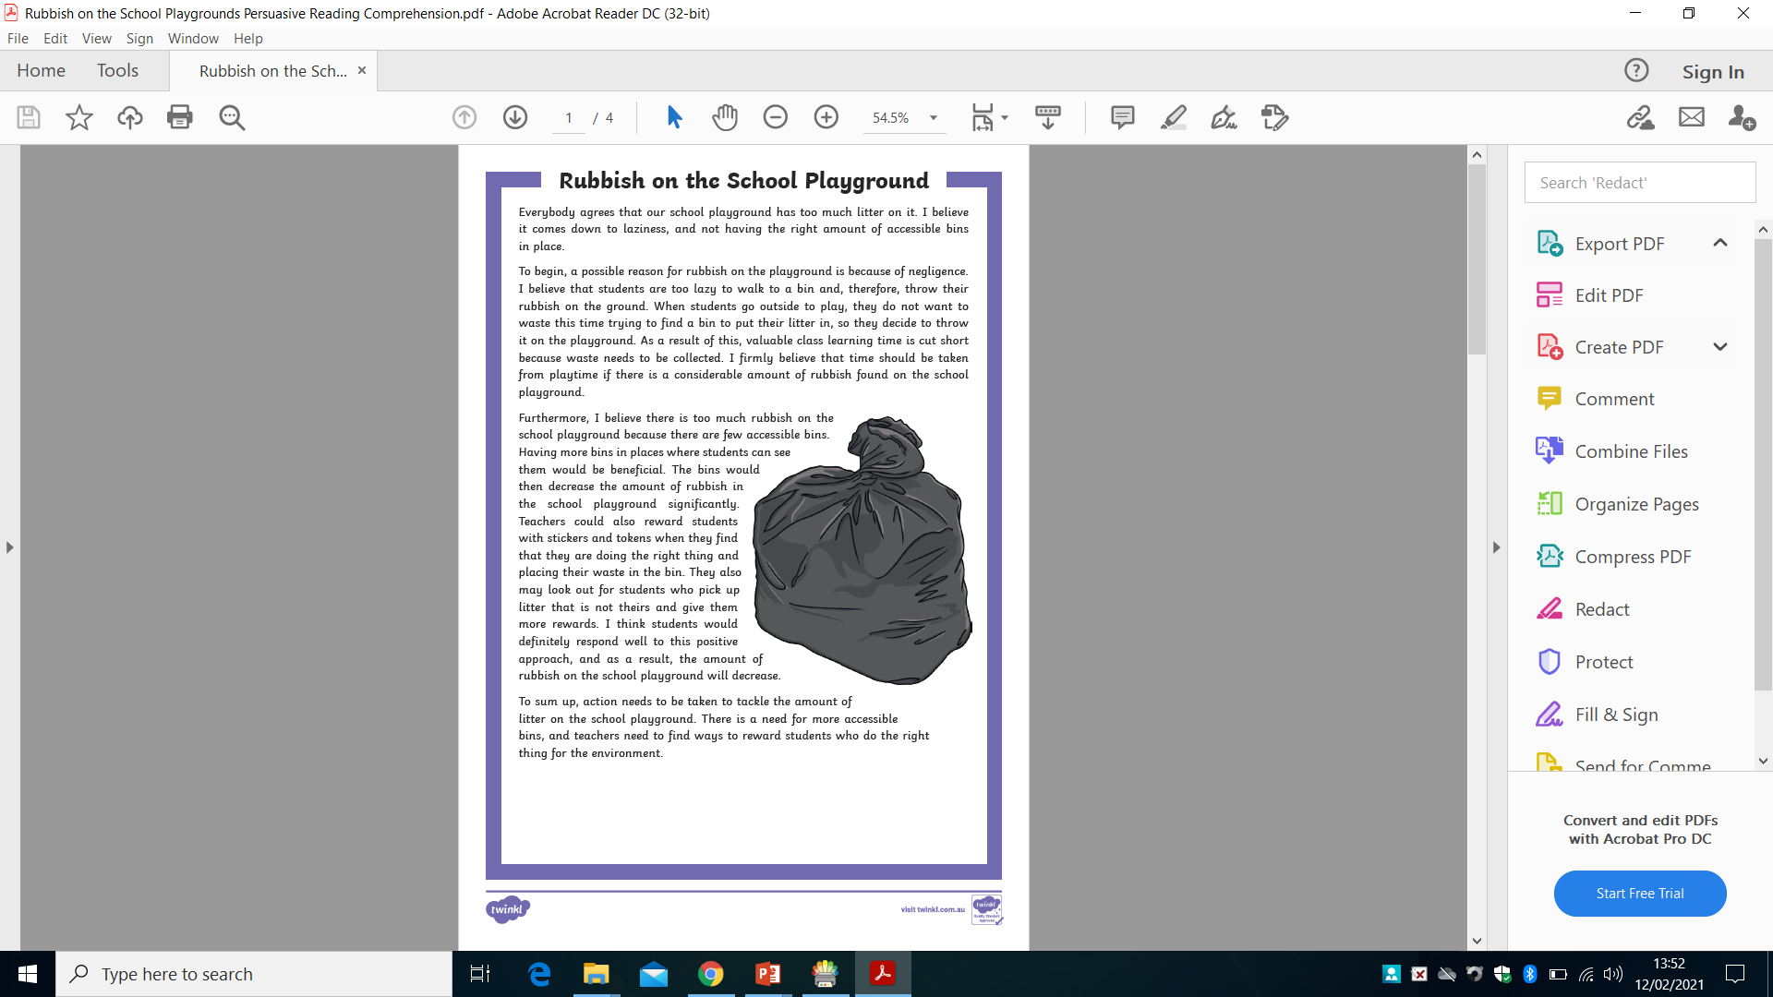
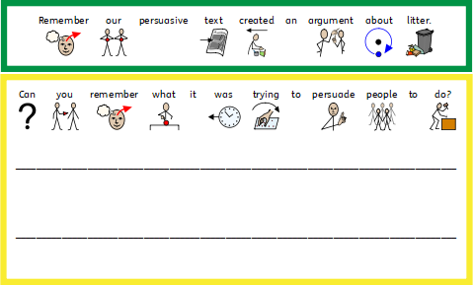

Slide 5

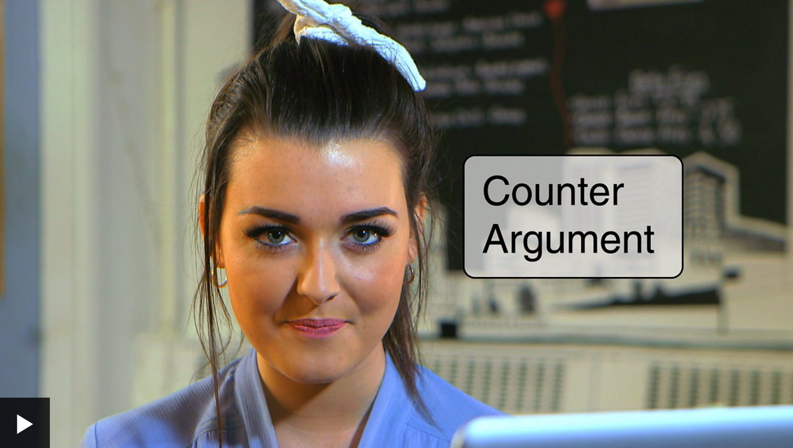
https://www.bbc.co.uk/teach/class-clips-video/how-to-write-a-persuasive-text/zkcfbdm

Slide 6








Slide 7

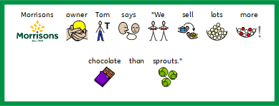


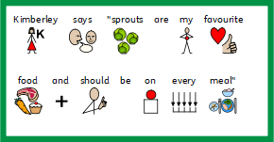



Slide 8




Slide 9



Slide 10
Date: Tuesday 2nd March 2021
L.O. To be able to write a persuasive introduction.
Subject: English

Slide 11
Pre-recorded Teaching
Access the online teaching video below that will support you to complete the work in this lesson. This video will act as a support but all of the work can still be successfully understood & completed using paper-based versions of this pack. If you need further support to understand / complete work then please contact school via e-mail or telephone.
Play Video
You can also copy and paste this link if you would prefer:
https://classroom.thenational.academy/lessons/to-understand-the-features-of-a-persuasive-letter-74tk4d?from_query=persuasive+

Slide 12
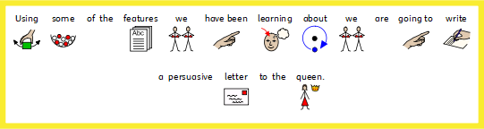


Slide 13


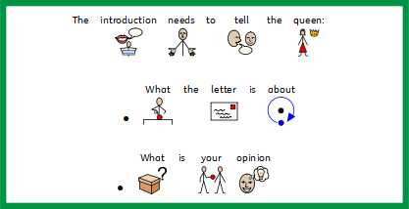

Slide 14


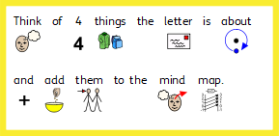


Slide 15
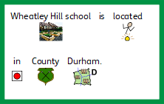
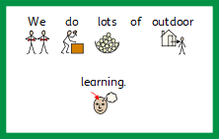




Slide 16

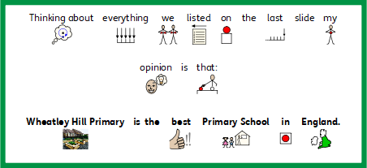


Slide 17







Your Majesty,
I am writing to tell you all about an amazing primary school located in County Durham, England. In my opinion it is
the best primary school in England and I am going to tell you why. The school works exceptionally hard to make
everybody feel welcome therefore ensuring all children and staff have a wonderful experience when part of the school community.
In addition, they also do lots to help the local community and the people who live in the nearby villages surrounding the
school. Their ethos is to make learning fun by creating real life expereinces linked to the learning in class. The school is called
Wheatley Hill Primary and we would love you to come and see how amazing it is.

Slide 18



Slide 19
Date: Wednesday 3rd March 2021
L.O. To be able to write the main body of my persuasive letter.
Subject: English

Slide 20
Pre-recorded Teaching
Access the online teaching video below that will support you to complete the work in this lesson. This video will act as a support but all of the work can still be successfully understood & completed using paper-based versions of this pack. If you need further support to understand / complete work then please contact school via e-mail or telephone.
Play Video
You can also copy and paste this link if you would prefer:
https://classroom.thenational.academy/lessons/to-write-a-persuasive-letter-free-write-75j38e?from_query=persuasive+

Slide 21
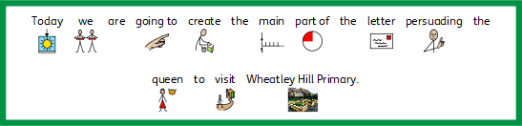
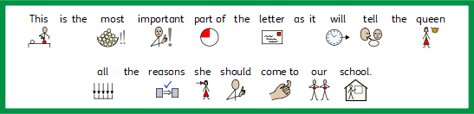





Slide 22









Slide 23


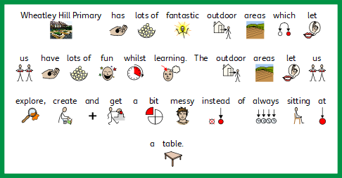

Slide 24

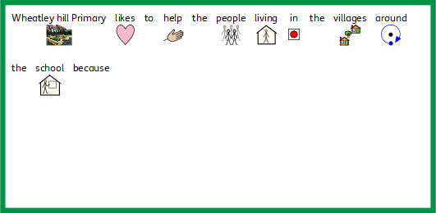

Slide 25



Slide 26
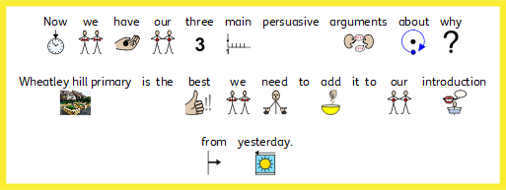
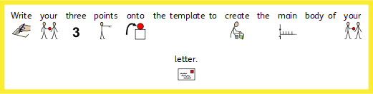


Slide 27
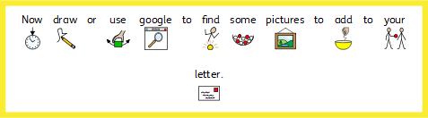


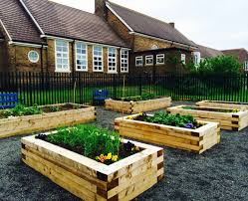


Slide 28



Slide 29
Date: Thursday 4th March 2021
World Book Day activity.
L.O. To share my favourite book.
Subject: English

Slide 30

Today is World Book Day, so this week we have a special activity because we would like to know all about your favourite book.

Slide 31





Slide 32



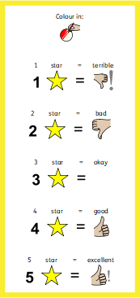




Slide 33



Slide 34
Date: Friday 5th March 2021
L.O. To spell words ending in -y.
Subject: English

Slide 35

Spellings
Remember:
Very
Family
Try
Cry
Play
May

Slide 36



Spellings
Do not forget:
Can you put each one in a sentence?
Try:
Cry:
Why:

Slide 37
Spellings
Do not forget:
Can you put each one in a sentence?
Play:
May:
Family:

