Slide 1



Date: 25.01.2021
LO: To estimate and compare right angles, obtuse, actues and reflex angles.
Subject: Maths

Slide 2

Times table practise
Spend at least 15mins practising your times tables.
This can be done on TTRS, hit the button or any other times table website.
Use the Times Tables Rock Stars app or website.
Alternatively, copy and paste the following link into a web browser:
https://www.topmarks.co.uk/maths-games/7-11-years/times-tables

Slide 3
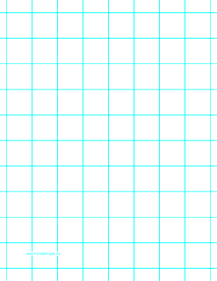
I draw a horizontal and a vertical line, that meet at a point.
We use this symbol to show a right angle.
This is a right angle.
A right angle always will have a degree of 90°.

Slide 4

I draw two straight lines that meet at a point.
This is an acute angle.
An acute angle is less than a right angle.
An acute angle will have a degree less than 90°.

Slide 5

I draw two straight lines that meet at a point.
This is an obtuse angle.
An obtuse angle is more than one right angle but less than two right angles.
An obtuse angle will have a degree more than 90° and less than 180°.

Slide 6

I draw two straight lines that meet at a point.
This is a reflex angle.
A reflex angle is more than two right angles.
A reflex angle will have a degree more than 180° and less than 360°.

Slide 7

I draw two straight lines that meet at a point.
This is also another
reflex angle.

Slide 8
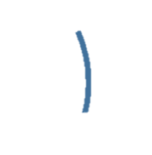
What type of angle is this?
Less than 90°

Slide 9
What type of angle is this?
This is an acute angle
Less than 90°

Slide 10
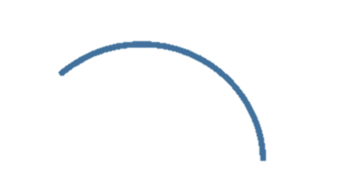
What type of angle is this?
More than 90°, but less than 180°

Slide 11
What type of angle is this?
This is an obtuse angle
More than 90°, but less than 180°

Slide 12
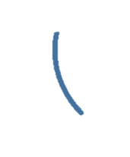
What type of angle is this?
Less than 90°

Slide 13
What type of angle is this?
This is an acute angle
Less than 90°

Slide 14

What type of angle is this?
More than 180°

Slide 15
What type of angle is this?
This is a reflex angle
More than 180°

Slide 16

What type of angle is this?
More than 90°, but less than 180°

Slide 17
What type of angle is this?
This is an obtuse angle
More than 90°, but less than 180°

Slide 18
A reminder:
Right angles are 90º.
Acute angles are less than 90º.
Obtuse angles are more than 90º but less than 180º.
Reflex angles are more than 180º.

Slide 19
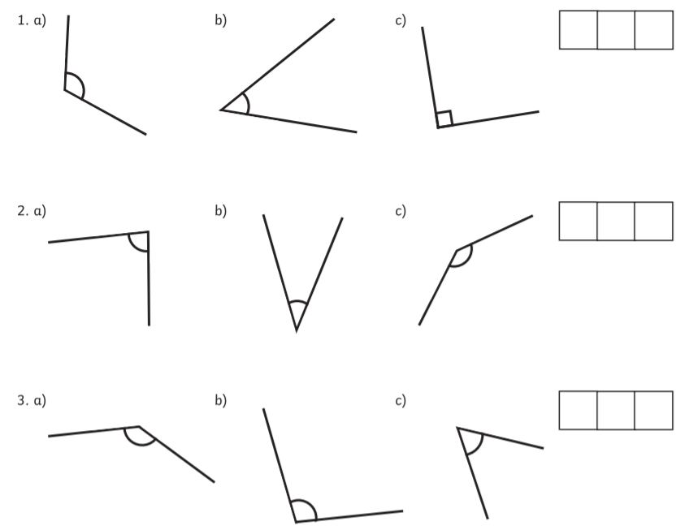
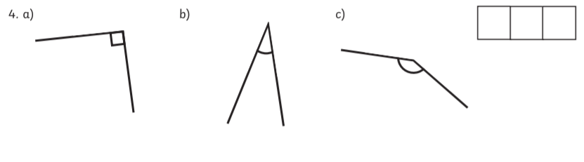
Have a go at ordering these angles from smallest to largest.

Slide 20
Have a go at ordering these angles from smallest to largest.
b, c, a
b, a, c
c, b, c
b, a, c

Slide 21
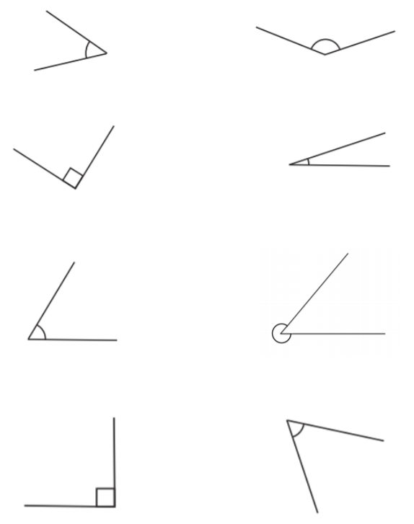
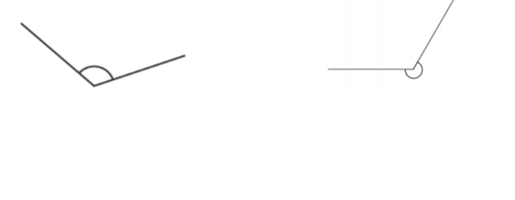
Name each of these angles.
a)
b)
Right angles are 90º.
Acute angles are less than 90º.
Obtuse angles are more than 90º but less than 180º.
Reflex angles are more than 180º.
i)
c)
d)
e)
f)
j)
g)
h)

Slide 22
Name each of these angles.
a)
b)
Acute angle
Obtuse angle
Right angle
Acute angle
Acute angle
Reflex angle
Right angle
Acute angle
Reflex angle
Obtuse angle
i)
c)
d)
e)
f)
j)
g)
h)

Slide 23
End of Lesson

Slide 24
Date: 26.01.2021
LO: To be able to calculate angles on a straight line.
Subject: Maths

Slide 25
Times table practise
Spend at least 15mins practising your times tables.
This can be done on TTRS, hit the button or any other times table website.
Use the Times Tables Rock Stars app or website.
Alternatively, copy and paste the following link into a web browser:
https://www.topmarks.co.uk/maths-games/7-11-years/times-tables

Slide 26
Recap
Can you identify the different types of angles?
2)
3)
4)
1)

Slide 27
Recap
Can you identify the different types of angles?
2)
3)
4)
1)
Right angle
Acute angle
Obtuse angle
Reflex angle
Acute angles measure less than 90°.
Right angles measure exactly 90°.
Obtuse angles measure from 90°-180°.
Reflex angles measure from 180°-360°.

Slide 28
Recap
Can you work out the missing numbers below?
100 + ____ = 180
90 + ____ = 180
75 + ____ = 180
180 – 30 = ____
180 – 45 = ____
180 – 20 = ____

Slide 29
Recap
Can you work out the missing numbers below?
100 + 80 = 180
90 + 90 = 180
75 + 105 = 180
180 – 30 = 150
180 – 45 = 135
180 – 20 = 160

Slide 30
Angles on a straight line ALWAYS add up to 180°.
180°

Slide 31
Here we have two angles on a straight line.
100°
x
Because we don’t know the size of this angle, we will call it x.

Slide 32
Here we have two angles on a straight line.
Can we work out the size of angle x?
100°
x

Slide 33
If I asked you to work out…
180-100= ___
2) 100+ __ = 180
Could you do it?
Yes! We did this at the start of the lesson.
100°
x

Slide 34
We do the same thing when we want to find the value of x.
We know that angles on a straight line add up to 180°.
So, 100° plus something must equal 180°.
Or, we can say that 180° minus 100° equals the size of angle x.
Either way, our answer is 80°.
x= 80°
100+80=180
100°
x
180- 100 = 80

Slide 35
Our working out should look like this.
 | 1 | 0 | 0 | + | x |  | = | 1 | 8 | 0
 | 1 | 0 | 0 | + | 8 | 0 | = | 1 | 8 | 0
 |  |  | x | = | 8 | 0 | °
 |  |  |  |  | or
 | 1 | 8 | 0 | - | 1 | 0 | 0 | = | x
 | 1 | 8 | 0 | - | 1 | 0 | 0 | = | 8 | 0
 |  |  | x | = | 8 | 0 | °
Work out the size of angle x.
Always remember your degrees symbol.

Slide 36
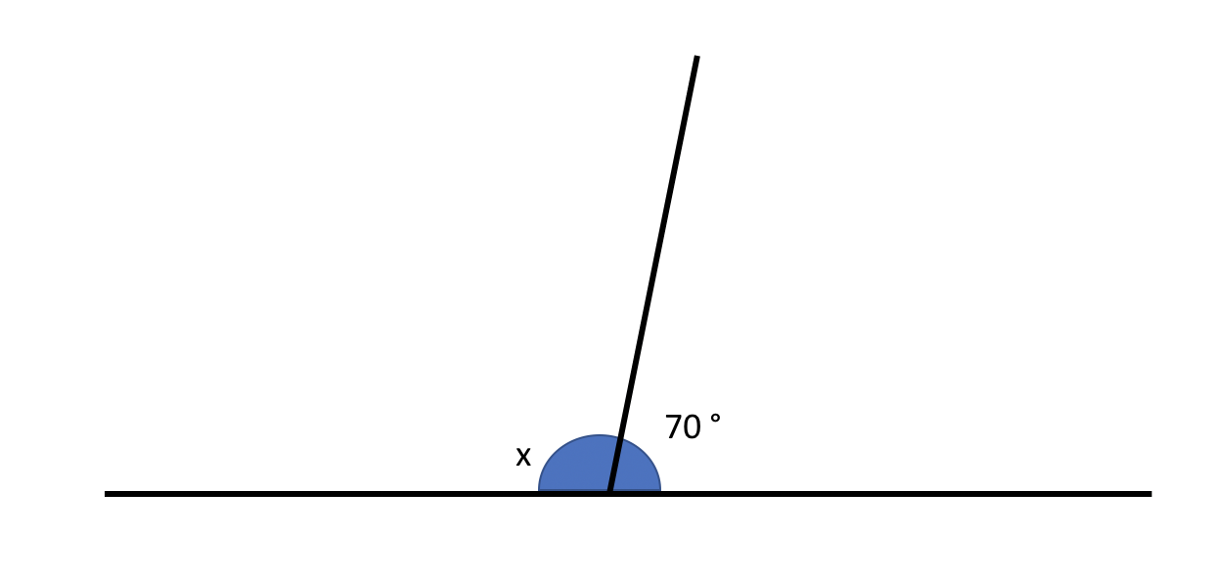

Here we have two angles on a straight line.
Can we work out the size of angle x?
Angles on a straight line always add up to 180°.

Slide 37
We know that angles on a straight line add up to 180°.
So, 70° plus something must equal 180°.
Or, we can say that 180° minus 70° equals the size of angle x.
Either way, our answer is 110°. x= 110°

Slide 38
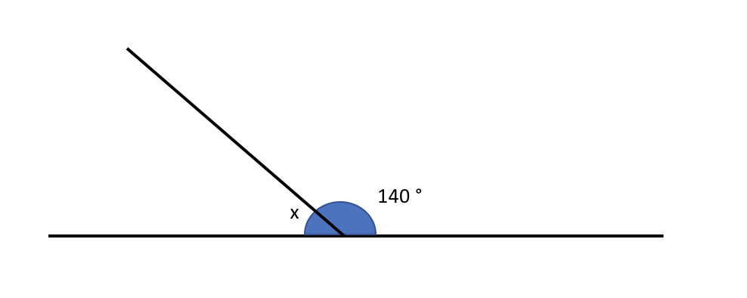
Try this on your own.
Can we workout the size of angle x?
Angles on a straight line always add up to 180°.

Slide 39
We know that angles on a straight line add up to 180°.
So, 140° plus something must equal 180°.
Or, we can say that 180° minus 140° equals the size of angle x.
Either way, our answer is 40°. x= 40°

Slide 40
Here we have three angles on a straight line.
Can we workout the size of angle x?
100°
70°
x
Angles on a straight line always add up to 180°.

Slide 41
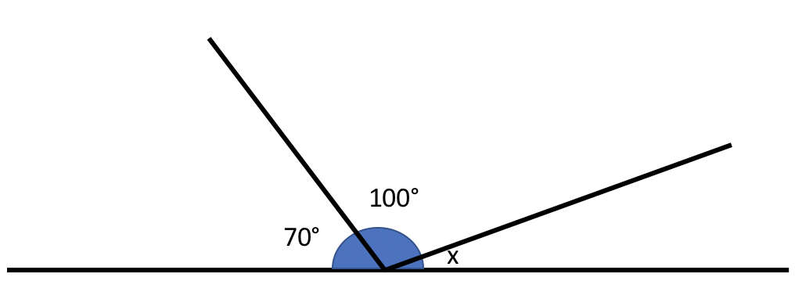
Here we have three angles on a straight line.
Can we workout the size of angle x?
We know that angles on a straight line add up to 180°.
So, 100° + 70° + something must equal 180°.
Or, we can say that 180° - 100° - 70° equals the size of angle x.
Either way, our answer is 10°.
x= 10°
100+70+ 10=180
180- 100 - 70 = 10

Slide 42
Try this on your own.
Can we workout the size of angle x?
110°
40°
x
Remember, we are doing the exact same method as before, but we have one more number to put into the working out.
Angles on a straight line always add up to 180°.

Slide 43
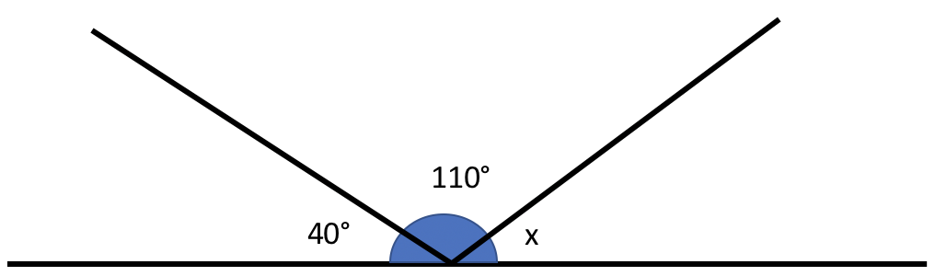
We know that angles on a straight line add up to 180°.
So, 110° + 40° + something must equal 180°.
Or, we can say that 180° - 110° - 40° equals the size of angle x.
Either way, our answer is 30°. x= 30°

Slide 44
Emily is measuring two angles on a straight line.
My angles measure 90° and 100°.
Why must one of Emily’s angles be wrong?

Slide 45
Emily is measuring two angles on a straight line.
My angles measure 90° and 100°.
Angles on a straight line ALWAYS add up to 180°. Emily’s angles add up to 190°.
Why must one of Emily’s angles be wrong?

Slide 46
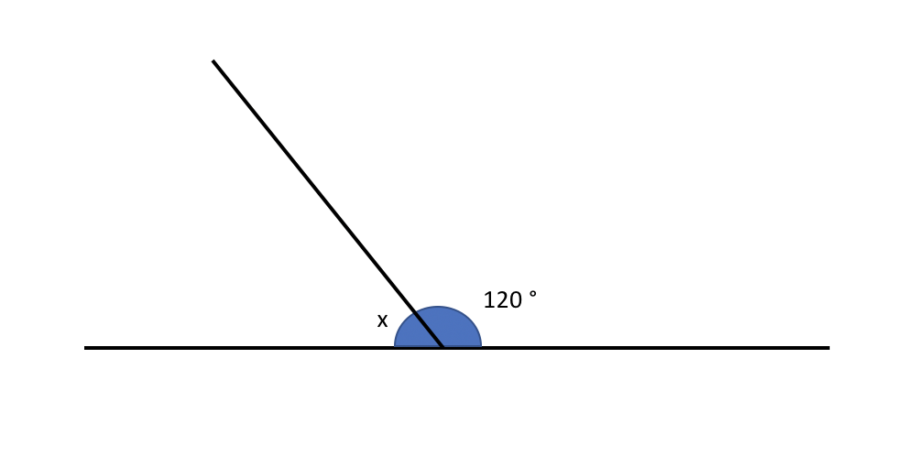
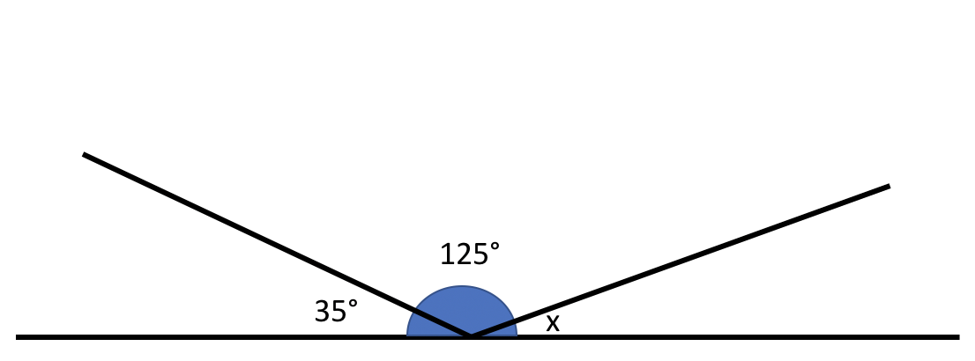
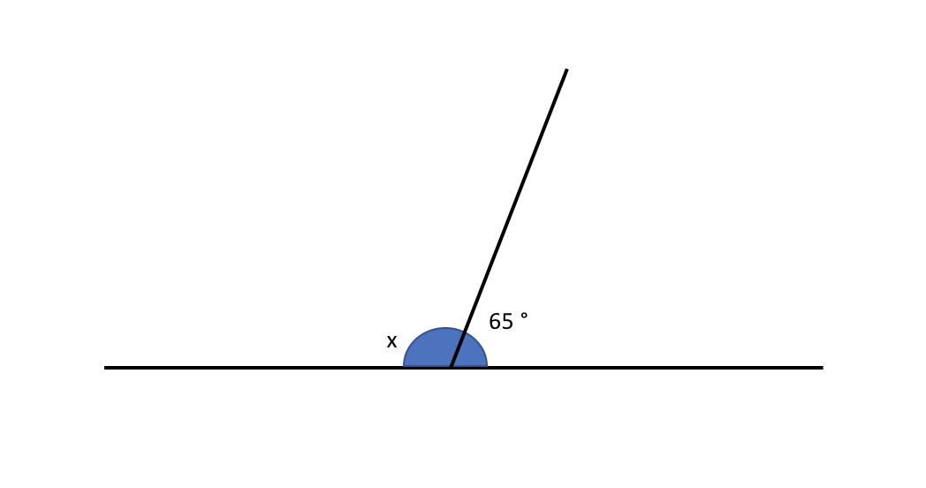
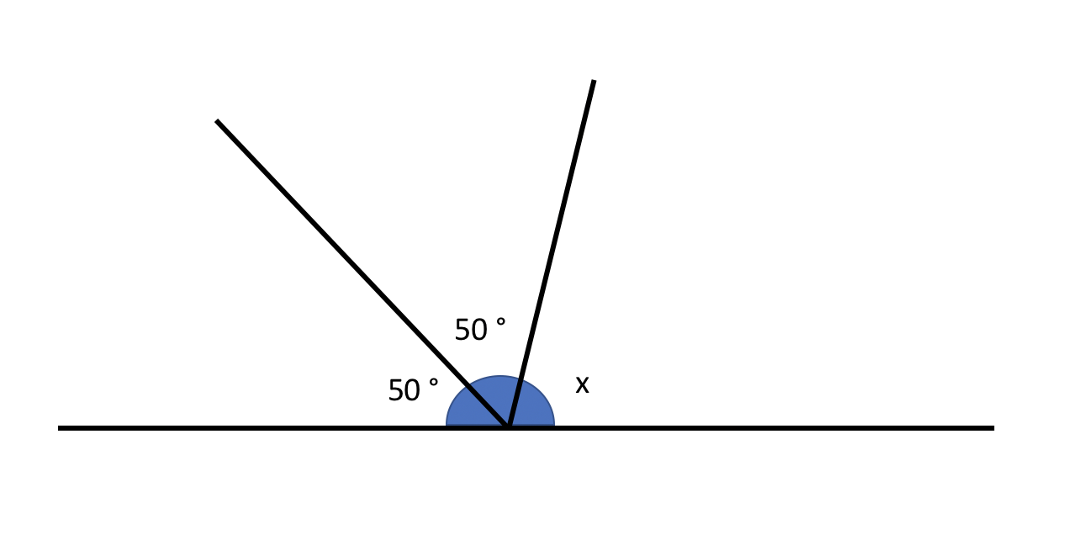
Work out the size of angle x for each question.
1.
3.
2.
4.

Slide 47
Did you remember your degrees symbol?
Work out the size of angle x for each question.
1.
3.
x = 60°
x = 20°
2.
4.
x = 115°
x = 80°

Slide 48
Recap of Lesson
LO: To be able to calculate angles on a straight line.
We have identified the different types of angles.
We know the angle rule for a straight line.
We can calculate missing angles on a straight line.

Slide 49
End of Lesson

Slide 50
Date: 27.01.2021
LO: To be able to calculate angles around a point.
Subject: Maths

Slide 51
Times table practise
Spend at least 15mins practising your times tables.
This can be done on TTRS, hit the button or any other times table website.
Use the Times Tables Rock Stars app or website.
Alternatively, copy and paste the following link into a web browser:
https://www.topmarks.co.uk/maths-games/7-11-years/times-tables

Slide 52
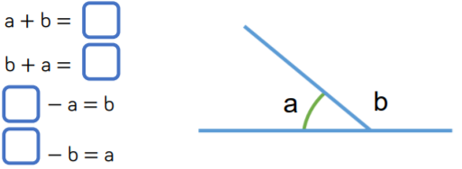
Recap
Can you complete the number sentences below?
Remember, angles on a straight line add up to 180°

Slide 53
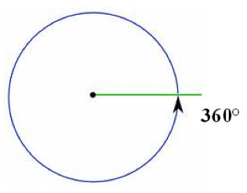
There are 360°in a full turn

Slide 54
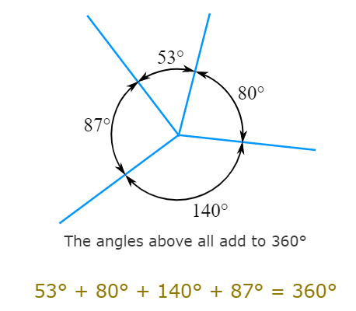
Angles that meet at a point

Slide 55
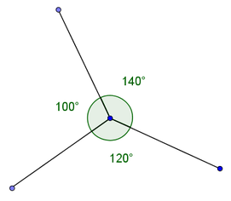
Angles that meet at a point
These will always have a total of 360°
To find a missing angle we can find the total of
the angles we have and subtract this from 360°
E.g.
100 + 120 = 220°
360 – 220 = 140°
Therefore, the missing angle is 140°

Slide 56
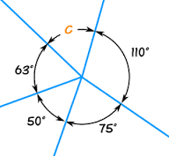
Angles that meet at a point
Another example:
To find the missing angle (c), we need to firstly add all of the known angles together.
110° + 75° + 50° + 63° = 298°
Next, we subtract this from 360°
360° - 298° = 62°
C = 62°

Slide 57
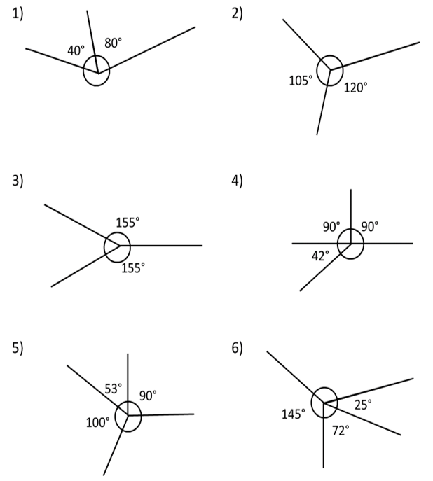
Task 1: Have a go at finding the missing angles.
Add the known angles
Subtract the known angles from 360.
Remember to add your °symbol in your answer.

Slide 58
Task 1 answers:
135°
240°
50°
138°
118°
117°

Slide 59
Task 1 Extension:
Four angles make up a full turn.
Angle A is a third of a right angle.
Angle B is 4 times more than angle A.
Angle C is a right angle.
Angle D is the remaining turn left.
What are the 4 angles?
A=
B=
C=
D=

Slide 60
Extension Answers:
Four angles make up a full turn.
Angle A is a third of a right angle.
Angle B is 4 times more than angle A.
Angle C is a right angle.
Angle D is the remaining turn left.
What are the 4 angles?
A= (90° ÷ 3)= 30°
B= (30° x 4) = 120°
C= 90°
D= (360° - 30° – 120° – 90°) = 120°

Slide 61
End of Lesson

Slide 62
Date: 28.01.2021
LO: To be able to calculate angles in triangles and quadrilaterals.
Subject: Maths

Slide 63
Times table practise
Spend at least 15mins practising your times tables.
This can be done on TTRS, hit the button or any other times table website.
Use the Times Tables Rock Stars app or website.
Alternatively, copy and paste the following link into a web browser:
https://www.topmarks.co.uk/maths-games/7-11-years/times-tables

Slide 64
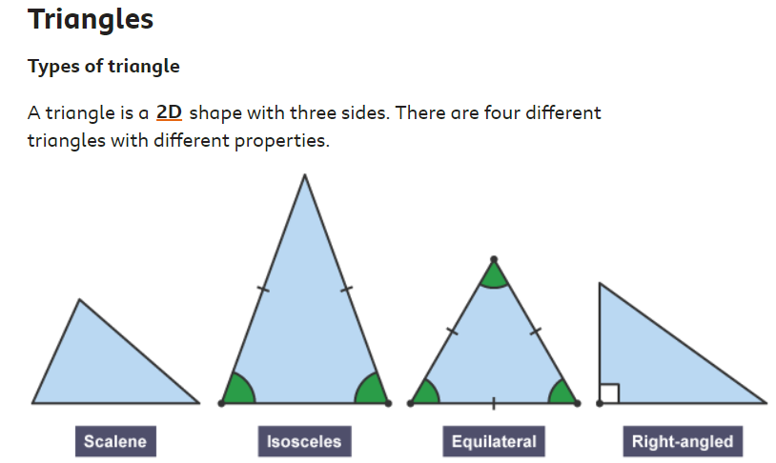
Angles in a triangle

Slide 65
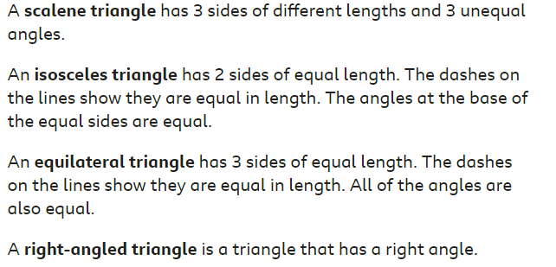
Angles in a triangle

Slide 66
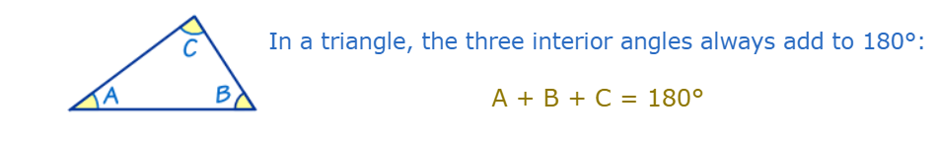
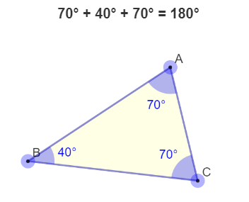
Angles in a triangle
E.g.

Slide 67
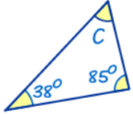
Angles in a triangle
Interior angles in an triangle always add to 180°
We can use this to find missing angles.
E.g.
38° + 85° + c = 180°
38° + 85° = 123°
180° - 123° = 57°
C = 57°

Slide 68
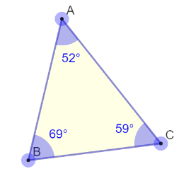
Angles in a triangle
Another example:
E.g.
52° + 69° + c = 180°
52° + 69° = 121°
180° - 121° = 59°
C = 59°
c

Slide 69
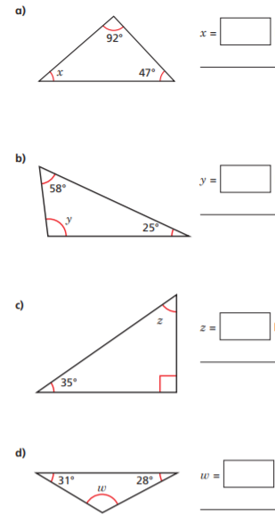
Task 1: Have a go at finding the missing angles.

Slide 70
Task 1 Answers:
41°
55°
97°
121°

Slide 71
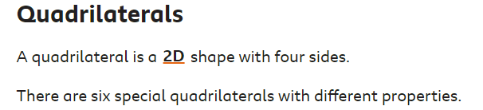
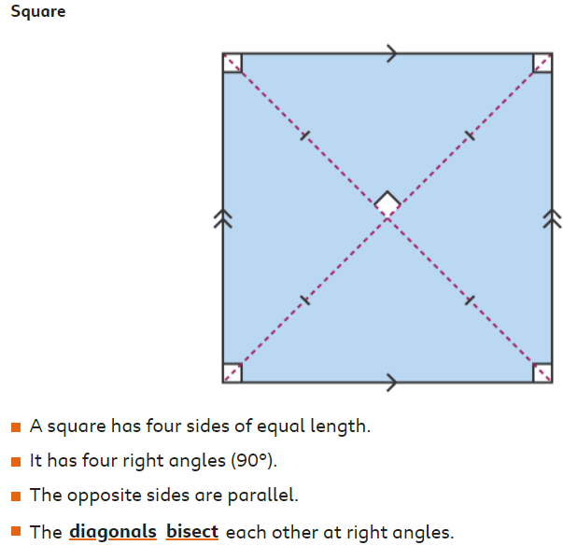
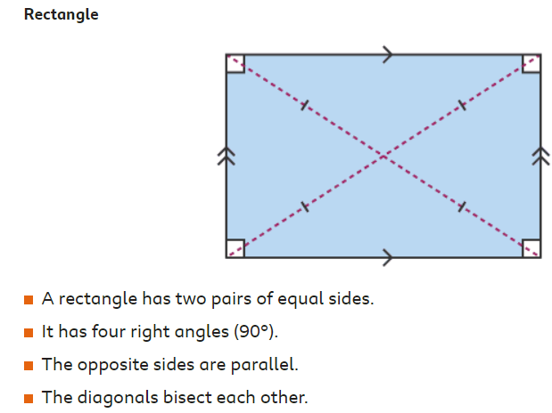
Quadrilaterals

Slide 72
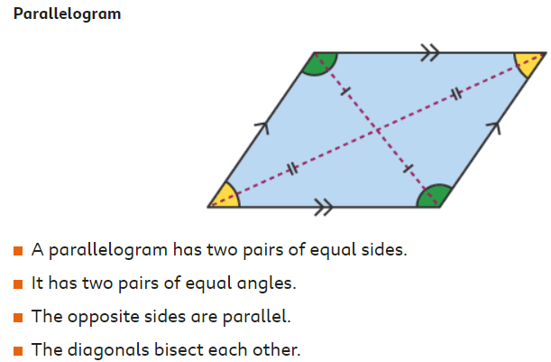
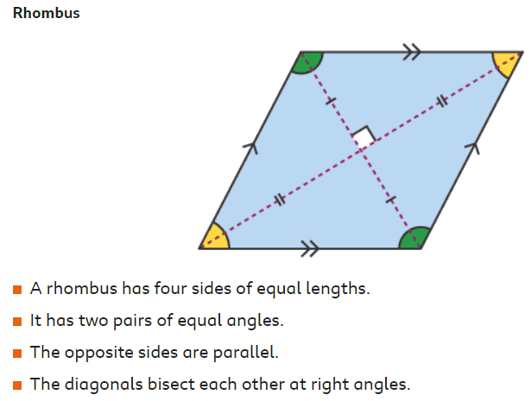
Quadrilaterals

Slide 73
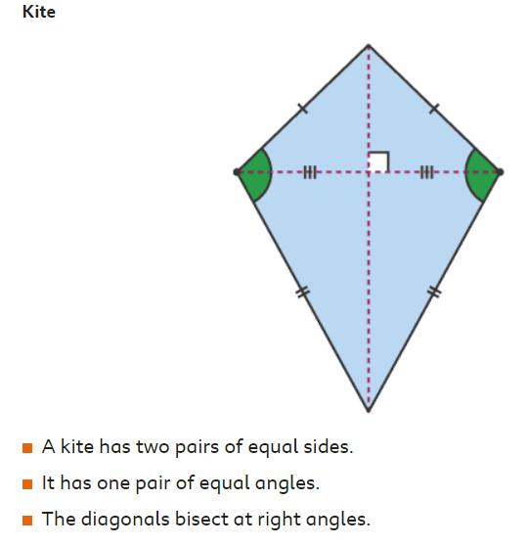
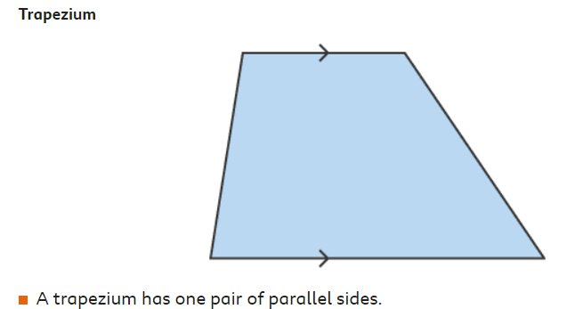
Quadrilaterals

Slide 74
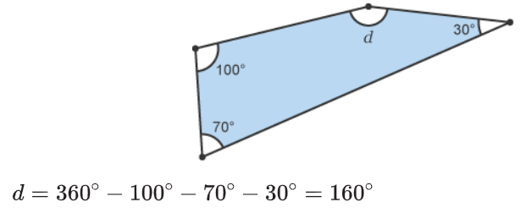
Quadrilaterals
The sum of interior angles in a quadrilateral is 360°
As we did with triangles, we can use this information to find missing angles.

Slide 75
Quadrilaterals
Interior angles in a quadrilateral always add to 360°
We can use this to find missing angles.
E.g.
100° + 70° + 30° + d = 360°
100° + 70° + 30° = 200°
360° - 200° = 160°
d = 160°

Slide 76
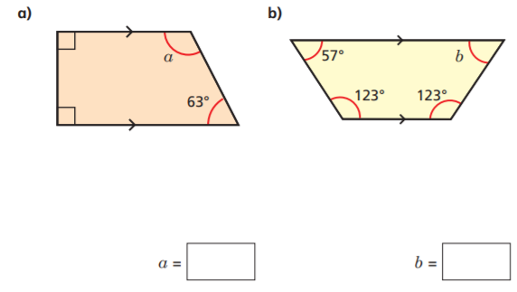
Task 2: Find the missing angles

Slide 77
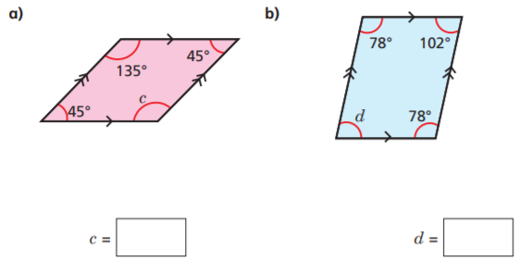
Task 2 (cont): Find the missing angles
c)
d)

Slide 78
End of Lesson

Slide 79
Date: 29.01.2021
LO: To be able to solve reasoning problems involving angles.
Subject: Maths

Slide 80
Times table practise
Spend at least 15mins practising your times tables.
This can be done on TTRS, hit the button or any other times table website.
Use the Times Tables Rock Stars app or website.
Alternatively, copy and paste the following link into a web browser:
https://www.topmarks.co.uk/maths-games/7-11-years/times-tables

Slide 81
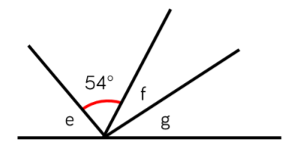
Let’s reason about angles on a straight line
Task 1:
Remember, angles on a straight line always add up to 180°.
180°
The total of angle f and g are the same as angle e
Angle e is 10° more than the size of the given angle
Angle g is 10° larger than angle f

Slide 82
Let’s reason about angles on a straight line
Task 1 answers :
Remember, angles on a straight line always add up to 180°.
27°
64°
37°
180°
The total of angle f and g are the same as angle e
Angle e is 10° more than the size of the given angle
Angle g is 10° larger than angle f

Slide 83
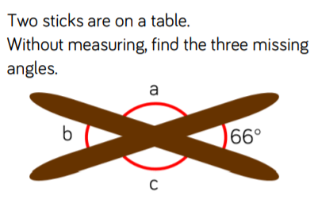
Let’s reason about angles around a point
Task 2 :
Remember, angles around a point add up to 360°
Angle b is the same as the opposite angle.
Angles a and c are equal.

Slide 84
Let’s reason about angles around a point
Task 2 answers :
114°
Remember, angles around a point add up to 360°
66°
114°
Angle b is the same as the opposite angle.
Angles a and c are equal.

Slide 85
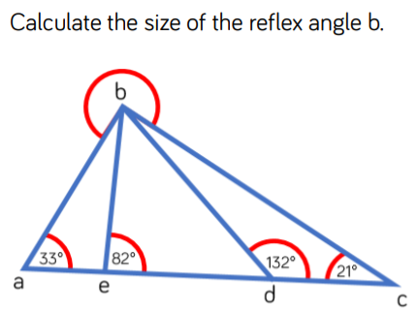
Let’s reason about angles
Task 3:
To solve this problem, you will need to know:
Angles on a straight line add up to 180°
- all angles inside a triangle add together to make 180°.

Slide 86
Let’s reason about angles at a point
Task 3 answers :
To solve this problem, you will need to know:
Angles on a straight line add up to 180°
- all angles inside a triangle add together to make 180°.
234°

Slide 87
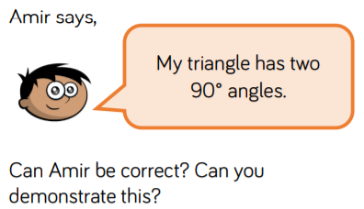
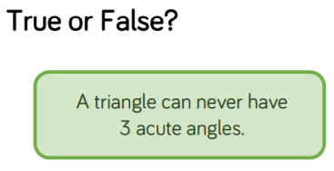
Let’s reason about angles inside of triangles
Tasks 4 and 5:
a)
b)
Prove it with a diagram!

Slide 88
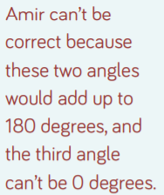
Let’s reason about angles inside of triangles
Tasks 4 and 5 answers:
a)
b)
Prove it with a diagram!
False, it can. Any combination of 3 angles, which are less than 90° that add up to 180°, e.g 60° + 60° +60°

Slide 89
End of Lesson

