Slide 1

Hello everyone,
We hope you have all had a lovely Christmas holiday.
Unfortunately we all can’t be together right now but we have worked together to give you some activities to try at home.
We are going to learn all about a story this week but please continue to have lots of fun learning through play.
If you need any help or support please get in touch.
Miss Wilkinson, Mrs Cairns & Miss Anderson
Phone: 014290 820594
Email: explorerspupils@gmail.com
We would love to see photos of your home learning, please send them to the Explorers Facebook page inbox.

Slide 2
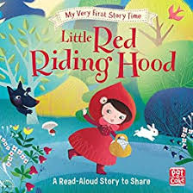
Tuesday 5th January 2021
Our book this week is ‘Little Red Riding Hood’
You might have this story book at home if so, ask your grown up to read it with you.
If not use the link below to paste it into google and watch the story together.
Can you name the different characters?
Who is your favourite?
https://www.youtube.com/watch?v=K7_WDosMSXA

Slide 3

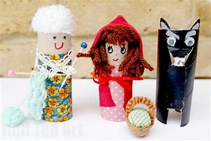
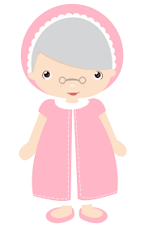
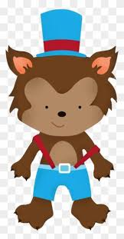
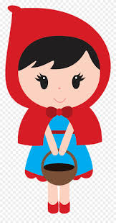
Here are some activities that we would like you to try…
Can you draw a picture of your favourite character?
Ask your grown up to help you write their name…
Little Red Riding Hood
Grandma
Now you know your favourite character, can you create your own puppet using materials at home?
Big Bad Wolf

Slide 4



Play ispy with your grown up. Using the sounds we have learnt in nursery
m,s,a,d
Can you write your name?
More ideas…
See how many circles you can find in your house.
Sing your favourite nursery rhyme.

Slide 5
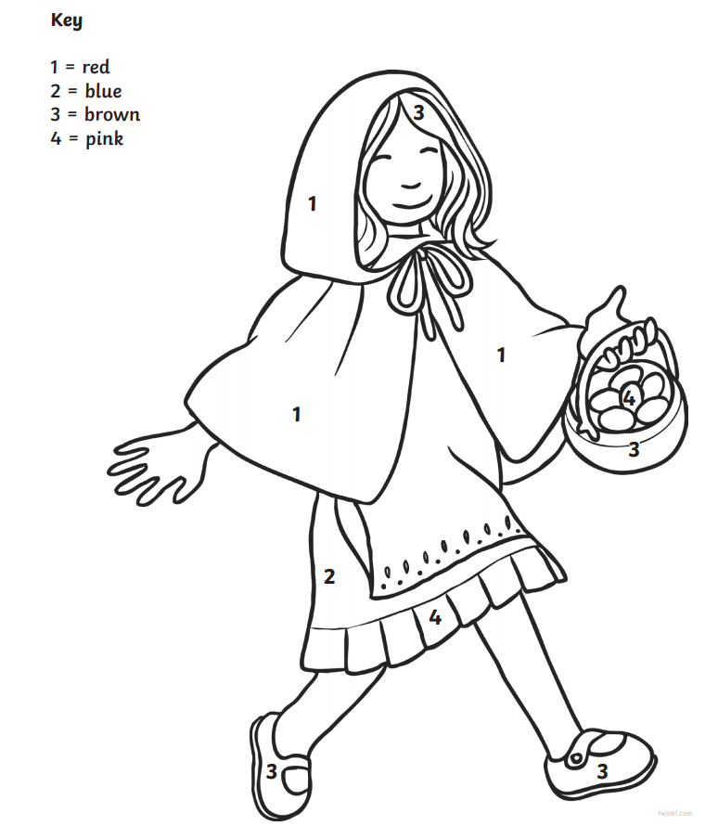
Wednesday 6th January 2021
Try our Little Red Riding Hood colour by number activity
We have attached the picture for you to print.
Can you name the colours you are using?
Try to recognise and name the numbers you can see…

Slide 6

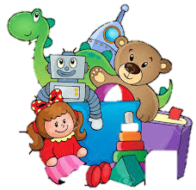
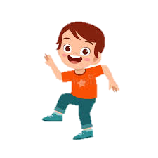
Choose your favourite story to read.
Can you draw your family?
More ideas…
Can you count ten of your toys?
Join in with our favourite action song. Use the link below
https://www.youtube.com/watch?v=qeSSmNRBlgY

Slide 7
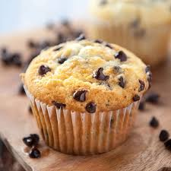
Thursday 7th January 2021
Can you make some cupcakes for Grandma?
Use our nursery recipe to bake cakes with your grown up.
Can you use the scales to measure the ingredients?
Can you mix the ingredients together?
Can you count out 12 cases?
Chocolate chip cupcakes
Makes 12
Ingredients:
130g self raising flour
130g caster sugar
2 eggs
130g margarine
Handful of chocolate chips(optional)
Mix the ingredients all together in
a large mixing bowl.
2. Add a spoon full of mixture into each case.
3. Bake for 15 to 20 minutes at 180 degrees.

Slide 8
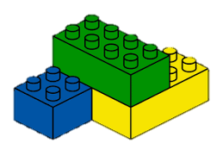

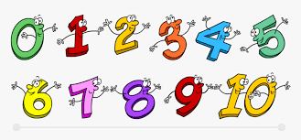
Can you build Grandma a cottage using your blocks?
Can you write the numbers we have learnt…
0,1,2,3,4,5,6,
More ideas…
Sing some number songs.
See how many red objects you can find in your home.

Slide 9

WANTED
Friday 8th January 2021
Can you help us find the Big Bad Wolf?
HAVE YOU SEEN THE BIG BAD WOLF?
Reward amount
Use our template or make your own to create a wanted poster to help us find the big bad wolf.
Can you draw his picture?
Can you use your magic writing to explain what he did?
Try to use the sounds we have learnt in phonics, in your magic writing.
Last seen
Clues found
The crime:
________________________________________________
________________________________________________
________________________________________________

Slide 10

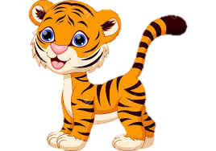
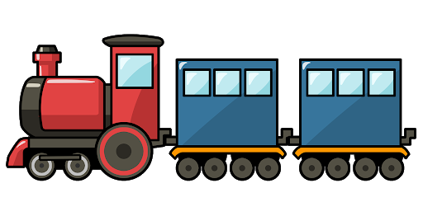
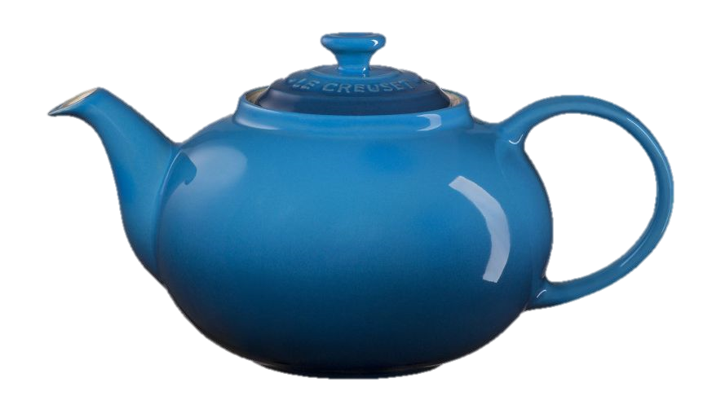
Our sound of the week is…
Can you find some objects in your home that start with our new sound?
Have a go at writing our new sound using the writing rhyme…
“Down the tower, across the tower”
Enjoy a cup of tea and tasty treat with your family.
t

Slide 11



Our number of the week is…
7
Can you count 7 objects in your home?
Have a go at writing our new number using the writing rhyme…
“Along and down the slide”
Try and make a rainbow number using all of your colours at home.

Slide 12
Have a great weekend everyone!
Please send us any photos of your home learning to our email or our Explorers Facebook page.
Email: explorerspupils@gmail.com

