Slide 1
Date: Monday 1st February
L.O. To be able to identify what are ‘near-homophones.’
Subject: English

Slide 2
Pre-recorded Teaching
Access the online teaching video below that will support you to complete the work in this lesson. This video will act as a support but all of the work can still be successfully understood & completed using paper-based versions of this pack. If you need further support to understand / complete work then please contact school via e-mail or telephone.
Play Video
You can also copy and paste this link if you would prefer:
https://teachers.thenational.academy/lessons/to-investigate-homophones-69jk0r?from_query=near+homophones

Slide 4
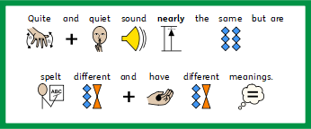

Slide 6
.
My Turn
In the library it is quite quiet so people can read their books.

Slide 7
Build A Sentence – Build 3 sentences using the homophones.

Slide 8
Scaffold A Sentence - – Finish the 3 sentences by adding the homophones then underline all the homophones.

Slide 9
Write A Sentence – Find 3 pairs of homophones then use them to write 6 sentences.
Device / Devise : I used my ipad device to devise a new game.
Advice /advise: I listened to the advice so I could advise my friends.
Won / one: The tall, athletic runner only won one of the medals.

Slide 10
Nd
Date: Tuesday 2nd February
L.O. To be able to write an introductory paragraph using present tense.
Subject: English

Slide 11
Pre-recorded Teaching
Access the online teaching video below that will support you to complete the work in this lesson. This video will act as a support but all of the work can still be successfully understood & completed using paper-based versions of this pack. If you need further support to understand / complete work then please contact school via e-mail or telephone.
Play Video
You can also copy and paste this link if you would prefer:
https://teachers.thenational.academy/lessons/to-write-the-opening-of-an-explanation-text-6hk30c?from_query=explanation+texts

Slide 15
As the tectonic plates move, it feels like the Earth is shaking or quaking. Therefore we call it an Earthquake.

Slide 16
Scaffold A Sentence - – Finish the 3 sentences adding you own information to create an introduction.

Slide 17
Write A Sentence – Use what, where and when to write 6 sentences for your introduction.

Slide 18
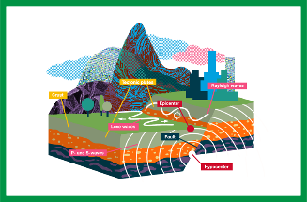
As the tectonic plates move, it feels like the Earth is shaking or quaking. Therefore we call it an Earthquake.

Slide 21
Date: Wednesday 3rd January
L.O. TO be able to write a main paragraph using the features of an explanatory text.
Subject: English

Slide 22
Pre-recorded Teaching
Access the online teaching video below that will support you to complete the work in this lesson. This video will act as a support but all of the work can still be successfully understood & completed using paper-based versions of this pack. If you need further support to understand / complete work then please contact school via e-mail or telephone.
Play Video
You can also copy and paste this link if you would prefer:
https://teachers.thenational.academy/lessons/to-write-the-second-section-of-an-explanation-text-68wkcr?from_query=explanation+texts

Slide 23
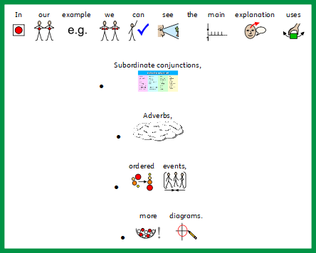

Slide 26
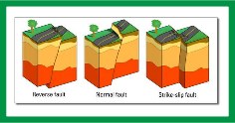
Finally, the movement causes friction between the plates. Which creates a build up of pressure. Eventually, when the pressure is released it creates an Earthquake.

Slide 27
Scaffold A Sentence - Finish the 3 sentences using adverbs and subordinate conjunctions.
v

Slide 28
Write A Sentence – Use adverbs and subordinate conjunctions to write 6 sentences for your introduction.

Slide 29
v

Slide 31
Date: Thursday 4th February
L.O. To be able to evaluate and improve my work.
Subject: English

Slide 32
Pre-recorded Teaching
Access the online teaching video below that will support you to complete the work in this lesson. This video will act as a support but all of the work can still be successfully understood & completed using paper-based versions of this pack. If you need further support to understand / complete work then please contact school via e-mail or telephone.
Play Video
You can also copy and paste this link if you would prefer:
https://teachers.thenational.academy/lessons/evaluating-6cup2d?from_query=evaluating+writing

Slide 34
As the tectonic plates move, it feels like the Earth is shaking or quaking. Therefore we call it an Earthquake.

Slide 35
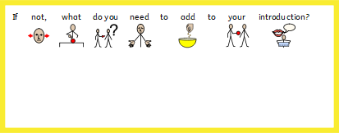
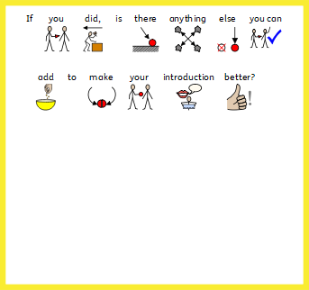

Slide 36
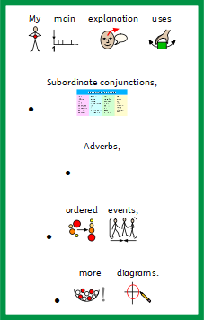
Finally, the movement causes friction between the plates. Which creates a build up of pressure. Eventually, when the pressure is released it creates an Earthquake.

Slide 37
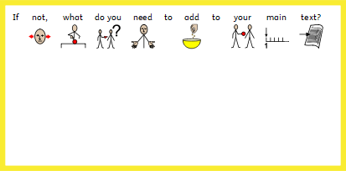
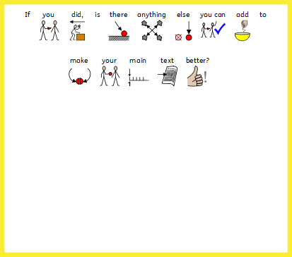

Slide 38
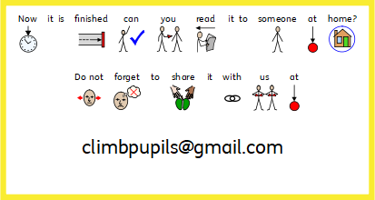

Slide 39
Date: Friday 29th January
L.O. To be able to spell near homophones.
Subject: English

Slide 40
Spellings
Remember:
One
Won
Loose
Lose
Quiet
Quite

Slide 41
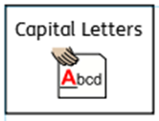
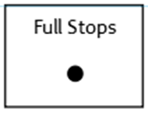
Spellings
Do not forget:
Can you put each one in a sentence?
One:
Won :
Loose:
Lose:

Slide 42
Spellings
Do not forget:
Can you put each one in a sentence?
Quiet:
Quite:

