Slide 1



Date: Tuesday 5th – Friday 8th January
L.O To be able to recognise special friends.
Please practise phonics every day for 20 minutes.
Subject: Phonics

Slide 2

Special Friends – Sound 1
‘Special friends’ are two letters that make one sound.
When we put ‘s’ and ‘h’ together they form the sound ‘sh’.
Try my turn, your turn with a partner “sh” > “sh”
Say: The horse says shhhh to the
Hissing snake
(This is a stretchy sound)

Slide 3


Blending Independently – Special Friends
Fred Talk - Fred Frog can only say words in sounds but not the entire word all at once for example sh-i-p.
Read the Phonics green word card: Special Friends, Fred talk, read the word.
fish
sheb
ship
shoop
Review the words
Special Friends, Fred Talk, read the word
Fred in your head
Speedy reading
Can you separate the real words from the alien words?

Slide 4

Review and Write
Can you spot todays Special Friends?
Try thinking of some other words that have the sound ‘sh’.
Examples - ship shook shed
Challenge! Can you put a word from your list into a sentence?
Example- The pirate sailed across the waves in his ship.

Slide 5
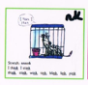
Special Friends – Sound 2
‘Special friends’ are two letters that make one sound.
When we put ‘n’ and ‘k’ together they form the sound ‘nk’.
Try my turn, your turn with a partner “nk” > “nk”
Say: nnnnk
The rat in the cage says
I think I stink
(stretchy sound)

Slide 6


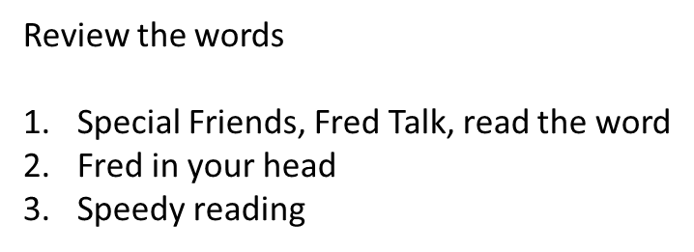

Blending Independently – Special Friends 2
Fred Talk - Fred Frog can only say words in sounds but not the entire word all at once for example s- i- nk.
Read the Phonics green word card: Special Friends, Fred talk, read the word.
sink
dink
wink
tink

Slide 7


Review and Write 2
Try and think of other words that have the sound ‘nk’.
Examples – wink stink blink
Challenge! Can you put a word from your list into a sentence?
Example – I got a drink from the sink.

Slide 8
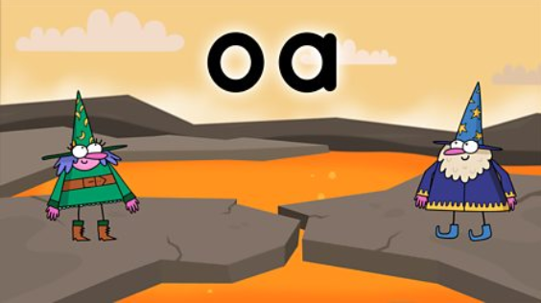

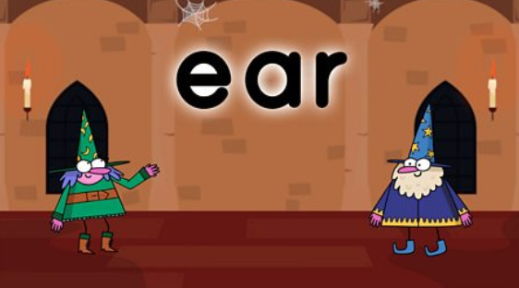
Phonics
BBC Bitesize has lots of 30 second videos focusing on each of the phonics sounds.
https://www.bbc.co.uk/bitesize/topics/zvq9bdm
Copy and paste the link.

Slide 9
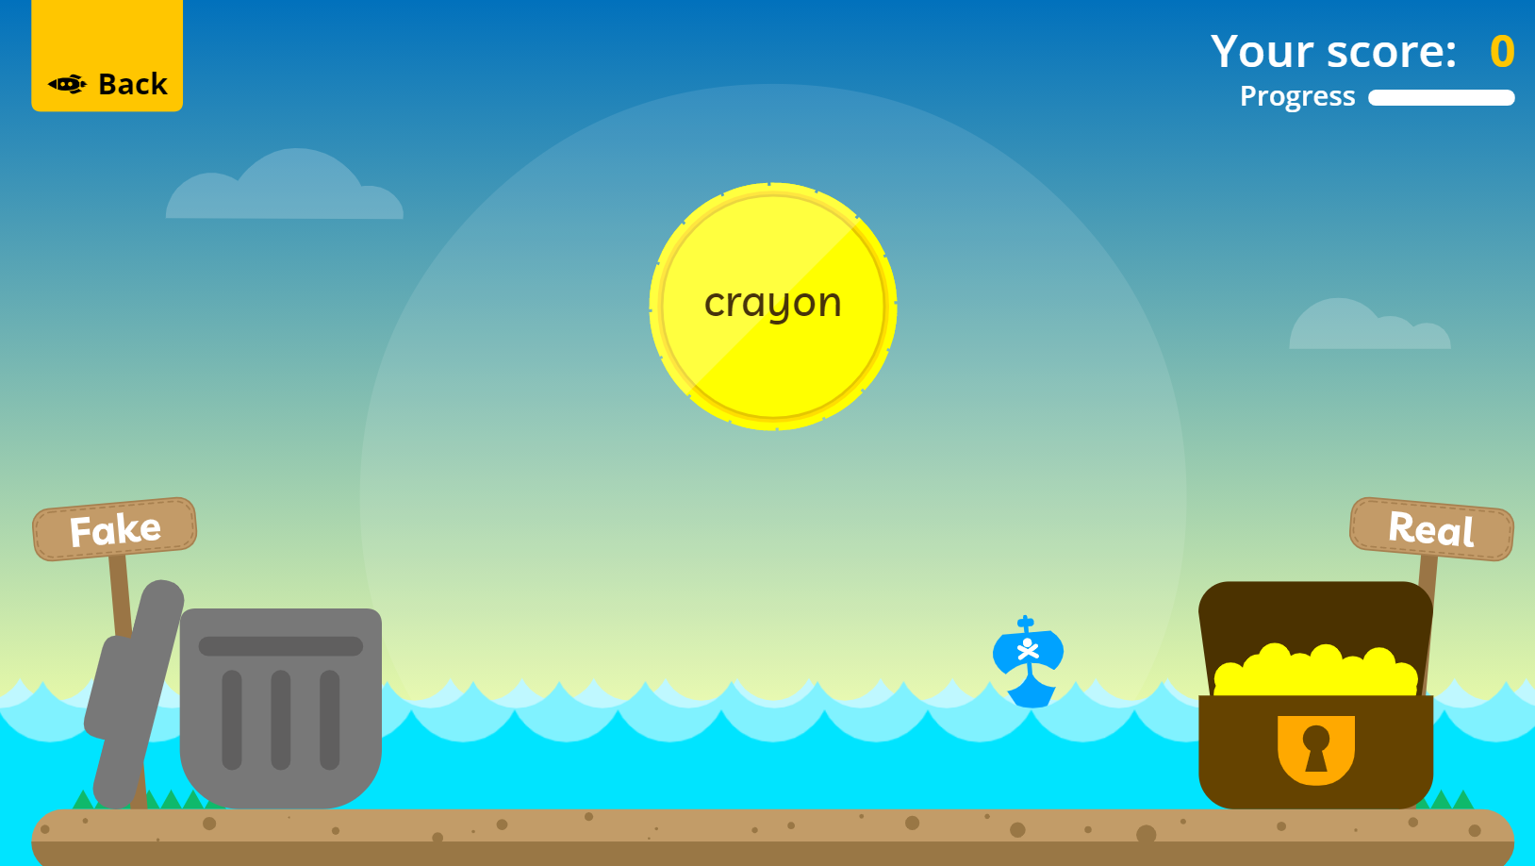
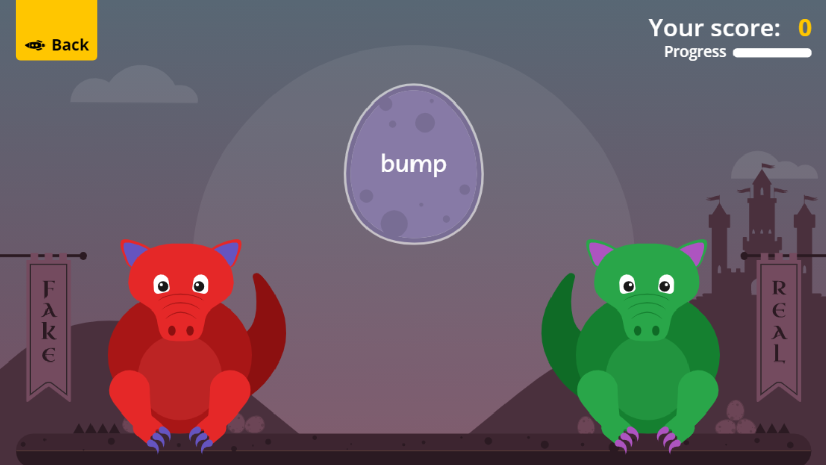

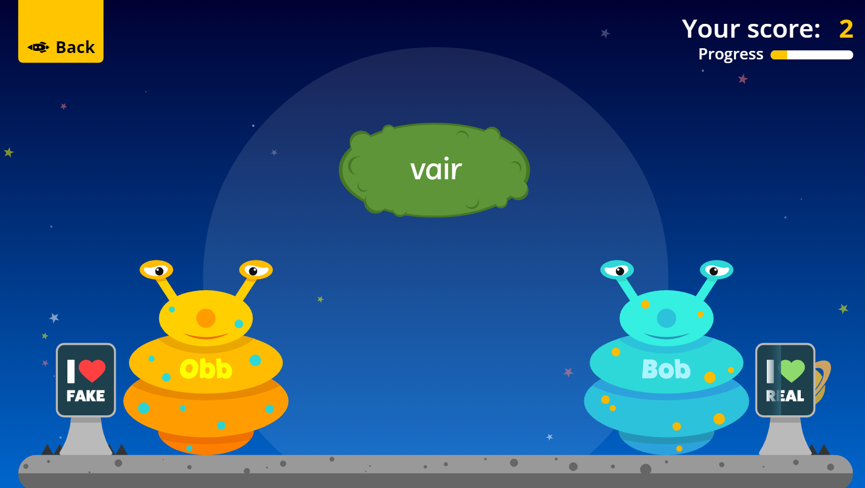
Fun Phonics Games!
Copy and paste the link to play these fun phonics games!
https://www.phonicsplay.co.uk/resources/phase/2/buried-treasure
All phases
https://www.phonicsplay.co.uk/resources/phase/2/dragons-den
All phases
https://www.phonicsplay.co.uk/resources/phase/2/picnic-on-pluto
All phases

