Slide 1
Date:
Monday 11th January
LO
To be able to use tools for a purpose
Subject: Art & Design

Slide 2
Today we are going to be looking how to use tools for a purpose. First, we are going to use a pencil.
Using a pencil to see if you can trace the dotted line.
Now try different sizes…

Slide 3
Now we are going to see if we can follow the circle using a paintbrush. Using whatever colour paint you have at home have a go at making circles.

Slide 4
Now let's see if we can combine our circles and make a teddy bear! Using a pencil see if you can connect all the circles to make your teddy. Ask a grown-up for help if you need it.
When your done feel free to use your colours/paints and colour it in!

Slide 5
Date:
Tuesday 12th January
LO
To use tools for a purpose
Subject: Art & Design

Slide 6
Today we are going to be looking using scissors and cutting round our circles.
We need to ask our grown-up to help supervise us for this!
Using your scissors holding them like the picture see if you can cut around the circles.
Add your own circles to make the eyes, ears and the nose.

Slide 7
Using the circles we have just cut out, see if you can make a Teddy Bear. Use the teddy bear we drew round earlier as a template. You can use sticky tape or glue. When your finished make sure you colour him in using pens/crayons or paints.

Slide 8
Date:
Wednesday 13th January 2021
LO
To create dance using circular motions.
Subject: PE

Slide 9
Today we are going explore how we can move our bodies in circular motions.
First, we start with our hands. Slowly turning at the wrists move your hands round in circles. Then move to the elbows and make small circles with them. Then move to your shoulders- make small circle movements gradually getting bigger and bigger until your whole arm is moving in big circles. Once your gong in one direction switch it and go the other way.
Next, we can move our hips in a circle- moving it one way then the next. Then we can try with our knees down to our feet.
Let's enjoy this clip exploring how we can move in circles!
https://www.youtube.com/watch?v=NMqVRgle5po

Slide 10
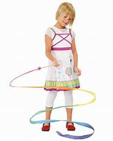
Next, we are going to see if we can use some ribbon or string like a streamer and make big huge circle movements with our arms. Watch as the ribbon goes round and round.
Now we are all warmed up, why don’t we try dancing to other shapes too! Please follow the link below.
https://www.youtube.com/watch?v=0B6Ge0FzHG0

Slide 11
Date:
Thursday 14th January 2021
LO
To be able to identify circle household objects
Subject: Art & Design

Slide 12
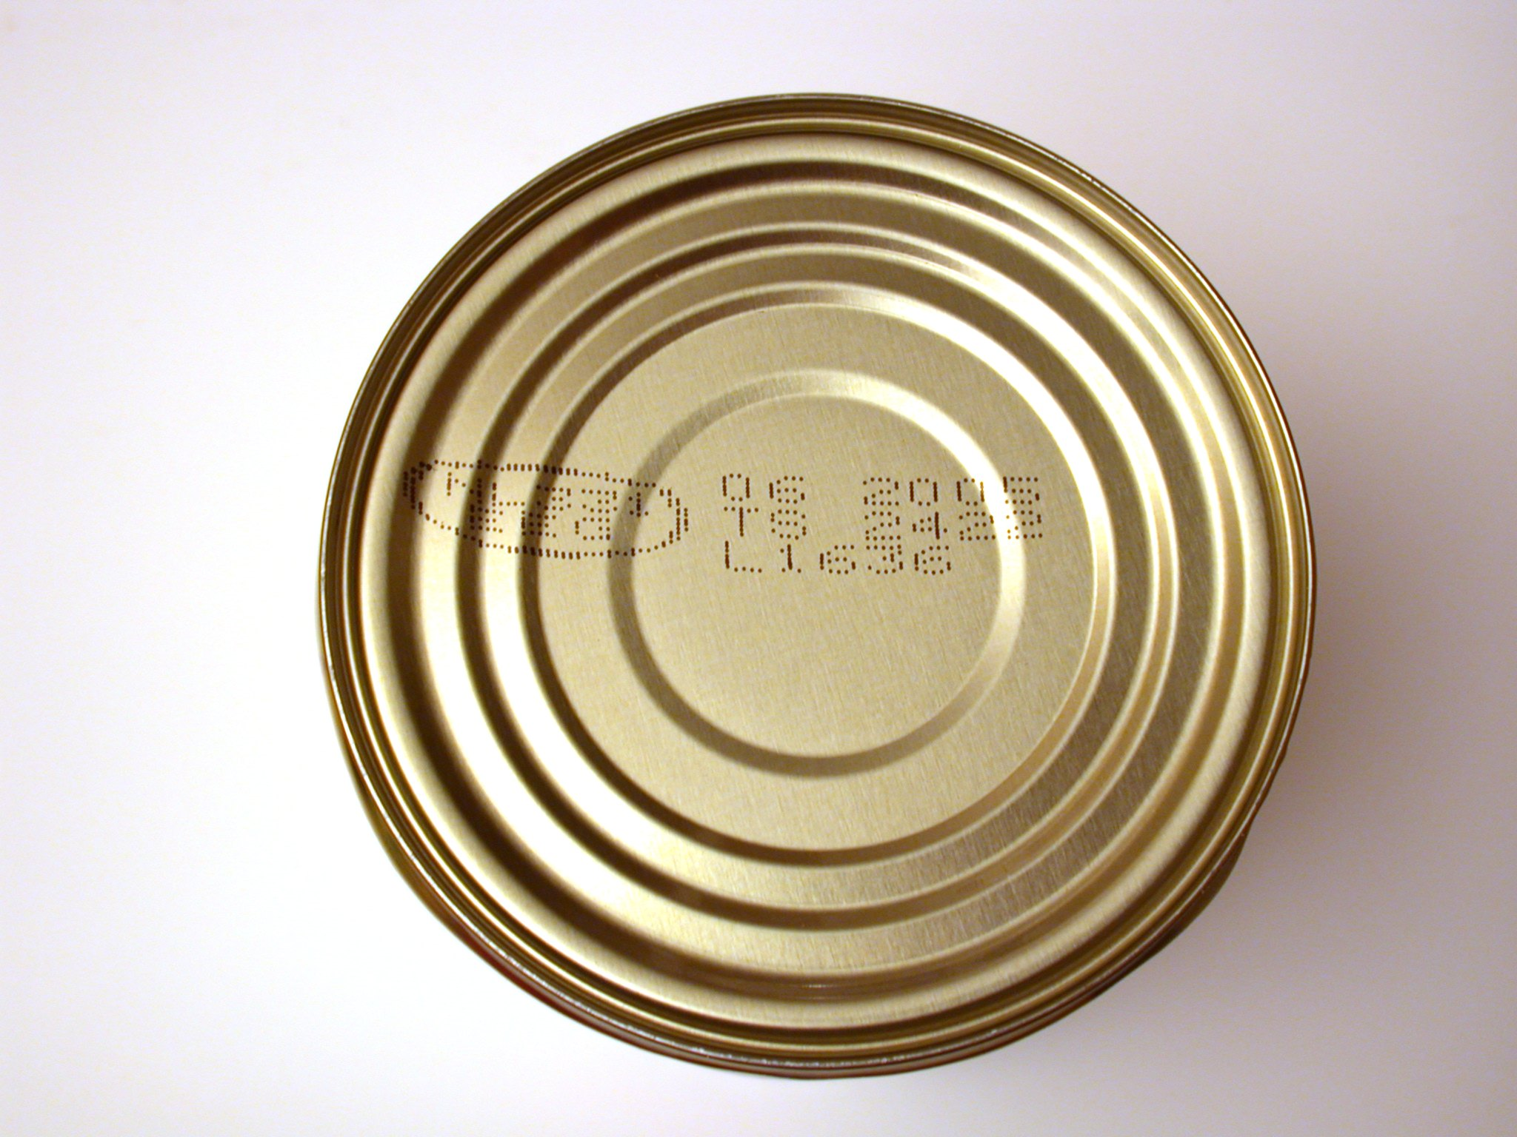
Today, we are going to be looking in and around our home to see if we can see anything circular.
What shape is your Tv?
What shape is the wall clock?
Is there a circle in the kitchen? How about an apple?
Let's see if you can find 10 things.
Get a grown up to help you and write it down!

Slide 13
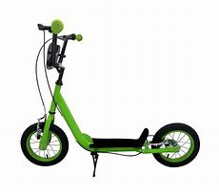
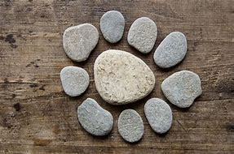
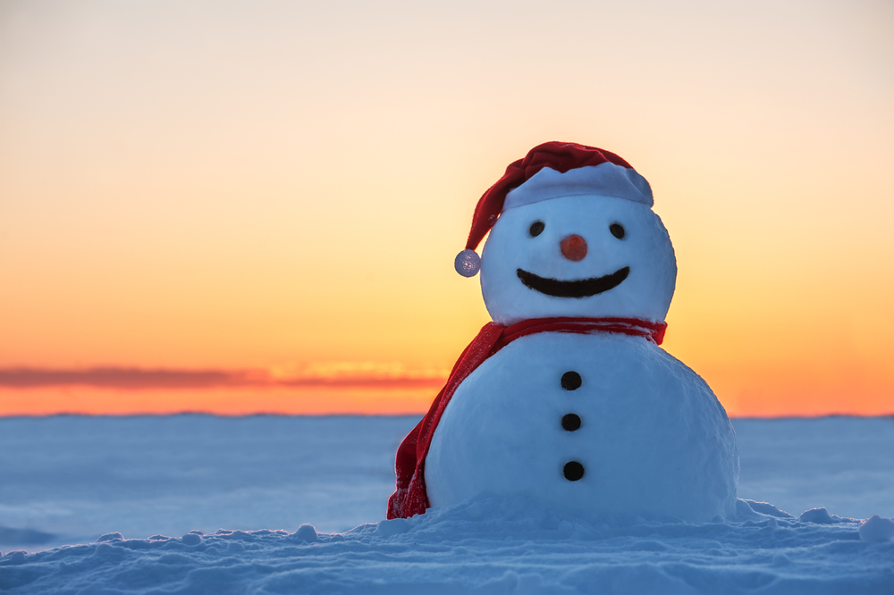
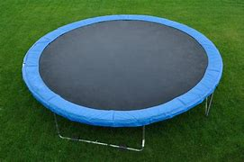
Next, we are going to wrap up and go outside and see if we can find anything circle.
Can you see any circle shaped stones?
How many things in your garden can you find that are circle? Ask your grown-up to help you make a list.

Slide 14
Friday 15th January
Date:
LO
To be able to follow a playdough recipe and make circular models with it
Subject: DT

Slide 15
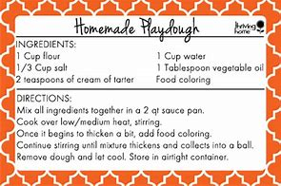
Today, we are going to get messy and make some playdough.
Follow this simple recipe with your adult.

Slide 16
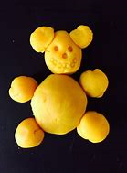
Now, you have made your playdough,
Can you make a ball with it?
Can you make a circle?
Looking at the teddy bear we made earlier in the week can you copy this with your playdough?
What other objects can you make from circles of playdough?
I cannot wait to see what creations you make with circles!
Here is a link to watch to help make your teddy!
https://www.google.co.uk/url?sa=t&rct=j&q=&esrc=s&source=video&cd=&cad=rja&uact=8&ved=2ahUKEwjyhKLj_YzuAhUi4YUKHbOYAuQQtwIwBXoECAQQAg&url=https%3A%2F%2Fwww.youtube.com%2Fwatch%3Fv%3Dsp-BCugu8EQ&usg=AOvVaw2d8r1Lxay6Ql1lDgV4q0Yj

