Slide 1
Date: 01.02.21
LO: To recognise common 3d shapes in real life contexts.
Subject: Maths

Slide 2
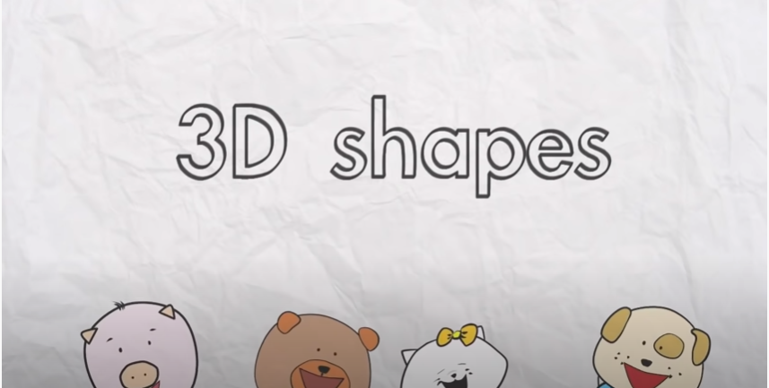
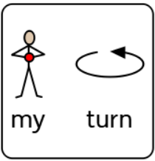
https://www.youtube.com/watch?v=guNdJ5MtX1A

Slide 3
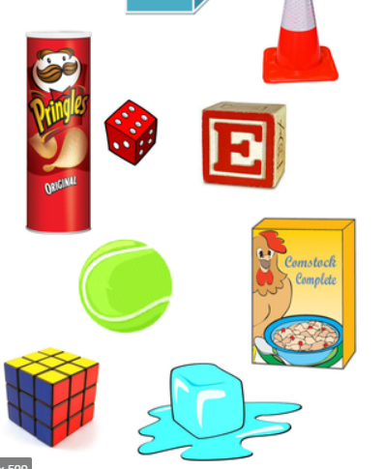
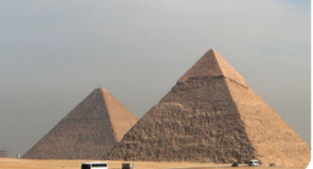

Slide 4
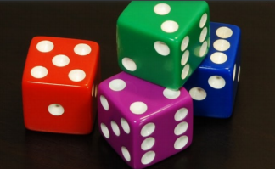
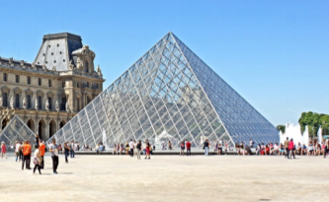
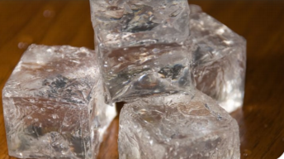

Slide 5
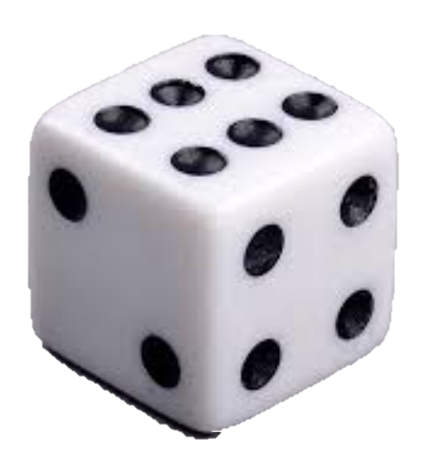
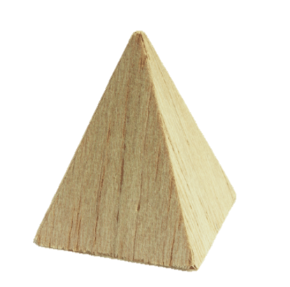
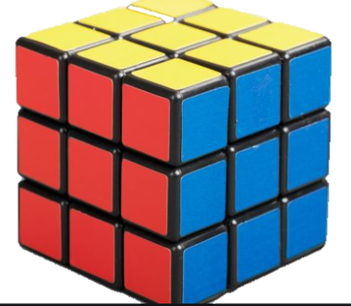

Slide 6
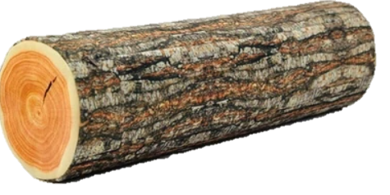
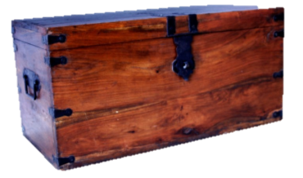

Slide 7
Date: 02.02.21
LO: To make a model using 3d shapes.
Subject: Maths

Slide 8
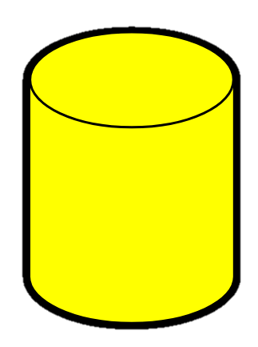
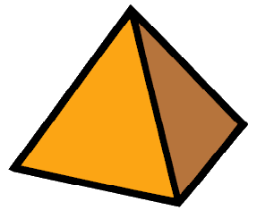
Let’s look at some 3d shapes again…

Slide 9
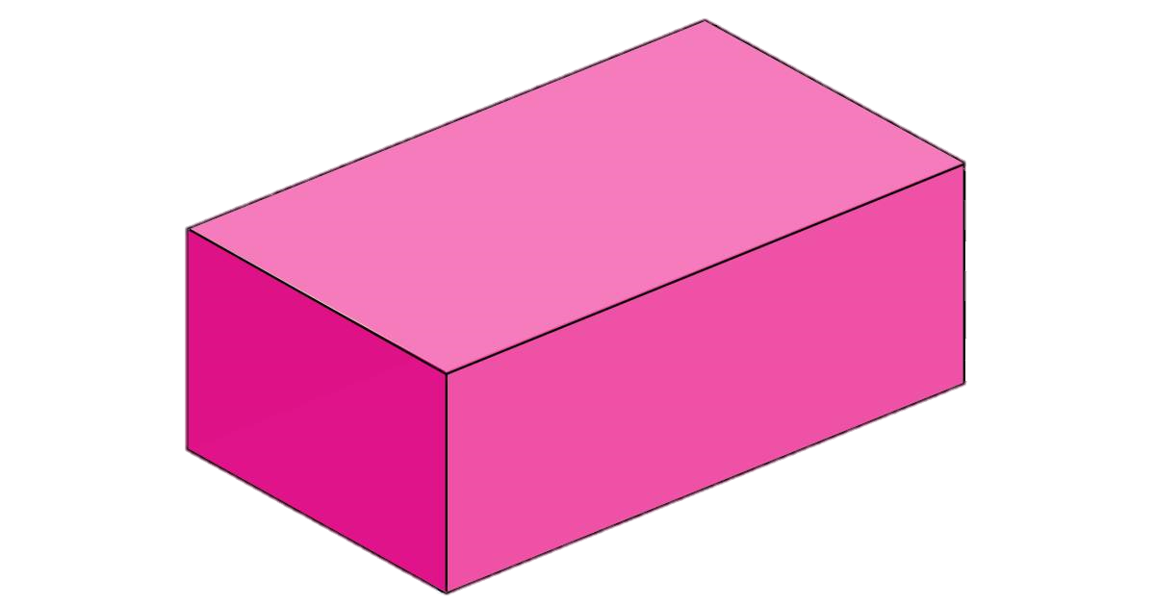
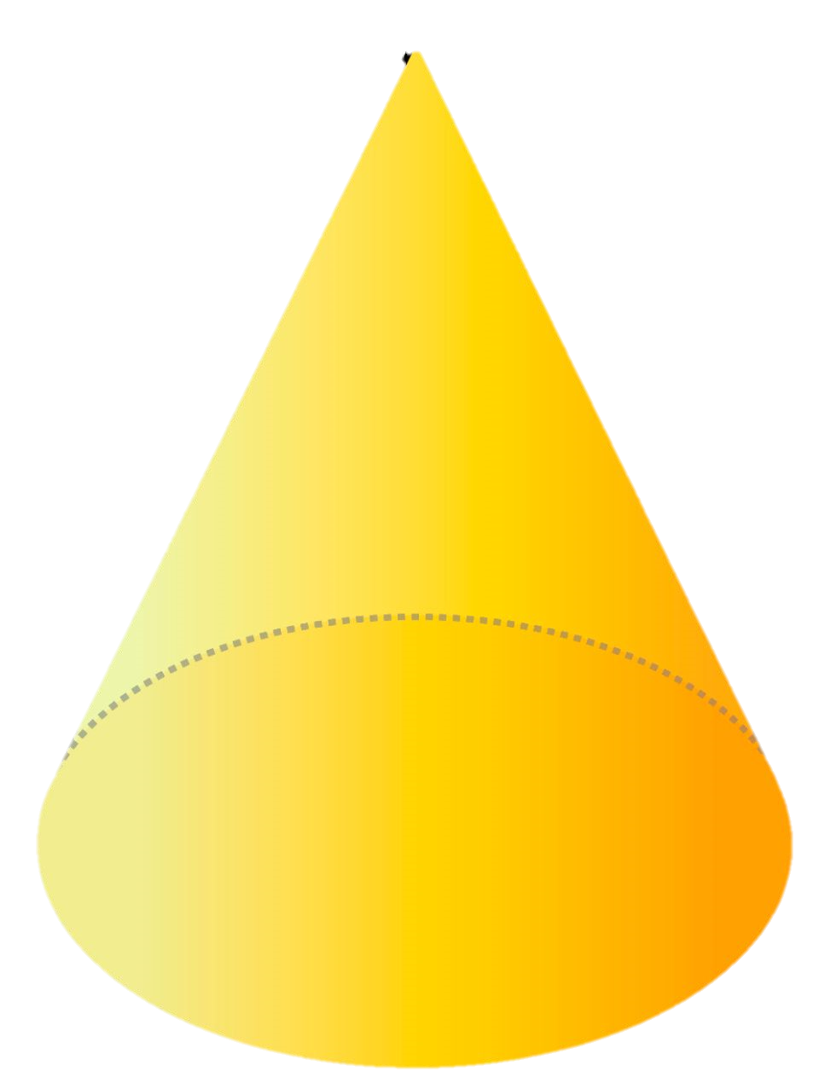

Slide 10
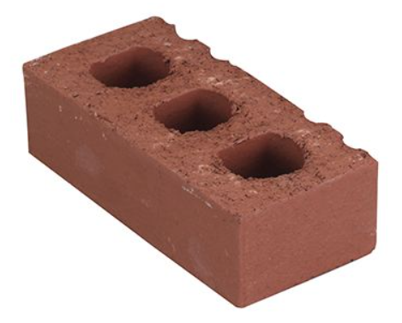
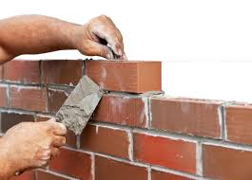

Slide 11
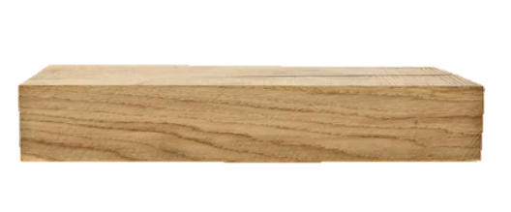

Slide 12
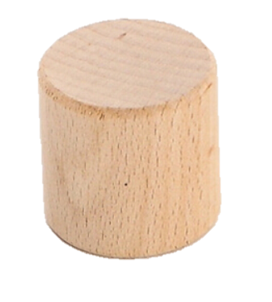

Slide 14
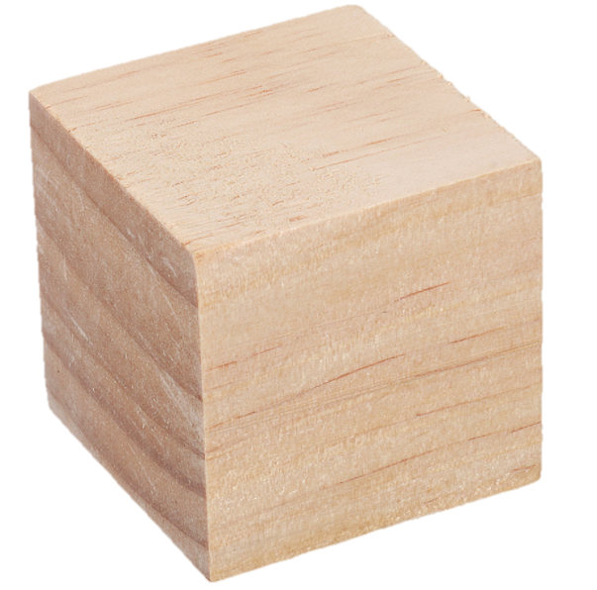

Slide 15
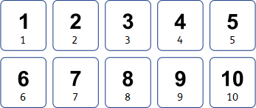

Slide 16
Date: 03.02.21
LO: To make a model using 3d shapes.
Subject: Maths

Slide 18
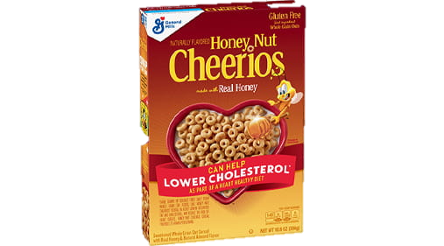

Slide 19
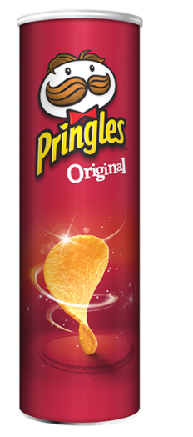

Slide 20
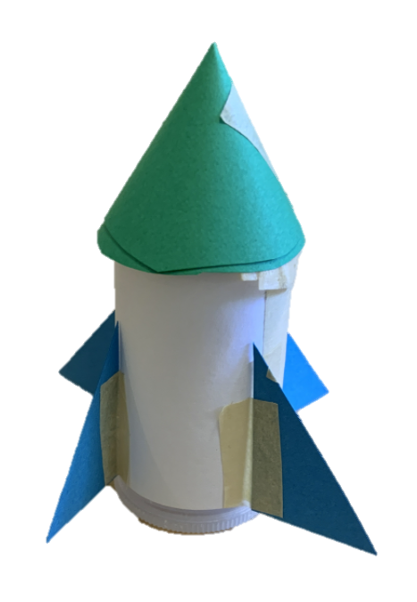

Slide 21
Date: 04.02.21
LO: To continue a repeating pattern using 3d shapes.
Subject: Maths

Slide 22
Let’s look at some 3d shapes again…

Slide 27
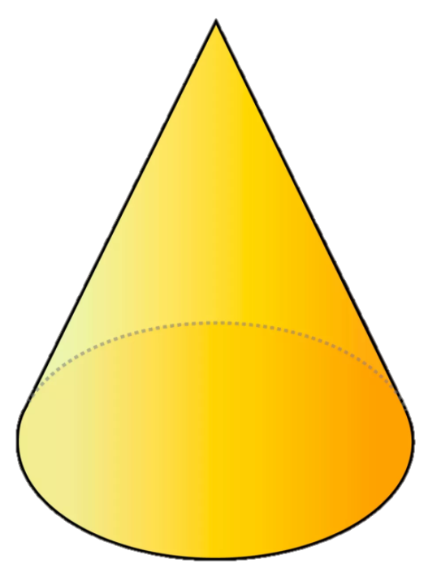

Slide 32
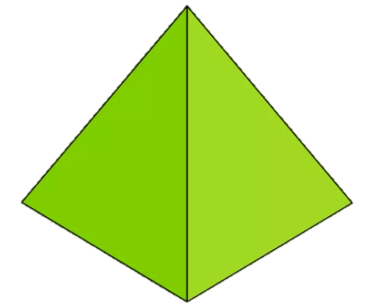
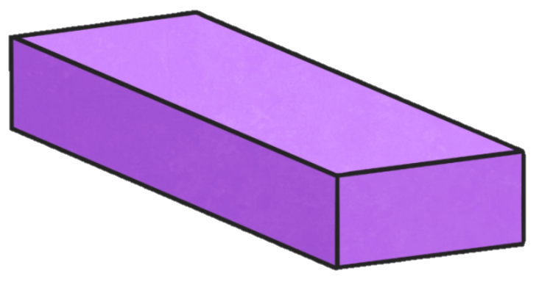

Slide 33
Date: 05.02.21
LO: To continue a repeating pattern using 3d shapes.
Subject: Maths

Slide 36
?

Slide 37
?

Slide 38
?

Slide 39
?

Slide 40
?

Slide 41
?

Slide 42
?

Slide 43
?

