Slide 1
Hello everyone,
Another great week of home learning last week. Thank you so much to everyone who sent in photos and videos of your learning. I’ve loved seeing it all, I can see you’re having lots of fun at home.
Please continue to send us anything you do at home and have lots of fun learning through play.
Miss Wilkinson, Mrs Cairns & Miss Anderson ☺
Phone: 01429 820594
Email: explorerspupils@gmail.com
Facebook: Explorers - WHPS

Slide 2
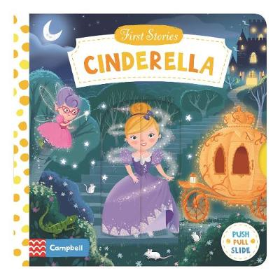
Monday 25th January 2021
Our book this week is ‘Cinderella’
You might have this story book at home. If so, ask your grown up to read it with you.
You can also use the link below to paste it into google and watch the story together.
Can you talk about what happens in the story?
Can you talk about the events in the story?
What did the fairy godmother transform?
https://www.youtube.com/watch?v=DgwZebuIiXc

Slide 3
Time to practice our names, try and do this everyday. If you can write your first name you could try to do your surname too.
Can you write the different sounds we have learnt? m,s,a,d,t,I,n
You could try writing some simple words too.
More ideas…
See how many rectangles you can find in your house.
Joe Wicks is on today at 9am doing his live PE. You could try to join in.
How many sides does a rectangle have?
https://www.youtube.com/channel/UCAxW1XT0iEJo0TYlRfn6rYQ

Slide 4
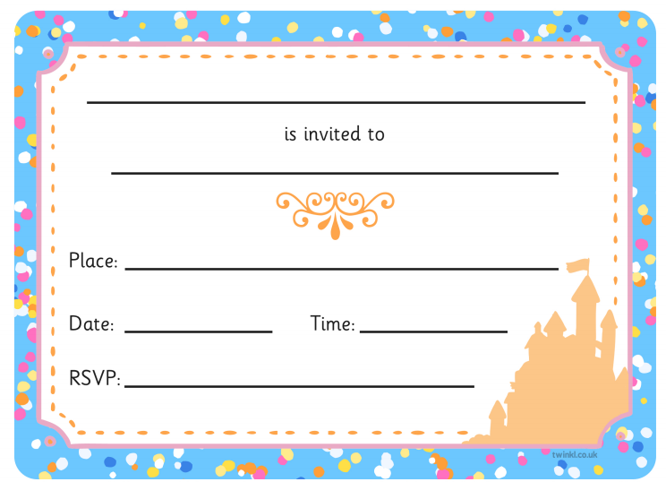
Tuesday 26th January 2021
Can you write an invitation?
Here is a template to write your own invitation just like in our story.
Who will you invite?
What kind of party will you have?
Can you use your magic writing to fill it in. You can practice your name writing and number formation again too. Ask your grown up to help you copy them on the invitation.

Slide 5
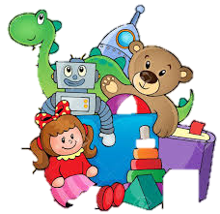
Choose your favourite story to read. Tell you grown up about what happens.
Draw a picture of your favourite part of the story.
More ideas…
Can you count ten of your toys?
Remember to check on your beanstalk from last week. Has it started to change? Talk to your family about what you can see.
What happens if you take one of your toys away? Does the amount change?

Slide 6
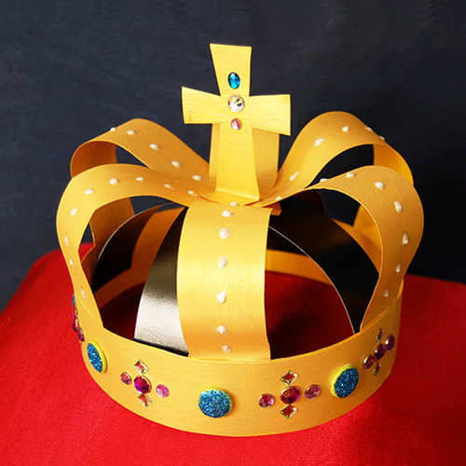
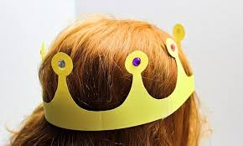
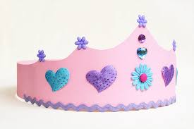
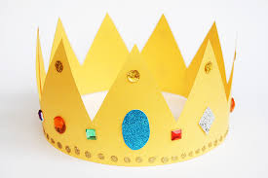
Wednesday 27th January 2021
Make a Crown…
Use the resources you have at home to create your own crown.
Use your creative skills to decorate it too.
You will be a perfect Prince/Princess in your very own crown. Ready for a ball.

Slide 7
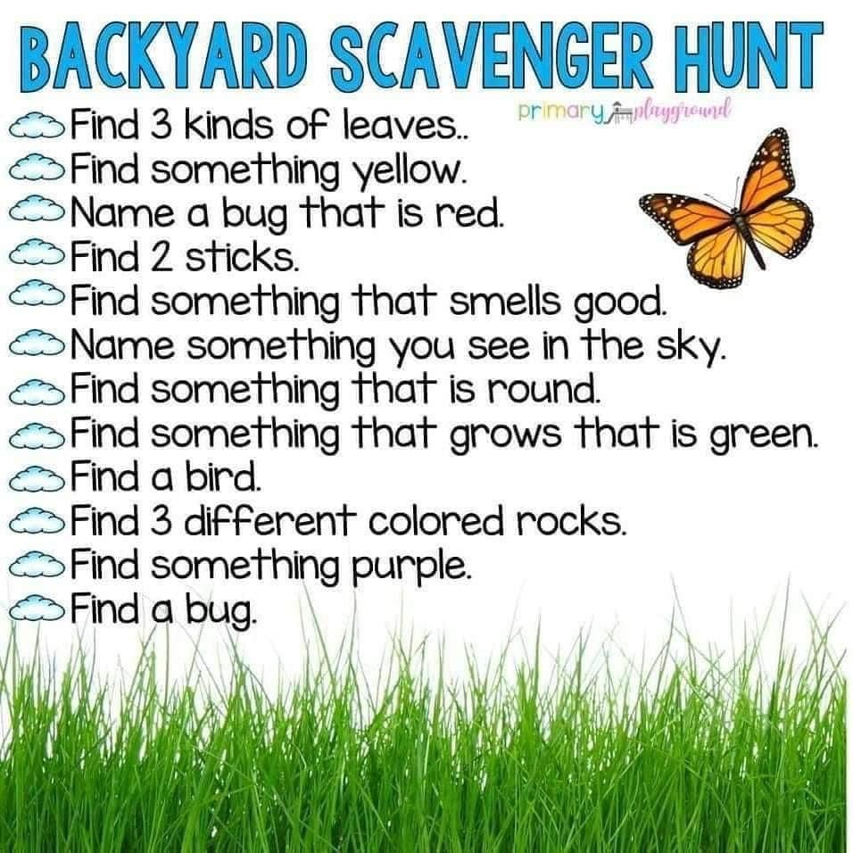
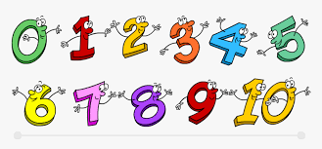
Can you cut out a shoe just like Cinderella’s and design your own? You could make a shoe for the prince too.
Can you write the numbers we have learnt…
0,1,2,3,4,5,6,7,8,9
More ideas…
Sing some number songs.
The weather was so bad last week, try and see if you could do the hunt this week. Hopefully it is dry outside.

Slide 8
Thursday 28th January 2021
Can you add the correct amount of sparkles to the number wands?
1
3
5
2
4
Either on here or print and add them practically.

Slide 9
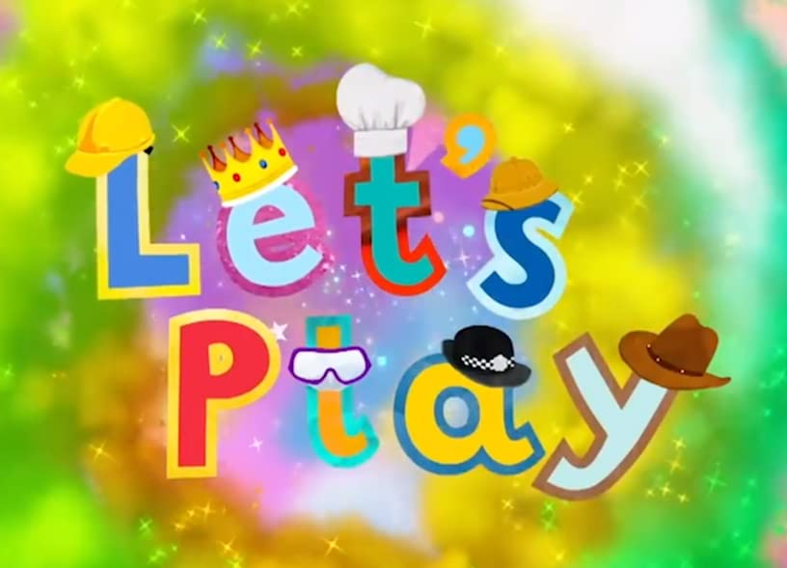
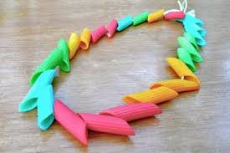
Time to practice those fine motor skills. Can you make a necklace with pasta or beads?
You could create a party with your family or your toys.
More ideas…
See how many blue objects you can find in your home.
Sing your favourite nursery rhyme.
Can you make up a dance?

Slide 10
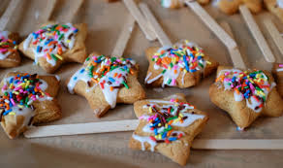
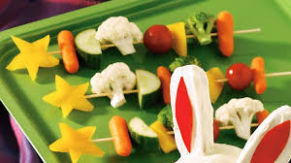
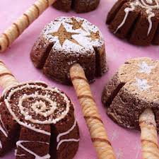
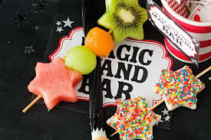
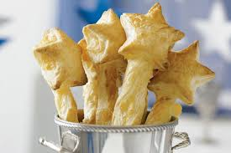
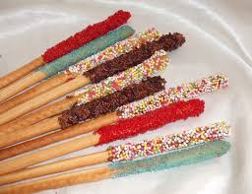
Friday 29th January 2021
Making Magic Wands…
Use what you have at home to create a wand using food…
Biscuit wands
Vegetable wands
Cake wands
Fruit wands
Remember to send us photos!!
Pastry wands
Breadstick wands

Slide 11
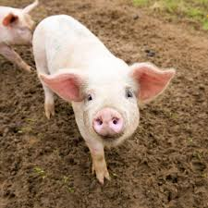
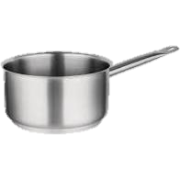
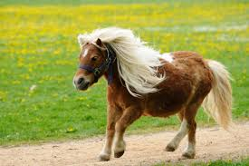
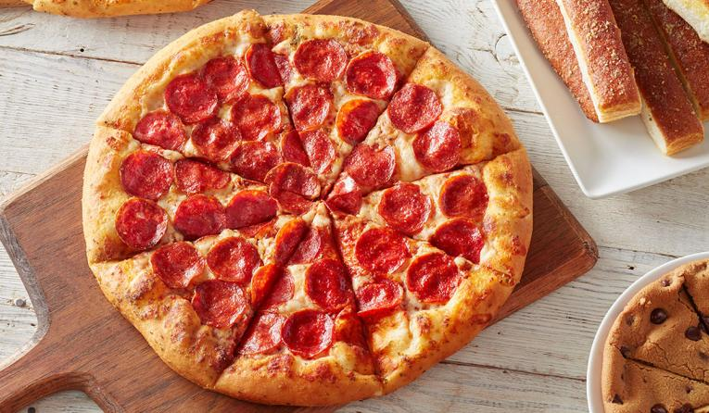
Our sound of the week is…
Can you find some objects in your home that start with our new sound?
Have a go at writing our new sound using the writing rhyme…
“Down the plait and over the pirates face”
This week our practical experience is to enjoy a PARTY! Just like in our story. Make some party food your lunch. Can you think of any foods starting with a p?

Slide 12
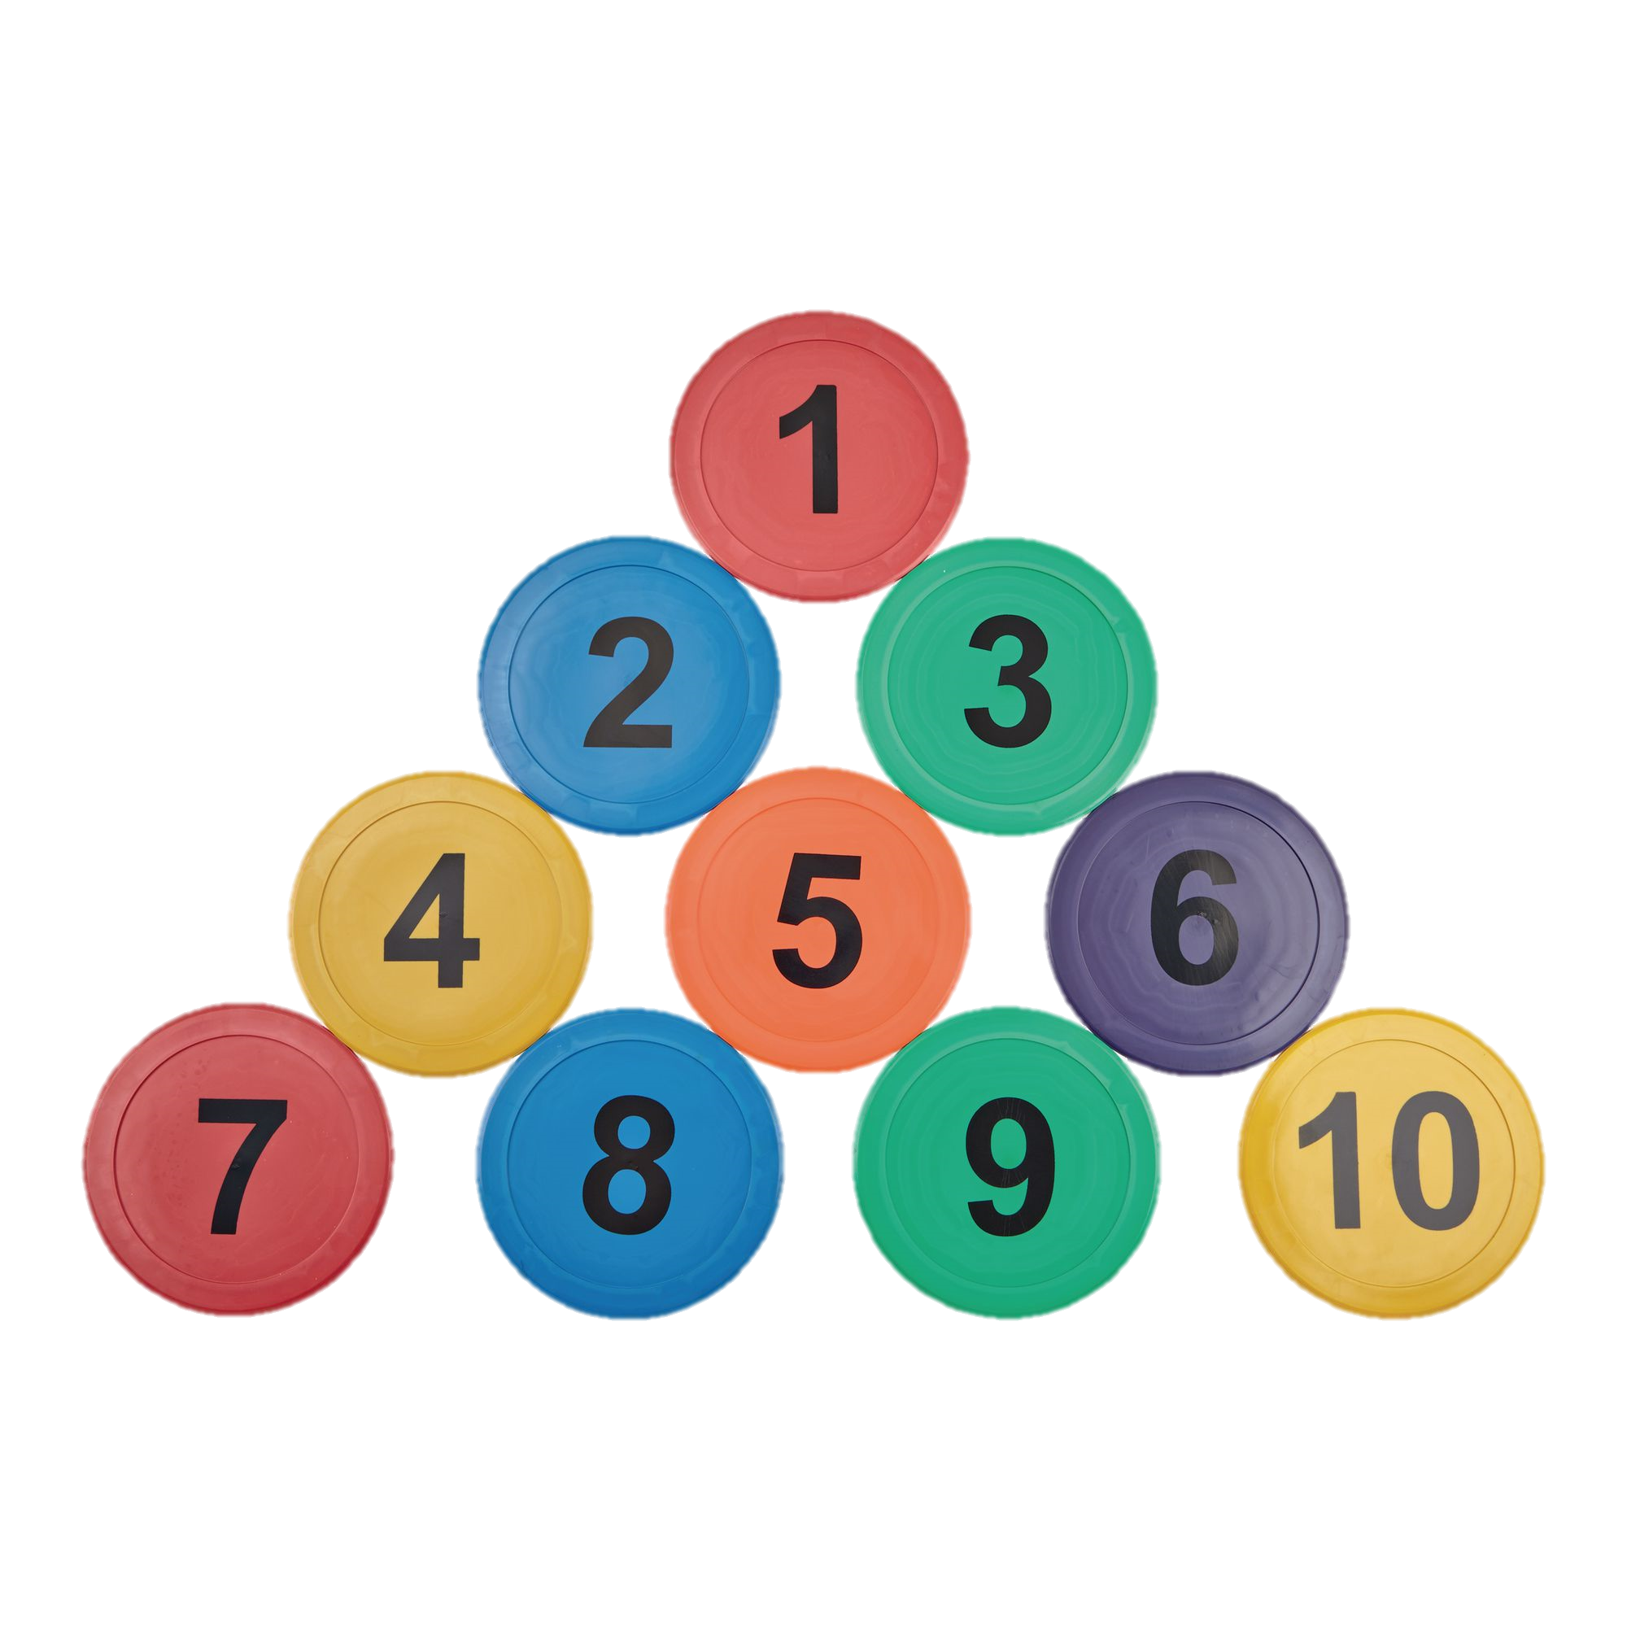
Our number of the week is…
10
Can you count 10 objects in your home?
Have a go at writing our new number using the writing rhyme…
“One and a zero. Down and stop then around and stop”
Can you draw around your hands and then count your fingers? Add a number to each one.

Slide 13
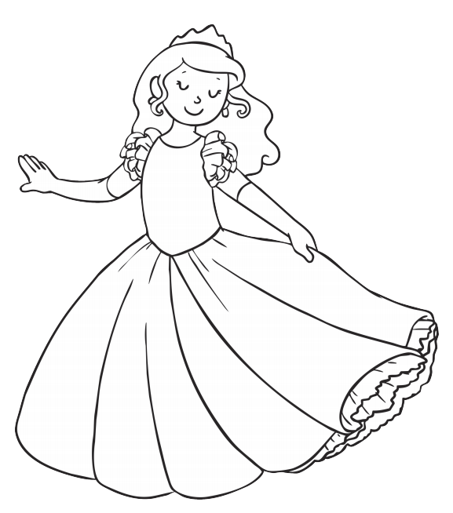
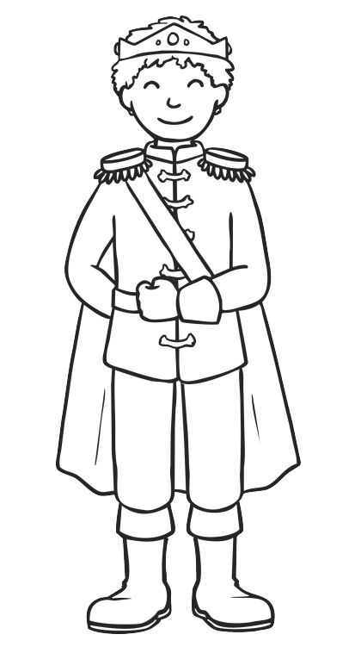
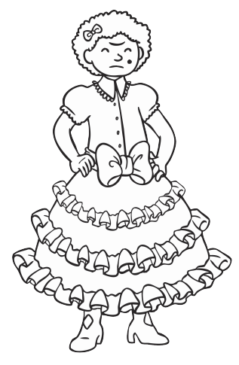
Colouring…

Slide 14
Have a great weekend everyone!
Please send us any photos of your home learning to our email or our Explorers Facebook page.
Email: explorerspupils@gmail.com

