Slide 1
Subject: English
Pack: A

Slide 2
Date: Monday 22nd February
LO To be able to identify features of a non – chronological report.
Subject: English

Slide 3
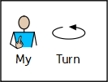
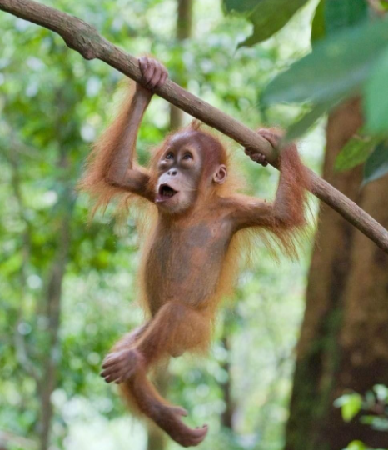
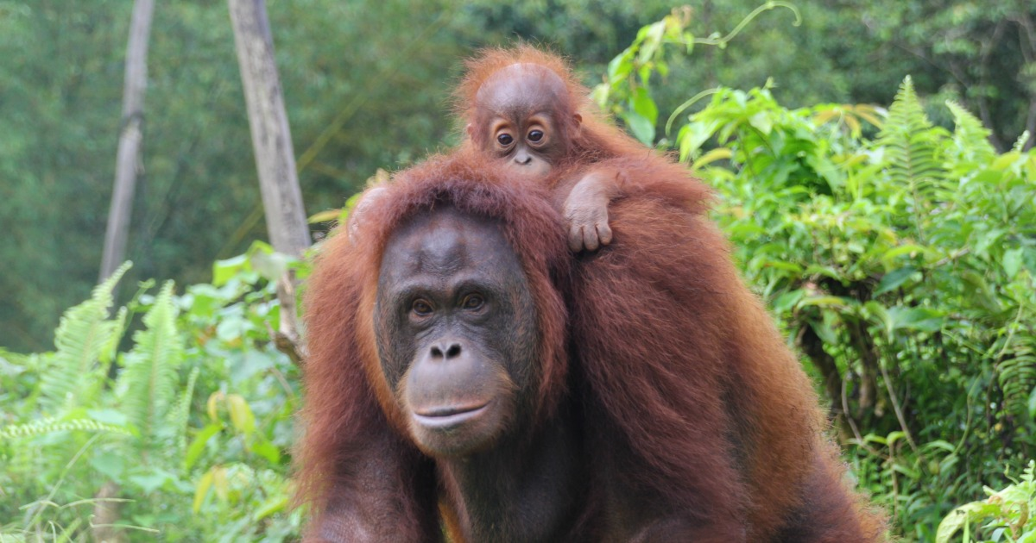
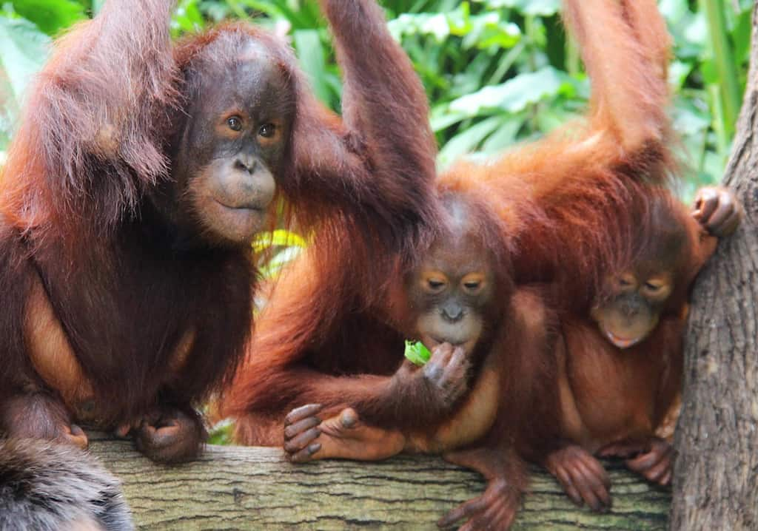
Outstanding orange orangutans!
This week we are going to be writing a report about orangutans
To learn more about orangutans click on the link or copy and paste the link into your internet browser to watch the video.
If you are unable to watch the video online you will find pictures of each page of the book on slides 3 – 10.
Children's Read Along Books: “Orangutan A Day In The Rainforest Canopy” by Rita Goldner - YouTube

Slide 4
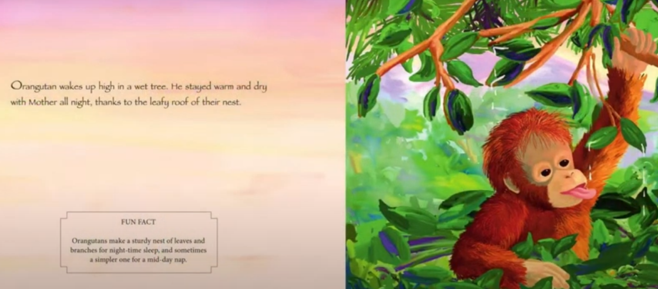
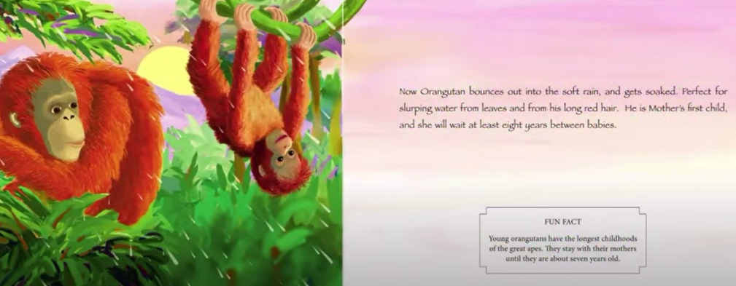
Orangutan – A day in the rainforest canopy

Slide 5
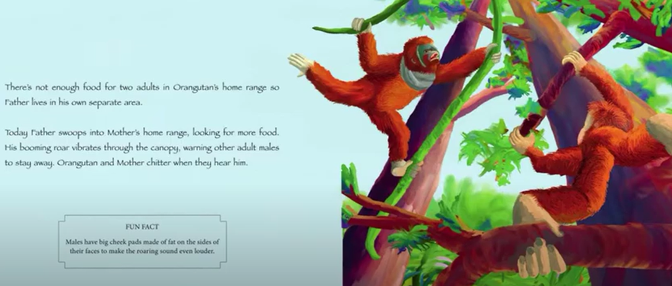
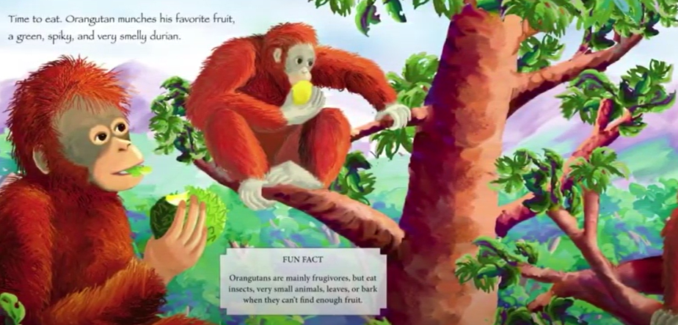
Orangutan – A day in the rainforest canopy

Slide 6
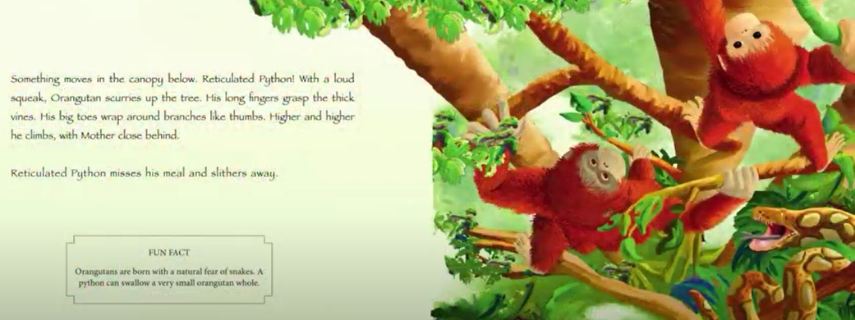
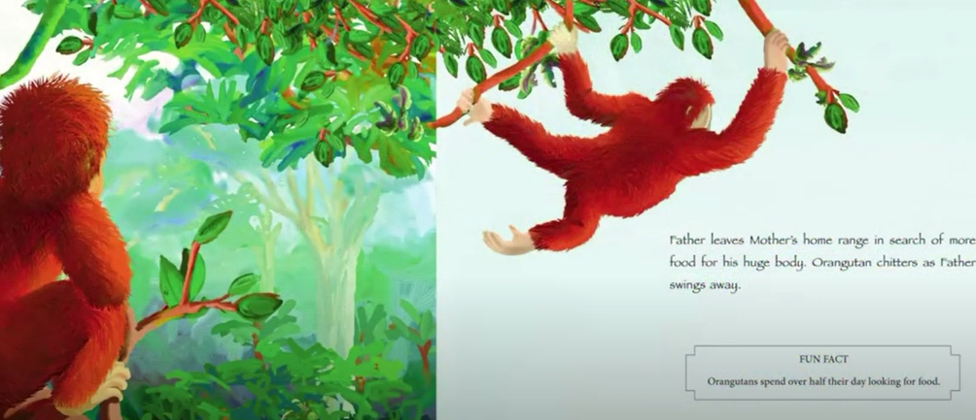
Orangutan – A day in the rainforest canopy

Slide 7
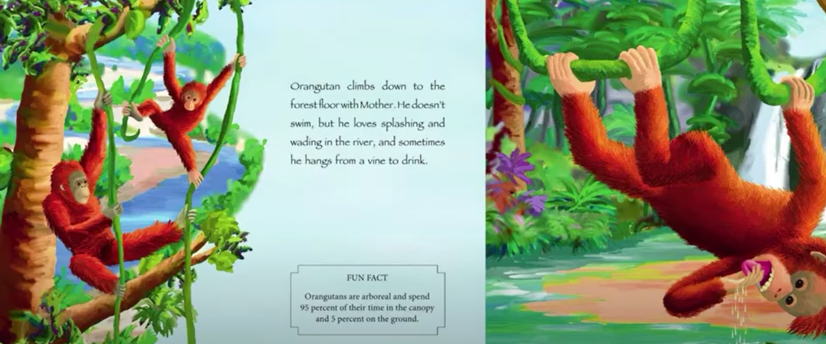
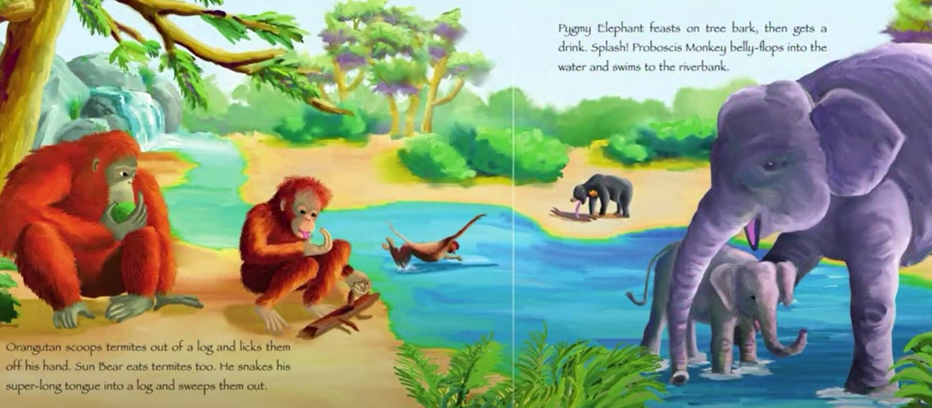
Orangutan – A day in the rainforest canopy

Slide 8
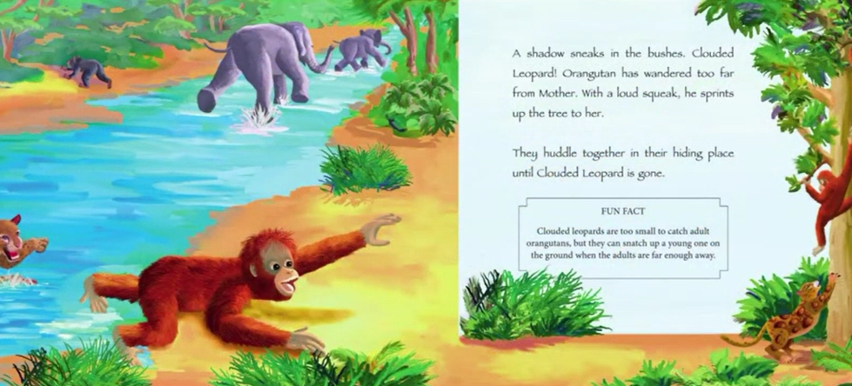
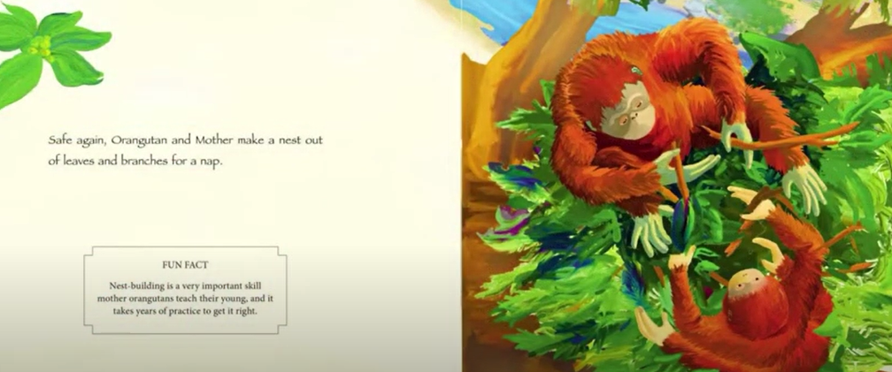
Orangutan – A day in the rainforest canopy

Slide 9
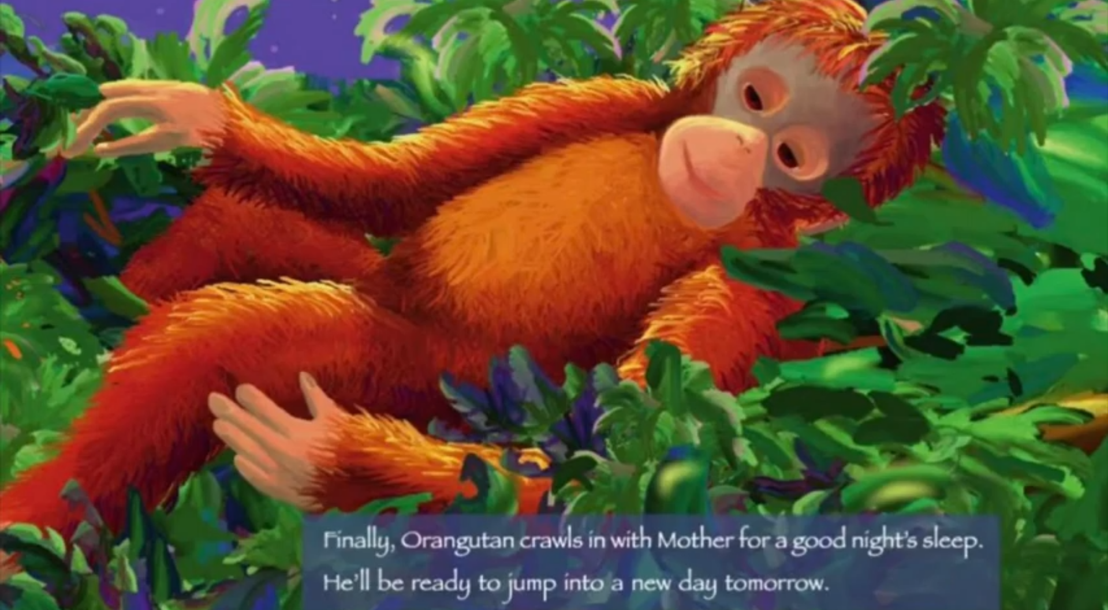
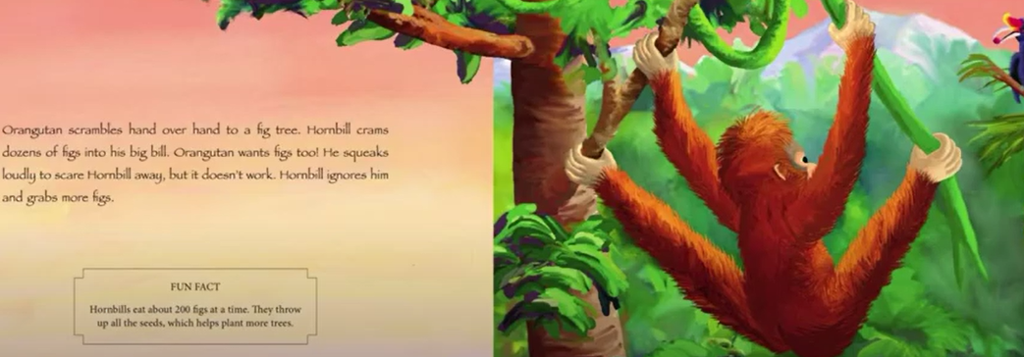
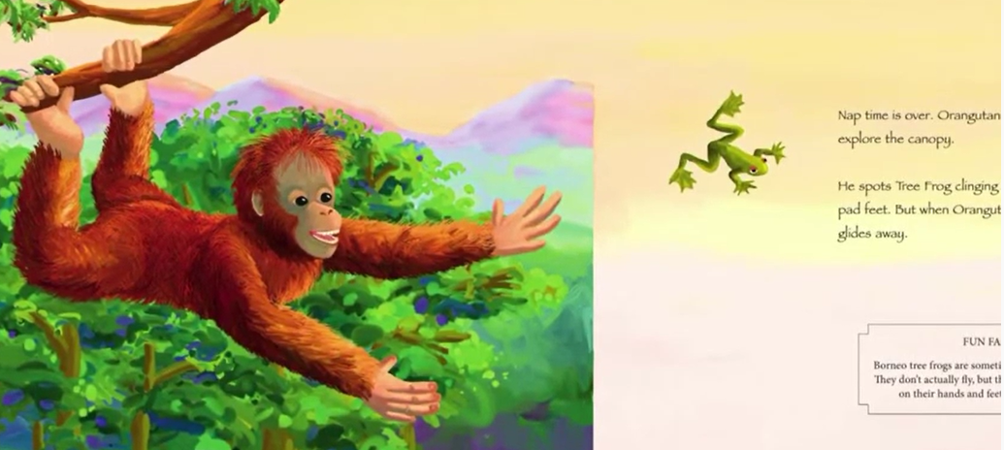
Orangutan – A day in the rainforest canopy

Slide 10
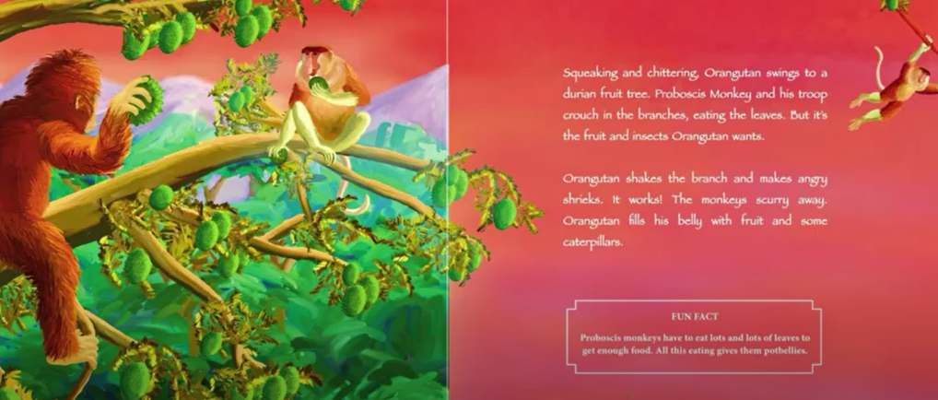
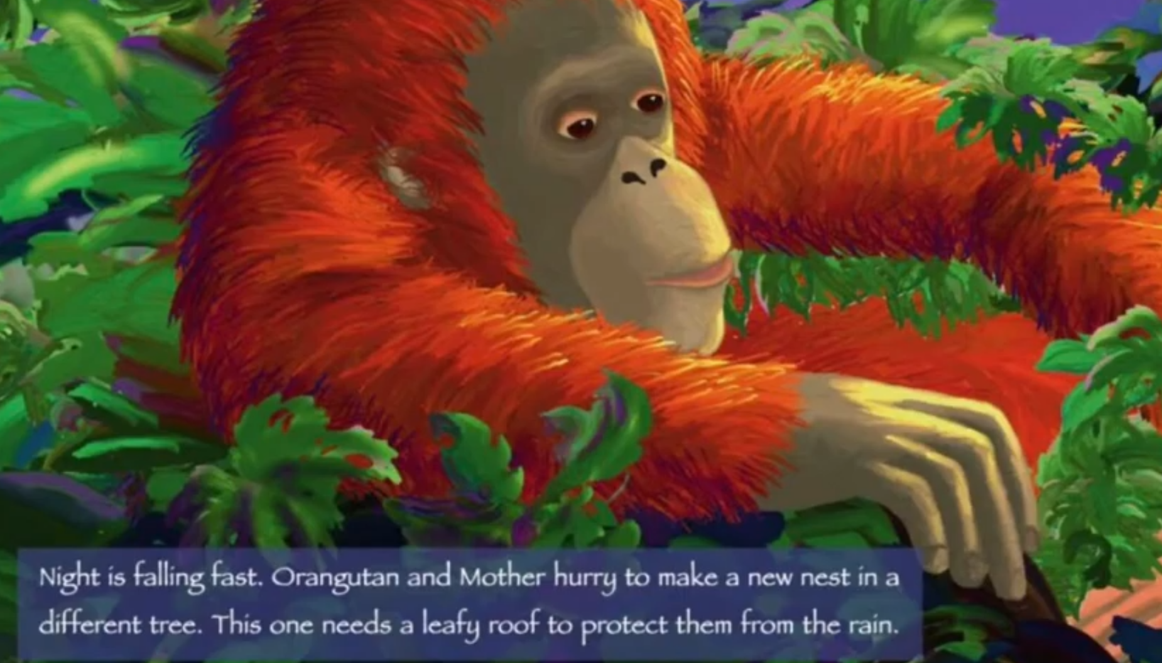
Orangutan – A day in the rainforest canopy

Slide 11
Orangutan – A day in the rainforest canopy

Slide 12
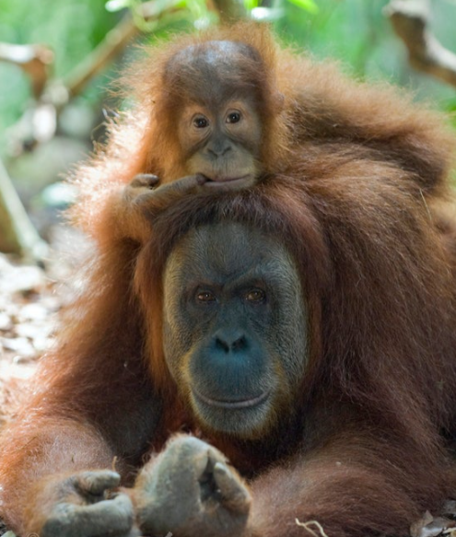
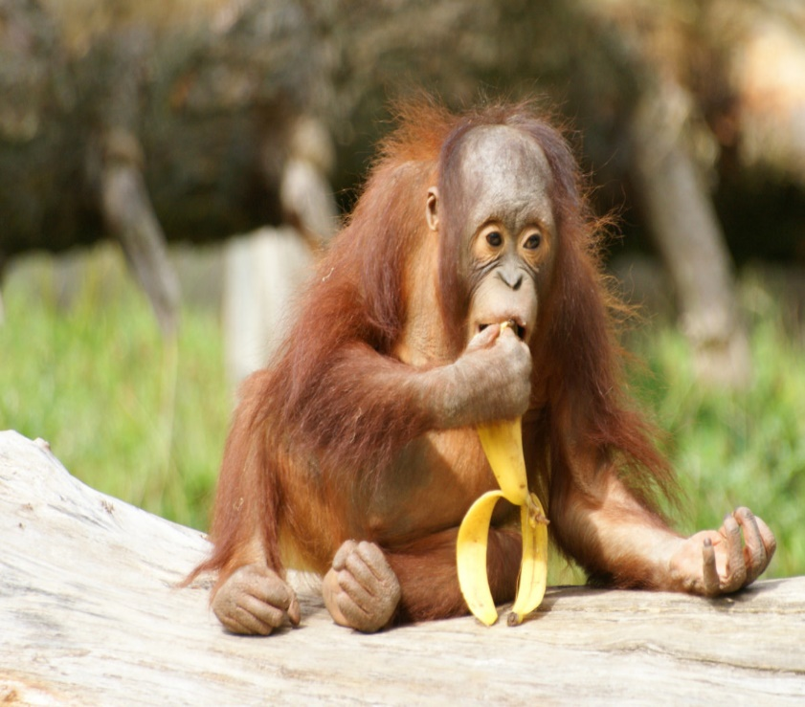
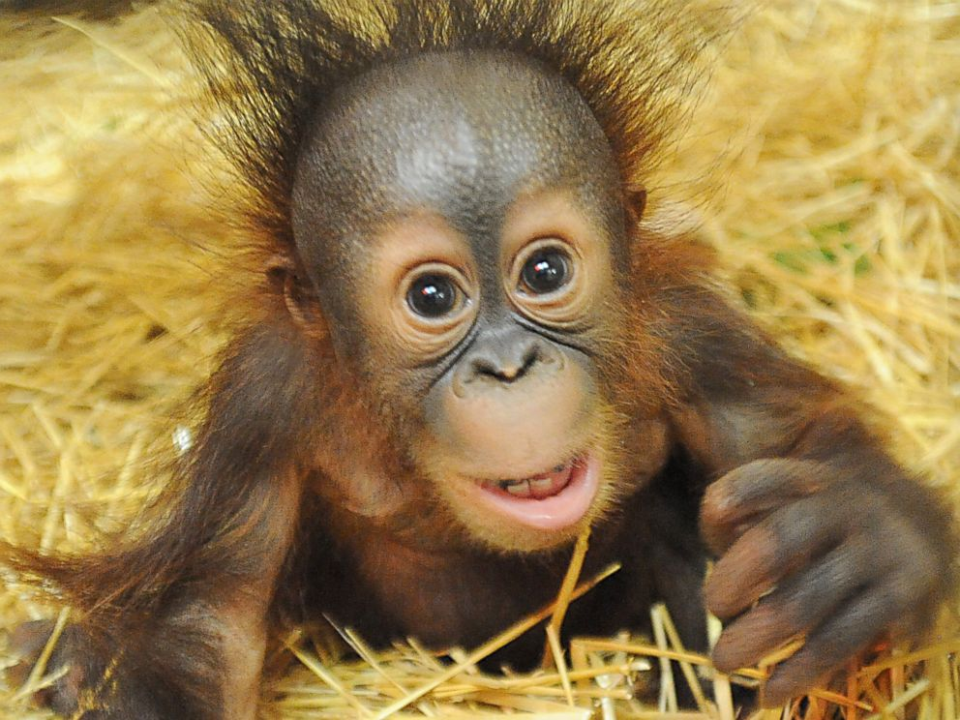
Read my report!
Outstanding orange orangutans!
Orangutans are red-haired apes that live in tropical rainforests. Orangutans are mammals and have many features and characteristics that are similar to humans.
Where do orangutans live?
Orangutans are native to the tropical rainforests of Sumatra and Borneo in Southeast Asia. Orangutans spend 95% of their time in the canopy of the rainforest (up in the trees). They use their long, strong arms and hook shaped hands to climb and swing from branch to branch. Each night orangutans make a sturdy nest of leaves, twigs and branches to sleep in. Nest building is an important skill for young orangutans to learn and it takes years of practise to get it right!
Did you know?
Young orangutans stay with their mothers until they are around 7 years old. This is longer than any other wild animal.
What do orangutans look like?
Orangutans are hairy mammals covered in red or brown hair. They measure between 1.2 metres to 1.5 metres tall. Orangutans have super, long arms! Male orangutans can stretch their arms 2 metres from fingertip to fingertip. Like humans, orangutans have eight fingers, two thumbs and fingernails! Orangutans feet look almost identical to their hands. They use their feet and hands to climb trees, peel fruit and groom each other. Male orangutans have big cheek pads made of fat on the sides of their faces to make their roaring sound louder and scare off predators.
Did you know?
Orangutans are born with a natural fear of snakes – pythons can swallow small orangutans whole!
What do orangutans eat?
Orangutans love to eat fruit, approximately 60% of an orangutans diet is made up of fruit. The other 40% is made up of insects, small animals, leaves and bark.
Did you know?
Orangutans spend more than half of the day looking for food!

Slide 13
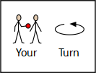
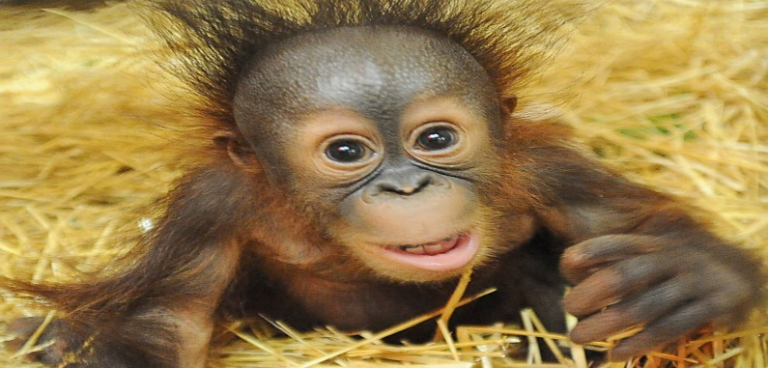
Now find the features
Outstanding orange orangutans!
Orangutans are red-haired apes that live in tropical rainforests. Orangutans are mammals and have many features and characteristics that are similar to humans.
Where do orangutans live?
Orangutans are native to the tropical rainforests of Sumatra and Borneo in Southeast Asia. Orangutans spend 95% of their time in the canopy of the rainforest (up in the trees). They use their long, strong arms and hook shaped hands to climb and swing from branch to branch. Each night orangutans make a sturdy nest of leaves, twigs and branches to sleep in. Nest building is an important skill for young orangutans to learn and it takes years of practise to get it right!
Did you know?
Young orangutans stay with their mothers until they are around 7 years old. This is longer than any other wild animal.
What do orangutans look like?
Orangutans are hairy mammals covered in red or brown hair. They measure between 1.2 metres to 1.5 metres tall. Orangutans have super, long arms! Male orangutans can stretch their arms 2 metres from fingertip to fingertip. Like humans, orangutans have eight fingers, two thumbs and fingernails! Orangutans feet look almost identical to their hands. They use their feet and hands to climb trees, peel fruit and groom each other. Male orangutans have big cheek pads made of fat on the sides of their faces to make their roaring sound louder and scare off predators.
Did you know?
Orangutans are born with a natural fear of snakes – pythons can swallow small orangutans whole!
What do orangutans eat?
Orangutans love to eat fruit, approximately 60% of an orangutans diet is made up of fruit. The other 40% is made up of insects, small animals, leaves and bark.
Did you know?
Orangutans spend more than half of the day looking for food!
Use the key to highlight/ underline the key features in the correct colour
Remember commas are used to separate things in a list.
The last two things in the list are separated with the word ‘and’.
Title
Subheading
Picture
Question
Commas in a list
Exclamation mark

Slide 14
Well done for all of your hard work today! We cant wait to see your completed work.
Could any completed work / photographic evidence of completed work please be sent to pioneerspupils@gmail.com
Thank you!

Slide 15
Date: Tuesday 19th January
Date: Tuesday 23rd February
LO To be able to use commas in a list.
Subject: English

Slide 16
Pre-Recorded Teaching
Access the teaching video by Miss Noble that will support you to complete the work in this lesson. This video will act as a support but all of the work can still be successfully understood & completed using paper-based versions of this pack. If you need further support to understand / complete work then please contact school via e-mail or telephone.

Slide 17
Commas in a list
What is a comma?
A comma is a piece of punctuation and it looks like this ,
What are commas in a list?
Commas are used to separate things in a list. For example this could include: colours, objects, names and places.

Slide 18
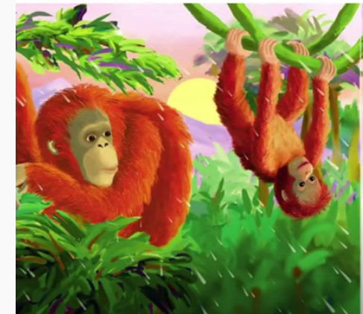
Commas in a list
Example
Use of commas in a list
Orangutans love to eat fruit, leaves and bark.
Key:
objects
Comma
and
Commas are used to separate things in a list.
The last two things in the list are separated by the word ‘and’

Slide 19
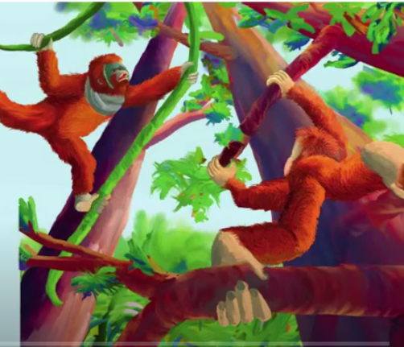
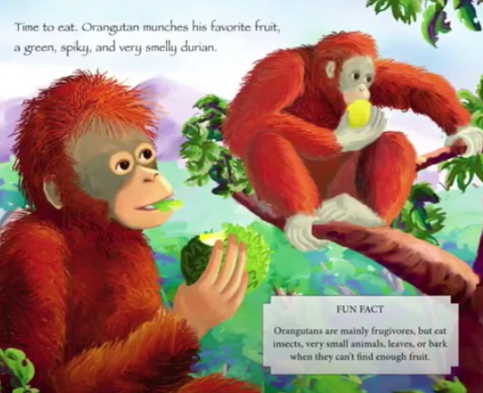
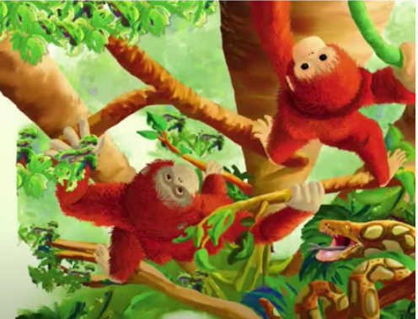
Commas in a list
Punctuate the sentences correctly
First add the ,
1. Orangutans love to eat bananas ___ durians ________ figs.
2. They like to spend their day relaxing ___ climbing trees ________ eating.
3. Orangutans have red hair ___ long arms ________ two round eyes.
4. They get their water from fruit___ rivers ________ streams.
Then add the word and

Slide 20
Commas in a list Answers
First add the ,
1. Orangutans love to eat bananas, durians and figs.
2. They like to spend their day relaxing, climbing trees and eating.
3. Orangutans have red hair, long arms and two round eyes.
4. They get their water from fruit, rivers and streams.
Then add the word and

Slide 21
Outstanding orange orangutans!
Read my report and highlight/underline the commas in a list.
Orangutans are red-haired apes that live in tropical rainforests. Orangutans are mammals and have many features and characteristics that are similar to humans.
Where do orangutans live?
Orangutans are native to the tropical rainforests of Sumatra and Borneo in Southeast Asia. Orangutans spend 95% of their time in the canopy of the rainforest (up in the trees). They use their long, strong arms and hook shaped hands to climb and swing from branch to branch. Each night orangutans make a sturdy nest of leaves, twigs and branches to sleep in. Nest building is an important skill for young orangutans to learn and it takes years of practise to get it right!
Did you know?
Young orangutans stay with their mothers until they are around 7 years old. This is longer than any other wild animal.
What do orangutans look like?
Orangutans are hairy mammals covered in red or brown hair. They measure between 1.2 metres to 1.5 metres tall. Orangutans have super, long arms! Male orangutans can stretch their arms 2 metres from fingertip to fingertip. Like humans, orangutans have eight fingers, two thumbs and fingernails! Orangutans feet look almost identical to their hands. They use their feet and hands to climb trees, peel fruit and groom each other. Male orangutans have big cheek pads made of fat on the sides of their faces to make their roaring sound louder and scare off predators.
Did you know?
Orangutans are born with a natural fear of snakes – pythons can swallow small orangutans whole!
What do orangutans eat?
Orangutans love to eat fruit, approximately 60% of an orangutans diet is made up of fruit. The other 40% is made up of insects, small animals, leaves and bark.
Did you know?
Orangutans spend more than half of the day looking for food!
Remember commas are used to separate things in a list.
The last two things in the list are separated with the word ‘and’.

Slide 22
Answers
Outstanding orange orangutans!
Orangutans are red-haired apes that live in tropical rainforests. Orangutans are mammals and have many features and characteristics that are similar to humans.
Where do orangutans live?
Orangutans are native to the tropical rainforests of Sumatra and Borneo in Southeast Asia. Orangutans spend 95% of their time in the canopy of the rainforest (up in the trees). They use their long, strong arms and hook shaped hands to climb and swing from branch to branch. Each night orangutans make a sturdy nest of leaves, twigs and branches to sleep in. Nest building is an important skill for young orangutans to learn and it takes years of practise to get it right!
Did you know?
Young orangutans stay with their mothers until they are around 7 years old. This is longer than any other wild animal.
What do orangutans look like?
Orangutans are hairy mammals covered in red or brown hair. They measure between 1.2 metres to 1.5 metres tall. Orangutans have super, long arms! Male orangutans can stretch their arms 2 metres from fingertip to fingertip. Like humans, orangutans have eight fingers, two thumbs and fingernails! Orangutans feet look almost identical to their hands. They use their feet and hands to climb trees, peel fruit and groom each other. Male orangutans have big cheek pads made of fat on the sides of their faces to make their roaring sound louder and scare off predators.
Did you know?
Orangutans are born with a natural fear of snakes – pythons can swallow small orangutans whole!
What do orangutans eat?
Orangutans love to eat fruit, approximately 60% of an orangutans diet is made up of fruit. The other 40% is made up of insects, small animals, leaves and bark.
Did you know?
Orangutans spend more than half of the day looking for food!
Remember commas are used to separate things in a list.
The last two things in the list are separated with the word ‘and’.

Slide 23
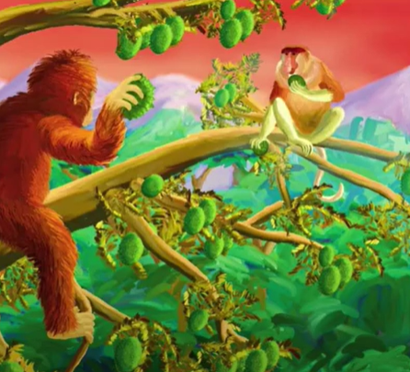
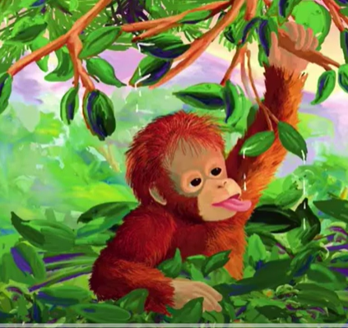
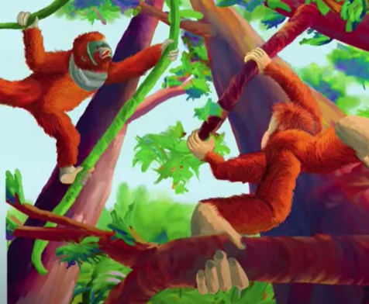
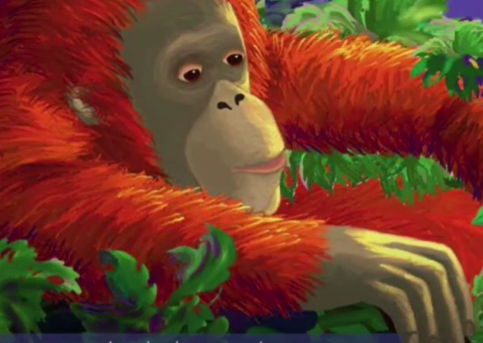
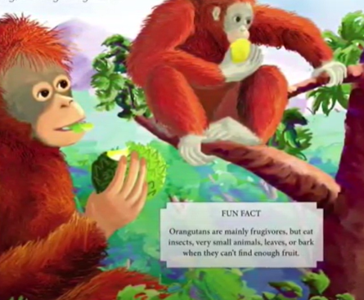
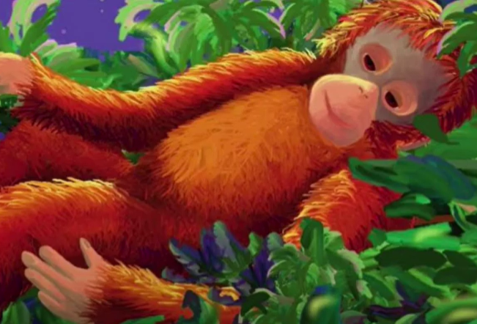
My turn …
Don’t forget:

Slide 24
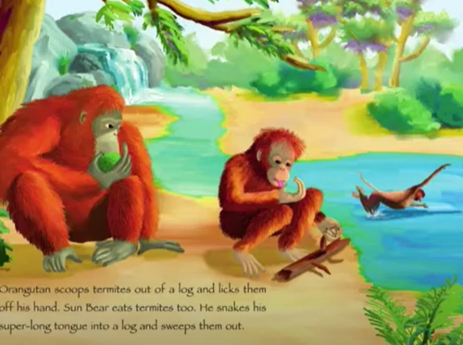
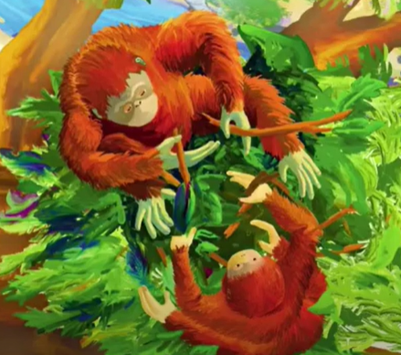
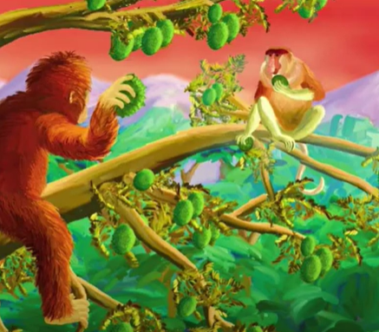
Using commas in a list
Use the pictures to help you write your own sentences using commas in a list.
Don’t forget:

Slide 25
Well done for all of your hard work today! We cant wait to see your completed work.
Could any completed work / photographic evidence of completed work please be sent to pioneerspupils@gmail.com
Thank you!

Slide 26
Date: Wednesday 24th February
LO To be able to punctuate questions with a question mark.
Subject: English

Slide 27
Question Mark
A question mark looks like this ?
It goes at the end of a question
Can you draw a question mark with your finger?
Now can you write a question mark on your paper?

Slide 28
What?
Question words
When?
Who?
Now can you ask questions about orangutans using these question words?
Where?
Why?
How?
Example
Where do orangutans live?
Write 3 questions on the lines below or on a piece of paper.

Slide 29
Did
The word ‘did’ is often used to start questions.
Look at these examples:
Did you like enjoy playing in the snow?
Did you have breakfast this morning?
Did you go to bed early last night?
Did you know that orangutans have long arms?
Did you know rainforests are near the Equator?
All of the examples end with a question mark because when we use the word ‘did’ at the start of a sentence we are asking a question.

Slide 30
Add the question mark
Can you punctuate the sentences correctly using a question mark – remember a question mark looks like this ?
What do orangutans eat
Where do orangutans live
How do orangutans swing through the trees
Why do orangutans build nests
Did you know that orangutans have long, thin fingers
Remember the ? goes at the end of the sentence

Slide 31
Add the question mark - answers
Can you punctuate the sentences correctly using a question mark – remember a question mark looks like this ?
What do orangutans eat ?
Where do orangutans live ?
How do orangutans swing through the trees ?
Why do orangutans build nests ?
Did you know that orangutans have long, thin fingers ?

Slide 32
Question or statement?
A statement is a simple sentence.
A statement is always punctuated with a full stop at the end.
A question is something you can ask or answer.
A question is always punctuated with a question mark at the end .

Slide 33
Question or statement?
Read the sentences and decide if they need a full stop or question mark at the end. Use the word at the start of the sentence to help you decide.
1. How do orangutans build nests
2. Orangutans have long arms
3. Did you know orangutans love fruit
4. Orangutans have hands and feet like humans
5. Where do orangutans live
6. Orangutans are scared of snakes
7. Orangutans infants stay with their mother until they are seven
8. Why do orangutans groom each other

Slide 34
Question or statement? Answers
1. How do orangutans build nests?
2. Orangutans have long arms.
3. Did you know orangutans love fruit?
4. Orangutans have hands and feet like humans.
5. Where do orangutans live?
6. Orangutans are scared of snakes.
7. Orangutans infants stay with their mother until they are seven.
8. Why do orangutans groom each other?

Slide 35
Now can you write 6 of your own questions about orangutans?
You can use some of the questions we have already looked at to help.
What?
Who?
Question words
When?
Why?
Where?
Write your questions neatly onto a piece of paper or type them on the lines below. You will be able to use them in your writing tomorrow!
How?
Did?

Slide 36
Well done for all of your hard work today! We cant wait to see your completed work.
Could any completed work / photographic evidence of completed work please be sent to pioneerspupils@gmail.com
Thank you!

Slide 37
Date: Thursday 25th February
LO To be able to write a non-chronological report.
Subject: English

Slide 38
Re read my report to get it back in your head
Outstanding orange orangutans!
Orangutans are red-haired apes that live in tropical rainforests. Orangutans are mammals and have many features and characteristics that are similar to humans.
Where do orangutans live?
Orangutans are native to the tropical rainforests of Sumatra and Borneo in Southeast Asia. Orangutans spend 95% of their time in the canopy of the rainforest (up in the trees). They use their long, strong arms and hook shaped hands to climb and swing from branch to branch. Each night orangutans make a sturdy nest of leaves, twigs and branches to sleep in. Nest building is an important skill for young orangutans to learn and it takes years of practise to get it right!
Did you know?
Young orangutans stay with their mothers until they are around 7 years old. This is longer than any other wild animal.
What do orangutans look like?
Orangutans are hairy mammals covered in red or brown hair. They measure between 1.2 metres to 1.5 metres tall. Orangutans have super, long arms! Male orangutans can stretch their arms 2 metres from fingertip to fingertip. Like humans, orangutans have eight fingers, two thumbs and fingernails! Orangutans feet look almost identical to their hands. They use their feet and hands to climb trees, peel fruit and groom each other. Male orangutans have big cheek pads made of fat on the sides of their faces to make their roaring sound louder and scare off predators.
Did you know?
Orangutans are born with a natural fear of snakes – pythons can swallow small orangutans whole!
What do orangutans eat?
Orangutans love to eat fruit, approximately 60% of an orangutans diet is made up of fruit. The other 40% is made up of insects, small animals, leaves and bark.
Did you know?
Orangutans spend more than half of the day looking for food!

Slide 39
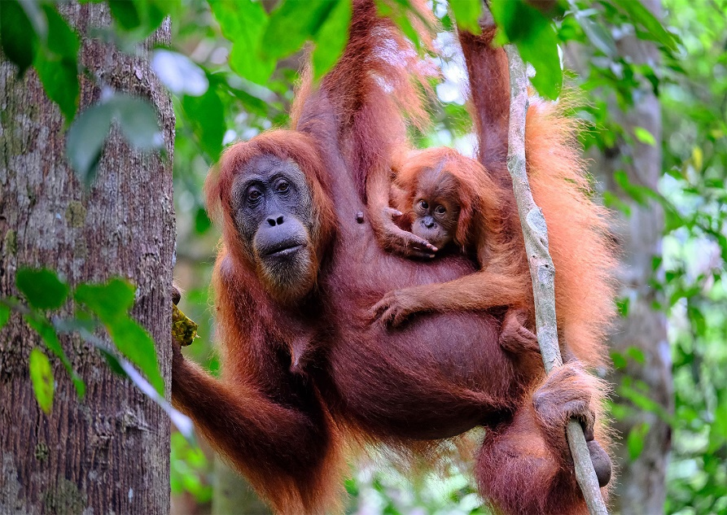
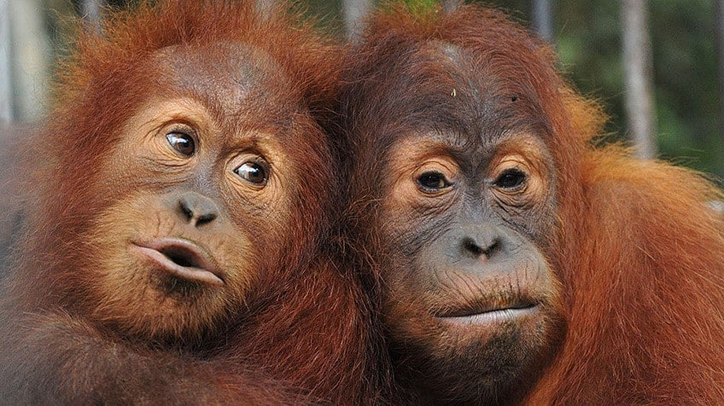
Outstanding orange orangutans!
Before you write your report click on the links to watch the videos and read the facts to learn more!
Video 1
8 Mind Blowing Orangutan Facts | Our Planet | Netflix Futures - YouTube
Video 2
Amazing Facts about Orangutans - YouTube
Links to websites for facts:
10 orangutan facts! | National Geographic Kids (natgeokids.com)
Orangutan Facts for Kids (kiddle.co)
Orangutan Facts For Kids | Top 10 Amazing Facts about Orangutans (animalstime.com)
If you are unable to access the videos or websites you will find some of our favourite facts on the next two slides.

Slide 40
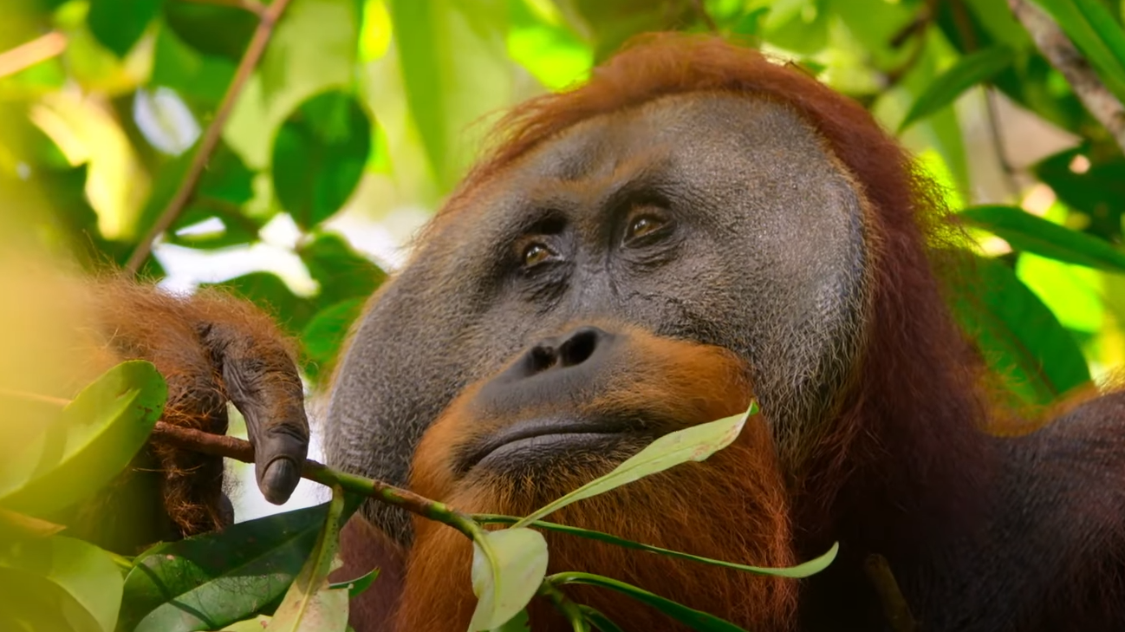
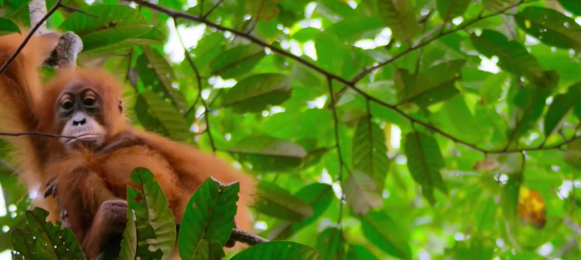
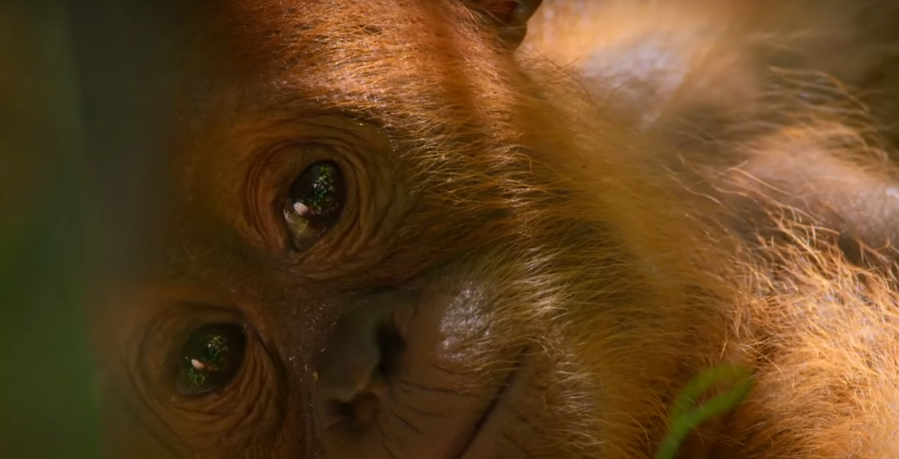
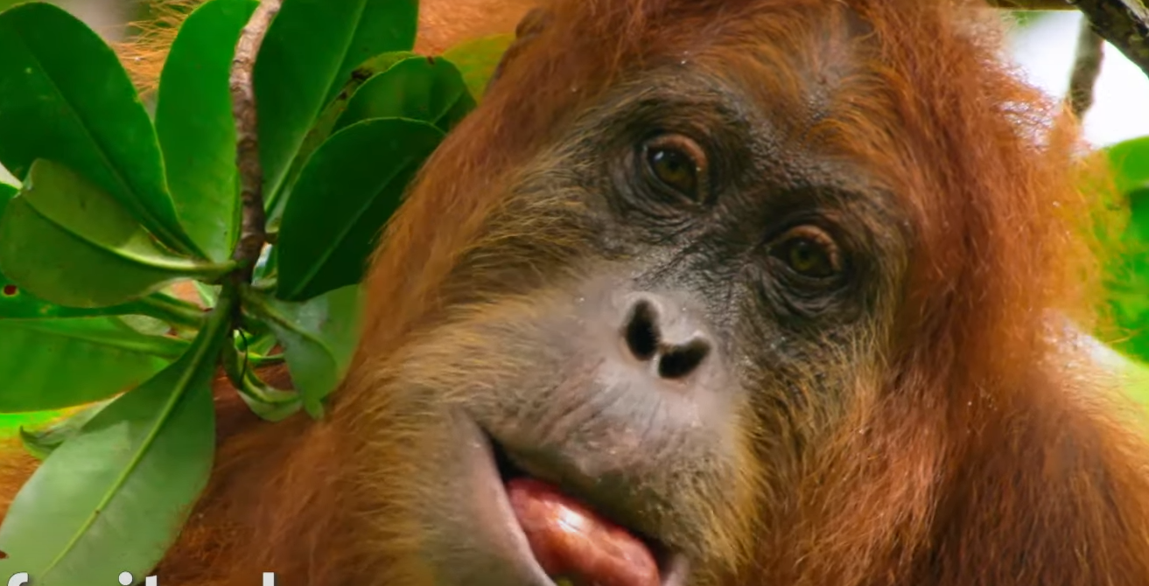
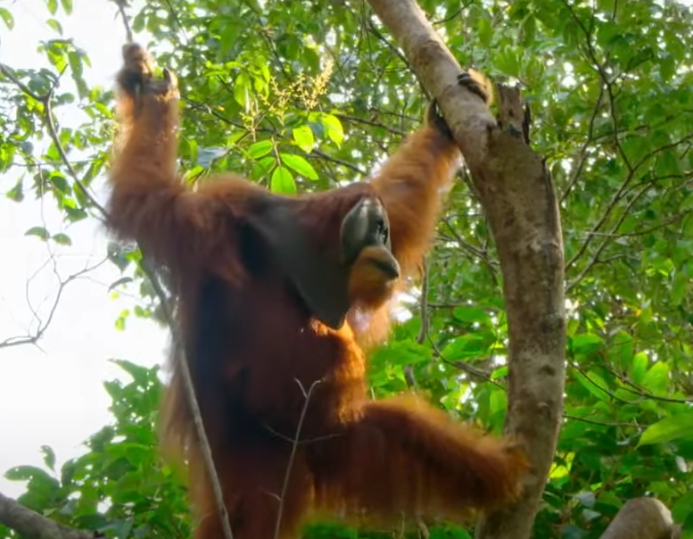
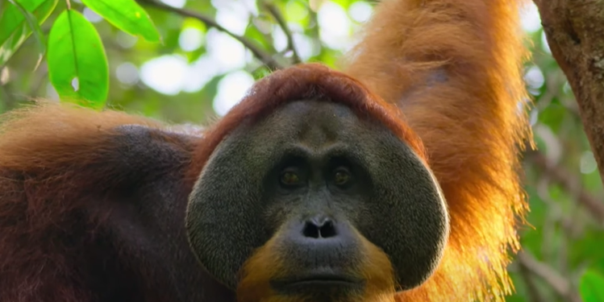
An orangutan is an ape
They spend 95% of their life up in the canopy.
A baby orangutan can take up to 10 years to become independent and learns everything from its mother.
Around 60% of an orangutans diet consists of fruit and vegetables
Orangutans can live to be around 40 years old in the wild.
Adults can weight over 200pounds.

Slide 41
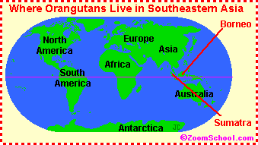
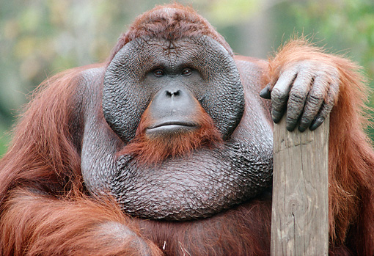
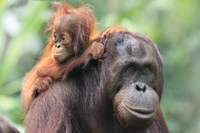
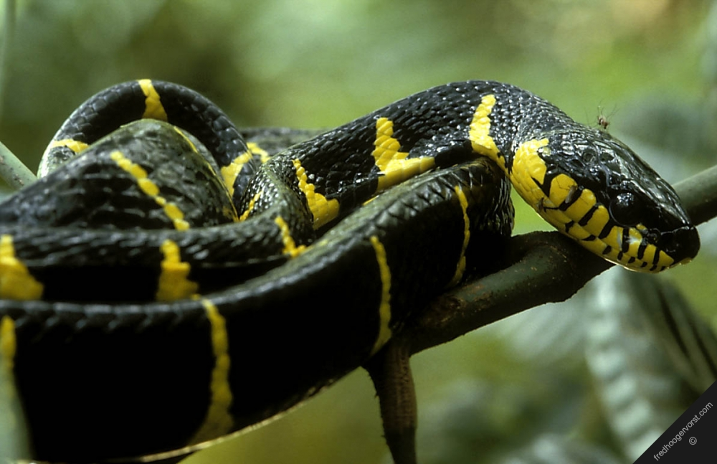
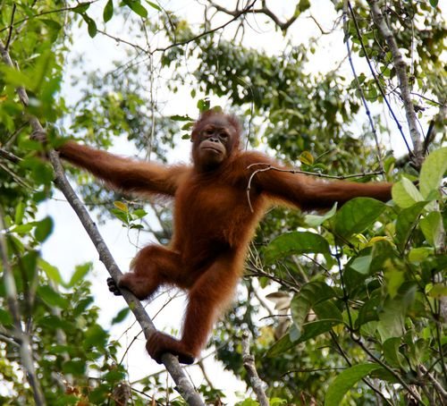
Facts
The word orangutan means ‘man of the woods’ in Malay.
Orangutans are native to Southeast Asian rainforests.
Orangutans have two hands and two feet like humans.
Orangutan infants stay with their mother until they are around seven years old. This is longer than any other wild animal.
Orangutans are endangered because of deforestation.
Orangutans are born with a natural fear of snakes.
Orangutans have super long arms, male orangutans have an arm span of 2metres from finger tip to finger tip.

Slide 42
Pre-Recorded Teaching
Access the teaching video by Miss Malloy that will support you to complete the work in this lesson. This video will act as a support but all of the work can still be successfully understood & completed using paper-based versions of this pack. If you need further support to understand / complete work then please contact school via e-mail or telephone.

Slide 43
Write a non chronological report
Your report must include:
A title
Subheadings (at least 2)
Each subheading must have at least 6 sentences
Commas in a list (at least 3)
Question marks (at least 3)
Describing words
Pictures
You can use the blank template on the next slide or create your own report on paper.
Title
Picture
Information
Picture
Remember commas are used to separate things in a list.
The last two things in the list are separated with the word ‘and’.

Slide 45
Well done for all of your hard work today! We cant wait to see your completed work.
Could any completed work / photographic evidence of completed work please be sent to pioneerspupils@gmail.com
Thank you!

Slide 46
Date: Friday 26th February
LO To be able to read and spell words with the ‘i’ sound spelt ‘y’.
Subject: English

Slide 47
‘i’ – sound spelt as ‘y’
The spelling rule we are focusing on today is ‘i’ but it is spelt ‘y’.
The ‘i’ sound spelt ‘y’ is used at the end of words.
Click on the links or copy and paste the links into your internet browser to watch the spelling videos.
-y 😃 Fun Phonics 😄 How to Read 📖 Made by Kids vs Phonics – YouTube
Phonics (Long I - y) – YouTube

Slide 48
Read the words
by
try
cry
dry
fry
fly
spy
shy
why
sky
reply
sly
July
Now write the words on a piece of paper and underline the ‘y’ sound which sounds like ‘i’ .

Slide 49
Match the picture to the correct word
cry
sky
why
spy
fly

Slide 50
Match the picture to the correct word - answers
cry
sky
why
spy
fly

Slide 51
Write the word under the picture

Slide 52
Read the sentences and fill in the missing word
Choose from the 5 words below. Read the sentence and decide which word makes sense.
why
fly
cry
spy
sky
The __________ was filled with fluffy white clouds.
A boy hurt his knee and started to __________.
An annoying __________ was buzzing in my ear.
__________ is the sky filled with stars?
The __________ was hiding behind the big, green bush.

Slide 53
word | 1st try | 2nd try | 3rd try
cry
fly
spy
sky
why
try
dry
July
Practice writing the words on a piece of paper or type into the table on your computer.

Slide 54
‘i’ spelt ‘y’
Now pick 3 words and write a sentence including each word.
fry
try
fly
why
July
cry
sky
spy
dry

Slide 55
Word search

Slide 56
Unscramble the words

Slide 57
Spelling game!
Use the link to play the game and practice spelling the ‘y’ words
Spelling games: ai spelt with a y (spellzone.com)

Slide 58
Spelling game!
Use the link to play the game and practice spelling the ‘i’ spelt ‘y’ words
Look, Cover, Write, Check- mobile friendly (ictgames.com)

Slide 59
Well done for all of your hard work today! We cant wait to see your completed work.
Could any completed work / photographic evidence of completed work please be sent to pioneerspupils@gmail.com
Thank you!

