Slide 1
Hello everyone,
Another great week of home learning last week. Thank you so much to everyone who sent in photos and videos of your learning. I’ve loved seeing it all, I can see you’re having lots of fun at home.
Please continue to send us anything you do at home and have lots of fun learning through play.
Miss Wilkinson, Mrs Cairns & Miss Anderson ☺
Phone: 01429 820594
Email: explorerspupils@gmail.com
Facebook: Explorers - WHPS

Slide 2
Monday 8th February 2021
Our story this week is ‘The Chinese New Year Animal Race’
We are going to be learning about Chinese New Year this week and would like to start by sharing the story about the great animal race.
Use the link below to paste it into google and watch the story together.
https://www.youtube.com/watch?v=NrKQmI4vSwA
I have also added a link to watch a video of people celebrating Chinese New Year around the world.
What do you notice about the video? What colours can you see?
https://www.youtube.com/watch?v=1cRMRp9-Z08

Slide 3
Time to practice our names, try and do this everyday. If you can write your first name you could try to do your surname too.
Can you play ispy with your family. See if you can guess the sounds from your grown up.
More ideas…
Can you remember the shapes we have been learning? See how many you can draw.
Joe Wicks is on today at 9am doing his live PE. You could try to join in.
https://www.youtube.com/channel/UCAxW1XT0iEJo0TYlRfn6rYQ

Slide 4
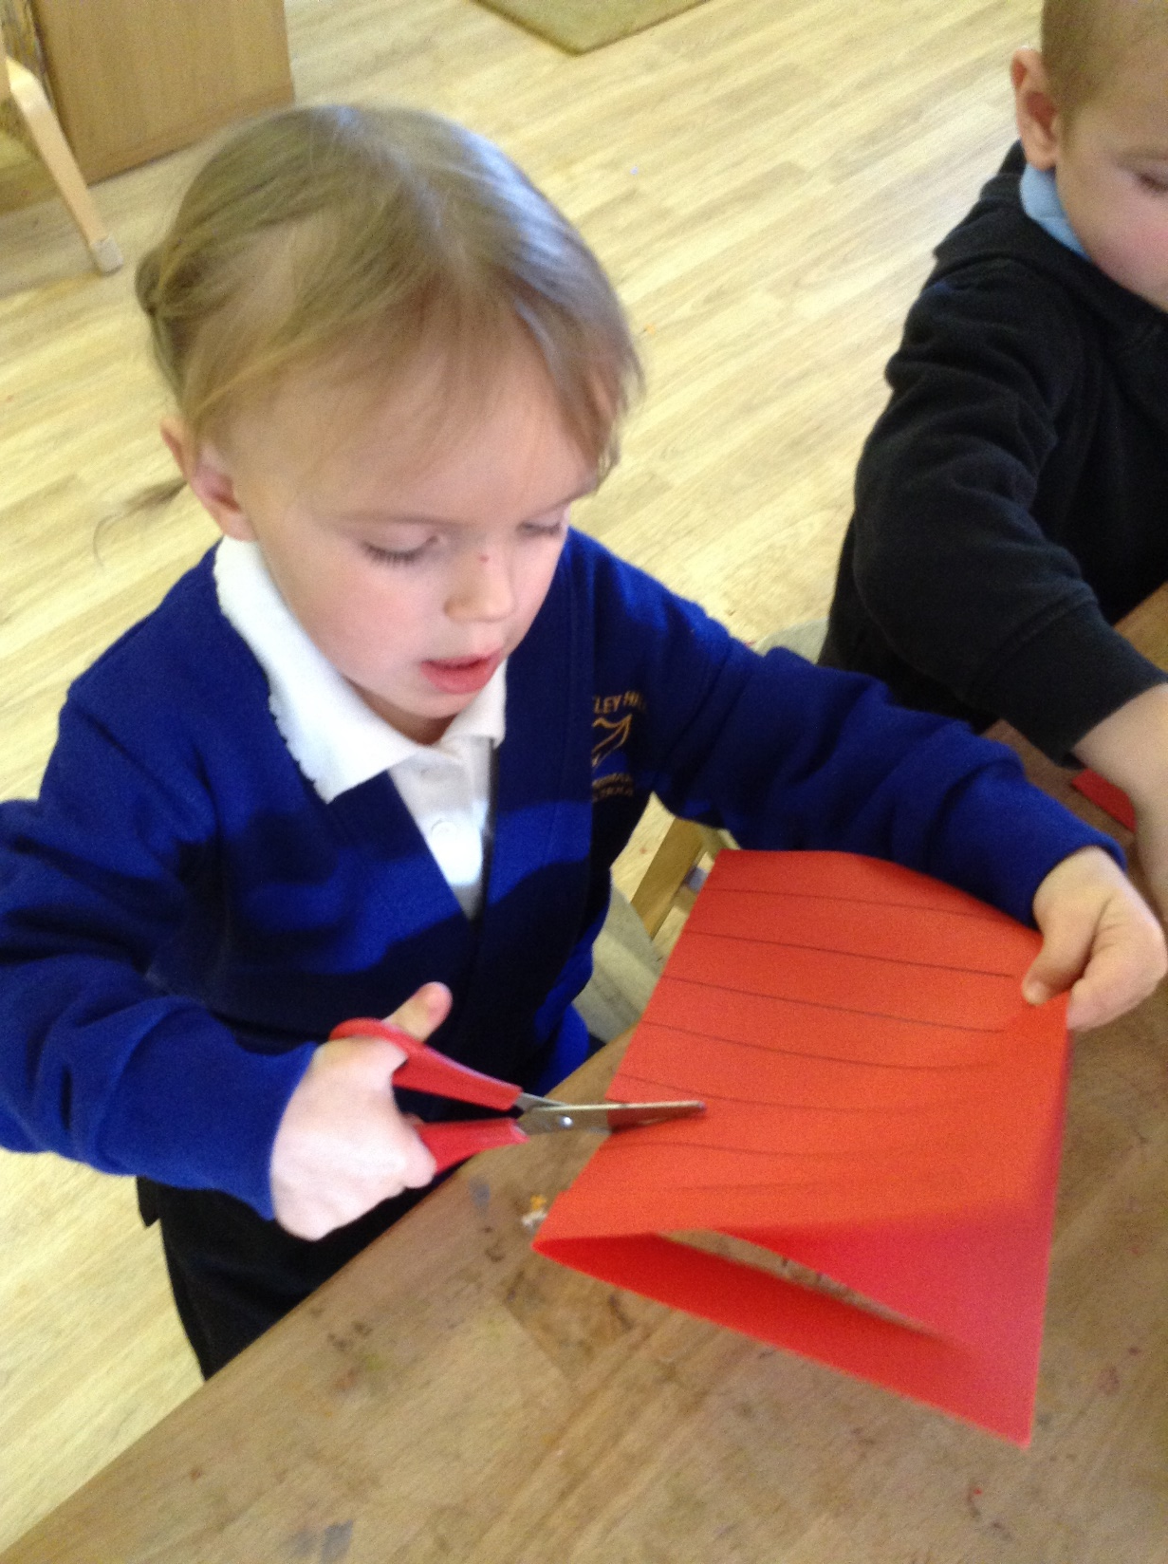
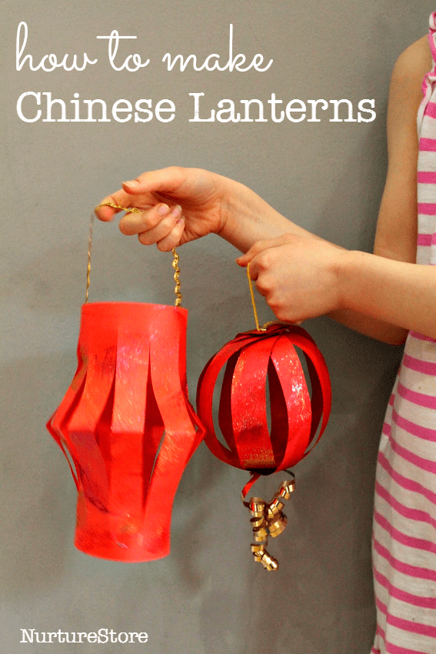
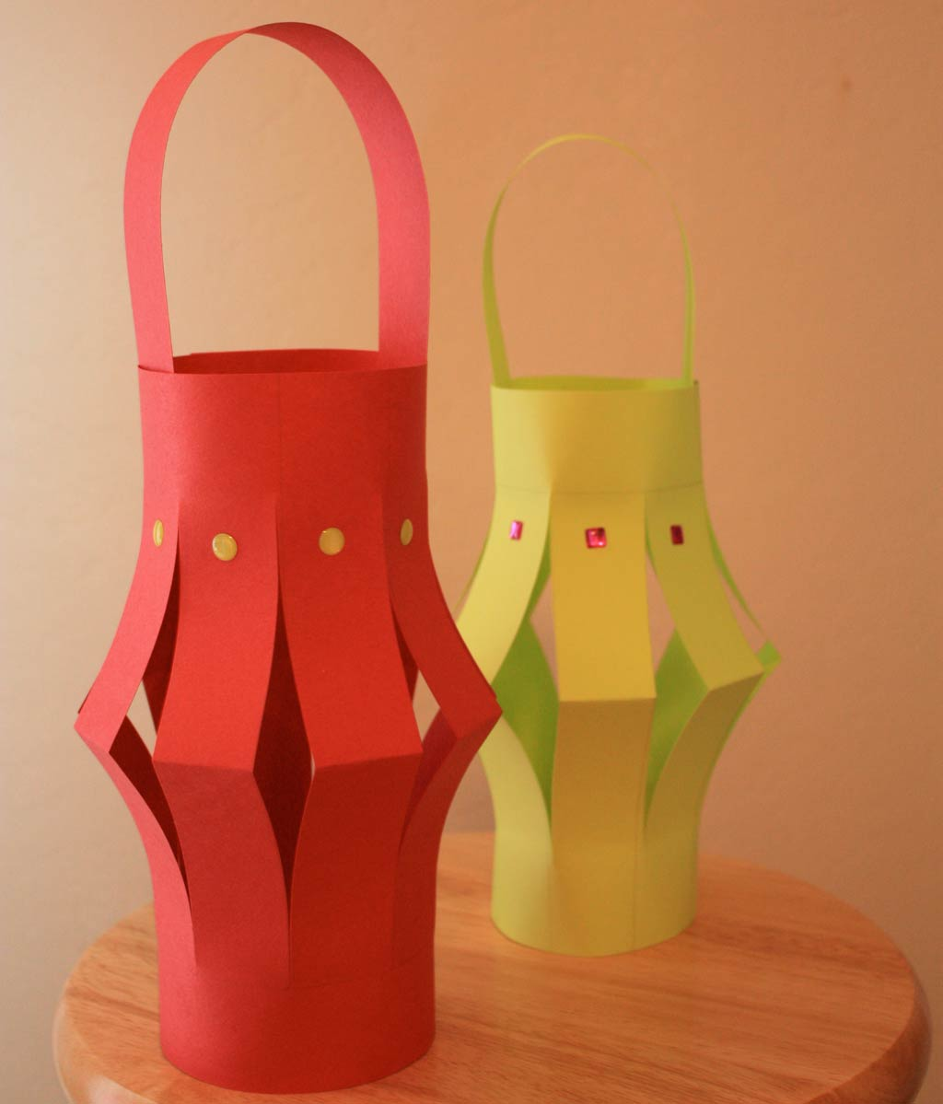
Tuesday 9th February 2021
Can you make a Chinese lantern?
You will need some paper or card, scissors and some pens or collage materials to decorate.
Step 1 – Fold you paper/card in half and ask your grown up to draw some lines along the middle.
Step 2 – Carefully cut along the lines, but make sure to stop before reaching the edge.
Step 3 – Open your lantern out to decorate with pens or collage pieces.
Step 4 – Attach string or an extra piece of paper/card to create a handle.
Step 5 – Decorate your home with your lantern to celebrate Chinese New Year.

Slide 5
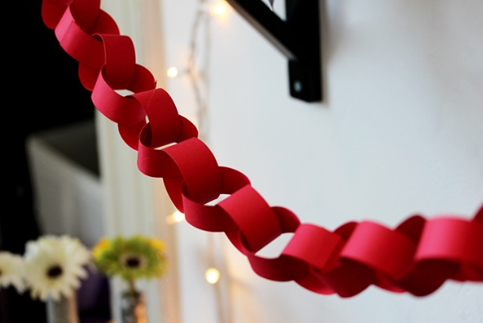
Choose your favourite story to read. Tell you grown up about what happens.
Draw a picture of your favourite animal from the story. Can you remember who won the race?
More ideas…
We’re planning a Chinese New Year party tomorrow. Can you make some decorations? Maybe a paper chain or some bunting?
Can you count ten of your toys?
Can you put them in two groups? How many in each?

Slide 6
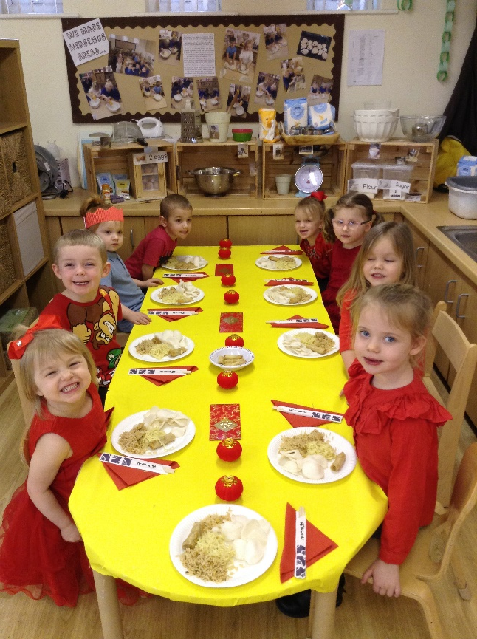
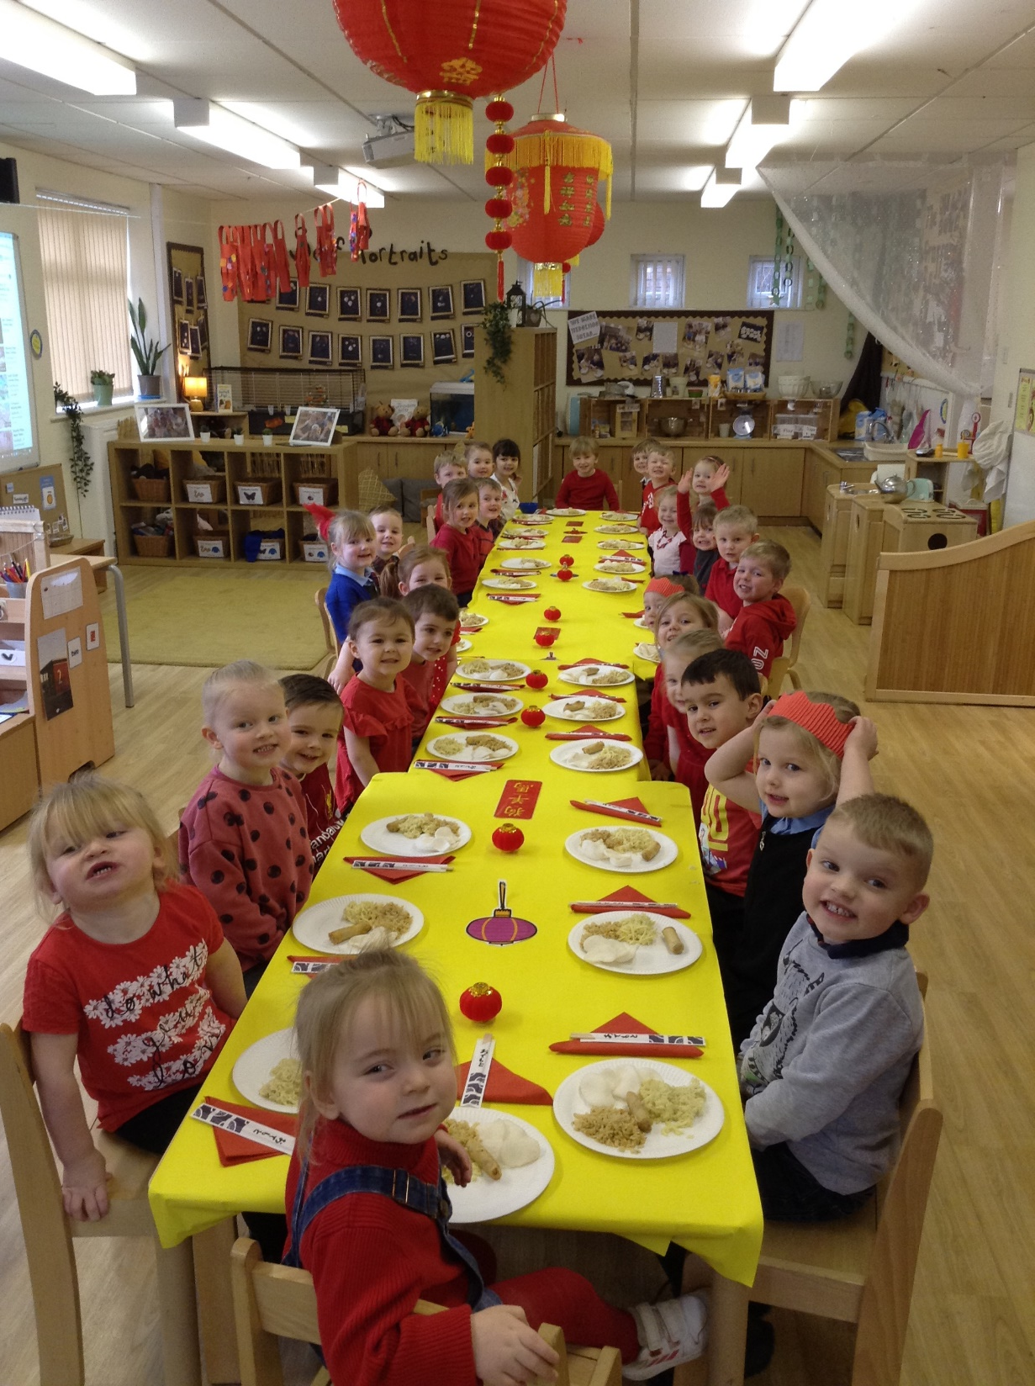
Wednesday 10th February 2021
We’re having a Chinese Banquet
Although we cant celebrate all together like we normally would, we would love to see you still enjoying a Chinese style party at home.
So find something red to wear, display your Chinese lantern and see if you could make some Chinese food to try with your family.
You could try noodles, rice, prawn crackers or spring rolls. Yummy!!!

Slide 7
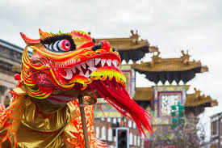
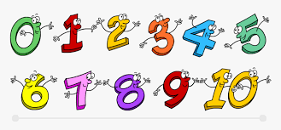
See if you can create a dragon dance like the one in this video
Can you write the numbers we have learnt…
0,1,2,3,4,5,6,7,8,9,10
https://www.youtube.com/watch?v=aVKILdeob4E
More ideas…
Sing some number songs.
Go for a walk with your family. See if you can move in different ways whilst outside.
Walking, jogging, jumping, hopping, running.

Slide 8
Thursday 11th February 2021
Chinese Shape Dragon
You can use the shapes on here or cut them out to try to build your own Chinese Dragon using the 2D shapes. Can you name the shapes you are using?

Slide 9
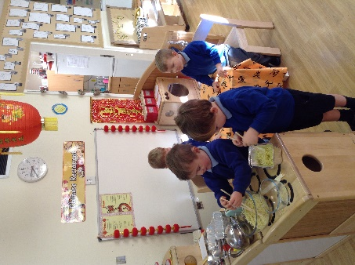
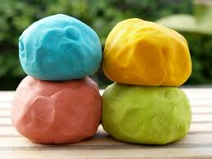
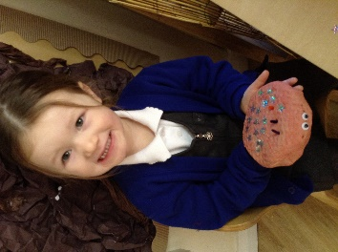
If you still have the playdough from last week you could try to create one of the animals from the story.
You could make a Chinese restaurant at home? Can you take the orders?
More ideas…
See how many purple objects you can find in your home.
Sing your favourite nursery rhyme.
Can you dance whilst you sing. Maybe you could search for some Chinese music.

Slide 10
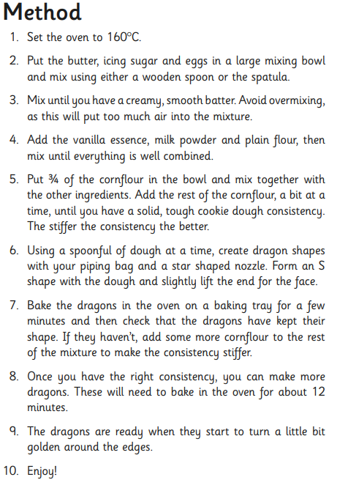
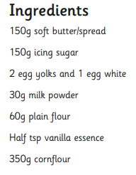
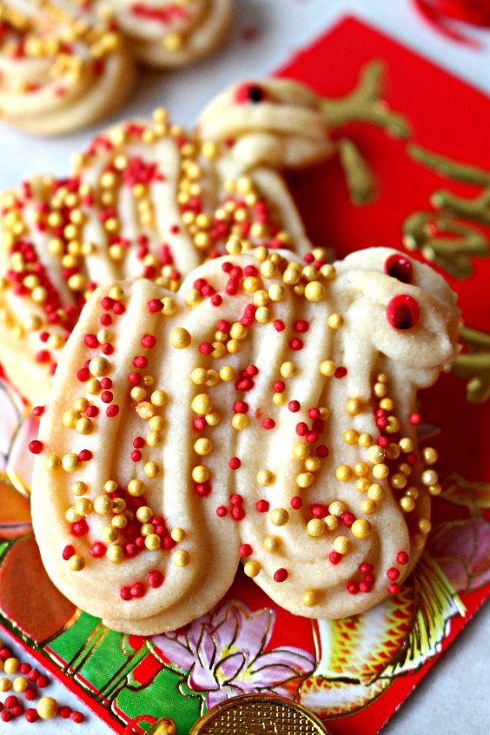
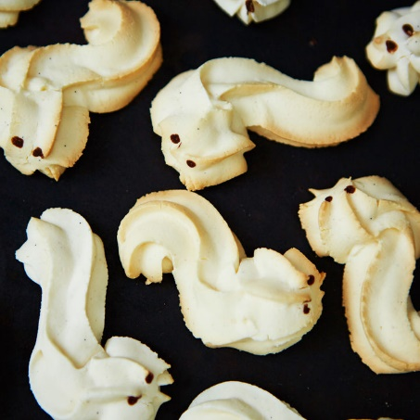
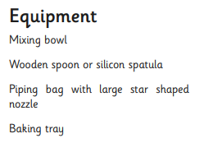
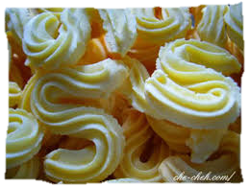
Friday 12th February 2021
Dragon Cookies…

Slide 11
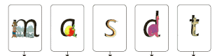
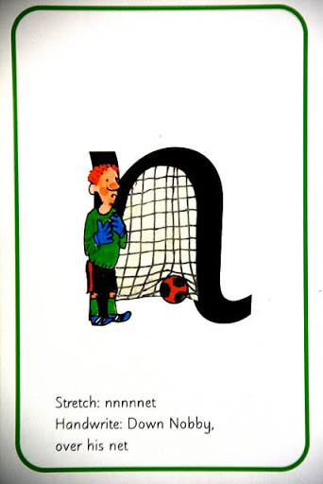
Lets look back at the sounds we have learnt…
Can you name them all?
Can you write them all?
See if you can name something that begins with each of the sounds.

Slide 12
Chinese Numbers 1- 10
Here are the Chinese numbers with our numbers 1-10.
Can you copy them?

Slide 13
Colouring…

Slide 14
Well done for all of your hard work this half term.
Have a great half term holiday!
Please send us any photos of your home learning to our email or our Explorers Facebook page.
Email: explorerspupils@gmail.com

