Slide 1
Subject: Maths
Pack: B

Slide 2
Date: 08.02.21
L.O. To be able to compare the mass of two objects.
Subject: Maths

Slide 3
Pre-recorded Teaching
Access the online teaching video below that will support you to complete the work in this lesson. This video will act as a support but all of the work can still be successfully understood & completed using paper-based versions of this pack. If you need further support to understand / complete work then please contact school via e-mail or telephone.
Play Video
Or copy and paste the below link
https://classroom.thenational.academy/lessons/to-compare-the-mass-of-two-objects-68ukgc?step=2&activity=video

Slide 4
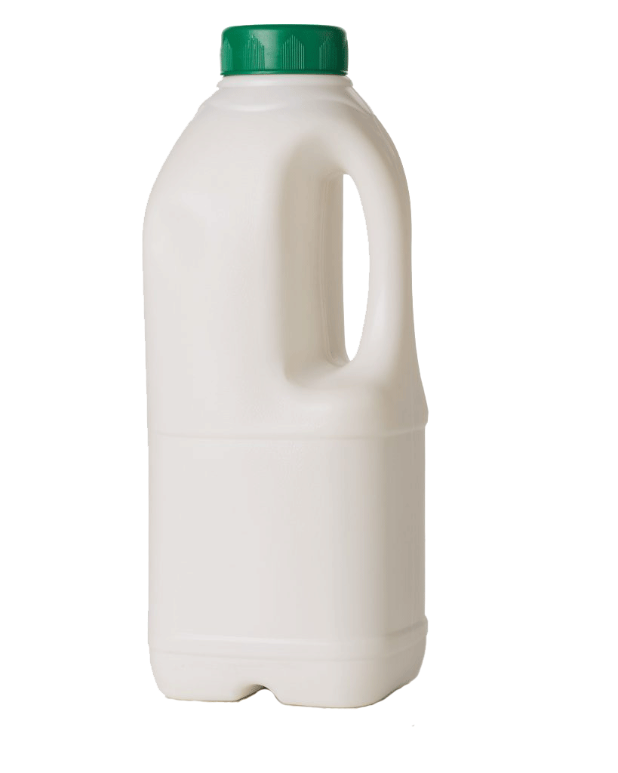
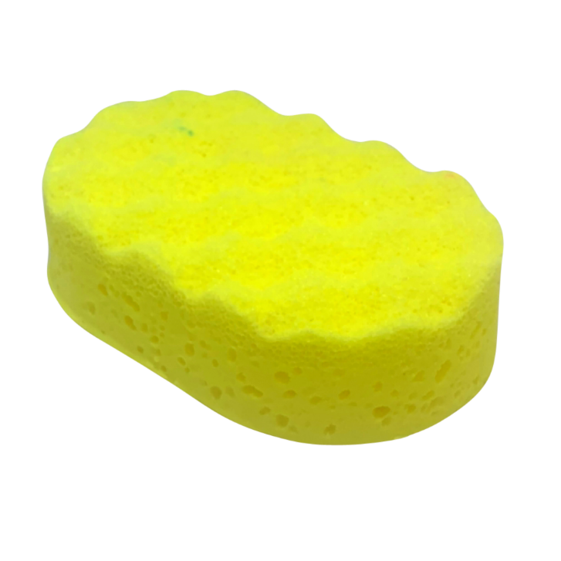
Comparing Mass
Mass is another word for how heavy something is.
I have picked two objects from my house:
sponge
milk
The milk is heavier than the sponge.
The sponge is lighter than the milk.

Slide 5
Comparing Mass
Mass is another word for how heavy something is.
Task 1: Can you find two objects from your house? Feel the weight of the two objects. Which one is heavier? Which one is lighter?
Use my sentences below to compare the weight of your two objects.
The (object) is heavier than the (object).
The (object) is lighter than the (object).

Slide 6
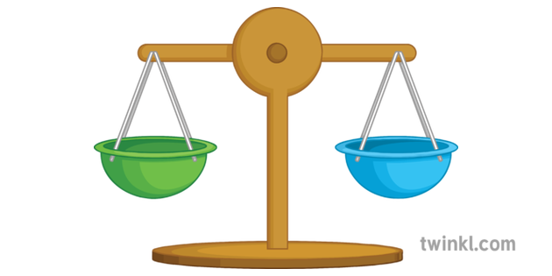
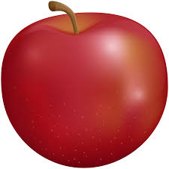
Comparing Mass
If we were in school, we would have been using balance scales. They help us find out if objects are the same weight, or which object is heavier or lighter than another object.
They are called balance scales because if you put 2 objects which are the same weight either side of the scales, it will balance.
I am weighing apples to find out which is the heaviest.
The scales are balanced. They are the same height. This means the apples are the same weight.

Slide 7
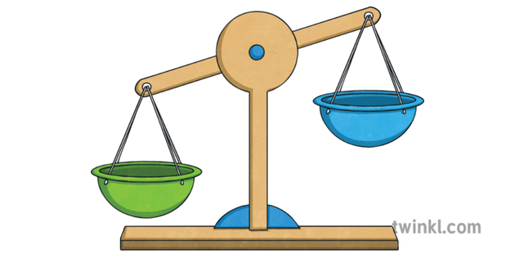
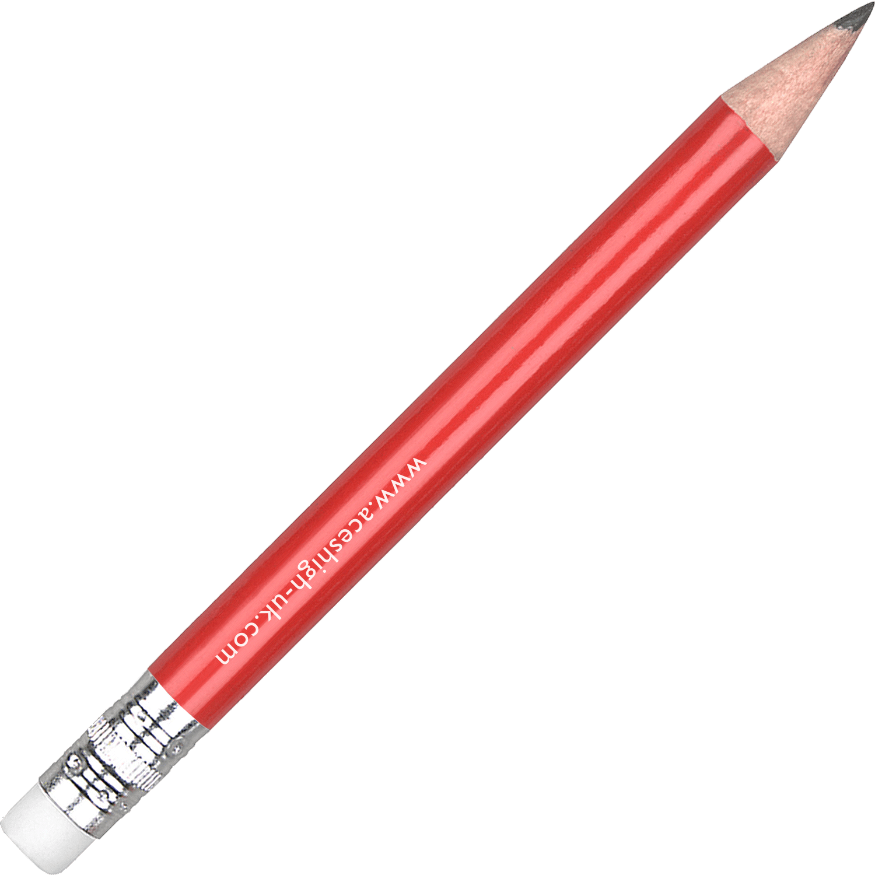
Comparing Mass
If we were in school, we would have been using balance scales. They help us find out if objects are the same weight, or which object is heavier or lighter than another object.
I am weighing an apple and a pencil to find out which object is the heaviest.
The scales are unbalanced. They are a different height. The apple has fell further down because it is heavier than the pencil.

Slide 8
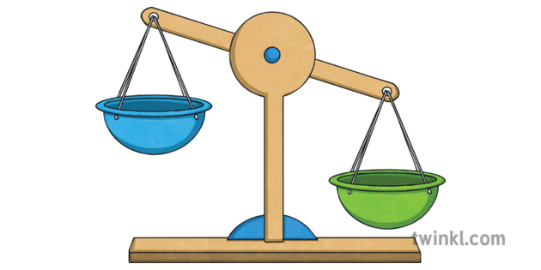
Comparing Mass
If we were in school, we would have been using balance scales. They help us find out if objects are the same weight, or which object is heavier or lighter than another object.
I am weighing an apple and a full milk bottle to find out which object is the heaviest.
The scales are unbalanced. They are a different height. The milk bottle has fell further down because it is heavier than the apple.

Slide 9
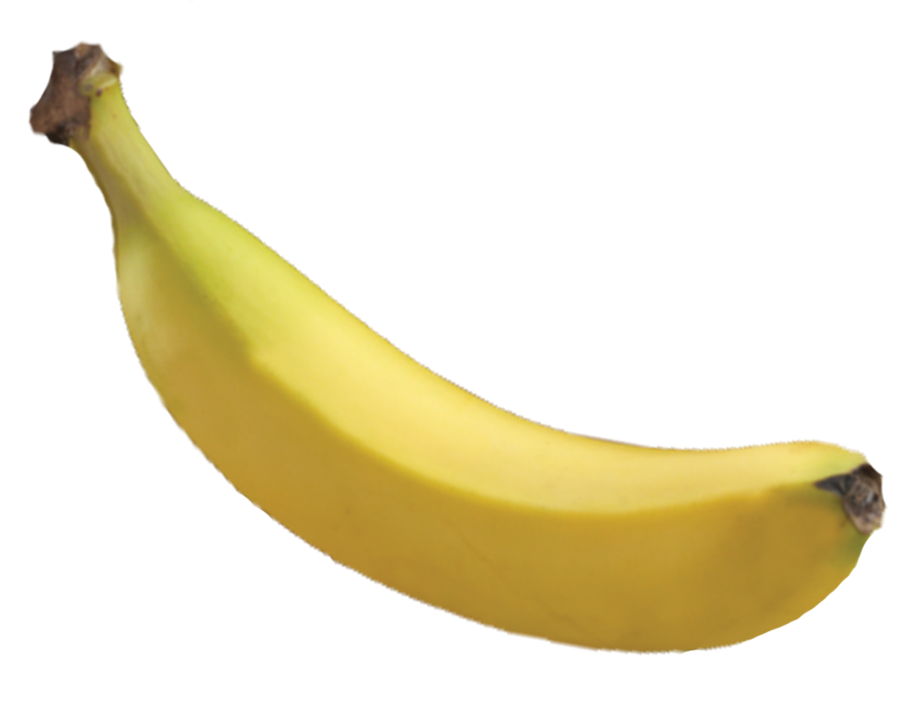
Comparing Mass
Task 2: Can you draw / insert an arrow to the object which is the heaviest?
Remember:
The heaviest objects make the scales unbalanced and fall further to the bottom.

Slide 10
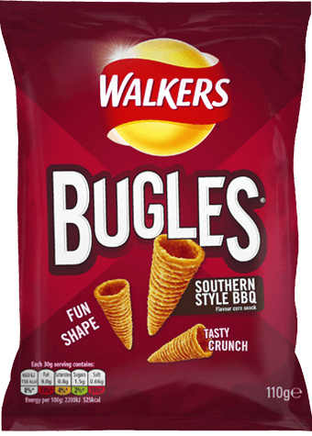
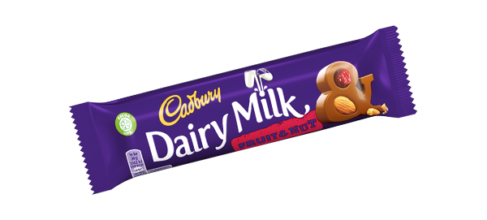
Comparing Mass
Task 3: Can you draw / insert an arrow to the object which is the lightest?
Remember:
The heaviest objects make the scales unbalanced and fall further to the bottom.

Slide 11
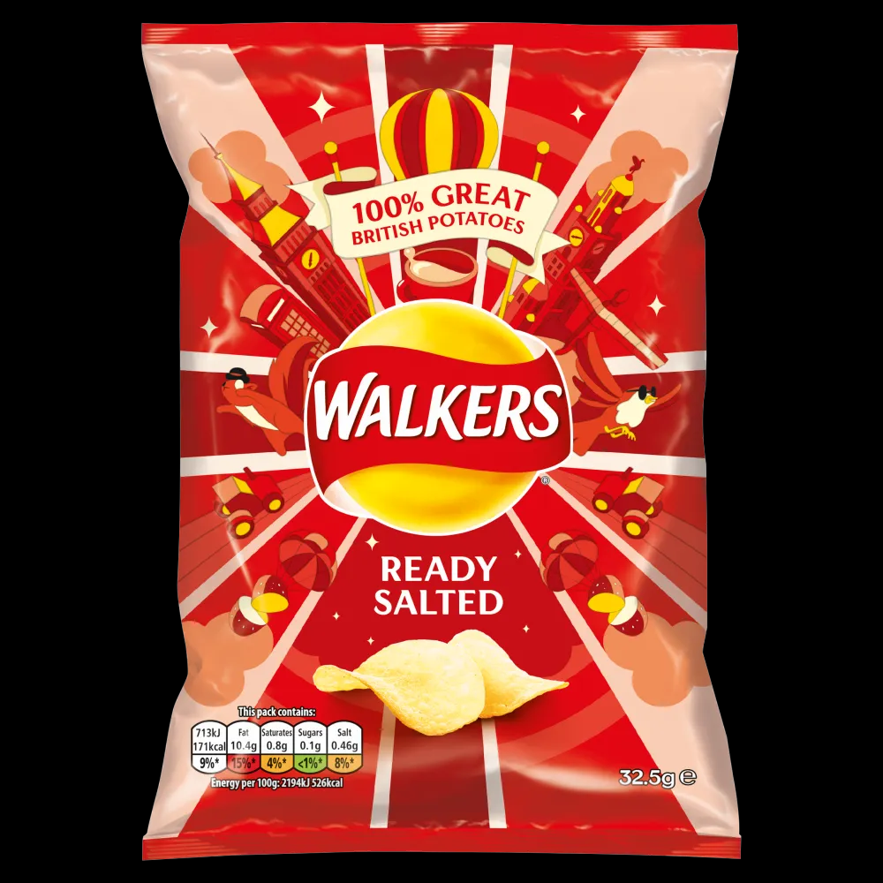
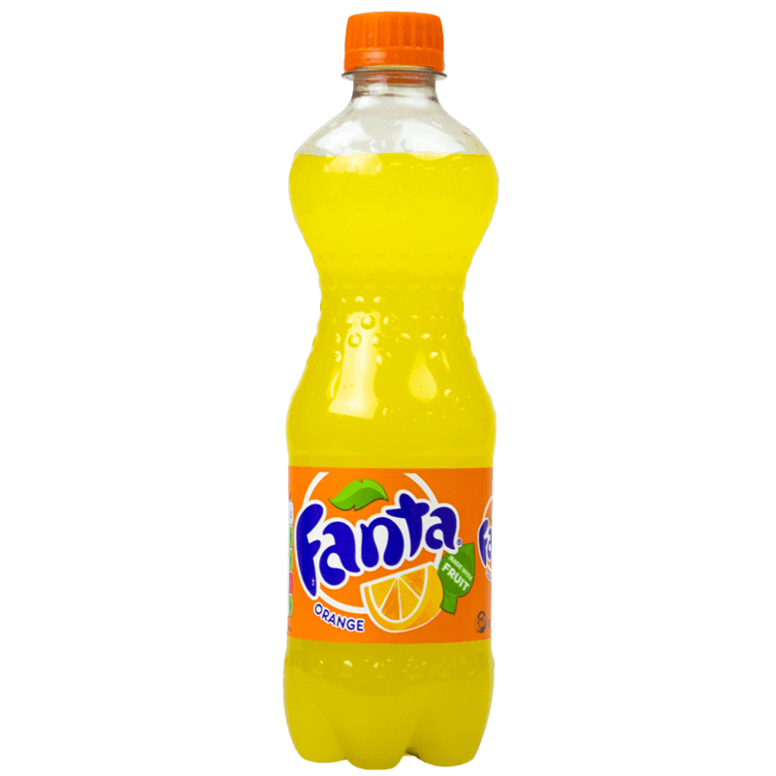
Comparing Mass
Task 4: Complete the sentence to compare the mass of the objects.
Choose from:
lighter
heavier
same
The Fanta is ___________ than the crisps.

Slide 12
Comparing Mass
Task 5: Complete the sentence to compare the mass of the objects.
Choose from:
lighter
heavier
same
The banana is ___________ than the milk.

Slide 13
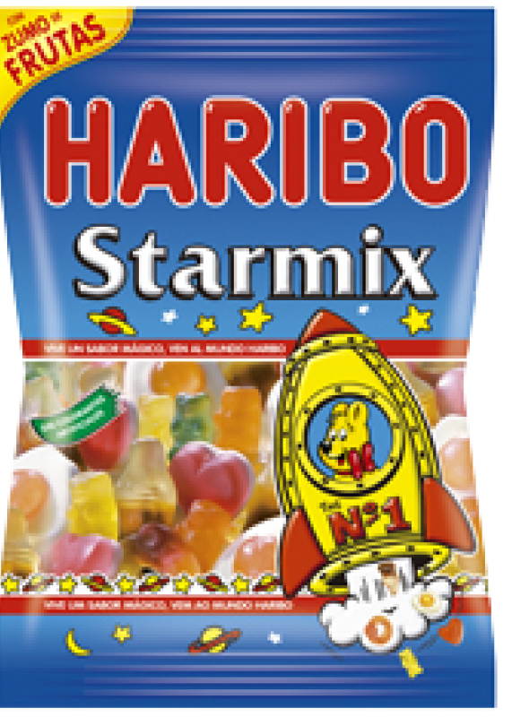
Comparing Mass
Task 6: Complete the sentence to compare the mass of the objects.
Choose from:
lighter
heavier
same
The chocolate weighs the ___________ as the sweets.

Slide 14
Comparing Mass
Task 7: Read the sentence and draw the objects in the scales to show which object is heavier and which is lighter.
Remember:
The heavier object falls further to bottom.
The lighter object is higher up.
The orange is heavier than the banana.

Slide 15
Comparing Mass
Task 8: Read the sentence and draw the objects in the scales to show which object is heavier and which is lighter.
Remember:
The heavier object falls further to bottom.
The lighter object is higher up.
The chocolate is lighter than the bottle of water.

Slide 16
Challenge!
If you are working on a computer, insert a text box to type your answer.

Slide 17
Well done for your hard work today!
Could any completed work / photographic evidence of completed work please be sent to Pioneerspupils@gmail.com or submitted into the drop box at school.
Thank you

Slide 18
Date: 09.02.21
L.O. To be able to compare masses using non-standard units.
Subject: Maths

Slide 19
Pre-recorded Teaching
Access the online teaching video below that will support you to complete the work in this lesson. This video will act as a support but all of the work can still be successfully understood & completed using paper-based versions of this pack. If you need further support to understand / complete work then please contact school via e-mail or telephone.
Play Video
Or copy and paste the below link
https://classroom.thenational.academy/lessons/to-compare-masses-using-non-standard-units-crwker?step=2&activity=video

Slide 20
Recap: Comparing Mass
Task 1: Can you draw / insert an arrow to show which object is the heaviest?

Slide 21
Comparing Mass
This time I am going to compare the weight of objects with cubes.
The pencil is the same weight as 4 cubes.

Slide 22
Comparing Mass
This time I am going to compare the weight of objects with cubes.
The chocolate is the heavier than the 4 cubes. The 4 cubes are lighter than the chocolate.

Slide 23
Comparing Mass
This time I am going to compare the weight of objects with cubes.
The feather is the lighter than the 4 cubes. The 4 cubes are heavier than the feather.

Slide 24
Comparing Mass
Task 2: Can you complete the sentence to compare the weight of the object with the cubes? I have done the first one to help you.
Choose from:
lighter
heavier
same
The Fanta is the heavier than the 7 cubes. The 7 cubes are _______ than the Fanta.

Slide 25
Comparing Mass
Task 3: Can you complete the sentence to compare the weight of the object with the cubes?
Choose from:
lighter
heavier
same
The toy car is the ______ than the 7 cubes. The 7 cubes are _______ than the toy car.

Slide 26
Comparing Mass
Task 4: Can you complete the sentence to compare the weight of the object with the cubes?
Choose from:
lighter
heavier
same
The sweets are the ______ weight as the 7 cubes.

Slide 27
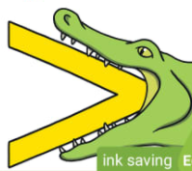
Comparing Mass
This time when we are comparing objects with cubes, we aren’t going to use the words ‘heavier’, ‘lighter’ or ‘the same’. We are going to use the symbols < > =.
Lets recap what the symbols mean!
We know that crocodiles eat the bigger number. Today the crocodiles are going to eat the heavier object. If they are the same we use =
Less than
More than
The chocolate bars are the same weight so we would use this symbol.
Milk is heavier so the symbol faces this way. It looks like a crocodile is eating the heaviest object.
Fanta is heavier so the symbol faces this way. It looks like a crocodile is eating the heaviest object.
Equal to

Slide 28
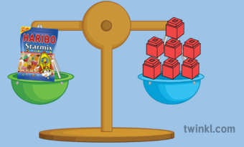
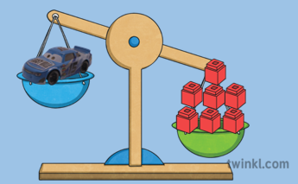
Comparing Mass
I am going to use the correct symbols to compare the mass of objects and cubes.
The sweets are = 7 cubes.
The toy car is < the 7 cubes.
The Fanta is > the 7 cubes.
I can see the scales are balanced so I know the weight is the same. This means I will use the = symbol.
I can see the scales are unbalanced and that the cubes are further down. This means the cubes are heavier so the crocodile will eat the cubes.
I can see the scales are unbalanced and that the Fanta is further down. This means the Fanta is heavier so the crocodile will eat the Fanta.

Slide 29
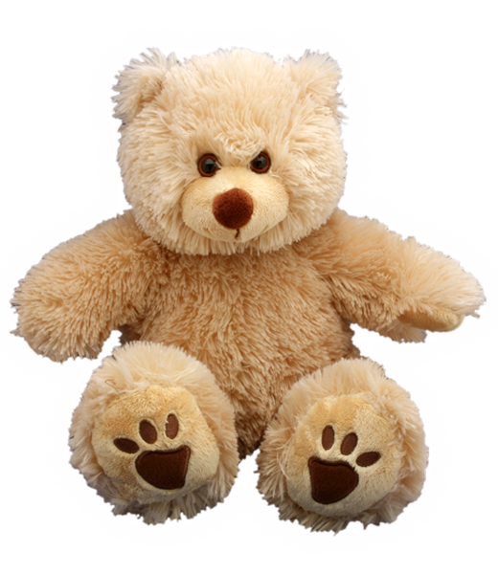
Comparing Mass
Task 5: Can you complete the sentence using the correct symbol to compare the mass of the object and the cubes?
The scales are balanced so the weight of the teddy bear and the cubes must be the same!
Choose from:
<
>
=
The teddy bear is ______ the cubes.

Slide 30
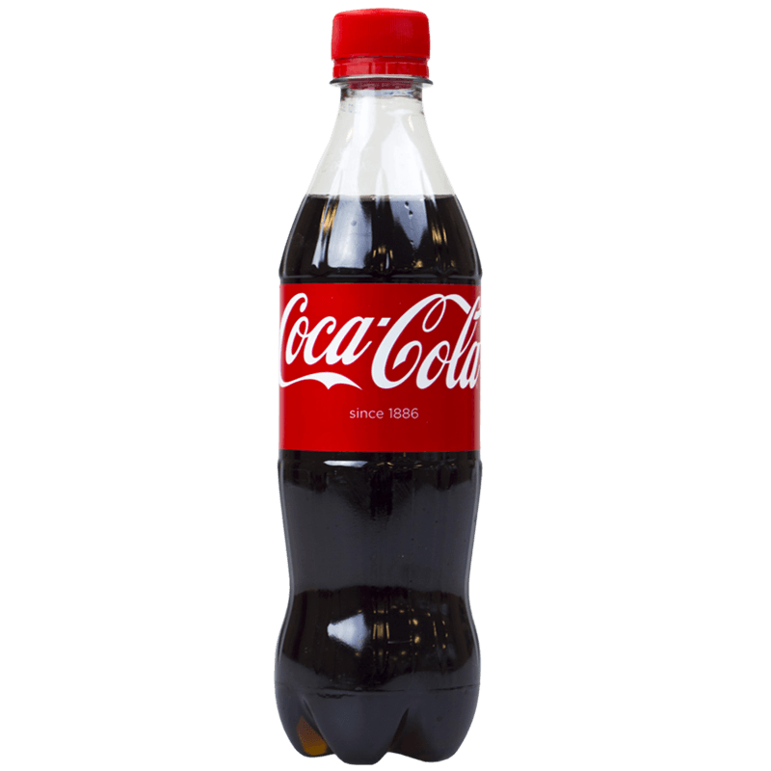
Comparing Mass
Task 6: Can you complete the sentence using the correct symbol to compare the mass of the object and the cubes?
Remember, the crocodile eats the heavier object.
Choose from:
<
>
=
The coke is ______ the cubes.

Slide 31
Comparing Mass
Task 7: Can you complete the sentence using the correct symbol to compare the mass of the object and the cubes?
Remember, the crocodile eats the heavier object.
Choose from:
<
>
=
The feather is ______ the cubes.

Slide 32
Challenge!
Or write how many blocks there would be.

Slide 33
Well done for your hard work today!
Could any completed work / photographic evidence of completed work please be sent to Pioneerspupils@gmail.com or submitted into the drop box at school.
Thank you

Slide 34
Date: 10.02.21
L.O. To be able to find the mass of objects in units.
Subject: Maths

Slide 35
Pre-recorded Teaching
Access the online teaching video below that will support you to complete the work in this lesson. This video will act as a support but all of the work can still be successfully understood & completed using paper-based versions of this pack. If you need further support to understand / complete work then please contact school via e-mail or telephone.
Play Video
Or copy and paste the below link
https://classroom.thenational.academy/lessons/to-find-the-mass-of-objects-in-units-6mukae?step=1&activity=video

Slide 36
Recap: Comparing Mass
Task 1: Can you complete the sentence using the correct symbol to compare the mass of the object and the cubes?
Remember, the crocodile eats the heavier object.
Choose from:
<
>
=
The Ribena is ______ the cubes.

Slide 37
Finding the mass of an object
Today we are going to find out the mass (the weight) of objects. To do this we need to try make the scales balance, just like this!

Slide 38
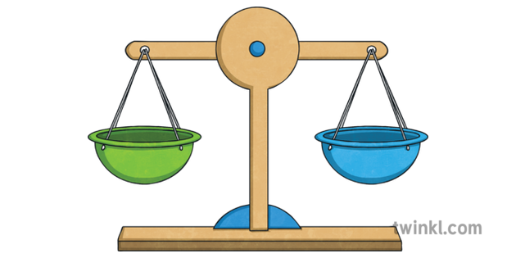
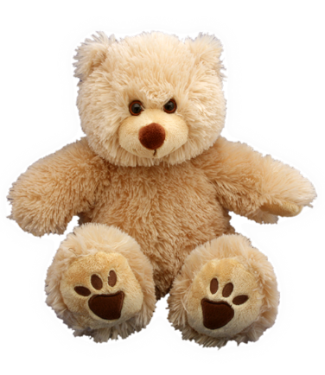
Finding the mass of an object
We are going to measure the weight by using cubes.
The cubes are our units.
The number of cubes which are used to balance the scales is the number of units which the objects weighs.
I need to add cubes to try and balance the scales.
It still isn’t balanced. I need to keep adding cubes.
The scales balanced once I had added 4 cubes.
This means the teddy bear weighs the same as 4 cubes (units).
The teddy bear weighs 4 units.

Slide 39
Finding the mass of an object
I added cubes until the scales balanced. This shows the chocolate bar weighs the same as 6 cubes.
Count how many cubes have made the scales balance. This is the amount of units the object weighs.
The chocolate bar weighs 6 units.

Slide 40
Finding the mass of an object
Task 2: I added cubes until the scales balanced. Can you complete the sentence to tell me how many units the sweets weigh?
4 cubes made the scales balance.
The sweets weigh _________ units.

Slide 41
Finding the mass of an object
Task 3: I added cubes until the scales balanced. Can you complete the sentence to tell me how many units the toy car weighs?
The toy car weighs ______ units.

Slide 42
Finding the mass of an object
Now we need to estimate how many units an object weighs before we find out.
Remember, estimate means think and guess!
I estimate the pencil weighs 4 units.
Let’s find out. I will begin to add the cubes…

Slide 43
Finding the mass of an object
I added cubes until the scales balanced.
The pencil weighs 2 units!

Slide 44
Finding the mass of an object
I estimate that the scissors weigh 6 units…

Slide 45
Finding the mass of an object
Task 4: Can you count how many units the scissors weigh to see if my estimation was correct?
The scissors weigh _____ units.

Slide 46
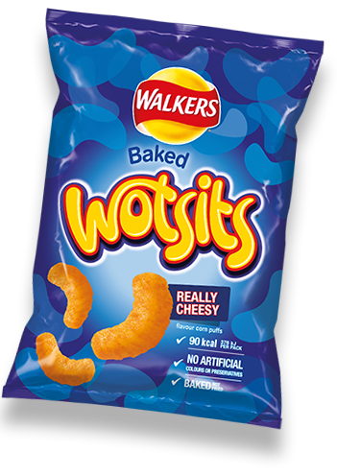
Finding the mass of an object
Task 5: Can you estimate how many units the crisps weigh?
I estimate the crisps weigh _______ units.

Slide 47
Finding the mass of an object
Task 6: Can you count how many units the crisps weigh? Was your estimation correct?
The crisps weigh _____ units.

Slide 48
Finding the mass of an object
Task 7: Can you estimate how many units the Kit Kat weighs?
I estimate the Kit Kat weighs _______ units.

Slide 49
Finding the mass of an object
Task 8: Can you count how many units the Kit Kat weighs? Was your estimation correct?
The Kit Kat weighs _____ units.

Slide 50
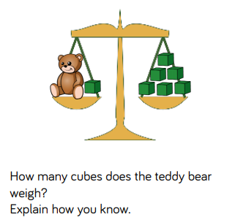
Challenge!

Slide 51
Well done for your hard work today!
Could any completed work / photographic evidence of completed work please be sent to Pioneerspupils@gmail.com or submitted into the drop box at school.
Thank you

Slide 52
Date: 11.02.21
L.O. To be able to experience standard units of mass.
Subject: Maths

Slide 53
Pre-recorded Teaching
Access the online teaching video below that will support you to complete the work in this lesson. This video will act as a support but all of the work can still be successfully understood & completed using paper-based versions of this pack. If you need further support to understand / complete work then please contact school via e-mail or telephone.
Play Video
Or copy and paste the below link
https://classroom.thenational.academy/lessons/to-experience-standard-units-of-mass-70upcd?step=2&activity=video

Slide 54
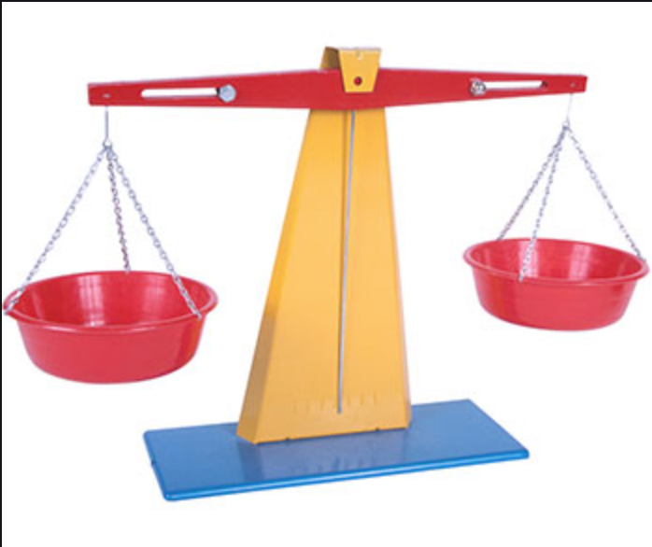
Standard unit of mass
Today we are going to be looking at measuring weight using something different. Below is an example of a set of balancing scales we could use.
We will be looking at whether objects are lighter, heavier or equal to using scales. If you do not have any scales, you can estimate the weight by holding the objects in your hand.

Slide 55
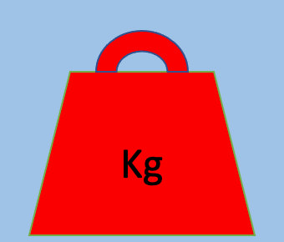
Standard unit of mass
For this lesson you will need an object that weighs around 1kg. This could be something such as a bag of sugar. We will use this throughout the lesson to compare with other objects to see if they are heavier, lighter or equal to.
We use weight to measure the mass of an object.
Kilogram

Slide 56
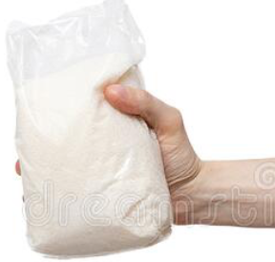
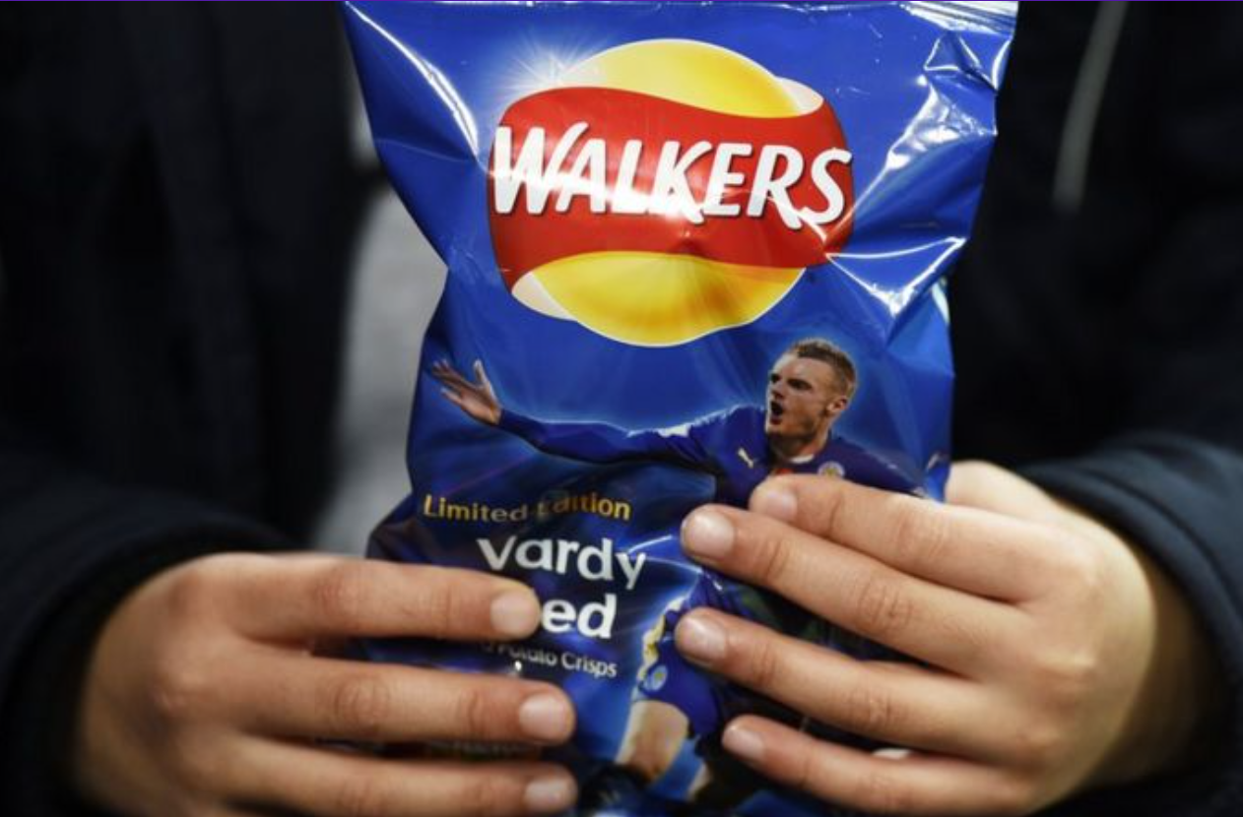
Standard unit of mass
Task 1: Can you find objects in your house to measure, looking for things that are heavier, lighter or equal to 1kg?

Slide 57
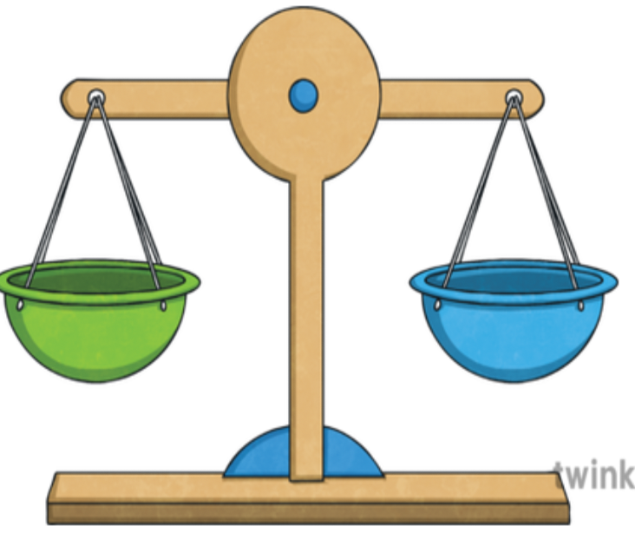
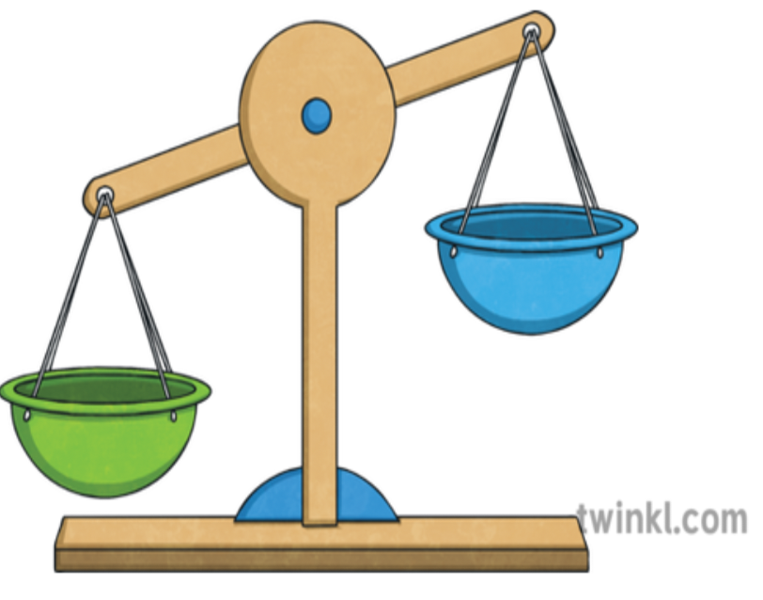
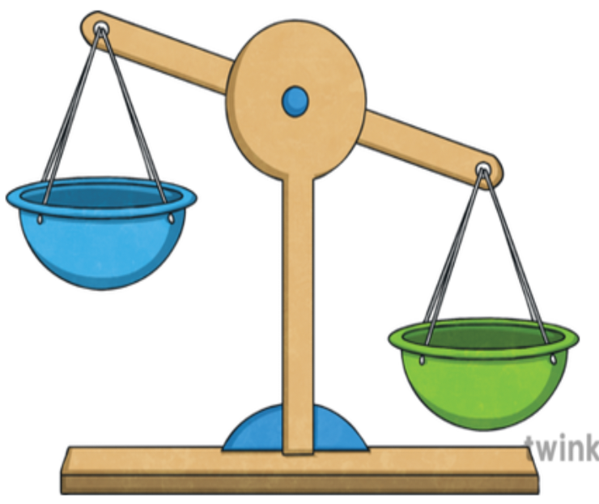
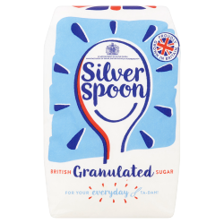
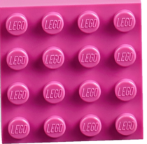
Standard units of mass
Kg is short for kilogram. It is a word we use for measuring the weight of an object. 1kg is the same weight as a full bag of sugar. Have you felt how heavy 1Kg is?
A bag of sugar is the same as a 1kg weight.
A pencil is lighter than a 1kg weight.
A 1kg weight is heavier than a piece of Lego.
Remember if the scales go down it means that the object at the bottom is heavier than the object at the top.

Slide 58
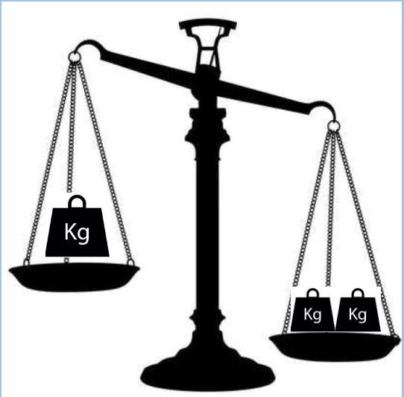
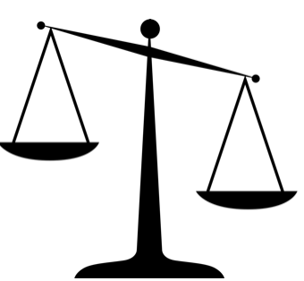
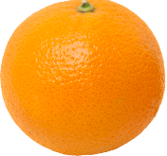
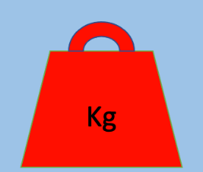
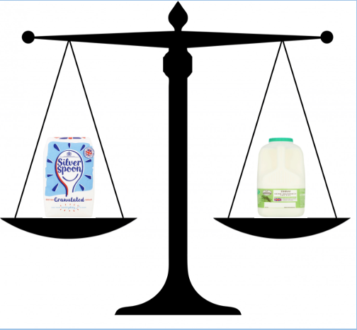
Standard unit of mass
Task 2: Complete the sentences using the words heavier, lighter or the same as.
2kg is ____________ than 1kg.
The orange is ____________ than 1kg.
The bag of sugar is _____________ the 1L bottle of milk.

Slide 59
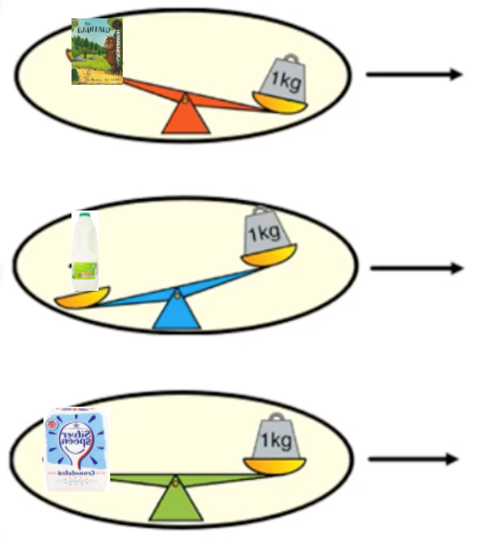
Standard unit of mass
Task 3: Complete the sentences using the words heavier, lighter or the same as..
The book is ___________ than the 1kg weight.
Don’t forget to use the words heavier, lighter or the same.
The milk is ___________ than the 1kg weight.
The sugar is __________ the 1kg weight.

Slide 60
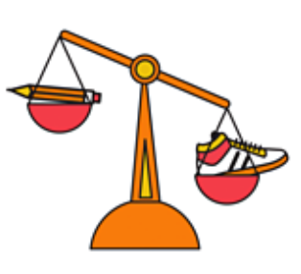
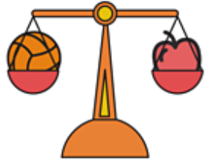
Standard units of mass
The ball is > than the flower.
Let’s look at the units of mass using the symbols <> or =. Remember < means lighter, > is heavier and = is the same.
The pencil is < than the trainer.
The ball is = to the apple.

Slide 61
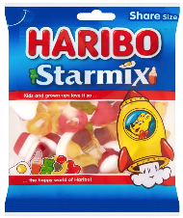
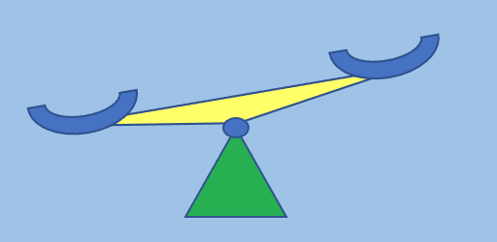
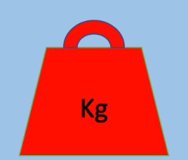
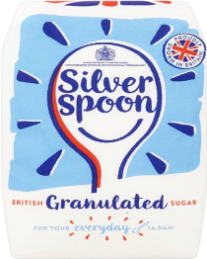
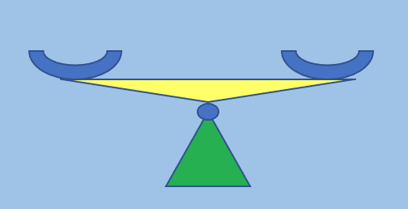
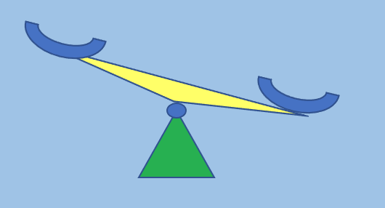
Standard unit of mass
Task 4: Now can you try to complete the sentences using < > or =
The 1kg weight is _____ the share bag of Haribos.
Remember < is lighter, > is heavier and = is the same.
The 1kg weight is ________ a bag of sugar.
The pencil is _____ 1kg weight.

Slide 62
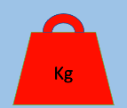
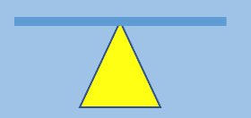
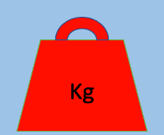
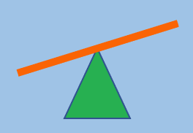
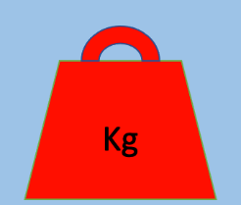
Standard unit of mass
Task 5: Complete the sentences using the mass symbols as on the previous slide <> or =.
The 1kg weight is ____ as a bag of flour.
The 1kg weight is _____ than the toy car.
The paperclip is ____ than 1kg weight.

Slide 63
Stem sentences
Task 6: Read the sentences and draw pictures to show which items are heavier, lighter or equal to.
The 1kg weight is equal to a bag of sugar.
The pencil is lighter than 1kg weight.
1kg weight is heavier than a piece of Lego.

Slide 64
Independent activity
Task 7: Can you look for objects around your house and list them in the table. Tick the box to show the mass of the object.
Object | Less than 1kg | Equal to 1kg | More than 1kg
A -
B -
C -
D -
Think about how the object feels. Does it feel heavier, lighter or the same as the bag of sugar or 1kg weight?
If the object is heavy you could ask an adult to help and maybe weigh the object on some scales if you have any.

Slide 65
If you are working on a computer, insert a text box to type your answer.
Challenge!

Slide 66
Well done for your hard work today!
Could any completed work / photographic evidence of completed work please be sent to Pioneerspupils@gmail.com or submitted into the drop box at school.
Thank you

Slide 67
Date: 12.02.21
L.O. To be able to weigh using scales to make biscuits.
Subject: Maths

Slide 68
Pre-recorded Teaching
Recap – Measuring with Scales
Access the online teaching video by Miss Malloy on the school website that will support you to complete the work in this lesson.
This video will act as a support but all of the work can still be successfully understood & completed using paper-based versions of this pack.
If you need further support to understand / complete work then please contact school via e-mail or telephone.

Slide 69
Weighing with scales
We are going to practise using scales in real life to make some biscuits!
We aren’t using balance scales today, we are going to use some scales you might have in your house. An adult will have to help you with this.
They might look like this:

Slide 70
Reading Scales in Grams
When you put ingredients on the scales, the hand (pointer) points to the number of how much it weighs.
How much do the cherries weigh?
10g
We know it’s 10g because we are measuring in g’s and the hand (pointer) is pointing right at the 10.

Slide 71
Baking Activity
On the next slides you will find the recipe to follow.
Make sure you measure the ingredients accurately so that your biscuits taste delicious!
Email photos of you baking your biscuits to
pioneerspupils@gmail.com so that you can be in our weekly Facebook post!

Slide 72
Biscuit Recipe
Use your scales to weigh your ingredients accurately. Follow the recipe closely to make your valentines biscuits.
Ingredients:
100g butter, softened
50g caster sugar
170g plain flour
Icing and edible decorations (optional)

Slide 73
Biscuit Recipe
Use your scales to weigh your ingredients accurately. Follow the recipe closely to make your valentines biscuits.
Equipment:
Scales
Non-stick baking paper
Mixing bowl
Wooden spoon
Rolling pin
Cutters or knife
Baking trays

Slide 74
Biscuit Recipe
Use your scales to weigh your ingredients accurately. Follow the recipe closely to make your valentines biscuits.
1. Preheat the oven to 180°C/160°C Fan/Gas Mark 4 and line two baking trays with non-stick baking paper.
2. Beat the butter and sugar until they are pale and creamy. Then work in the flour to make a stiff dough. You may find it easier to do this with your hands.
3. Turn the dough out onto a lightly floured surface and knead gently until smooth. Roll out to the thickness of a pound coin.
4. Cut out the dough with heart shaped cutter. If you do not have one, use your cup to cut out a circular shape or use a knife to cut out the shape of a heart (with adult supervision).
Continued…

Slide 75
Biscuit Recipe
Use your scales to weigh your ingredients accurately. Follow the recipe closely to make your valentines biscuits.
5. Carefully, transfer to the baking sheet and bake for 12 to 15 minutes.
6. Leave them to cool on the baking sheet for a few minutes to firm up, before transferring to a wire cooling rack.
7. Once they are completely cool, decorate with icing. You could also sprinkle with some edible decorations (if you have some).

Slide 76
Challenge!
Have a go at these problems…

Slide 77
Challenge
What is the weight of 1 of your finished biscuits?
________________
Are all of your biscuits the same weight?
_________________
Email a photo of you and your biscuits to
pioneerspupils@gmail.com so that you can be in our weekly Facebook post!

Slide 78
Well done for all of your hard work this lesson!
Please send any completed work/photographed evidence of completed work (practical activities) to pioneerspupils@gmail.com or deliver it to the dropbox outside of school on a Friday.

