Slide 1


Subject: Maths
Pack: B

Slide 2


Date: 01.02.21
L.O. To be able to compare lengths and heights of objects.
Subject: Maths

Slide 3


Pre-recorded Teaching
Access the online teaching video below that will support you to complete the work in this lesson. This video will act as a support but all of the work can still be successfully understood & completed using paper-based versions of this pack. If you need further support to understand / complete work then please contact school via e-mail or telephone.
Play Video
Or copy and paste the below link
https://classroom.thenational.academy/lessons/to-compare-lengths-and-heights-of-objects-6wrpce?step=1&activity=video

Slide 4


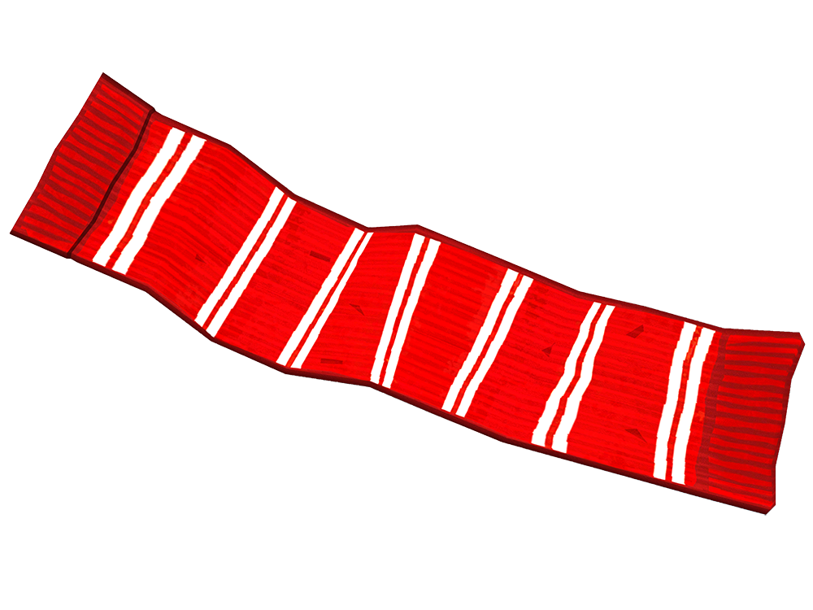
Long & Tall
This object stands up and goes from bottom to top, so we would say it is tall!
When someone/something is tall, another word for length is height.
This object lies flat and goes from left to right, so we would say it is long!

Slide 5
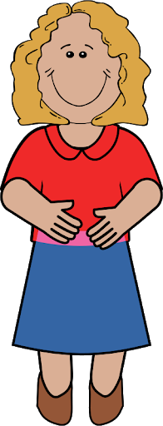
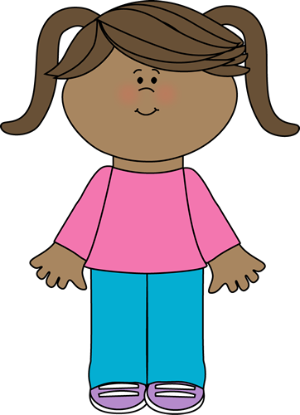
Comparing Length
I have put a circle around the person who is the tallest.

Slide 6


Comparing Length
Task 1: Can you point to or circle the person who is the tallest?
I have made sure they start in the same place to help us compare the length

Slide 7
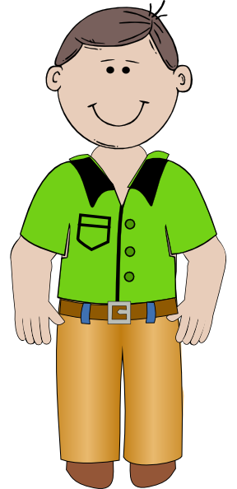
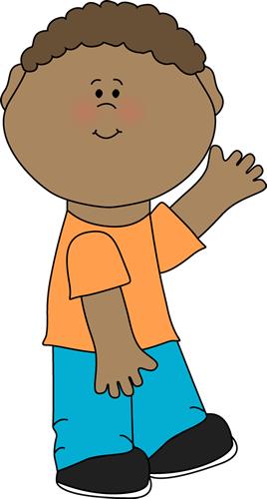
Comparing Length
Task 2: Can you point to or circle the person who is the shortest?

Slide 8
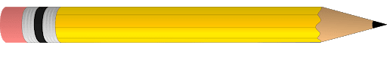
Comparing Length
Task 3: Can you point to or circle the pencil which is the longest?
I have made sure they start in the same place to help us compare the length

Slide 9
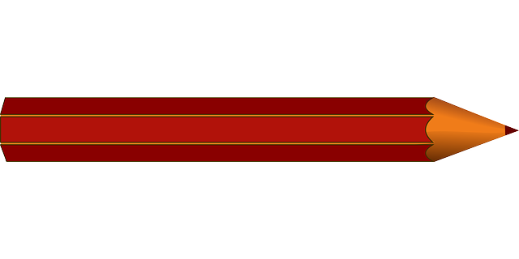
Comparing Length
Task 4: Can you point to or circle the pencil which is the shortest?

Slide 10
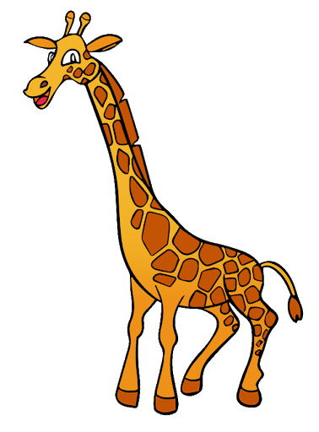


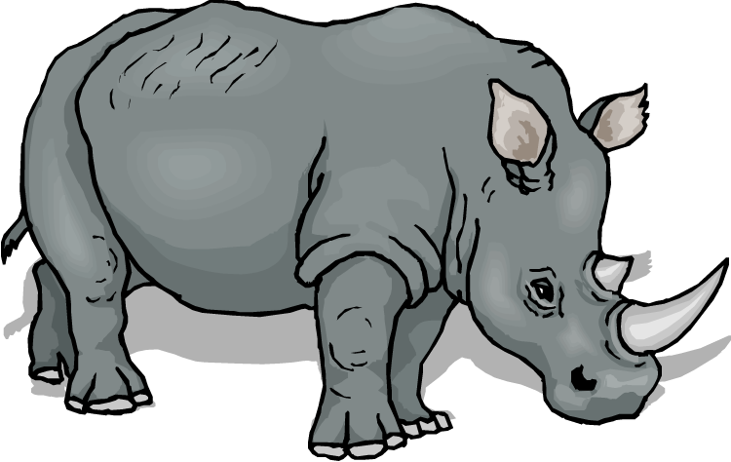
Comparing Length
I am choosing from the words longer, shorter and taller.
The rhino is ___________ than the giraffe.
longer
shorter
The blue pencil is ___________ than the red pencil.

Slide 11



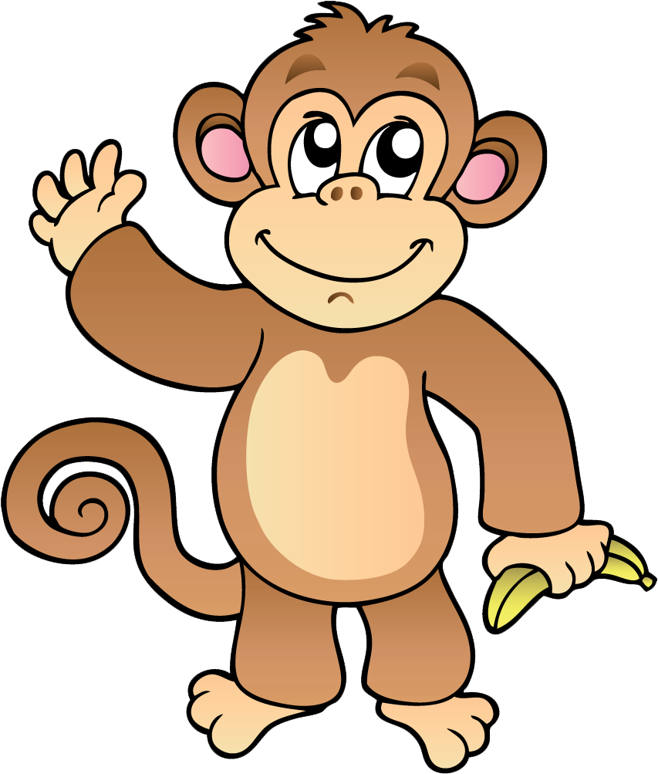
Comparing Length
Choose from the words longer, shorter and taller.
Task 5
The green pencil is ___________ than the blue pencil.
The elephant is ___________ than the monkey.

Slide 12
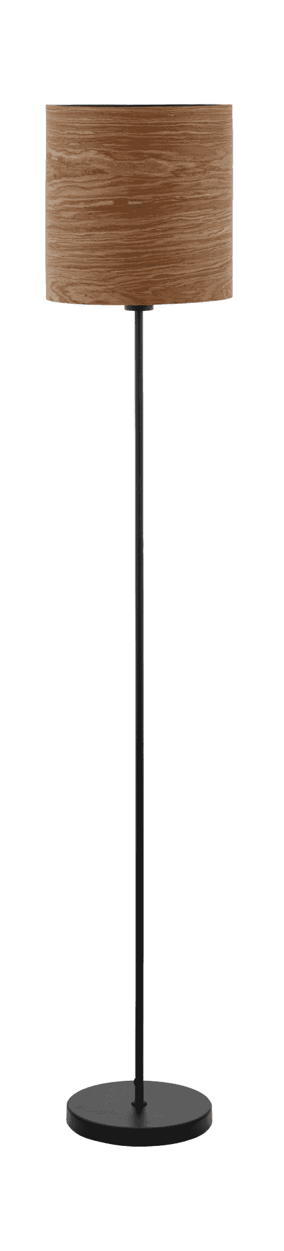
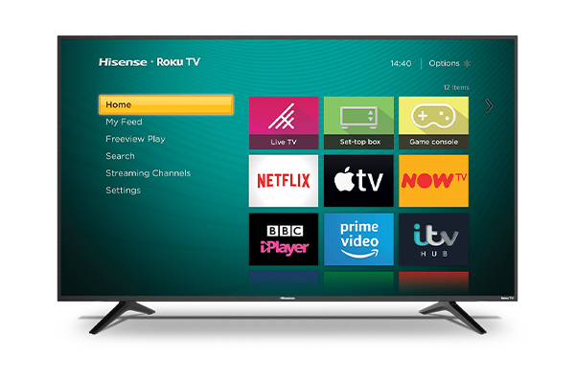
Comparing Length
Task 6: Can you find objects around your house and compare the length? Which one is longer / shorter or taller / shorter?
Use this sentence to help you compare the length
The (object) is ___________ than the (object)
For example:
The lamp is taller than the TV.

Slide 13
Comparing Length
Task 7: Finish the sentence to compare the lengths of the people.
Choose from the words longer, shorter and taller.
The man is ___________ than the girl.
The boy is ___________ than the man.

Slide 14
Comparing Length
Task 8: Can you compare the height of you and other people in your home?
Who is taller or shorter?
Use this example sentence to help you compare your height
My sister is taller than me.
My brother is shorter than my Mam.

Slide 15
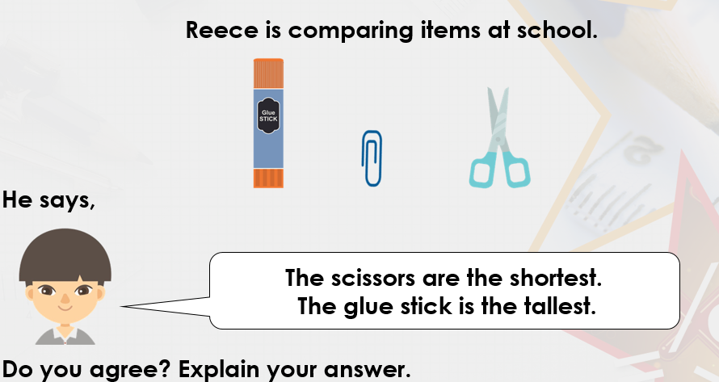

Challenge!
If you are working on a computer, insert a text box to type your answer.

Slide 16

Well done for your hard work today!
Could any completed work / photographic evidence of completed work please be sent to Pioneerspupils@gmail.com or submitted into the drop box at school.
Thank you

Slide 17
Date: 02.02.21
L.O. To be able to measure lengths using non-standard units.
Subject: Maths

Slide 18
Pre-recorded Teaching
Access the online teaching video below that will support you to complete the work in this lesson. This video will act as a support but all of the work can still be successfully understood & completed using paper-based versions of this pack. If you need further support to understand / complete work then please contact school via e-mail or telephone.
Play Video
Or copy and paste the below link
https://classroom.thenational.academy/lessons/to-measure-lengths-using-non-standard-units-part-1-64v30t?step=1&activity=video

Slide 19
Recap: Comparing Length
Your turn
Task 1: Can you complete the sentences to compare the length of the objects?
The monkey is ___________ than the giraffe.
The green pencil is ___________ than the red pencil.

Slide 20

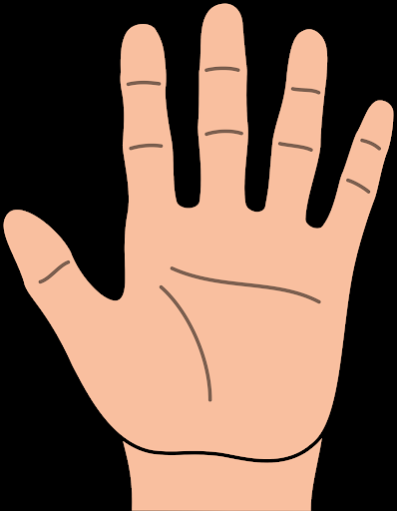
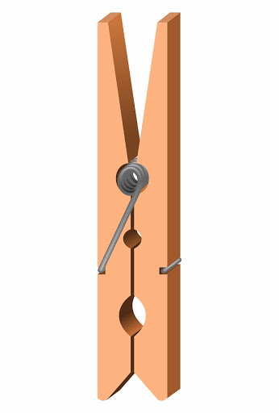
Task 2
Measuring Objects
Today we are going to measure objects using our hands!
To measure something means to find out how long or tall something is.
Can you find 3 objects which are longer than your hand?
Can you find 3 objects which are shorter than your hand?
Can you write what you have found or take pictures of them to show us?

Slide 21
Measuring Objects
I have used my hands to measure how tall the TV is.
The TV is about 4 hands tall!
Make sure the hands start at the bottom of the object and all hands are touching.

Slide 22
Measuring Objects
Task 3: Can you complete the sentence to tell me how tall the lamp is?
I have used my hands to measure how tall the lamp is.
The lamp is about ______ hands tall!

Slide 23
Measuring Objects
Your turn
Task 4: Can you have a look around your house and measure things with your hands?
Use this example sentence to help you when measuring with your hands
The (object) is _____ hands tall.
Or
The (object) is _____ hands long.
Can you write some examples to show us what you have measured.

Slide 24

Measuring Objects
This time I’m going to estimate how tall an object is and then I’m going to measure with my hands.
Estimate is when you think and guess!
I estimate that the chair will be around 6 hands tall!

Slide 25
Measuring Objects
This time I’m going to estimate how tall an object is and then I’m going to measure with my hands.
Estimate is when you think and guess!
Nearly! I estimated that the chair was around 6 hands tall but when I measured it was actually around 4 hands tall.
I’ve made sure all hands are touching.

Slide 26

Measuring Objects
Task 5: Can you estimate how tall this object is before we work it out with our hands?
Estimate is when you think and guess!
I estimate it is _______ hands tall.

Slide 27
Measuring Objects
Task 6: Now, count how many hands tall it is.
Estimate is when you think and guess!
Were you right?
It is _______ hands tall.

Slide 28
Measuring Objects
Task 7: Now look for different objects in your house. Estimate how many hands long/tall they will be and then measure with your hands!
Use this example sentence to help you when measuring with your hands
The (object) is _____ hands tall.
Can you write some examples to show us what you have measured.
Make sure the hands start at the bottom of the object and all hands are touching.

Slide 29
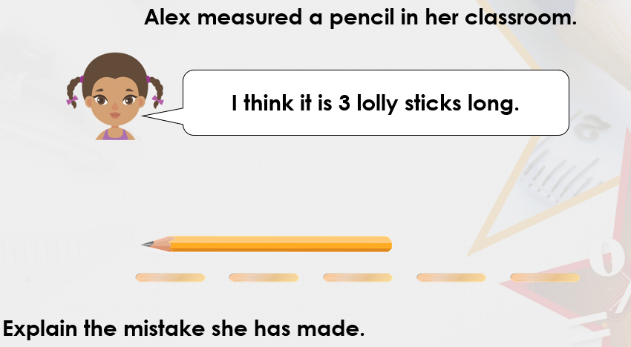
Challenge!
This time they haven’t measured with their hands, they have measured with lolly sticks.
(Look at how the sticks are spaced out)

Slide 30
Well done for your hard work today!
Could any completed work / photographic evidence of completed work please be sent to Pioneerspupils@gmail.com or submitted into the drop box at school.
Thank you

Slide 31
Date: 03.02.21
L.O. To be able to measure lengths using non-standard units.
Subject: Maths

Slide 32
Pre-recorded Teaching
Access the online teaching video below that will support you to complete the work in this lesson. This video will act as a support but all of the work can still be successfully understood & completed using paper-based versions of this pack. If you need further support to understand / complete work then please contact school via e-mail or telephone.
Play Video
Or copy and paste the below link
https://classroom.thenational.academy/lessons/to-measure-lengths-using-non-standard-units-part-2-6ngkac?step=1&activity=video

Slide 33
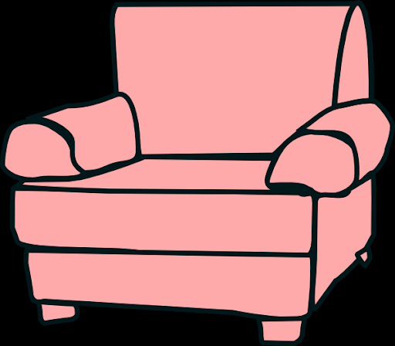
Recap: Measuring length
Task 1: Can you complete the sentence to tell me how tall the chair is.
The chair is about ______ hands tall!

Slide 34
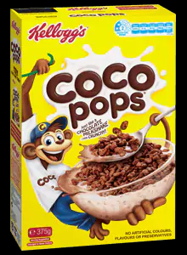
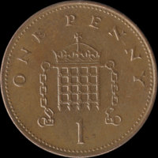
Measuring Objects
Yesterday we measured objects with our hands. Today we are going to measure with objects!
In school, we might have measured objects with cubes, but because you don’t have cubes could you use coins which are the same size?
I have used 1ps to measure the length of a cereal box.
I have made sure they are the same coins and they are lined up on top of each other.
You can use any object, as long as they’re all the same size!

Slide 35
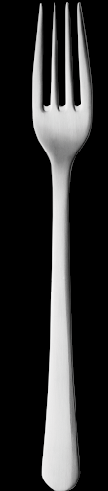
Measuring Objects
I have used coins (1ps) to measure the length of a fork.
I counted how many coins are used to measure the fork.
The fork is around 10 coins tall.

Slide 36

Measuring Objects
Task 2: Complete the sentence to tell me how long the book is?
I have used coins (1ps) to measure the length of the book.
The book is ____ coins long.

Slide 37
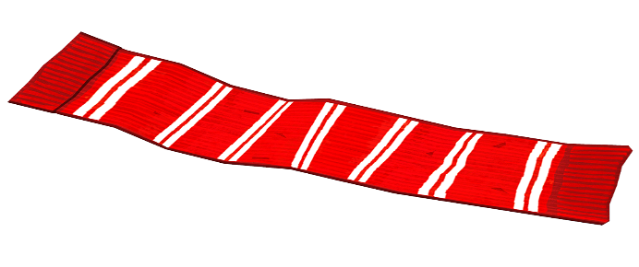
Measuring Objects
Task 3: Choose objects from around your house and start measuring them with coins (or another object you have lots of)
Use this example sentence to help you when measuring with coins
The (object) is _____ coins tall.
Or
The (object) is _____ coins long.
Can you write some examples to show us what you have measured.
Remember:
Long
Tall

Slide 38

Measuring Objects
Remember:
Estimate is when you think and guess!
I am going to estimate how many coins tall the bottle is.
I estimate the bottle is around 7 coins tall.
Lets find out if I am correct on the next slide

Slide 39
Measuring Objects
Remember:
Estimate is when you think and guess!
I estimated the bottle is 7 coins tall.
Nearly!
The bottle is around 9 coins tall.

Slide 40
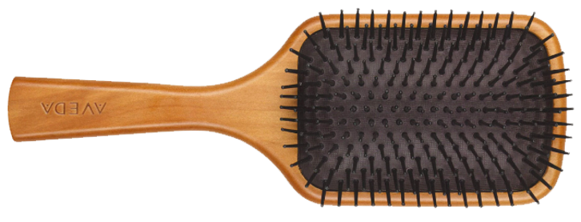
Measuring Objects
Remember:
Estimate is when you think and guess!
Task 4: Can you estimate how long the hairbrush is before we work it out with coins?
I estimate it is _______ coins long.

Slide 41
Measuring Objects
Remember:
Estimate is when you think and guess!
Task 5: Count how many coins have been used to measure the hairbrush.
Was your estimation correct?
The hairbrush is _______ coins long.
It is really important to start measuring from the start of the object!

Slide 42
Measuring Objects
Remember:
Start measuring at the start of the object
Task 6: Choose objects from around your home. Estimate and then measure how long or tall they are using coins. Fill in the table below to record your results. I have done the first one for you.
Object | Estimate | Measurement
Water bottle | 7 coins tall | 9 coins tall
Fill in this column once you have measured the objects with the coins

Slide 43
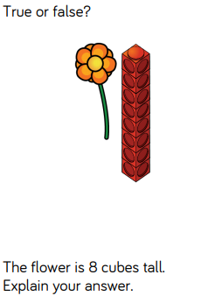
Challenge!
If you are working on a computer, insert a text box to type your answer.

Slide 44
Well done for your hard work today!
Could any completed work / photographic evidence of completed work please be sent to Pioneerspupils@gmail.com or submitted into the drop box at school.
Thank you

Slide 45
Date: 04.02.21
L.O. To be able to measure lengths using a ruler.
Subject: Maths

Slide 46
Pre-recorded Teaching
Access the online teaching video below that will support you to complete the work in this lesson. This video will act as a support but all of the work can still be successfully understood & completed using paper-based versions of this pack. If you need further support to understand / complete work then please contact school via e-mail or telephone.
Play Video
Or copy and paste the below link
https://classroom.thenational.academy/lessons/measuring-length-in-centimetres-70r6ad?step=2&activity=video

Slide 47
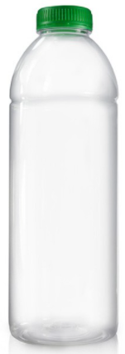
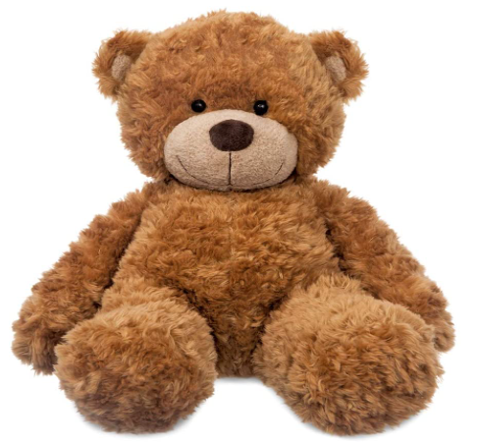


Recap: Measuring Objects
Task 1: I have measured the objects with cubes. Can you count how many cubes tall they are?
The teddy bear is ____ cubes tall
The bottle is _____ cubes tall

Slide 48
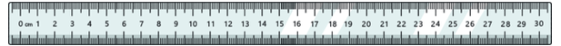
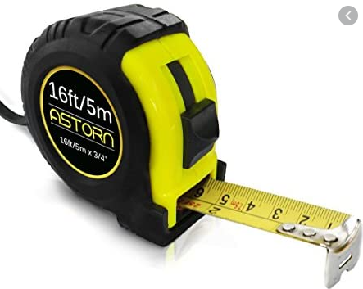
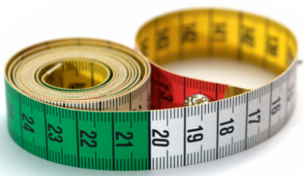
Measuring objects with a ruler
Today we are going to be measuring objects using a ruler.
A ruler is a piece of equipment we use to measure length or to draw straight lines.
Ruler
You need a ruler to complete this lesson. If you do not have a ruler, you could use a tape measure.
Tape measure

Slide 49
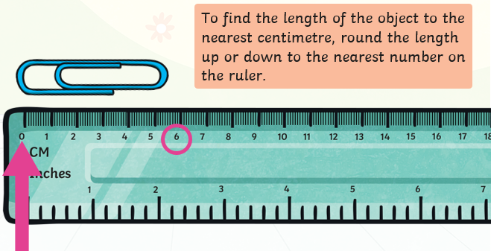
Measuring objects with a ruler
When we measure with a ruler, we use the words ‘centimetre’ after the number. You write ‘cm’ for short!
Always put the start of your object at 0cm as shown on the picture below.

Slide 50
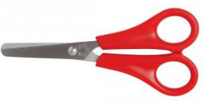
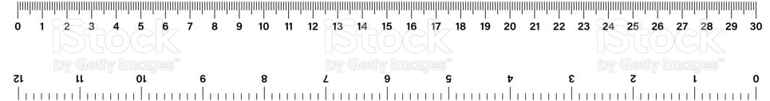
Measuring objects with a ruler
I put the start of scissors on 0cm.
The end of the scissors is next to the number 9.
This means the scissors are 9cm.

Slide 51

Measuring objects with a ruler
Task 2: Can you measure this pencil using the ruler?
I have remembered to start at 0cm.
The pencil is _____cm long.
The pencil ends on the number 7.

Slide 52

Measuring objects with a ruler
Task 3: Use the ruler to measure how long the toothbrush is.
The toothbrush is _____cm long.

Slide 53

Measuring objects with a ruler
Task 4: Use the ruler to measure how long the remote is.
The remote is _____cm long.

Slide 54
Greater than and less than
Greater is another word for bigger
Below the number 15 has been circled
Any number lower than 15 and to the left of the number would be classed as less than.
Any number higher than 15 and to the right of the number would be classed as greater than.
Less than
Greater than

Slide 55
Greater than and less than
This time… number 13 is circled on the ruler.
Number 6 is less than the number 13.
I know this because 6 is a smaller number and is closer to 0.
Less than
Greater than

Slide 56
Greater than and less than
Choose from:
Less than
Greater than
Number 13 is still circled on the ruler.
Task 5: The number 10 is _________________ 13.
Less than
Greater than

Slide 57
Greater than and less than
Choose from:
Less than
Greater than
Number 13 is still circled on the ruler.
Task 6: The number 4 is _________________ 13.
Less than
Greater than

Slide 58
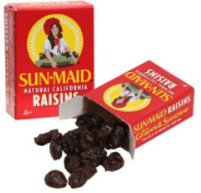

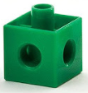
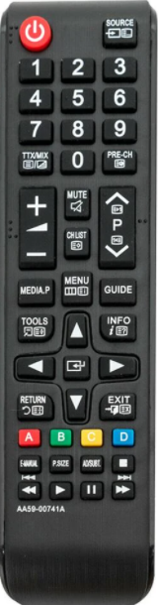

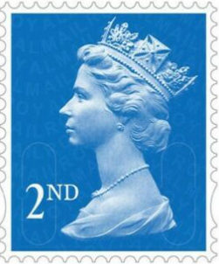

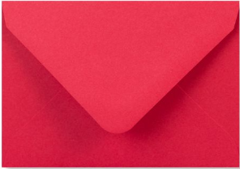
Greater than and less than
I have measured objects and grouped them into 2 groups.
If they measure less than 13cm I have put them in this group.
If they measure greater than 13cm I have put them in this group.
Less than 13cm
Greater than 7cm

Slide 59
Greater than and less than
Your turn
Task 7: Can you go on a scavenger hunt around your home for objects you can measure with your ruler or tape measure? Put the objects in the correct group once you have measured them!
Less than 13cm
Greater than 13cm
Take a picture or draw/write the items so we can see!

Slide 60
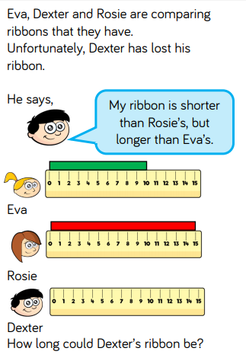
Challenge!
If you are working on a computer, insert a text box to type your answer.

Slide 61
Well done for your hard work today!
Could any completed work / photographic evidence of completed work please be sent to Pioneerspupils@gmail.com or submitted into the drop box at school.
Thank you

Slide 62
Date: 05.02.21
L.O. To be able to measure lengths using a ruler.
Subject: Maths

Slide 63
Pre-recorded Teaching
Access the online teaching video below that will support you to complete the work in this lesson. This video will act as a support but all of the work can still be successfully understood & completed using paper-based versions of this pack. If you need further support to understand / complete work then please contact school via e-mail or telephone.
Play Video
Or copy and paste the below link
https://classroom.thenational.academy/lessons/measuring-length-in-centimetres-70r6ad?step=2&activity=video

Slide 64
Recap: Measuring objects with a ruler
Remember, we always put the start of the object at 0cm.
The end of the scissors are next to the number 9.
This means the scissors are 9cm.

Slide 65
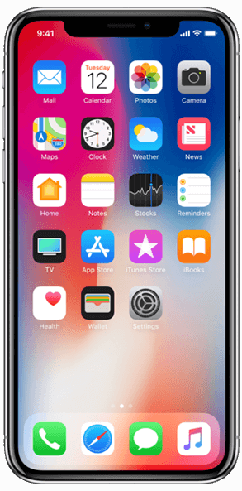
Measuring objects with a ruler
Your turn
Task 1: Use the ruler to measure how long the phone is.
The phone is _____ cm long.

Slide 66
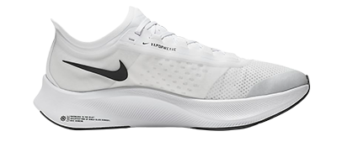
Measuring objects with a ruler
My turn
Now I am going to estimate how long an object is, and then measure it with a ruler to see if I am correct!
I estimate the shoe is 14cm long.

Slide 67
Measuring objects with a ruler
My turn
Lets see if I am correct…
I estimated the shoe is 14cm long.
Nearly!
The shoe is 12cm long.

Slide 68
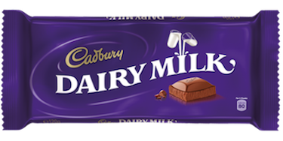
Measuring objects with a ruler
Our turn
Lets estimate and measure the chocolate bar together
I estimate the chocolate is 6cm long.

Slide 69
Measuring objects with a ruler
Our turn
Task 3: Measure the chocolate bar. Was my estimation correct?
The chocolate is ____cm long.

Slide 70

Measuring objects with a ruler
Your turn
Task 4: Can you estimate how long the bag of crisps is?
I estimate the bag of crisps is ____cm long.

Slide 71
Measuring objects with a ruler
Your turn
Task 5: Now measure the bag of crisps. Was your estimation correct?
The bag of crisps is ____cm long.

Slide 72
Measuring objects with a ruler
Your turn
Task 6: Choose objects from around your home. Estimate and then measure how long or tall they are using a ruler. Fill in the table below to record your results. I have done the first one for you.
Object | Estimate | Measurement
Trainers | 14cm | 12cm

Slide 73
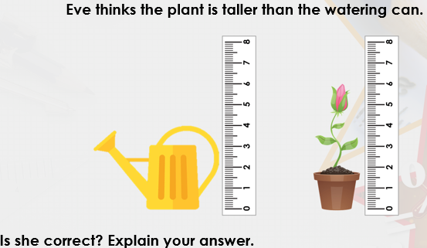
Challenge!

Slide 74
Well done for your hard work today!
Could any completed work / photographic evidence of completed work please be sent to Pioneerspupils@gmail.com or submitted into the drop box at school.
Thank you

