Slide 1
Date: Monday 18th January
LO To be able to practise phonics sounds.
LO To be able to answer questions about a text.
Please practise phonics every day for 20 minutes.
Subject: Phonics/Guided Reading

Slide 2
Each day we are going to focus on a different sound.
Please choose from set 1, set 2, set 3 or guided reading. Each day, for phonics, there will be a video to watch and some words to read linked to the taught sound. For guided reading, there will be a text to read and some questions to answer.
Here are the sounds which are in each set.
Please contact the school if you are not sure which set your child should be focusing on, or whether you’re unsure if your child does guided reading rather than phonics.
Then, play some phonics games!
Guided Reading
For those children who know all of the phonics sounds from set 1, set 2 and set 3 and are confident readers.

Slide 3
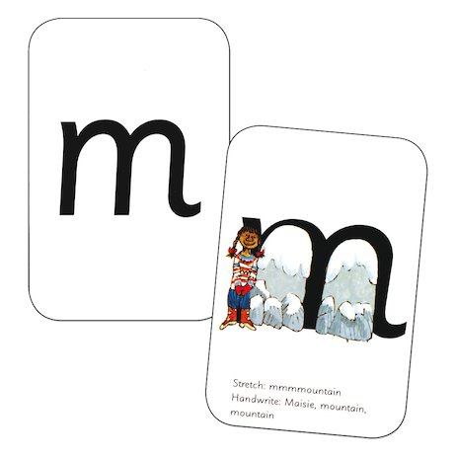
Set 1 Sounds
Skip this slide if your child is not focusing on this set.
Today’s sound:
Please click the link or copy the below link into the internet:
https://www.youtube.com/watch?v=nIlZqEnXPc8&list=PLPVrkr0oJX1tBTpbocNce93WUH8G-um6A
Or copy the below into YouTube:
‘Phonic Lesson - Set 1 Sound - Learning to Read and Write "m" for Reception and Year 1’ – Early Years Learning is Fun
Scavenger Hunt!
What can you find in your house that begins with m?

Slide 4
Set 1 Sounds
Now time to read some words beginning with ‘m’. You could even practise writing these words!

Slide 5
Set 2 Sounds
Skip this slide if your child is not focusing on this set.
Today’s sound:
Please click the link or copy the below link into the internet:
https://www.youtube.com/watch?v=WL_-QHxJnFQ&list=PLPVrkr0oJX1sBGLJU2hNbPE2neuhezWSu
Or copy the below into YouTube:
‘Phonic Lesson - Set 2 ‘ay’ sound for Reception and Year 1’ – Early Years Learning is Fun
Can you think of any words with the ‘ay’ sound in it?

Slide 6
Set 2 Sounds
Now time to read some words including ‘ay’. You could even practise writing these words!

Slide 7
Set 3 Sounds
Skip this slide if your child is not focusing on this set.
Today’s sound:
Please click the link or copy the below link into the internet:
https://www.youtube.com/watch?v=rP3OP3qaYYw&list=PLPVrkr0oJX1smTl2RWUHKgvupRrMZkKEE
Or copy the below into YouTube:
‘Phonic Lesson - Set 3 ‘oi’ sound for Reception and Year 1’ – Early Years Learning is Fun
Can you think of any words with the ‘oi’ sound in it?

Slide 8
Set 3 Sounds
Now time to read some words including ‘oi’. You could even practise writing these words!

Slide 9
Guided Reading
Page 1
Read the text below before answering the questions on the following slides.

Slide 10
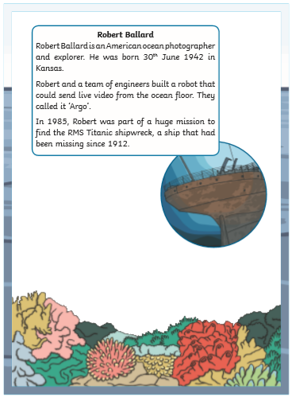
Guided Reading
Page 2
Read the text below before answering the questions on the following slides.

Slide 11
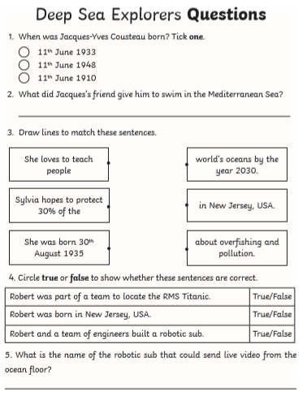
Questions

Slide 12
Date: Tuesday 19th January
LO To be able to practise phonics sounds.
Please practise phonics every day for 20 minutes.
Subject: Phonics

Slide 13
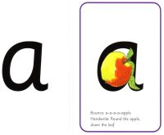
Set 1 Sounds
Skip this slide if your child is not focusing on this set.
Today’s sound:
Please click the link or copy the below link into the internet:
https://www.youtube.com/watch?v=zl6Sb44zneQ&list=PLPVrkr0oJX1tBTpbocNce93WUH8G-um6A&index=2
Or copy the below into YouTube:
‘Phonic Lesson - Set 1 Sound - Learning to Read and Write “a" for Reception and Year 1’ – Early Years Learning is Fun
Scavenger Hunt!
What can you find in your house that begins with a?

Slide 14
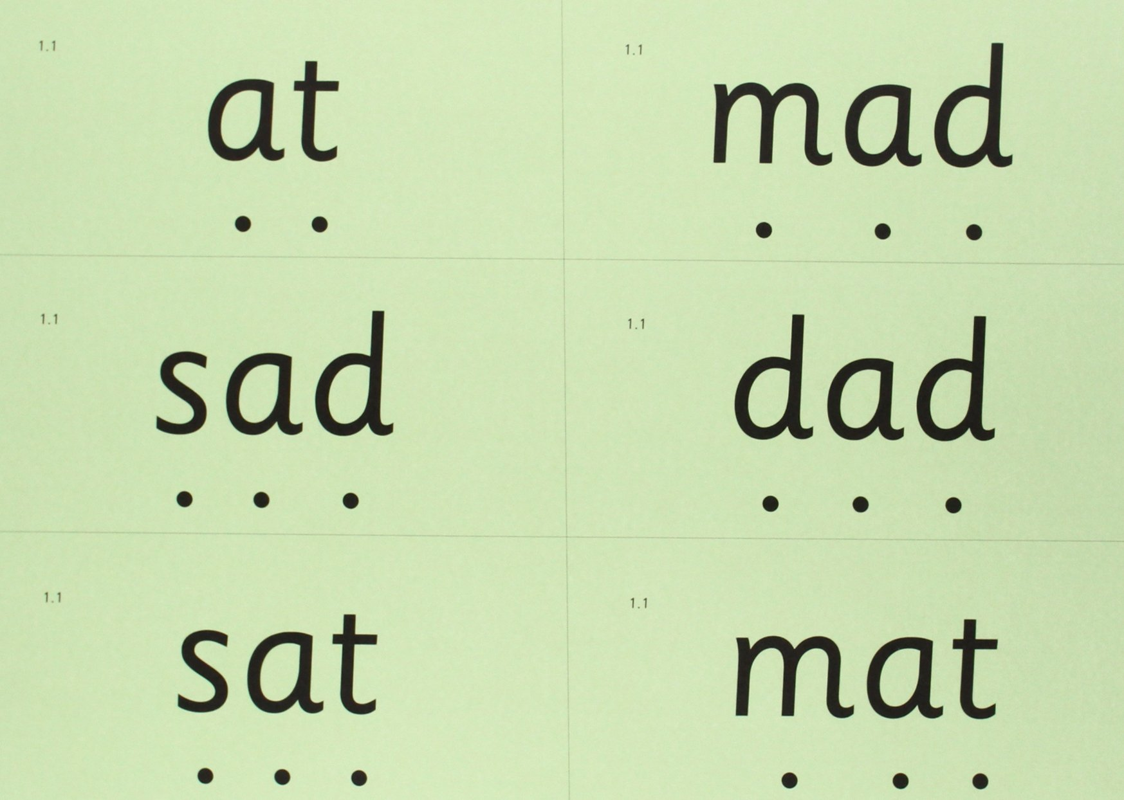
Set 1 Sounds
Now time to read some words including ‘a’. You could even practise writing these words!

Slide 15
Set 2 Sounds
Skip this slide if your child is not focusing on this set.
Today’s sound:
Please click the link or copy the below link into the internet:
https://www.youtube.com/watch?v=M1uW4OtU7aU&list=PLPVrkr0oJX1sBGLJU2hNbPE2neuhezWSu&index=2
Or copy the below into YouTube:
‘Phonic Lesson - Set 2 ‘ee’ sound for Reception and Year 1’ – Early Years Learning is Fun
Can you think of any words with the ‘ee’ sound in it?

Slide 16
Set 2 Sounds
Now time to read some words including ‘ee’. You could even practise writing these words!

Slide 17
Set 3 Sounds
Skip this slide if your child is not focusing on this set.
Today’s sound:
Please click the link or copy the below link into the internet:
https://www.youtube.com/watch?v=UHzu7dkn3sY&list=PLPVrkr0oJX1smTl2RWUHKgvupRrMZkKEE&index=2
Or copy the below into YouTube:
‘Phonic Lesson - Set 3 ‘ea’ sound for Reception and Year 1’ – Early Years Learning is Fun
Can you think of any words with the ‘ea’ sound in it?

Slide 18
Set 3 Sounds
Now time to read some words including ‘ea’ You could even practise writing these words!

Slide 19
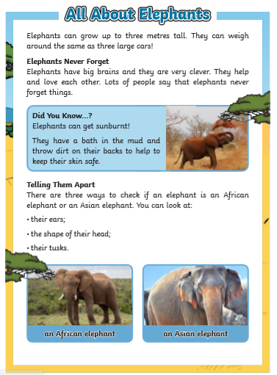
Guided Reading
Page 1
Read the text below before answering the questions on the following slides.

Slide 20
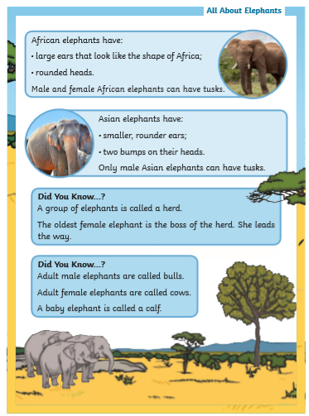
Guided Reading
Page 2
Read the text below before answering the questions on the following slides.

Slide 21
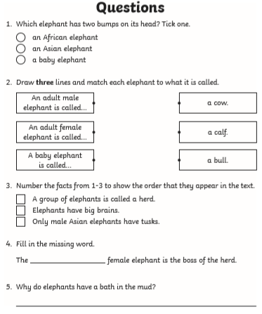
Questions

Slide 22
Date: Wednesday 20th January
LO To be able to practise phonics sounds.
Please practise phonics every day for 20 minutes.
Subject: Phonics

Slide 23
Set 1 Sounds
Skip this slide if your child is not focusing on this set.
Today’s sound:
Please click the link or copy the below link into the internet:
https://www.youtube.com/watch?v=F6rwQhGL_oM&list=PLPVrkr0oJX1tBTpbocNce93WUH8G-um6A&index=3
Or copy the below into YouTube:
‘Phonic Lesson - Set 1 Sound - Learning to Read and Write “s" for Reception and Year 1’ – Early Years Learning is Fun
Scavenger Hunt!
What can you find in your house that begins with s?

Slide 24
Set 1 Sounds
Now time to read some words including ‘s’. You could even practise writing these words!

Slide 25
Set 2 Sounds
Skip this slide if your child is not focusing on this set.
Today’s sound:
Please click the link or copy the below link into the internet:
https://www.youtube.com/watch?v=Y46--B_7BMs&list=PLPVrkr0oJX1sBGLJU2hNbPE2neuhezWSu&index=3
Or copy the below into YouTube:
‘Phonic Lesson - Set 2 ‘igh’ sound for Reception and Year 1’ – Early Years Learning is Fun
Can you think of any words with the ‘igh’ sound in it?

Slide 26
Set 2 Sounds
Now time to read some words including ‘igh’. You could even practise writing these words!

Slide 27
Set 3 Sounds
Skip this slide if your child is not focusing on this set.
Today’s sound:
Please click the link or copy the below link into the internet:
https://www.youtube.com/watch?v=jmR3fRRwNB8&list=PLPVrkr0oJX1smTl2RWUHKgvupRrMZkKEE&index=3
Or copy the below into YouTube:
‘Phonic Lesson - Set 3 ‘a-e’ sound for Reception and Year 1’ – Early Years Learning is Fun
Can you think of any words with the ‘a-e’ sound in it?

Slide 28
Set 3 Sounds
Now time to read some words including ‘a-e’ You could even practise writing these words!

Slide 29
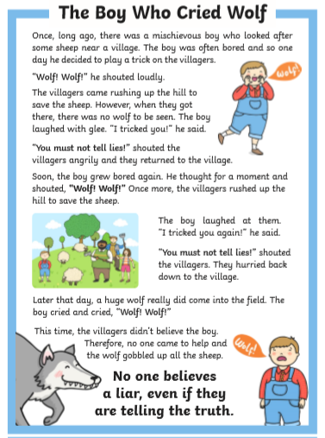
Guided Reading
Guided Reading
Page 1
Page 1
Read the text below before answering the questions on the following slides.

Slide 30
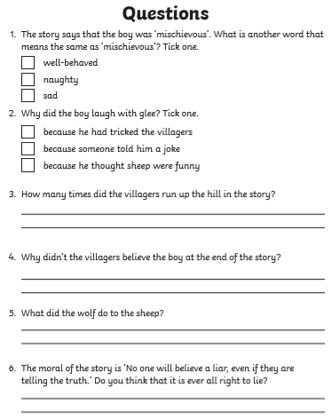
Questions

Slide 31
Date: Thursday 21st January
LO To be able to practise phonics sounds.
Please practise phonics every day for 20 minutes.
Subject: Phonics

Slide 32
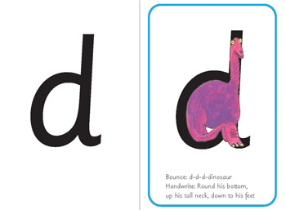
Set 1 Sounds
Skip this slide if your child is not focusing on this set.
Today’s sound:
Please click the link or copy the below link into the internet:
https://www.youtube.com/watch?v=kI6pKABC7P4&list=PLPVrkr0oJX1tBTpbocNce93WUH8G-um6A&index=4
Or copy the below into YouTube:
‘Phonic Lesson - Set 1 Sound - Learning to Read and Write “d" for Reception and Year 1’ – Early Years Learning is Fun
Scavenger Hunt!
What can you find in your house that begins with d?

Slide 33
Set 1 Sounds
Now time to read some words including ‘d’. You could even practise writing these words!

Slide 34
Set 2 Sounds
Skip this slide if your child is not focusing on this set.
Today’s sound:
Please click the link or copy the below link into the internet:
https://www.youtube.com/watch?v=iiap-EZwJAs&list=PLPVrkr0oJX1sBGLJU2hNbPE2neuhezWSu&index=4
Or copy the below into YouTube:
‘Phonic Lesson - Set 2 ‘ow’ sound for Reception and Year 1’ – Early Years Learning is Fun
Can you think of any words with the ‘ow’ sound in it?

Slide 35
Set 2 Sounds
Now time to read some words including ‘ow’. You could even practise writing these words!

Slide 36
Set 3 Sounds
Skip this slide if your child is not focusing on this set.
Today’s sound:
Please click the link or copy the below link into the internet:
https://www.youtube.com/watch?v=SFW1vnaXZBI&list=PLPVrkr0oJX1smTl2RWUHKgvupRrMZkKEE&index=4
Or copy the below into YouTube:
‘Phonic Lesson - Set 3 ‘i-e’ sound for Reception and Year 1’ – Early Years Learning is Fun
Can you think of any words with the ‘i-e’ sound in it?

Slide 37
Set 3 Sounds
Now time to read some words including ‘i-e’ You could even practise writing these words!

Slide 38
Guided Reading
Page 1
Read the text below before answering the questions on the following slides.

Slide 39
Guided Reading
Page 2
Read the text below before answering the questions on the following slides.

Slide 40
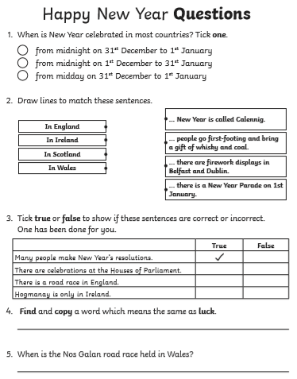
Questions

Slide 41
Date: Friday 22nd January
LO To be able to practise reading and writing tricky words.
Please practise phonics every day for 20 minutes.
Subject: Phonics

Slide 42
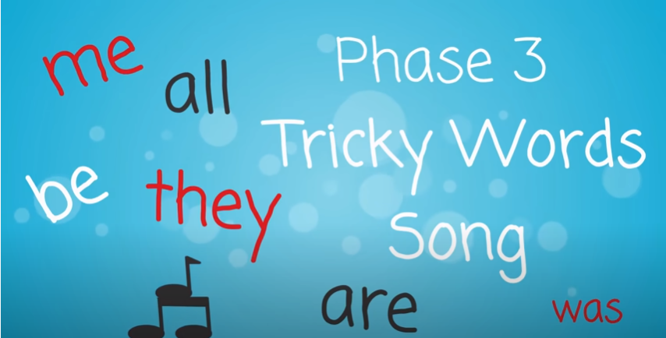
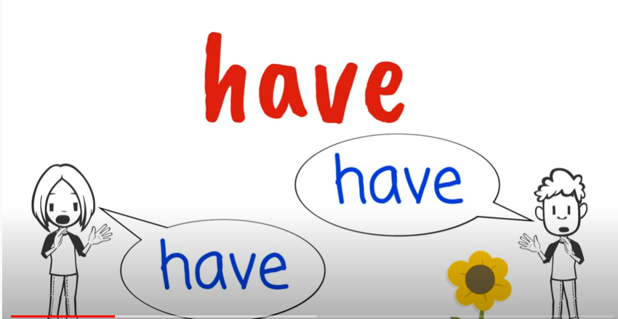
Tricky Words!
Pause the video on each word. How many times can you write that word in 1 minute?
Go!
https://www.youtube.com/watch?v=TvMyssfAUx0
‘Tricky Words and Sight Words Song’ - YouTube
https://www.youtube.com/watch?v=R087lYrRpgY&t=2s
‘Phase 3 Say Hello To’ - YouTube
https://www.youtube.com/watch?v=3NOzgR1ANc4
‘Phase 4 Tricky Words Song’ - YouTube

Slide 43
Games & Videos!
https://www.phonicsplay.co.uk/resources
Username: jan21
Password: home
https://www.bbc.co.uk/bitesize/topics/zcqqtfr
https://www.phonicsbloom.com/
https://www.bbc.co.uk/cbeebies/shows/alphablocks
https://www.youtube.com/channel/UC_qs3c0ehDvZkbiEbOj6Drg

Slide 44
Daily Phonics Videos
Click the below link, copy and paste into the internet or search ‘Ruth Miskin Training’ in YouTube to see daily phonics videos.
Read Write Inc are offering free phonics lessons on YouTube. Videos for all abilities are available.
They are posted at 9.30am and are available for 24 hours.
https://www.youtube.com/channel/UCo7fbLgY2oA_cFCIg9GdxtQ

Slide 45
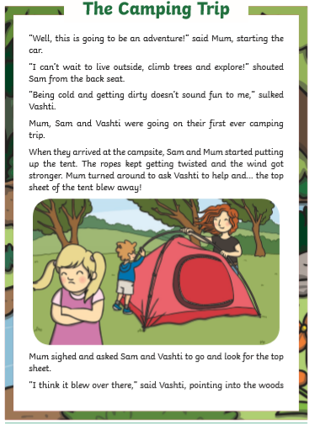
Guided Reading
Page 1
Read the text below before answering the questions on the following slides.

Slide 46
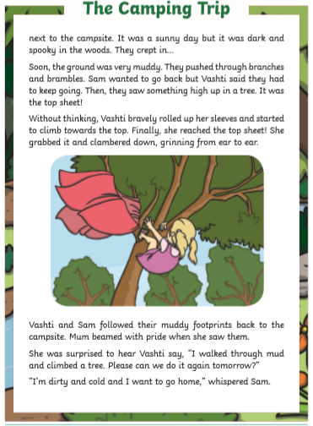
Guided Reading
Page 2
Read the text below before answering the questions on the following slides.

Slide 47
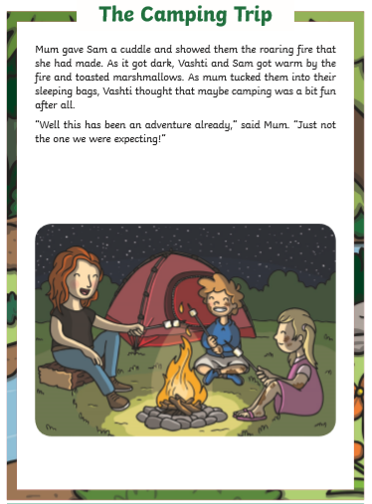
Guided Reading
Page 3
Read the text below before answering the questions on the following slides.

Slide 48
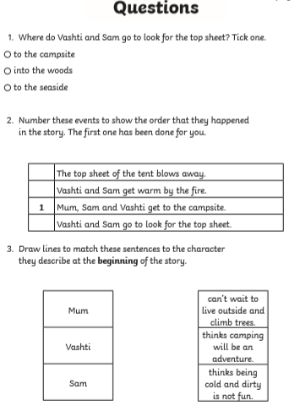
Questions

Slide 49
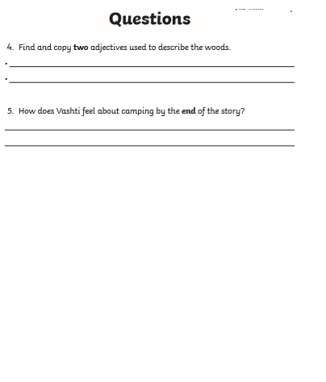
Questions

