Slide 1
Date: 05.01.21
LO To be able to count in 10s.
Subject: Maths

Slide 2
Watch this fun video and count in 10s!
https://www.youtube.com/watch?v=W8CEOlAOGas
Click the link or copy and paste the above into the internet to play the video.

Slide 3
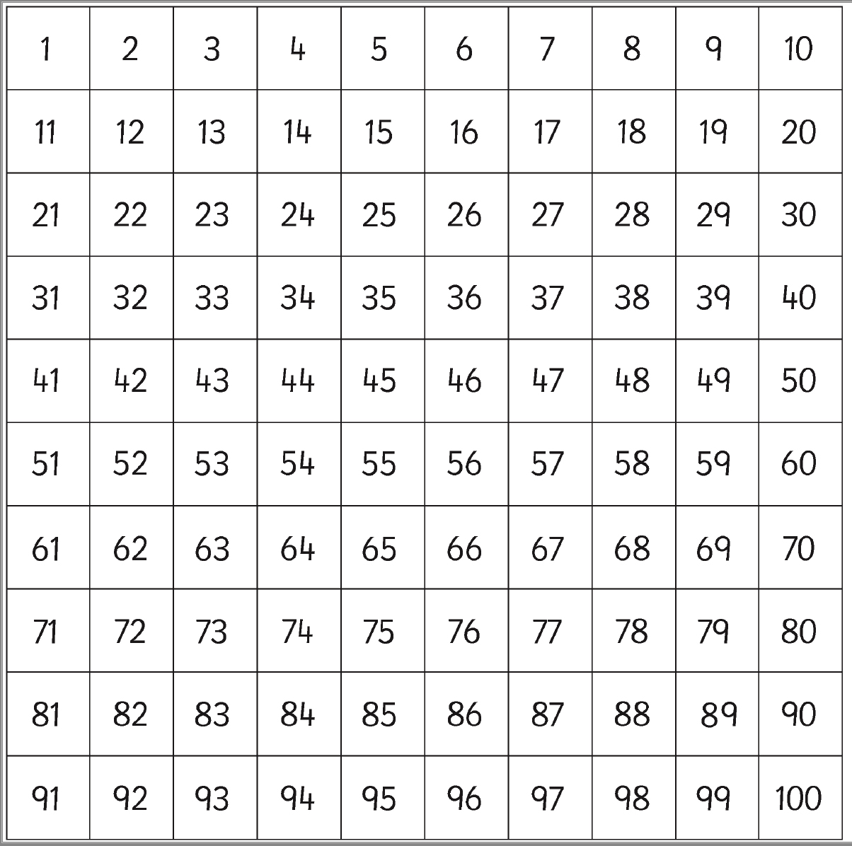
Count in 10s
10, 20, 30, 40, 50, 60, 70, 80, 90, 100
Can you notice the pattern?
Counting in 10s always ends in 0.
Highlight/colour the multiples of 10s

Slide 4
Count in 10s
10, 20, 30, 40, 50, 60, 70, 80, 90, 100
Can you notice the pattern?
Counting in 10s always ends in 0.
Highlight/colour the multiples of 10s

Slide 5
Fill in the missing numbers …
10 ____ 30 ____ 50 ____ 70 ____ 90 ____
0 ____ ____ 30 40 ____ ____ 70 80 90
10 20 ____ ____ 50 ____ ____ 80 ____ 100
20 ____ ____ 50 ____ 70 ____ 90 ____ 110 120
40 ____ ____ 70 ____ ____ 100 ____ ____

Slide 6
Answers!
20 30 40 50 60 70 80 90 100
0 10 20 30 40 50 60 70 80 90
10 20 30 40 50 60 70 80 90 100
20 30 40 50 60 70 80 90 100 110 120
40 50 60 70 80 90 100 110 120

Slide 7
Count in 10s
Lets count how many fingers there are altogether
10
There are 10 fingers on a pair of hands so we need to count in 10s.
20
There are 40 fingers altogether!
30
40

Slide 8
Count in 10s
Your turn! Count how many fingers there are altogether.
There are 10 fingers on a pair of hands so we need to count in 10s.
Answer:
There are 50 fingers!
Move the box to find the answer

Slide 9
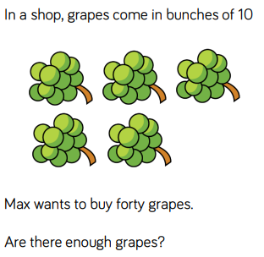
Challenge!

Slide 10
Date: 06.01.21
LO To be able to recall number bonds to 10.
Subject: Maths

Slide 11
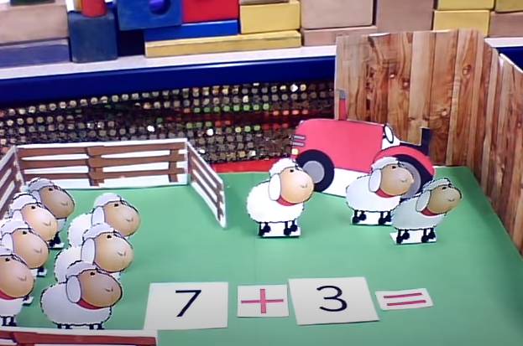
Watch this video of Farmer Pete’s sheep. Can you notice the 2 numbers which add together to make 10?
https://www.youtube.com/watch?v=poJmS5iWfEs
Click the link or copy and paste the above into the internet to play the video.

Slide 12
Number Bond Rainbow
2 numbers which add together to make 10!
Use the rainbow to help you
Which number goes with 6 to make 10? ______
Which number goes with 1 to make 10? ______

Slide 13
Missing Number Bonds…
How many more counters do you need to make 10?
= 10
6
+
?

Slide 14
Answer
How many more counters do you need to make 10?
= 10
6
+
4

Slide 15
Missing Number Bonds…
How many more counters do you need to make 10?
= 10
8
+
?

Slide 16
Answer
How many more counters do you need to make 10?
= 10
8
+
2

Slide 17
Number Bond Matching
Drag the numbers or draw a line to match the two numbers that make 10.
1
5
5
4
3
9
6
7
8
2

Slide 18
Number Bond Matching
Drag the numbers or draw a line to match the two numbers that make 100.
7
8
4
6
9
3
2
1

Slide 19
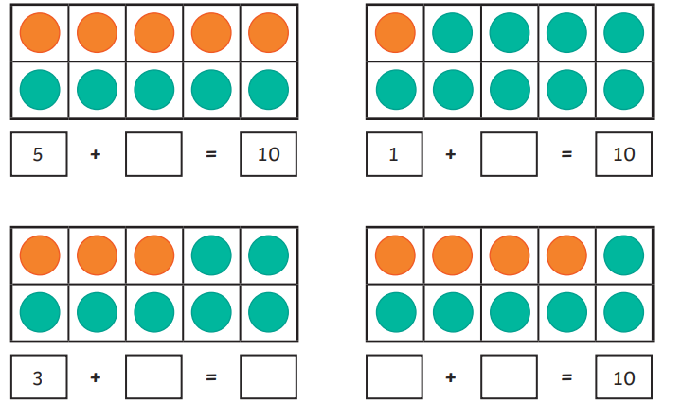
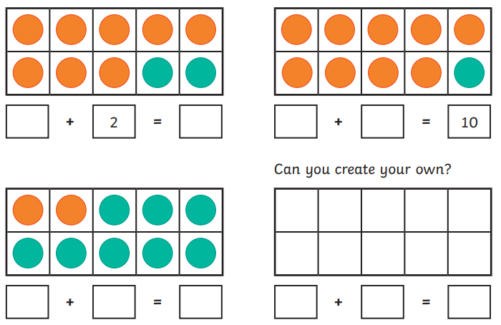
Number Bonds to 100

Slide 20
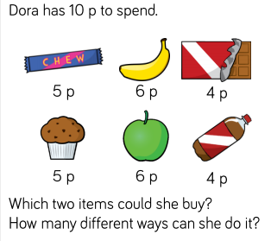
Challenge!

Slide 21
Date: 07.01.21
LO To be able to add two 1 digit numbers together.
Subject: Maths

Slide 22
Watch this fun video and count to 20!
https://www.youtube.com/watch?v=_MVzXKfr6e8
Click the link or copy and paste the above into the internet to play the video.

Slide 23
Adding 1-digit numbers …
4 + 2 =
6
Use the cubes to help you or count on your fingers.

Slide 24
Add 1-digit numbers …
7 + 2 =
Use the cubes to help you or count on your fingers.
Answer:
9
Move the box to show the answer.

Slide 25
Add 1-digit numbers …
1 + 6 =
Use the cubes to help you or count on your fingers.
Answer:
7
Move the box to show the answer.

Slide 26
Try it yourself …
Draw cubes to help you or count on your fingers.
1. 2 + 4 =
2. 5 + 1 =
3. 4 + 3 =
4. 5 + 4 =
5. 2 + 5 =
6. 5 + 3 =
7. 3 + 2 =
8. 6 + 3 =

Slide 27
Answers!
Draw cubes to help you or count on your fingers.
1. 2 + 4 = 6
2. 5 + 1 = 6
3. 4 + 3 = 7
4. 5 + 4 = 9
5. 2 + 5 = 7
6. 5 + 3 = 8
7. 3 + 2 = 5
8. 6 + 3 = 9

Slide 28
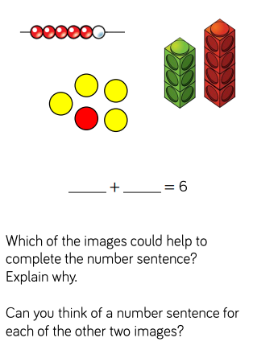
Challenge!

Slide 29
Date: 08.01.21
LO To be able to count with money.
Subject: Maths

Slide 30
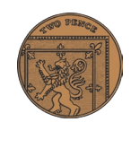
Coins
Lets have a look at the coins we have been learning about!
1p
2p
5p
10p
20p
50p
£1
£2

Slide 31
Match the coins with the value!
Draw a line or drag the coins.
5p
20p
£2
2p
50p
£1
1p
10p

Slide 32
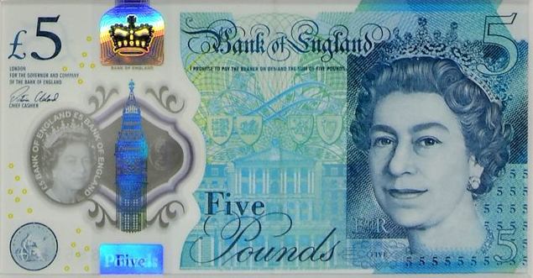
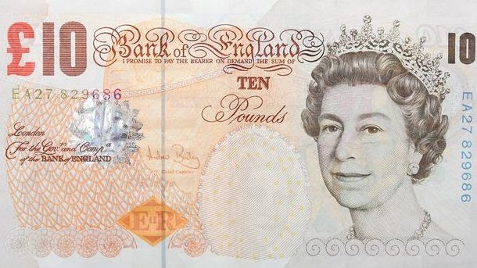
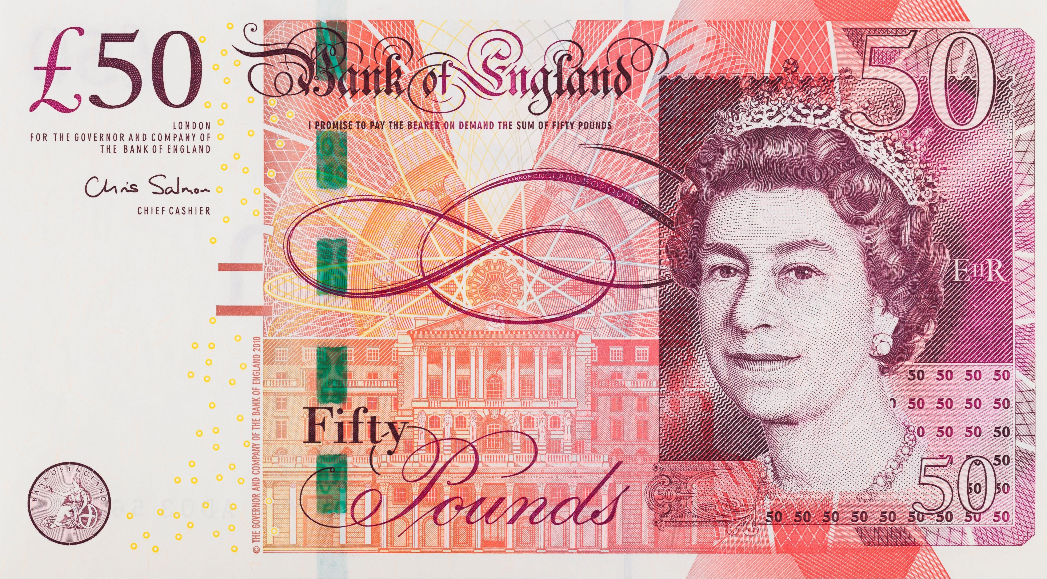
Notes
Lets have a look at the notes we have been learning about!
£5
£10
£20
£50

Slide 33
Match the notes with the value!
Draw a line or drag the notes.
£10
£50
£20
£5

Slide 34
Counting money
=
6p
1p
1p
1p
1p
1p
1p

Slide 35
Counting money
Your turn!
Answer:
=
___p
7p
1p
1p
1p
1p
1p
1p
1p
Drag box to see answer
Answer:
=
___p
1p
1p
1p
1p
1p
1p
1p
1p
1p
9p
Drag box to see answer

Slide 36
Counting money
Your turn!
We are counting in pounds now.
Answer:
=
£___
£8
£1
£1
£1
£1
£1
£1
£1
£1
Drag box to see answer
Answer:
=
£___
£5
£1
£1
£1
£1
£1
Drag box to see answer

Slide 37
Counting money
My turn!
We need to count in 10s now!
=
£30
£10
£10
£10

Slide 38
Counting money
Your turn!
We need to count in 10s now!
=
£___
Answer:
£40
£10
£10
£10
£10
Drag box to see answer
Answer:
=
£___
£10
£10
£20
Drag box to see answer

Slide 39
Challenge!

