Slide 1
Date: Tuesday 5th January
LO To be able to locate the oceans of the world.
Subject: Geography

Slide 2
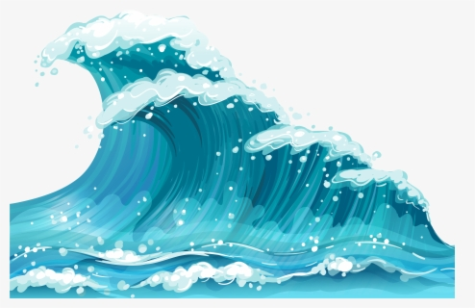
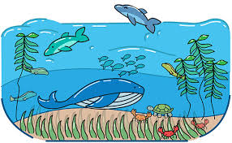
Oceans of the world …
https://www.youtube.com/watch?v=1WZsxVDTqcU
Watch this video to learn more about the oceans
https://www.youtube.com/watch?v=gFIS3aLQPfs
Listen to this song about the oceans and the continents of the world

Slide 3
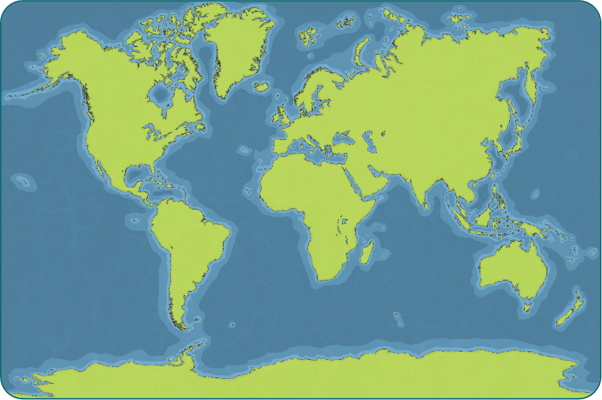
The Earth’s Oceans
Oceans cover two thirds of our Earth.
Did you know…?
Oceans cover 362 million km² of the Earth’s surface – that’s more than twice as much ocean as there is land!

Slide 4
Indian Ocean
Arctic Ocean
Pacific Ocean
Pacific Ocean
Atlantic Ocean
Antarctic Ocean

Slide 5
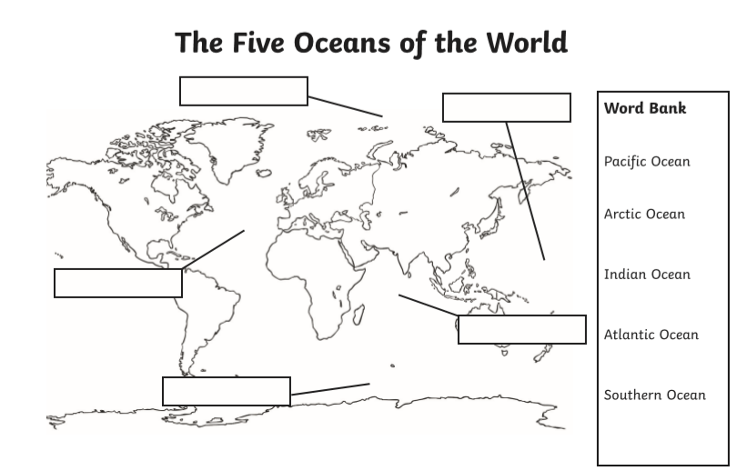
Fill in the labels

Slide 6
Date: Wednesday 6th January
LO To be able to order the lifecycle of a living thing found under the sea.
Subject: Science

Slide 7
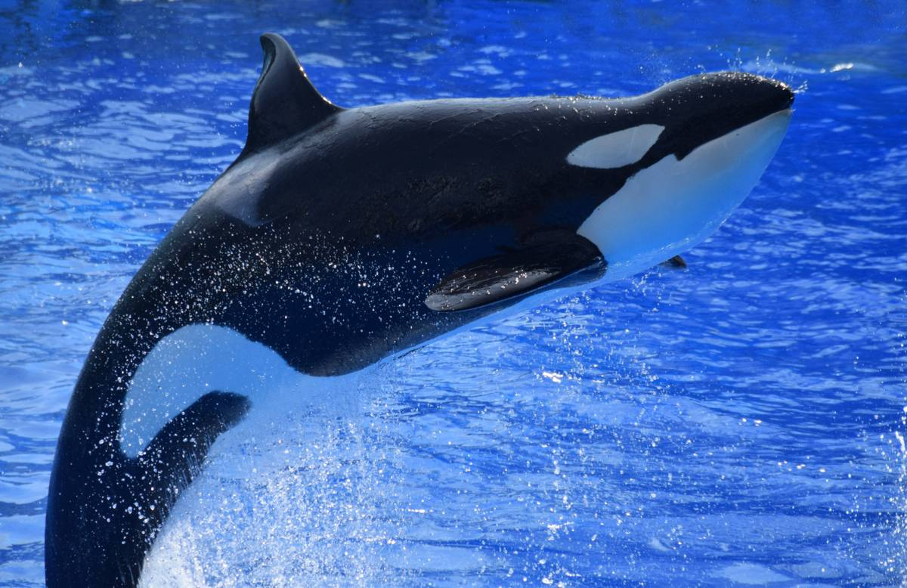
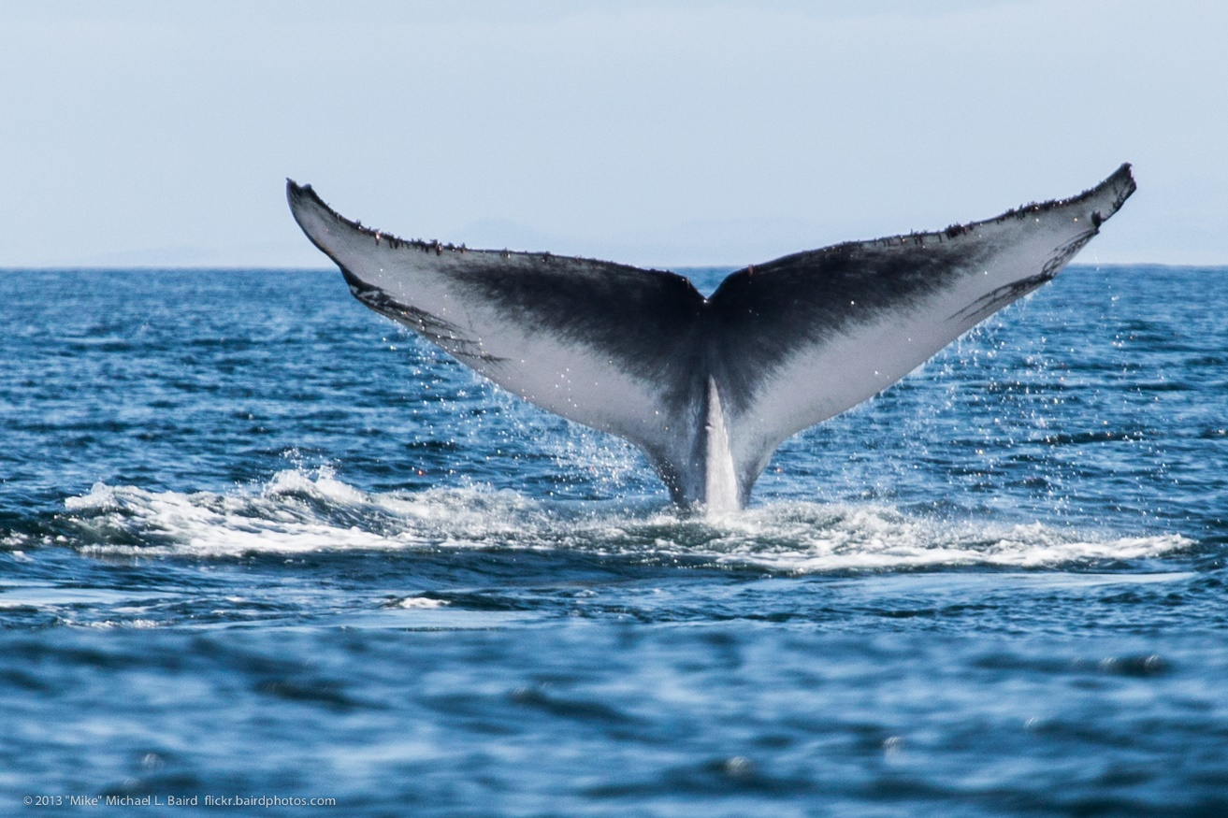
Wonderful Whales
Watch the video to learn more about Blue Whales
https://www.youtube.com/watch?v=bgiPTUy2RqI

Slide 8
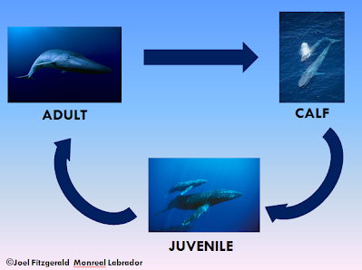
Life cycle of a Blue Whale
Blue Whales are mammals and grow inside of their mother before the female Blue Whale gives birth at around 12 months. When baby Blue Whales are born they are called a ‘Calf’ and feed on their mothers milk. After approximately one year the Calf is weaned off its mothers milk and starts to search for its own food at this stage they are called ‘Juvenile’. They become adults between the age of 6-10 depending on their levels of maturity.

Slide 9
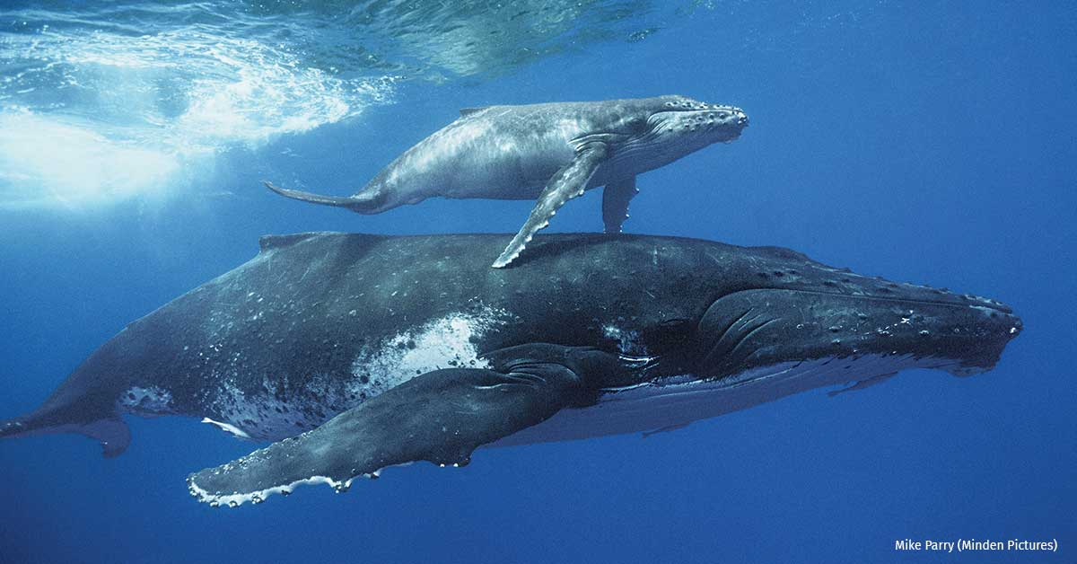
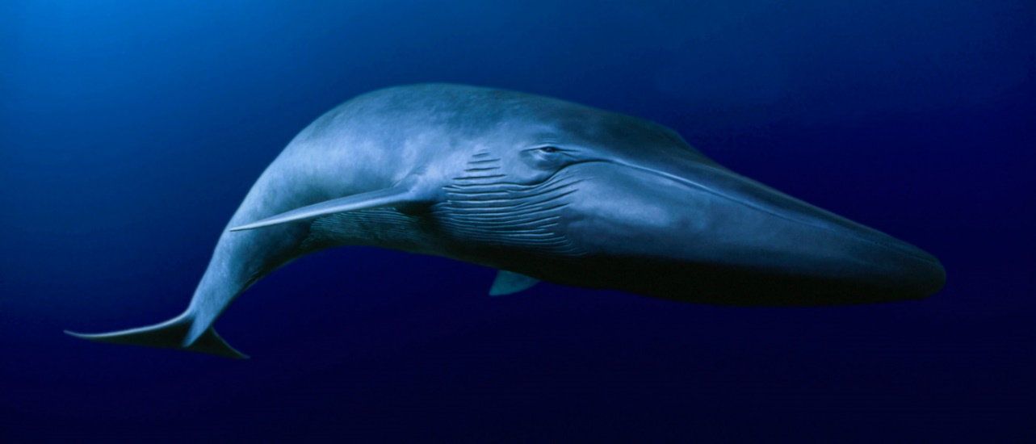
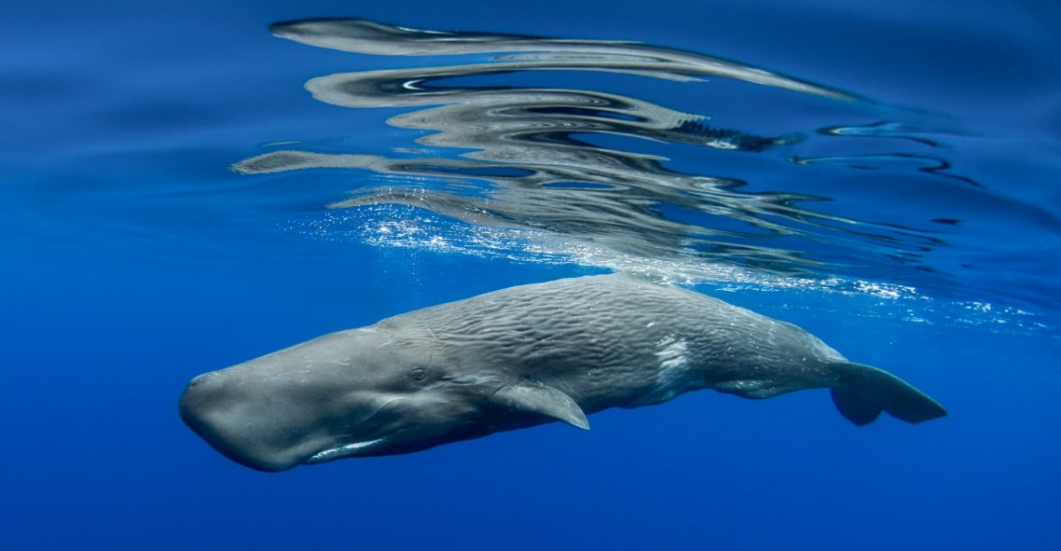
1.
Life Cycle of a Blue Whale
3.
2.

Slide 10
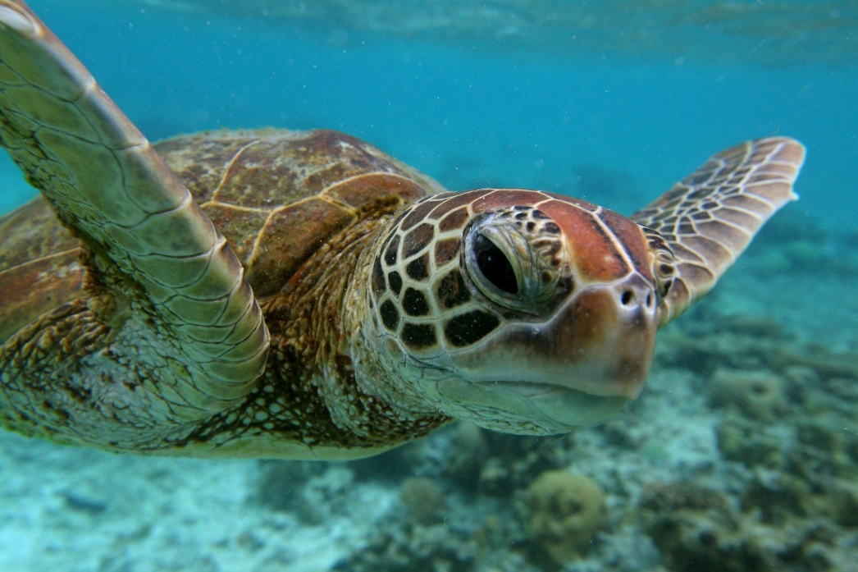
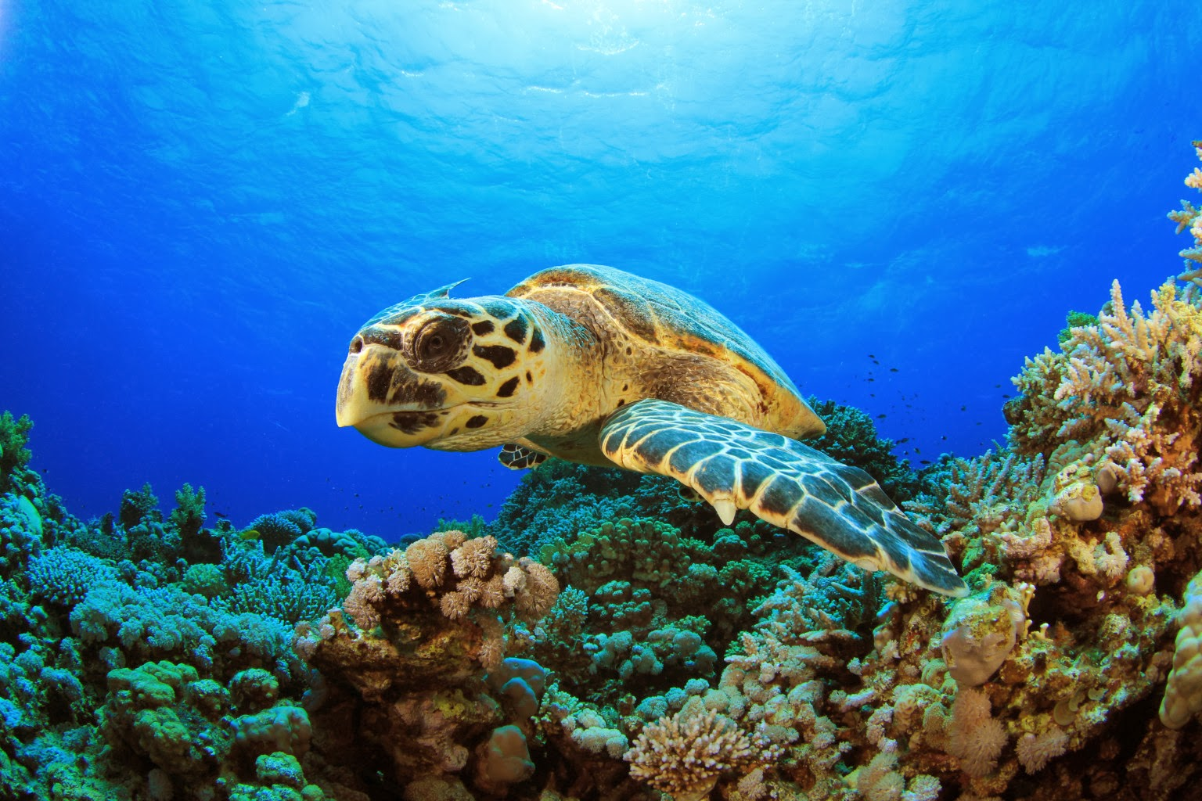
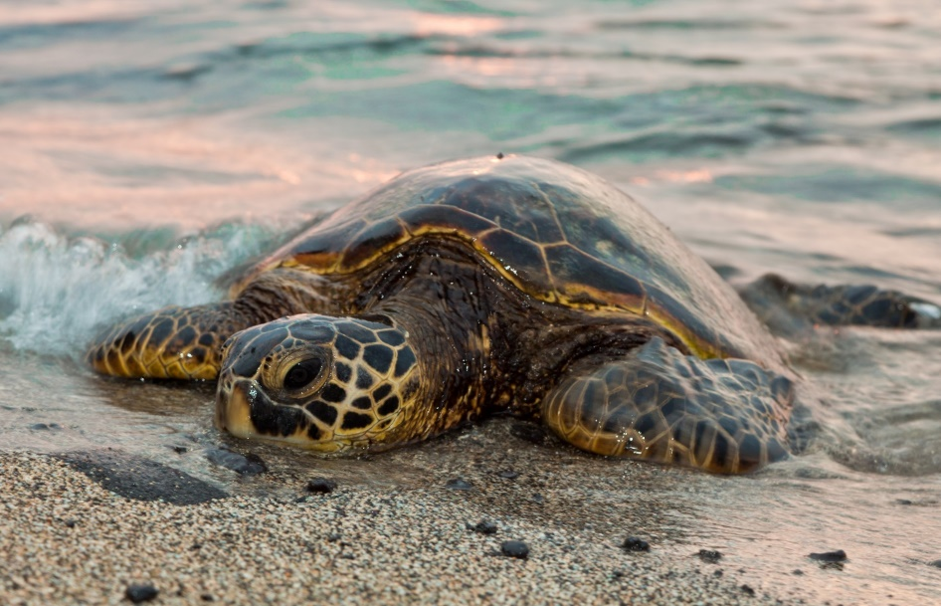
Terrific Turtles
Watch the video to learn more about Sea Turtles
https://www.youtube.com/watch?v=5Rmv3nliwCs

Slide 11
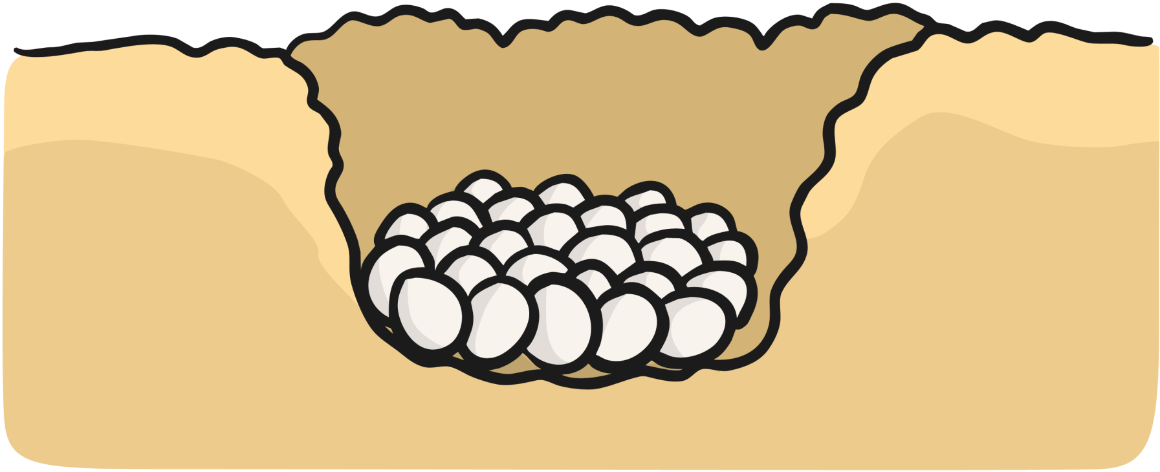
Life cycle of a Sea Turtle …
Baby Sea Turtles are born on the beach. Sea Turtles begin life as an egg which has been laid in a nest on the beach. After 7-12 weeks, when they are ready to hatch they break out of the egg with an egg tooth called a ‘caruncle’. Hatchlings then move slowly across the sand until they reach the water where they will spend the rest of their life. Young turtles are called juveniles. They become adults between the age of 5 – 10.

Slide 12
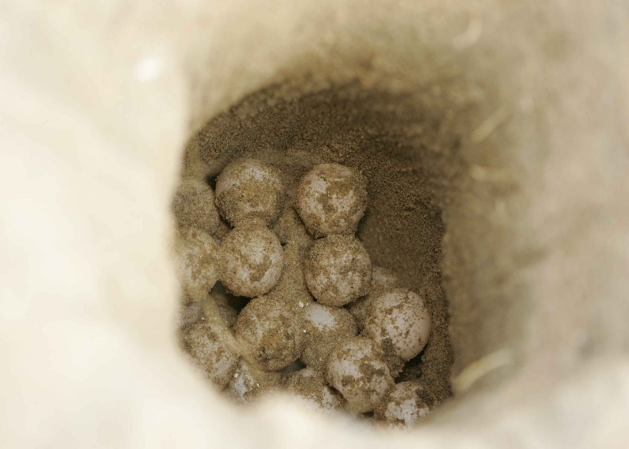
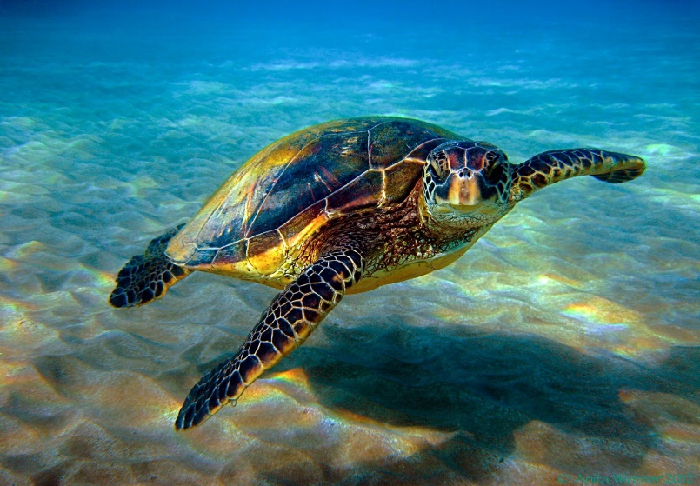
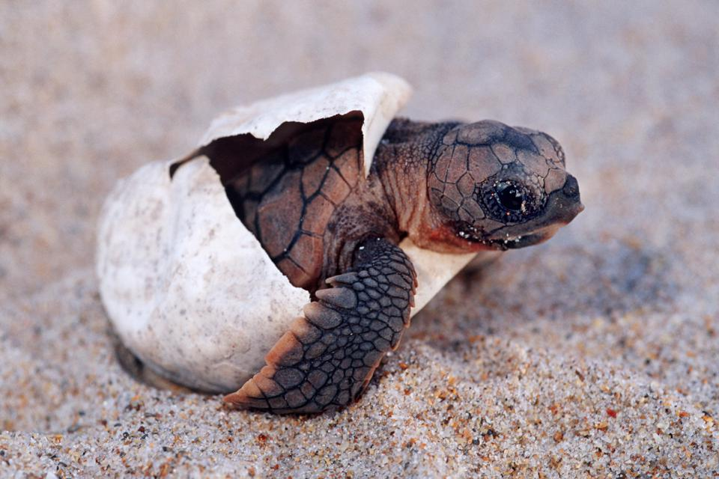
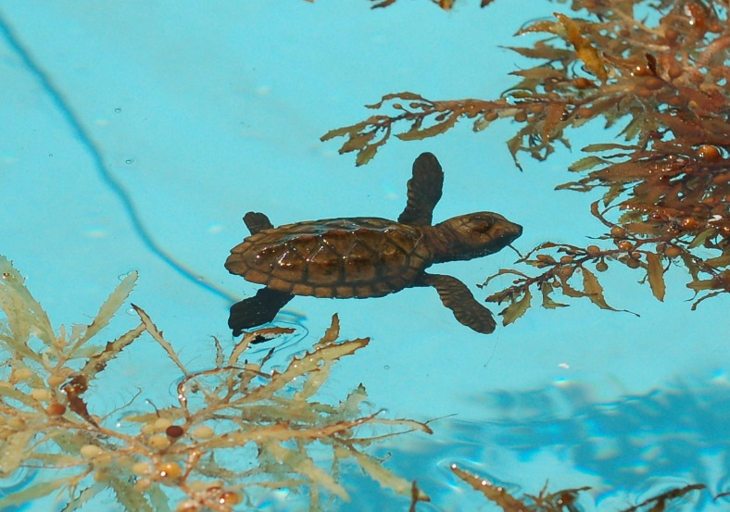
1.
4.
2.
Life Cycle of a Sea Turtle
3.

Slide 13
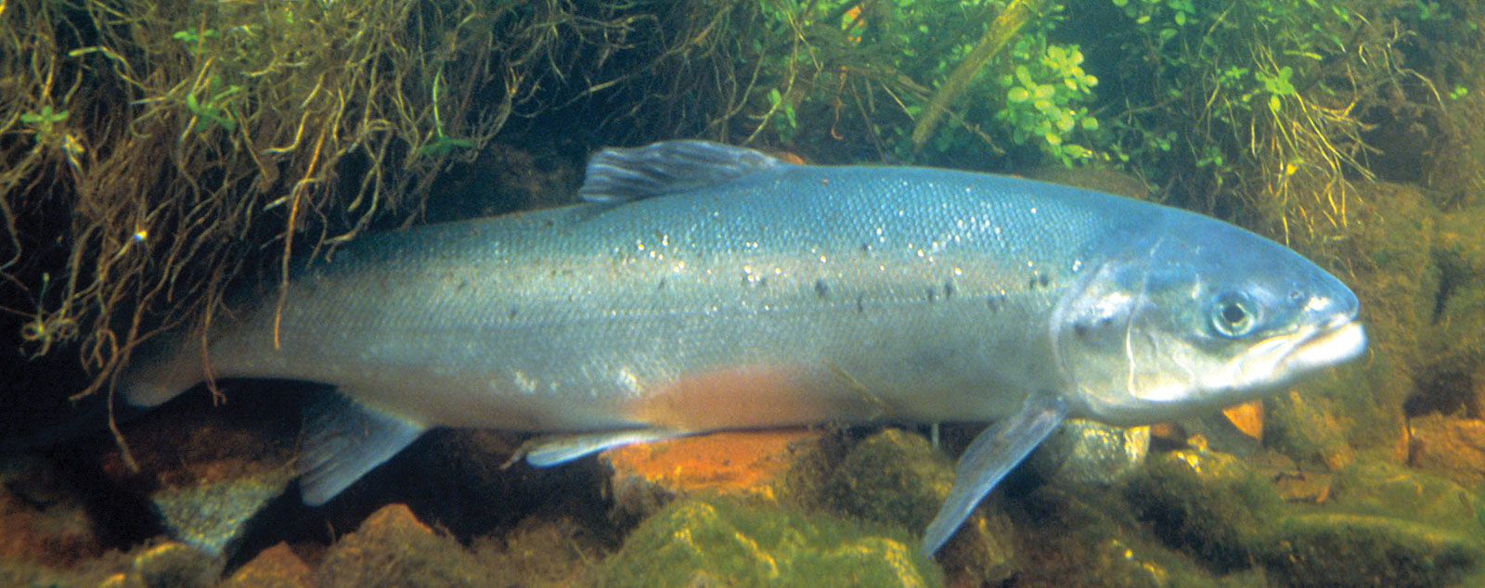
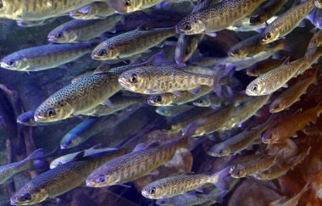
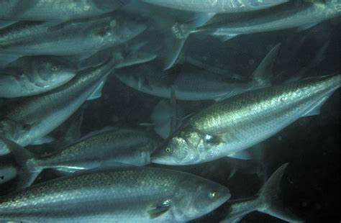
Super Salmon…
Watch the video to learn more about salmon
https://www.youtube.com/watch?v=wtrC7rvetH0

Slide 14
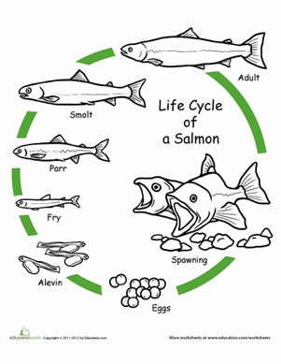
Life cycle of a salmon…
During fall season, salmon eggs are laid in gravel beds at the bottom of streams and lakes. Hatchlings are called Alevins and spend the first 3-4 months of their life in the gravel nest which they were born in. The next stage is that of a Fry, the young Fry come out of the gravel nest and feed on small plants that grow under water. When Fry mature to the Parr stage they measure roughly 6 inches. Parr grow in streams until they are between 1 – 3 years old and then they travel towards the ocean. When they enter the ocean they become Smolt and turn a silvery white colour. Finally the fish becomes an adult and is called a Salmon.

Slide 15
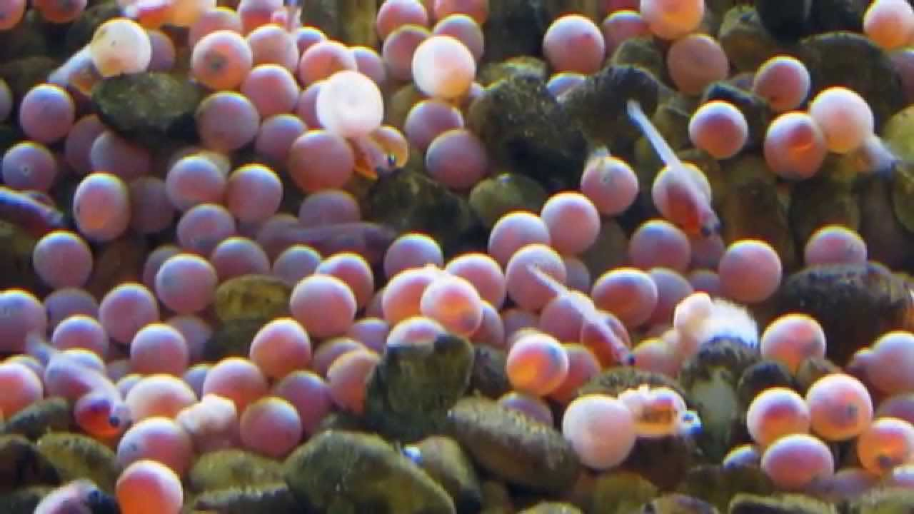
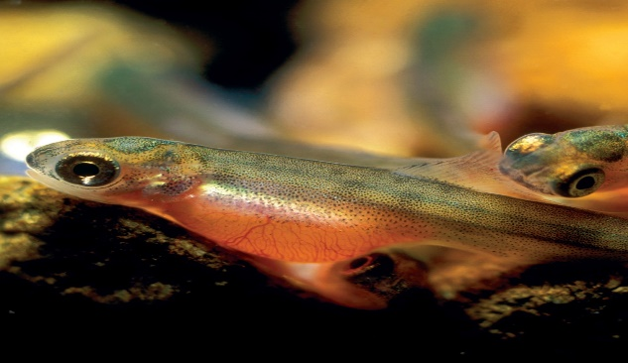
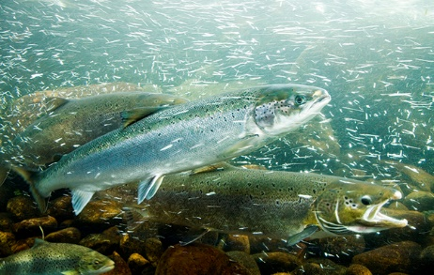
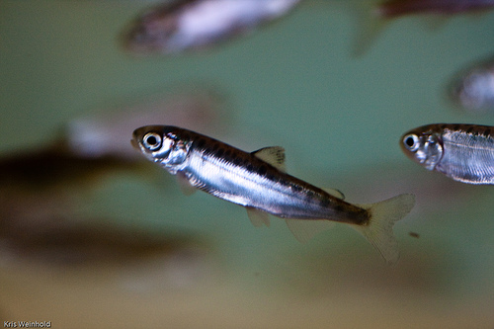
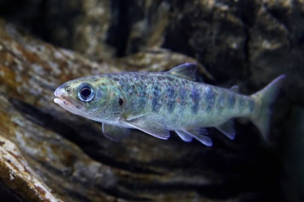
1.
2.
5.
Life Cycle of a salmon
3.
4.

Slide 16
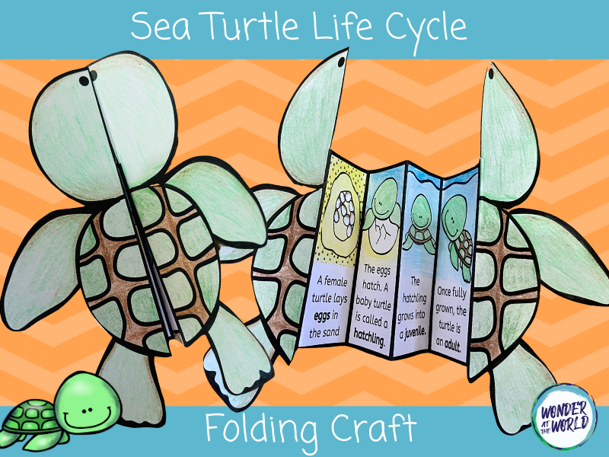
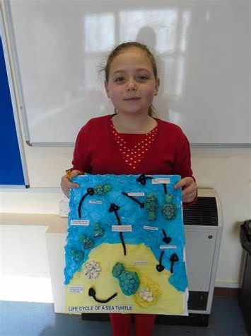
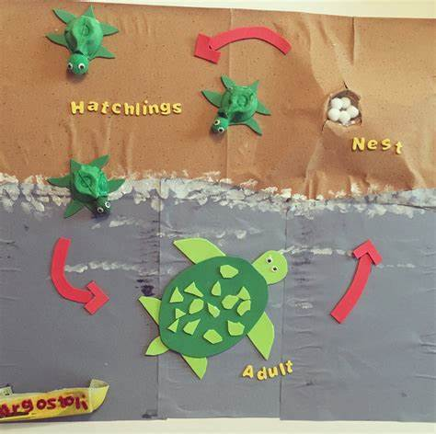
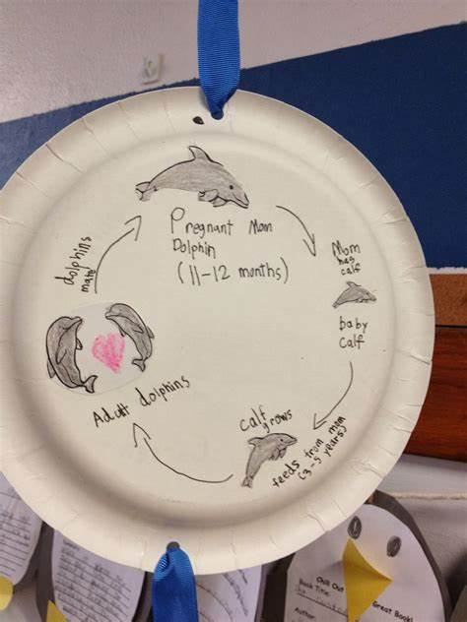
Research your own under the sea creature…
Create your own under the sea life cycle. You can use these examples or pick a different creature. You can be creative with how you present your life cycle including: a paper plate, a 3D poster, a salt dough model or a power point on the computer …
Here are some examples …

Slide 17
Date: Thursday 7th January
LO To be able to order a three part food chain.
Subject: Science

Slide 18
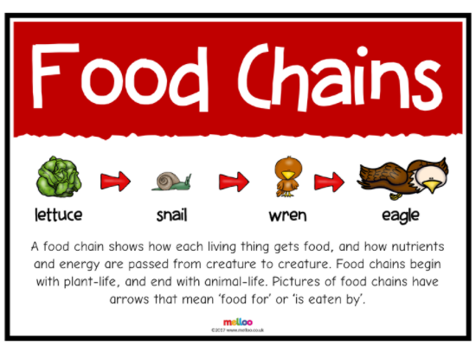
Food chains …
What is a food chain?
A food chain shows how each living thing gets food. All living things need nutrients to survive and they get this in different ways. Food chains begin with plant-life which can create its own food through photosynthesis. Some animals eat plants and some animals eat other animals to survive.
https://www.bbc.co.uk/bitesize/clips/z96r82p
Watch the video to find out more

Slide 19
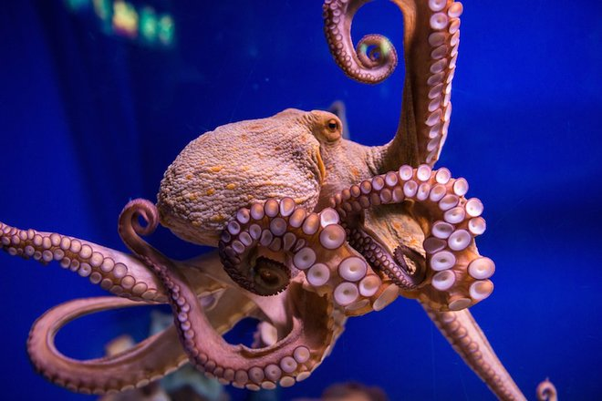
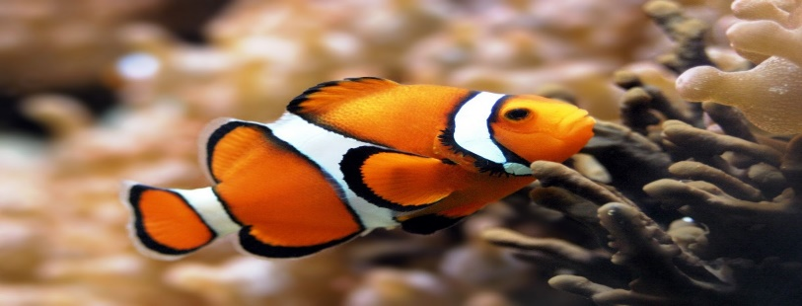
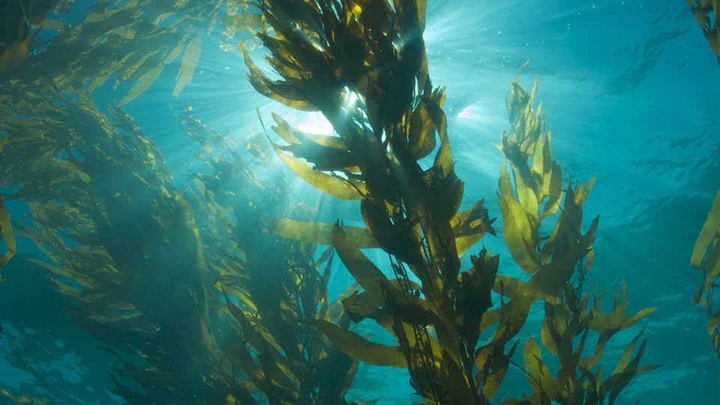
The small animal is eaten by a larger animal
Octopus
The plant is eaten by a small animal
Clown Fish
The food chain begins with a plant
Kelp

Slide 20
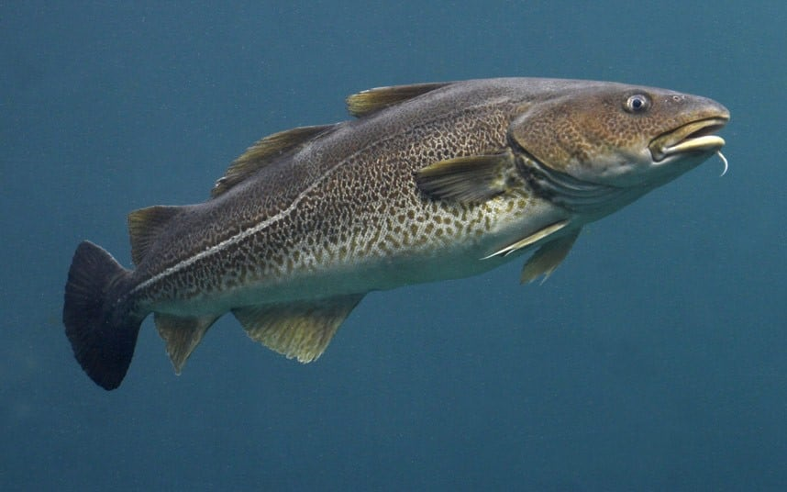
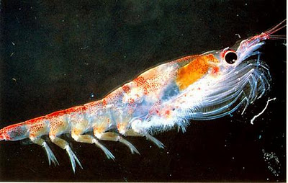
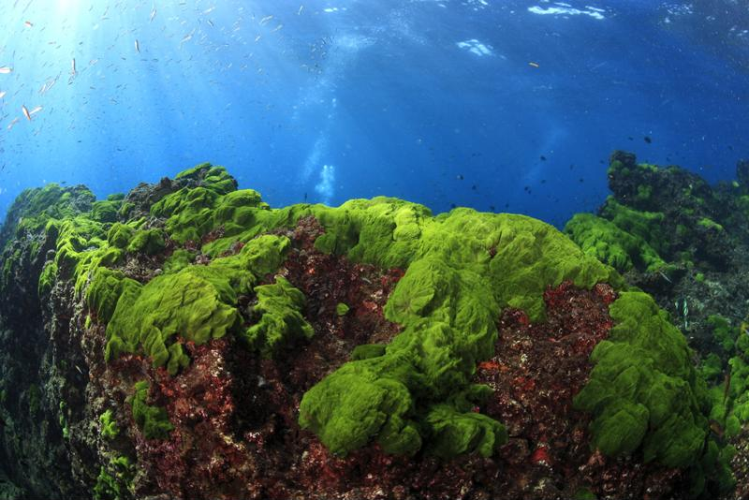
The small animal is eaten by a larger animal
Cod
The plant is eaten by a small animal
Krill
The food chain begins with a plant
Algae

Slide 21
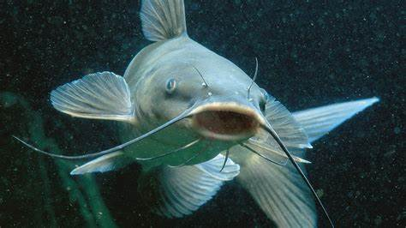
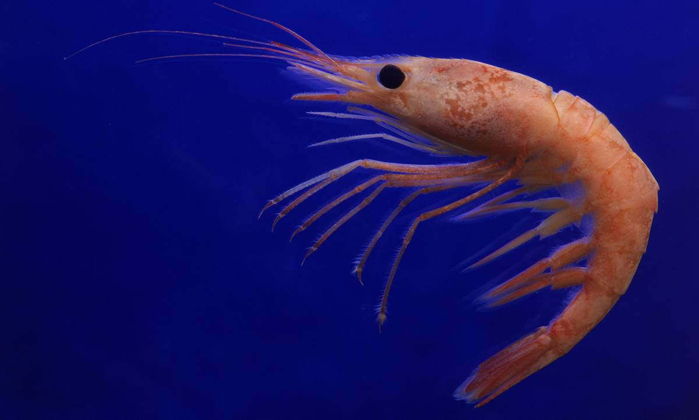
The small animal is eaten by a larger animal
Catfish
The plant is eaten by a small animal
Shrimp
The food chain begins with a plant
Algae

Slide 22
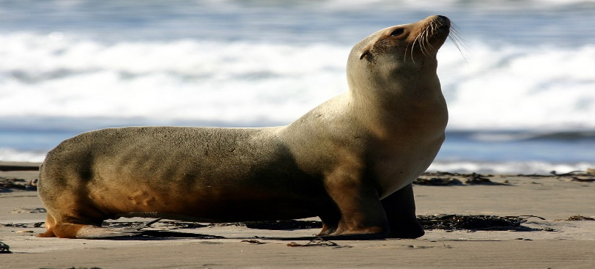
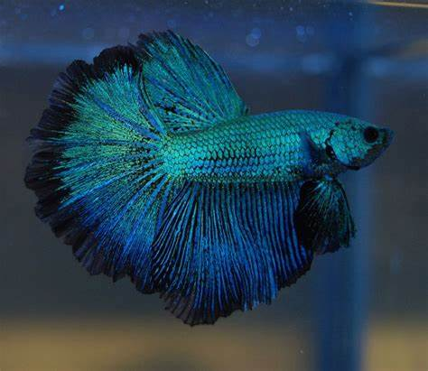
Now its your turn …
Sea Lion
Kelp
Half moon fish
Can you order this food chain? Draw your food chain and label it
Once you have completed your food chain – check if you were correct
by looking at the answers on the next slide.

Slide 23
The small animal is eaten by a larger animal
Answers
Sea Lion
The plant is eaten by a small animal
Half moon fish
The food chain begins with a plant
Kelp

Slide 24
Date: Friday 8th January
LO To be able to sketch an underwater picture
Subject: Art & Design

Slide 25
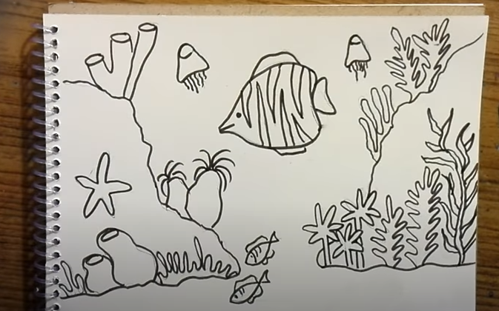
Under the water scene …
https://www.youtube.com/watch?v=NQS2Vf91YkY

Slide 26
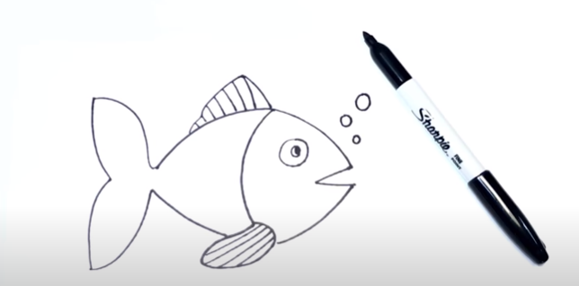
A fish …
https://www.youtube.com/watch?v=QtGeB5tu2xU

Slide 27
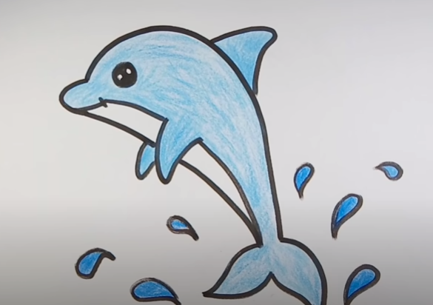
A dolphin …
https://www.youtube.com/watch?v=iK0nGZVsPBc

Slide 28
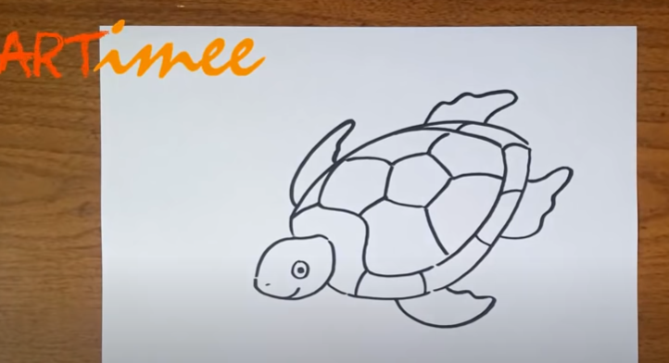
A dolphin …
https://www.youtube.com/watch?v=HFQ-22wUGz4

