Slide 1
Date: Monday 1st March
LO To be able to identify the features of an advert.
Subject: English

Slide 2
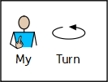
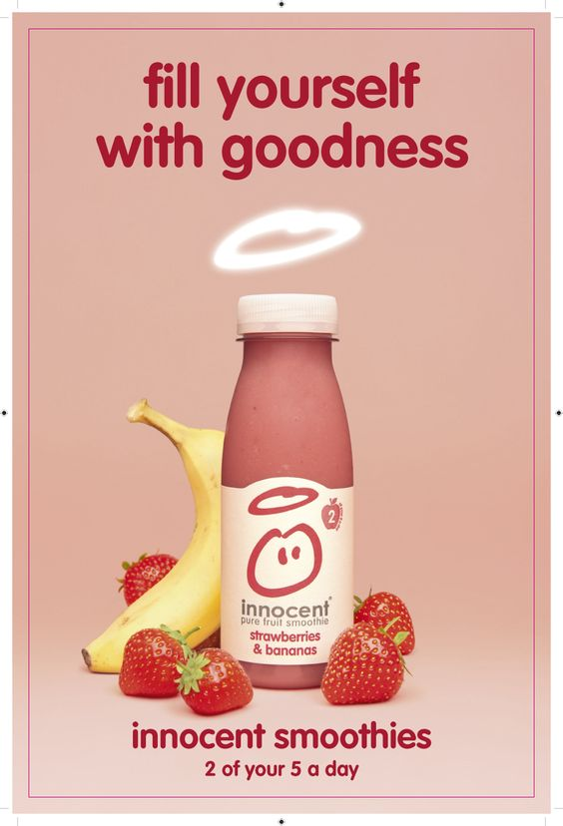
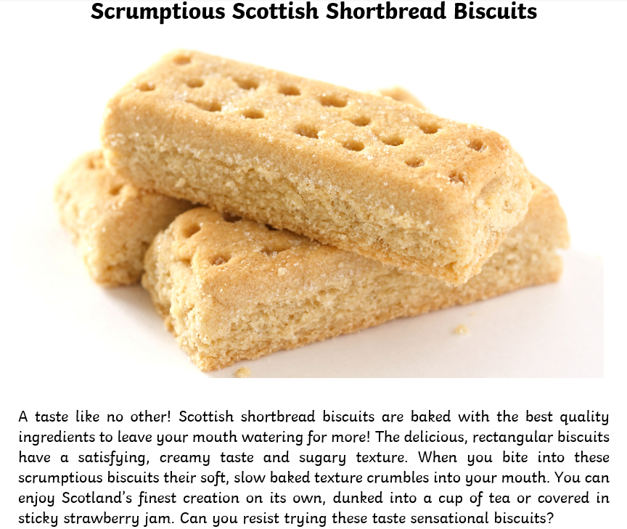
Adverts
This week we are going to look at adverts. Adverts are designed to make people want to buy a product.
Here are some examples:
Health benefits
Descriptions to make the product sound good
Catchy slogans
Eye catching pictures
Rhetorical questions

Slide 3
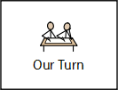
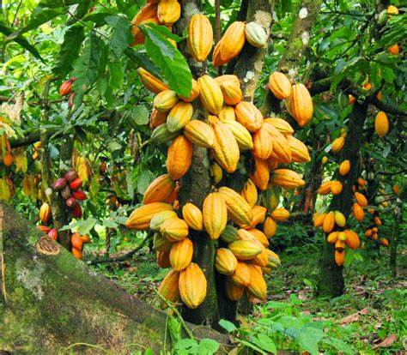
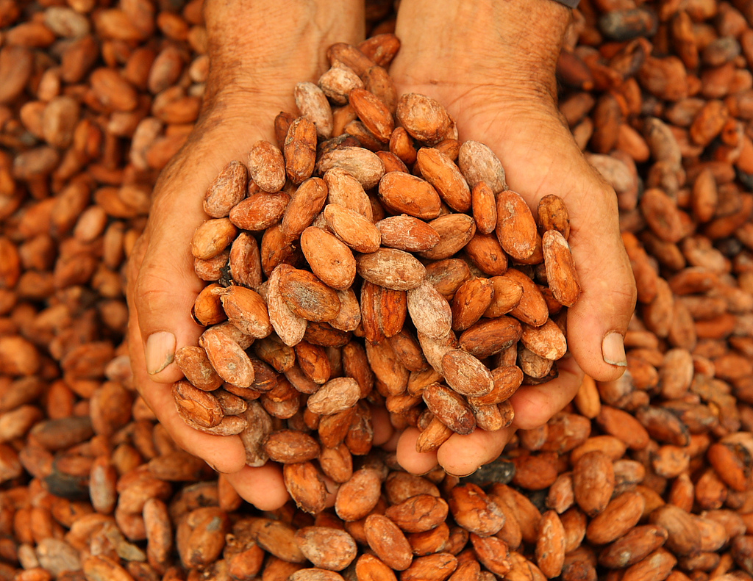
Read my advert!
Delicious delightful dark chocolate
A taste like no other! Gola rainforest chocolate will leave your mouth watering for more! Grown in the depth of the luxurious Amazon Rainforest this chocolate is harvested and crafted with passion and perfection. Gola chocolate is made using the best quality cocoa beans to provide you with a taste sensation in every bite! The delicious chocolate bar has a creamy texture which melts in your mouth. You can enjoy this chocolate on its own, melted and drizzled over strawberries or baked as part of a chocolate cake.
Can you resit trying this taste sensational chocolate? Why wait buy your Gola Rainforest chocolate bar today!
Not only does Gola Rainforest chocolate taste sensational, every bar you buy helps to save the rainforests. Chocolate that tastes good and does good!

Slide 4
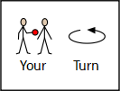
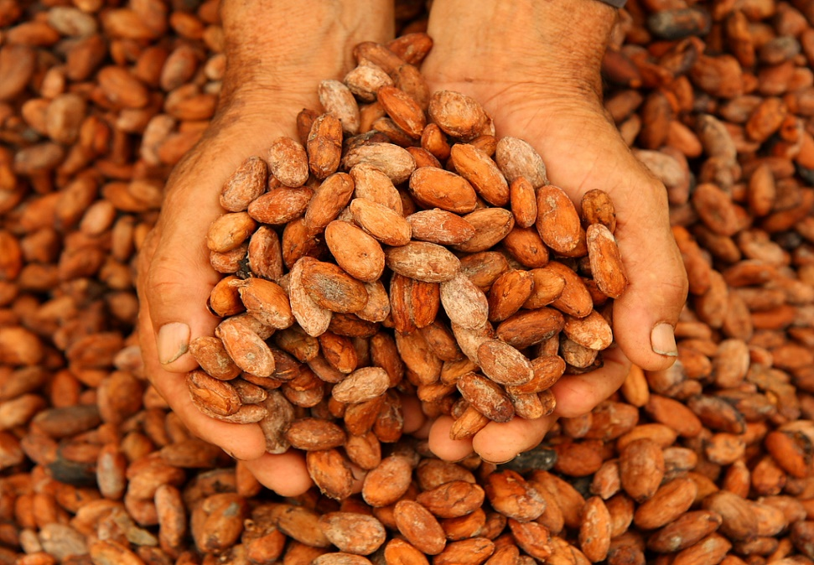
Now find the features
Delicious delightful dark chocolate
A taste like no other! Gola rainforest chocolate will leave your mouth watering for more! Grown in the depth of the luxurious Amazon Rainforest this chocolate is harvested and crafted with passion and perfection. Gola chocolate is made using the best quality cocoa beans to provide you with a taste sensation in every bite! The delicious chocolate bar has a creamy texture which melts in your mouth. You can enjoy this chocolate on its own, melted and drizzled over strawberries or baked as part of a chocolate cake.
Can you resit trying this taste sensational chocolate? Why wait buy your Gola Rainforest chocolate bar today!
Not only does Gola Rainforest chocolate taste sensational, every bar you buy helps to save the rainforests. Chocolate that tastes good and does good!
Use the key to highlight/ underline the key features in the correct colour
Remember adjectives are describing words!
title
picture
adjectives
question
exclamation mark

Slide 5
Well done for all of your hard work today! We cant wait to see your completed work.
Could any completed work / photographic evidence of completed work please be sent to pioneerspupils@gmail.com
Thank you!

Slide 6
Date: Tuesday 2nd March
LO To be able to write sentences using adjectives.
Subject: English

Slide 7
Recap on adjectives
Here are some examples…
bright
green
An adjective is a describing word.
delicious
smooth
tasty
small
yellow
delicious
ripe
creamy
brown

Slide 8
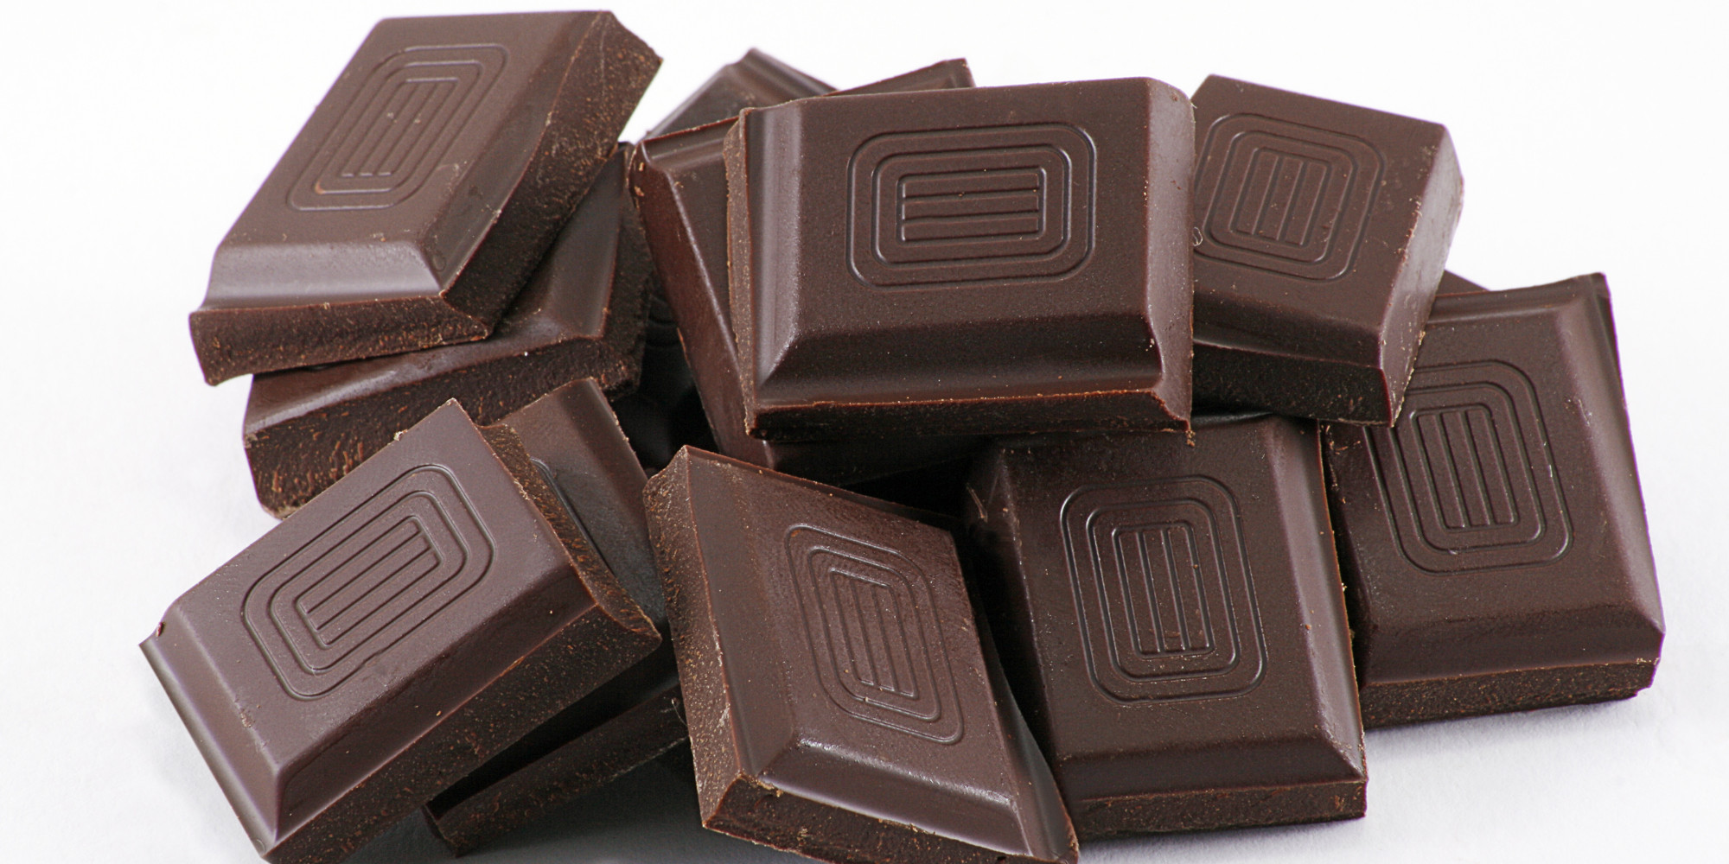
Adjectives are describing words…
creative wrapper
yellow pods
green leaves
tall tree
vibrant packaging
delicious chocolate
solid beans
Can you think of any others to describe the pictures?

Slide 9
Adjectives are describing words…
Complete the noun phrases by
adding 2 adjectives before the noun.
yellow pods
green leaves
_____________ tree
_____________ beans
______________ chocolate
______________ taste
_____________ texture
______________ shape

Slide 10
Example advert
Read my advert …
A taste like no other! Gola rainforest chocolate will leave your mouth watering for more! Grown in the depth of the green Amazon Rainforest this chocolate is harvested and crafted with passion and perfection. Gola chocolate is made using the best quality cocoa beans to provide you with a taste sensation in every bite! The delicious chocolate bar has a creamy texture which melts in your mouth. You can enjoy this chocolate on its own, melted and drizzled over strawberries or baked as part of a scrumptious chocolate cake.
Can you resit trying this taste sensational chocolate? Why wait buy your Gola Rainforest chocolate bar today!
Not only does Gola Rainforest chocolate taste sensational, every bar you buy helps to save the beautiful rainforests. Chocolate that tastes good and does good!

Slide 11
Read through the description again and highlight/underline the adjectives.
What is an adjective?
A describing word!
A taste like no other! Gola rainforest chocolate will leave your mouth watering for more! Grown in the depth of the green Amazon Rainforest this chocolate is harvested and crafted with passion and perfection. Gola chocolate is made using the best quality cocoa beans to provide you with a taste sensation in every bite! The delicious chocolate bar has a creamy texture which melts in your mouth. You can enjoy this chocolate on its own, melted and drizzled over strawberries or baked as part of a scrumptious chocolate cake.
Can you resit trying this taste sensational chocolate? Why wait buy your Gola Rainforest chocolate bar today!
Not only does Gola Rainforest chocolate taste sensational, every bar you buy helps to save the beautiful rainforests. Chocolate that tastes good and does good!

Slide 12
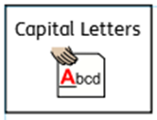
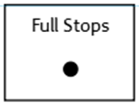
Sentences using adjectives…
Choose 4 of your chosen adjectives and turn them into full sentences.
Don’t forget:
The Amazon rainforest is filled with yellow pods of cocoa.
If you are finding this task a bit tricky, you can have a go at the sentence building activity on the next few slides.
Keep your sentences safe, you will be able to use them in your advert on Thursday!

Slide 13
Sentence building
Read and order the cards to build the sentence. Remember the capital letter goes at the start of the sentence and the full stop goes at the end. Use the symbols to help you work out the word if you are finding it tricky to read.
You can cut and stick the pictures in the correct order or drag them into the correct boxes on your computer.

Slide 14
Sentence building
Read and order the cards to build the sentence. Remember the capital letter goes at the start of the sentence and the full stop goes at the end. Use the symbols to help you work out the word if you are finding it tricky to read.
You can cut and stick the pictures in the correct order or drag them into the correct boxes on your computer.
Once you have ordered the sentence cards, copy the words to write your sentence.
For example:
Chocolate is tasty!

Slide 15
Sentence building
Read and order the cards to build the sentence. Remember the capital letter goes at the start of the sentence and the full stop goes at the end. Use the symbols to help you work out the word if you are finding it tricky to read.
You can cut and stick the pictures in the correct order or drag them into the correct boxes on your computer.

Slide 16
Sentence building
Read and order the cards to build the sentence. Remember the capital letter goes at the start of the sentence and the full stop goes at the end. Use the symbols to help you work out the word if you are finding it tricky to read.
You can cut and stick the pictures in the correct order or drag them into the correct boxes on your computer.

Slide 17
Sentence building
Read and order the cards to build the sentence. Remember the capital letter goes at the start of the sentence and the full stop goes at the end. Use the symbols to help you work out the word if you are finding it tricky to read.
You can cut and stick the pictures in the correct order or drag them into the correct boxes on your computer.

Slide 18
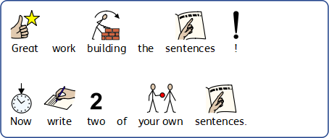
Sentence building
You can write your sentences neatly on a piece of paper or type them on the lines below.

Slide 19
Well done for all of your hard work! We can’t wait to see your completed work.
Could any completed work / photographic evidence of completed work please be sent to pioneerspupils@gmail.com
Thank you!

Slide 20
Date: Wednesday 3rd March
LO To be able to punctuate sentences with an exclamation mark.
Subject: English

Slide 21
Pre-Recorded Teaching
Access the online teaching video below by Miss Noble that will support you to complete the work in this lesson. This video will act as a support but all of the work can still be successfully understood & completed using paper-based versions of this pack. If you need further support to understand / complete work then please contact school via e-mail or telephone.
You can play this video on our school website.

Slide 22
Exclamation Mark
An exclamation mark looks like this !
Can you draw an exclamation mark with your finger?
Now can you write an exclamation mark on your paper?

Slide 23
Exclamation Mark
Exclamation marks can be used for a command or an exclamation.
Command
You must go to the shop now!
Exclamation
The rainforest is in danger!

Slide 24
Command or exclamation
Can you decide if these sentences are a command or an exclamation ?
1. You must save the animals from danger!
2. This chocolate is divine!
3. Stop cutting down the trees!
4. We need to take care of the forest and live together!
5. You must save the rainforest!

Slide 25
Command or exclamation- Answers
Can you decide if these sentences are a command or an exclamation ?
1. You must save the animals from danger! Command
2. This chocolate is divine! Exclamation
3. Stop cutting down the trees! Command
4. We need to take care of the forest and live together! Exclamation
5. You must save the rainforest! Command

Slide 26
Exclamation Mark
Exclamation marks are used at the end of sentences when a strong emotion is being expressed.
shocked
cross
angry
happy
Expressions
scared
excited
sad
surprised

Slide 27
Add the exclamation mark
Can you punctuate the sentences correctly using an exclamation mark – remember an exclamation mark looks like this !
I can’t wait to eat this chocolate, it smells amazing
This chocolate tastes scrumptious
Eat chocolate and save the rainforest
It’s not too late to save the animals
Remember the ! goes at the end of the sentence

Slide 28
Add the exclamation mark - answers
Can you punctuate the sentences correctly using an exclamation mark – remember an exclamation mark looks like this !
I can’t wait to eat this chocolate, it smells amazing !
This chocolate tastes scrumptious !
Eat chocolate and save the rainforest !
It’s not too late to save the animals !

Slide 29
Exclamation mark or question mark?
Read the sentences and decide if they need a exclamation mark or a question mark at the end.
1. Help save our homes
2. What is your favourite chocolate
3. This chocolate is so tasty, you won’t want to stop eating it
4. Did you know chocolate is made from cocoa beans
5. The animals need your help

Slide 30
Exclamation mark or question mark? Answers
1. Help save our homes !
2. What is your favourite chocolate ?
3. This chocolate is so tasty, you won’t want to stop eating it !
4. Did you know chocolate is made from cocoa beans ?
5. The animals need your help !

Slide 31
Now write 6 of your own sentences that end with an exclamation mark. Your sentences could be about chocolate or saving the rainforest.
Write your sentences neatly onto a piece of paper or type them on the lines below.
If you are finding this task a bit tricky, you can have a go at the sentence building activity on the next few slides.
Don’t forget:

Slide 32
Sentence building
Read and order the cards to build the sentence. Remember the capital letter goes at the start of the sentence and the full stop goes at the end. Use the symbols to help you work out the word if you are finding it tricky to read.
You can cut and stick the pictures in the correct order or drag them into the correct boxes on your computer.
Once you have ordered the sentence cards, copy the words to write your sentence.
For example:
Chocolate is tasty!

Slide 33
Sentence building
Read and order the cards to build the sentence. Remember the capital letter goes at the start of the sentence and the full stop goes at the end. Use the symbols to help you work out the word if you are finding it tricky to read.
You can cut and stick the pictures in the correct order or drag them into the correct boxes on your computer.

Slide 34
Sentence building
Read and order the cards to build the sentence. Remember the capital letter goes at the start of the sentence and the full stop goes at the end. Use the symbols to help you work out the word if you are finding it tricky to read.
You can cut and stick the pictures in the correct order or drag them into the correct boxes on your computer.

Slide 35
Sentence building
Read and order the cards to build the sentence. Remember the capital letter goes at the start of the sentence and the full stop goes at the end. Use the symbols to help you work out the word if you are finding it tricky to read.
You can cut and stick the pictures in the correct order or drag them into the correct boxes on your computer.

Slide 36
Sentence building
You can write your sentences neatly on a piece of paper or type them on the lines below.

Slide 37
Well done for all of your hard work today! We cant wait to see your completed work.
Could any completed work / photographic evidence of completed work please be sent to pioneerspupils@gmail.com
Thank you!

Slide 38
Date: Thursday 4th March
LO To be able to write an advert.
Subject: English

Slide 39
Re read my advert to get it back in your head.
Delicious delightful dark chocolate
A taste like no other! Gola rainforest chocolate will leave your mouth watering for more! Grown in the depth of the luxurious Amazon Rainforest this chocolate is harvested and crafted with passion and perfection. Gola chocolate is made using the best quality cocoa beans to provide you with a taste sensation in every bite! The delicious chocolate bar has a creamy texture which melts in your mouth. You can enjoy this chocolate on its own, melted and drizzled over strawberries or baked as part of a chocolate cake.
Can you resit trying this taste sensational chocolate? Why wait buy your Gola Rainforest chocolate bar today!
Not only does Gola Rainforest chocolate taste sensational, every bar you buy helps to save the rainforests. Chocolate that tastes good and does good!

Slide 40
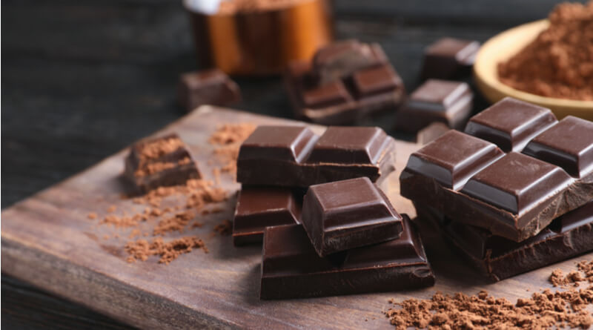
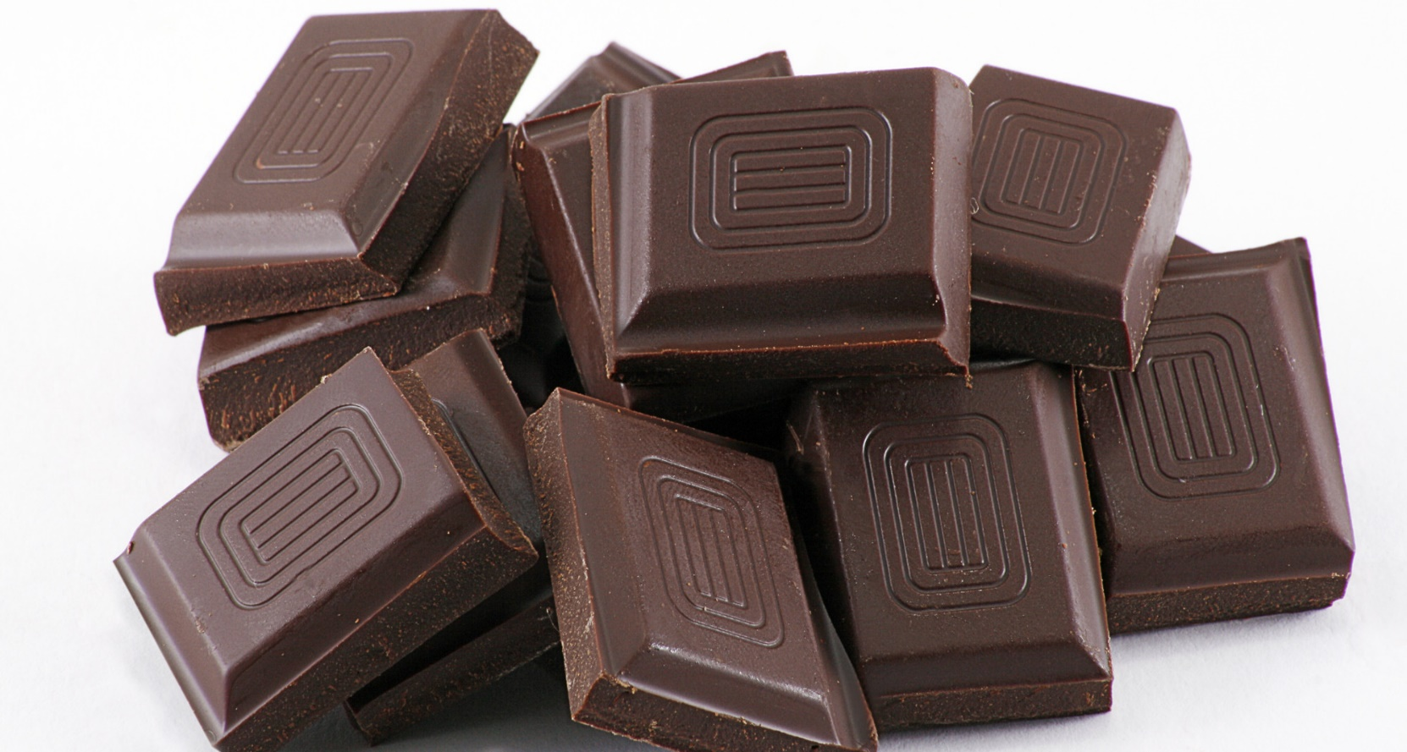
Delicious delightful dark chocolate
Before you write your advert click on the links to watch different chocolate companies try and sell their products using adverts. This will help you get some ideas of what to include in your advert!
How chocolate is saving the rainforest - YouTube
Lindt Lindor - "Do you dream in chocolate?" - YouTube
If you are unable to access the videos online you will find clips of the adverts on the next two slides.

Slide 41
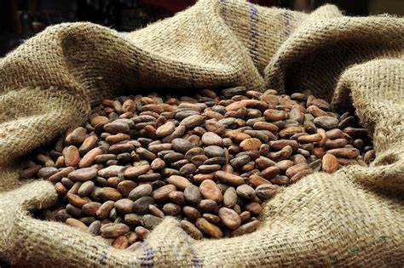
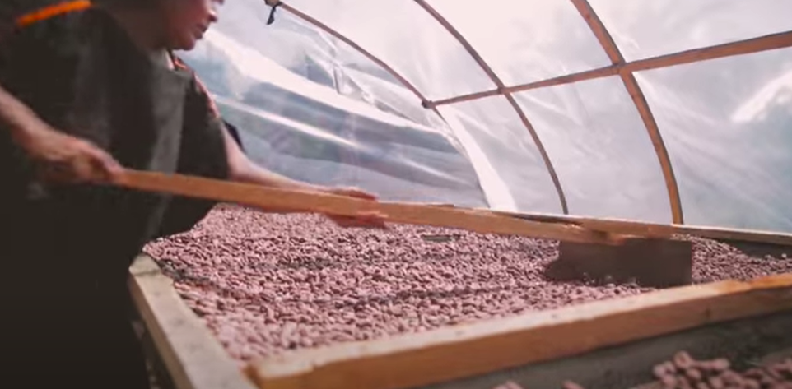
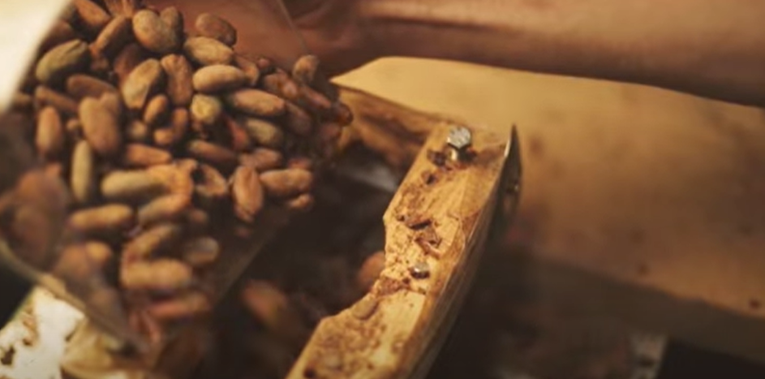
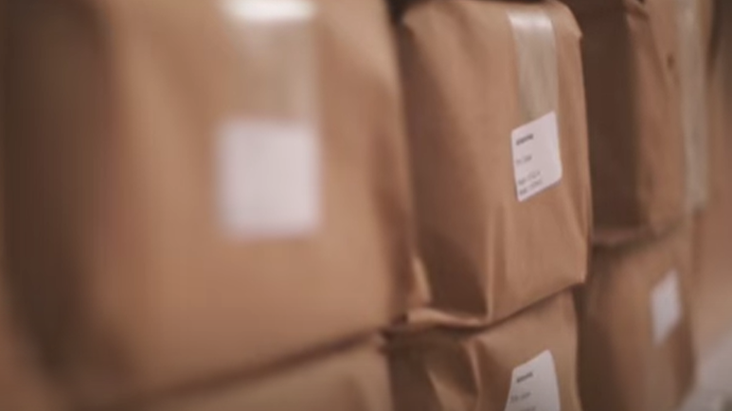
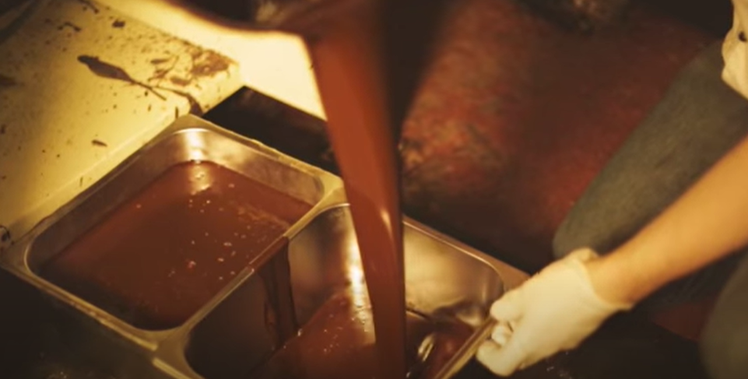
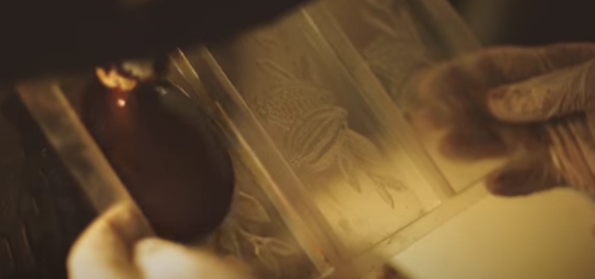
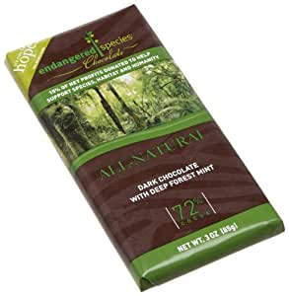
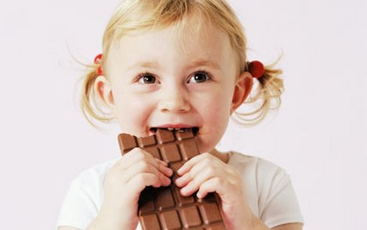
Process of chocolate making (how chocolate is saving the rainforest video)
The beans are grown on trees and are hand picked when they have grown to perfection.
The cocoa beans are then roasted to bring out their sensational natural flavours.
The cocoa beans are then grinded into small pieces.
The beans are then wrapped up and left to ‘age’ for 40 days until they reach the desired delicious taste.
The rich, creamy chocolate is then melted for 16 hours.
The chocolate is then added to a mould to turn it into the desired shape and size.
The packaging is then added to the chocolate and the chocolate is sent to the shops to be sold.
Finally the mouth watering chocolate is ready for us to eat and enjoy.

Slide 42
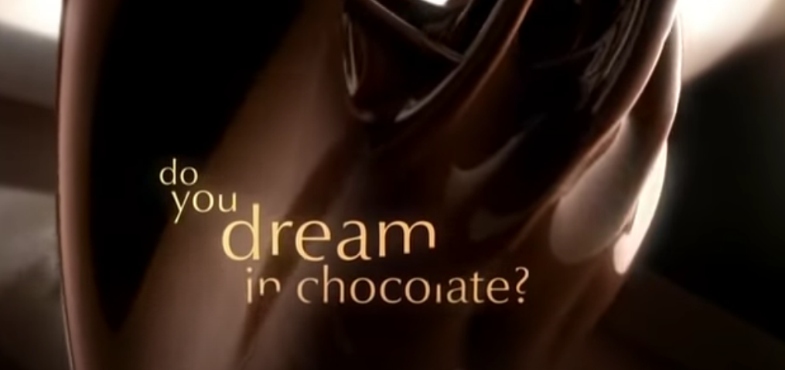
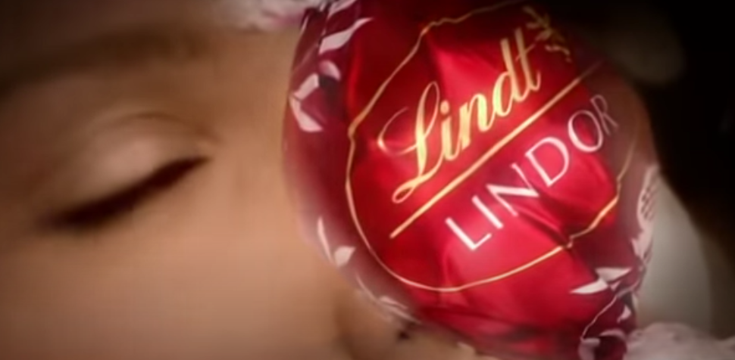
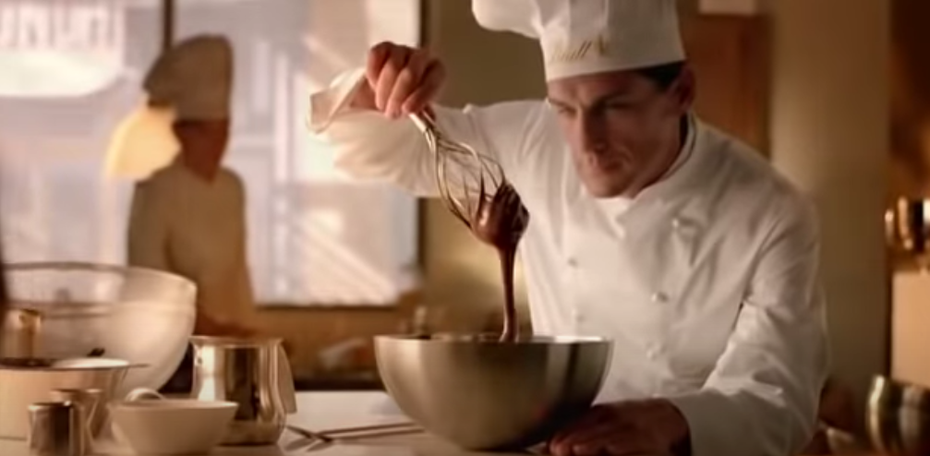
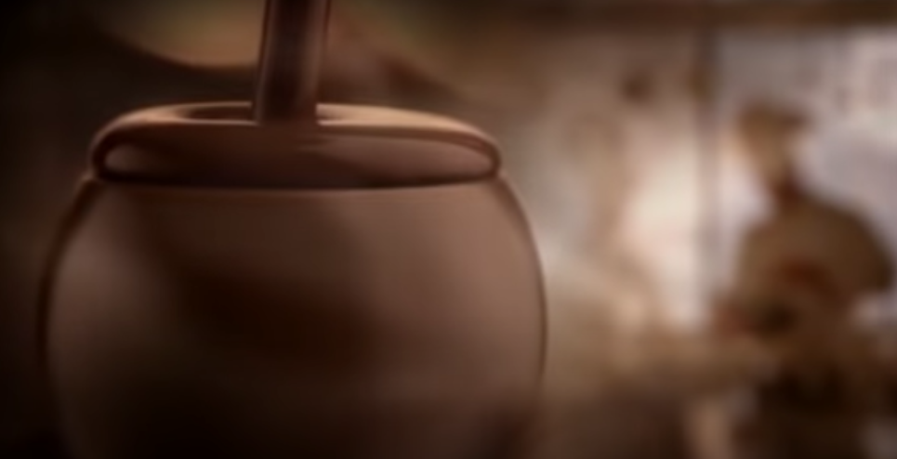
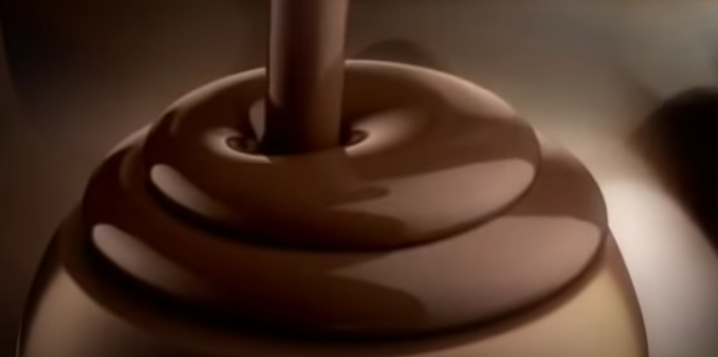
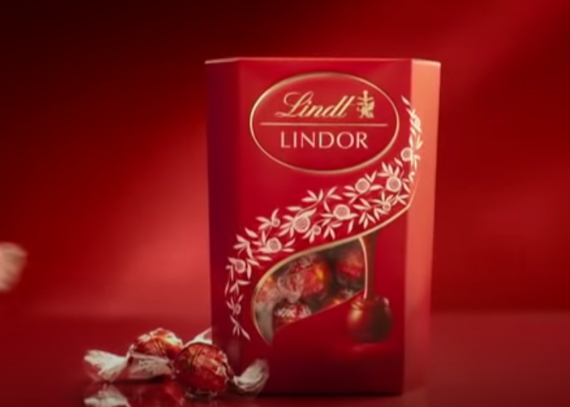
Lindt Lindor – do you dream in chocolate? (Video)
Taste the Lindor truffle.
created with passion only by Lindt’s master chocolatiers
like nothing you’ve ever experienced
when Lindor's irresistible centre starts to melt
so will you
Smooth, flowing luscious chocolate like no other
The Lindor truffle from the Lindt master chocolatier

Slide 43
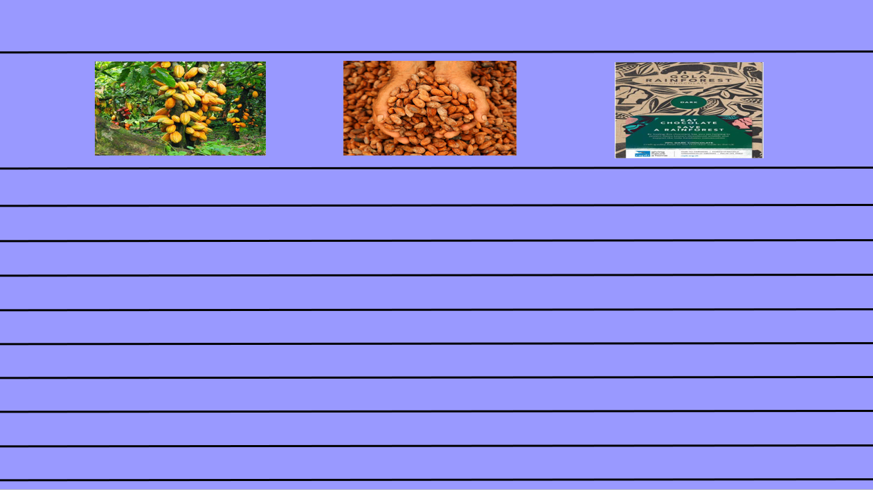
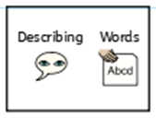
Writing an advert
Today you are going to write an advert for ‘Gola Rainforest Chocolate’.
Your aim is to make people want to buy the chocolate! Describe how delicious the chocolate is and how it helps to save the rainforest!
If you are finding this task a bit tricky, you can have a go at the sentence building activity on the next few slides.
Your advert must include:
At least 6 sentences
Adjectives (at least 4)
Exclamations (at least 2)
Questions (at least 2)
Pictures
You can use the blank template on the next slide to type your advert or you can write your advert on paper.
Title
Pictures
This piece of writing should take approximately 45 minutes
Advert - writing

Slide 45
Sentence building
Read and order the cards to build the sentence. Remember the capital letter goes at the start of the sentence and the full stop goes at the end. Use the symbols to help you work out the word if you are finding it tricky to read.
You can cut and stick the pictures in the correct order or drag them into the correct boxes on your computer.
Once you have ordered the sentence cards, copy the words to write your sentence.
For example:
Chocolate is tasty!

Slide 46
Sentence building
Read and order the cards to build the sentence. Remember the capital letter goes at the start of the sentence and the full stop goes at the end. Use the symbols to help you work out the word if you are finding it tricky to read.
You can cut and stick the pictures in the correct order or drag them into the correct boxes on your computer.

Slide 47
Sentence building
Read and order the cards to build the sentence. Remember the capital letter goes at the start of the sentence and the full stop goes at the end. Use the symbols to help you work out the word if you are finding it tricky to read.
You can cut and stick the pictures in the correct order or drag them into the correct boxes on your computer.

Slide 48
Sentence building
Read and order the cards to build the sentence. Remember the capital letter goes at the start of the sentence and the full stop goes at the end. Use the symbols to help you work out the word if you are finding it tricky to read.
You can cut and stick the pictures in the correct order or drag them into the correct boxes on your computer.

Slide 49
Sentence building
You can write your sentences neatly on a piece of paper or type them on the lines below.

Slide 50
Well done for all of your hard work today! We cant wait to see your completed work.
Could any completed work / photographic evidence of completed work please be sent to pioneerspupils@gmail.com
Thank you!

Slide 51
Date: Friday 5th March
LO To be able to read and spell words with the ‘oi’ sound.
Subject: English

Slide 52
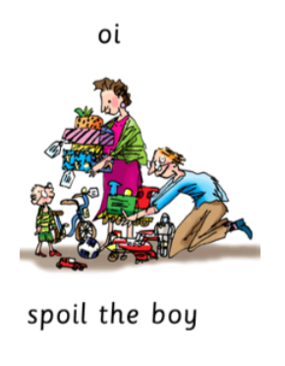
oi
The sound we are focusing on today is oi.
The oi sound is used at the start or in the middle of words.
Click on the links or copy and paste the links into your internet browser to watch the phonics videos.
Read Write Inc. Set 3 oi sound – YouTube
RWI Set 3 Sounds - oi – YouTube
Mr Phonics and the Oi Words - YouTube

Slide 53
Read the ‘oi’ words
oil
coin
foil
join
soil
boil
point
joint
noise
spoil
hoist
moist
Now write the words on a piece of paper and underline the ‘oi’ sound.

Slide 54
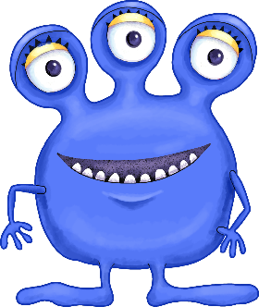
Real or Alien words?
Read the words and decide if they are real words or alien words.
Real words
coin
Alien words
goil
broik
oil
soil
zoim
choif
boil
point
floib
noise
Remember alien words are made up words!

Slide 55
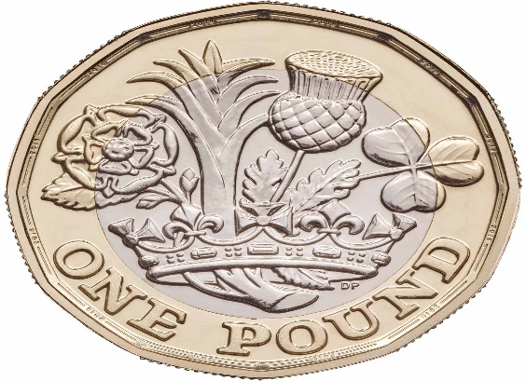
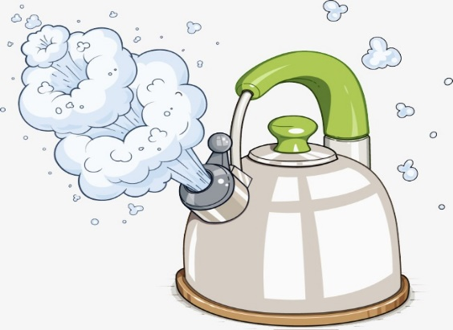
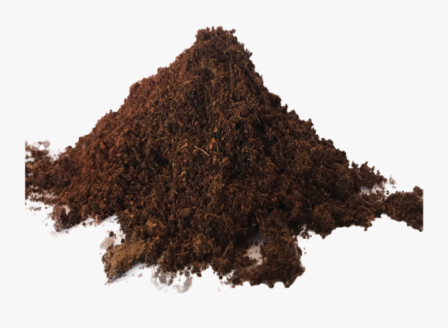
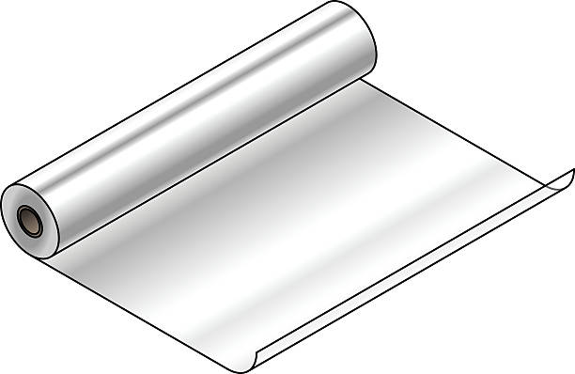
Match the picture to the correct word
foil
boil
coin
soil
oil

Slide 56
Match the picture to the correct word - answers
foil
boil
coin
soil
oil

Slide 57
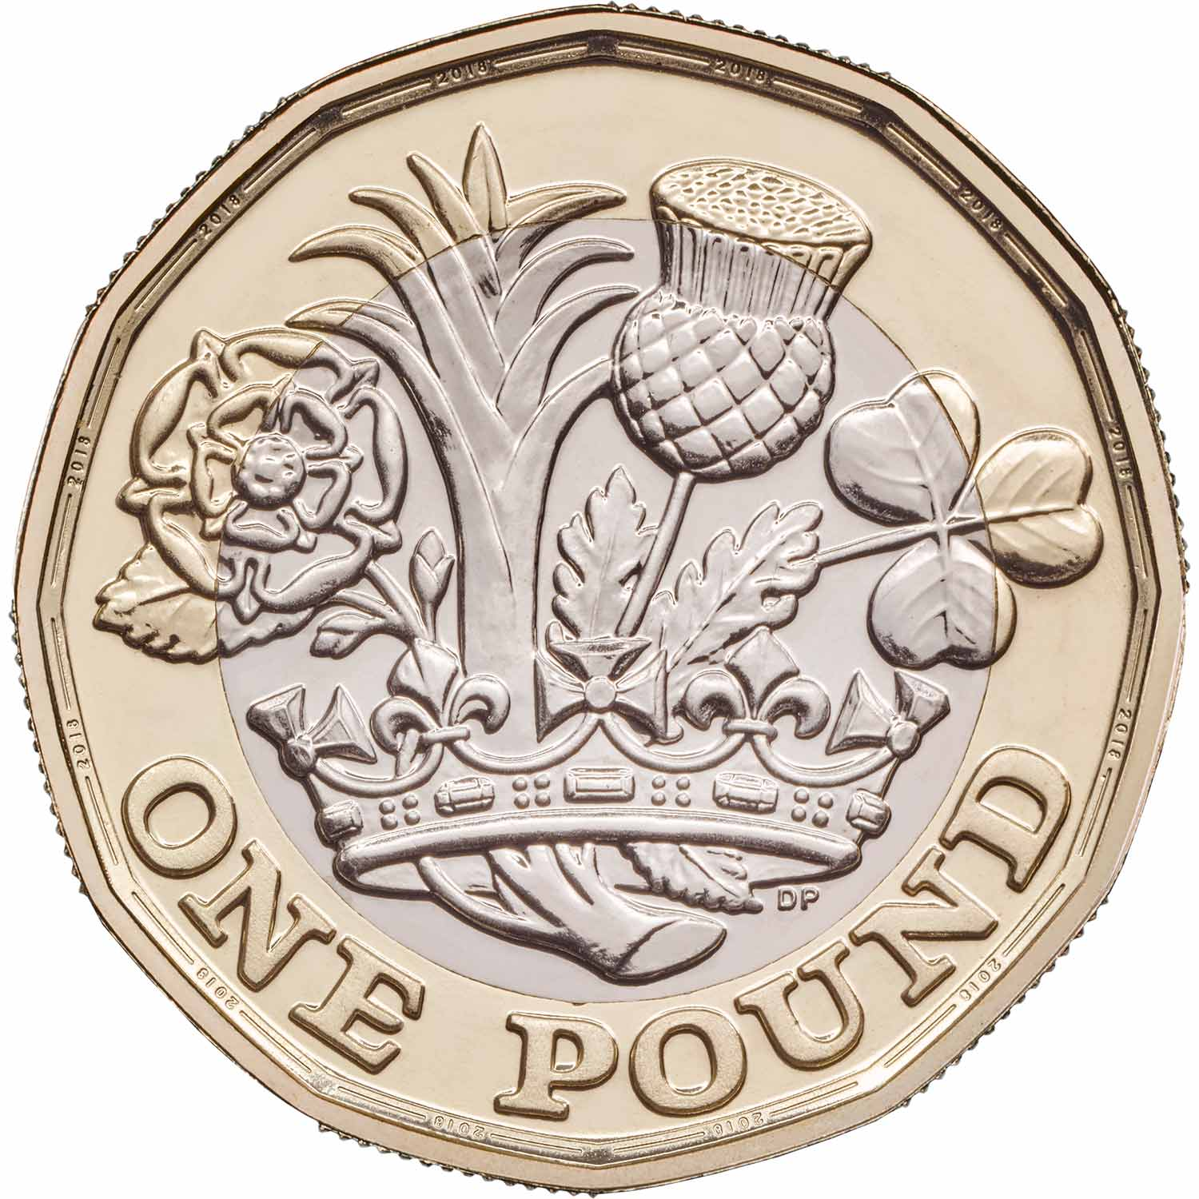
Write the word under the picture

Slide 58
Read the sentences and fill in the missing word
Choose from the 5 words below. Read the sentence and decide which word makes sense.
coin
foil
oil
soil
boil
Seeds need __________ to grow.
I wrapped my cake in some __________.
You have to heat the __________ in the pan.
My dad gave me a shiny __________.
The kettle has to __________ before you make a cup of tea.

Slide 59
word | 1st try | 2nd try | 3rd try
oil
coin
boil
foil
soil
noise
point
spoil
Practice writing the words on a piece of paper or type into the table on your computer.

Slide 60
‘oi’ sound
Now pick 3 ‘oi’ words and write a sentence including each word.
oil
foil
soil
noise
spoil
coin
boil
join
point

Slide 61
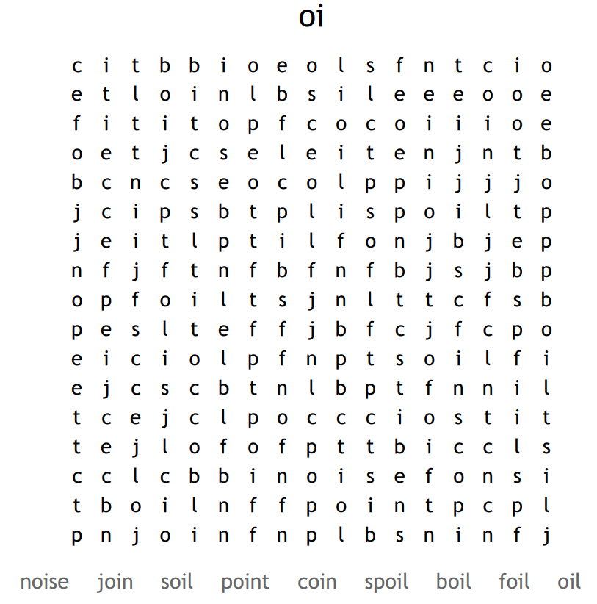
Word search

Slide 62
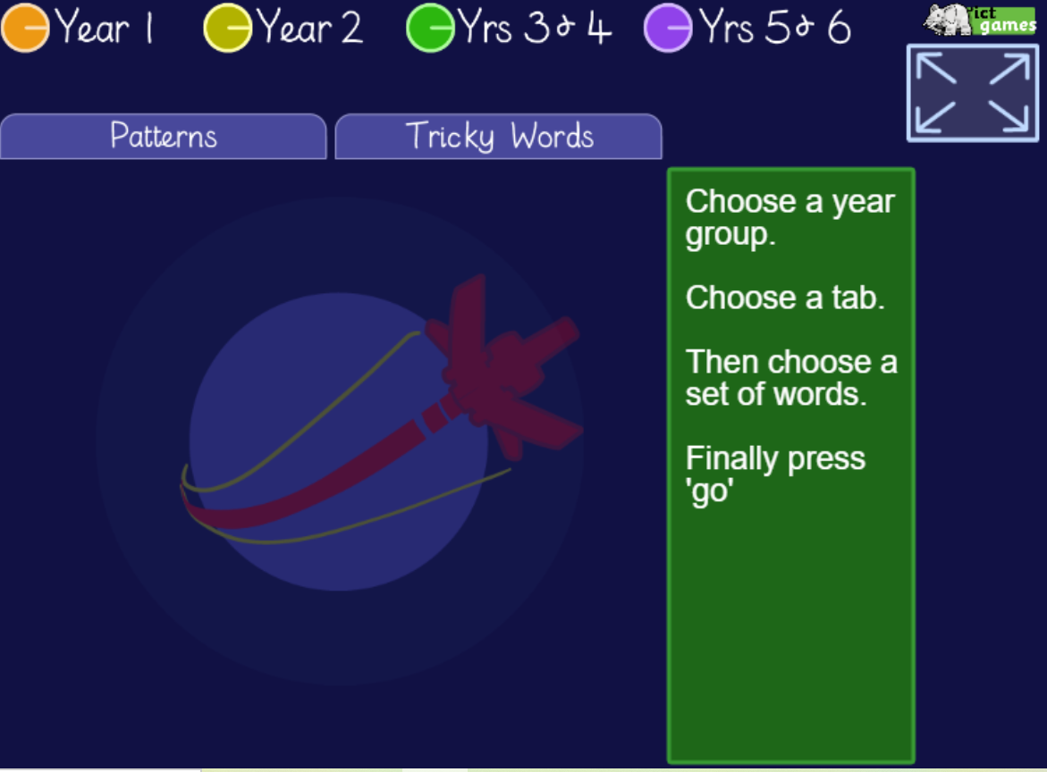
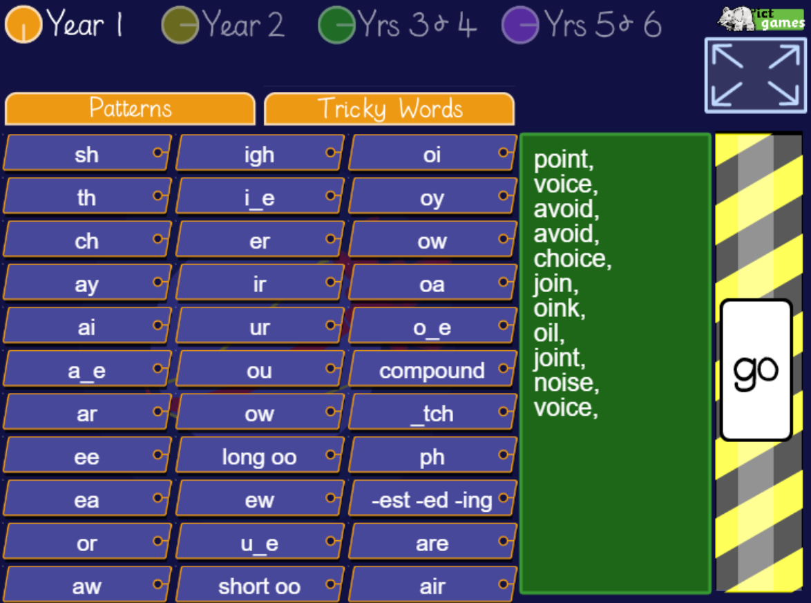
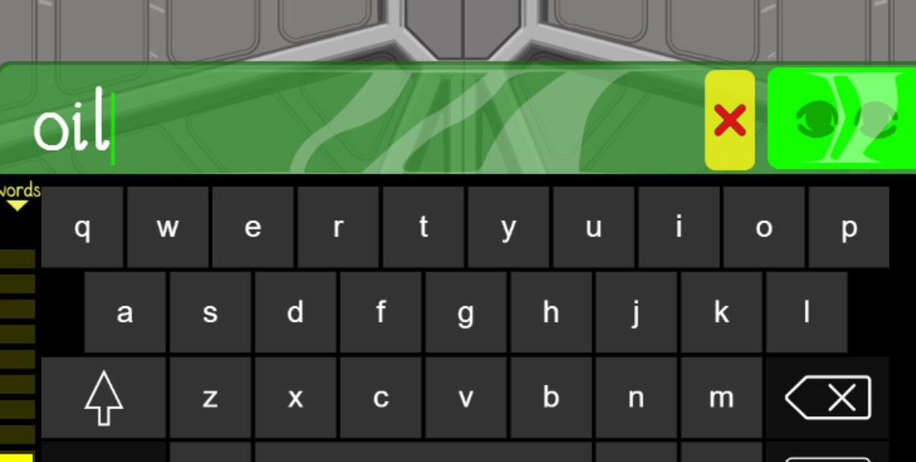
Spelling game!
Use the link to play the game and practice spelling the ‘oi’ words
Look, Cover, Write, Check- mobile friendly (ictgames.com)

Slide 63
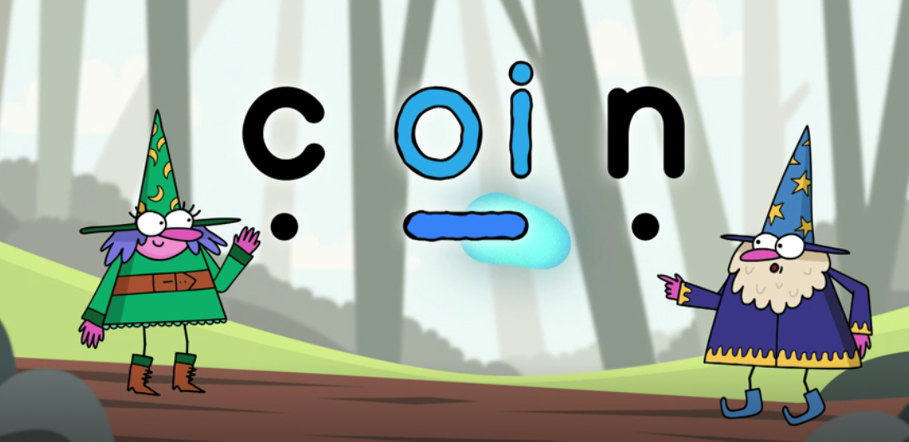
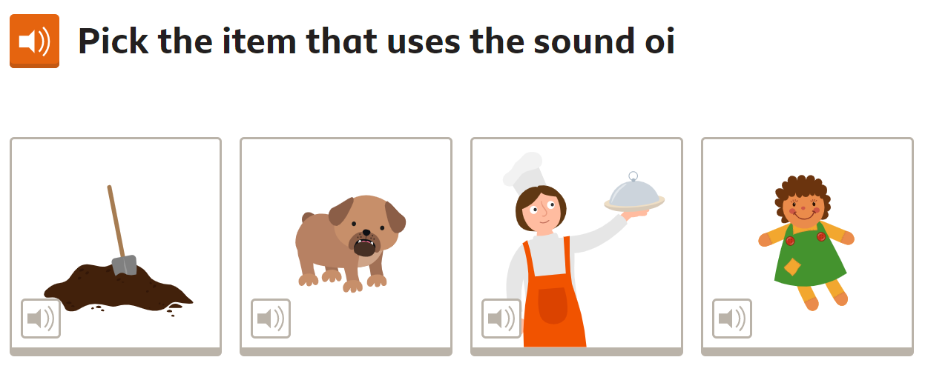
Spelling game!
Use the link to play the game and practice spelling the ‘oi’ words
The oi sound | Phase 3 Phonics | oi words - BBC Bitesize

Slide 64
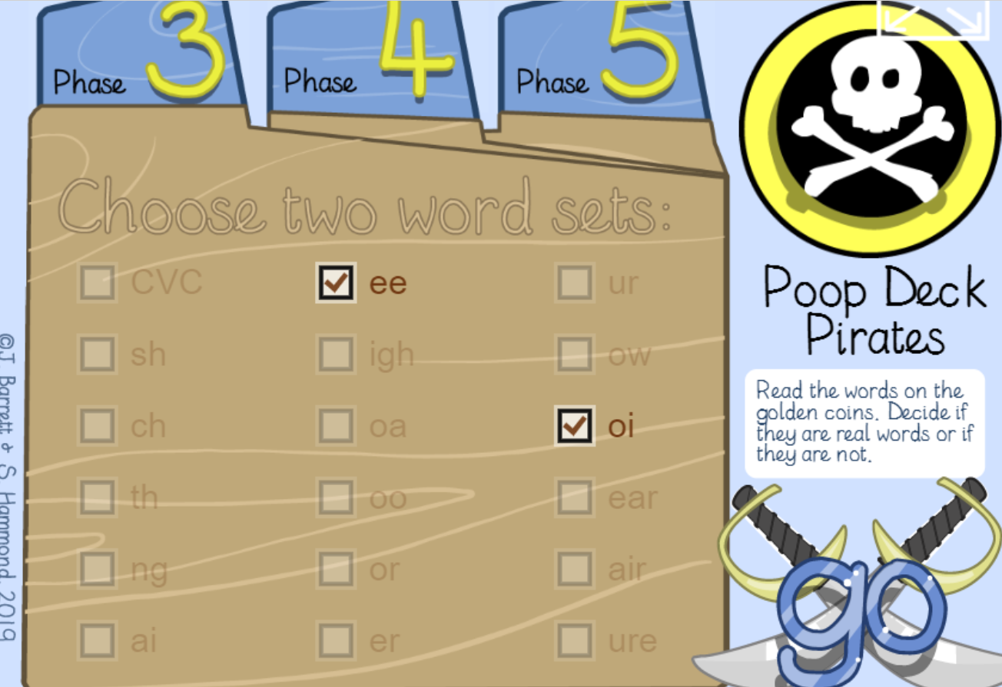
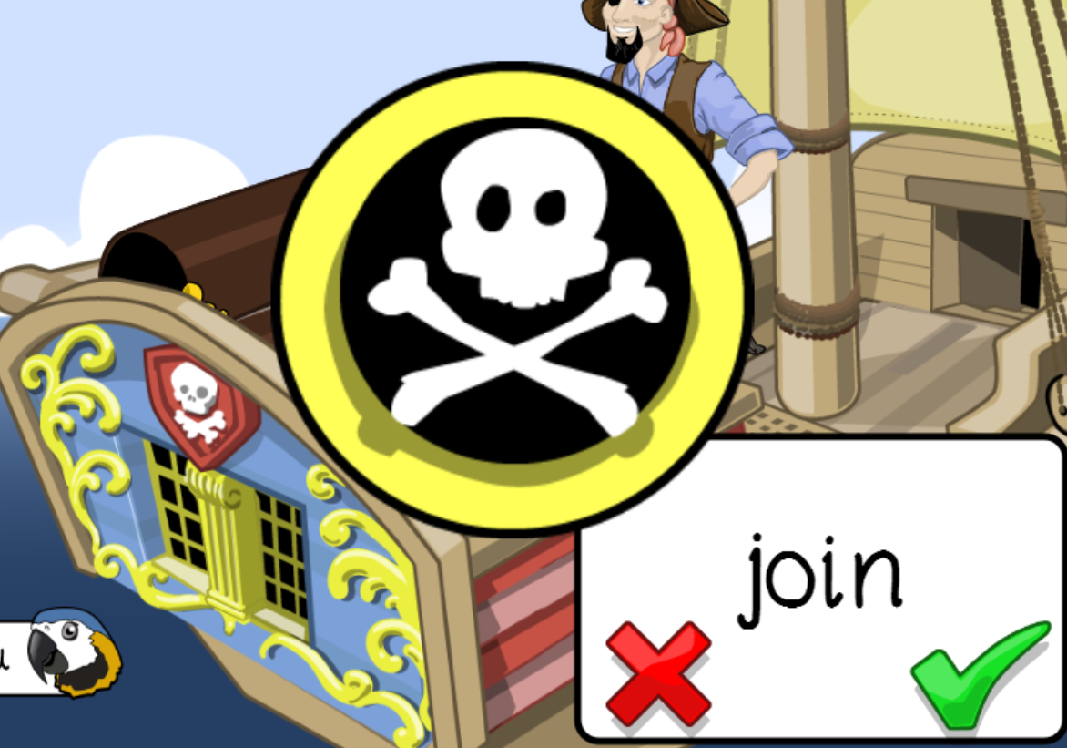
Spelling game!
Use the link to play the game and practice spelling the ‘oi’ words
Poop Deck Pirates - mobile friendly (ictgames.com)

Slide 65
Well done for all of your hard work! We can’t wait to see your completed work.
Could any completed work / photographic evidence of completed work please be sent to pioneerspupils@gmail.com
Thank you!

Slide 66
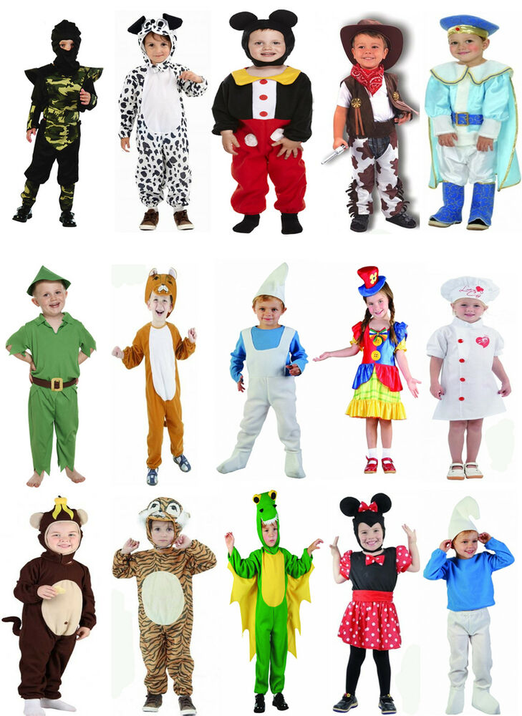
World Book Day!
World book day is this week, so lets spend some time looking at our favourite books, characters and authors.
You could dress up as one of your favourite characters …
You could build a den and read your favourite story …
We would love to see some photos!

Slide 67
World Book Day!
World book day is this week, so lets spend some time looking at our favourite books, characters and authors.
Choose your favourite book and write a book review
Think about:
Why do you like this book?
What is your favourite part?
Who is your favourite character? Why?
We would love to see some photos!

Slide 68
World Book Day!
World book day is this week, so lets spend some time looking at our favourite books, characters and authors.
Design a character mask
We would love to see some photos!

Slide 69
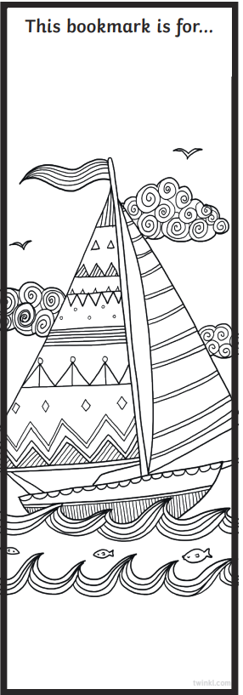
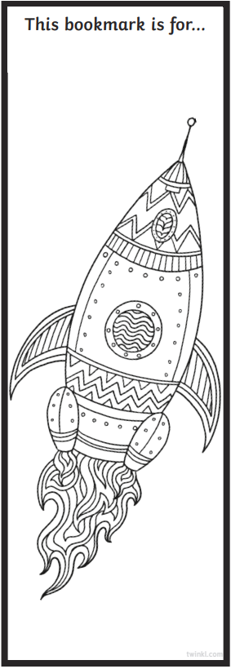
World Book Day!
World book day is this week, so lets spend some time looking at our favourite books, characters and authors.
Create a book mark
You could design your own book mark or colour in these templates.
We would love to see some photos!

Slide 70
World Book Day!
World book day is this week, so lets spend some time looking at our favourite books, characters and authors.
Object | Title of book | Page number
Apple | Snow white | 12
Witch
Bear
Frog
Dog
Tree
Car
Horse
Train
House
Dinosaur
Book scavenger hunt
Look through your books at home and see how many of the objects you can find. Remember to write down the title of the book you found the object in!
We would love to see some photos!

Slide 71
Well done for all of your hard work today! We cant wait to see your completed work.
Could any completed work / photographic evidence of completed work please be sent to pioneerspupils@gmail.com
Thank you!

