Slide 1
Date: Tuesday 5th January
LO To be able to identify expanded noun phrases to describe Winnie’s holiday.
Subject: English

Slide 2
This is our story book for the next two weeks.
Hope you enjoy it!
https://www.youtube.com/watch?v=D5YE4rxQJhg
Click on the link or copy and paste into the internet to listen to the story being read.

Slide 3
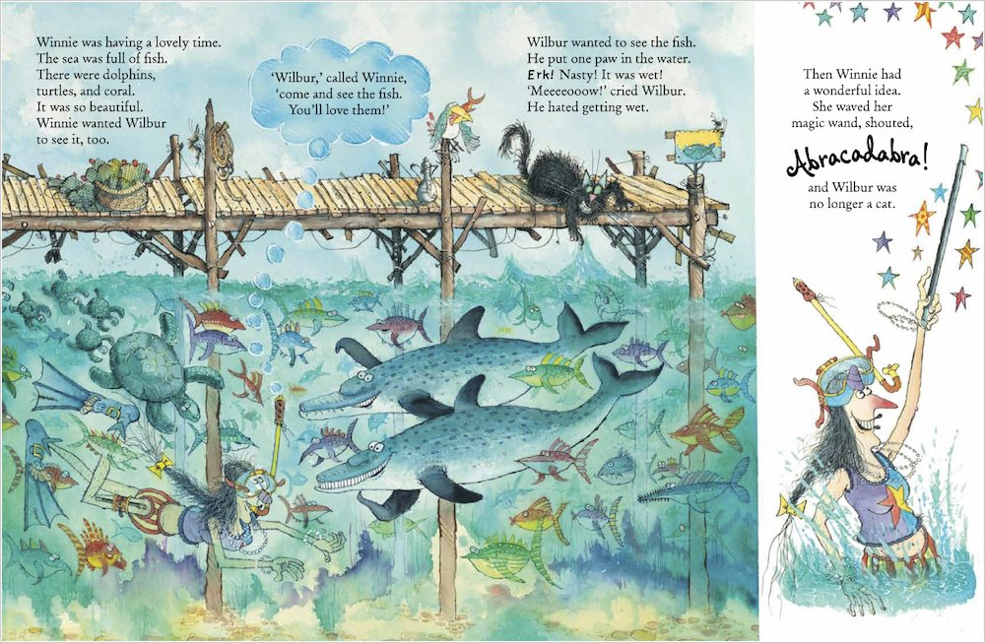

Slide 4
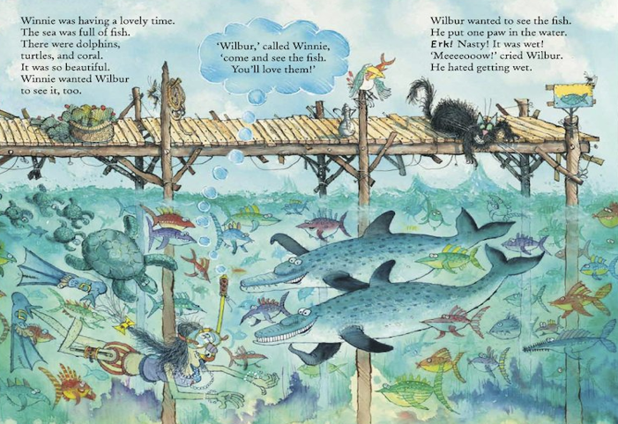
Example
Setting description
Read my description …
Winnie swam down into the deep, clear water. It was filled with colourful, scaly fish and slimy, green seaweed. On top of the water stood a broken, brown jetty. Wilbur the mischievous, black cat tried to grab a big, delicious fish for his dinner. The sky was filled with large, grey clouds and the strong, powerful waves crashed against the wooden poles. Winnie explored the water through her red and yellow snorkel as the creatures floated around her. The small, baby turtles darted after their large, green mother swimming elegantly above Winnie’s head.

Slide 5
Winnie swam down into the deep, clear water. It was filled with colourful, scaly fish and slimy, green seaweed. On top of the water stood a broken, brown jetty. Wilbur the mischievous, black cat tried to grab a big, delicious fish for his dinner. The sky was filled with large, grey clouds and the strong, powerful waves crashed against the wooden poles. Winnie explored the water through her red and yellow snorkel as the creatures floated around her. The small, baby turtles darted after their large, green mother swimming elegantly above Winnie’s head.
What is an expanded noun phrase?
adjective , adjective noun
Read through the description again and highlight/colour in the expanded noun phrases.

Slide 6
Nouns are things.
clouds
sky
Wilbur
jetty
waves
turtles
Winnie
fish
seaweed
snorkel
water
Can you think of any others?

Slide 7
Date: Wednesday 6th January
LO To be able to write sentences using expanded noun phrases to describe the sea.
Subject: English

Slide 8
Setting

Slide 9
Nouns are things.
clouds
sky
Wilbur
jetty
waves
turtles
Winnie
fish
seaweed
snorkel
water
Can you think of any others?

Slide 10
Adjectives are describing words.
Complete the expanded noun phrases by
adding 2 adjectives before the noun.
deep , clear water
colourful , scaly fish
_____________ _____________ jetty
_____________ _____________ seaweed
______________ _____________ turtle
_____________ _______________ clouds
______________ _____________ sky
______________ _____________ Wilbur
Don’t forget!! Have you put a comma between your two describing words?

Slide 11
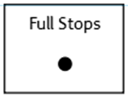
Sentences using expanded noun phrases.
Choose 4 of your expanded noun phrases
write into full sentences.
Don’t forget:
On top of the water stood a broken, brown jetty.

Slide 12
Date: Thursday 7th January
LO To be able to use ‘and’ to extend sentences.
Subject: English

Slide 13
The word ‘and’ can be used as a conjunction. Conjunctions join two sentences together …
Wilbur is black and fluffy.
The and in this sentence is not used correctly
because it joins two words not two sentences.
Wilbur sat on the jetty and watched the big, colourful fish swim past.

Slide 14
Match the correct ending to the sentences
Sentence starters:
Ending:
Wilbur sat on the jetty and
swam with friendly sea turtles.
She dived into the deep water and
watched the big, colourful fish swim past.
The hungry sharks searched for snacks and
laughed as he ate it.
The greedy seagull stole Winnie’s lunch and
chased small creatures away.

Slide 15
Complete my sentences:
Wilbur sat on the jetty and ___________________________________________.
High above the jetty, the sky is blue and it ______________________.
Winnie swam through the fresh, cold water and ________________________________.
The word ‘and’ is a …
Conjunction

Slide 16
Your Sentences…
Challenge!
Write your own sentences to describe the setting using the conjunction ‘and’ to extend your sentences
Use my expanded noun phrases or some of your own to make your sentences even better!
black, fluffy cat
big, colourful fish
scaly, green sea turtles
brown, wooden jetty
strong , powerful waves

Slide 17
Date: Friday 8th January
LO To be able to write a setting description of the sea.
Subject: English

Slide 18
Read my description again to get it back in your head…
Winnie swam down into the deep, clear water. It was filled with colourful, scaly fish and slimy, green seaweed. On top of the water stood a broken, brown jetty. Wilbur the mischievous, black cat tried to grab a big, delicious fish for his dinner. The sky was filled with large, grey clouds and the strong, powerful waves crashed against the wooden poles. Winnie explored the water through her red and yellow snorkel as the creatures floated around her. The small, baby turtles darted after their large, green mother swimming elegantly above Winnie’s head.

Slide 19
and
Remember to use ‘and’ to extend some of your sentences!
large , grey clouds
Write your own description of the sea …
Use the expanded noun phrases to help you!
broken , brown jetty
deep , clear water
colourful , scaly fish
slimy , green seaweed
I have started for you…
Below
High above
Surrounding
Next to
Underneath
In the distance
Winnie swam down into the deep, clear water.
It was filled with colourful, scaly fish and slimy, green
seaweed.

