Slide 1
Subject: Maths
Pack: A

Slide 2
Date: 28.06.21
LO To be able to recall my 2, 5 and 10 times tables.
Subject: Maths

Slide 3
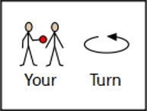
Warm Up
Timed Twenty!
Get someone to time you! We will repeat these each day – can you beat your time???
Have a go at working out the answer to these 20 arithmetic sums as quickly as you can!
2 + 5 =
10 + 1 =
3 + 3 =
4 + 6 =
7 + 1 =
2 + 2 =
9 + 5 =
10 + 6 =
8 + 8 =
6 + 2 =
11. 10 – 2 =
8 – 1 =
7 – 4 =
2 – 0 =
5 – 5 =
6 – 3 =
10 – 7 =
9 – 4 =
8 – 6 =
14 – 4 =

Slide 4
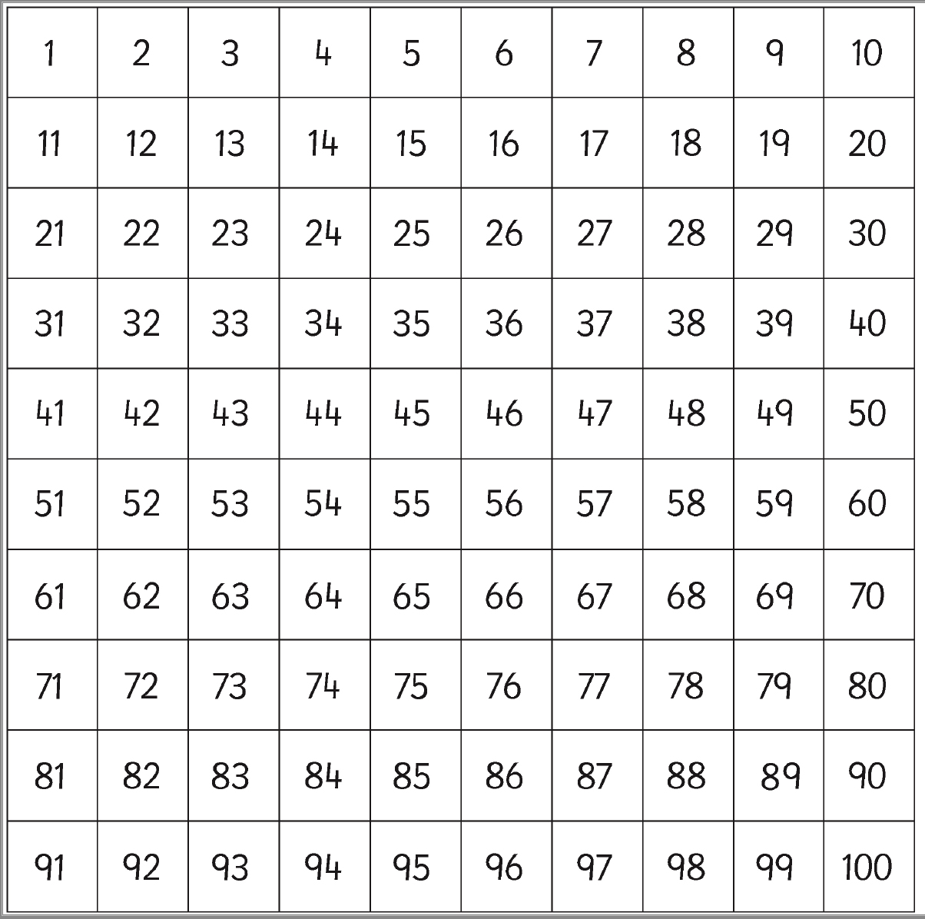
Count in 2’s, 5’s and 10’s
Warm Up
Colour the multiples of 2 in one colour (e.g. red)
Colour the multiples of 5 one colour (e.g. green)
Colour the multiples of 10 one colour (e.g. yellow)
Are there any numbers that are a multiple of 2, 5 and 10? Write them in this bubble:

Slide 5
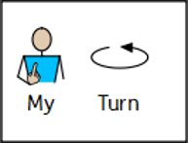
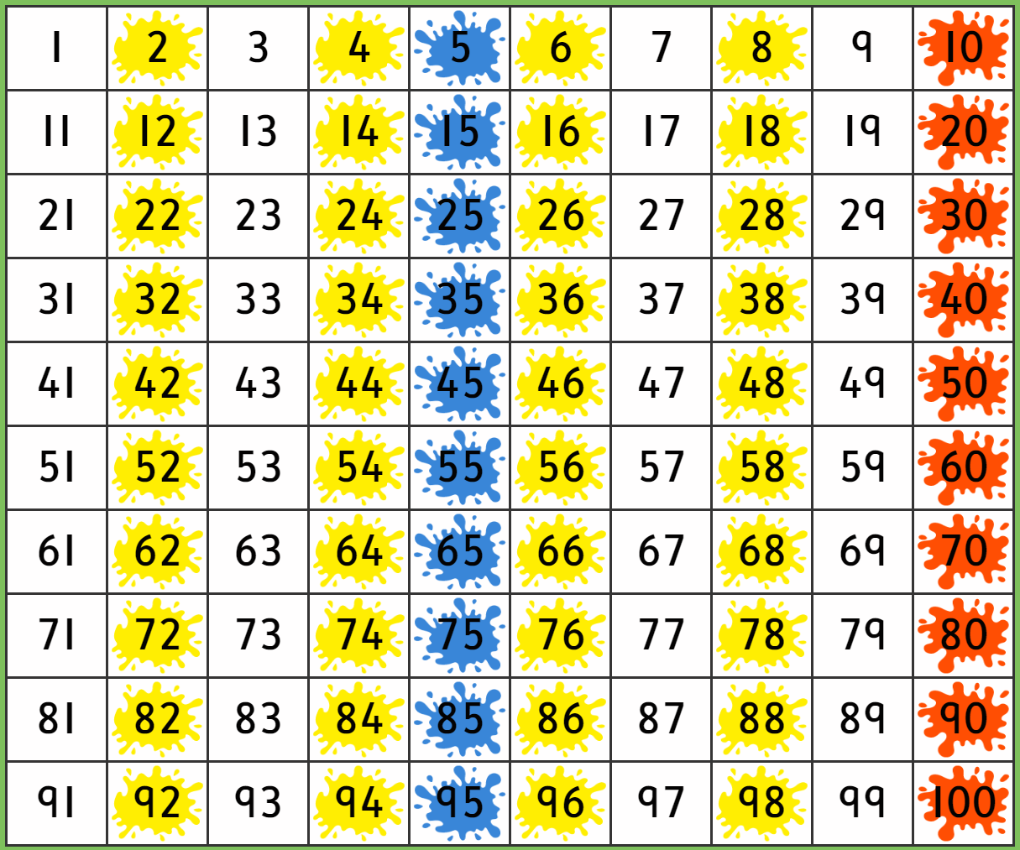
Count in 2’s, 5’s and 10’s - Answers
Use my hundred square to check your answers.
These numbers are all multiples of 2, 5 and 10:
10
20
30
40
50
60
70
80
90
100

Slide 6
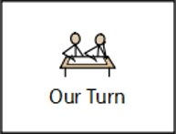
Warm Up
Fill in the Missing Numbers – Counting in 2’s …
4
8
12
16
20
2, ____, 6, ____, 10, ____, 14, ____, 18, ____
0, ____, ____, 6, 8, ____, ____, 14, 16, 18
10, ____, 14, ____, ____, 20, ____, ____, 26, ____, 30
24, ____, ____, 18, ____, 14, ____, 10, ____, 6, 4
30, ____, ____, 24, ____, ____, 18, ____, 14, ____, 10
16
28
22
20
16
12
8
28

Slide 7
Warm Up
Fill in the Missing Numbers – Counting in 5’s …
5, ____, 15, ____, 25, ____, 35, ____, 45, ____
10, ____, 20, ____, ____, 35, ____, ____, 50 ____
40, ____, ____, 55, ____, ____, 70, ____, 80, ____
40, 35, 30, ____, 20, _____, _____, 5, 0
55, ____, _____, 40, 35, 30, _____, 20, _____

Slide 8
Warm Up
Fill in the Missing Numbers – Counting in 10’s …
10, ____, 30, ____, 50, ____, 70, ____, 90, ____
50, ____, ____, 80, 90, _____, _____, 120, _____
60, ____, 40, ____, ____, 10, ____
120, _____, _____, 90, ____, 70, ____ 50 ____ 30
100, 90, ____, ____, ____, ____, 40, ____, 20

Slide 9
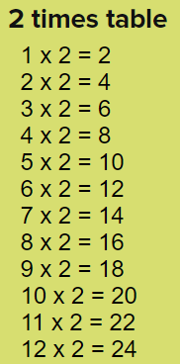
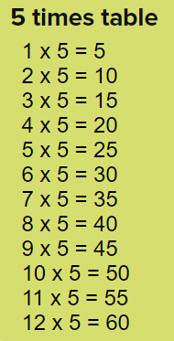
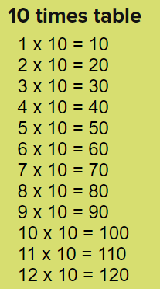
Times Tables
Chant your times tables to yourself – try different voices like we do in class!

Slide 10
Times Tables
Fill in the missing answers by counting in your 2’s, 5’s or 10’s…
Count in 5’s … 3 times!
Count in 2’s … 7 times!
Count in 5’s…
Count in 2’s…
3 x 5 =
2 x 10 =
7 x 2 =
2 x 9 =
Count in 10’s … 2 times!
Count in 2’s…
Count in 10’s…
… 9 times!
Even though this one is the other way round, do exactly the same.

Slide 11
Times Table Recall
Fill in the missing answers to your 2x and 5x tables – count in 2’s or 5’s to help you.
1 x 5 =
2 x 5 =
3 x 5 =
4 x 5 =
5 x 5 =
6 x 5 =
7 x 5 =
8 x 5 =
9 x 5 =
10 x 5 =
11 x 5 =
12 x 5 =
1 x 2 =
2 x 2 =
3 x 2 =
4 x 2 =
5 x 2 =
6 x 2 =
7 x 2 =
8 x 2 =
9 x 2 =
10 x 2 =
11 x 2 =
12 x 2 =

Slide 12
Jumbled Up Times Table Recall..
4 x 10 =
5 x 5 =
2 x 1 =
10 x 0 =
9 x 5 =
11 x 2 =
10 x 8 =
5 x 12 =
7 x 2 =
10 x 12 =
4 x 5 =
4 x 2 =
3 x 10 =
11 x 5 =
2 x 9 =
9 x 10 =
6 x 5 =
2 x 2 =
Remember – count in whichever of the two numbers is easiest!

Slide 13
Times Table Games
Copy and paste the links into ‘Google’.
10x Table Games and Activities
https://www.timestables.co.uk/10-times-table.html
5x Table Games and Activities
https://www.timestables.co.uk/5-times-table.html
2x Table Games and Activities
https://www.timestables.co.uk/2-times-table.html

Slide 14
Challenge!
Have a go at these problems…

Slide 15
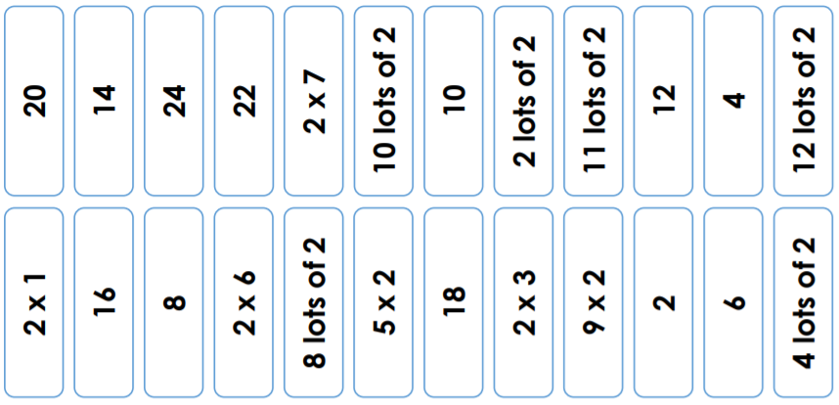
Challenge Game
If you can’t print the slide to cut out the cards, don’t worry! You could use some little pieces of paper and write the numbers/sums on them.
Cut the cards below with a partner and place them face down. Take it in turns to choose two cards, matching the multiplication with its answer. If they match, you keep the pair. The person with the most pairs, wins!

Slide 16
Tricky
Challenge!
Find at least 4 different combinations of birds.
Write your multiplication sentences in the boxes!
Possible Answers: Next Slide

Slide 17
Tricky
Challenge!
Answers
1. If there are 36 wings and each bird has 2 wings each, we need to count in 2’s until we get to 36.
This is the same as finding ½.
This is 18.
Here are some of the different combinations you could have had – but there are others too!
3 birds
5 birds
5 birds
5 birds
Wings 2x3=6
Wings 2x5=10
Wings 2x5=10
Wings 2x5=10
10 birds
4 birds
2 birds
2 birds
Wings 2x10=20
Wings 2x4=8
Wings 2x2=4
Wings 2x2=4
2. All of the 4 types of birds need to add together to make the 18 birds.
8 birds
1 bird
1 bird
8 birds
Wings 2x8=16
Wings 2x1=2
Wings 2x1=2
Wings 2x8=16
1 bird
6 birds
5 birds
6 birds
Wings 2x1=2
Wings 2x6=12
Wings 2x5=10
Wings 2x6=12

Slide 18
Well done for all of your hard work this lesson!
Please send your completed work for this session to: pioneerspupils@gmail.com

Slide 19
Date: 29.06.21
LO To be able to add 2 digit numbers.
Subject: Maths

Slide 20
Warm Up
Timed Twenty!
Get someone to time you!
Have a go at working out the answer to these 20 arithmetic sums as quickly as you can!
2 + 5 =
10 + 1 =
3 + 3 =
4 + 6 =
7 + 1 =
2 + 2 =
9 + 5 =
10 + 6 =
8 + 8 =
6 + 2 =
11. 10 – 2 =
8 – 1 =
7 – 4 =
2 – 0 =
5 – 5 =
6 – 3 =
10 – 7 =
9 – 4 =
8 – 6 =
14 – 4 =
DID YOU BEAT YESTERDAY’S TIME?

Slide 21
Warm Up
Strategy 1 - Tens and Ones …
T O T O T O
Count up the counters, start with your tens
and then move to your ones…
22 + 34 =
5 6
10
1
10
1
10
1
10
1
10
1
1
Count… 10, 20, 30, 40, 50, 51, 52, 53, 54, 55, 56

Slide 22
Warm Up
Strategy 1 - Tens and Ones …
T O T O T O
64 + 13 =
10
10
1
10
1
10
1
1
10
1
1
Count up your tens and ones and
write your answer here!
10
1
10

Slide 23
Warm Up
Strategy 1 - Tens and Ones …
T O T O T O
42 + 47 =
This time draw the
tens and ones yourself…
Count up your tens and ones and
write your answer here!

Slide 24
Strategy 2 - Mentally …
T O T O T O
45 + 24 = 69
6 tens
9 ones

Slide 25
Strategy 2 - Try these mentally …
1. 53 + 41 =
2. 44 + 52 =
3. 32 + 37 =

Slide 26
Strategy 3 – Column Addition…
TO
53
+ 22
75
TO
53
+ 22
75
1. Add up your ones first and write the answer below the line.
2. Then, add up your tens and write the answer below the line.
Keep your ones lined up in one column
Keep your tens lined up in one column

Slide 27
Strategy 3 – Column Addition…
TO
28
+ 61
7
TO
28
+ 61
1. Add up your ones first and write the answer below the line.
2. Then, add up your tens and write the answer below the line.
Keep your ones lined up in one column
Keep your tens lined up in one column

Slide 28
Try these questions yourself …
(Choose whichever strategy you prefer to help you!)
24 + 43 =
15 + 21 =
52 + 33 =
61 + 32 =
44 + 43 =
70 + 29 =
33 + 31 =
65 + 24 =
If you found these really easy, have a go at the next 8 on the following slide!

Slide 29
Try these questions yourself …
(Choose whichever strategy you prefer to help you!)
27 + 45 =
19 + 24 =
51 + 39 =
65 + 37 =
48 + 46 =
73 + 19 =
36 + 46 =
64 + 37 =
Have a go at these if you found the last 8 questions easy.

Slide 30
Challenge!
Have a go at these problems…

Slide 31
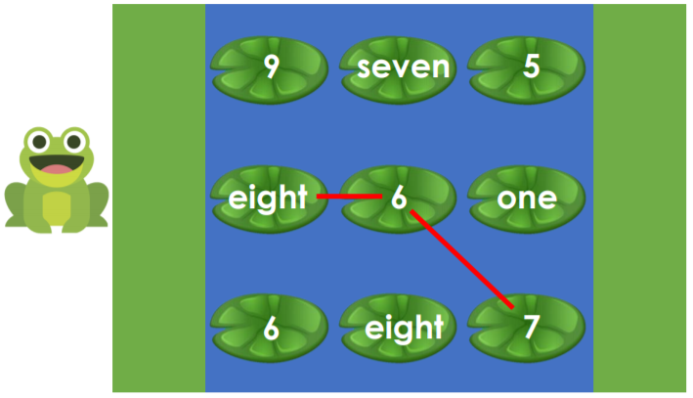
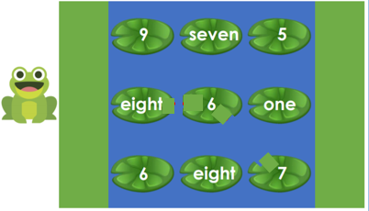
Problem Solving…
Help Freddie the frog cross the river by jumping across 3 lily pads. Freddie can jump horizontally and diagonally.
Explore the different ways he could cross the river by adding 3 numbers that have a total of > 20.
For example:
21
What do you notice about the totals of each lily pad path that Freddie jumps across?

Slide 32
Problem Solving… - Answers
Help Freddie the frog cross the river by jumping across 3 lily pads. Freddie can jump horizontally and diagonally.
Explore the different ways he could cross the river by adding 3 numbers that have a total of > 20.
21
21
21
What do you notice about the totals of each lily pad path that Freddie jumps across?
Each path equals 21 because 8 + 6 + 7 = 21, 9 + 7 + 5 = 21 and 6 + 8 + 7 = 21.

Slide 33
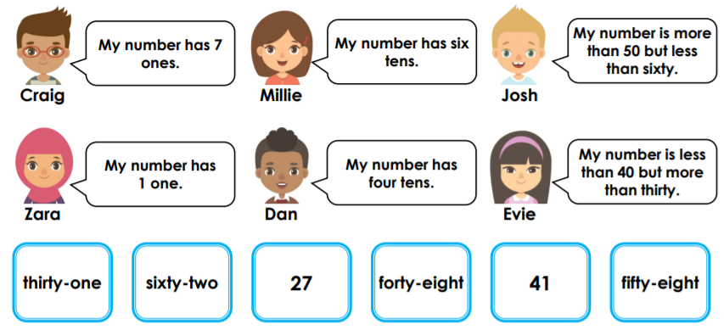
Challenge!
The children are selecting one number card each. Read their number descriptions and work out which child has which number card.
Write the child and their number card here.
Pair up the children so that their number cards total 89. Investigate the pairs that will create a total of 89.
Write the pairs here and the number sentence that proves it.

Slide 34
Challenge - Answers
The children are selecting one number card each. Read their number descriptions and work out which child has which number card.
Craig = 27
Zara = 41
Millie = 62
Dan = 48
Josh = 58
Evie = 31
Pair up the children so that their number cards total 89. Investigate the pairs that will create a total of 89.
Craig and Millie 27 + 62 = 89
Josh and Evie 58 + 31 = 89
Dan and Zara 48 + 41 = 89

Slide 35
Well done for all of your hard work this lesson!
Please send your completed work for this session to: pioneerspupils@gmail.com

Slide 36
Date: 30.06.21
LO To be able to subtract from a 2 digit number.
Subject: Maths

Slide 37
Warm Up
Timed Twenty!
Get someone to time you!
Have a go at working out the answer to these 20 arithmetic sums as quickly as you can!
2 + 5 =
10 + 1 =
3 + 3 =
4 + 6 =
7 + 1 =
2 + 2 =
9 + 5 =
10 + 6 =
8 + 8 =
6 + 2 =
11. 10 – 2 =
8 – 1 =
7 – 4 =
2 – 0 =
5 – 5 =
6 – 3 =
10 – 7 =
9 – 4 =
8 – 6 =
14 – 4 =
DID YOU BEAT YESTERDAY’S TIME?

Slide 38
Warm Up
Strategy 1: Tens and Ones…
T O T O T O
1. Make your biggest number (56 – 5 tens and 6 ones).
56 - 23 =
3 3
10
1
1
10
1
2. Then cross out the number of tens you are taking away (23 - 2 tens and 3 ones).
10
1
3. Count up how many you have got left…
10, 20, 30, 31, 32, 33
10
1
10
1

Slide 39
Warm Up
Strategy 1: Tens and Ones…
T O T O T O
1. Make your biggest number (64 – 6 tens and 4 ones).
64 - 41 =
10
10
1
Write your answer here!
10
1
2. Then cross out the number of tens you are taking away (41 - 4 tens and 1 ones).
10
1
10
1
Count up how many you have got left…
__________________________________
10

Slide 40
Warm Up
Strategy 1: Tens and Ones…
T O T O T O
Make your biggest number – draw your tens and ones here:
98 - 38 =
Write your answer here!
Cross out your tens and ones.
Count up how many you have got left…
__________________________________

Slide 41
Strategy 2: Mentally …
T O T O T O
76 - 31 = 45
4 tens
5 ones

Slide 42
Strategy 2: Try these mentally …
1. 53 - 41 =
2. 44 - 12 =
3. 98 - 57 =

Slide 43
Strategy 3: Column Subtraction…
TO
53
- 22
71
TO
53
- 22
31
1. Subtract your 2nd number of ones from your 1st number of ones and write the answer below the line.
2. Then, subtract your 2nd number of tens from your first number of tens and write the answer below the line.
Keep your ones lined up in one column.
Keep your tens lined up in one column.

Slide 44
Strategy 3: Column Subtraction…
TO
68
- 21
7
TO
68
- 21
1. Subtract your 2nd number of ones from your 1st number of ones and write the answer below the line.
2. Then, subtract your 2nd number of tens from your first number of tens and write the answer below the line.
Keep your ones lined up in one column
Keep your tens lined up in one column

Slide 45
Subtracting 2-digit numbers
(Choose whichever strategy you prefer to help you!)
69 – 32 =
87 – 25 =
95 – 41 =
76 – 35 =
5. 63 – 43 =
6. 77 – 52 =
7. 88 – 24 =
8. 59 – 51 =
If you found these really easy, have a go at the next 8 on the following slide!

Slide 46
Subtracting 2-digit numbers
(Choose whichever strategy you prefer to help you!)
44 – 28 =
57 – 29 =
91 – 44 =
75 – 36 =
5. 63 – 19 =
6. 72 – 55 =
7. 80 – 24 =
8. 54 – 48 =
Have a go at these if you found the last 8 questions easy.

Slide 47
Challenge!
Have a go at these problems…

Slide 48
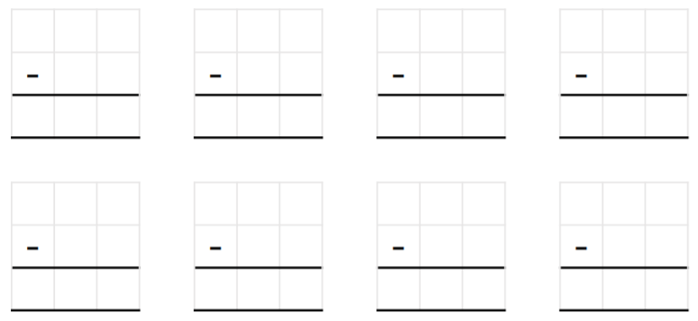
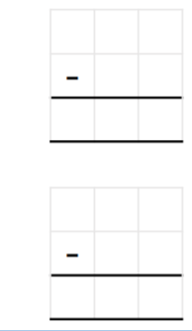
Challenge Game
Roll your dice twice to generate a 2-digit number. Starting from 99, subtract every 2-digit number you roll until you reach a 1-digit number.
If you don’t have a dice at home, you could pull numbers out of a hat!

Slide 49
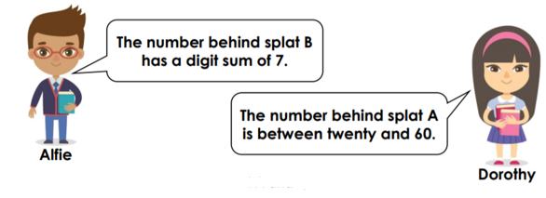
Challenge…
Combination 1:
=
=
Alfie and Dorothy have drawn this bar model:
Combination 2:
=
=
Combination 3:
=
=
Combination 4:
=
=
Investigate the possible values of splat A and splat B.
Find at least 4 different combinations.

Slide 50
Challenge - Answers
Combination 1:
= 51
= 25
Alfie and Dorothy have drawn this bar model:
Combination 2:
= 42
= 34
100 – 24 = 76
Combination 3:
= 76
= 24
= 52
Investigate the possible values of splat A and splat B.
Find at least 4 different combinations.
Combination 4:
= 33
= 43
Two digits add up to 7:
61
52
34 43
Between 20-60.
Here are some solutions you might have found!

Slide 51
Well done for all of your hard work this lesson!
Please send your completed work for this session to: pioneerspupils@gmail.com

Slide 52
Date: 01.07.21
LO To be able to divide by 2, 5 and 10.
Subject: Maths

Slide 53
Warm Up
Timed Twenty!
Get someone to time you!
Have a go at working out the answer to these 20 arithmetic sums as quickly as you can!
2 + 5 =
10 + 1 =
3 + 3 =
4 + 6 =
7 + 1 =
2 + 2 =
9 + 5 =
10 + 6 =
8 + 8 =
6 + 2 =
11. 10 – 2 =
8 – 1 =
7 – 4 =
2 – 0 =
5 – 5 =
6 – 3 =
10 – 7 =
9 – 4 =
8 – 6 =
14 – 4 =
DID YOU BEAT YESTERDAY’S TIME?

Slide 54
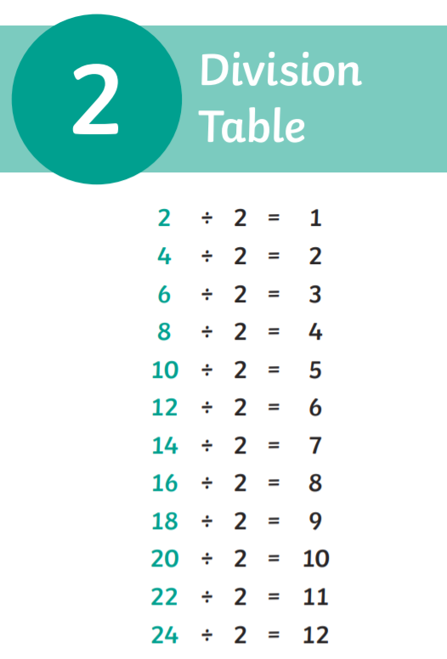
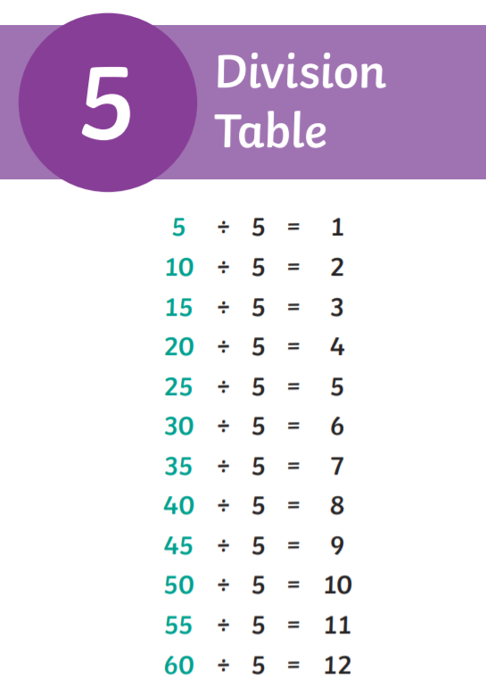
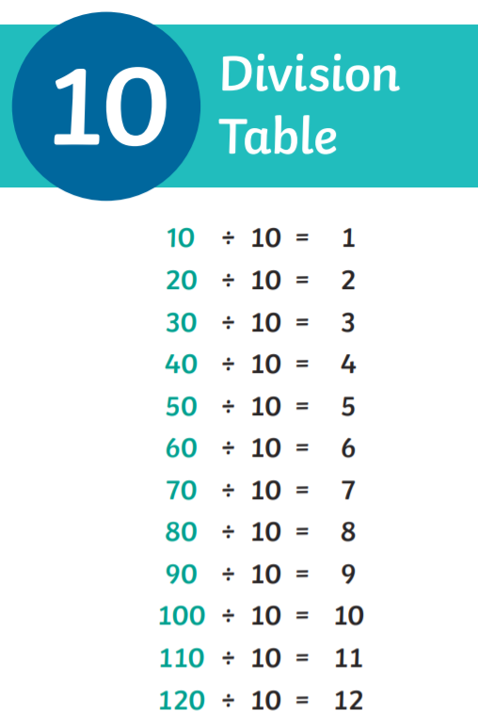
Warm Up
Division Tables
Chant your division tables to yourself – try different voices like we do in class!

Slide 55
Division Tables
Fill in the missing answers by counting in your 2’s…
… until you get to 12
… until you get to 8
Count in 2’s…
Count in 2’s…
6
4
12 2 =
20 2 =
8 2 =
14 2 =
Have a go at these!
… until you get to 20
… until you get to 14
Count in 2’s…
Count in 2’s…

Slide 56
Division Tables
Fill in the missing answers by counting in your 5’s…
… until you get to 15
… until you get to 30
Count in 5’s…
Count in 5’s…
15 5 =
40 5 =
30 5 =
55 5 =
Have a go at these!
… until you get to 40
… until you get to 55
Count in 5’s…
Count in 5’s…

Slide 57
Division Tables
Fill in the missing answers by counting in your 10’s…
… until you get to 20
… until you get to 100
Count in 10’s…
Count in 10’s…
20 10 =
70 10 =
100 10 =
40 10 =
Have a go at these!
… until you get to 70
… until you get to 40
Count in 10’s…
Count in 10’s…

Slide 58
Division Table Recall
Fill in the missing answers to your 2 and 5 division tables – count in 2’s or 5’s to help you, or see if you can remember them!
5 5 =
10 5 =
15 5 =
20 5 =
25 5 =
30 5 =
35 5 =
40 5 =
45 5 =
50 5 =
55 5 =
60 5 =
2 2 =
4 2 =
6 2 =
8 2 =
10 2 =
12 2 =
14 2 =
16 2 =
18 2 =
20 2 =
22 2 =
24 2 =

Slide 59
Jumbled Up Division Table Recall..
40 10 =
25 5 =
20 2 =
10 10 =
45 5 =
12 2 =
80 10 =
30 5 =
8 2 =
110 10 =
50 5 =
24 2 =
50 10 =
15 5 =
14 2 =
90 10 =
60 5 =
2 2 =
Remember – count in 2’s, 5’s or 10’s to help you!

Slide 60
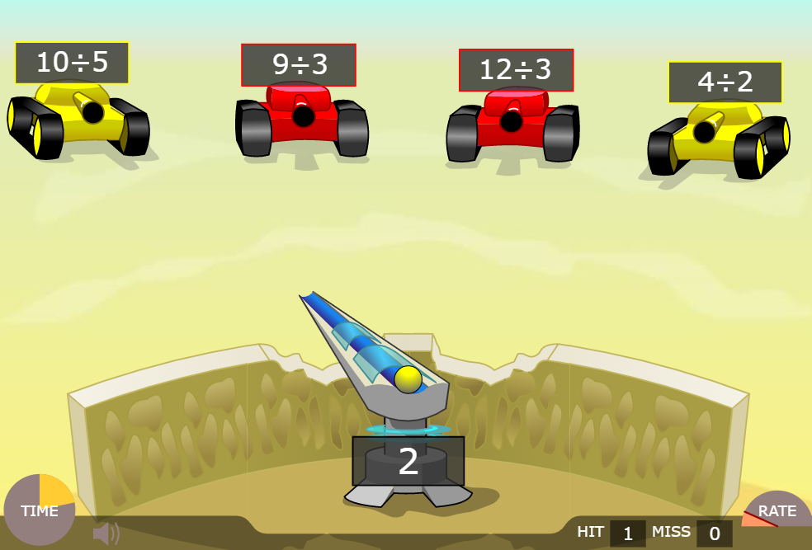
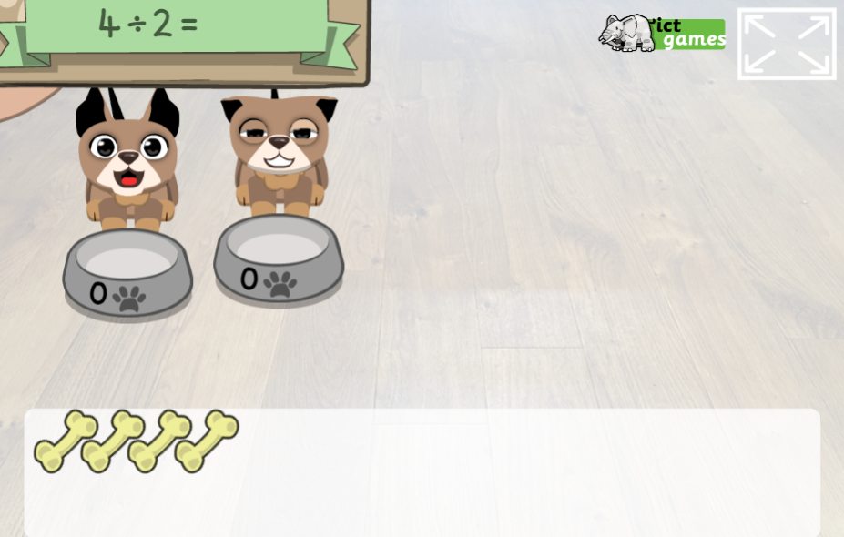
Division Games
Division Puppy Game
Copy and paste the links into ‘Google’.
https://www.ictgames.com/mobilePage/doggyDivision/index.html
Division Demolition Game
https://www.arcademics.com/games/demolition
2x Table Games and Activities
https://www.timestables.co.uk/2-times-table.html

Slide 61
Challenge!
Have a go at these problems…

Slide 62
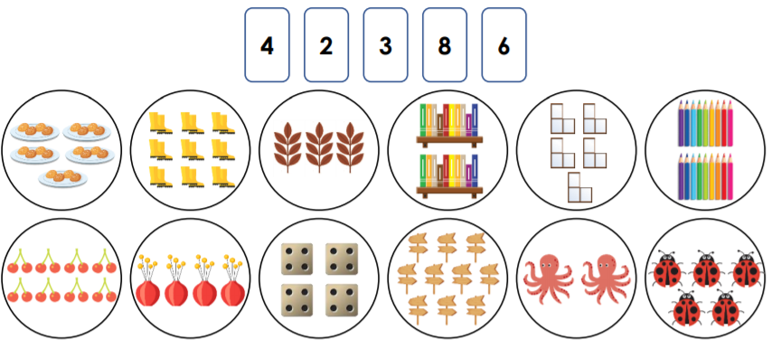
Challenge…
Use the stem sentence to investigate which digit cards can be used to describe the possible groups below.
Draw an arrow from the picture and complete the corresponding stem sentence.
Stem Sentence: There are _______ equal groups with ______ in each group.
There are _______ equal groups with ______ in each group.
There are _______ equal groups with ______ in each group.
There are _______ equal groups with ______ in each group.
Use the remaining digit cards to complete the stem sentence and draw the groups:
There are _______ equal groups with ______ in each group.
There are _______ equal groups with ______ in each group.

Slide 63
Challenge - Answers
Use the stem sentence to investigate which digit cards can be used to describe the possible groups below.
Stem Sentence: There are _______ equal groups with ______ in each group.
2
8
There are _______ equal groups with ______ in each group.
4
4
There are _______ equal groups with ______ in each group.
8
2
There are _______ equal groups with ______ in each group.
Use the remaining digit cards to complete the stem sentence and draw the groups:
3
6
6
3
There are _______ equal groups with ______ in each group.
There are _______ equal groups with ______ in each group.

Slide 64
Challenge 2…
Charles and Kendra are guessing each other’s number. They have chosen their number from this number grid.
These are the numbers they could have chosen from.
Here are the clues they both gave:
Which numbers could Kendra and Charles be thinking of?
Kendra’s possible numbers:
Charles’ possible numbers:

Slide 65
Challenge 2…
Charles and Kendra are guessing each other’s number. They have chosen their number from this number grid.
These are the numbers they could have chosen from.
Charles’ number could have been 12, 24 or 32 because they are all divisible by 4 (counting in 4’s numbers).
Here are the clues they both gave:
Kendra’s number could only be 12 or 24 because they are the only numbers that can be shared into groups of 2 and 3.
Kendra’s possible numbers:
Charles’ possible numbers:
12
24
12
24
32

Slide 66
Well done for all of your hard work this lesson!
Please send your completed work for this session to: pioneerspupils@gmail.com

Slide 67
Date: 02.07.21
LO To be able to solve maths problems.
Subject: Maths

Slide 68
Warm Up
Timed Twenty!
Get someone to time you!
Have a go at working out the answer to these 20 arithmetic sums as quickly as you can!
2 + 5 =
10 + 1 =
3 + 3 =
4 + 6 =
7 + 1 =
2 + 2 =
9 + 5 =
10 + 6 =
8 + 8 =
6 + 2 =
11. 10 – 2 =
8 – 1 =
7 – 4 =
2 – 0 =
5 – 5 =
6 – 3 =
10 – 7 =
9 – 4 =
8 – 6 =
14 – 4 =
DID YOU BEAT YESTERDAY’S TIME?

Slide 69
Word Problems
Jenny and Thomas put their pocket money together to buy some sweets. If Jenny has 52p and Thomas has 28p, how much money do they have to spend altogether?
You can use whichever strategy is easiest for you to find out the answer!
TO TO
52p + 28p = 70 + 10 = 80
Altogether tells us that we need to add the two amounts.
7 tens (70)
10 ones (10)
+
=
7 tens and 1 ten
=
80
(10 ones)
+
=
7 tens and 1 ten
=
80
(10 ones)

Slide 70
Word Problems
Carly and Emma put their pocket money together to buy some sweets. If Jenny has 35p and Thomas has 53p, how much money do they have to spend altogether?
Write your answer
here!
You can use whichever strategy is easiest for you to find out the answer!
TO TO
35p + 53p = ____
Altogether tells us that we need to add the two amounts.
Show your working out in this box:
35p + 53p =

Slide 71
Word Problems
Jake had 17 marbles and Billy had 51 marbles. How many marbles do they have altogether to put in the marble jar?
Write your number sentence here!
You can use whichever strategy is easiest for you to find out the answer!
TO TO
___ + ___ = ____
Altogether tells us that we need to add the two amounts.
Show your working out in this box:

Slide 72
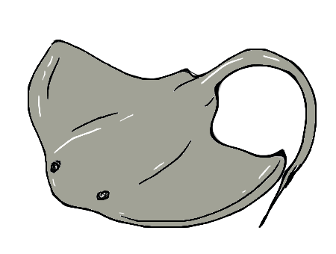
Word Problems
At the aquarium, there are 15 stingrays and 60 clownfish that share a tank. How many sea creatures are in the tank altogether?
Write your number sentence here!
You can use whichever strategy is easiest for you to find out the answer!
TO TO
___ + ___ = ____
Altogether tells us that we need to add the two amounts.
Show your working out in this box:

Slide 73
Word Problems
Chloe holds a bake sale to raise money for charity. Chloe bakes 34 cupcakes for the event and her best friend Tim brings 29 crispy cakes. How many cakes do they have altogether to sell at the bake sale?
Write your number sentence here!
You can use whichever strategy is easiest for you to find out the answer!
TO TO
___ + ___ = ____
Altogether tells us that we need to add the two amounts.
Show your working out in this box:

Slide 74
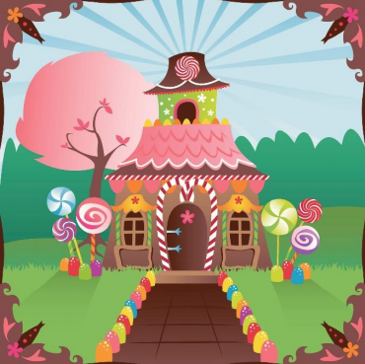
Wilma’s Wonderful Party
Wilma the witch is hosting a big party of all of her neighbours in the forest. She needs your help with some of the preparations to make sure that she hosts the BEST party ever!
Each problem you solve will help Wilma organized for the celebrations! Don’t worry though, if you’re not sure how to work out the answer to a problem, there is help and guidance on the following page.
I want my house to look like this for the party!

Slide 75
Wilma’s Wonderful Party
First, Wilma needs to get some decorations! She would like some giant gum drops to go around the front of her cottage.
She knows that she needs more than 10 but less than 20 giant gumdrops in total to go along the front path. She already has 6 giant gumdrops at home.
How many more does she need to buy at the shop? How many different combinations can you find?
Show your working out in this box:
More than 10 but less than 20 means:
11, 12, 13, 14, 15, 16, 17, 18, 19
For
example:
6 + 5 = 11
Have a go at writing all the different combinations to give you the right amount of gumdrops!

Slide 76
Wilma’s Wonderful Party - Answers
First, Wilma needs to get some decorations! She would like some giant gum drops to go around the front of her cottage.
She knows that she needs more than 10 but less than 20 giant gumdrops in total to go along the front path. She already has 6 giant gumdrops at home.
How many more does she need to buy at the shop? How many different combinations can you find?
Show your working out in this box:
More than 10 but less than 20 means:
11, 12, 13, 14, 15, 16, 17, 18, 19
For
example:
6 + 5 = 11
Other possible combinations:
6 + 6 = 12
6 + 7 = 13
6 + 8 = 14
6 + 9 = 15
Wilma could buy 6, 7, 8, 9, 10, 11, 12 or 13 giant gumdrops!
How many she needs to buy.
How many she needs altogether.
How many Wilma has already.
6 + 10 = 16
6 + 11 = 17
6 + 12 = 18
6 + 13 = 19

Slide 77
Wilma’s Wonderful Party
Next, Wilma wants to decorate the rest of the garden so she goes to Gemma’s Garden Utopia. She looks at the cost of some different garden decorations:
Wilma wants 3 candy floss trees, 3 chocolate drop bushes and 3 liquorice vines to make her garden look amazing for the party! Luckily, the three things are on sale.
How much does she spend on each different thing?
3 candy floss trees:
Show your working out in this box:
Write your number sentence for each different thing.
3 chocolate drop bushes:
3 liquorice vines:

Slide 78
Wilma’s Wonderful Party - Answers
Next, Wilma wants to decorate the rest of the garden so she goes to Gemma’s Garden Utopia. She looks at the cost of some different garden decorations:
Wilma wants 3 candy floss trees, 3 chocolate drop bushes and 3 liquorice vines to make her garden look amazing for the party! Luckily, the three things are on sale.
How much does she spend on each different thing?
3 candy floss trees:
Show your working out in this box:
£4 + £4 + £4 = £12
You have to add 3 of each thing together.
3 chocolate drop bushes:
£7 + £7 + £7 = £21
3 liquorice vines:
£6 + £6 + £6 = £18

Slide 79
Wilma’s Wonderful Party
Because the chocolate drop bushes are in the sale, Wilma thinks that she has saved £5.
Is she correct?
Explain in the box:
Make sure you explain WHY.

Slide 80
Wilma’s Wonderful Party - Answers
Because the chocolate drop bushes are in the sale, Wilma thinks that she has saved £5.
Is she correct?
The normal price of the bushes is £9 and the sale price is £7. That means that each bush is £2 cheaper because £9 - £7 = £2.
Explain in the box:
Wilma is incorrect because in the sale each bush is £2 cheaper than its normal price.
Your answer doesn’t have to worded exactly the same but should be similar.
Wilma is buying 3 bushes so she would have to work out 3x£2 or £2+£2+£2 to find out
how much money she has saved. 3 x £2 = £6 so Wilma saved £6 altogether
rather than £5.

Slide 81
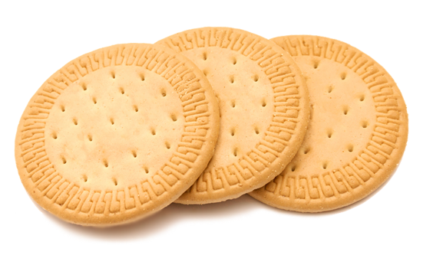
Wilma’s Wonderful Party
Finally, Wilma wants to make sure there are plenty of biscuits for her guests to eat! She wants to buy 40 biscuits altogether to make sure she has enough.
One single biscuit costs £2 or Wilma can buy a pack of 10 biscuits which costs £22.
Which is the least expensive way for Wilma to buy 40 biscuits?
(cheapest)
Show your working out in this box:
40 biscuits - single
40 biscuits - packs
Work out the price of 10 first!

Slide 82
Wilma’s Wonderful Party - Answers
Finally, Wilma wants to make sure there are plenty of biscuits for her guests to eat! She wants to buy 40 biscuits altogether to make sure she has enough.
One single biscuit costs £2 or Wilma can buy a pack of 10 biscuits which costs £22.
Which is the least expensive way for Wilma to buy 40 biscuits?
(cheapest)
Show your working out in this box:
40 biscuits - single
40 biscuits - packs
1 biscuit = £2
Pack of 10 biscuits = £22
10 biscuits = £2 x 10 = £20
We know that 4 lots of 10 makes 40 biscuits.
We know that 4 lots of 10 makes 40 biscuits.
Work out the price of 10 first!
10
10
10
10
= 40 biscuits
10
10
10
10
= 40 biscuits
4 lots of £22:
£22 + £22 + £22 + £22
4 lots of £20:
£20 + £20 + £20 + £20
Single Biscuits is cheaper!
£44
+
£44
= £88
£40
+
£40 = £80

Slide 83
Wilma’s Wonderful Party
Thank you for all of your help!

Slide 84
Well done for all of your hard work this lesson!
Please send your completed work for this session to: pioneerspupils@gmail.com

