Slide 1
Subject: English
Pack: A

Slide 2
Non-fiction: Narrative
Trailblazers
Monday | Tuesday | Wednesday | Thursday | Friday
L.O. To be able to use imagery. | L.O. To be able to use direct speech. | L.O. To be able to vary sentence length for effect. | L.O. To be able to add description through action. | L.O. To be able to write a narrative.

Slide 3
Read, copy, cover, spell this week’s spellings.
Date: Monday 1st February 2021
famous
nervous
ridiculous
carnivorous
herbivorous
porous
adventurous
courageous
outrageous
advantageous

Slide 4
Date: Monday 1st February 2021
LO: To be able to add imagery using metaphors.
Subject: English

Slide 5
Pre-recorded Teaching
Miss Umbleby’s online teaching video is on our school website. It will support you to complete the work in this lesson. This video will act as a support but all of the work can still be successfully understood & completed using paper-based versions of this pack. If you need further support to understand / complete work then please contact school via e-mail or telephone.
You can also copy and paste this link if you would prefer:
https://www.whprimary.com/copy-4-of-covid19

Slide 6
What is a metaphor?
A metaphor is a way of describing something by saying it is or was something else.
It is a way of comparing two things.

Slide 7
Let's look at an example.
The snow is a white blanket on the ground.
In this metaphor we are comparing the snow on the ground to a blanket.
We are saying it is something else. We don’t use the words as or like.

Slide 8
Let's look at an example.
The thunder was a roaring lion.
In this metaphor we are comparing the sound of thunder to a lion.
We are saying it is something else. We don’t use the words as or like.

Slide 9
Let's look at some more examples.
He is a shining star.
The clouds are balls of cotton.
Her tears were a river cascading down her cheeks.
Her long hair was a flowing golden waterfall.
The stormy ocean was a raging bull.

Slide 10
Can you spot which is the metaphor?
The snow was laying like a blanket.
The snow was a white blanket.
The clouds are balls of cotton.
The clouds are like balls of cotton.
The stars sparkled like diamonds
The stars are sparkling diamonds
The moon is as bright as a spotlight
The moon is a bright spotlight

Slide 11
Can you spot which is the metaphor?
The snow was laying like a blanket.
The snow was a white blanket.
The clouds are balls of cotton.
The clouds are like balls of cotton.
The stars sparkled like diamonds
The stars are sparkling diamonds
The moon is as bright as a spotlight
The moon is a bright spotlight

Slide 12
Can you spot the metaphors in these sentences?
I opened my eyes and there it was, Earth. I was finally on my way home. As I started to land, the rocket was a shaking leaf. This was it. This was the moment I had dreamed of for 65 years. I made it back to Earth. When I stepped out of the rocket, my heart was a beating drum. But, when I looked up, I didn’t recognise anything. The streets I had know and loved were a disaster zone.

Slide 13
Can you spot the metaphors in these sentences?
I opened my eyes and there it was, Earth. I was finally on my way home. As I started to land, the rocket was a shaking leaf. This was it. This was the moment I had dreamed of for 65 years. I made it back to Earth. When I stepped out of the rocket, my heart was a beating drum. But, when I looked up, I didn’t recognise anything. The streets I had known and loved were a disaster zone.

Slide 14
Add the words was or were to these sentences.
When the rocket set off, it _____ a bolt of lightning.
As I made my way to the launch pad, my hands ____ jelly.

Slide 15
Add the words was or were to these sentences.
When the rocket set off, it was a bolt of lightning.
As I stepped out of the rocket, my hands were jelly.

Slide 16
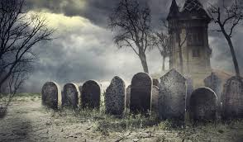
Add a metaphor to the end of these sentences.
As I looked into the sky, the stars ______________________
As I stepped out of the rocket, my home__________

Slide 17
Add a metaphor to the end of these sentences.
As I looked into the sky, the stars were sparkling diamonds.
As I stepped out of the rocket, my home was an abandoned graveyard.

Slide 18
Can you think of an opener for these metaphors?
________________________ was a disaster zone.
________________________ tears were a flowing river down my cheeks.

Slide 19
Can you think of an opener for these metaphors?
The planet I had returned to was a disaster zone.
I tried to contain my emotions, but tears were a flowing river down my cheeks.

Slide 20
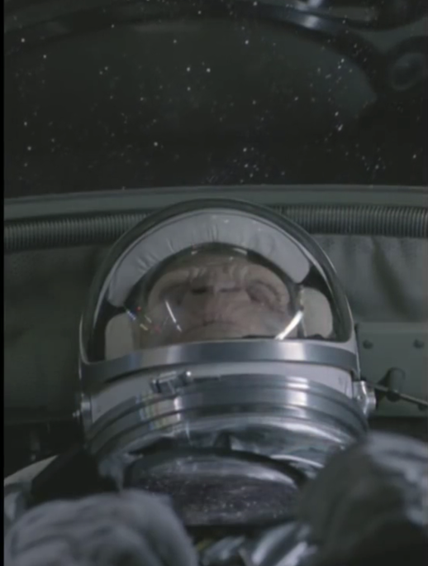
Now it's your turn.
Can you think of 3 metaphors to describe the following situations?
The monkey is on his way back to Earth.
The landing of the rocket onto Earth.
How the world looks when the monkey has returned.
Example Metaphors
The stars were sparkling diamonds.
The rocket was a shaking leaf.
My heart was a beating drum.
The planet was a disaster zone.
Tears were a flowing river down my cheeks.

Slide 21
Reading time
Now that you have finished your main task, please enjoy some reading time.
You can read to yourself, an adult or sibling.
This can be done by logging on to your myON account, picking a book or magazine and enjoying at least 15 minutes reading time.
https://www.myon.co.uk/login/index.html
Remember that your login is your first name and first letter of your surname then password:
harryp
password1
Please email trailblazerspupils@gmail.com if you have any login issues.

Slide 22
End of lesson.

Slide 23
Read, copy, cover, spell this week’s spellings.
Date: Tuesday 2nd February 2021
famous
nervous
ridiculous
carnivorous
herbivorous
porous
adventurous
courageous
outrageous
advantageous

Slide 24
Date: Tuesday 2nd February 2021
LO: To be able to use embedded reporting clauses.
Subject: English

Slide 25
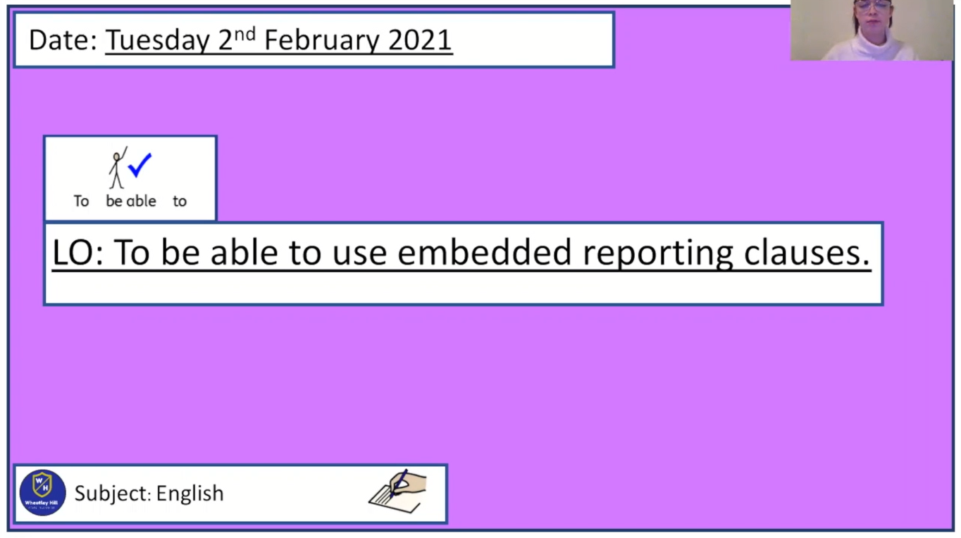
Pre-recorded Teaching
Miss Umbleby’s online teaching video is on our school website. It will support you to complete the work in this lesson. This video will act as a support but all of the work can still be successfully understood & completed using paper-based versions of this pack. If you need further support to understand / complete work then please contact school via e-mail or telephone.
You can also copy and paste this link if you would prefer:
https://www.whprimary.com/copy-4-of-covid19

Slide 26
Starter
Punctuate this sentence
today is 65 years since I left Earth said timothy
i must be close to home now sighed timothy

Slide 27
Starter
Punctuate this sentence
“Today is 65 years since I left Earth,” said Timothy.
“I must be close to home now,” sighed Timothy.

Slide 28
What do you already know?
Extend the reporting clauses.
“Today is 65 years since I left Earth,” said Timothy _________________
“I must be close to home now,” sighed Timothy _________________

Slide 29
Recap
Extend the reporting clauses. Here are two examples.
“Today is 65 years since I left Earth,” said Timothy, wondering if he will ever make it home.
“I must be close to home now,” sighed Timothy, sadly looking out into space.

Slide 30
What is an embedded reporting clause?
“I must be close to home now,” sighed Timothy, sadly looking out into space.
Here we have a reported clause and a reporting clause.
The reporting clause is at the end of one piece of speech.
A reported clause is what has been said.

Slide 31
What is an embedded reporting clause?
“I must be close to home now,” sighed Timothy, sadly looking out into space, “____ _________________________.”
To create an embedded reporting clause, we need to add another reported clause on the end.
A reported clause is what has been said.

Slide 32
What is an embedded reporting clause?
“I must be close to home now,” sighed Timothy, sadly looking out into space, “I wonder if anything has changed.”
To create an embedded reporting clause, we need to add another reported clause on the end. Here is an example.

Slide 33
What is an embedded reporting clause?
“I must be close to home now,” sighed Timothy, sadly looking out into space, “I wonder if anything has changed.”
The second reported clause must start with a capital letter. It must end with a full stop, question mark or exclamation mark before the speech marks.

Slide 34
Let's do another one together. Have a think what Timothy could say next.
“Here we go,” said Timothy, stepping out of the rocket, “______________.”
We need to add another reported clause on the end.
A reported clause is what has been said.

Slide 35
Let's do another one together. Here is an example.
“Here we go,” said Timothy, opening the rocket door, “I'm finally home.”
The second reported clause must start with a capital letter. It must end with a full stop, question mark or exclamation mark before the inverted comma.

Slide 36
Have a go at creating an embedded reporting clause.
“This can’t be Earth!” exclaimed Timothy, angrily folding his arms,
“_______________________________.”
The second reported clause must start with a capital letter. It must end with a full stop, question mark or exclamation mark before the inverted comma.

Slide 37
Have a go at creating an embedded reporting clause. Here is one example.
“This can’t be Earth!” exclaimed Timothy, angrily folding his arms,
“I don’t recognise anything.”

Slide 38
Have a go at creating an embedded reporting clause.
“Today is 65 years since I left Earth,” said Timothy, "___________________________."
The second reported clause must start with a capital letter. It must end with a full stop, question mark or exclamation mark before the inverted comma.

Slide 39
Have a go at creating an embedded reporting clause. Here is one example.
“Today is 65 years since I left Earth,” said Timothy, “I hope I make it home soon.”

Slide 40
What might Timothy say in the first reported clause?
“____________________” asked Timothy, “I must be dreaming.”
Remember your capital letter and punctuation.

Slide 41
What might Timothy say in the first reported clause? Here is one example.
“Is that Earth?” asked Timothy, “I must be dreaming.”

Slide 42
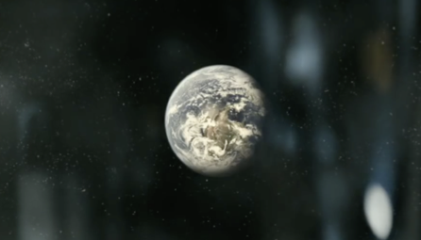
Think of a sentence for this picture that uses an embedded reporting clause.
“____________________,” ____________, “_________________.”

Slide 43
Think of a sentence for this picture that uses an embedded reporting clause.
“____________________,” ____________, “_________________.”

Slide 44
Think of a sentence for this picture that uses an embedded reporting clause.
“____________________,” ____________, “_________________.”

Slide 45
Reading time
Now that you have finished your main task, please enjoy some reading time.
You can read to yourself, an adult or sibling.
This can be done by logging on to your myON account, picking a book or magazine and enjoying at least 15 minutes reading time.
https://www.myon.co.uk/login/index.html
Remember that your login is your first name and first letter of your surname then password:
harryp
password1
Please email trailblazerspupils@gmail.com if you have any login issues.

Slide 46
End of lesson.

Slide 47
Read, copy, cover, spell this week’s spellings.
Date: Wednesday 3rd February 2021
famous
nervous
ridiculous
carnivorous
herbivorous
porous
adventurous
courageous
outrageous
advantageous

Slide 48
Date: Wednesday 3rd February 2021
LO: To be able to vary sentence length for effect.
Subject: English

Slide 49
Pre-recorded Teaching
Access the online teaching video below that will support you to complete the work in this lesson. This video will act as a support but all of the work can still be successfully understood & completed using paper-based versions of this pack. If you need further support to understand / complete work then please contact school via e-mail or telephone.
Play Video
You can also copy and paste this link if you would prefer:
https://classroom.thenational.academy/lessons/to-vary-sentence-length-for-effect-c4rk6e?activity=video&step=1

Slide 50
Today…
…we are going to focus on the part of your narrative where the monkey (you can choose their name) comes back down to Earth.
We want the reader to ask ‘will he make it?’
We are going to do this by varying the length of sentences we use.
This will create suspense and make the reader want to read on.

Slide 51
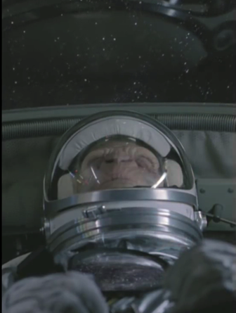
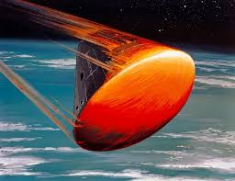
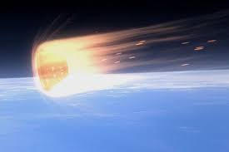
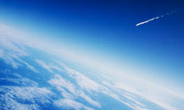
What a good one looks like.
65 years of space exploration and research would amount to nothing. Nothing if the brave astronaut could not re-enter the Earth’s atmosphere without being incinerated. The time had come. Would the ship withstand the astonishing temperatures long enough to make it down to the surface? Instantly, the fuselage began to shake uncontrollably. The temperature rose. Hot. Hotter. Too hot. Trying to distract himself from the feeling of being baked alive, Timothy thought of his loved ones waiting for him at home. The shuttle was now a blazing star shooting across the sky.

Slide 52
Varying the pace.
Build a sense of tension by making references to time.
Could she make it in time?
She searched desperately for a way to escape. Now frantic… time was running out.
The next few seconds unfolded in horrifying slow motion.
For fatal seconds, she stared, unable to think or move.
Here are some examples.

Slide 53
Have a try at completing these sentences by making a reference to time.
Would the heat shield _______________?
He began to bake. Timothy could feel himself cooking. Time _____________.
Re-entry only took 40 seconds but _______________ .
You could use the previous slide to help you.

Slide 54
Varying the pace
Vary the length of words, sentences and paragraphs to increase the pace and tension:
Put a group of short sentences together.
She ducked. He lunged.
Include one or two-word sentences.
“Oh no!”
Coming closer. Too close.
The temperature rose. Hot. Hotter. Too hot.

Slide 55
Short sentences can:
• create a quick, punchy rhythm
• draw attention to dramatic thoughts or actions
• create a sense of panic
The temperature rose. Hot. Hotter. Too hot.

Slide 56
Have a try at completing these group of short sentences.
The shuttle rattled. Parts began to groan. A panel ____________.
His heart stopped. Time _________. This was it.
Alarms scream. The shuttle groaned. Timothy _________.
You could use the previous slide to help you.

Slide 57
Long sentences can:
• create a slow rhythm
• include plenty of descriptive detail
• create a sense of time moving slowly.
Trying to distract himself from the feeling of being baked alive, Timothy thought of his loved ones waiting for him at home.

Slide 58
Have a try at completing these long sentences.
Thinking ________________, Timothy had to hold on. He had to make it.
Although the brave astronaut knew re-entry _____________ , he never _________.
Use these examples to up-level your sentences.
Hyphenated words Thinking about the final part of the mission, he feared that he would burn up when re-entering the atmosphere.
re-enter high-risk eye-popping blood-red blazing-hot red-hot super-strong world-famous
Fronted adverbial phrases Desperately gripping onto his seat, the astronaut prayed that he would make it.
Bravely______, Cautiously______, Proudly______, Anxiously______, Bleakly ______, Desperately______,

Slide 59
What a good one looks like.
65 years of space exploration and research would amount to nothing. Nothing if the brave astronaut could not re-enter the Earth’s atmosphere without being incinerated. The time had come. Would the ship withstand the astonishing temperatures long enough to make it down to the surface? Instantly, the fuselage began to shake uncontrollably. The temperature rose. Hot. Hotter. Too hot. Trying to distract himself from the feeling of being baked alive, Timothy thought of his loved ones waiting for him at home. The shuttle was now a blazing star shooting across the sky.

Slide 60
Task
Now write a paragraph (6-8 sentences) about when the astronaut re-enters the Earth’s atmosphere.
Include:
Shot sentences
Long sentences
Use these examples to up-level your sentences.
Hyphenated words Thinking about the final part of the mission, he feared that he would burn up when re-entering the atmosphere.
re-enter high-risk eye-popping blood-red blazing-hot red-hot super-strong world-famous
Fronted adverbial phrases Desperately gripping onto his seat, the astronaut prayed that he would make it.
Bravely______, Cautiously______, Proudly______, Anxiously______, Bleakly ______, Desperately______,

Slide 61
Reading time
Now that you have finished your main task, please enjoy some reading time.
You can read to yourself, an adult or sibling.
This can be done by logging on to your myON account, picking a book or magazine and enjoying at least 15 minutes reading time.
https://www.myon.co.uk/login/index.html
Remember that your login is your first name and first letter of your surname then password:
harryp
password1
Please email trailblazerspupils@gmail.com if you have any login issues.

Slide 62
End of lesson.

Slide 63
Read, copy, cover, spell this week’s spellings.
Date: Thursday 4th February 2021
famous
nervous
ridiculous
carnivorous
herbivorous
porous
adventurous
courageous
outrageous
advantageous

Slide 64
Date: Thursday 4th February 2021
L.O. To be able to add description through actions.
Subject: English

Slide 65
Today…
…we are going to focus on the part of your narrative where the monkey (you can choose their name) steps out of the space craft and realises that Earth has been destroyed.
We want to introduce brilliantly detailed descriptions through the actions of the character.

Slide 66
What do you think of this description?
He had an eyepatch. His hat was black and pointy. He had a sharp sward on his waist. He was wearing a leather coat. He has a map and his hands were wrinkly. His eyes were blue like the sea.

Slide 67
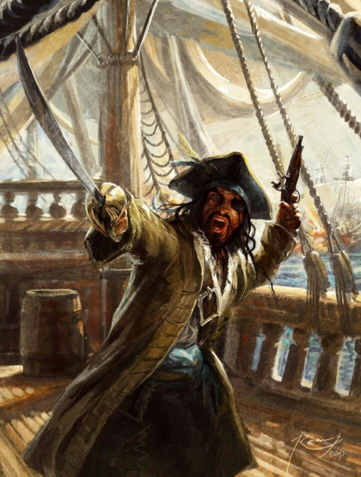
What a good one looks like.
While meticulously studying the weathered map clutched tightly in his gnarled hands, the cogs of the captain’s mind slowly turned. Suddenly, his deep, emerald eyes gleamed. His dreams had been realised. Stuffing his prized possession into the breast pocket of his tattered, leather overcoat, Jack marched across the salt encrusted deck to address his waiting crew. They waited unblinking. Silent. After divulging his discovery with his maties, Captain Jack wrenched his cutlass from his belt and pointed towards the gleaming sun.

Slide 68
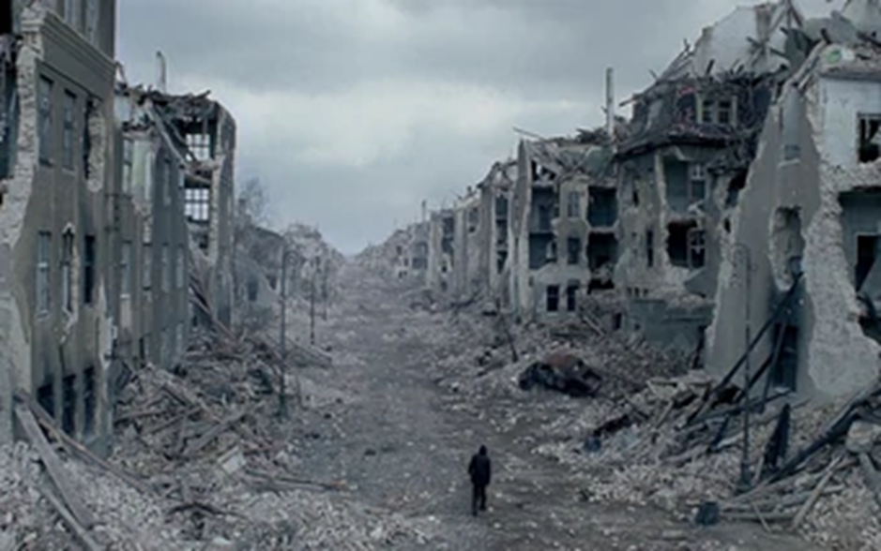
How do we do it?
To add description through actions, we need to think of things the character can do (verbs) that will allow us to introduce a description rather than just writing a description on it own.

Slide 69
How do we do it?
A description on its own:
The buildings were all destroyed.
A description through actions:
As Timothy wandered through the crumbling streets, every way he looked he was surrounded by the remnants of a horrific disaster.
My actions (verbs) are in red.

Slide 70
How do we do it?
A description on its own:
The buildings had holes blown through them.
A description through actions:
Mournfully staring into the distance, through the holes blown into the demolished buildings, he could not comprehend what must have happened.
My actions (verbs) are in red.

Slide 71
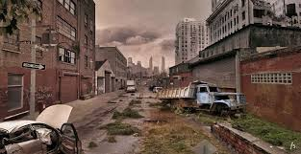
Rewrite the sentence using description through action.
A description on its own:
The vehicles had been abandoned.
A description through actions:
________________________________________________________________________________________________________________________________
Hyphenated words Broken-hearted, the solitary survivor weaved through the sea of abandoned vehicles.
bone-chilling high-risk eye-popping blood-red broken-hearted ill-equipped dull-orange
Fronted adverbial phrases Fearful that he would not find his family, the solitary survivor weaved through the sea of abandoned vehicles.
Fearfully______, Cautiously______, Proudly______, Anxiously______, Bleakly ______, Desperately______,

Slide 72
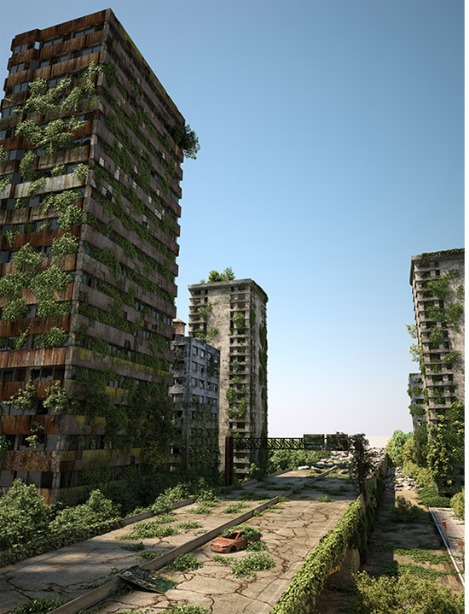
Rewrite the sentence using description through action.
A description on its own:
Trees and plants grew amongst the buildings.
A description through actions:
________________________________________________________________________________________________________________________________
Hyphenated words Broken-hearted, the solitary survivor weaved through the sea of abandoned vehicles.
bone-chilling high-risk eye-popping blood-red broken-hearted ill-equipped dull-orange
Fronted adverbial phrases Fearful that he would not find his family, the solitary survivor weaved through the sea of abandoned vehicles.
Fearfully______, Cautiously______, Proudly______, Anxiously______, Bleakly ______, Desperately______,

Slide 73
Task:
Now, write 3 sentences of your own that add description through action .
Hyphenated words Broken-hearted, the solitary survivor weaved through the sea of abandoned vehicles.
bone-chilling high-risk eye-popping blood-red broken-hearted ill-equipped dull-orange
Fronted adverbial phrases Fearful that he would not find his family, the solitary survivor weaved through the sea of abandoned vehicles.
Fearfully______, Cautiously______, Proudly______, Anxiously______, Bleakly ______, Desperately______,

Slide 74
Reading time
Now that you have finished your main task, please enjoy some reading time.
You can read to yourself, an adult or sibling.
This can be done by logging on to your myON account, picking a book or magazine and enjoying at least 15 minutes reading time.
https://www.myon.co.uk/login/index.html
Remember that your login is your first name and first letter of your surname then password:
harryp
password1
Please email trailblazerspupils@gmail.com if you have any login issues.

Slide 75
End of lesson.

Slide 76
Read, copy, cover, spell this week’s spellings.
Date: Friday 5th February 2021
famous
nervous
ridiculous
carnivorous
herbivorous
porous
adventurous
courageous
outrageous
advantageous

Slide 77
Date: Thursday 4th February 2021
L.O. To be able to write a narrative.
Subject: English

Slide 78
Writing warm-up
Write a sentence using a fronted adverbial phrase and a hyphenated word that you could use in your narrative.
Hyphenated words Broken-hearted, the solitary survivor weaved through the sea of abandoned vehicles.
bone-chilling high-risk eye-popping blood-red broken-hearted ill-equipped dull-orange
Fronted adverbial phrases Fearful that he would not find his family, the solitary survivor weaved through the sea of abandoned vehicles.
Fearfully______, Cautiously______, Proudly______, Anxiously______, Bleakly ______, Desperately______,

Slide 79
Check your writing
Mournfully staring at the dull-orange sunset, through the holes blown into the demolished buildings, he could not comprehend what must have happened
Hyphenated words Broken-hearted, the solitary survivor weaved through the sea of abandoned vehicles.
bone-chilling high-risk eye-popping blood-red broken-hearted ill-equipped dull-orange
Fronted adverbial phrases Fearful that he would not find his family, the solitary survivor weaved through the sea of abandoned vehicles.
Fearfully______, Cautiously______, Proudly______, Anxiously______, Bleakly ______, Desperately______,
Have you included a commas after the fronted adverbial phrase?

Slide 80
What a good one looks like.
65 years of space exploration and research would amount to nothing. Nothing if the brave astronaut could not re-enter the Earth’s atmosphere without being incinerated. The time had come. Would the ship withstand the astonishing temperatures long enough to make it down to the surface? Instantly, the fuselage began to shake uncontrollably. The temperature rose. Hot. Hotter. Too hot. Trying to distract himself from the feeling of being baked alive, Timothy thought of his loved ones waiting for him at home. The shuttle was now a blazing star shooting across the sky.
As the dust settled, the weary space traveller wrenched open the escape hatch to allow the sunlight to flood in. A warmth overcame him as he could step out without the need for a helmet for first time in a lifetime. Timothy squinted in the bright light. The warming blanked of comfort that he felt for only a moment was ripped away. It was gone. Destroy. Obliterated beyond recognition.
“This can’t be Earth!” exclaimed Timothy, angrily folding his arms, "I don’t recognise anything.”
The sound of his voice drifted away with the wind. Mournfully staring at the dull-orange sunset, through the holes blown into the demolished buildings, he could not comprehend what must have happened. All he knew was that he must try and find his family. Were they alive? As Timothy wandered through the crumbling streets, every way he looked he was surrounded by the remnants of a horrific disaster.

Slide 81
Task
My work is finished when:
Two paragraphs
Metaphors
Third person
Past tense
Embedded reporting clause
Short and long sentences
Action through description
Subordinate conjunctions
Hyphenated words
Write a narrative about the day the astronaut came back to Earth. Start from when the spaceship has to re-enter the Earth’s atmosphere.

Slide 82
Reading time
Now that you have finished your main task, please enjoy some reading time.
You can read to yourself, an adult or sibling.
This can be done by logging on to your myON account, picking a book or magazine and enjoying at least 15 minutes reading time.
https://www.myon.co.uk/login/index.html
Remember that your login is your first name and first letter of your surname then password:
harryp
password1
Please email trailblazerspupils@gmail.com if you have any login issues.

Slide 83
End of lesson

