Slide 1
Date: Monday 18th January
L.O To be able to answer questions about a text
Subject: English

Slide 2
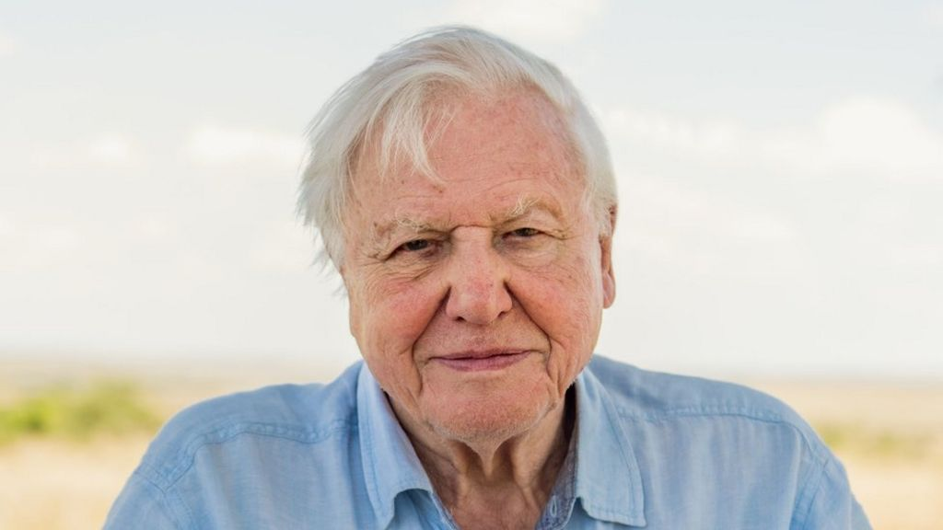
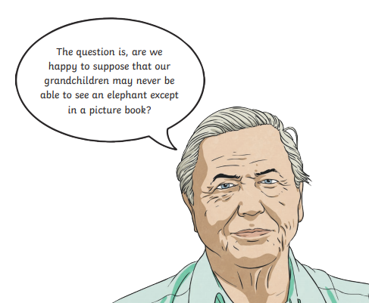
David Attenborough
Do you know who David Attenborough is?
Have you seen any of his programmes on TV?
Read through the information provided and answer the questions which follow.

Slide 3
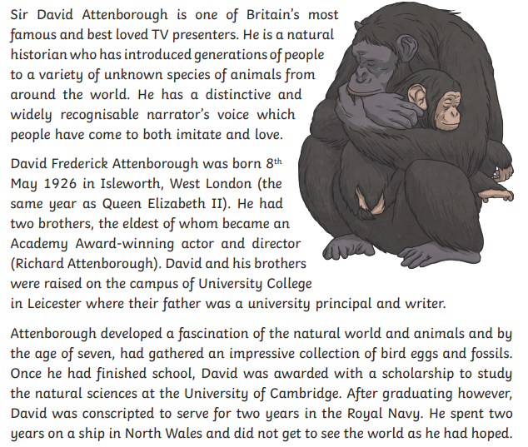

Slide 4
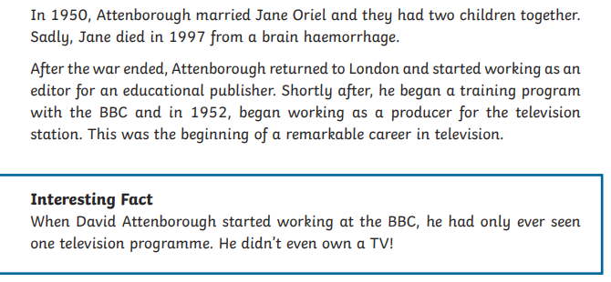
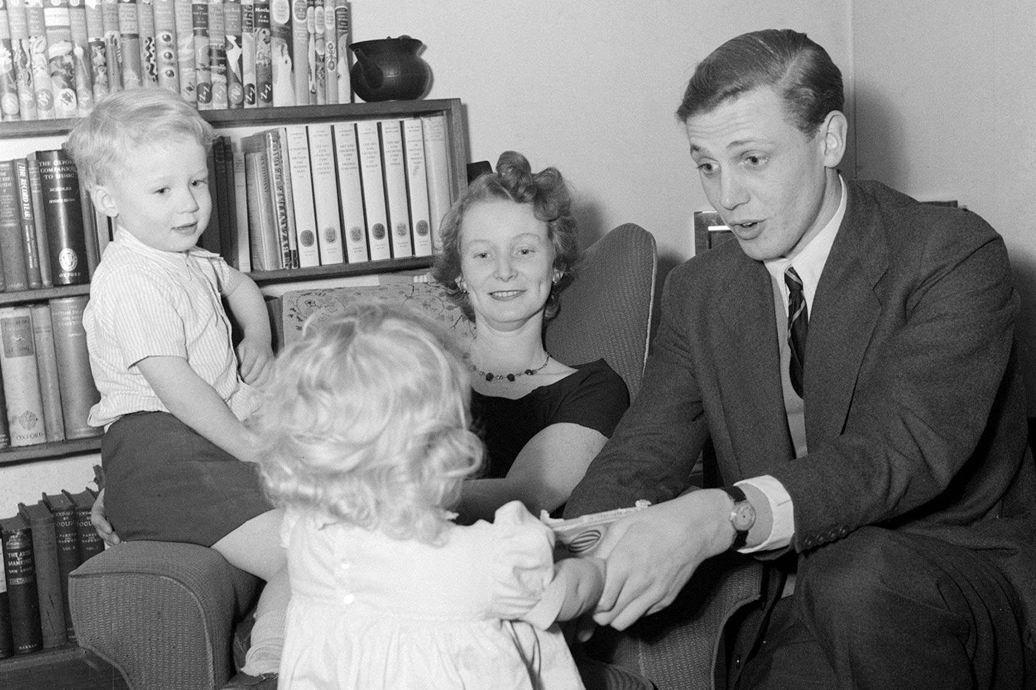

Slide 5
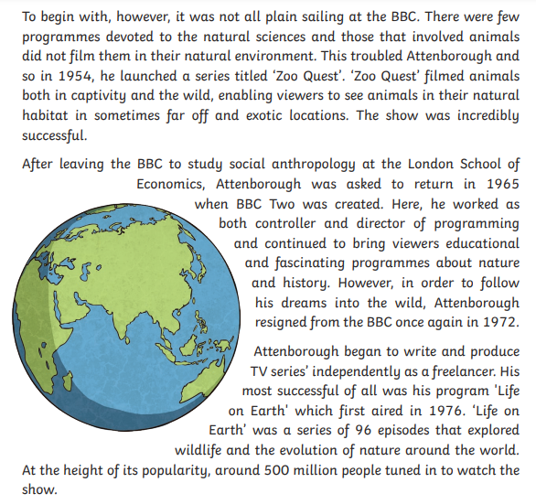

Slide 6
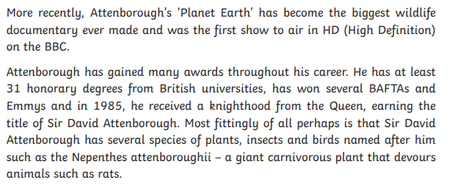
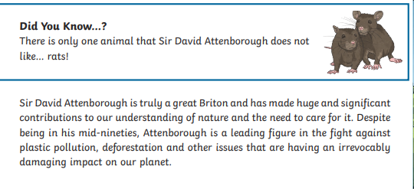

Slide 7
Write your answers to the questions below in full sentences.
Explain what the phrase ‘ distinctive and widely recognisable voice’ means.
When and where was Sir David Attenborough born?
What interested David when he was a young boy?
How do you think David felt when he was made to join the navy? Give a positive and negative emotion then explain your answer fully.
Why did Attenborough launch the TV series ‘Zoo Quest’?
Explain the two different reasons Attenborough left the BBC.
Why do you think many people like to watch Attenborough programmes?
Write down two interesting facts you have found out about Sir David Attenborough.

Slide 8
Here are some examples of answers:
The phrase ‘ distinctive and widely recognisable voice’ means lots of people know who he is and his voice is easy to recognise as him.
Sir David Attenborough was born on May 8th 1926 in Isleworth, London.
When he was a young boy, David was interested in animals and nature.
I think David might have felt excited when he was made to join the navy because he would be able to travel. However, he may have felt nervous because it was during the war and he could be killed.
Attenborough launched the TV series ‘Zoo Quest’ because he wanted to show viewers about animals in captivity to raise awareness.
Attenborough first left the BBC to study anthropology then in 1972 to follow his dreams in the wild .
I think many people like to watch Attenborough programmes because they are interesting and he is a well liked man.
Write down two interesting facts you have found out about Sir David Attenborough- these can be any from the text.

Slide 9
Reading time
Now that you have finished your main task, please enjoy some reading time.
You can read to yourself, an adult or sibling.
This can be done by logging on to your myON account, picking a book or magazine and enjoying at least 15 minutes reading time.
https://www.myon.co.uk/login/index.html
Remember that your login is your first name and first letter of your surname then password:
harryp
password1
Please email trailblazerspupils@gmail.com if you have any login issues.

Slide 10
Date: Tuesday 19th January
L.O To be able to identify features of a non- chronological report and research facts
Subject: English

Slide 11
What are non- chronological reports?
A non-chronological report is focused on a single topic and includes various facts about this topic.
The features of a non-chronological report include some of the following:
An eye-catching heading in a large font
An introductory paragraph
Text split up into paragraphs and each paragraph on a different aspect of the subject
Sub-headings for each paragraph
Usually written in present tense (but may have some elements of past tense)
Pictures of the subject
Captions under each picture to explain what is in the picture
Diagrams with labels
Lists of facts in bullet points

Slide 12
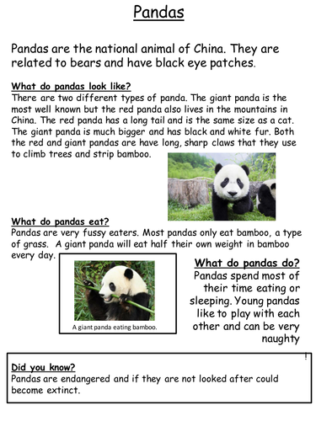
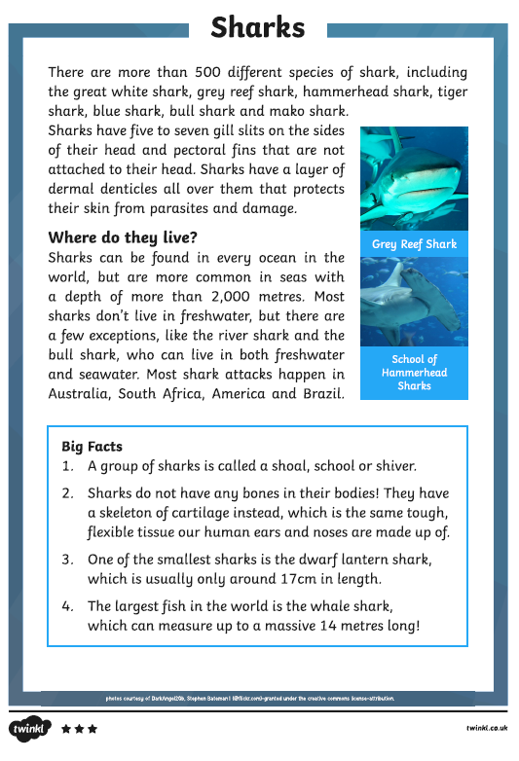
Examples of non- chronological reports
Heading
An introductory paragraph
Text split up into paragraphs and each paragraph on a different aspect of the subject
Sub-headings for each paragraph
Usually written in present tense (but may have some elements of past tense)
Pictures of the subject
Captions under each picture to explain what is in the picture

Slide 13
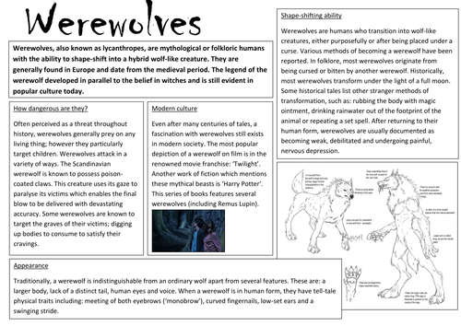
You do not need to read the information (don’t worry if it is blurry).
Task: Look over the next few examples of non- chronological reports. As the examples show, identify and highlight features of a non- chronological report.
The features are listed on the slides that follow as well as the second slide for today’s lesson.

Slide 14
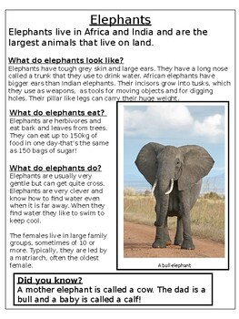
Use the checklist (on the next slide) to identify different features on the examples of non- chronological reports.

Slide 15
Task: Use the checklist to identify different features on the examples of non- chronological reports.
Features to identify:
An eye-catching heading in a large font
An introductory paragraph
Text split up into paragraphs and each paragraph on a different aspect of the subject
Sub-headings for each paragraph
Usually written in present tense (but may have some elements of past tense)
Pictures of the subject
Captions under each picture to explain what is in the picture
Diagrams with labels
Lists of facts in bullet points

Slide 16
Task 2: Researching facts- this will count as your reading task for today.
Now spend some time to find out more about Sir David Attenborough.
You may want to find out more about his early life, wife, family, time in the navy, TV shows or species/ plants named after him.
Take notes of facts you discover, these can be wrote in bullet points ( as we went over the other week).

Slide 17
Reading time
Now that you have finished your main task, please enjoy some reading time.
You can read to yourself, an adult or sibling.
This can be done by logging on to your myON account, picking a book or magazine and enjoying at least 15 minutes reading time.
https://www.myon.co.uk/login/index.html
Remember that your login is your first name and first letter of your surname then password:
harryp
password1
Please email trailblazerspupils@gmail.com if you have any login issues.

Slide 18
Date: Wednesday 20th January
L.O To be able to use brackets for parentheses
Subject: English

Slide 19
We covered this the week before last but here is a recap:
Copy and paste the web address below into a browser and watch the video. It might make you smile as you find out more!
https://www.bbc.co.uk/teach/supermovers/ks2-english-commas-brackets-dashes-with-ben-shires/zh32cqt
Here are some example sentences using brackets:
Sir David Attenborough was born during the same year as Queen Elizabeth II ( 1926 ) on 8th May in London.
Unfortunately, after graduating, David was conscripted (made to sign up) to the navy for two years.
Task : Where would the brackets go in this example? Add them in.
Sadly, David Attenborough’s wife Jane Oriel died because of a brain haemorrhage in 1997.

Slide 20
Task : Answer:
Sadly, David Attenborough’s wife (Jane Oriel) died because of a brain haemorrhage in 1997.
Task :
Look back over the reading comprehension information (from Monday’s lesson).
Can you find any examples of brackets?

Slide 21
Task : Write 6 sentences of your own about David Attenborough which include brackets. Use the reading comprehension and facts you researched (yesterday).
Remember to check your sentences are correctly punctuated and make sense.

Slide 22
Reading time
Now that you have finished your main task, please enjoy some reading time.
You can read to yourself, an adult or sibling.
This can be done by logging on to your myON account, picking a book or magazine and enjoying at least 15 minutes reading time.
https://www.myon.co.uk/login/index.html
Remember that your login is your first name and first letter of your surname then password:
harryp
password1
Please email trailblazerspupils@gmail.com if you have any login issues.

Slide 23
Date: Thursday 21st January
L.O To be able to use relative pronouns
Subject: English

Slide 24
What are relative clauses?
A relative clause can be used to give additional information about a noun.
They are introduced by a relative pronoun like 'that', 'which', 'who', 'whose', 'where' and 'when'.
For example:
I won’t stand by the man who smells of slime.
In this example, the relative clause is ‘who smells of slime’. It provides more information about the man. The relative pronoun, ‘who’, is used to connect these clauses in the sentence.
Copy and paste the web address into a browser then watch the video.
https://www.bbc.co.uk/bitesize/topics/zwwp8mn/articles/zsrt4qt

Slide 25
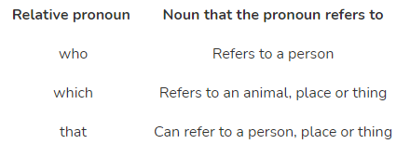
More information…
A relative clause is a specific type of subordinate clause that adapts, describes or modifies a noun. Relative clauses add information to sentences by using a relative pronoun such as who, that or which.

Slide 26
Examples of relative clauses:
Almost 95 years ago, Sir David Attenborough was born in Isleworth which is in West London.
A relative clause can also be an embedded clause if it is positioned in the middle of a sentence. Commas are used around the embedded clause, for example:
Famously, Sir David Attenborough, who is almost 95, has filmed lots of interesting nature programmes filmed in amazing locations.

Slide 27
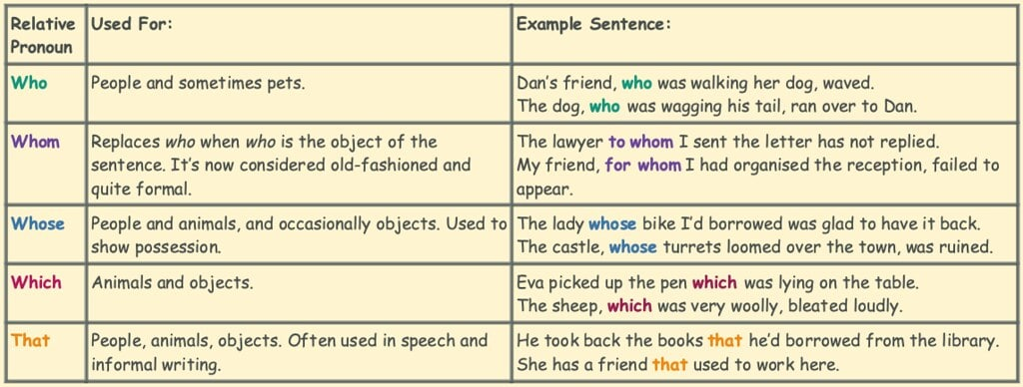
Task: Write 8 sentences of your own about Sir David Attenborough which include a relative clause.
Try to use a variety of relative pronouns (as shown before).
Use the relative pronouns to create embedded clauses in at least 2 sentences.
Sentence ideas:
Who is David Attenborough and why is he famous?
Facts about his family
Early life
TV shows
His passions and interests
Species named after him
Achievements

Slide 28
Reading time
Now that you have finished your main task, please enjoy some reading time.
You can read to yourself, an adult or sibling.
This can be done by logging on to your myON account, picking a book or magazine and enjoying at least 15 minutes reading time.
https://www.myon.co.uk/login/index.html
Remember that your login is your first name and first letter of your surname then password:
harryp
password1
Please email trailblazerspupils@gmail.com if you have any login issues.

Slide 29
Date: Friday 22nd January
L.O To be able to write a non- chronological report
Subject: English

Slide 30
Recap:
The features of a non-chronological report include some of the following:
An eye-catching heading in a large font
An introductory paragraph
Text split up into paragraphs and each paragraph on a different aspect of the subject
Sub-headings for each paragraph
Usually written in present tense (but may have some elements of past tense)
Pictures of the subject
Captions under each picture to explain what is in the picture
Diagrams with labels
Lists of facts in bullet points

Slide 31
Task: To write a non- chronological report about Sir David Attenborough
Give your report a title and write it at the top of your page.
Introduction- write a sentence to explain who Sir David Attenborough is. Include an embedded clause.
Write down a sub- heading eg:
Early Life
Look back over the work from this week and your notes. Write 4 sentences about David Attenborough’s early life. Include a sentence with a relative clause and one with brackets.
Decide upon your next sub- heading such as TV shows, Achievements, Working Life, New Species.
Write it down and complete two paragraphs of writing. Remember to include brackets, relative clause and embedded clauses. ( At least one example of each).

Slide 32
Reading time
Now that you have finished your main task, please enjoy some reading time.
You can read to yourself, an adult or sibling.
This can be done by logging on to your myON account, picking a book or magazine and enjoying at least 15 minutes reading time.
https://www.myon.co.uk/login/index.html
Remember that your login is your first name and first letter of your surname then password:
harryp
password1
Please email trailblazerspupils@gmail.com if you have any login issues.

