Slide 1
Date: Tuesday 5th January – Friday 8th January
LO To be able to read real words and alien words.
Please practise phonics every day for 20 minutes.
Subject: Phonics

Slide 2
Daily Phonics Videos
Read Write Inc
Click the below link or copy and paste into the internet to see daily phonics videos.
Read Write Inc are offering free phonics lessons on YouTube. They are posted at 9.30am and are available for 24 hours.
https://www.youtube.com/channel/UCo7fbLgY2oA_cFCIg9GdxtQ

Slide 3
Phonics
BBC Bitesize has lots of 30 second videos focusing on each of the phonics sounds.
https://www.bbc.co.uk/bitesize/topics/zvq9bdm
Copy and paste the link.

Slide 4
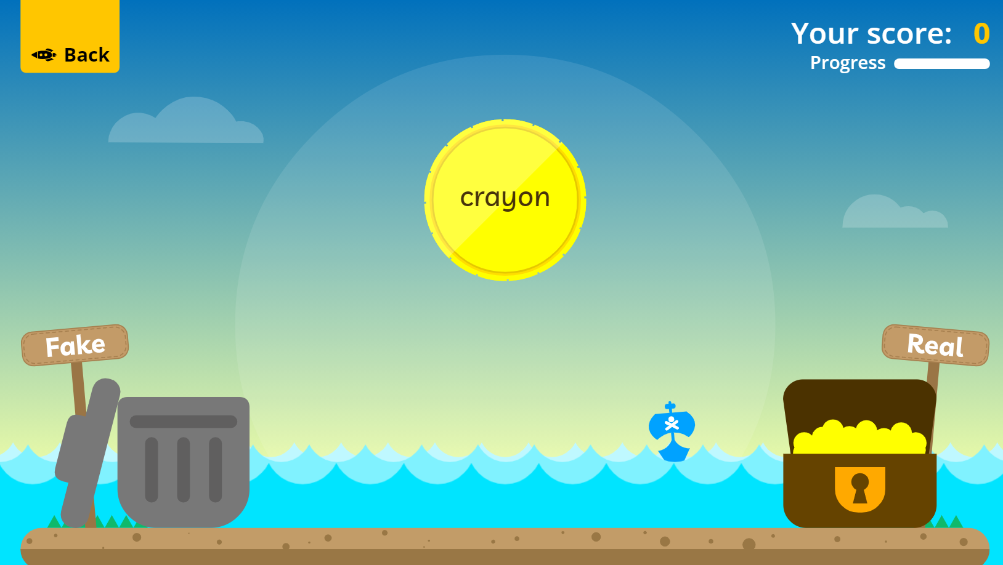
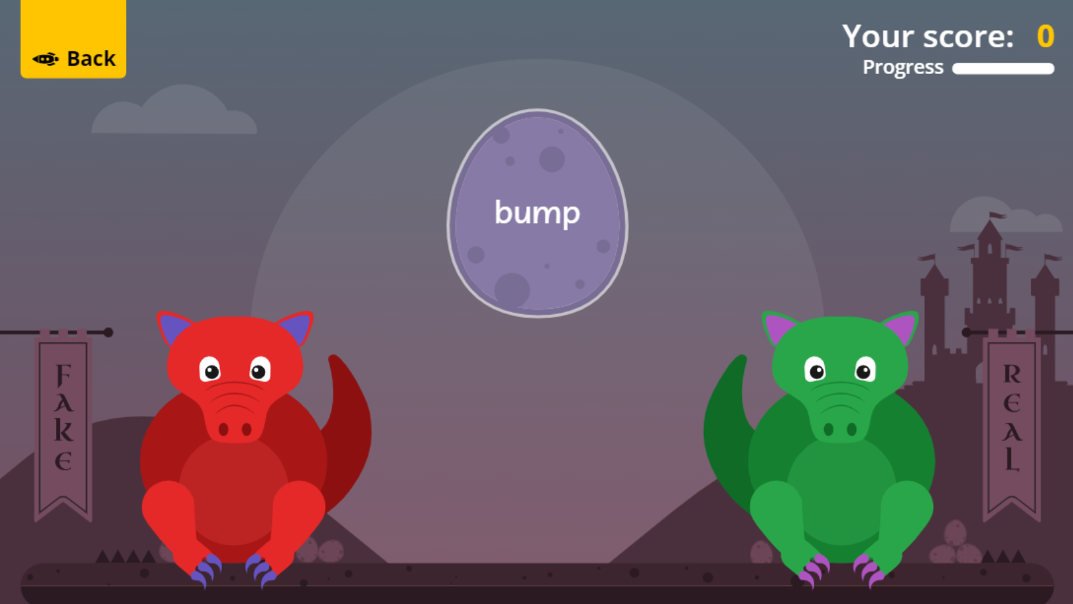
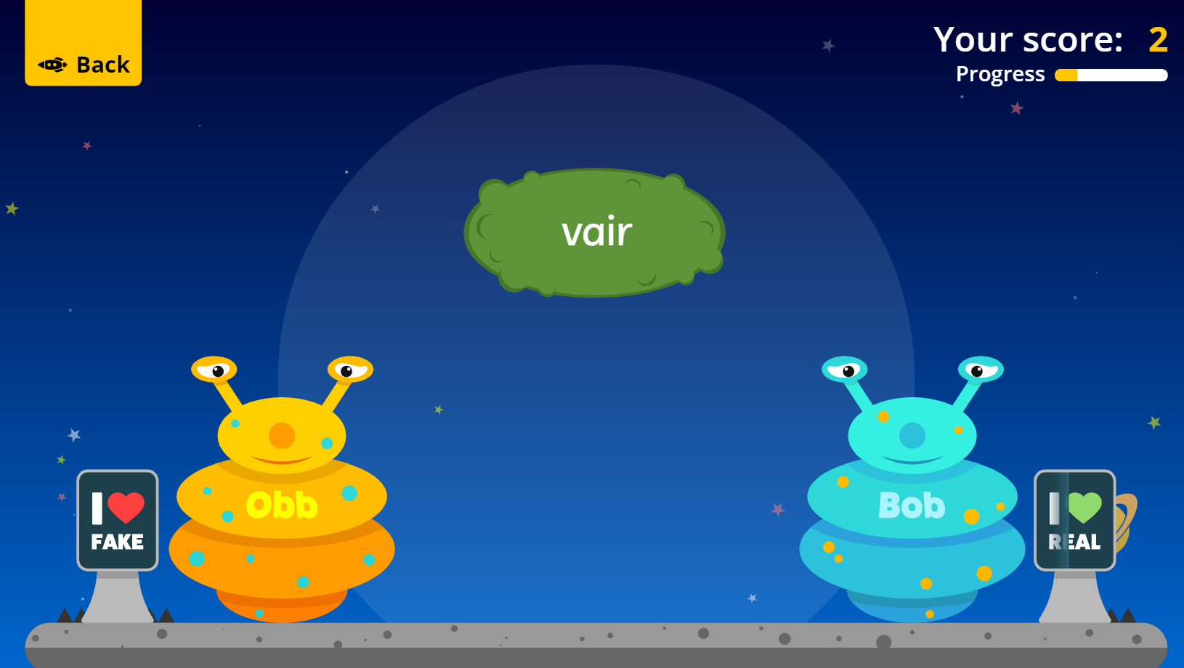
Fun Phonics Games!
Copy and paste the link to play these fun phonics games!
https://www.phonicsplay.co.uk/resources/phase/2/buried-treasure
All phases
https://www.phonicsplay.co.uk/resources/phase/2/dragons-den
All phases
https://www.phonicsplay.co.uk/resources/phase/2/picnic-on-pluto
All phases

