Slide 1
Subject: English
Pack: A

Slide 2
This lesson was also included in the first powerpoint so you may have completed it if you were ahead
Monday 28th June
L.O To be able to use ing openers
Subject: English

Slide 3
L.O To be able to spell words from the Y3/4 spelling list
Pick three of these words and write a sentence using each of them.
______________________________________________________________________________________________
______________________________________________________________________________________________
______________________________________________________________________________________________

Slide 4
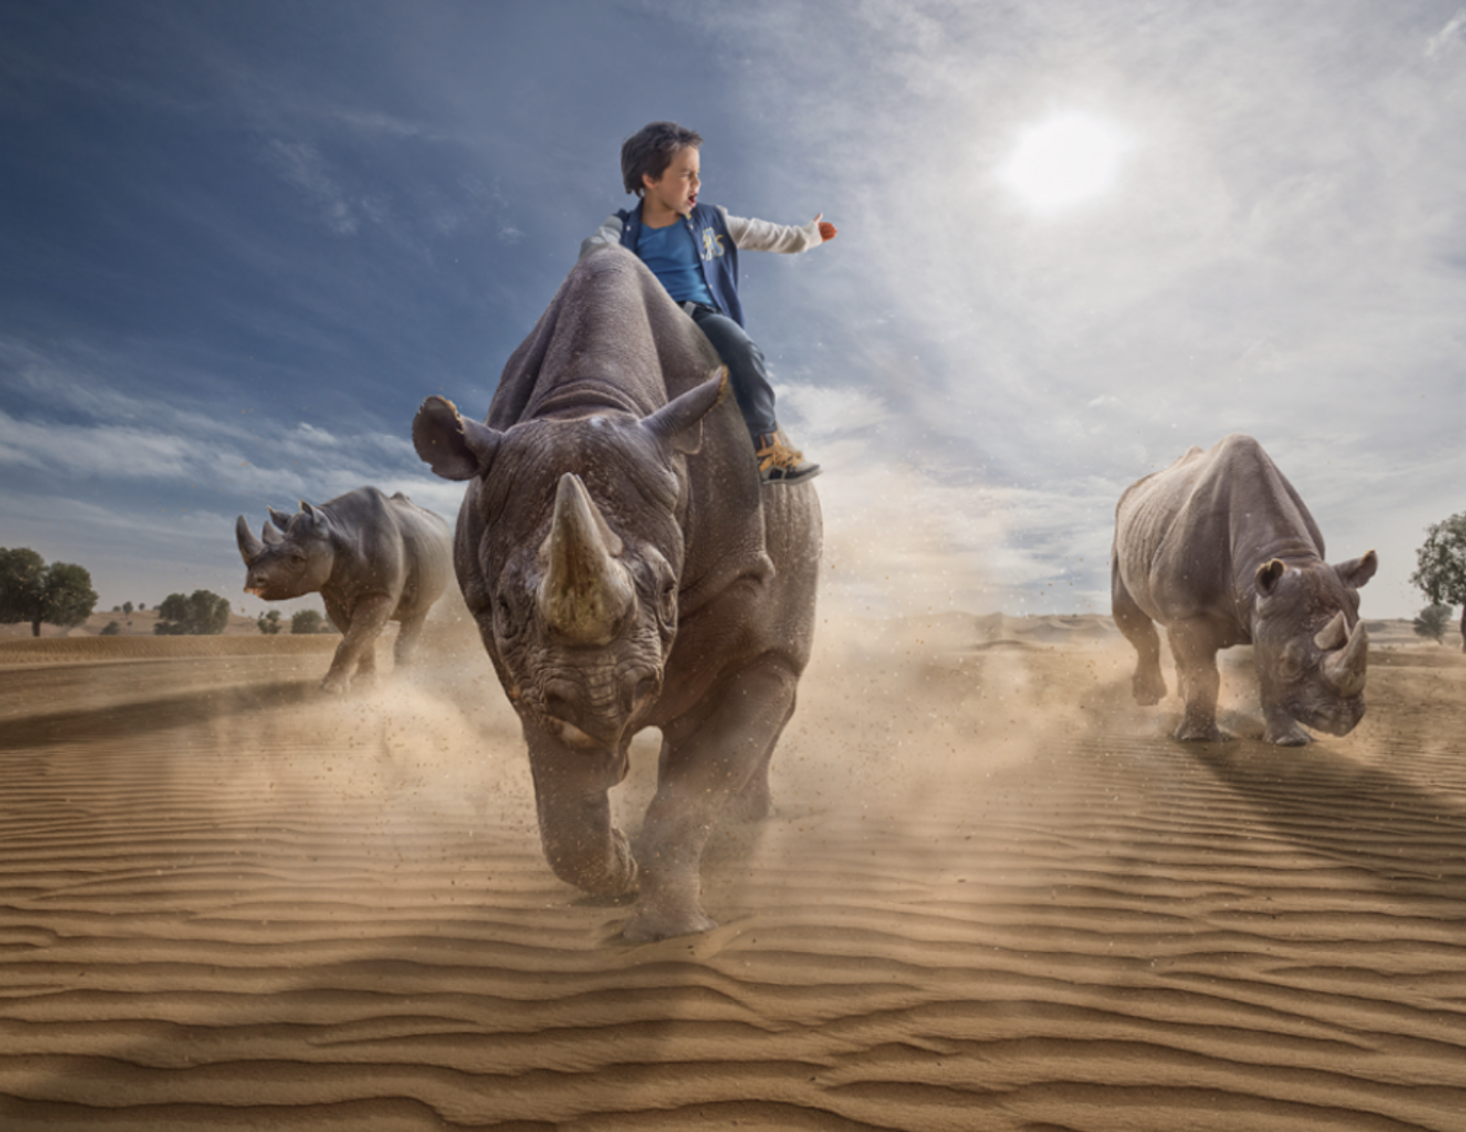
Write a list of ing words/ verbs (doing words) around the picture of the troll, I'll start you off :)
Running
Stampeding
Charging
Blowing

Slide 5
The ing opener goes at the start of the sentence and is followed by a comma after the full phrase
E.g.
Feeling brave, the boy lifted one arm into the air.
Blowing across the desert, the sand flew into the boy's eyes.

Slide 6
Use the verbs you wrote around the picture to help write the sentences.
The first few have been started for you. Dont forget the commas!
1. Heading across the desert, __________________________________________
_______________________________________________________________________
2. Charging as fast as possible, _________________________________________
_______________________________________________________________________
3. _________________________________________________________________
______________________________________________________________________ .

Slide 7
4._____________________________________________________________________________________________________________________________________________
5._____________________________________________________________________________________________________________________________________________
6._____________________________________________________________________________________________________________________________________________
7._____________________________________________________________________________________________________________________________________________

Slide 8
Monday 28th June
Add an apostrophe in the correct place
The boys face was covered in dust and sand from the desert.

Slide 9
Tuesday 29th June
L.O To be able to use apostrophes for possession
Subject: English

Slide 10
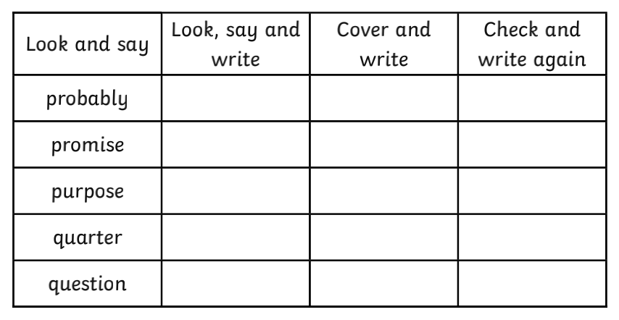
L.O To be able to spell words from the Y3/4 spelling list

Slide 11
A possessive appostrophes show that something belongs to someone
Singular apostrophes (1 person)
The girl's hair was long. .... The apostrophe shows that the hair belongs to the girl.
Jess' shoes were muddy. ... The shoes belong to Jess. When a word/name ends in a s the apostrophe goes after the S at the end.
Plural apostrophes (more than 1 person)
The brothers' toy was broken .... The toy belongs to the brothers. Brothers is a plural noun (e.g. 2 brothers) that ends in an S so the apostrophe goes after the S.

Slide 12
Click on the picture or follow the link to play a game and to learn more about apostophes.
https://www.spellingplay.co.uk/planning-and-resources/year-2/apostrophes/possessive-apostrophe

Slide 13
Example-
The boy's arm was raised into the air.
The arm belongs to the boy.
Put the apostrophes in the right places.
1. Sand blew into the young boys eyes.
2. The suns rays covered the entire desert.
3. The rhinos legs moved as fast as possible.

Slide 14
Now add 4 sentences of your own.
Remember to make sure something belongs to
someone in your sentences. An apostrophe doesn't go after every
S you see.
4. ____________________________________________________________
5. ____________________________________________________________
6. ____________________________________________________________
7. ________________________________________________________

Slide 15
Tuesday 29th June
Add inverted commas to this sentence.
Charge! As fast as you can! screamed the boy in panic.

Slide 16
Wednesday 30th June
L.O To answer questions based on a text
Subject: English

Slide 17
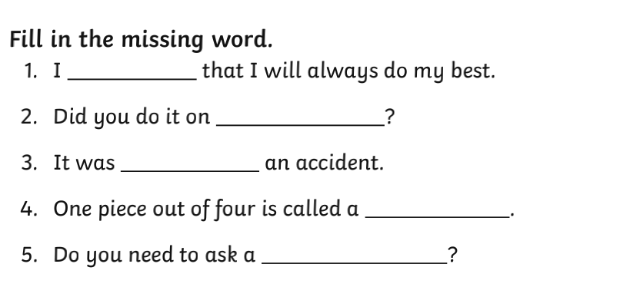
L.O To be able to spell words from the Y3/4 spelling list

Slide 18
As our work has been on rhinos this week, I thought we could learn more about them. Read all the information on these 2 pages.

Slide 19
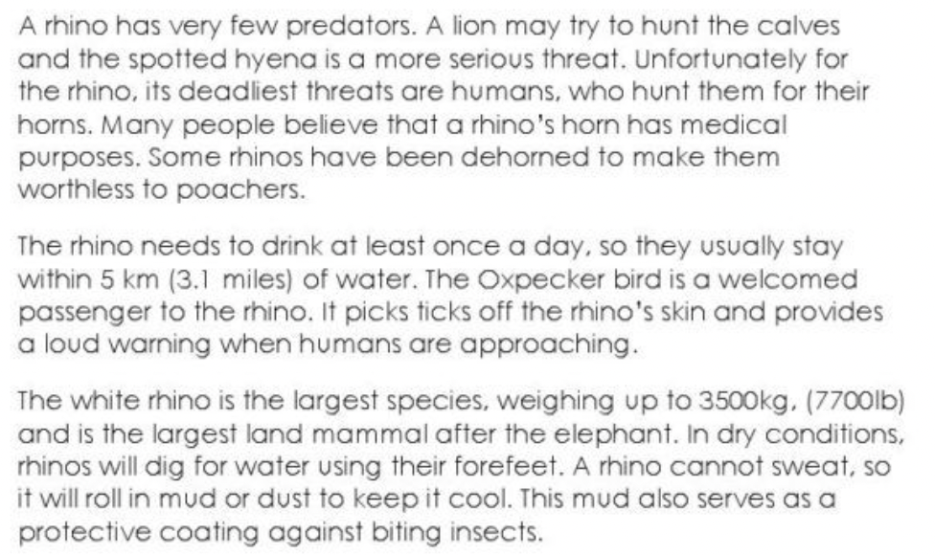
As our work has been on rhinos this week, I thought we could learn more about them. Read all the information on these 2 pages.

Slide 20
Answer the questions in full sentences. Use the information given to help you
1. How many species of rhinoceros are there?
_______________________________________________________________
2. What makes the black rhino so dangerous?
_______________________________________________________________
_______________________________________________________________
3. How does an Oxpecker bird help a rhino?
__________________________________________________________________________________________________________________________________

Slide 21
Answer the questions in full sentences. Check back on the information to help you.
4. How does a rhino keep cool?
__________________________________________________________________________________________________________________________________
5. What is the rhino's horn compared to? _______________________________________________________________
_______________________________________________________________
6. What is the biggest threat to rhinos? How does this make you feel?
__________________________________________________________________________________________________________________________________

Slide 22
Wednesday 30th June
Complete this sentence
I think a rhino is an interesting creature because
__________________________________________________________________________________________

Slide 23
Thursday 1st July
L.O To be able to start sentences with prepositions
Subject: English

Slide 24
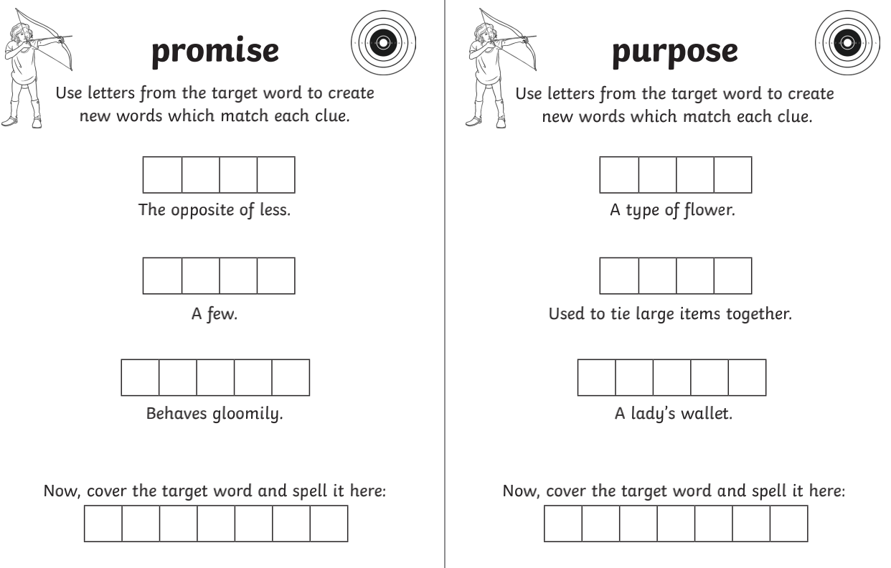
L.O To be able to spell words from the Y3/4 spelling list

Slide 25
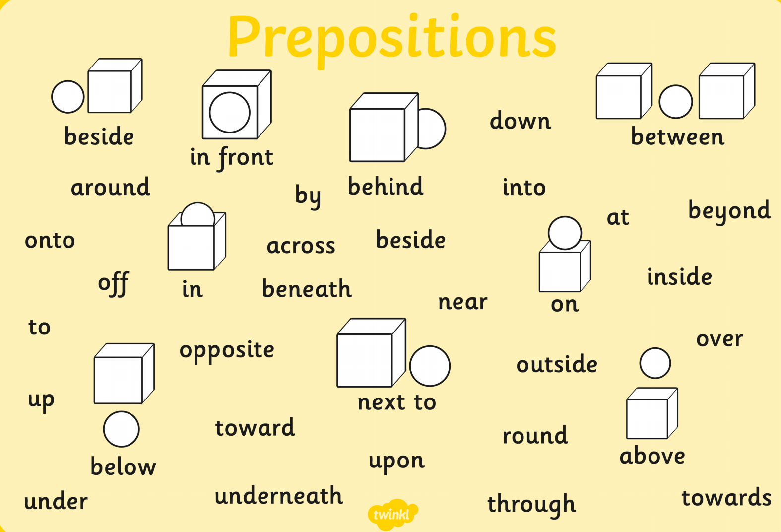
A preposition is a word that tells you where or when something is in relation to something else.
Examples
https://www.bbc.co.uk/bitesize/topics/zwwp8mn/articles/zw38srd
Click this link for some games and more information

Slide 26
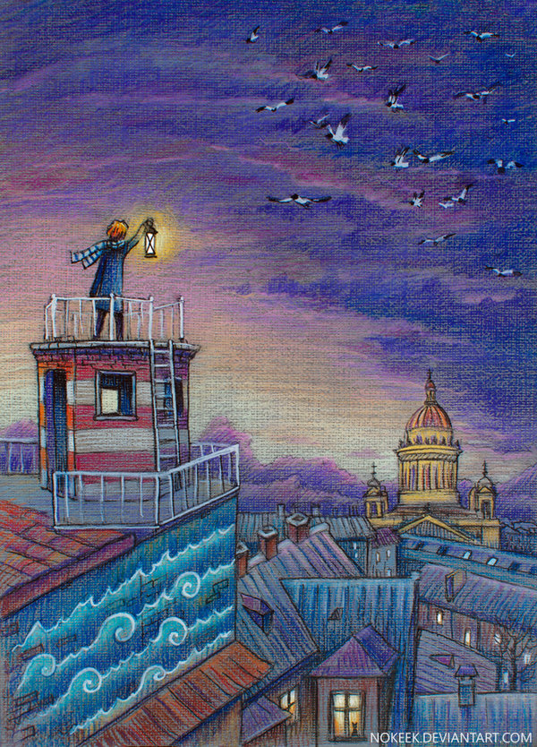
Here is a new picture to look at for today's work.
Have a think about everything you can see -
Lamp
Birds
Cathedral

Slide 27
Today our prepositions will go at the start
of the sentences.
E.g. Opposite the lighthouse, the cathedral's
bells chimed loudly.
Complete the rest of the sentence
1. Above his head, _____________________________________________
______________________________________________________________
2. Below the beautiful sky, ______________________________________
_______________________________________________________________

Slide 28
Now write 4 sentences of your own, try to use a different preposition for each opener.
3. ______________________________________________________________
________________________________________________________________
4. ______________________________________________________________
________________________________________________________________
5. ______________________________________________________________
________________________________________________________________
6. ______________________________________________________________
________________________________________________________________

Slide 29
Thursday 1st July
Add an opener to this sentence
___________________________ , the seagulls swooped across the peaceful sky.

Slide 30
Friday 2nd July
L.O To be able to describe a picture
Subject: English

Slide 31
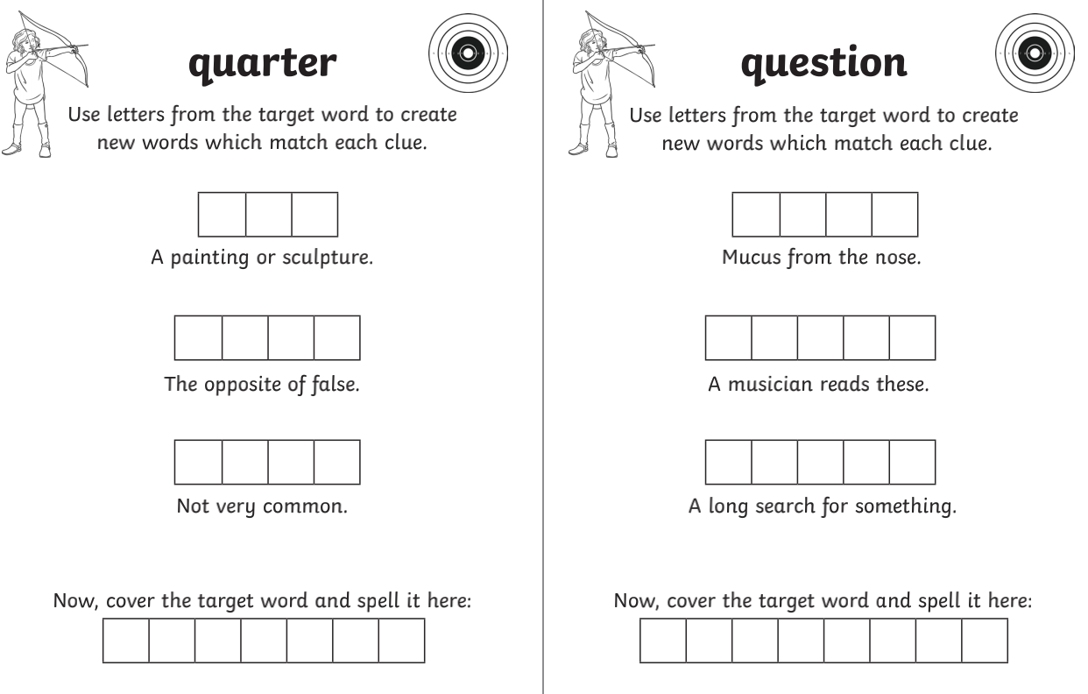
L.O To be able to spell words from the Y3/4 spelling list

Slide 32
Describe some of the things we can see in the picture to help with your paragraph. I've started you off :)
Peaceful
Quiet
Lonely
Bright
Golden

Slide 33
Here are some prompts to start you off :)
A lonely man stood on top of the lighthouse, he had a striped scarf around his neck and was holding a _____________ , ____________ lamp. Looking down below, he could see _________________________ _____________________________________ _____________________________________
____________________________________________________________________________

Slide 34
You could include how he feels as he looks over the town, what he can see/ hear etc..
__________________________________________________________________________________________________________________
__________________________________________________________________________________________________________________
__________________________________________________________________________________________________________________

Slide 35
Friday 2nd July
Correct this sentence
quietly the boy stood and looked up at the blue cloudy sky

