Slide 1
Subject: Maths
Pack: A

Slide 2
Date: 01.02.2021
LO: To be able to describe the position of a shape in the first and second quadrant.
Subject: Maths

Slide 3
Pre-recorded Teaching
Mr. Herdman’s online teaching video is on our school website. It will support you to complete the work in this lesson. This video will act as a support but all of the work can still be successfully understood & completed using paper-based versions of this pack. If you need further support to understand / complete work then please contact school via e-mail or telephone.
You can also copy and paste this link if you would prefer:
https://www.whprimary.com/copy-4-of-covid19

Slide 4
Times table practise
Spend at least 15mins practising your times tables.
This can be done on TTRS, hit the button or any other times table website.
Use the Times Tables Rock Stars app or website.
Alternatively, copy and paste the following link into a web browser:
https://www.topmarks.co.uk/maths-games/7-11-years/times-tables

Slide 5
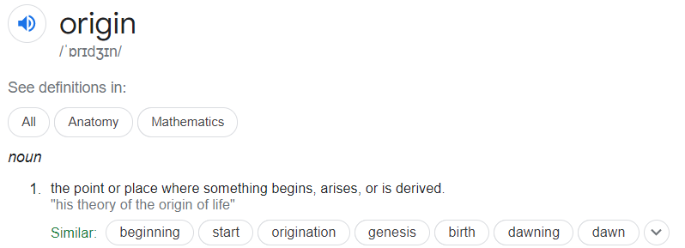
A coordinate system
10
y-axis
9
8
7
6
5
Origin
4
3
2
1
x-axis
0
3
4
5
9
10
1
2
6
7
8
Notes:
A cartesian coordinate system is a coordinate system that we are going to use today. This is a 10 by 10 grid cartesian coordinate system.
Outside of a cartesian coordinate system, coordinates is used in mapping to chart the landscape.
In a cartesian coordinate system, coordinates are a set of values that shows an exact position on a grid. The horizontal line are called x-axis, and the vertical line are called a y-axis.
The origin is the starting point. The origin is the point where the planes meet, and the value of coordinates are normally defied as zero. Here is a definition of Origin from a dictionary. Axes refers to the two line, x-axis and y-axis and the word, intersect means a place where two things meet.
I have explained the basics of a cartesian coordinate system, now we are going to use coordinates to plot and discover shapes, let’s move on.

Slide 6
Horizontal and Vertical lines
Horizonal
Vertical
y-axis
x-axis
Notes:
Before we start, I am going to explain what x and y axis are, and doing this, I will quickly recap a lesson that you all probably have learnt before.
x-axis are horizontal, which is a straight line that goes from left to right or right to left, and a tip for you, horizontal sounds like horizon, which is a landscape, which should help you remember the direction of a horizonal. Horizon lies on the ground.
y-axis are vertical, which is a straight line that goes from top to bottom or bottom to top.

Slide 7
Marking coordinates in the first quadrant
y-axis
I am going to explain how to plot a coordinate on the first quadrant.
Firstly, we are going to focus on the x-axis on the first quadrant.
Starting from the origin of the x-axis (0), read along the x-axis to the number 2.
Secondly, from the origin of the y-axis, read along to the number 3.
At this point, mark the coordinate with a cross.
How do you write down the coordinate?
It is written (2, 3)
x-axis

Slide 8
Marking coordinates in the first quadrant
y-axis
Now we are going to try and plot these four coordinates.
(5, 8)
(1, 3)
(1, 9)
(5, 2)
Connect these plots to create a quadrilateral, can you name the shape of this quadrilateral?
x-axis

Slide 9
Marking coordinates in the first quadrant
y-axis
Now we are going to try and plot these four coordinates.
(5, 8)
(1, 3)
(1, 9)
(5, 2)
Connect these plots to create a quadrilateral, can you name the shape of this quadrilateral?
Answer: A parallelogram
x-axis

Slide 10
The first and second quadrant
y-axis
10
9
Second
quadrant
First
quadrant
8
7
6
5
4
3
2
1
x-axis
-10
-9
-8
-7
-6
-5
-4
-3
-2
-1
0
1
2
3
4
5
6
7
8
9
10
Notes:
This is a cartesian coordinate system covering both first and second quadrant? Can you guess which part of the grid belongs to the first quadrant? Which part of the grid belongs to the second quadrant? Pause the video and attempt to answer the question, before continuing the video. The first quadrant of the grid is actually on the right side, while the second quadrant is on the left side of the grid.
Got that? Now let’s go in depth about the first and second quadrant and how to mark coordinates to describe the position of a shape on the grid in both first and second quadrant.

Slide 11
The first and second quadrant
y-axis
The point where the horizonal and vertical axes intersect is at (0, 0) called the origin.
Second
quadrant
First
quadrant
When the x-axis line is extended beyond the origin into negative numbers, a much larger grid is created, which is made of two areas called quadrants. The first and second quadrant are displayed in the grid.
x-axis

Slide 12
The first and second quadrant
y-axis
The first quadrant
Positions in the first quadrant always have a positive x-axis coordinate and a
positive y-axis coordinate.
Second
quadrant
First
quadrant
The second quadrant
Positions in the second quadrant always have a negative x-axis coordinate and a positive y-axis coordinate.
x-axis

Slide 13
Marking coordinates in the second quadrant
y-axis
I am going to explain how to mark a coordinate on the second quadrant.
Firstly, we are going to focus on x-axis on the second quadrant.
Starting from the origin of the x-axis (0), read along the x-axis to the number -4.
Secondly, from the origin of the y-axis, read along to the number 8.
At this point, plot the coordinate with a cross.
How do you write down the coordinate?
It is written (-4, 8)
x-axis

Slide 14
Marking coordinates in the second quadrant
y-axis
Now we are going to try and plot these four coordinates.
(-3, 8)
(-5, 6)
(-3, 4)
(-1, 6)
Connect these plots to create a quadrilateral, can you name the shape of this quadrilateral?
x-axis

Slide 15
Marking coordinates in the second quadrant
y-axis
Now we are going to try and plot these four coordinates.
(-3, 8)
(-5, 6)
(-3, 4)
(-1, 6)
Connect these plots to create a quadrilateral, can you name the shape of this quadrilateral?
x-axis

Slide 16
Marking coordinates in the second quadrant
y-axis
Now we are going to try and plot these four coordinates.
(-3, 8)
(-5, 6)
(-3, 4)
(-1, 6)
Connect these plots to create a quadrilateral, can you name the shape of this quadrilateral?
Answer: A rhombus
x-axis

Slide 17
First and second quadrant
y-axis
Together, we have plotted the coordinate (2, 2) on the first quadrant and the coordinate (-4, 8) on the second quadrant.
Now, we are going to try and plot two further coordinates. Plot these coordinates;
(2, 8)
(-4, 2)
Now connect the marked coordinates using a ruler, can anyone confirm what shape is visible on the grid?
x-axis

Slide 18
First and second quadrant
y-axis
Together, we have plotted the coordinate (2, 2) on the first quadrant and the coordinate (-4, 8) on the second quadrant.
Now, we are going to try and plot two further coordinates. Plot these coordinates;
(2, 8)
(-4, 2)
Now connect the marked coordinates using a ruler, can anyone confirm what shape is visible on the grid?
Answer: A square.
x-axis

Slide 19
Plotting these coordinates
10
9
Plot these following vertices on the grid.
A vertex, or in plural form, vertices, shows the point of where two lines meet on a grid.
(3, 5)
(4, 4)
(0, 2)
(4, 0)
8
7
6
y-axis
5
4
3
2
1
0
1
2
3
4
5
6
7
8
9
10
x-axis

Slide 20
Plotting these coordinates
10
9
Plot these following vertices on the grid.
A vertex, or in plural form, vertices, shows the point of where two lines meet on a grid.
(3, 5)
(4, 4)
(0, 2)
(4, 0)
8
7
6
y-axis
5
4
3
2
1
0
1
2
3
4
5
6
7
8
9
10
x-axis

Slide 21
Plotting these coordinates
y-axis
10
9
What are the coordinates of the vertices of the rectangle?
( , )
( , )
( , )
( , )
8
7
6
5
4
3
2
1
-10
-9
-8
-7
-6
-5
-4
-3
-2
-1
0
x-axis

Slide 22
Plotting these coordinates - answer
Plotting these coordinates
y-axis
10
9
What are the coordinates of the vertices of the rectangle?
( , )
( , )
( , )
( , )
8
7
(-4, 2)
(-4, 3)
(0, 2)
(0, 3)
6
5
4
3
2
1
-10
-9
-8
-7
-6
-5
-4
-3
-2
-1
0
x-axis

Slide 23
Recap
Remember to start with the x-axis first, which is the horizonal line at the bottom, before moving on the y-axis, which the vertical line in the middle of the grid.
Always start from the origin of the axis, can anyone write down the coordinate of the origin of the axis?
(0, 0).

Slide 24
Task 1
Using the blank grid of the first quadrant on the next slide, draw these shapes. Write down the coordinate for their vertices.
A rectangle
A square
A triangle

Slide 25
Task 1
10
9
8
7
6
y-axis
5
4
3
2
1
0
1
2
3
4
5
6
7
8
9
10
x-axis

Slide 26
Task 2
In the next slide, Mr Herdman has plotted two vertices of a square, labelled (5, 2) and (-1, 2) on the grid.
Vertex or in plural form, vertices, shows a point where two lines meet.
What are the coordinates of vertices A and B? Using a ruler, connect the vertices to draw a square.
Vertex A = ( , ) Vertex B = ( , )

Slide 27
Task 2
y-axis
10
9
A
B
8
7
6
5
4
3
2
1
x-axis
-10
-9
-8
-7
-6
-5
-4
-3
-2
-1
0
1
2
3
4
5
6
7
8
9
10

Slide 28
Task 2 - answers
y-axis
10
(-1, 8)
9
B
(5, 8)
A
8
7
Vertex A = (-1, 8)
Vertex B = (5, 8)
6
5
4
3
2
1
x-axis
-10
-9
-8
-7
-6
-5
-4
-3
-2
-1
0
1
2
3
4
5
6
7
8
9
10

Slide 29
Task 3
In the next slide, Mr Herdman has plotted three vertices of a rectangle, labelled (-9, 2), (5, 2) and (5, 5) on the grid.
Mr Herdman estimates that the final vertex of the rectangle, marked D on the grid, is (4, -8).
Is Mr Herdman correct? Using a ruler, connect all of the vertices to draw your rectangle on the grid.
Vertex D = ( , )

Slide 30
Task 3
y-axis
10
9
8
7
6
D
5
4
3
2
1
x-axis
-10
-9
-8
-7
-6
-5
-4
-3
-2
-1
0
1
2
3
4
5
6
7
8
9
10

Slide 31
Task 3 - answer
y-axis
10
9
Vertex D = (-9, 5)
8
7
(-9, 5)
6
D
5
4
3
2
1
x-axis
-10
-9
-8
-7
-6
-5
-4
-3
-2
-1
0
1
2
3
4
5
6
7
8
9
10

Slide 32
Task 4
Mr Herdman has drawn a square, but silly Mr Herdman has somehow forgotten to draw a grid.
Mr Herdman reveals the first two coordinates of the two vertices.
Use the next slide to draw the square.
What are the coordinates of vertices A and B?
Vertex A = ( , )
Vertex B = ( , )
(-6, 9)
B
A
(2, 1)

Slide 33
Task 4
y-axis
10
9
8
7
6
5
4
3
2
1
x-axis
-10
-9
-8
-7
-6
-5
-4
-3
-2
-1
0
1
2
3
4
5
6
7
8
9
10

Slide 34
Task 4 - answers
(2, 9)
B
Vertex A = (-6, 1)
Vertex B = (2, 9)
Find out in the next slide for the correct position of the square.
(-6, 9)
A
(2, 1)
(-6, 1)

Slide 35
Task 4 - answers
y-axis
10
9
8
7
6
5
4
3
2
1
x-axis
-10
-9
-8
-7
-6
-5
-4
-3
-2
-1
0
1
2
3
4
5
6
7
8
9
10

Slide 36
Grey Box Challenge 1
Mr Herdman would like you to answer these questions.
What is an origin? ________________________________________________________________________________________________________________________________________________________________________
What is a vertex?
________________________________________________________________________________________________________________________________________________________________________
Mr Herdman thinks this line is a vertical line. Is Mr Herdman correct? (circle one) Yes No

Slide 37
Grey Box Challenge 1 = answers
Mr Herdman would like you to answer these questions.
What is an origin?
The origin is the starting point. The origin is the point where the planes meet, and the value of coordinates are normally defied as zero
What is a vertex?
Vertex is used to show a point where two lines meet.
Mr Herdman thinks this line is a vertical line. Is Mr Herdman correct? (circle one) Yes No

Slide 38
Grey Box Challenge # 2 (if you’re up for the challenge)
Mr Palmer and Mr Herdman have placed a red dot on a grid to plot the final vertex of a triangle.
Mr Palmer says, “The coordinates of the vertex we have plotted together is (0, 3).”
Mr Herdman exclaims, “That’s impossible, the coordinates of the vertex are actually (1, 3).
Who is correct? Explain why.
y-axis
10
9
8
7
6
5
4
3
2
1
x-axis
-10
-9
-8
-7
-6
-5
-4
-3
-2
-1
0
1
2
3
4
5
6
7
8
9
10

Slide 39
Grey Box Challenge # 2 - answer
y-axis
10
9
8
7
Mr Palmer is correct because his coordinates take us to the red dot. However, Mr Herdman’s coordinates would be in the wrong place, shown by the yellow dot.
6
5
4
3
2
1
x-axis
-10
-9
-8
-7
-6
-5
-4
-3
-2
-1
0
1
2
3
4
5
6
7
8
9
10

Slide 40
End of lesson.

Slide 41
Date: 02.02.2021
L.O.: To be able to describe the position of a shape in all 4 quadrants.
Subject: Maths

Slide 42
Pre-recorded Teaching
Miss Umbleby’s online teaching video is on our school website. It will support you to complete the work in this lesson. This video will act as a support but all of the work can still be successfully understood & completed using paper-based versions of this pack. If you need further support to understand / complete work then please contact school via e-mail or telephone.
You can also copy and paste this link if you would prefer:
https://www.whprimary.com/copy-4-of-covid19

Slide 43
Times table practise
Spend at least 15mins practising your times tables.
This can be done on TTRS, hit the button or any other times table website.
Use the Times Tables Rock Stars app or website.
Alternatively, copy and paste the following link into a web browser:
https://www.topmarks.co.uk/maths-games/7-11-years/times-tables

Slide 44
Recap
x
y
( , )
When we write coordinates, we go along the corridor and up the stairs.
We always write the number on the x axis first and then the number on the y axis.

Slide 45
Recap
Can you describe the position of these shapes using coordinates?
y
y
10
9
A
8
7
6
5
4
A
D
3
2
B
C
1
B
C
x
0
x
1
2
3
4
5
6
7
8
9
10
A ( , )
B ( , )
C ( , )
A ( , )
B ( , )
C ( , )
D ( , )

Slide 46
Recap
Can you describe the position of these shapes using coordinates?
y
y
10
9
A
8
7
6
5
4
A
D
3
2
B
C
1
B
C
x
0
x
1
2
3
4
5
6
7
8
9
10
A ( 6 , 8 )
B ( 3 , 2 )
C ( 9 , 2 )
A ( 1 , 4 )
B ( 1 , 1 )
C ( 6 , 1 )
D ( 6 , 4 )

Slide 47
The four quadrants.
y
2nd quadrant
1st quadrant
3rd quadrant
4th quadrant

Slide 48
The first quadrant.
y
A
We should now be confident to know that
A ( 2 , 3 )

Slide 49
The second quadrant.
y
Let's have a look at the second quadrant.
Remember we go along the corridor and up the stairs.
Along the x axis, point B is negative 3.
Along the y axis, point B is 2.
So, the coordinates of point B are .
B
(-3 , 2)
When points are in the second quadrant x is negative. This is shown by putting a – in front of the number.

Slide 50
Write the coordinates of points A to C
y
5
4
A
B
3
2
C
A ( , )
B ( , )
C ( , )
1
x
-5
-4
-3
-2
-1
0
1
2
3
4
5
-1
-2
-3
-4
-5

Slide 51
Write the coordinates of points A to C
y
5
4
A
B
3
2
C
A ( -5 , 3 )
B ( -2 , 2 )
C ( -4 , 1 )
1
x
-5
-4
-3
-2
-1
0
1
2
3
4
5
-1
-2
-3
-4
-5

Slide 52
The third quadrant.
y
Let's have a look at the third quadrant.
We go along the corridor and this time we go down the stairs.
Along the x axis, point C is negative 4.
Along the y axis, point C is negative 3.
So, the coordinates for point C are .
(-4 , -3)
When points are in the third quadrant both x and y are negative. This is shown by putting a – in front of both numbers.
C

Slide 53
Write the coordinates of points A to C
y
5
4
3
2
A ( , )
B ( , )
C ( , )
1
x
-5
-4
-3
-2
-1
0
1
2
3
4
5
-1
A
-2
B
-3
C
-4
-5

Slide 54
Write the coordinates of points A to C
y
5
4
3
2
A ( -4 , -2 )
B ( -1 , -3 )
C ( -3 , -4 )
1
x
-5
-4
-3
-2
-1
0
1
2
3
4
5
-1
A
-2
B
-3
C
-4
-5

Slide 55
The fourth quadrant.
y
Let's have a look at the fourth quadrant.
We go along the corridor and this time we go down the stairs.
Along the x axis, point D is 1.
Along the y axis, point D is negative 4.
So, the coordinates for point D are .
(1 , -4)
When points are in the fourth quadrant y is negative. This is shown by putting a – in front of the number.
D

Slide 56
Write the coordinates of points A to C
y
5
4
3
2
A ( , )
B ( , )
C ( , )
1
x
-5
-4
-3
-2
-1
0
1
2
3
4
5
-1
A
-2
B
-3
-4
C
-5

Slide 57
Write the coordinates of points A to C
y
5
4
3
2
A ( 1 , -2 )
B ( 4 , -3 )
C ( 3 , -5 )
1
x
-5
-4
-3
-2
-1
0
1
2
3
4
5
-1
A
-2
B
-3
-4
C
-5

Slide 58
y
2nd quadrant
1st quadrant
Negative x
Positive x
Positive y
Positive y
3rd quadrant
4th quadrant
Negative x
Positive x
Negative y
Negative y

Slide 59
Write the coordinates of points A to G
y
5
A ( , )
B ( , )
C ( , )
D ( , )
E ( , )
F ( , )
G ( , )
A
4
3
G
2
B
1
F
x
-5
-4
-3
-2
-1
0
1
2
3
4
5
-1
C
-2
D
-3
E
-4
-5

Slide 60
Write the coordinates of points A to G
y
5
A ( -4 , 4 )
B ( -3 , 1 )
C ( -5 , -1 )
D ( -2 , -3 )
E ( 3 , -4 )
F ( 4 , 0 )
G ( 1 , 2 )
A
4
3
G
2
B
1
F
x
-5
-4
-3
-2
-1
0
1
2
3
4
5
-1
C
-2
D
-3
E
-4
-5

Slide 61
Ways to complete this task:
Use insert → shapes to plot the coordinates onto this grid.
Print this grid and plot the coordinates by drawing on it.
Draw a grid that looks like the one on the left and plot the coordinates by drawing on it.
TASK: plot these co-ordinates on the grid.
y
(-1,2)
(-3,4)
(2, 3)
(4,-2)
Remember we go along the corridor and up/down the stairs.

Slide 62
y
Can you plot these co-ordinates on the graph?
(-1,2)
(-3,-4)
(2, 3)
(4,-2)

Slide 63
Ways to complete this task:
Use insert → shapes to plot the coordinates onto this grid.
Print this grid and plot the coordinates by drawing on it.
Draw a grid that looks like the one on the left and plot the coordinates by drawing on it.
y
Task: Draw a shape using the co-ordinates
(-2,2)
(-4,2)
(-2,-3)
(-4,-2)
What is the name of the shape?
Remember we go along the corridor and up/down the stairs.

Slide 64
y
Draw a shape using the co-ordinates
(-2,2)
(-4,2)
(-2,-3)
(-4,-3)
What is the name of the shape?
Rectangle

Slide 65
y
A
What are the coordinates for each vertex of the triangle?
A ( , )
B ( , )
C ( , )
B
C
Remember we go along the corridor and up the stairs.

Slide 66
y
A
Can you write the coordinates for each vertex of the triangle?
A ( -3 , 4 )
B ( -4 , 1 )
C ( -1 , 1 )
B
C

Slide 67
Name and write the coordinates for these 4 shapes.
y
Name:
A
B
C
Name:
H
I
J
K
A
L
O
C
M
N
B
H
K
Name:
D
E
F
G
Name:
L
M
N
O
D
G
E
F
I
J

Slide 68
Name and write the coordinates for these 4 shapes.
Name: Right Angled Triangle
A
B
C
Name: Rectangle
H
I
J
K
-5 4
3 -1
-5 1
3 -4
-1 1
5 -4
5 -1
Name: Square
D
E
F
G
Name: Parallelogram
L
M
N
O
-4 -2
2 4
-4 -4
1 1
-2 -4
4 1
-2 -2
5 4

Slide 69
y
A
Here, we have two identical triangles.
Find the coordinates of point A.
(-1,3)
x
(-1,0)
(6,0)

Slide 70
Here, we have two identical triangles.
Find the coordinates of point A.
y
A
Because the two triangles are identical the corresponding sides will be the same length.
Point C is -1 on the x axis
Point D is 6 on the x axis.
To get from -1 to 6, it is 7 spaces.
This means that from the x axis to point A it is 7 spaces.
So, the y coordinate of point A is 7.
B
(-1,3)
7
x
(-1,0)
7
(6,0)
C
D
7

Slide 71
Here, we have two identical triangles.
Find the coordinates of point A.
y
6
3
A
Point C is 0 on the y axis.
Point B is 3 on the y axis.
To get from 0 to 3, it is 3 spaces.
We know that point D is 6 on the x axis.
We need to add 3 more spaces to get to point A on the x axis.
6+3=9.
So, the x coordinate of point A is 9.
B
(-1,3)
3
x
9
7
(-1,0)
6
3
(6,0)
C
D

Slide 72
A
Try this one on try own.
Here we have an isosceles triangle.
What are the missing coordinates of point C?
B
C

Slide 73
Here we have an isosceles triangle.
What are the missing coordinates of point C?
A
We can see that point B and C are on the same y axis.
This means they will have the same y coordinate.
So now we can write.
What about the x coordinate?
Isosceles triangles have one line of symmetry. This one has line of symmetry down the middle.
We can see that point B is 4 away from the y axis. So, this must mean that point C is also 4 away from the y axis. This means it has an x coordinate of 4.
-6
B
C
4
-6

Slide 74
End of lesson.

Slide 75
Date: 03.02.2021
LO: To be able to represent the position of a shape, after a translation.
Subject: Maths

Slide 76
Times table practise
Spend at least 15mins practising your times tables.
This can be done on TTRS, hit the button or any other times table website.
Use the Times Tables Rock Stars app or website.
Alternatively, copy and paste the following link into a web browser:
https://www.topmarks.co.uk/maths-games/7-11-years/times-tables

Slide 77
Pre-recorded Teaching
Access the online teaching video below that will support you to complete the work in this lesson. This video will act as a support but all of the work can still be successfully understood & completed using paper-based versions of this pack. If you need further support to understand / complete work then please contact school via e-mail or telephone.
Play Video
Please fast forward to 8:00mins into the video for the relevant content.
You can also copy and paste this link if you would prefer:
https://classroom.thenational.academy/lessons/to-describe-movement-between-positions-as-translations-of-a-given-unit-leftright-or-updown-1-65h36t?step=2&activity=video

Slide 78
What does translation mean?

Slide 79
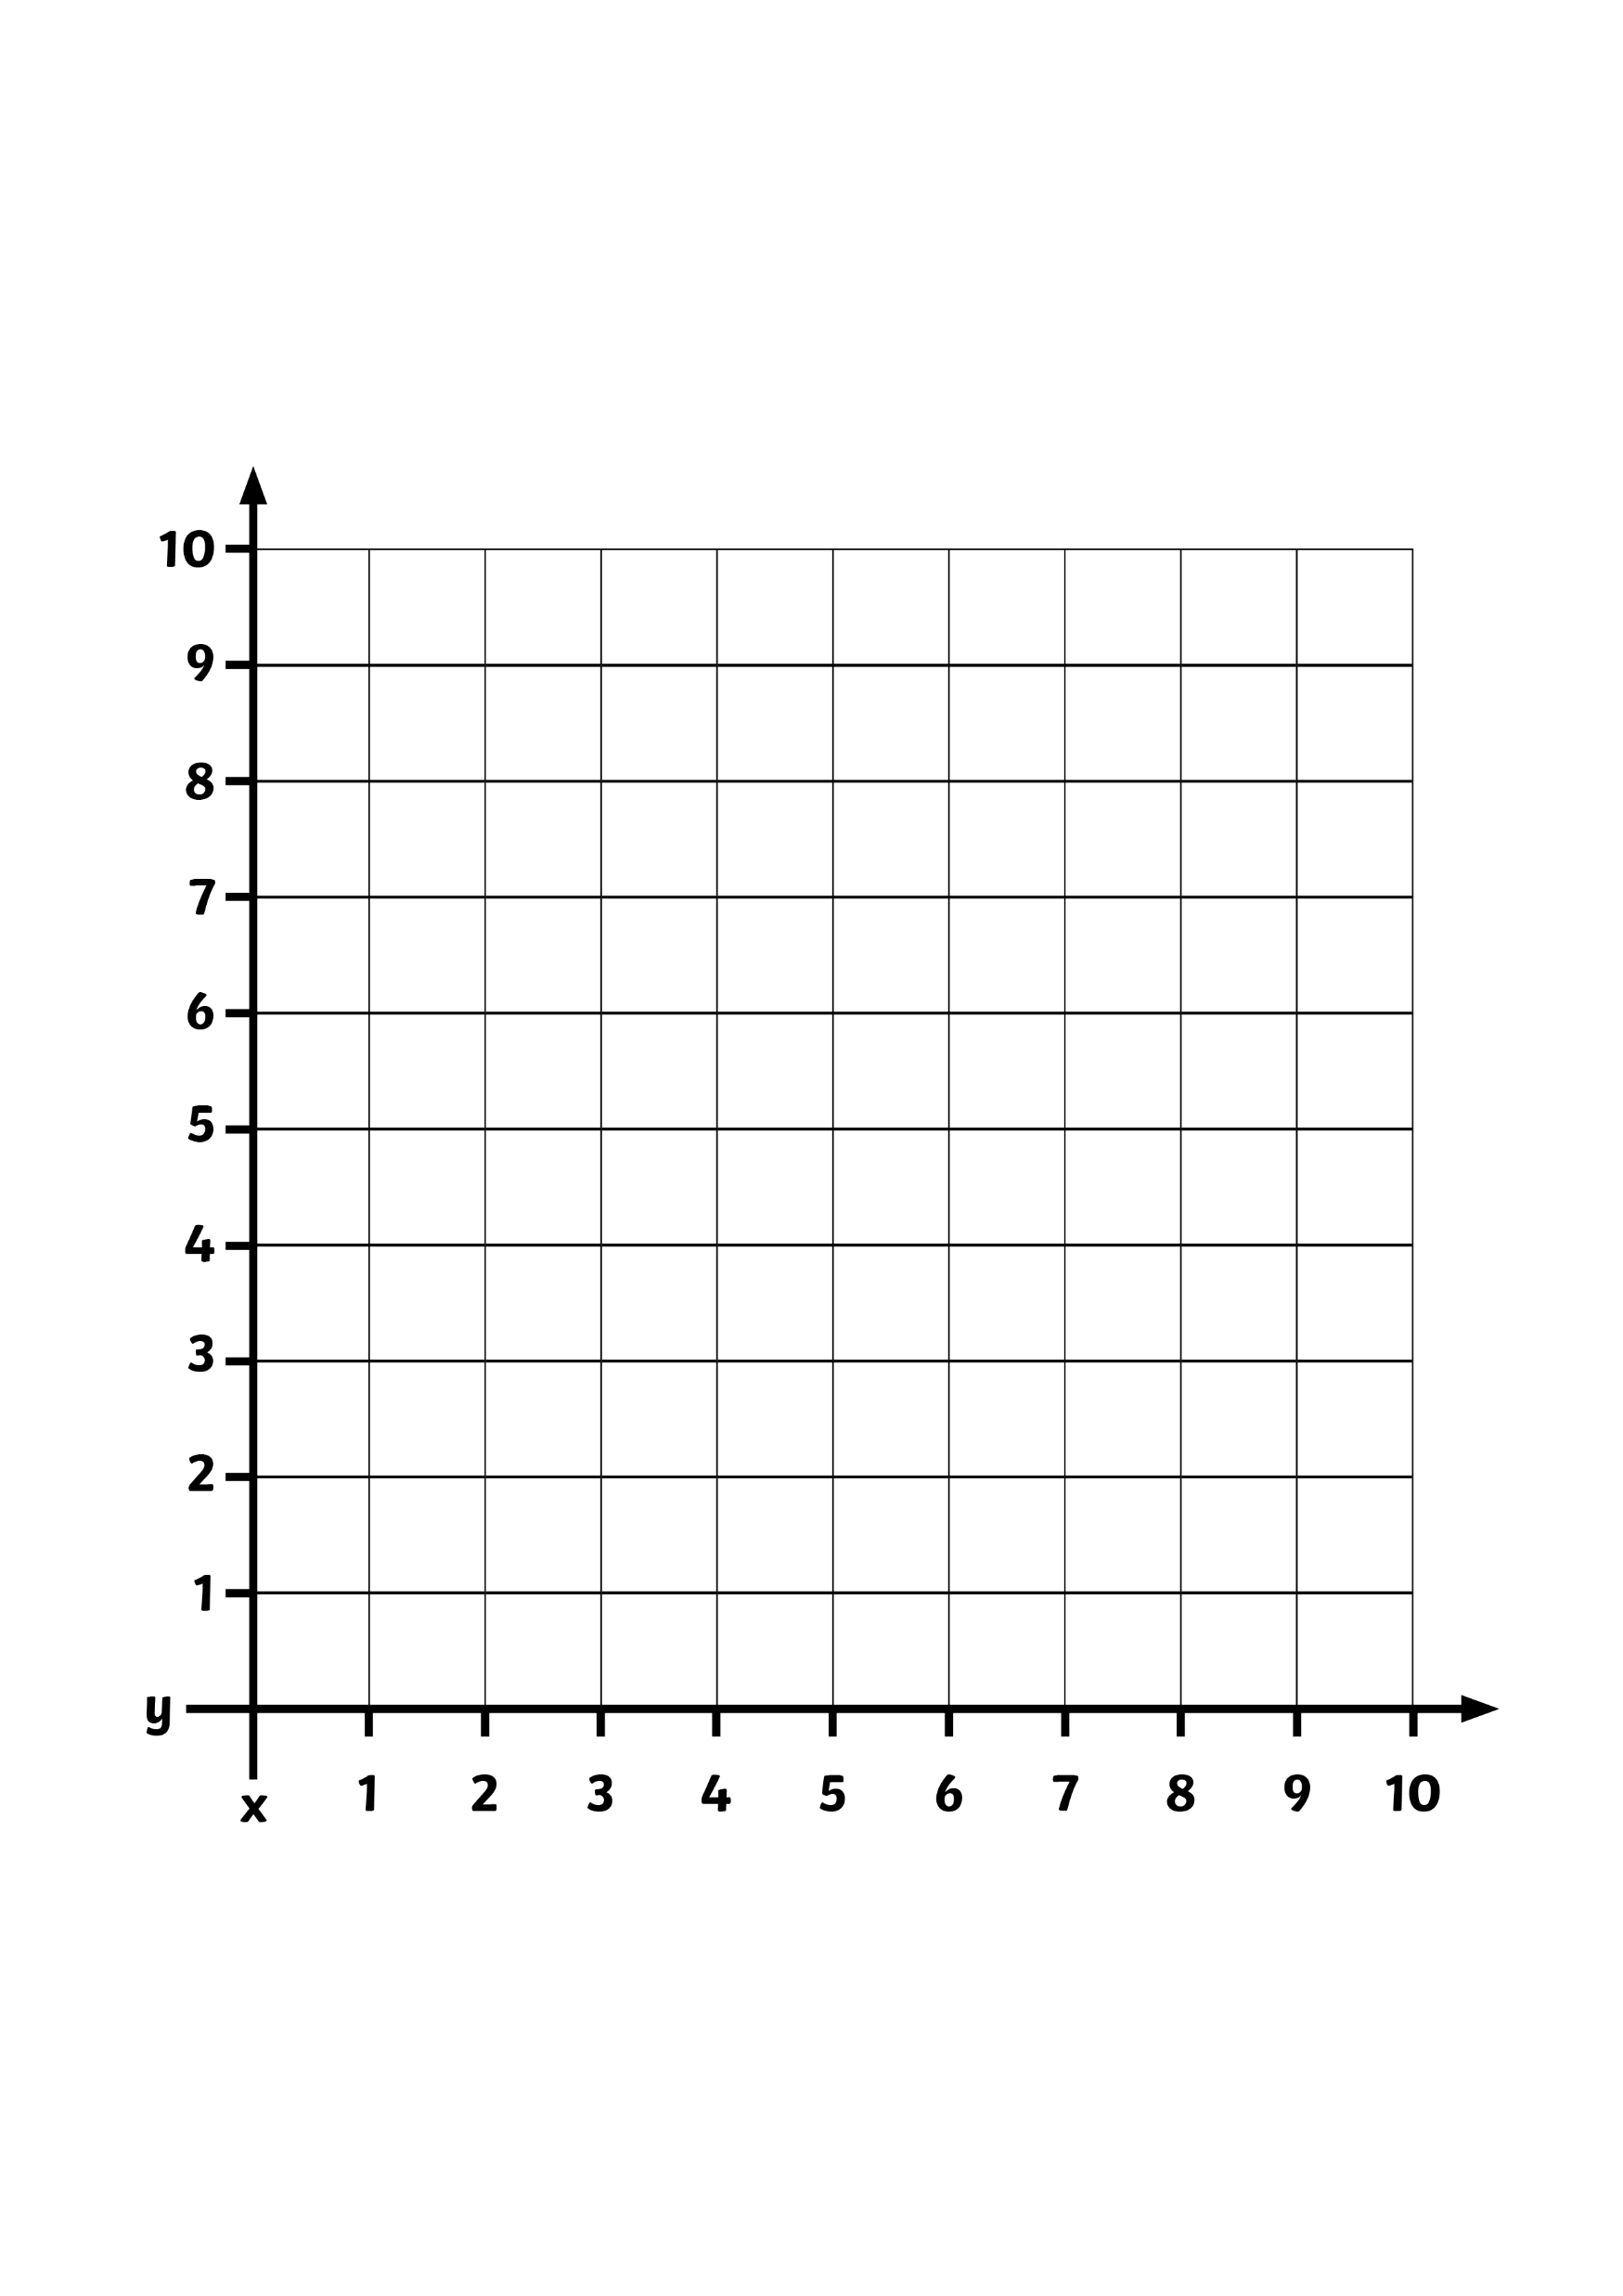
What is a Translation?
A translation is when a shape moves from one position to another without being rotated or flipped.
On this grid, rectangle A has been moved to position B.
B
A
x
y

Slide 80
What Is a Translation?
This is not a translation because the shape has
been rotated.
B
A
x
y

Slide 81
Translating Shapes
Is this a translation?
B
A
Yes
This is a translation.
x
y

Slide 82
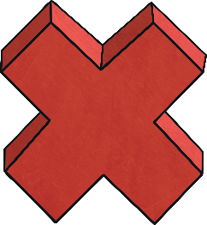
Translating Shapes
Is this a translation?
B
No
This is not a translation because the shape has been rotated.
A
x
y

Slide 83
Translating Shapes
Is this a translation?
B
No
This is not a translation because the shape has been rotated.
A
x
y

Slide 84
So, how do we translate?
This point represents the top left hand corner of the rectangle
To translate a shape, we must pick one of the shape’s vertices (corners).
We have chosen the top left hand corner on this rectangle.
I want to move this rectangle 5 squares to the right and 2 squares up.
2 squares up
5 squares to the right
B
A
We always move along the x-axis first, then then the y-axis.
x
y

Slide 85
So, how do we translate?
To translate a shape, we must pick one of the shape’s vertices (corners).
We have chosen the bottom left-hand corner on this triangle.
I want to move this triangle 5 squares to the left and 4 squares down.
A
4 squares down
B
5 squares to the left
We always move along the x-axis first, then then the y-axis.
x
y
This point represents the top left hand corner of the triangle

Slide 86
So, how do we translate?
This time, I would like to translate the triangle to another point on the coordinate grid.
I would like to move the bottom left-hand vertex from (1,1) to (4,6).
How far to the right and how many squares up do I need to translate?
B
Hopefully, you said 3 squares to the right and 5 squares up
A
x
y

Slide 87
Task 1:
The triangle is translated and one of its vertices ends up at A.
A has translated to (6,7)
A
A
Show the position of the shape, following a translation.

Slide 88
Task 1 answer:
A has translated to (6,7)
A
A
Point A has translate 3 squares to the right and 1 square up.

Slide 89
Task 2 :
The square is translated and one of its vertices ends up at A.
What are the coordinates of the vertex?
A
A
Show the position of the shape, following a translation.

Slide 90
Task 2 answer:
The square is translated and one of its vertices ends up at A.
What are the coordinates of the vertex?
A
A
The square has been translated 6 squares to the left and 2 squares up.

Slide 91
Task 3:
The rectangle is translated 3 squares to the left and 3 squares down.
A
What is the coordinate of A?
Can you show where the rectangle has been translated to?

Slide 92
Task 3 answer:
The rectangle is translated 3 squares to the left and 3 squares down.
A
What is the coordinate of A?
A
The vertex ‘A’ has moved from the coordinate (8,8) to the coordinate (5,5).

Slide 93
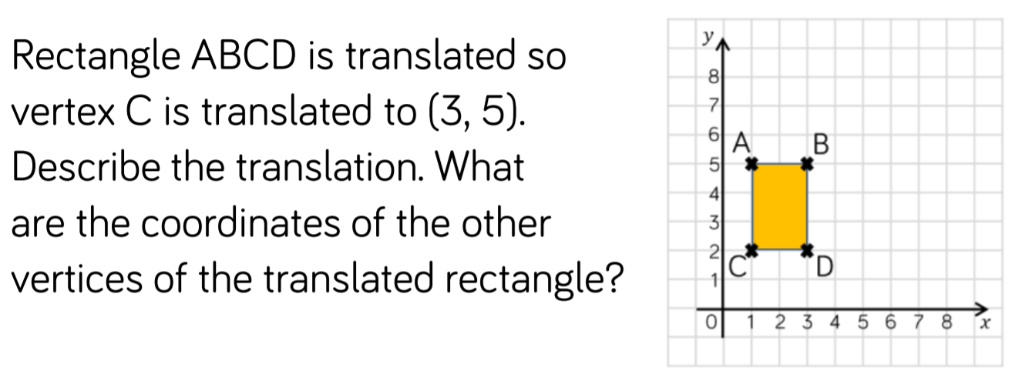
Task 4:

Slide 94
Task 4 answers:
The shape translated 2 squares to the right and 3 squares up.
New coordinates:
A: (3,8)
B: (5,8)
C: (3,5)
D: (5,5)

Slide 95
We will now look at translating across the first and second quadrant.
After translation A is at (-2,8)
The rectangle has translated 6 squares to the left and 3 squares up
y-axis
10
9
A
8
Before translation A is at (4,5)
7
6
5
A
4
3
2
1
x-axis
-10
-9
-8
-7
-6
-5
-4
-3
-2
-1
0
1
2
3
4
5
6
7
8
9
10

Slide 96
We will now look at translating across the first and second quadrant.
If you placed it here - well done!
y-axis
10
9
Can you translate this rectangle from its current position, to (-8,7)?
8
A
7
6
It translated 17 squares left and 2 squares up.
A
5
4
3
2
1
x-axis
-10
-9
-8
-7
-6
-5
-4
-3
-2
-1
0
1
2
3
4
5
6
7
8
9
10

Slide 97
We will now look at translating across the first and second quadrant.
I want to translate this right-angled triangle 9 squares to the right and 1 square down.
At which coordinate do you think A will be at, after translation?
y-axis
10
9
8
7
If you said A translated to (1,4), you were correct!
6
A
5
A
4
3
2
1
x-axis
-10
-9
-8
-7
-6
-5
-4
-3
-2
-1
0
1
2
3
4
5
6
7
8
9
10

Slide 98
Task 5:
Can you describe the points which A, B and C are at and record them.
y-axis
10
9
8
A
7
6
5
C
B
4
3
2
1
x-axis
-10
-9
-8
-7
-6
-5
-4
-3
-2
-1
0
1
2
3
4
5
6
7
8
9
10
Now, can you translate the rectangle by moving each point to the following coordinates:
C 12 squares left and 4 squares down:
A to (7,3):
B to (-6,5):

Slide 99
Task 5 answers:
Can you describe the points which A, B and C are at and record them.
y-axis
10
9
8
A
7
6
B
5
C
B
4
3
A
2
C
1
x-axis
-10
-9
-8
-7
-6
-5
-4
-3
-2
-1
0
1
2
3
4
5
6
7
8
9
10
Now, can you translate the rectangle by moving each point to the following coordinates:
C 12 squares left and 4 squares down:
A to (7,3):
B to (-6,5):

Slide 100
Task 6:
Here are the coordinates of a rectangle: (2,1), (3,1), (2,4), (3,4).
y-axis
10
9
8
7
6
5
4
3
2
1
x-axis
-10
-9
-8
-7
-6
-5
-4
-3
-2
-1
0
1
2
3
4
5
6
7
8
9
10
Two of the coordinates are (-5,1) and (-6,4) after it has been translated.
What are the tw other coordinates and can you plot both rectangles on the grid, above?

Slide 101
Task 6 answers:
Here are the coordinates of a rectangle: (2,1), (3,1), (2,4), (3,4).
y-axis
10
9
8
7
6
(-6,4)
5
4
Before translation
3
(-5,1)
2
1
x-axis
-10
-9
-8
-7
-6
-5
-4
-3
-2
-1
0
1
2
3
4
5
6
7
8
9
10
Two of the coordinates are (-5,1) and (-6,4) after it has been translated.
What are the tw other coordinates and can you plot both rectangles on the grid, above?

Slide 102
End of Lesson

Slide 103
Date: 04.02.2021
LO: To be able to represent the position of a shape, after a translation.
Subject: Maths

Slide 104
Times table practise
Spend at least 15mins practising your times tables.
This can be done on TTRS, hit the button or any other times table website.
Use the Times Tables Rock Stars app or website.
Alternatively, copy and paste the following link into a web browser:
https://www.topmarks.co.uk/maths-games/7-11-years/times-tables

Slide 105
Pre-recorded Teaching
Access the online teaching video below that will support you to complete the work in this lesson. This video will act as a support but all of the work can still be successfully understood & completed using paper-based versions of this pack. If you need further support to understand / complete work then please contact school via e-mail or telephone.
Play Video
Please select the ‘translation’ video.
You can also copy and paste this link if you would prefer:
https://whiterosemaths.com/homelearning/year-6/week-13-geometry-position-direction/

Slide 106
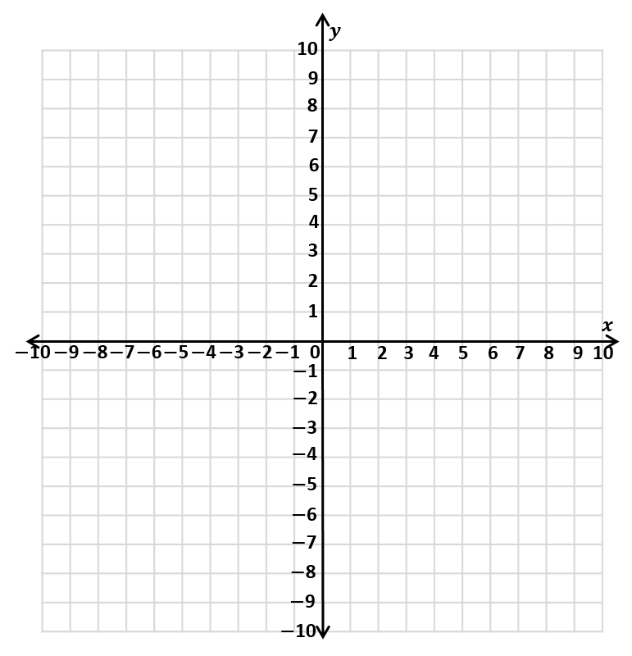
Recap
We are going to recap the learning you did on Tuesday about coordinates in all 4 quadrants.

Slide 107
Recap
1) What are the coordinates
of point A and B.
2) Plot the coordinate
(0,$−$4)
3) Plot the coordinate
($−$3,$−$7 )
4) Which quadrants are the points in?
B
A ($−$9,0)
B (3,5)
A
1st quadrant
3rd quadrant

Slide 108
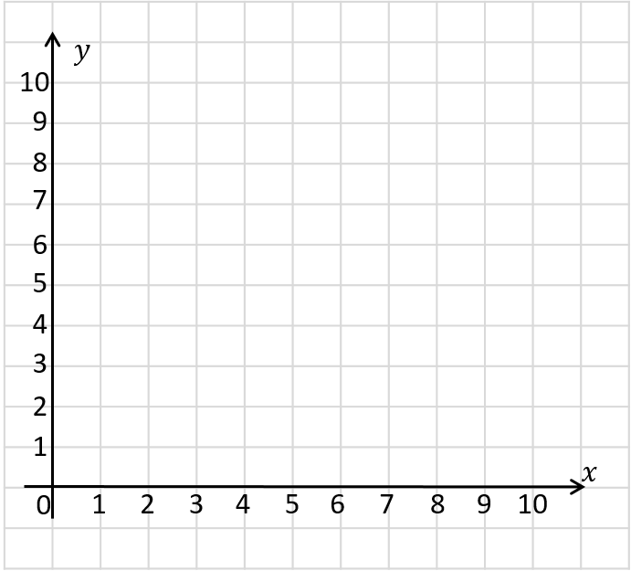
Recap
2 up
4 right
The point has been translated 4 right and 2 up.

Slide 109
Recap
3 right
3 down
Can you describe the translation?

Slide 110
Can you describe the translations?
A
B
A
B
5 right
1 down
B
C
C
2 left
3 down
B
A
5 left
1 up

Slide 111
We are now going to look at new learning: translating within all four quadrants.
y
5
4
3
The coordinates of the black point on shape A are (-4,-1).
We are going to move the triangle 5 squares right and 5 squares up.
2
1
x
-5
-4
-3
-2
-1
0
1
2
3
4
5
-1
-2
A
B
-3
-4
-5

Slide 112
We are now going to look at new learning: translating within all four quadrants.
7 right
A
We are going to look at the translation of triangle A to triangle B?
6 down
B

Slide 113
We’re now going to translate the triangle 9 squares to the left, then 11 squares up
B
A

Slide 114
We’re now going to translate the triangle 9 squares to the right, then 6 squares up
B
A

Slide 115
How Has This Shape Been Translated From A to B?
y
5
The black point on the triangle has translated to (1,-4)
4
3
B
How many squares left or right and how many squares up or down has the triangle moved?
2
A
1
(3 squares left, 5 squares down)
x
-5
-4
-3
-2
-1
0
1
2
3
4
5
-1
-2
-3
-4
-5

Slide 116
How Has This Shape Been Translated From A to B?
y
5
The shape has been translated 3 squares to the right and 4 squares down.
4
A
B
3
What are he coordinates of the black point on shape A and shape B?
2
1
(-4,2)
x
-5
-4
-3
-2
-1
0
1
2
3
4
5
-1
(-1,-2)
-2
-3
-4
-5

Slide 117
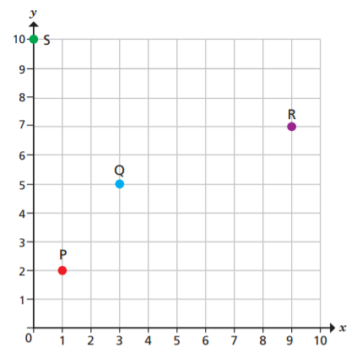
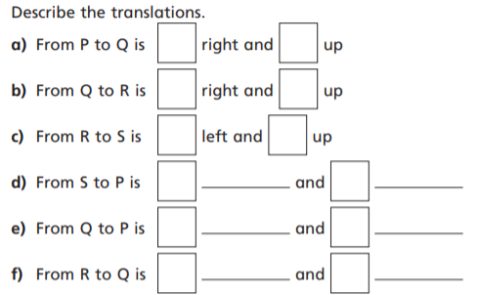
Task 1:

Slide 118
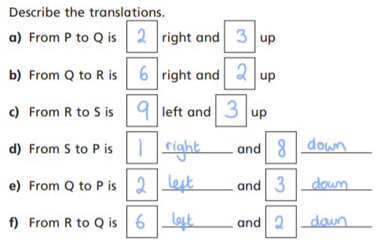
Task 1 answers:

Slide 119
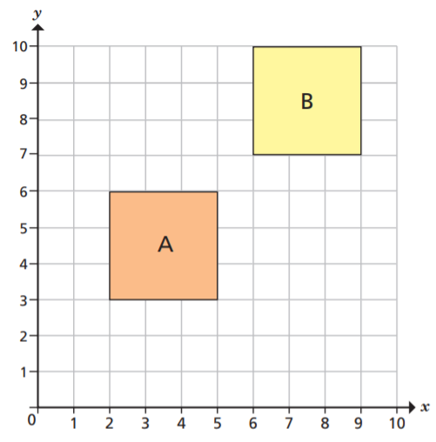
Task 2:
“The translation from A to B is 1 right and 1 up.”
Do you agree?
Explain your answer.

Slide 120
Task 2 answers:
“The translation from A to B is 1 right and 1 up.”
Do you agree?
Explain your answer.
No. The corners closest to each other have been translated, instead of the corresponding corners.

Slide 121
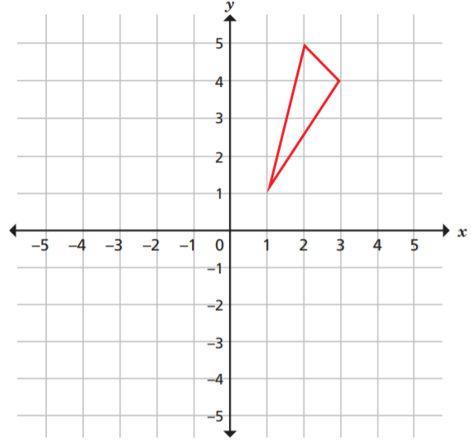
Task 3: Translate the triangle 6 left.

Slide 122
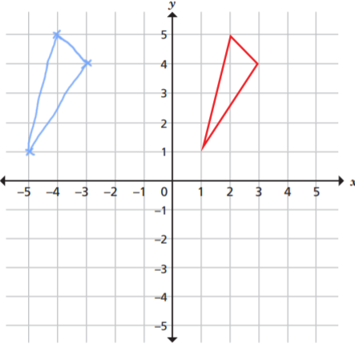
Task 3 answer:

Slide 123
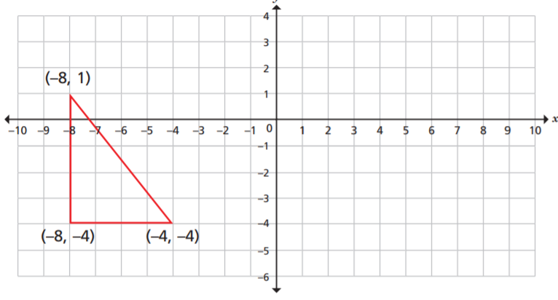
Task 4: Translate the triangle 9 right and 1 down.

Slide 124
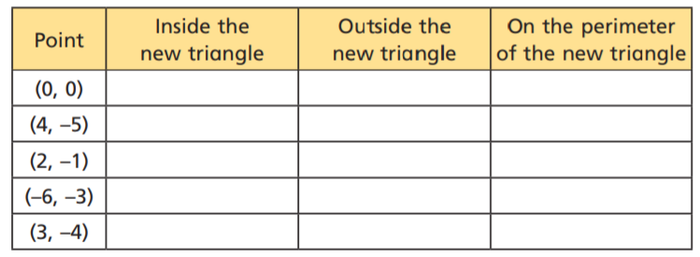
Task 4 extension: Using your answer from the previous slide, place a tick in each of the rows, to show where each coordinate can be found.

Slide 125
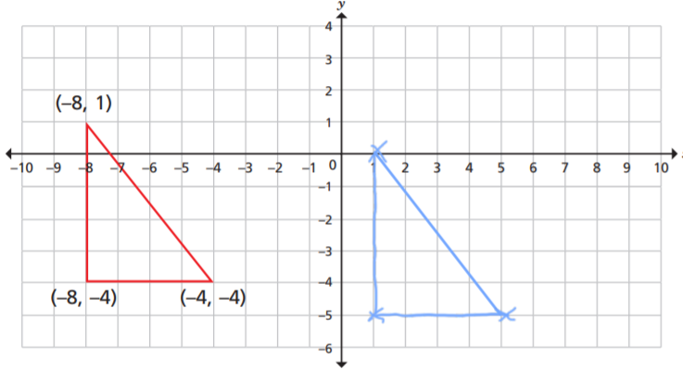
Task 4 answer:

Slide 126
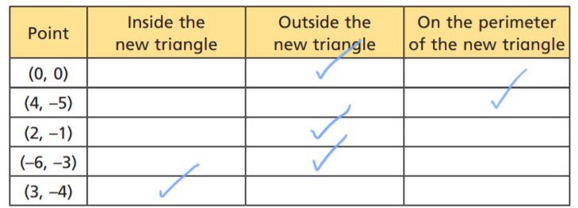
Task 4 extension answers: Using your answer from the previous slide, place a tick in each of the rows, to show where each coordinate can be found.

Slide 127
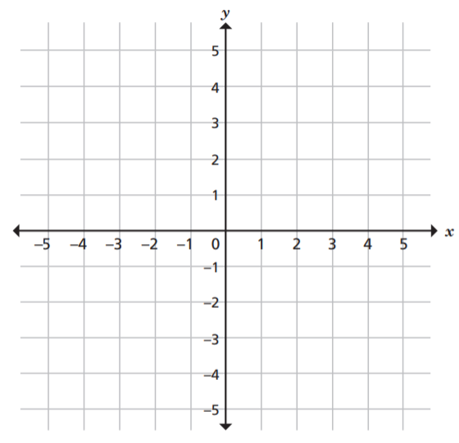
Task 5: These coordinates form a quadrilateral: (–5, 5), (–5, 1), (–1, 4), (–1, 2) It is translated 3 right and 4 down. Draw the quadrilateral on the grid in its new position.

Slide 128
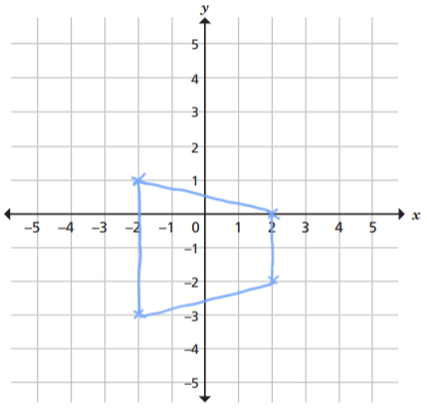
Task 5 answers: These coordinates form a quadrilateral: (–5, 5), (–5, 1), (–1, 4), (–1, 2) It is translated 3 right and 4 down. Draw the quadrilateral on the grid in its new position.

Slide 129
End of Lesson

Slide 130
Date: 05.02.2021
LO: To be able to represent the position of a shape, after a reflection.
Subject: Maths

Slide 131
Times table practise
Spend at least 15mins practising your times tables.
This can be done on TTRS, hit the button or any other times table website.
Use the Times Tables Rock Stars app or website.
Alternatively, copy and paste the following link into a web browser:
https://www.topmarks.co.uk/maths-games/7-11-years/times-tables

Slide 132
Pre-recorded Teaching
Access the online teaching video below that will support you to complete the work in this lesson. This video will act as a support but all of the work can still be successfully understood & completed using paper-based versions of this pack. If you need further support to understand / complete work then please contact school via e-mail or telephone.
Play Video
You can also copy and paste this link if you would prefer:
https://classroom.thenational.academy/lessons/reflecting-simple-shapes-6mu3ec?step=2&activity=video

Slide 133
Recap
1) Translate shape A
2 left and 4 down.
2) Write the coordinates
of each vertex of the
translated shape.
3) Describe the translation
from shape A to C.
A
C

Slide 134
1) Translate shape A
2 left and 4 down.
2) Write the coordinates
of each vertex of the
translated shape.
3) Describe the translation
from shape A to C.
A
C
(0,2) (5,2) (0,5) (5,5)
9 left and 11 down.

Slide 135
Reflections

Slide 136
What’s changed?
What’s stayed the same?
The boy looks the same, however his image has been ‘flipped’ in the mirror.
He has his right hand out, but in the mirror, it looks like his left hand

Slide 137
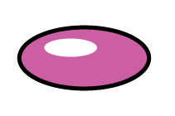
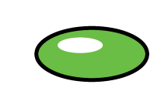
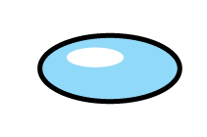
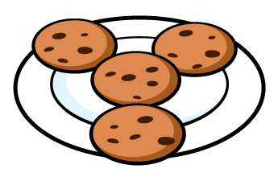
Which images are reflections? Which images are not?

Slide 138
Which images are reflections? Which images are not?

Slide 139
2 away
We are going to reflect the triangle in the $y$-axis
5 away
You can see that each point is reflected the same distance from the mirror line.
This is unlike translation, where the shape does not change!
The y-axis is the vertical line, here.
In this case, this is the mirror line

Slide 140
2 away
5 away
Reflect the shape in the
$y$-axis
6 away
3 away
We count how many squares each point of the shape is away from the mirror line.
We then plot that point the same distance on the other side of the mirror line.

Slide 141
6 away
We are going to reflect the triangle in the $x$-axis
2 away
This time, the mirror line is the x-axis (horizontal line).

Slide 142
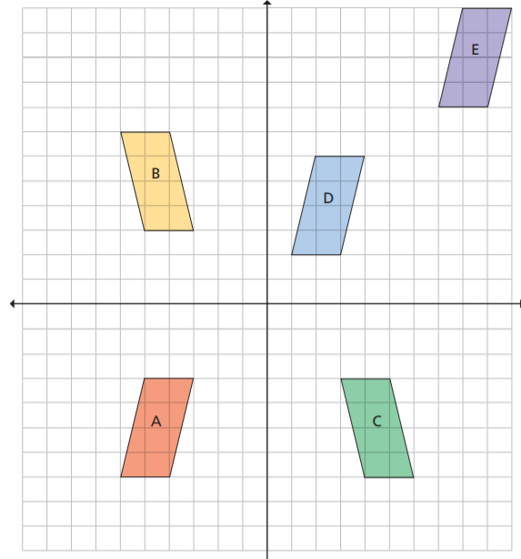
Task 1: Five parallelograms are shown on the coordinate grid. Circle the shapes that are reflections of shape A.

Slide 143
Task 1 answers:

Slide 144
Task 2: Reflect the triangle in the y-axis

Slide 145
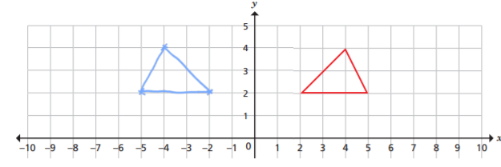
Task 2 answers: Reflect the triangle in the y-axis

Slide 146
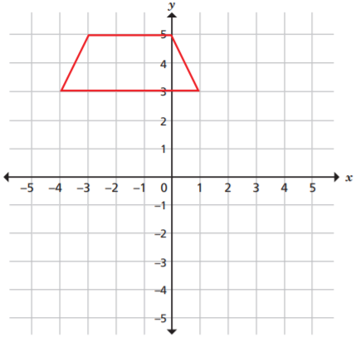
Task 3: Reflect the shape in the x-axis

Slide 147
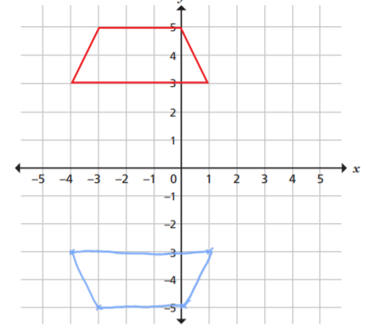
Task 3 answer:

Slide 148
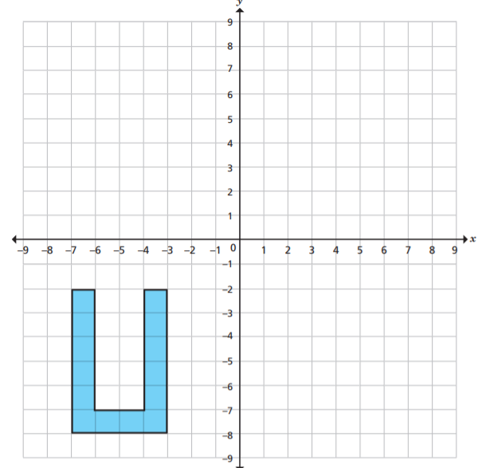
Task 4: Translate the shape in the x-axis.

Slide 149
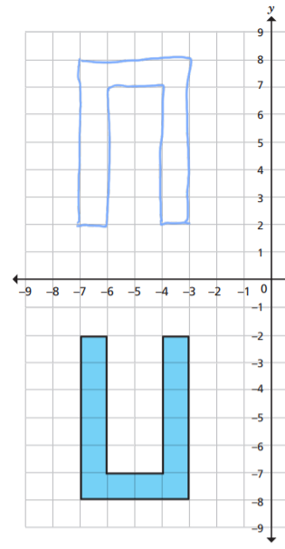
Task 4 answer:

Slide 150
$$y$$
$($3,9$)$
$$x$$
$$p$$
The triangle is reflected in the $x$-axis.
Let’s look at what the coordinate of the vertex $p$is?

Slide 151
$$y$$
$($3,9$)$
9
$$x$$
3
This vertex is 3 on the x-axis, so p must be the same.
It is 9 on the y-axis (9 away from the mirror line) so p must be -9 (9 away from the mirror line.)
-9
$$p$$
$($3,-9$)$
The triangle is reflected in the $x$-axis.

Slide 152
Extension:
$$y$$
$($3,9$)$
$$p$$
$$x$$
Use the previous slide to help you with this one.
The triangle is reflected in the $y$-axis.
What will be the coordinate of the vertex $p$?

Slide 153
Extension answer:
$$y$$
$($3,9$)$
$$p$$
$($-3,9$)$
9
$$x$$
-3
3
The triangle is reflected in the $y$-axis.
What will be the coordinate of the vertex $p$?

Slide 154
End of Lesson

