Slide 1
B

Slide 2
22.2.2021
L.O. To be able to know the amount of days and months in 1 year
Go to Times Tables Rock Stars to warm up your number brain before you start your maths activity.
Subject: Maths

Slide 3
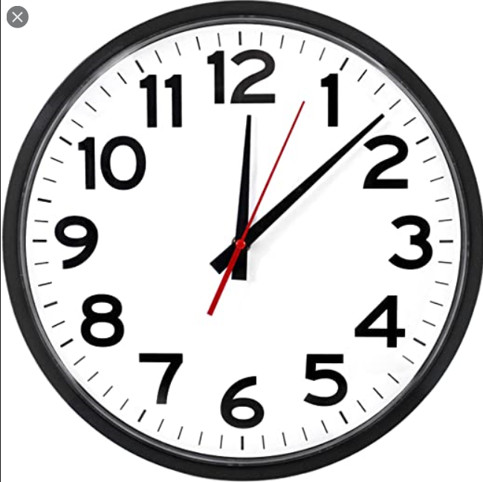
This week we are going to be looking at time
Time can be measured in many different ways including years, months, weeks, days, hours and seconds.
12 months in 1 year
52 weeks in 1 year
7 days in 1 week
24 hours in 1 day
60 minutes in 1 hour
60 seconds in 1 minute

Slide 4
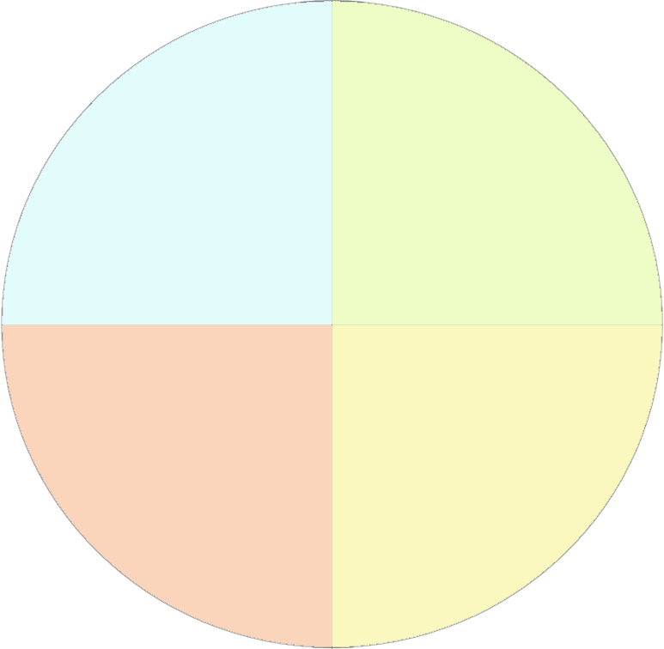
Decide which months should go into each season
July
Winter
Spring
November
September
March
October
December
June
Autumn
Summer
April
May
August
February
January

Slide 5
July
Winter
Spring
November
September
December
March
March
January
April
February
May
October
December
June
Autumn
Summer
April
September
June
May
October
July
August
November
August
February
January

Slide 6
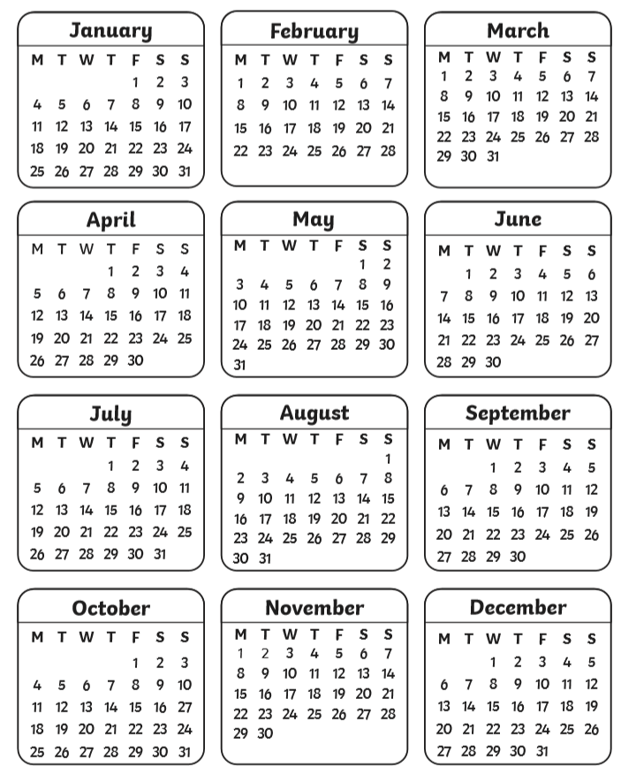
Look at the calendar for 2021 and see if you can work out how many days are in each month

Slide 7
How did you do?
January – 31
February – 28 (or 29 in a leap year)
March – 31
April -30
May – 31
June – 30
July – 31
August – 31
September – 30
October – 31
November – 30
December - 31

Slide 8
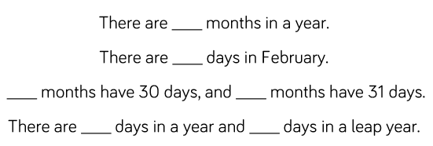
Use the calendar to help you complete the sentences

Slide 9
Use the calendar to help you complete the sentences
12
28
4
7
365
366

Slide 10
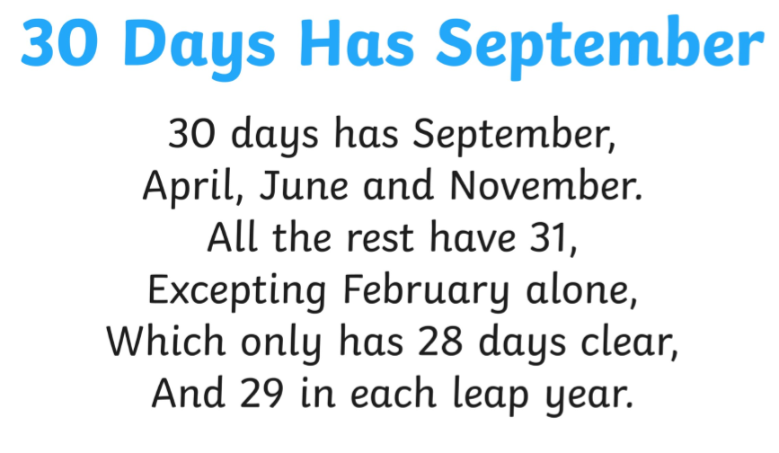
Here is a useful poem to help you remember how many days are in each month

Slide 11
1.

Slide 12
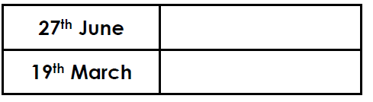
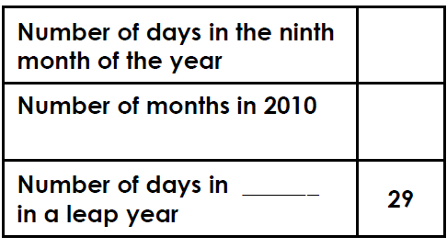
2. Write the dates that are 1 week later – use the calendar to work this out
3. Complete the table – use the calendar to work this out
4.

Slide 13
Complete the challenge

Slide 14
23.2.2021
L.O To be able to understand the hours in a day
Go to Times Tables Rock Stars to warm up your number brain before you start your maths activity.
Subject: Maths

Slide 15
Pre-recorded Teaching
Access the online teaching video below that will support you to complete the work in this lesson. This video will act as a support but all of the work can still be successfully understood & completed using paper-based versions of this pack. If you need further support to understand / complete work then please contact school via e-mail or telephone.
Play Video
You can also copy and paste this link if you would prefer:
https://teachers.thenational.academy/lessons/knowing-the-number-of-hours-in-one-day-69k30r

Slide 16
Yesterday we looked at the different months in the year. Use the calendar to help you sort the months into the correct column.
30 days | 31 days | 28 or 29 days
January
February
March
April
May
July
June
August
September
October
November
December

Slide 17
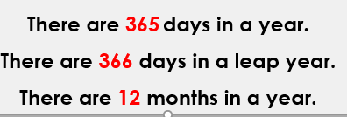
Sort the months
30 days | 31 days | 28 or 29 days
April June September November | January March May July August October December | February

Slide 18
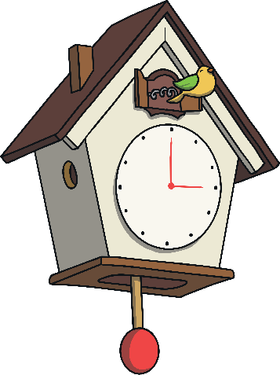
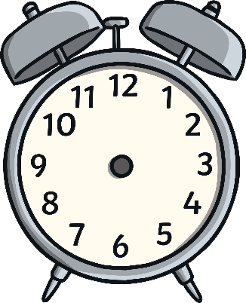
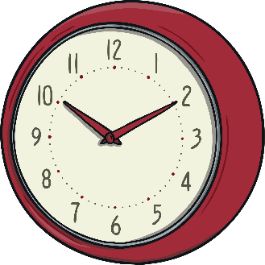
Spending Time
Time is a unit that can be measured
Time is measured in different units.
It can be measured in:
seconds
years
days
weeks
minutes
hours
months

Slide 19
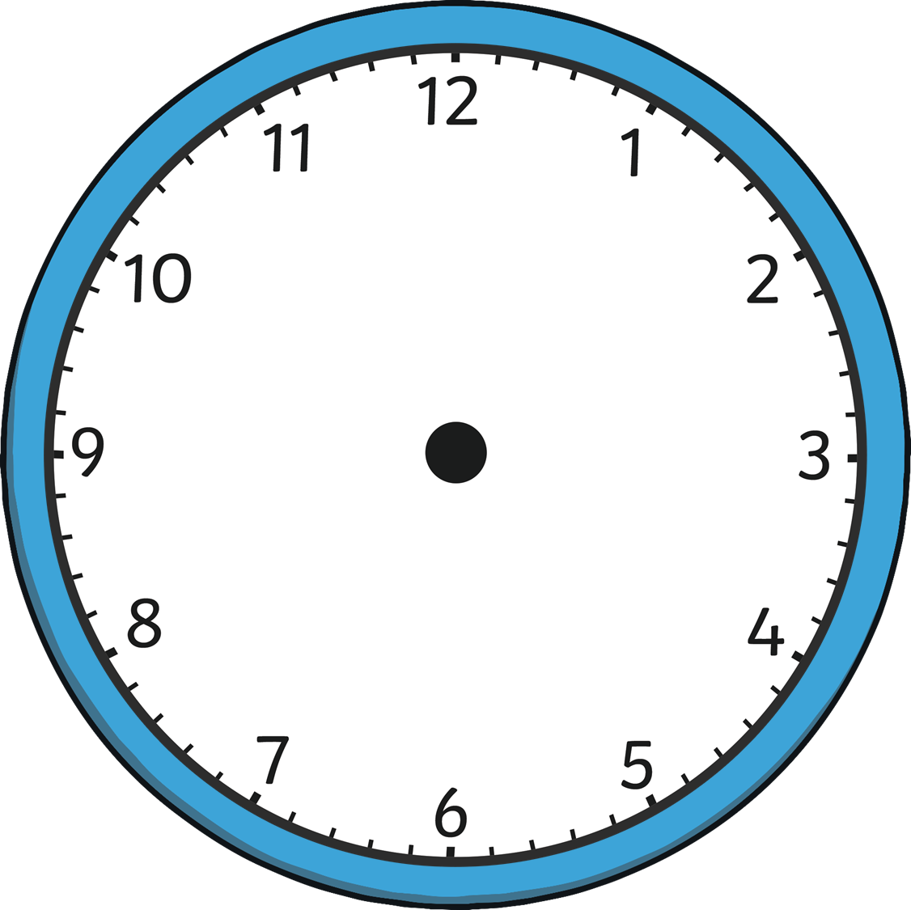
One way we can measure time is with clocks.
We use seconds, minutes and hours to measure time on a clock.
second hand
minute hand
hour hand

Slide 20
Let’s count the 1 hour interval markings together.
How many can you count?
The hour hand travels around the clock twice in 1 day. This means that there are 24 hours in 1 day.
12 hours + 12 hours = 24 hours

Slide 21
Here are some examples of different times of the day
Morning
Afternoon
Bed time
Evening
Lunch
Home time
Breakfast

Slide 22
Time
What kind of activities would you do in the morning?
What kind of activities would you do in the afternoon?
What kind of activities would you do on an evening?

Slide 23
Time
Wake up
Eat breakfast
Get dressed
Brush your teeth
Make your bed
Have a wash
Go to school
Eat lunch
Go shopping
Play out with friends
Go to after school clubs
Finish school
Go home
Complete homework
Eat tea
Read a book
Watch TV
Have a bath
Get ready for bed
Go to sleep

Slide 24
Complete the questions.
1.
2.
Complete the table
Morning | Afternoon | Evening | Night

Slide 25
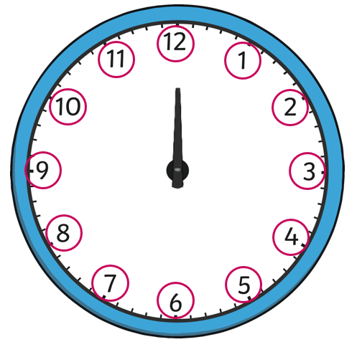
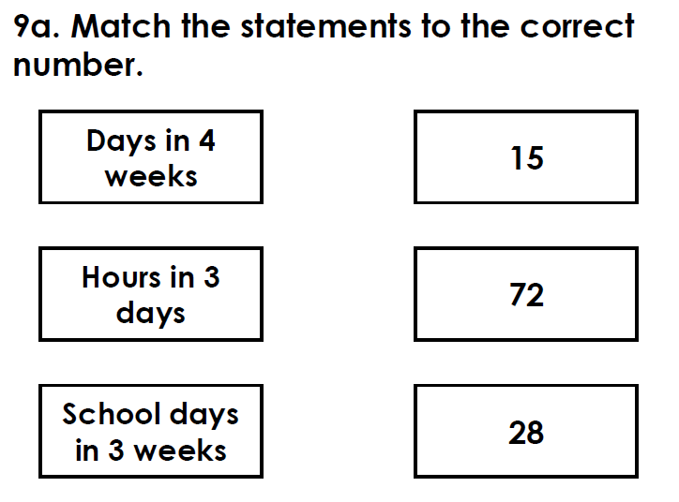
Complete the questions.
3.
4.

Slide 26
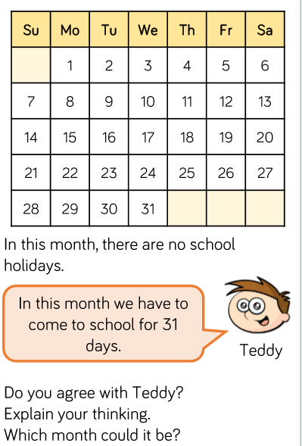
Challenge

Slide 27
24.2.2021
L.O To be able to tell the time to 5 minutes
Go to Times Tables Rock Stars to warm up your number brain before you start your maths activity.
Subject: Maths

Slide 28
Pre-recorded Teaching
Access the online teaching video below that will support you to complete the work in this lesson. This video will act as a support but all of the work can still be successfully understood & completed using paper-based versions of this pack. If you need further support to understand / complete work then please contact school via e-mail or telephone.
Play Video
You can also copy and paste this link if you would prefer:
https://classroom.thenational.academy/lessons/reading-the-time-on-the-clock-to-the-nearest-five-minutes-part-1-71jp4c?activity=video&step=2&view=1

Slide 29
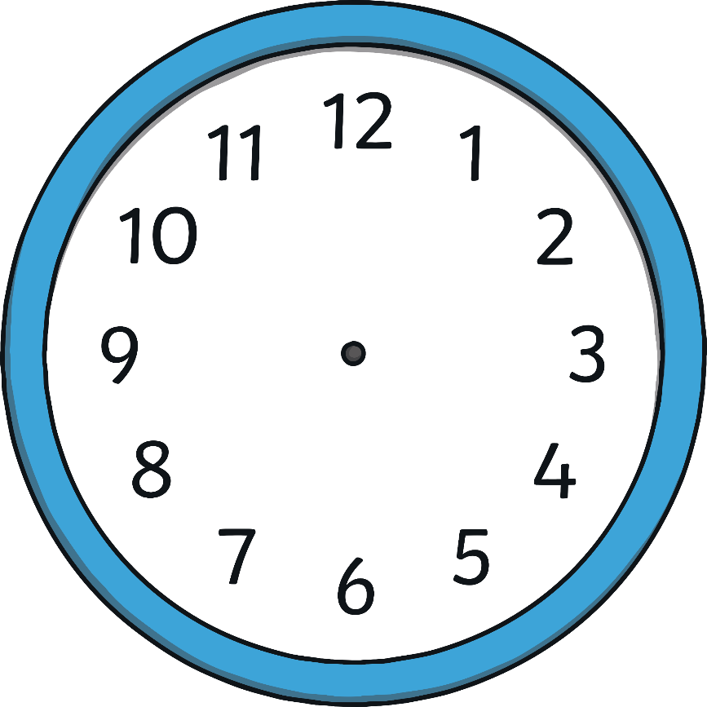
Hours and Minutes
This is the hour hand.
It is the shortest hand on the clock.
This is the minute hand.
It is longer than the hour hand.

Slide 30
Hours and Minutes
When the minute hand is pointing to 12, it is showing a full hour. We call this time ‘o’clock’.
On this clock, the hour hand is pointing at the 8 and the minute hand is pointing to the 12.
This clock is showing that the time is 8 o’clock.

Slide 31
What Time Is It?
12 o’clock
11 o’clock
1 o’clock
10 o’clock
2 o’clock
9 o’clock
3 o’clock
8 o’clock
4 o’clock
7 o’clock
5 o’clock
6 o’clock

Slide 32
What Time Is It?
It is 7 o’clock.

Slide 33
What Time Is It?
It is 3 o’clock.

Slide 34
What Time Is It?
It is 11 o’clock.

Slide 35
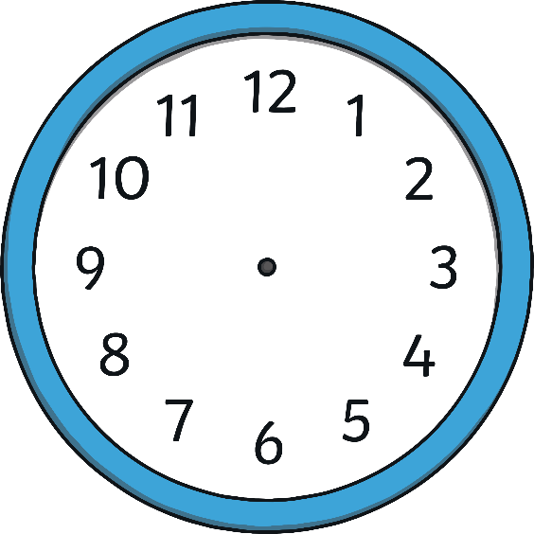
What Time Is It?
Which clock shows 2 o’clock?

Slide 36
What Time Is It?
Which clock shows 2 o’clock?

Slide 37
What Time Is It?
Which clock shows 3 o’clock?

Slide 38
What Time Is It?
Which clock shows 3 o’clock?

Slide 39
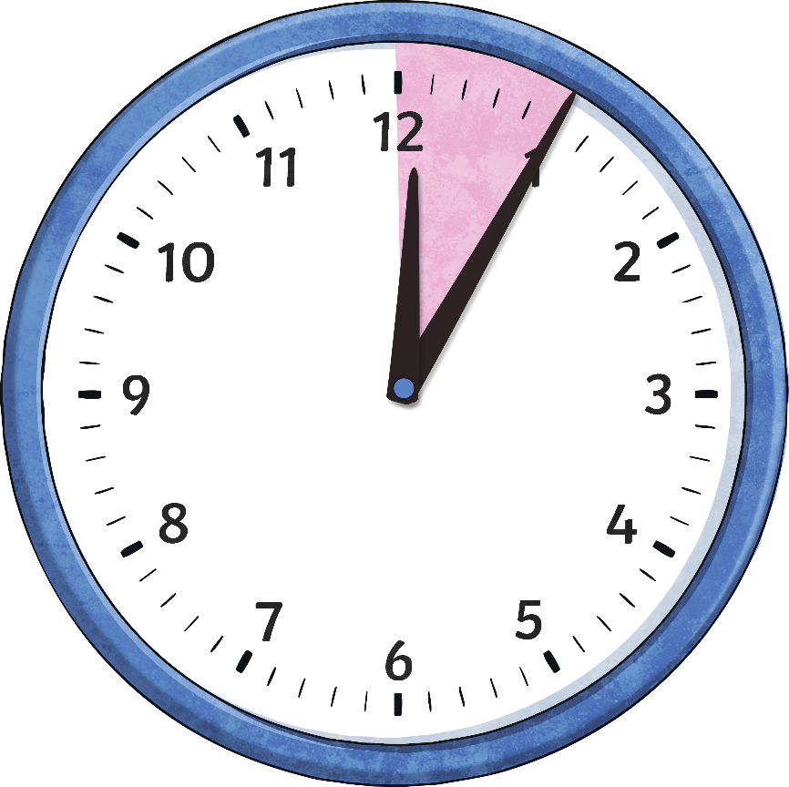
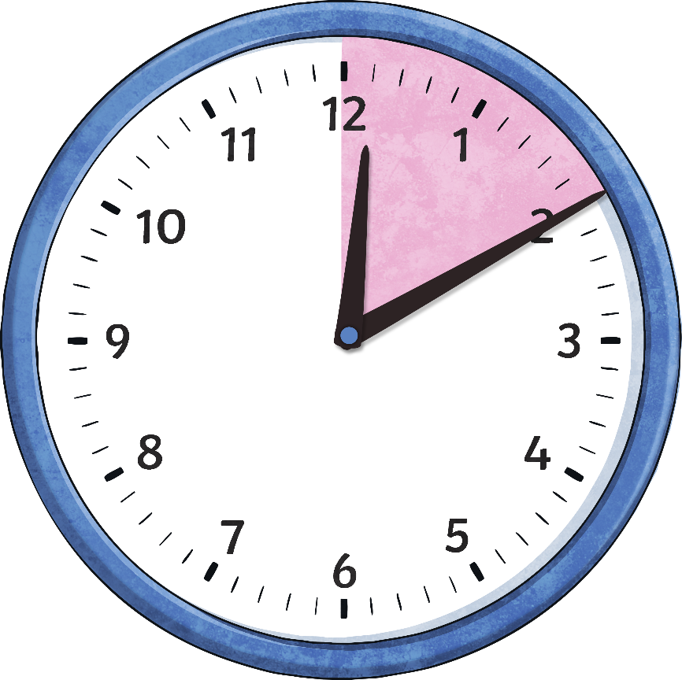
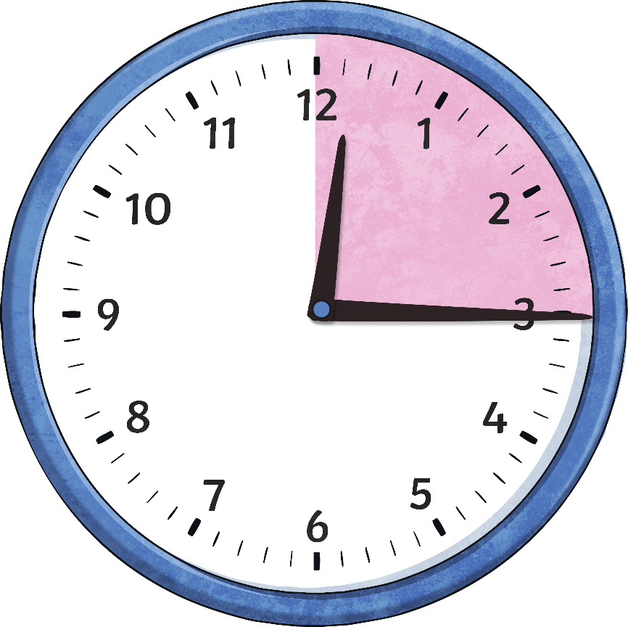
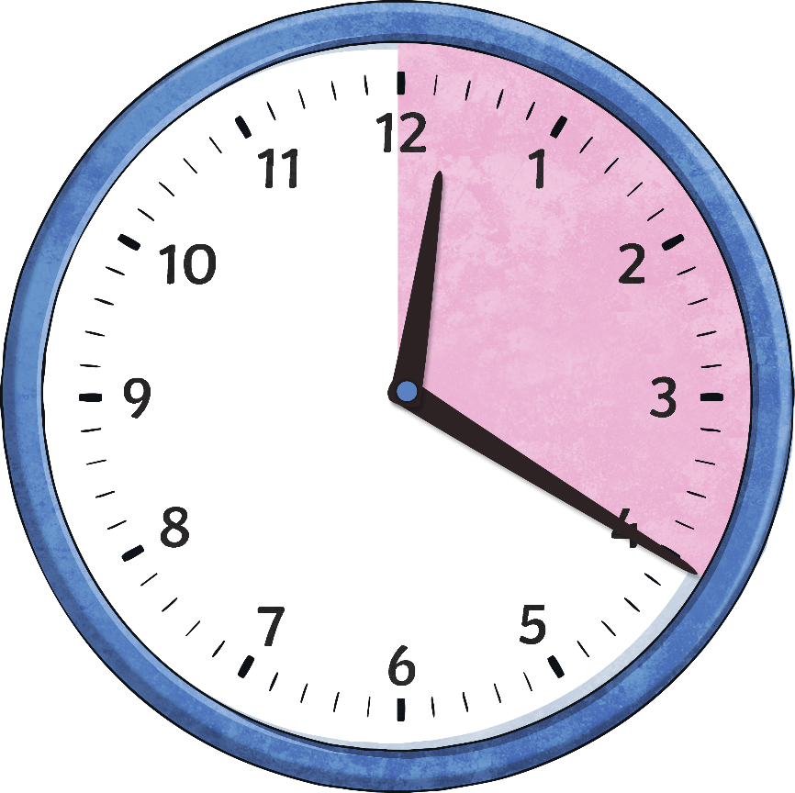
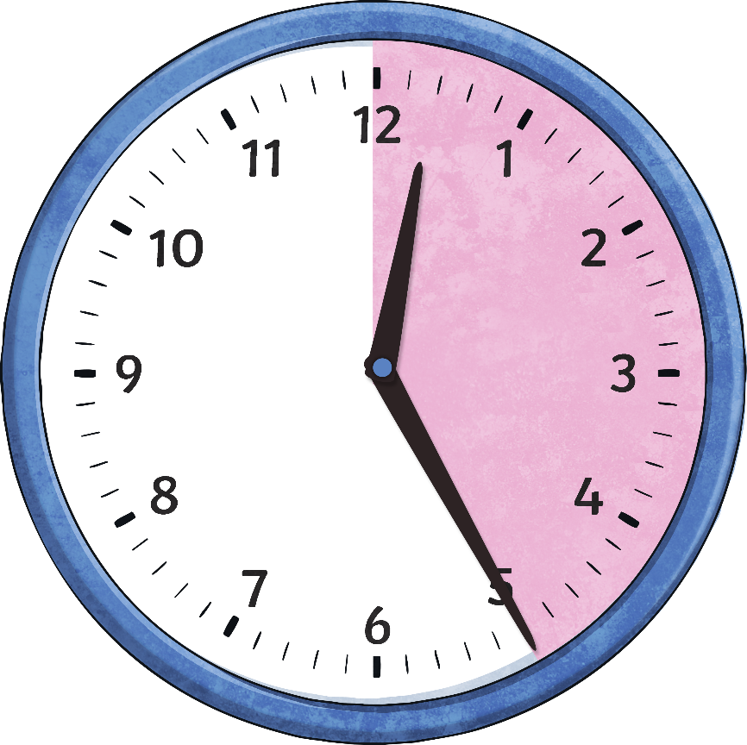
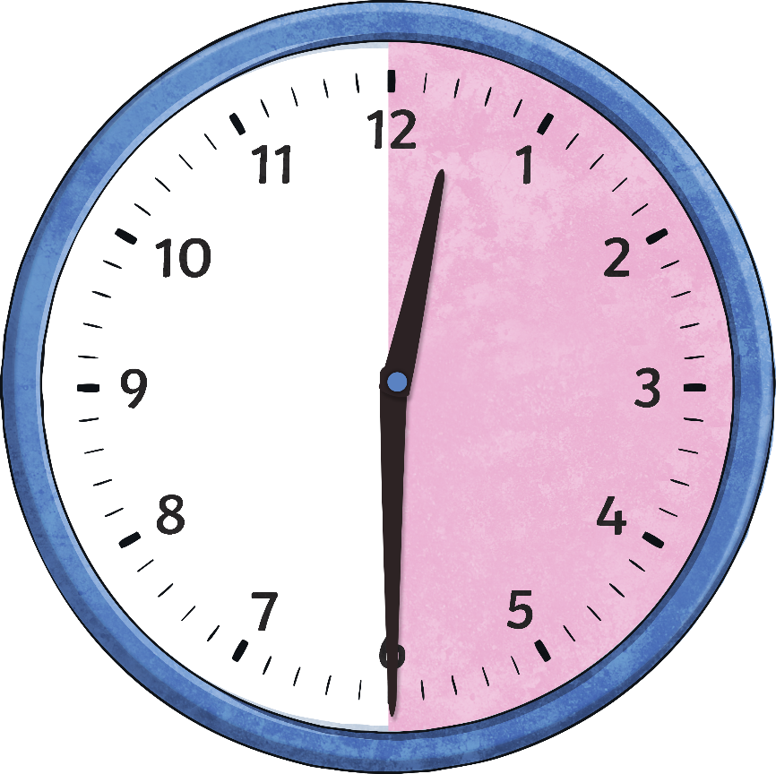
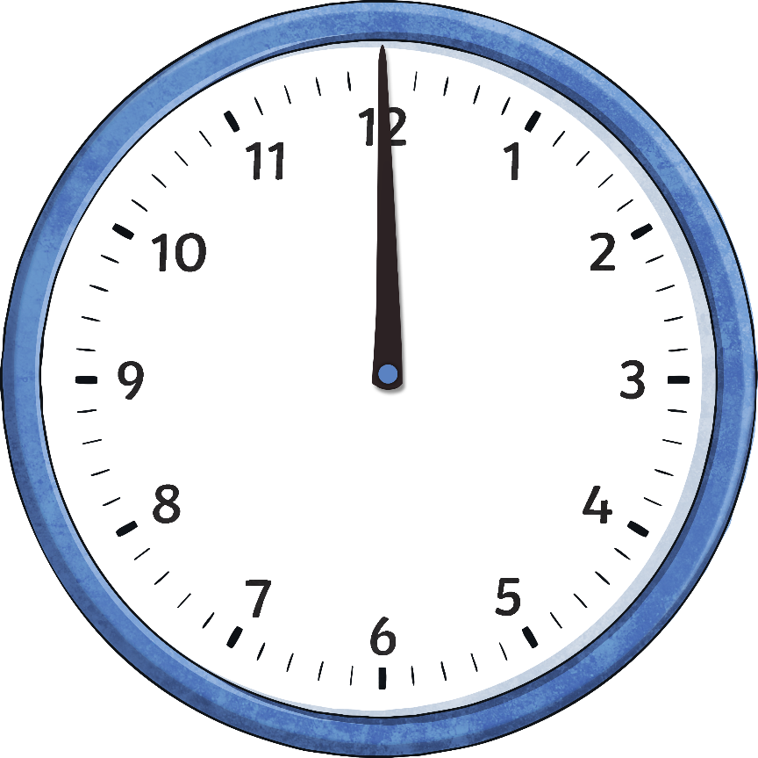
Telling the Time
The big hand on the clock counts the minutes and is called the minute hand.
We are going to look now at the minutes past the hour.
20
25
30
5
10
15
minutes
past
minutes
past
minutes
past
minutes
past
minutes
past
minutes
past
o’clock

Slide 40
When the big hand points to 1, it means…
When the big hand points to 2, it means…
10
5
minutes
past
minutes
past

Slide 41
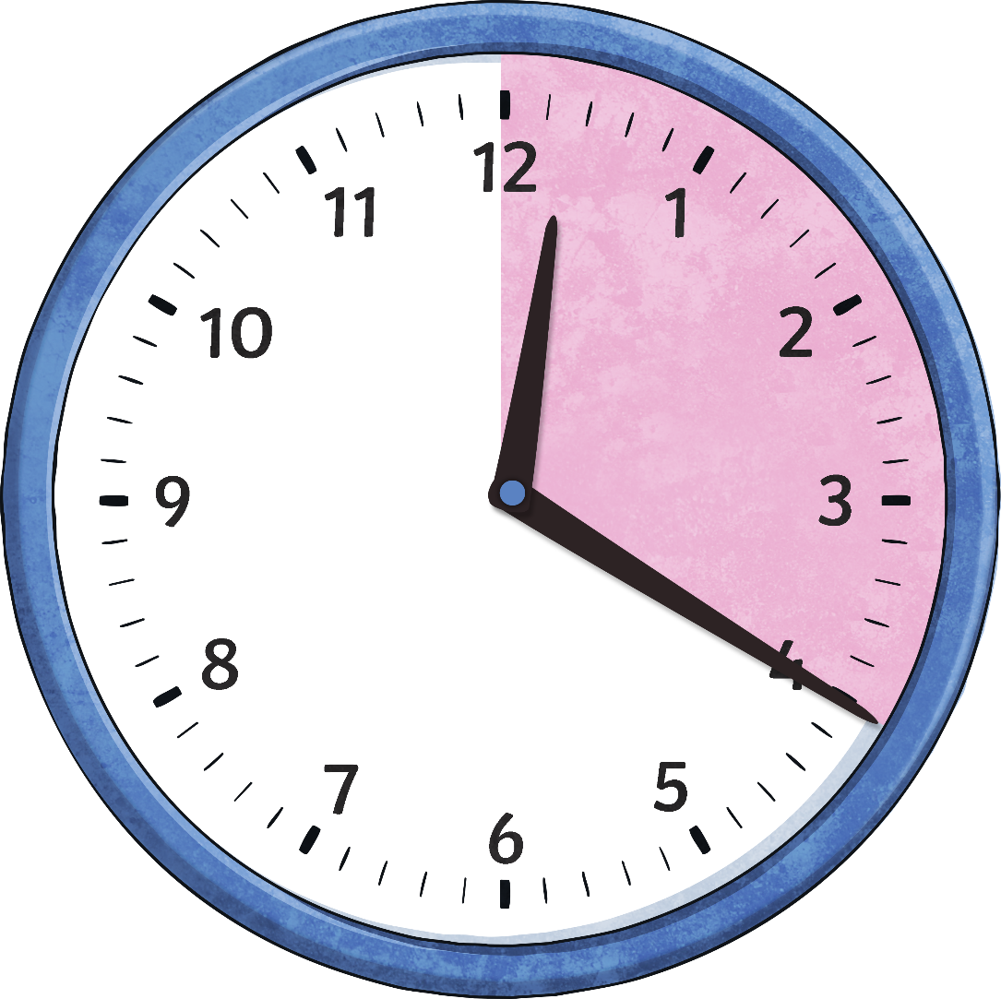
When the big hand points to 3, it means…
When the big hand points to 4, it means…
15
20
minutes
past
minutes
past

Slide 42
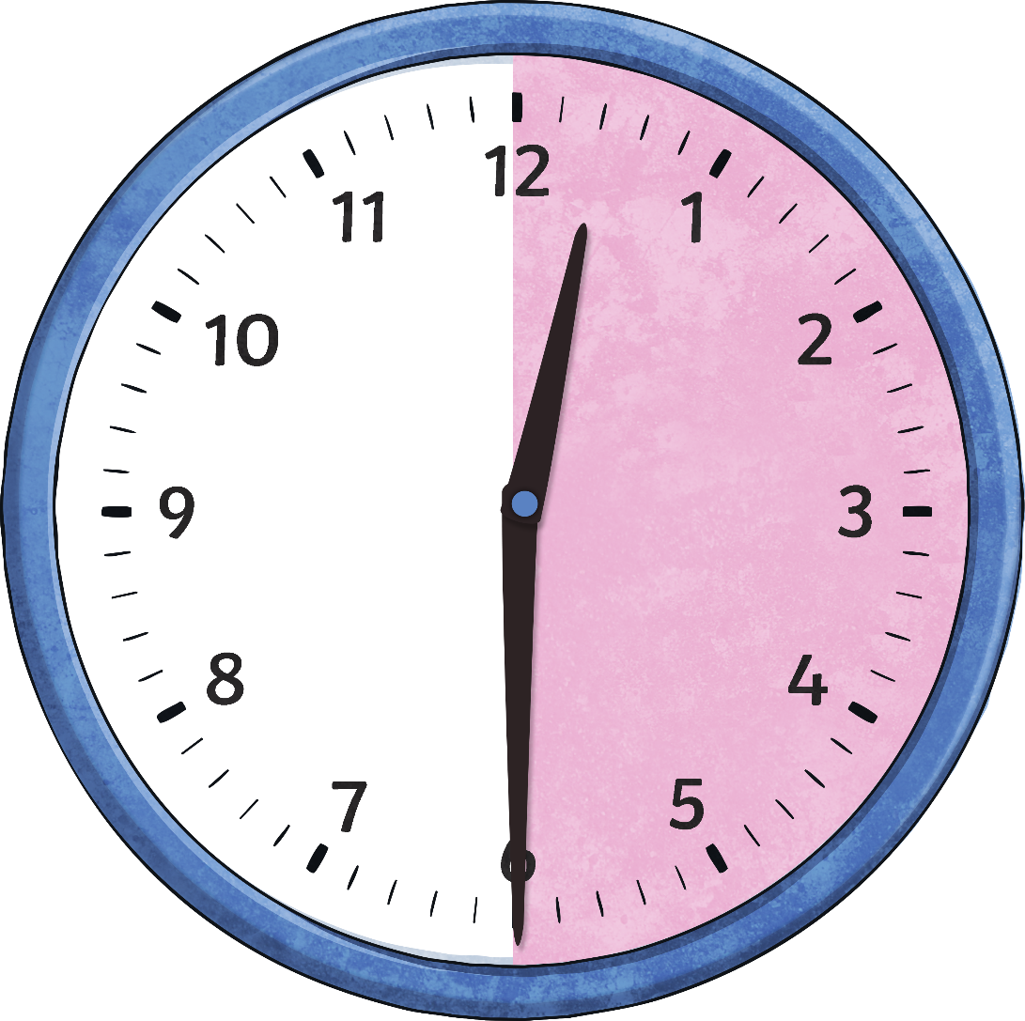
When the big hand points to 5, it means…
When the big hand points to 6, it means…
30
25
minutes
past
minutes
past

Slide 43
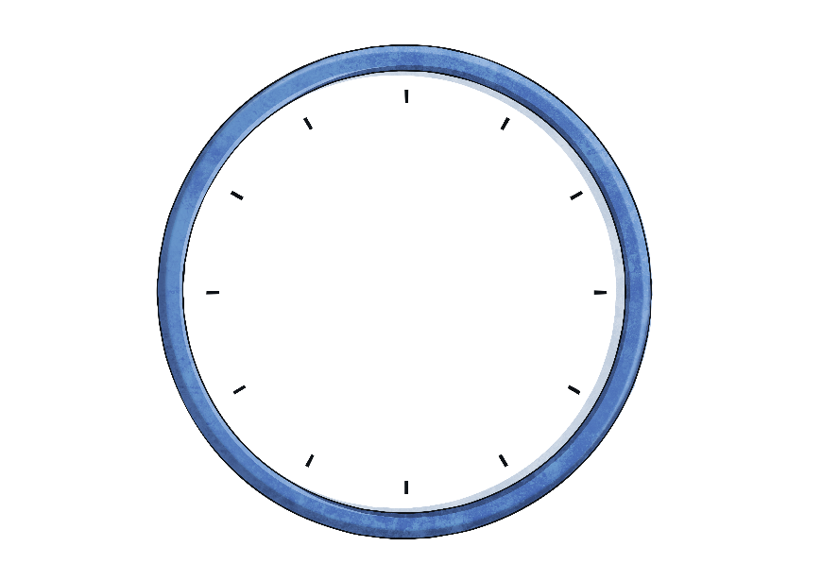
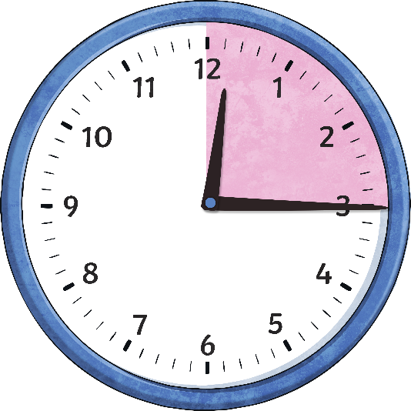
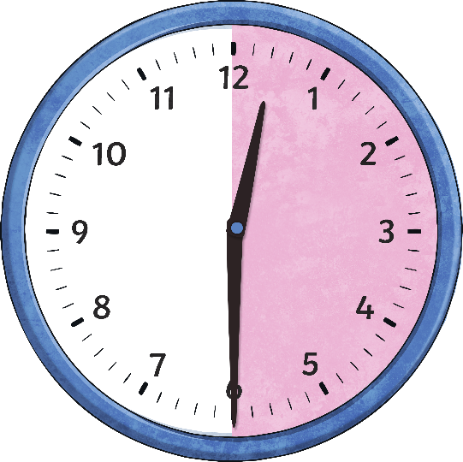
Telling the Time
How many minutes are in an hour?
Why is 15 minutes called ‘quarter past’?
Why is 30 minutes called ‘half past’?
60
minutes
15
minutes
30
minutes
= an hour
= a quarter of an hour
= half an hour

Slide 44
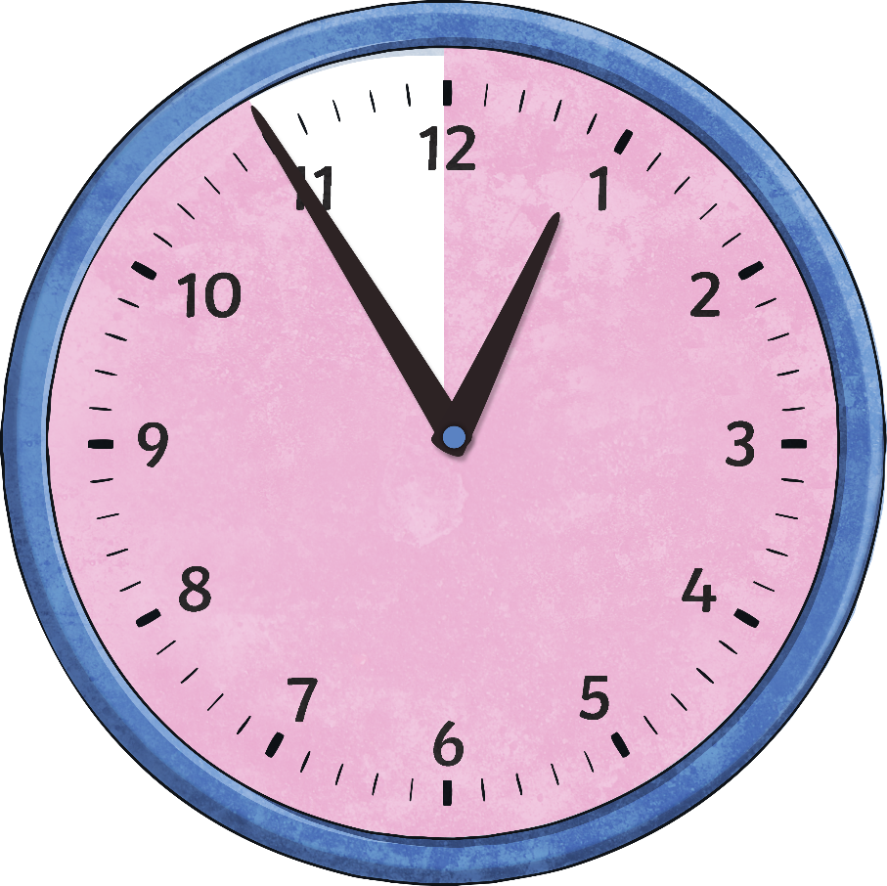
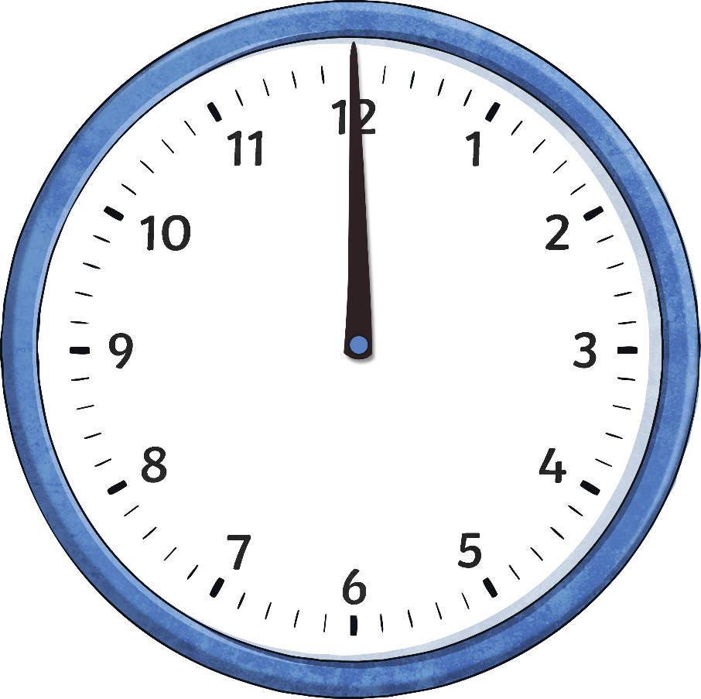
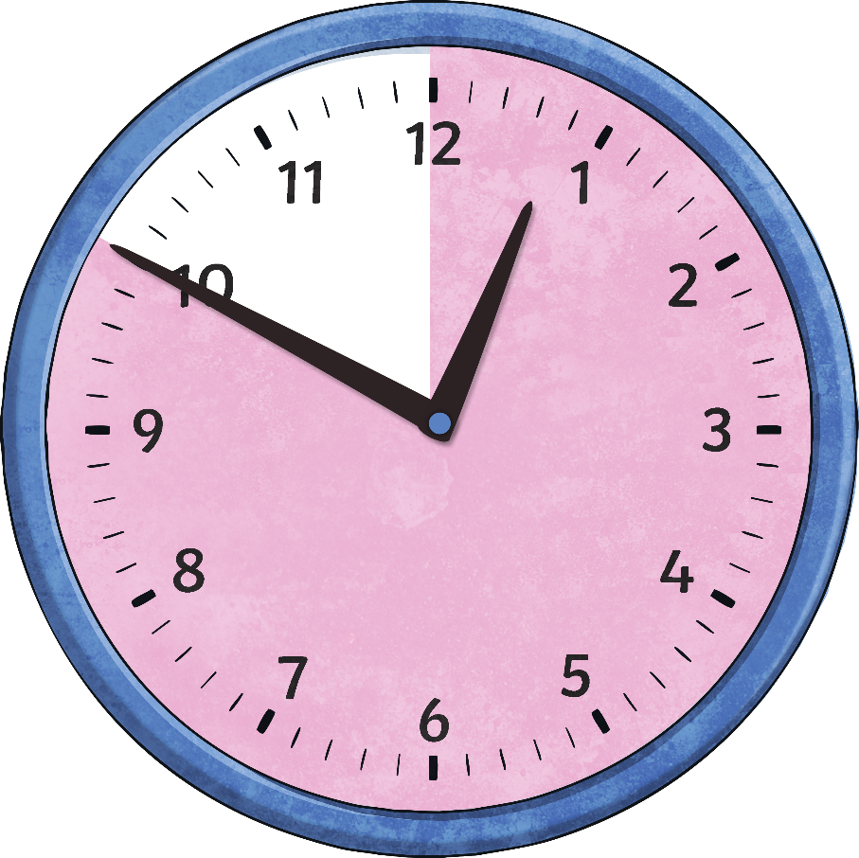
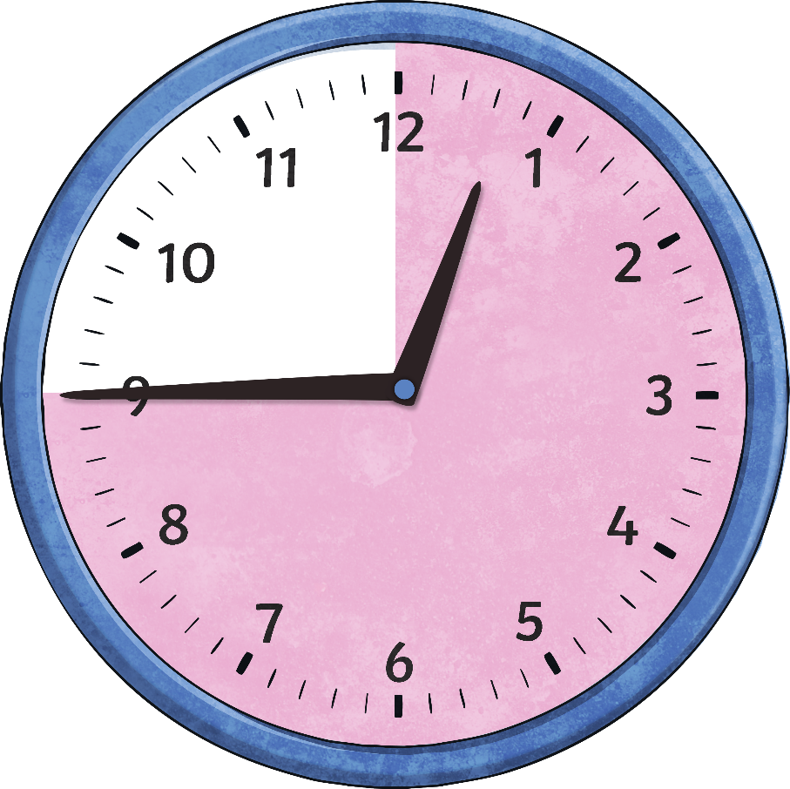
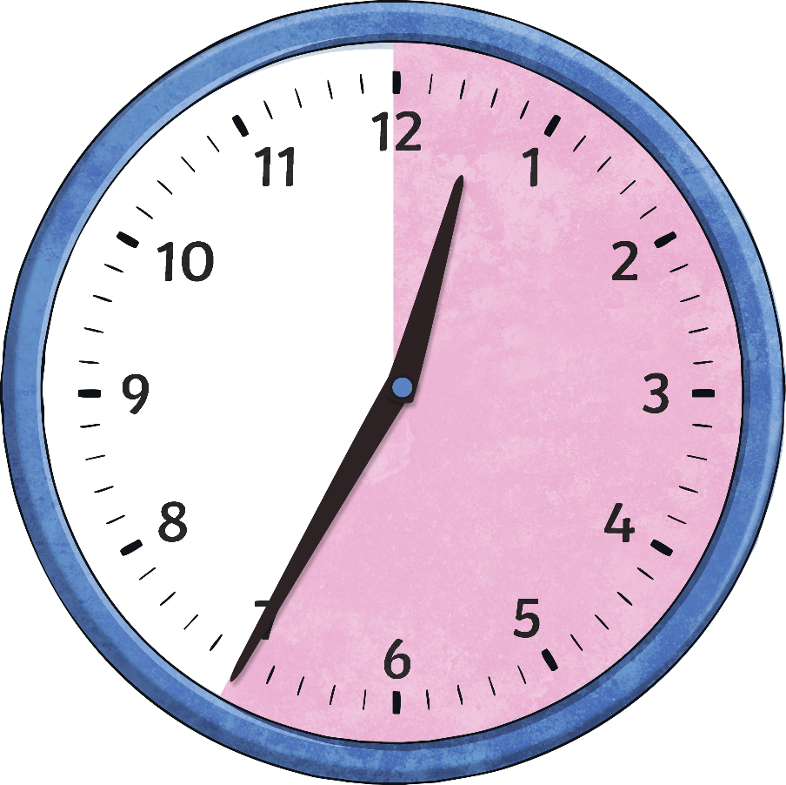
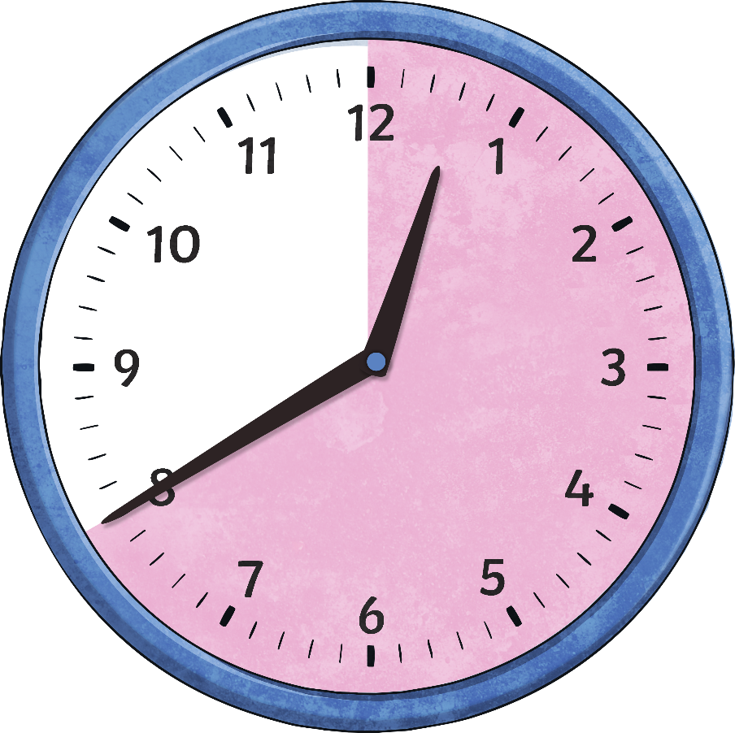
Telling the Time
Now let’s look at the other half of the clock. We are going to look at the minutes to the next hour.
5
10
15
25
20
minutes
to
minutes
to
minutes
to
minutes
to
minutes
to
o’clock

Slide 45
When the big hand points to 7, it means…
When the big hand points to 8, it means…
20
25
minutes
to
minutes
to

Slide 46
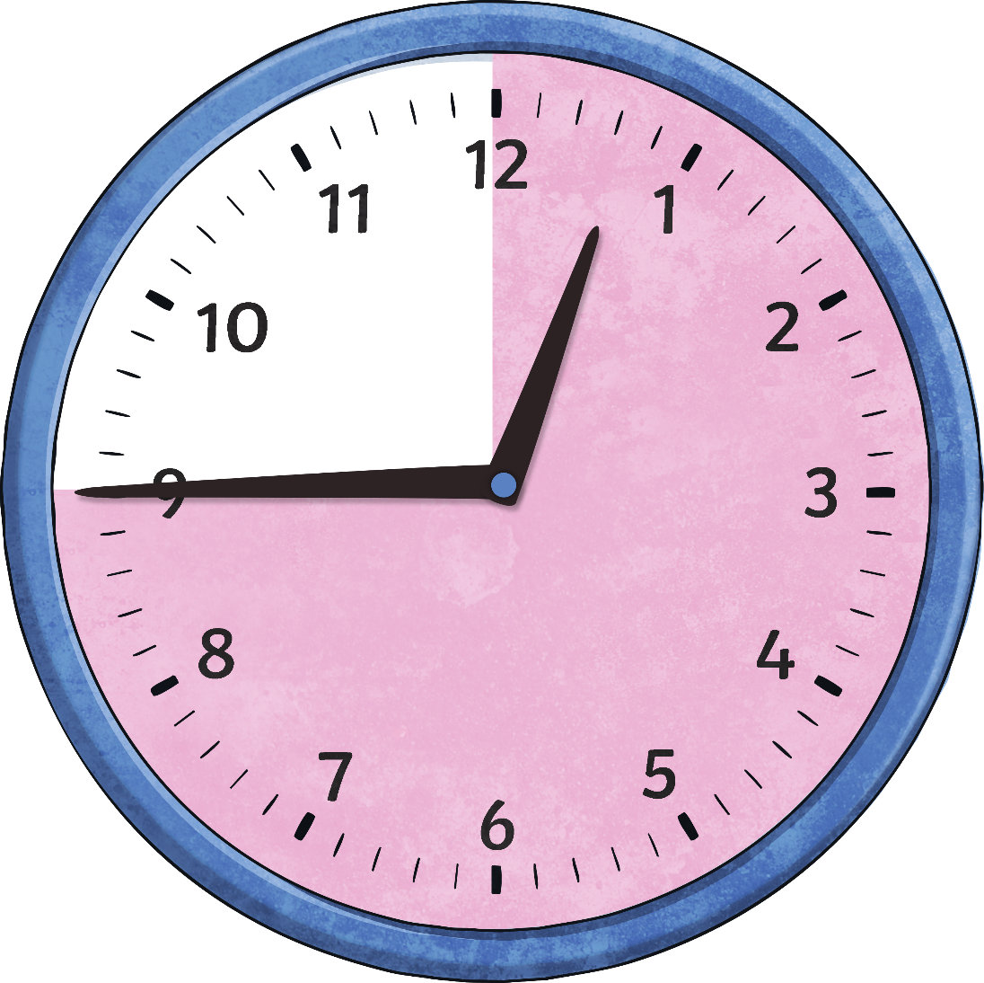
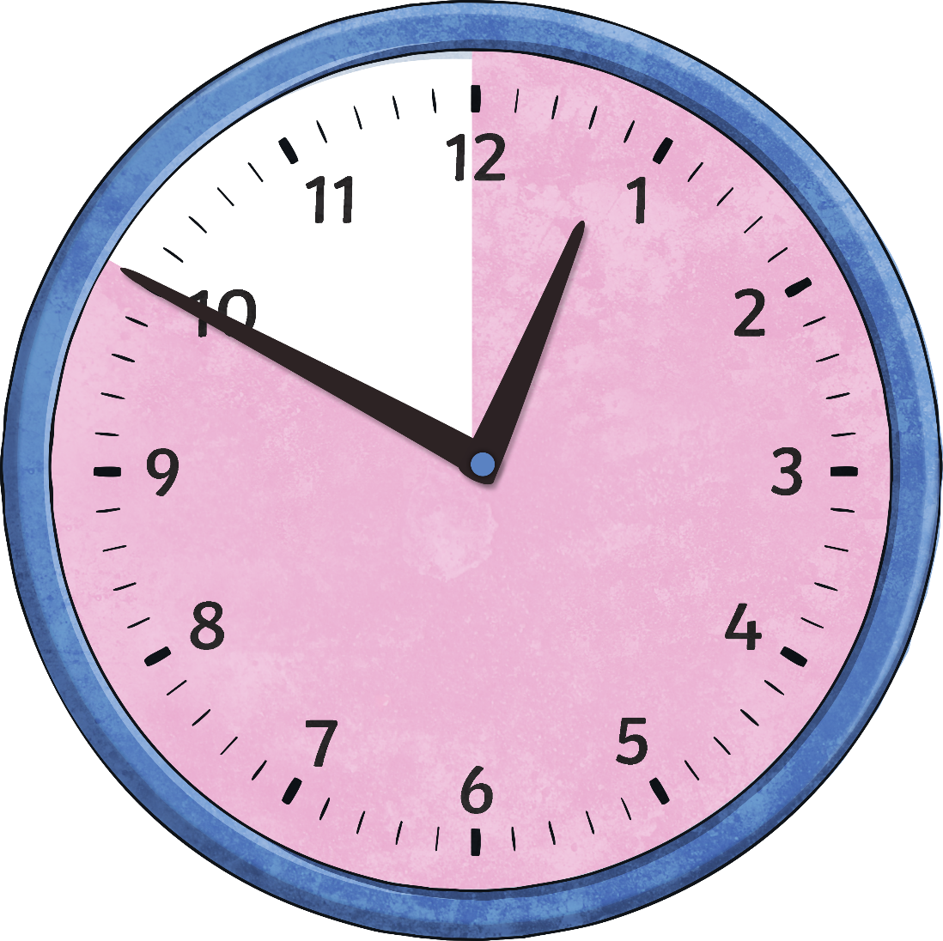
When the big hand points to 9, it means…
When the big hand points to 10, it means…
15
10
minutes
to
minutes
to

Slide 47
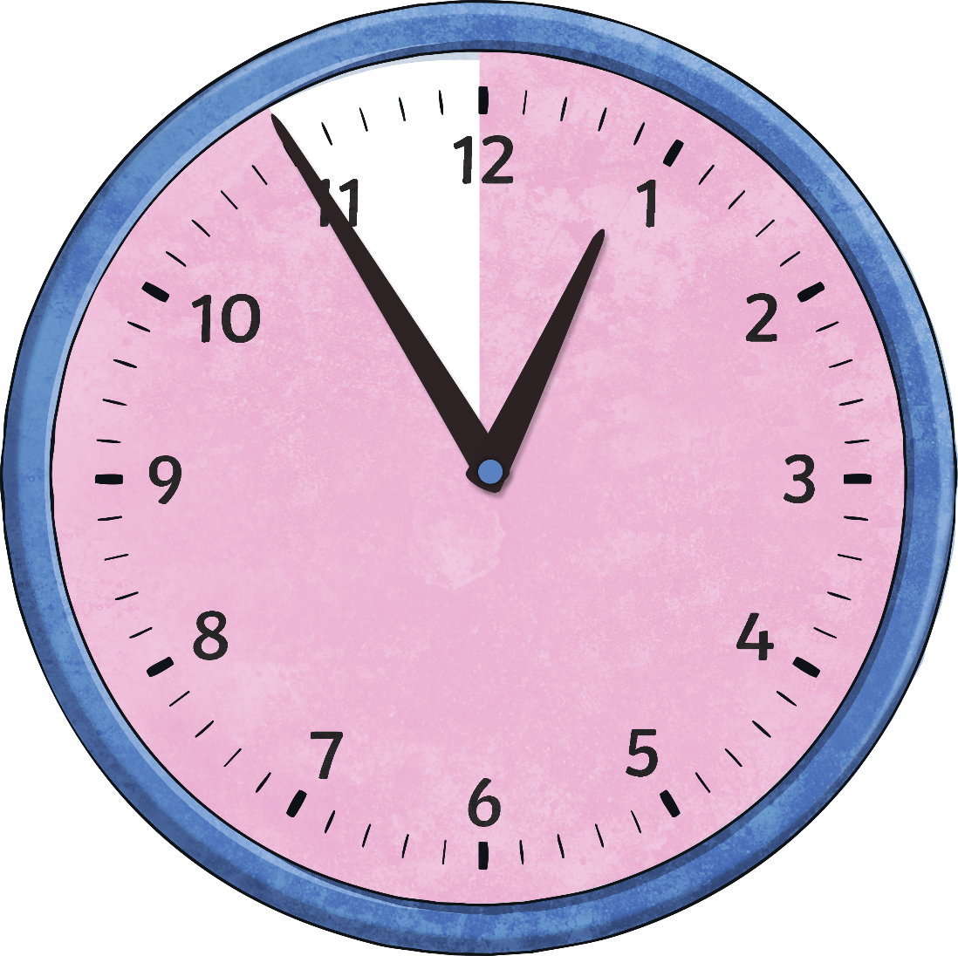
When the big hand points to 11, it means…
5
minutes
to

Slide 48
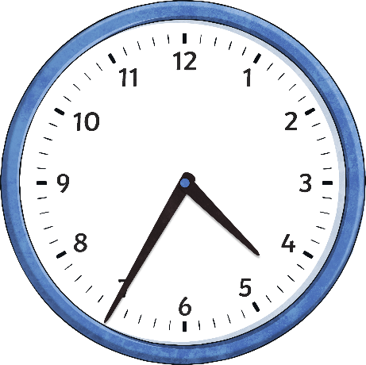
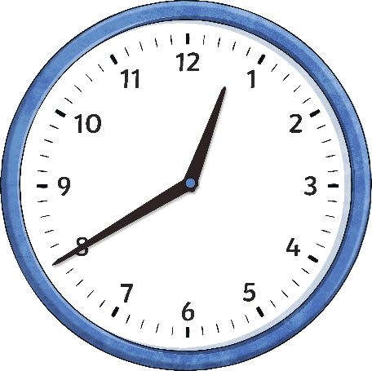
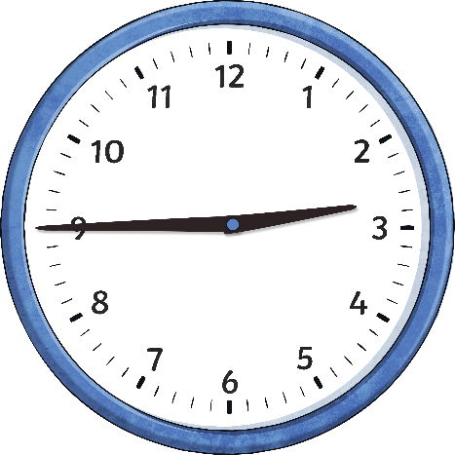
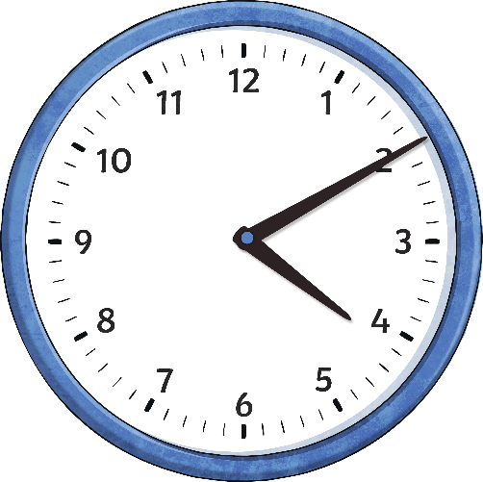
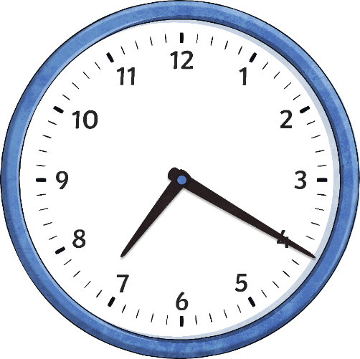
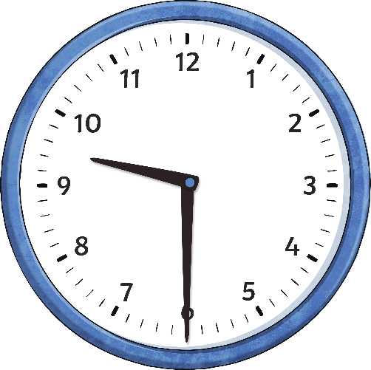
What Time Does it Say on the Clock?
___ minutes to ___
___ minutes to ___
______to ____
___ minutes past ____
___ minutes past ____
___ minutes past ____

Slide 49
What Time Does it Say on the Clock?
25 minutes to 5
20 minutes to 1
Quarter to 3
10 minutes past 4
20 minutes past 7
Half past nine

Slide 50
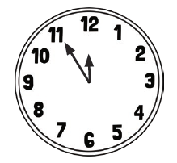
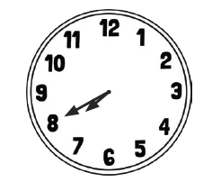
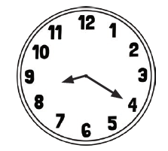
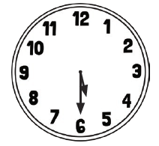
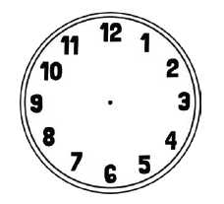
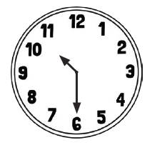
Write the time that is on the clock
Draw 10 minutes past 4 Draw 20 minutes to 3

Slide 51
Complete the challenge

Slide 52
25.2.2021
L.O To be able to tell the time to 1 minute
Go to Times Tables Rock Stars to warm up your number brain before you start your maths activity.
Subject: Maths

Slide 53
Pre-recorded Teaching
Access the online teaching video below that will support you to complete the work in this lesson. This video will act as a support but all of the work can still be successfully understood & completed using paper-based versions of this pack. If you need further support to understand / complete work then please contact school via e-mail or telephone.
Play Video
You can also copy and paste this link if you would prefer:
https://classroom.thenational.academy/lessons/reading-analogue-time-to-the-nearest-minute-cdgkjd

Slide 54
Telling the exact time
Each clock has 4 lines between the numbers. These show the minutes
The blue hand is pointing to 8. That means that the exact time shown is 8 minutes past 12.

Slide 55
Telling the exact time
Have a look at this example
How many minutes past the hour is the blue hand showing?
The blue hand is showing 13 minutes past 12.

Slide 56
Count On and Count Back
When telling the exact time, it helps to look for points around the clock you are familiar with.
quarter past (15 minutes past)
quarter to (45 minutes past)
half past (30 minutes past)
five minute intervals
Then either count on or count back to find the exact time.
In other words, do a simple addition or subtraction to find the correct time.

Slide 57
Count On and Count Back
What exact time is it?
The blue hand is pointing at 2 minutes after 25 minutes past. In other words:
The exact time here is 27 minutes past 1.
25 + 2 = 27

Slide 58
Count On and Count Back
Use the count on and count back method to tell the exact time.
The blue hand is pointing to 3 minutes after 20. That means that the exact time is 23 minutes past 12.
20+3=23
That means that the exact time is 23 minutes past 12

Slide 59
What time is on the clock?
The blue hand is pointing to 2 minutes after 25
So the time is 2+25= __________minutes past _________

Slide 60
What time is on the clock?
The blue hand is pointing to 2 minutes after 25
So the time is 2+25= 27 minutes past 2

Slide 61
What time is on the clock?
The blue hand is pointing to 1 minute to 25 minutes to 3
So 25+1= __________ minutes to __________

Slide 62
What is the time to the nearest minute?

Slide 63
Complete the challenge
Draw the hands on the clock for the following times.

Slide 64
26.2.2021
L.O To be able use a.m. and p.m.
Go to Times Tables Rock Stars to warm up your number brain before you start your maths activity.
Subject: Maths

Slide 65
Pre-recorded Teaching
Access the online teaching video below that will support you to complete the work in this lesson. This video will act as a support but all of the work can still be successfully understood & completed using paper-based versions of this pack. If you need further support to understand / complete work then please contact school via e-mail or telephone.
Play Video
You can also copy and paste this link if you would prefer:
https://classroom.thenational.academy/lessons/telling-the-time-to-am-and-pm-68w3cd?activity=video&step=1

Slide 66
There are different times of the day. There is A.M. which is classed as the morning and can be used for anytime of the day between 12 at night and 12 midday. There is also P.M. This is the afternoon and evening which can be used for anytime of the day after 12 midday and up until 12 at night.
Hours of the day that could be a.m.
1 a.m.
2 a.m.
3 a.m.
4 a.m.
5 a.m.
6 a.m.
7 a.m.
8 a.m.
9 a.m.
10 a.m.
11 a.m.
12 a.m.
Hours of the day that could be p.m
1 p.m.
2 p.m.
3 p.m.
4 p.m.
5 p.m.
6 p.m.
7 p.m.
8 p.m.
9 p.m.
10 p.m.
11 p.m.
12 p.m.

Slide 67
Using a.m. and p.m.
Which lessons are in the morning and which are in the afternoon?

Slide 68
Using a.m. and p.m.
Which lessons are in the morning and which are in the afternoon?
Maths | French | DT
Spelling | Geography | Grammar
morning
afternoon
afternoon
10:15 a.m.
1:20 p.m.
1:55 p.m.
morning
morning
afternoon
11:55 a.m.
10:40 a.m.
3:05 p.m.

Slide 69
There are two types of clocks, do you know what they are?
Analogue
Digital

Slide 70
When we tell the time we can do it in either analogue or digital.
Example
Imagine this clock is showing the time in the afternoon
In analogue we would say it’s 20 minutes to 1
In digital we would say it’s 12:40 p.m.

Slide 71
When we tell the time we can do it in either analogue or digital.
Example
Imagine this clock is showing the time in the morning
In analogue we would say it’s 10 minutes past 4
In digital we would say it’s 4:10 a.m.

Slide 72
When we tell the time we can do it in either analogue or digital.
Example
Imagine this clock is showing the time in the morning
In analogue we would say it’s half past 9
In digital we would say its 09:30 a.m.

Slide 73
Look at the clock
The time is 27 minutes past 1.
What would be the time in digital?
__________p.m.
__________a.m.

Slide 74
Look at the clock
The time is 27 minutes past 1.
What would be the time in digital?
01:27p.m.
01:27a.m.

Slide 75
Look at the clock
The time is 26 minutes to 3.
What would be the time in digital?
________p.m.
________a.m.

Slide 76
Look at the clock
The time is 26 minutes to 3.
What would be the time in digital?
3:26 p.m.
3:26 a.m.

Slide 77
1.

Slide 78
2. Show these times on both analogue and digital clocks
20 minutes past 4
25 minutes to 1
Quarter to 5
Half past 6

Slide 79
Complete the challenge

