Slide 2
Date: Monday 1st February 2021
LO: To be able to spell words ending in -ous
Subject: Reading

Slide 3
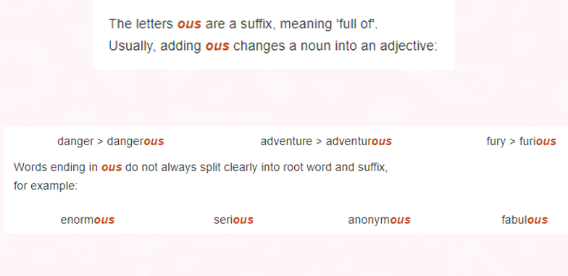

Slide 4
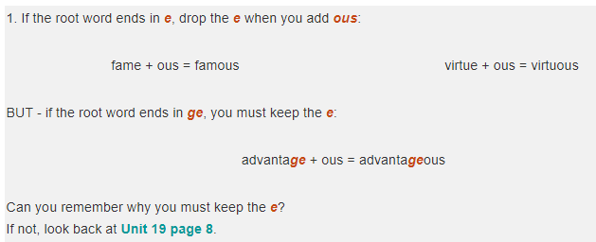

Slide 5
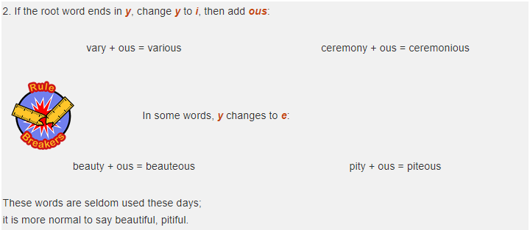

Slide 6
Task: Complete this table using your ten spelling words
If the root word ends in ‘e’, remove the ‘e’ and add -ous | If the root word ends in ‘ge’, keep the ‘e’ and add –ous.
famous
nervous
ridiculous
carnivorous
herbivorous
porous
adventurous
courageous
outrageous
advantageous

Slide 7
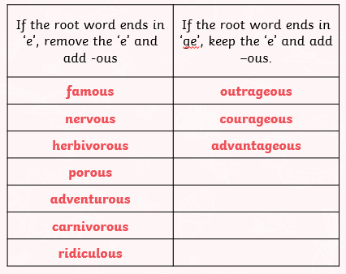
Answers to the task. Look over any errors you might have made and correct them.
Root word
fame
nerve
herbivore
pore
adventure
carnivore
ridicule
Root word
outrage
courage
advantage
Task: Any words you are unsure of, find them in a dictionary to clarify their meaning.

Slide 8
Definitions of some of the more unfamiliar words:
carnivorous: (of an animal) feeding on other animals. (adjective)
herbivorous: eating leaves, shrubs and stems of other plants (adjective)
porous: Something that is porous has many small holes in it, which water and air can pass (adjective)
courageous: not deterred by danger or pain; brave. (adjective)
outrageous: very bold and unusual and rather shocking (adjective)
advantageous: If something is advantageous to you, it is likely to benefit you/ upper hand (adjective)

Slide 9
Read, copy, cover, spell this week’s spellings.
Date: Monday 1st February 2021
famous
nervous
ridiculous
carnivorous
herbivorous
porous
adventurous
courageous
outrageous
advantageous

Slide 10
Date: Tuesday 2nd February 2021
LO: To be able to retrieve information and explain inferences.
Subject: Reading

Slide 11
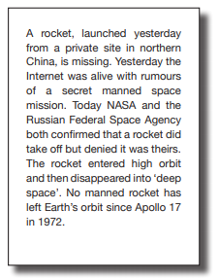
Read through the text on the next few pages and then answer the questions which follow.

Slide 12
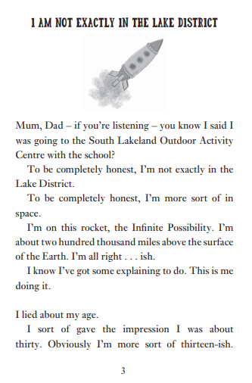
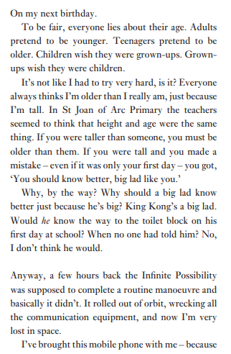

Slide 13
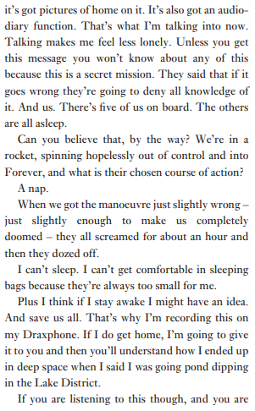
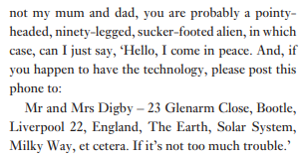

Slide 14
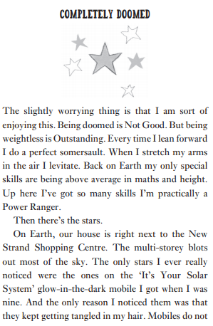
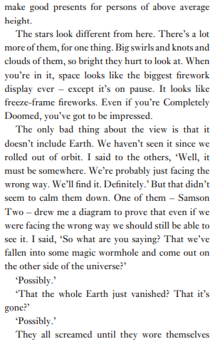

Slide 15
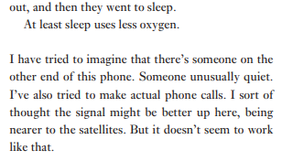
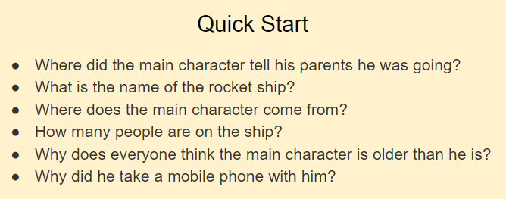
Now you have read the text, recall the answers to the questions below. You do not need to write these answers down.

Slide 16
For the next 6 questions, write your answers down onto a piece of paper.
1.
2.

Slide 17
3.
4.
5.
6.

Slide 18
Date: Wednesday 3rd February 2021
LO: To be able to retrieve information and explain inferences.
Subject: Reading

Slide 19
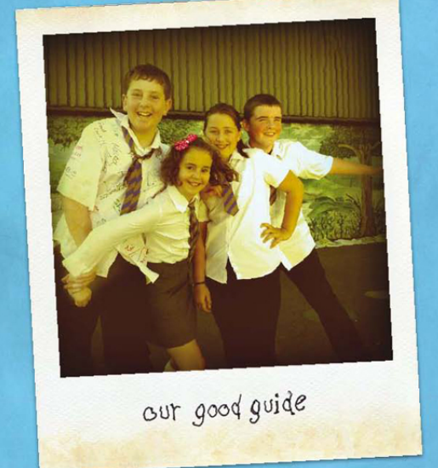
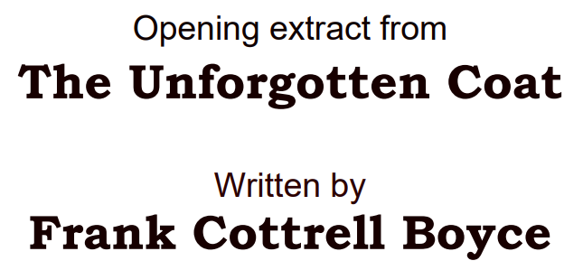
Read through the text on the next few pages and then answer the questions which follow.

Slide 20
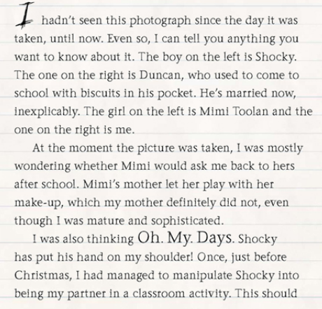

Slide 21
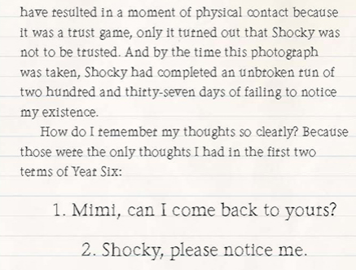

Slide 22
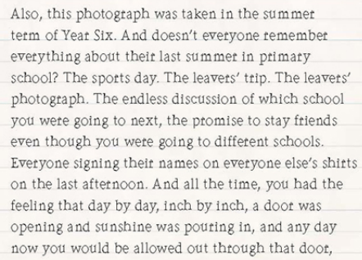

Slide 23
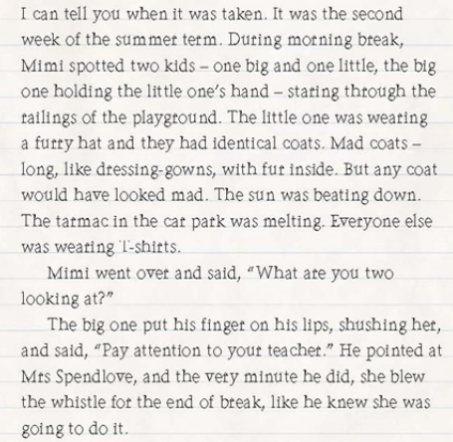

Slide 24
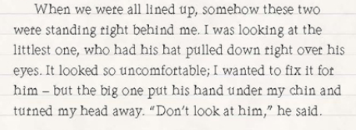
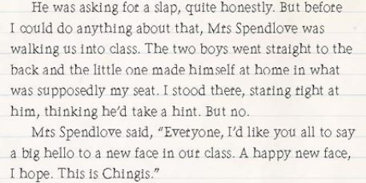

Slide 25
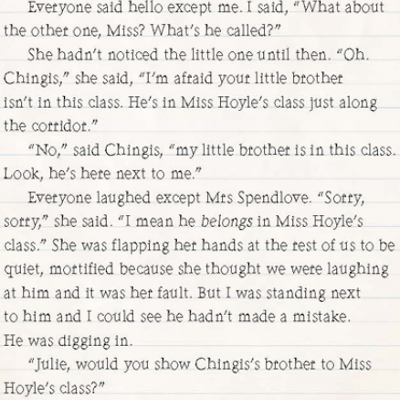

Slide 26
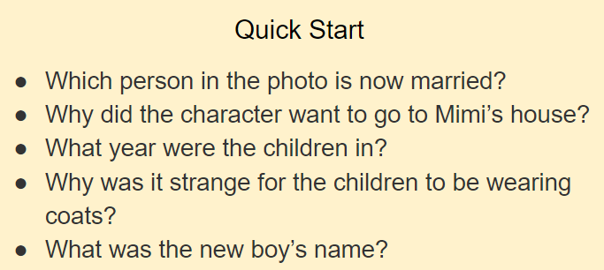
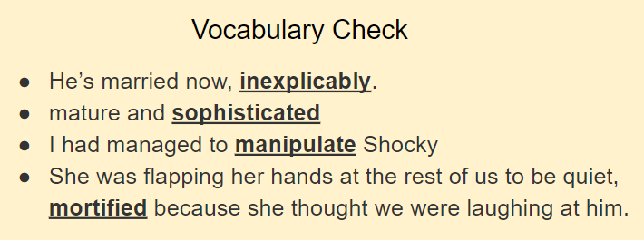
Now you have read the text, recall the answers to the questions below. You do not need to write these answers down.
Discuss or think about the meaning of the underlined words. If you are not sure, you could find the words in a dictionary.

Slide 27
For the next 6 questions, write your answers down onto a piece of paper.
1.
2.
3.

Slide 28
4.
5.
6.

Slide 29
Date: Thursday 4th February 2021
LO: To be able to retrieve information and explain inferences.
Subject: Reading

Slide 30
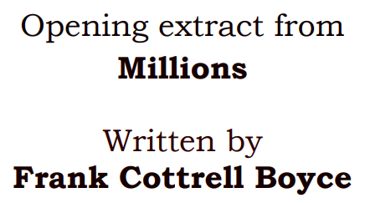
Read through the text on the next few pages and then answer the questions which follow.

Slide 31
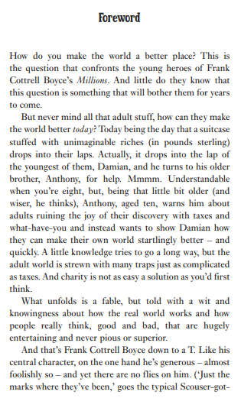
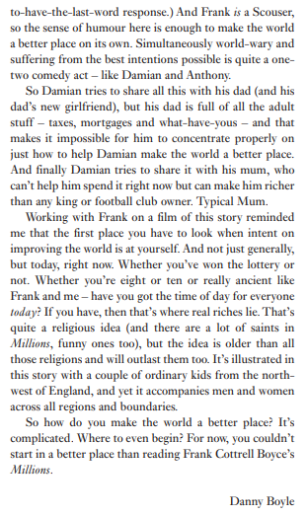

Slide 32
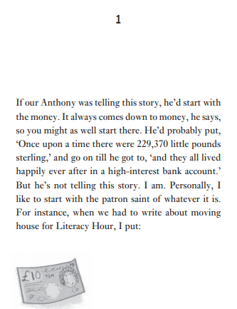
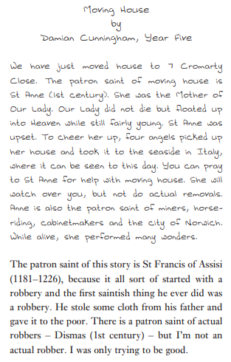

Slide 33
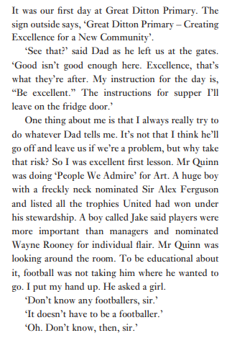
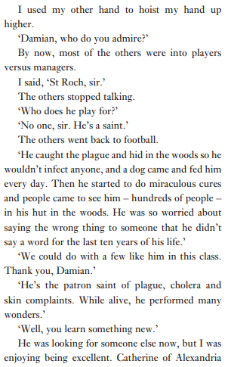

Slide 34
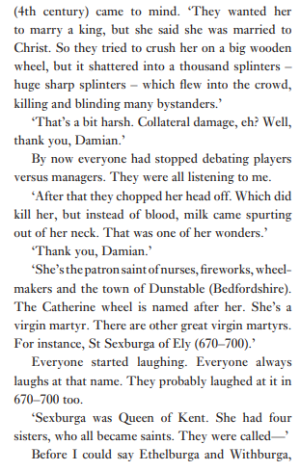
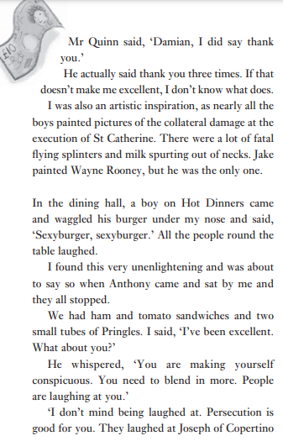

Slide 35
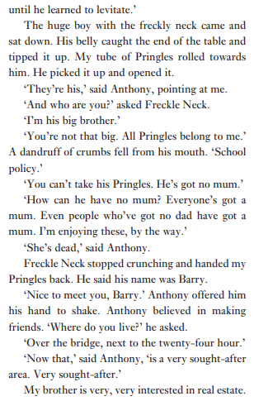
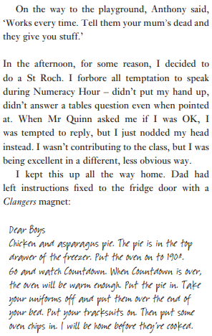

Slide 36
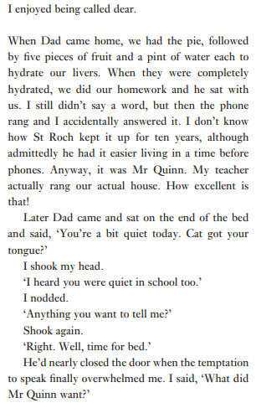
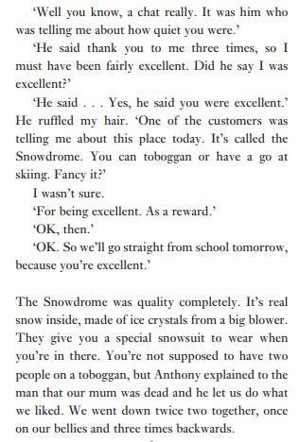

Slide 37
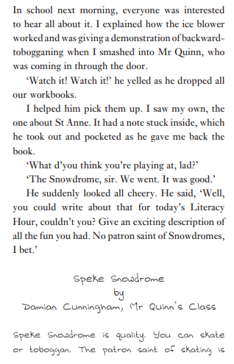
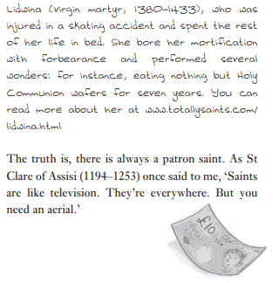

Slide 38
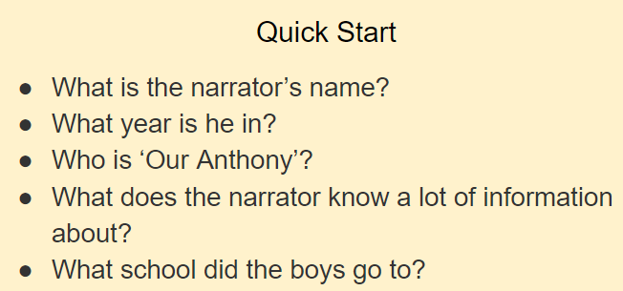
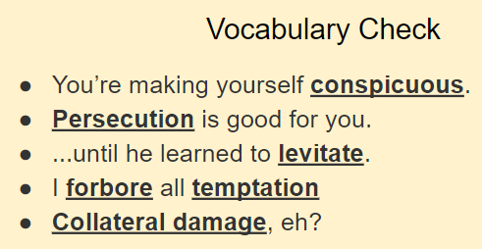
Now you have read the text, recall the answers to the ‘Quick Start’ questions. You do not need to write these answers down.
Discuss or think about the meaning of the underlined words. If you are not sure, you could find the words in a dictionary.

Slide 39
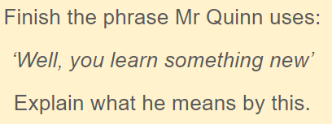
For the next 6 questions, write your answers down onto a piece of paper.
1.
2.
3.

Slide 40
4.
5.
6.

Slide 41
Date: Friday 5th February 2021
LO: To be able to spell words ending in -ous
Subject: Reading

Slide 42
Recap your spelling words from this week:
Spend time looking over the spelling of each word and which rule applies.
Ensure that you can spell each word correctly (from memory).
Ask someone to read the words out to you and write them down.
Once complete, check you have spelt the words correctly.
If any errors are made, spend time practicing those words.

