Slide 1
Subject: Topic

Slide 2
Date: Monday 8th February 2021
LO To be able to explain how housing changed throughout the stone age
Subject: History

Slide 3
Throughout the three ages of the Stone Age, people lived in a variety of places. This changed due to the new tools that were developed, language development and culture changes. These changes helped develop bigger and better houses.
The houses they had were nothing like the ones we have now. They didn’t have any electric, bricks or windows.
What do you think their houses were made from?

Slide 4
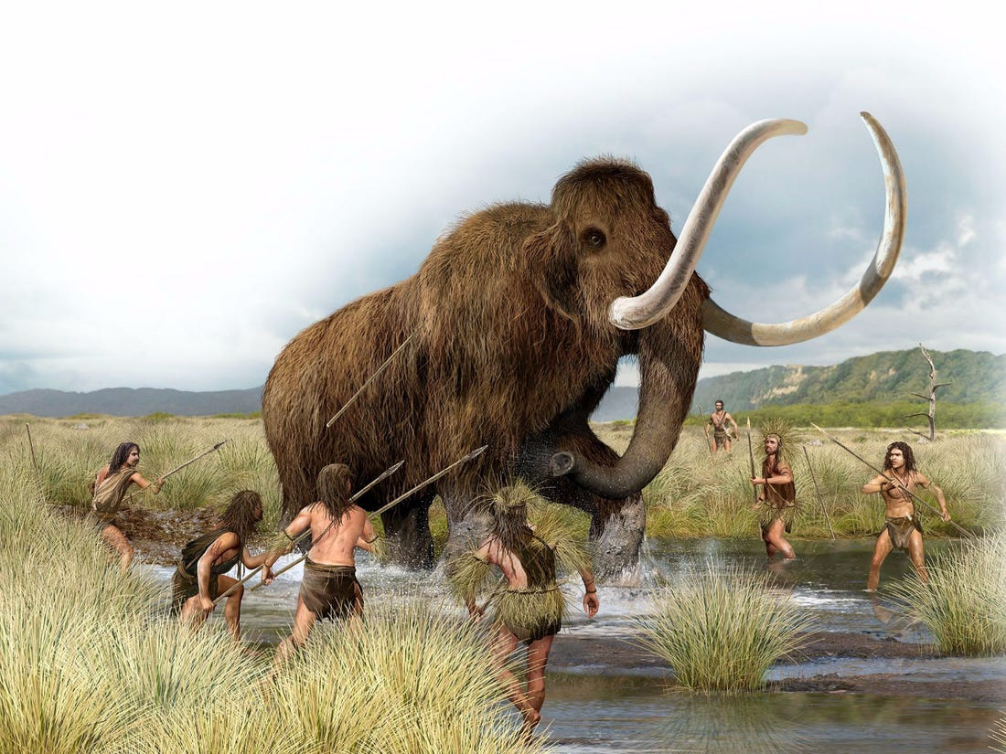
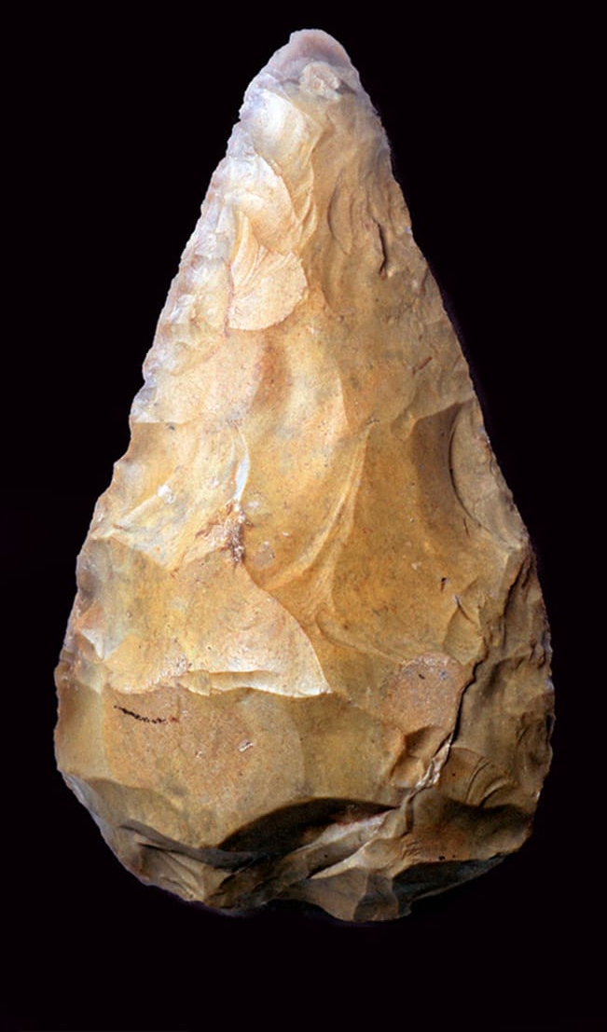
In the palaeolithic era, people were known as hunter-gatherers. They were always on the hunt for a wild animals, such as a woolly mammoth or deer, or gathering food such as berries and nuts. This meant they had to move around a lot.
In this era, people only had basic tools such as animal bones and stone. These tools were good for making weapons like axes and spears but not great for building houses.
Where do you think people lived in this era?

Slide 5
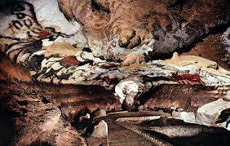
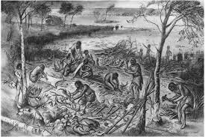
Stone Age people did not have a lot of tools and they had to keep searching for food so people in this era lived mostly in caves they found. They would not stay there for long maybe only for a night or two. The caves would be warmer and safer than sleeping outside.
Near the end of the era, people started cutting down trees. They used the wood to make new houses.
What material can you get from cutting down trees?

Slide 6
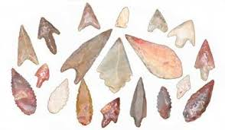
In the Mesolithic era, also called the middle stone age, people were creating better tools using materials such as antlers, bones, wood and stone. These materials made sharper and more effective tools such as knives.
Little groups started to live together and would make huts from wooden poles to keep the shelter up. They would use materials such as animal skins and bark as a roof. On the floor, they would use soft plants such as moss to keep cold air out and make the huts warmer. They also lived near bodies of water such as rivers and streams.
Can you guess why?

Slide 7
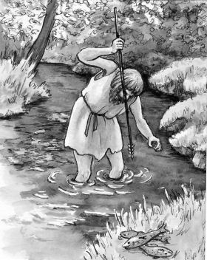
People realised that if they lived near water they had a better chance of finding food. They could fish in the water or hunt animals that were also trying to catch fish. It also means that they had fresh water at their doorstep.
During the Mesolithic era, the huts were only temporary as groups of people still had to move during different seasons. During winter the rivers or streams might freeze which meant
it was harder to get food from them.
What do you think the change was? Think back to last weeks lessons.
There was a massive change in the Neolithic era that changed the way people lived.

Slide 8
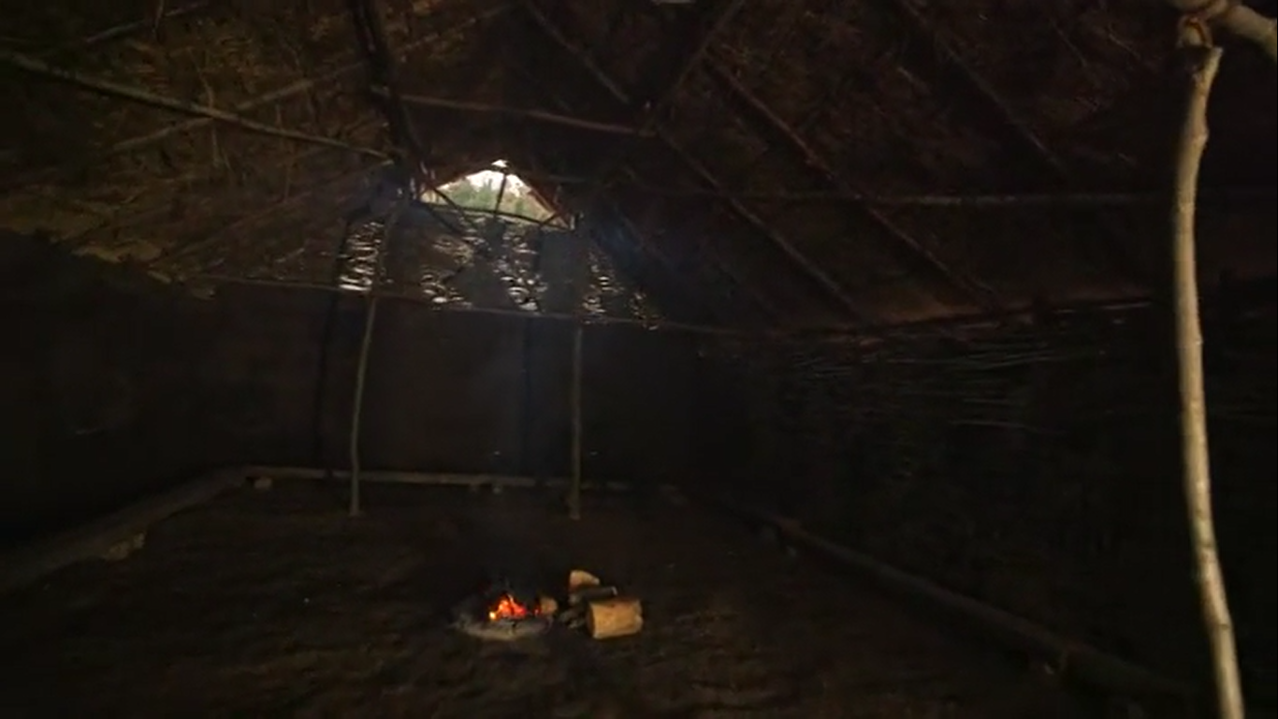
Farming changed the way people lived as they didn’t have to keep moving around. This meant they had more time to perfect their tools which they used to build well-structured, permanent buildings.
Watch this video to get a better in-sight into a Neolithic home
https://www.bbc.co.uk/teach/class-clips-video/history-ks2-stone-age-farming-and-homes/z479wty

Slide 9
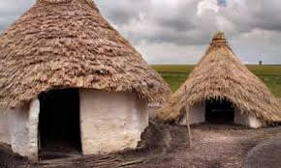
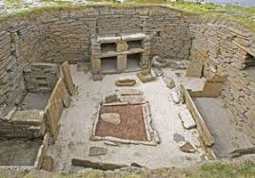
The walls of a Neolithic house was made of wattle and daub. Wattle is woven wood. It was very strong and it would take a lot to break it.
Daub is made from mixing materials like mud, clay, hay, water and even animal manure. They would rub it against the wattle using it like cement to make the walls stronger and keep cold air out. This meant the houses would be warmer. The roofs were made of chalk and straw.
In other areas, there were no trees which meant there was no wood nearby so houses were made out of stone. As there were no trees for wood, even beds and cupboards were made from stone!

Slide 10
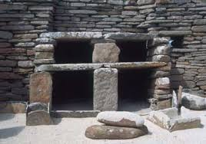
This is how a stone cupboard would look in the Neolithic era. Using everything we’ve learned, have a think about you think was stored in these cupboards.
Remember they needed tools for building and hunting. They were now farming so might have a lot of food to store.

Slide 11
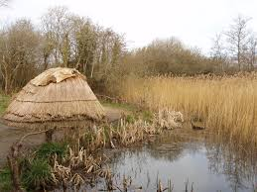
Lets take a look at a house from the Palaeolithic era and one from the Neolithic era.
What are some differences can you spot?
Think about what it is made from and what is next to it.
Which one do you think is better and why?

Slide 12
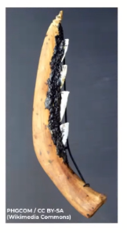
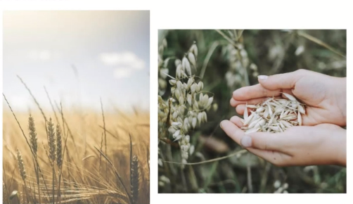
Write three sentences about how houses changed throughout the stone era and why:
They started chopping down trees so _____________________________
_______________________________________________________________
2. They started living closer to water because ___________________________
________________________________________________________________
3. _______________________________________________________
_________________________________________________________

Slide 13
Now, imagine you could go back and speak to a stone aged human. Write three questions that you would like to ask them? Ask 2 questions about where and how they lived and then you can ask them another question about something else.
________________________________________________________
___________________________________________________________
2.____________________________________________________________________________________________________________________
3.____________________________________________________________________________________________________________________

Slide 14
End of lesson

Slide 15
Date: Tuesday 9th February 2021
LO: To be able to recognise how to keep safe online
Subject: Computing

Slide 16
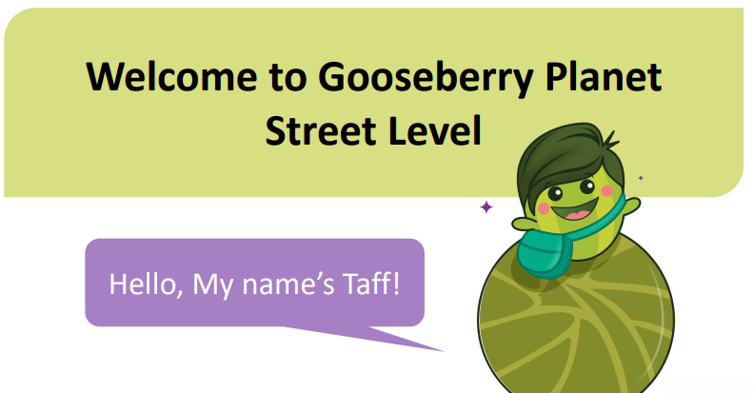
Today is Safer Internet Day. With the help of Taff, lets have a look at how we can keep ourselves safe whilst using the internet.

Slide 19
Can you give an example of personal information and think about why it is important not to share it with others.
Example: your name is personal information ________________________________________________________________________________________________________________________________________________

Slide 20
Here are some examples of personal information
Name
Address
Date of birth
Telephone number
Passwords
This information is personal to you and by not sharing it with others, helps to keep you safe from strangers.

Slide 21
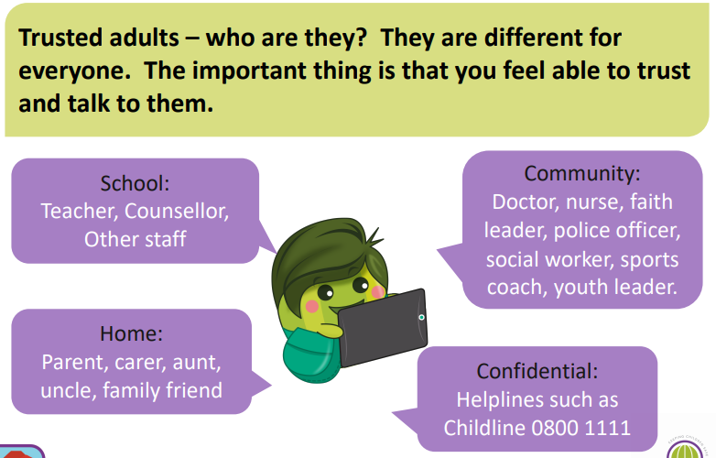
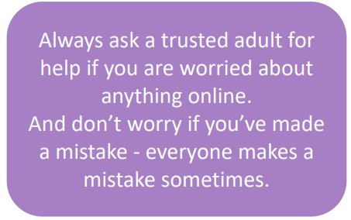

Slide 22
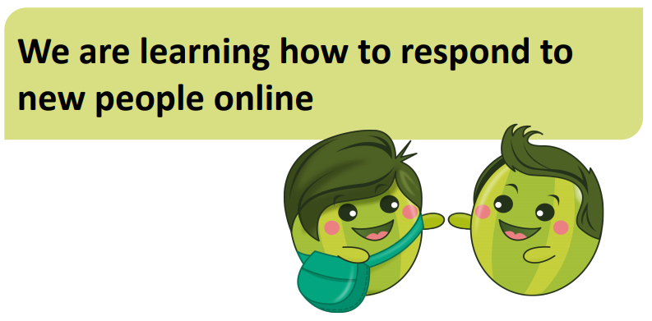

Slide 23
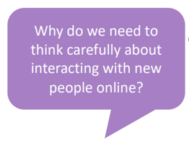
Remember we can’t see the person who is online and their information may be fake. If you don’t know them, don’t accept friend requests or share personal information with them. Tell a trusted adult if you are worried about anything online.

Slide 24
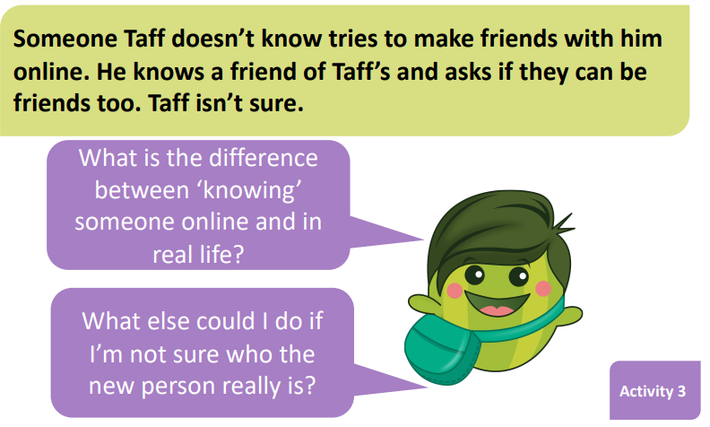
Choose one of the following
A. Accept his request or B. Ignore his request

Slide 25
Choose one of the following
A. Accept his request or B. Ignore his request

Slide 26
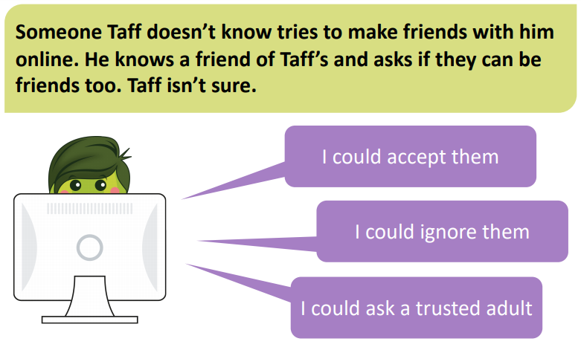
What should he do?

Slide 27
He could ignore them but he could also tell someone if he is feeling worried.

Slide 28
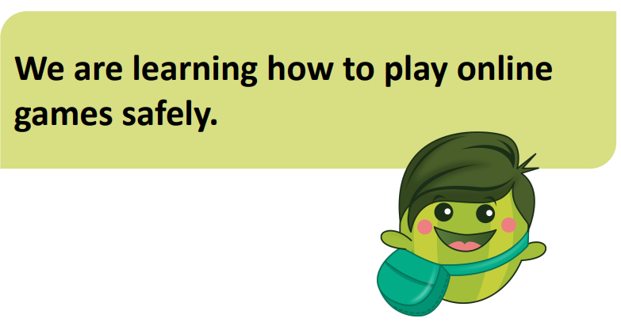

Slide 29
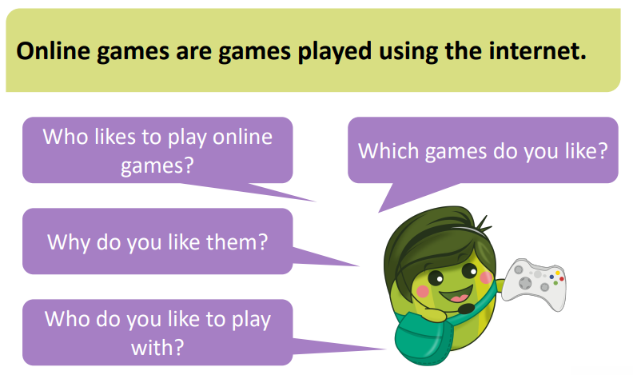
You can talk it through with your grown up or write it down below.
__________________________________________________________________________________________________________________________________________________________________

Slide 30
Ask a grown up if you need help to read the information.

Slide 32
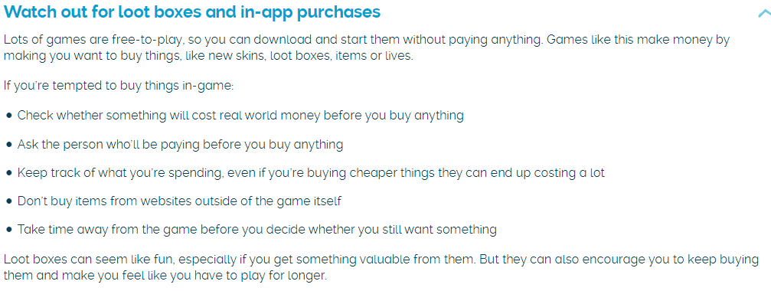

Slide 33
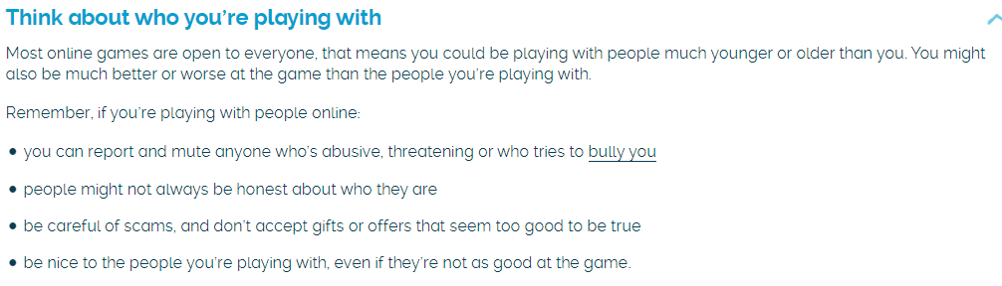

Slide 34
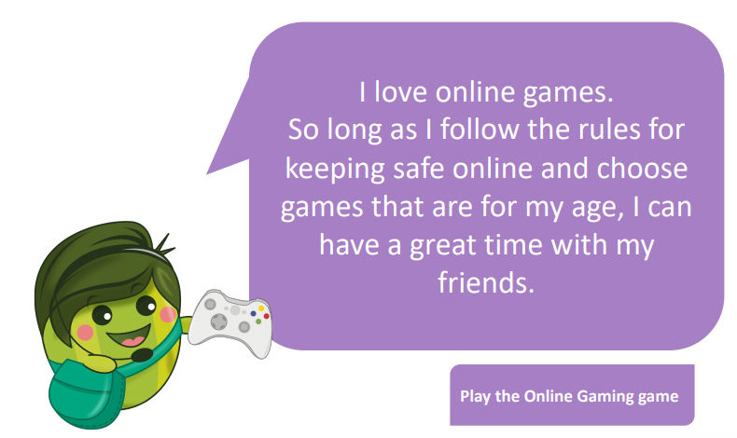

Slide 35
Lets have a look at some scenarios together and decide what we think we should do to keep ourselves safe.

Slide 36
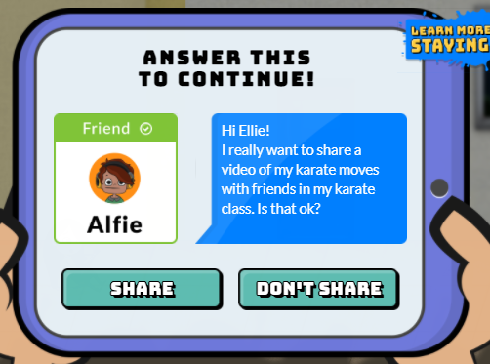
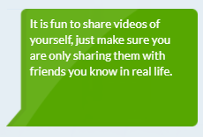

Slide 37
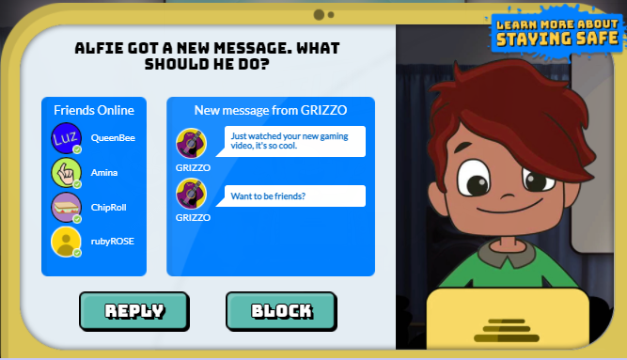
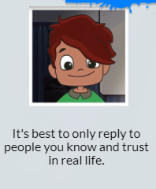

Slide 38
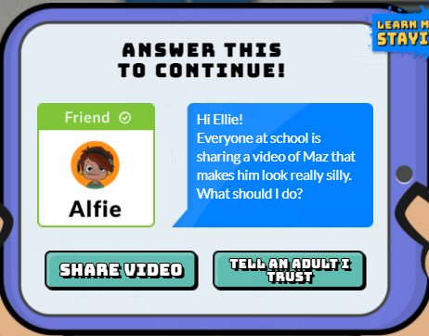
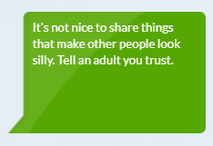

Slide 39
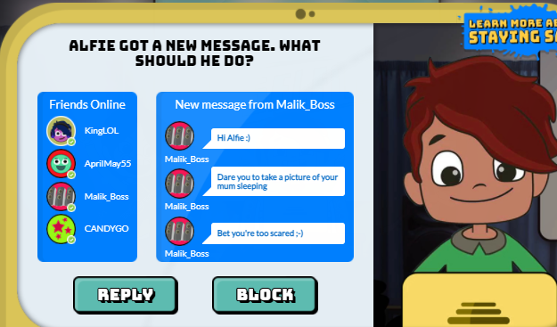
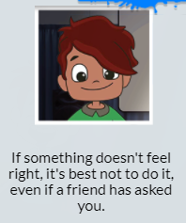

Slide 40
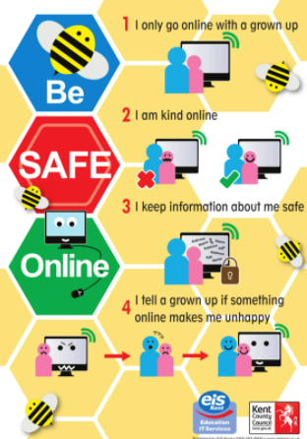
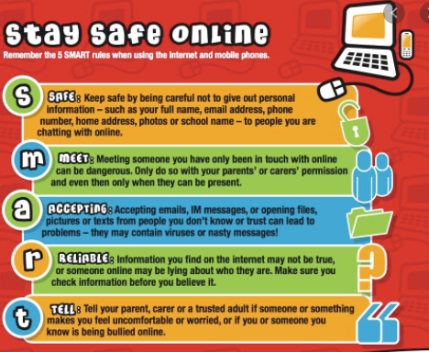
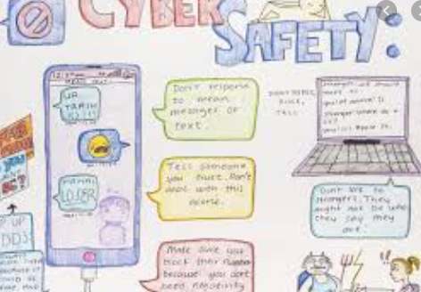
Task:
To design a poster about how to keep safe online. Think about all the things we have found out on the PowerPoint to help you.
EXAMPLES

Slide 41
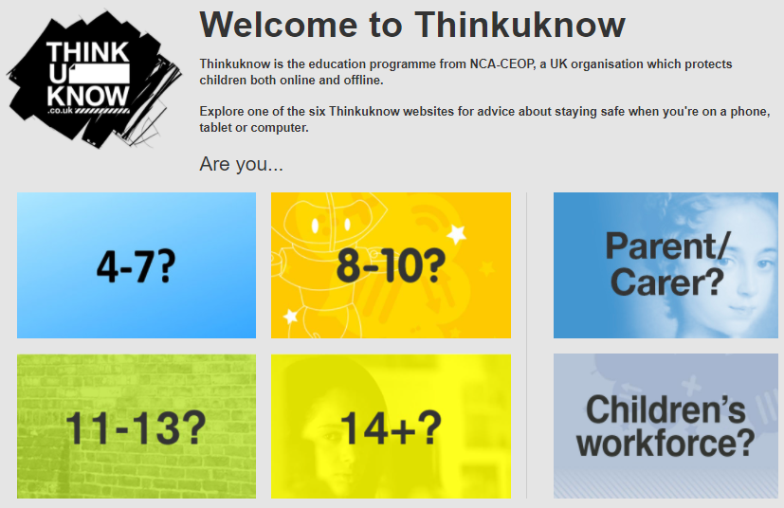
Using the following website to explore how you can keep safe online.
https://www.thinkuknow.co.uk/

Slide 42
End of lesson

Slide 43
Date: Wednesday 10th February 2021
L.O To be able to understand how shadows are formed.
Subject: Science

Slide 44
Pre-recorded Teaching
Access the online teaching video below that will support you to complete the work in this lesson. This video will act as a support but all of the work can still be successfully understood & completed using paper-based versions of this pack. If you need further support to understand / complete work then please contact school via e-mail or telephone.
Play Video
You can also copy and paste this link if you would prefer:
https://teachers.thenational.academy/lessons/what-is-light-and-where-does-it-come-from-6rv3je?from_query=light

Slide 45
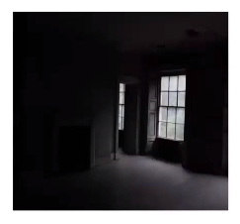
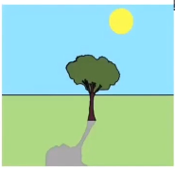
A shadow is created when light, from a light source, is blocked by an object.
When there is no light, we describe it as being dark.
Darkness is the absence of light.

Slide 46
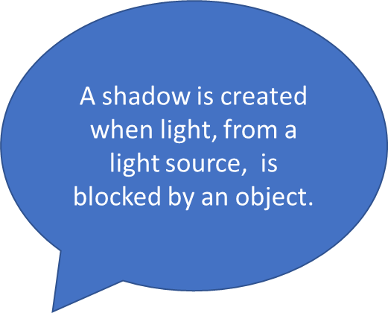
Here, the sun is the light source.
The light from the sun is being blocked by the tree.
There is an area behind the tree where no light can reach. That is why shadows usually look like the shape that is blocking the light.
A shadow is created because light can only travel in straight lines.

Slide 47
Ask an adult to help read this information with you if you are finding it a little tricky.

Slide 48
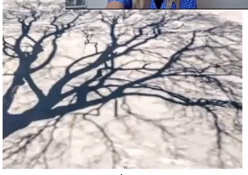
Complete these sentences below by filling in the missing spaces.
What is darkness ?
Darkness is the _______________ of light.
How is a shadow created?
A _________________ is created when light from a _______________ ______________ is blocked by an object.
What object do you think created the shadow in the picture?
__________________________________________
Means to bounce off
Means to take in
light source shadow absence

Slide 49
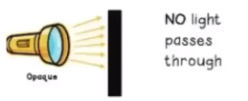
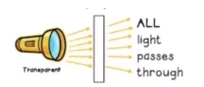
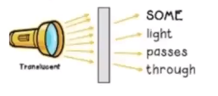
Opaque materials
Transparent materials
Translucent materials
The amount of light that passes through an object depends on whether the object is transparent, translucent or opaque.

Slide 50
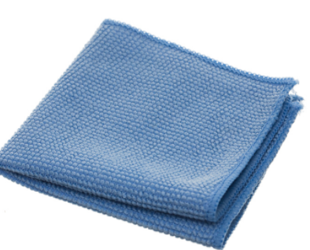
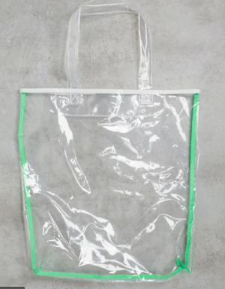
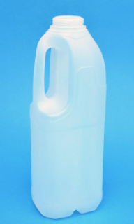
A cloth is an ________________ material because you can not see through it.
A clear plastic bag is a ________________ material because you can clearly see through it.
A plastic milk bottle is a ________________ material because you can see through it a bit but not as easily as
transparent materials.

Slide 51
Time to investigate.
Look around the room to find examples of materials that are transparent, translucent and opaque. Record your findings in the table below.
Shine a light at an object to see what type of material it is.
Transparent | Translucent | Opaque
If you don’t have a torch use the torch on a phone.

Slide 52
Shadows
https://www.bbc.co.uk/bitesize/clips/z6fnvcw

Slide 53
The size of shadows change.

Slide 55
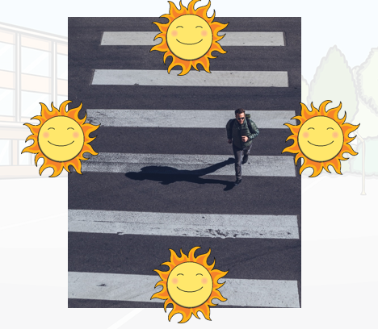
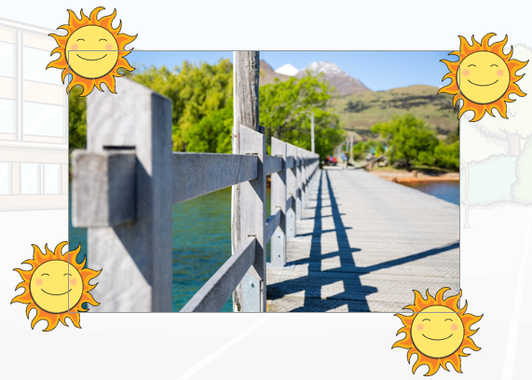
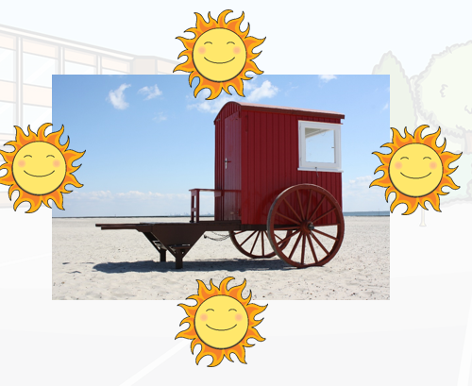
Circle or tick the sun that is creating the shadow to form on each picture.

Slide 56
Two children hold some objects between a lamp and a wall.
They see that a cardboard makes a dark shadow and a plastic sheet makes a faint shadow.
Explain why the shadows are different.
________________________________________________________________ ________________________________________________________________

Slide 58
Check your answers

Slide 59
Have a go at making your own shadows.
Butterfly
Dog
Swan
Experiment by making your shadows smaller and larger by moving your hand closer and further away from the light source.
Eagle
Deer

Slide 60
End of lesson
End of lesson

Slide 61
Thursday 11th February 2021
L.O To be able to identify colours.
Subject: French

Slide 62
Watch the video using the link below to help you pronounce the colours in French.
Click or copy and paste the following link:
https://www.youtube.com/watch?v=JkQGN86qTag

Slide 63
The colours from the video are shown in French and English below with pictures to help you remember.
violet
gris
purple
grey
rouge
bleu
marron
vert
jaune
red
blue
brown
green
yellow
orange
noir
blanc
rose
orange
black
white
pink

Slide 64
Practise saying each of the colours out loud.
violet
gris
marron
vert
rouge
bleu
jaune
orange
noir
blanc
rose

Slide 65
Work with a partner or an adult at home if you can.
Test yourself to see if you can remember what each of the colours are in English. Use the clues to help you.
On the next slide, write down what each of the colours are in English. The first one has been done for you.

Slide 66
rouge
red
Like a strawberry
blanc
__________
Like snow
bleu
__________
Like the sky
gris
__________
Like smoke
jaune
__________
Like a banana
rose
__________
Like your tongue
marron
__________
Like chocolate
noir
__________
Like coal
vert
__________
Like grass
violet
__________
Like a plum
orange
__________
Like the fruit

Slide 67
rouge
red
Like a strawberry
Answers
bleu
blue
blanc
white
Like snow
Like the sky
gris
grey
Like smoke
jaune
yellow
Like a banana
rose
pink
Like your tongue
marron
brown
Like chocolate
noir
black
Like coal
vert
green
Like grass
violet
purple
Like a plum
orange
orange
Like the fruit

Slide 68
Task
Rearrange anagrams to correctly spell colour then write it again in English.
The first one has been done for you.
1. ivolet violet purple
Now choose 4 different colours. Write the colour in French then draw a picture of something that is that colour. The first one has been started for you – can you colour it in the correct colour?
2. rigs
3. rnio
4. lanbc
5. rranom
rouge

Slide 69
Colour Word Search
Find all of the colours in the word search.

Slide 70
Answers

Slide 71
End of lesson

Slide 72
Date: Friday 12th February 2021
L.O To be able to recognise that light from the sun can be dangerous
Subject: Science

Slide 74
Ultraviolet rays are shorter light waves that are produced by the sun and can be very harmful.
How to protect your eyes in the sun
Don't look directly at the sun.
If the sun is strong enough to give you a tan - ALWAYS wear your sunglasses.
A baseball cap also helps to protect your eyes - but the peak has to face forward!
Sunlight bouncing off water or snow is even stronger so make sure you protect your eyes on the beach or if you're skiing.
5.Light is strongest in the middle of the day - so take extra care then.
6.Remember that strong light can get through clouds.

Slide 75
Sunglasses are also an excellent way of protecting your eyes from the UV light.
Many tints are available and the lightness or darkness and the colour of the tint are largely a matter of personal choice.
Sunglasses with a CE mark show that they are made to an agreed European standard. There is also a British standard for sunglasses which should be looked for when buying them British Standard BS EN ISO 12312-1.
Sunglasses for children should provide virtually 100% UVA protection and conform to European safety standards, EN 1836:2005.
Look out for those marked as UV400, which means they block a minimum of 99.9% UVB and 99% UVA.

Slide 78
There are many different ways you can stay safe in the sun.
Your head and face are extremely sensitive. When you are outside always wear a _____________ so that ________________________________________
Wear a _______________ sleeved top when you are in the sun to _________________________________________________
During the hottest part of the day ( 11am to 2pm) it is best to
_____________________________________________________
Apply sun cream frequently especially _______________________
______________________________________________________

Slide 80
Rays from the sun can cause damage to our skin and eyes. We have to protect ourselves from the sun.

Slide 81
Here is an example of sun safety poster.
Be creative with your posters. We are looking forward to seeing them.

Slide 82
End of lesson
End of lesson

