Slide 1
Date: 5.1.2021
L.O To be able to count in multiples.
Go to Times Tables Rock Stars to warm up your number brain before you start your maths activity.
Subject: Maths

Slide 2
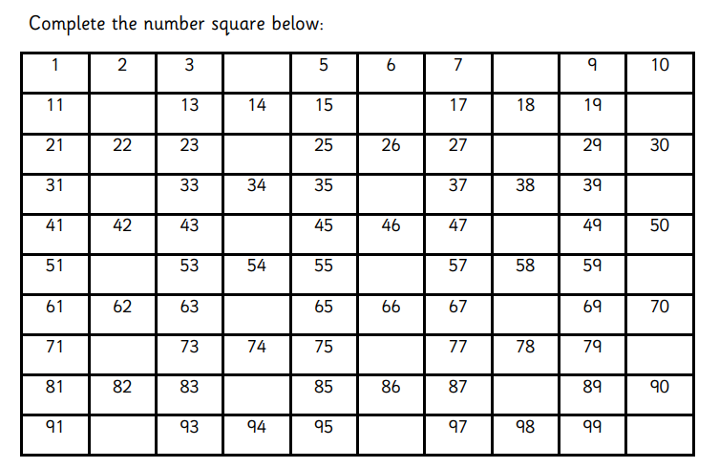
When you count in equal steps that is called counting in multiples .
Counting in multiples of 4 will start like this; 4 8 12 16 …
Subject: Maths

Slide 3
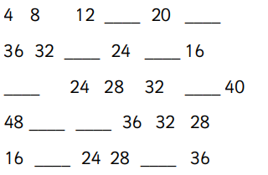
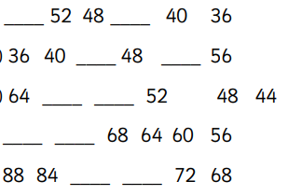
Complete the number sequences by counting on or back in jumps of 4.
1.
2.
3.
4.
5.
6.
7.
8.
9.
10.
Tip: Count on or back 4 from the last number. Use the number square on the last page to help.
Subject: Maths

Slide 4
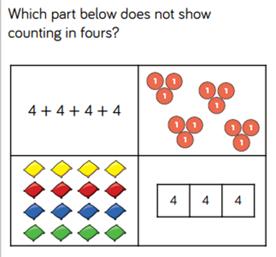
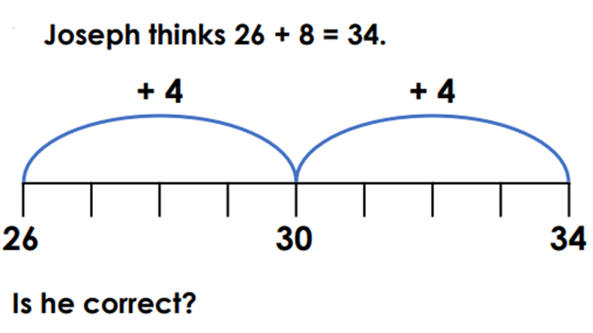
Try these challenges.
Subject: Maths

Slide 5
Date: 6.1.2021
L.O To be able to count in multiples.
Go to Times Tables Rock Stars to warm up your number brain before you start your maths activity.
Subject: Maths

Slide 6
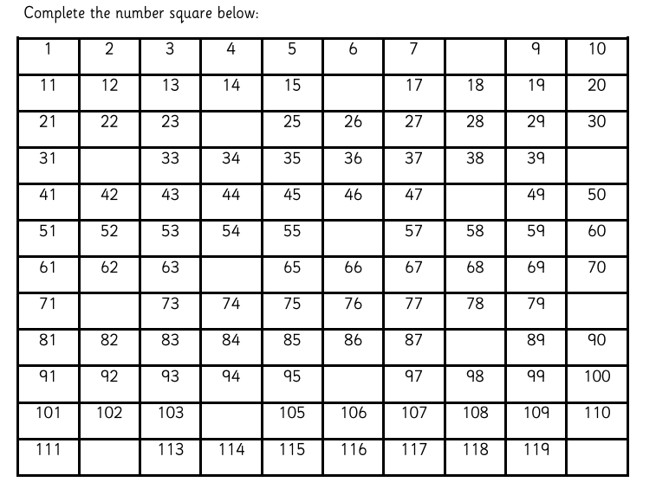
Yesterday you counted in multiples of 4. Today you are going to count in multiples of 8.
Subject: Maths

Slide 7
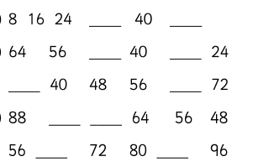
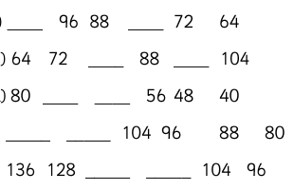
Complete the number sequences by counting on in jumps of 8.
1.
2.
3.
4.
5.
6.
7.
8.
9.
10.
Tip: Count on or back 8 from the last number. Use the number square on the last page to help.
Subject: Maths

Slide 8
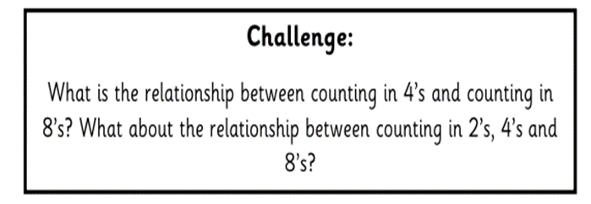
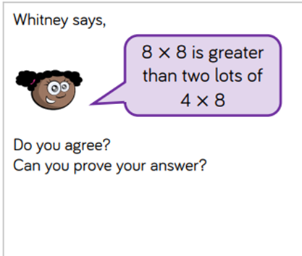
Subject: Maths

Slide 9
Date: 7.1.2021
L.O To be able to double numbers.
Go to Times Tables Rock Stars to warm up your number brain before you start your maths activity
Subject: Maths

Slide 10
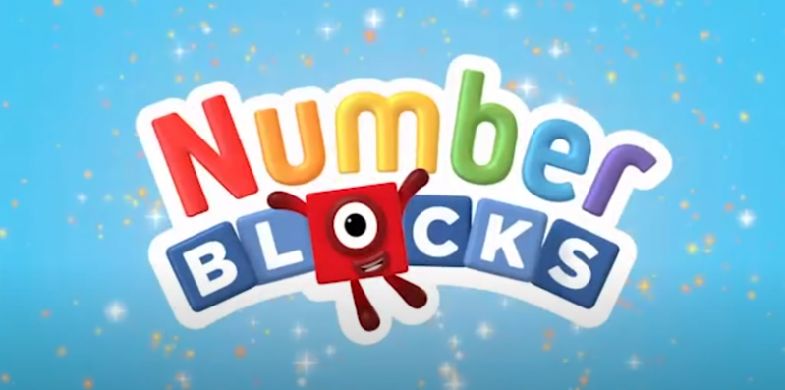
To get a double of a number, we add the same number to itself. For example, double of 2 is 2 + 2 = 4. ... It is easy to remember the numbers that we get by doubling one-digit numbers
https://www.youtube.com/watch?v=ylrjRxLsHAE
Follow the link to watch a short video about doubling numbers.
Subject: Maths

Slide 11
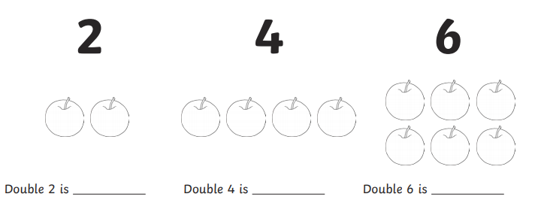
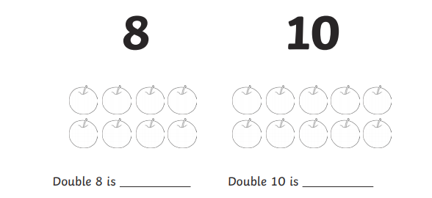

Slide 12
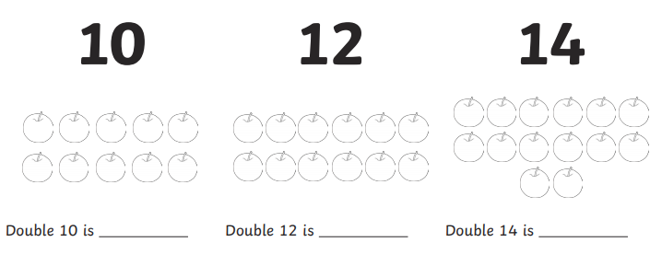

Slide 13
How does 6x4 = 24 help you work out how many legs the spiders have?
Tip: Spiders and octopuses have 8 legs
(which is double 4)
3 x 4 = 12 so 3 x _ = _

Slide 14
Date: 8.1.2021
L.O To be able to multiply numbers.
Go to Times Tables Rock Stars to warm up your number brain before you start your maths activity
Subject: Maths

Slide 15
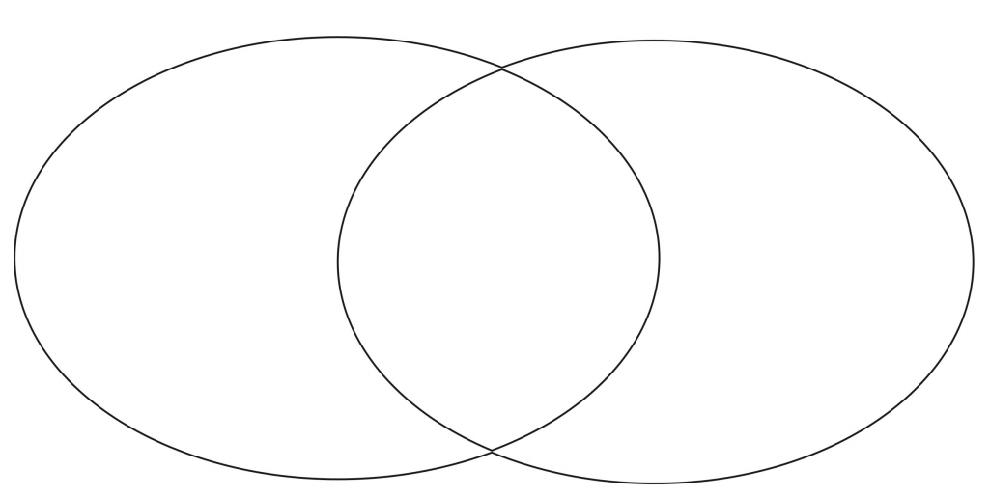
Place the numbers in the correct section of the Venn diagram.
8 6 12 2 18 16 22 10 24 20 14
Multiples of 2
Multiples of 4

Slide 16
Counting in multiples helps us learn our times tables.
4 x 4 =
3 x 4 =
7 x 4 =
2 x 4 =
6 x 4 =
8x 4 =
7. 4 x 8 =
8. 3 x 8 =
9. 7 x 8 =
10. 2 x 8 =
11. 6 x 8 =
12. 8 x 8 =

Slide 17
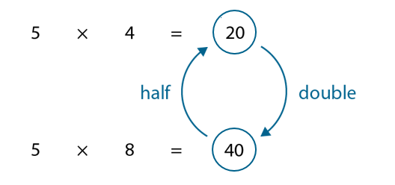
.
Tables can seat 4 or 8 people. There are 32 people.
____ x _____ =
How many tables will be needed if 8 people
could sit at a table?
Write the calculation (draw the tables if this helps).

Slide 18
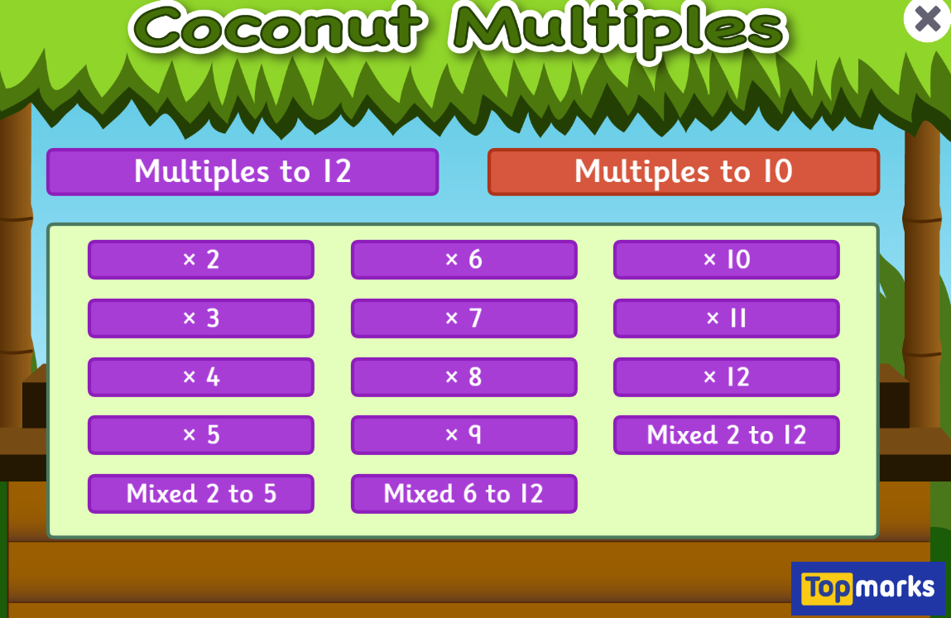
Fun Maths Games!
Copy and paste the link to play these fun maths games.
https://www.topmarks.co.uk/maths-games/hit-the-button
Times tables x4 x8 x3
https://www.topmarks.co.uk/times-tables/coconut-multiples
https://ttrockstars.com/
Multiples of numbers

