Slide 1


Slide 2




01.03.2021
L.O. To be able to tell the time on a 24-hour clock.
Go to Times Tables Rock Stars to warm up your number brain before you start your maths activity.
Subject: Maths

Slide 3


The 24 Hour Day
A day has 24 hours. A clock has 12 hours.
This means each time will happen twice every day.
half past 2 in the morning
half past 2 in the afternoon

Slide 4
a.m. and p.m.
We have to use a way to write these times differently. One way is to use a.m. and p.m.
a.m. (ante meridiem – before noon)
p.m. (post meridiem – after noon)
2:30 a.m.
2:30 p.m.

Slide 5
The 24 Hour Clock
Another way is to use a 24 hour clock.
This means the hours after 12 noon are converted to 13:00 to 23:00.
2:30
14:30
A 4 digit format is used. 2 digits for the hour, a colon (:) and 2 for the minutes.

Slide 6
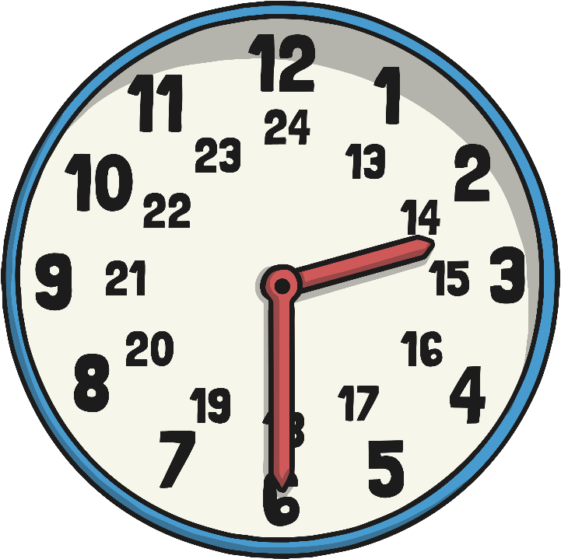
24 Hour Hours
This clock and table show the corresponding hours on a 24 hour clock.
0:00 = 12:00 AM | 12:00 = 12:00 PM
01:00 = 1:00 AM | 13:00 = 1:00 PM
02:00 = 2:00 AM | 14:00 = 2:00 PM
03:00 = 3:00 AM | 15:00 = 3:00 PM
04:00 = 4:00 AM | 16:00 = 4:00 PM
05:00 = 5:00 AM | 17:00 = 5:00 PM
06:00 = 6:00 AM | 18:00 = 6:00 PM
07:00 = 7:00 AM | 19:00 = 7:00 PM
08:00 = 8:00 AM | 20:00 = 8:00 PM
09:00 = 9:00 AM | 21:00 = 9:00 PM
10:00 = 10:00 AM | 22:00 = 10:00 PM
11:00 = 11:00 AM | 23:00 = 11:00 PM
Midnight is referred to as 00:00

Slide 7
24 Hour Time in the Morning
To convert between 12 and 24 hour time in the morning change the format.
6:00 a.m.
06:00
becomes
10:30
10:30 a.m.
becomes
The hours stay the same.

Slide 8

24 Hour Time in the Afternoon
To convert between 12 and 24 hour time in the afternoon add or subtract 12 hours and change the format.
6:00 p.m. becomes 18:00
22:30 becomes 10:30 p.m.

Slide 9

Have a try at converting 12 to 24 hour
Remember:
To convert between 12 and 24 hour time in the afternoon add or subtract 12 hours and change the format
To convert between 12 and 24 hour time in the morning change the format but the hours stay the same.
12 hour time
24 hour time
2:45 a.m.
10:20 a.m.
1:55 p.m.
3:05 p.m.

Slide 10
How did you do?
12 hour time
24 hour time
2:45 a.m.
02:45
10:20 a.m.
10:20
1:55 p.m.
13:55
3:05 p.m.
15:05

Slide 11
Convert 24 to 12 hour
Convert these times to 12 hour time
24 hour time
12 hour time
03:15
11:15
14:45
16:20

Slide 12
How did you do?
Convert these times to 12 hour time
24 hour time
12 hour time
03:15
3:15 a.m.
11:15
11:15 a.m.
14:45
2:45 p.m.
16:20
4:20 p.m.

Slide 13

Match the times to the correct clock
9 o’clock in the morning
Half past 3 in the afternoon
25 past 7 in the morning
Half 11 in the evening
20 past six in the morning
Quarter to 9 in the evening
20:45
07:25
23:30
09:00
15:30
06:20

Slide 14
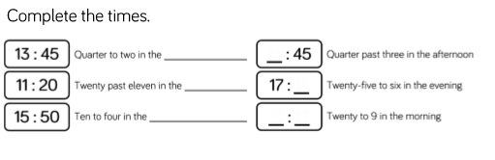
Complete the sentences
Quarter to two in the __________ Quarter past three in the afternoon
Twenty past elven in the __________ Twenty-five to six in the evening
Ten to four in the __________ Twenty to 9 in the morning

Slide 15
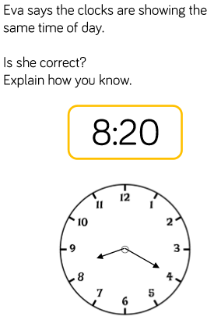
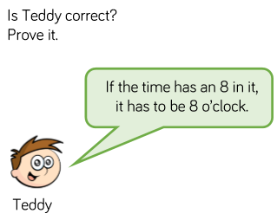
Complete the challenges

Slide 16
02.03.2021
L.O To be able to convert time between analogue and digital on a 12 hour clock
Go to Times Tables Rock Stars to warm up your number brain before you start your maths activity.
Subject: Maths

Slide 17

Pre-recorded Teaching
Access the online teaching video below that will support you to complete the work in this lesson. This video will act as a support but all of the work can still be successfully understood & completed using paper-based versions of this pack. If you need further support to understand / complete work then please contact school via e-mail or telephone.
Play Video
You can also copy and paste this link if you would prefer:
https://classroom.thenational.academy/lessons/reading-writing-and-converting-time-between-12-hour-and-24-hour-clocks-6hj66t?activity=video&step=1

Slide 18
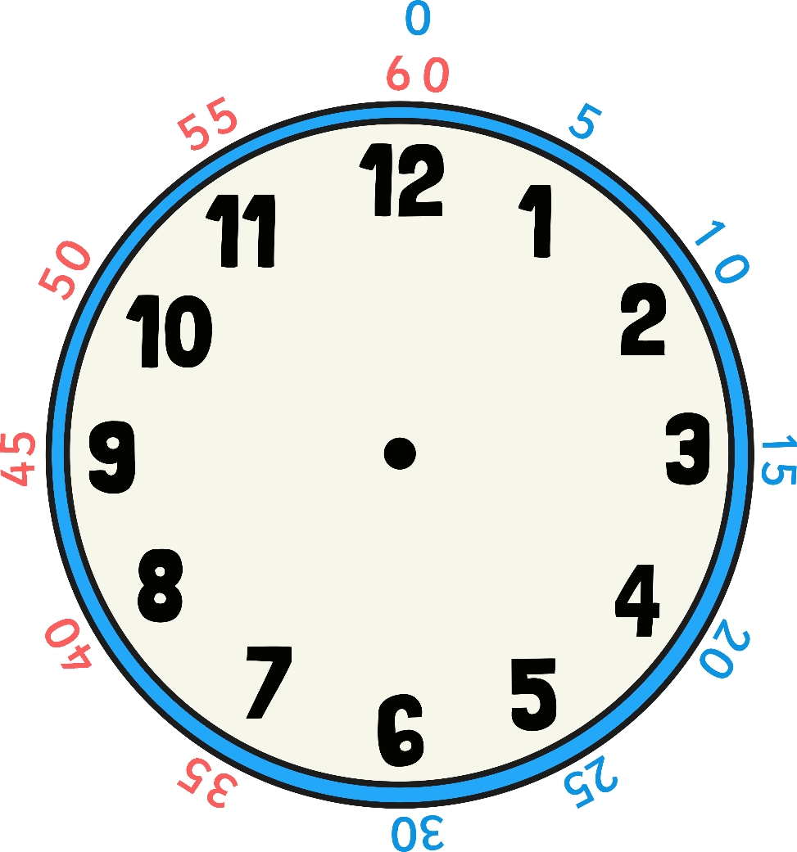
Each number on the clock represents 5 minutes. So we can count round in 5s.

Slide 19
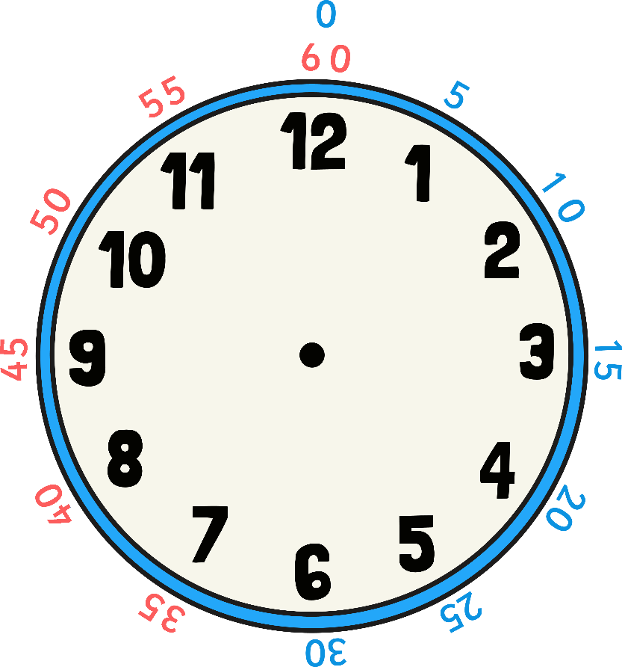

Converting from Analogue to Digital
1
2
1
5
Do the clocks show the same time?
What is the same about the clocks?
What is different?

Slide 20
Converting from Analogue to Digital
1
2
When we convert from analogue to digital look at the hour hand first. This is the smaller hand. The hour is pointing to 12 so the 12 comes first on the digital clock.

Slide 21
Converting from Analogue to Digital
1
2
1
5
Then look at the bigger hand which shows the minutes. Look at how many minutes past the hour hand it is. Remember each number counts in a multiple of 5 (the numbers in blue shows us this). This means the time is 12:15

Slide 22
Converting from Analogue to Digital
0
1
2
5
The hour hand is pointing to 1 so the 1 comes first on the digital clock. Now look at how many minutes past the hour hand it is. Remember each number counts in a multiple of 5 (the numbers in blue shows us this). This means the time is 01:25

Slide 23
Converting from Analogue to Digital
0
1
4
0
On an analogue clock the hour hand moves very slowly around the clock. Once you get past half past, we would say the time is 20 minutes to 2. However on a digital clock the hour hand doesn’t change until the next hour changes. So the time on a digital clock would say 01:40 (because it is 40 minutes past 1).

Slide 24
Converting from Analogue to Digital
0
3
5
5
On this analogue clock we would say it is 5 minutes to 4.
For digital it has not reached 4 o’clock yet so the time would be 3:55.

Slide 25
Converting from Analogue to Digital
0
4
On this analogue clock we would say the time is 20 minutes to 5.
For the digital clock we would start with the hour it is currently on which is 4 and add onto it how many minutes past 4 it is. Can you fill in the rest of the digital clock?

Slide 26
Converting from Analogue to Digital
0
4
4
0
The time is 04:40 because it is 40 minutes past the hour of 4.

Slide 27
Converting from Analogue to Digital
0
6
On this analogue clock we would say the time is 10 minutes past 6.
For the digital clock we would start with the hour it is currently on which is 6 and add onto it how many minutes past 6 it is. Can you fill in the rest of the digital clock?

Slide 28
Converting from Analogue to Digital
0
6
1
0
The time is 06:10 because it is 10 minutes past the hour of 6.

Slide 29
Converting from Analogue to Digital
0
5
On this analogue clock we would say the time is quarter to 6.
For the digital clock we would start with the hour it is currently on which is 5 and add onto it how many minutes past it is. Can you fill in the rest of the digital clock?

Slide 30
Converting from Analogue to Digital
0
5
4
5
The time is 05:45 because it is 45 minutes past the hour of 5.

Slide 31
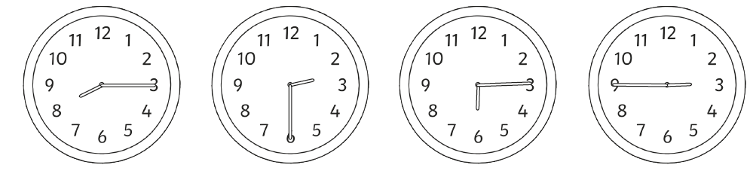
Write the time in digital

Slide 32
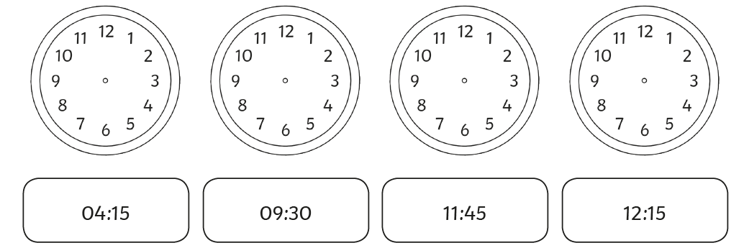
Draw the time on the clock faces

Slide 33
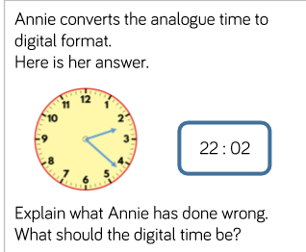
Complete the challenge

Slide 34
03.03.2021
L.O To be able to convert time between analogue and digital on a 24 hour clock
Go to Times Tables Rock Stars to warm up your number brain before you start your maths activity.
Subject: Maths

Slide 35
Pre-recorded Teaching
Access the online teaching video below that will support you to complete the work in this lesson. This video will act as a support but all of the work can still be successfully understood & completed using paper-based versions of this pack. If you need further support to understand / complete work then please contact school via e-mail or telephone.
Play Video
You can also copy and paste this link if you would prefer:
https://classroom.thenational.academy/lessons/reading-writing-and-converting-time-between-12-hour-and-24-hour-clocks-6hj66t?activity=video&step=1

Slide 36
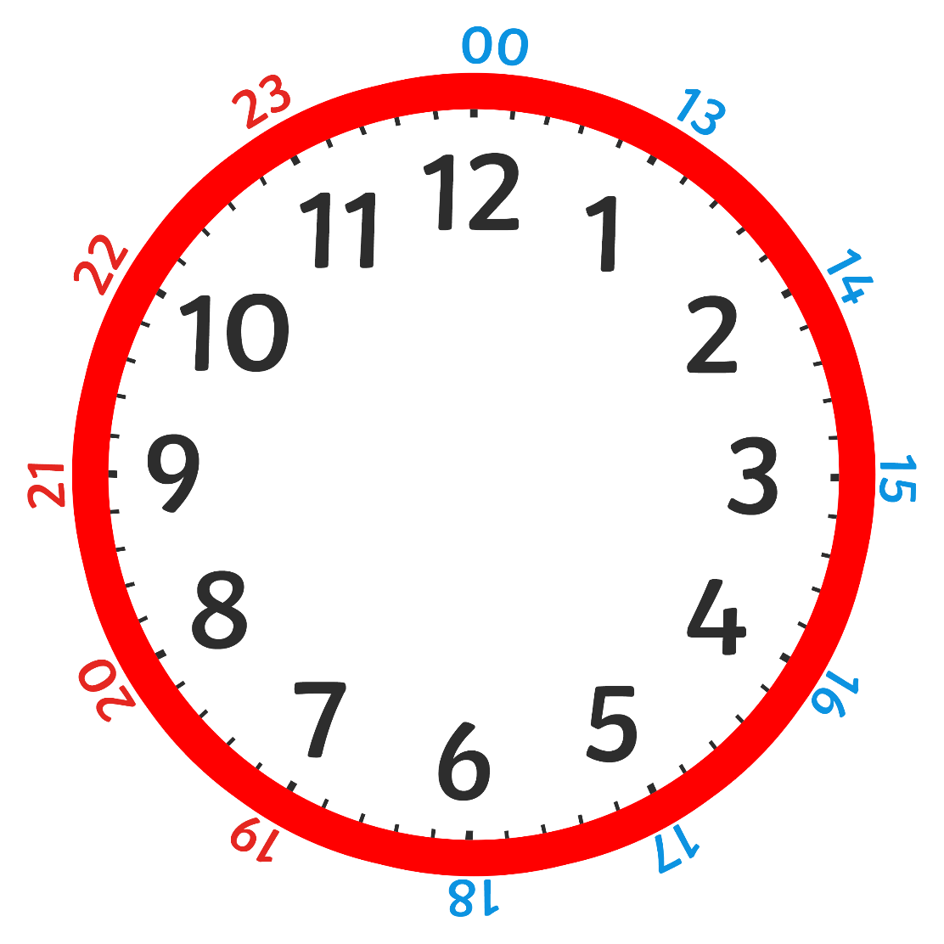
There are 24 hours in 1 day.
On a 24 hour clock, once we get past 12:00 we start at 12 and add the amount of hours past 12 that it is.

Slide 37
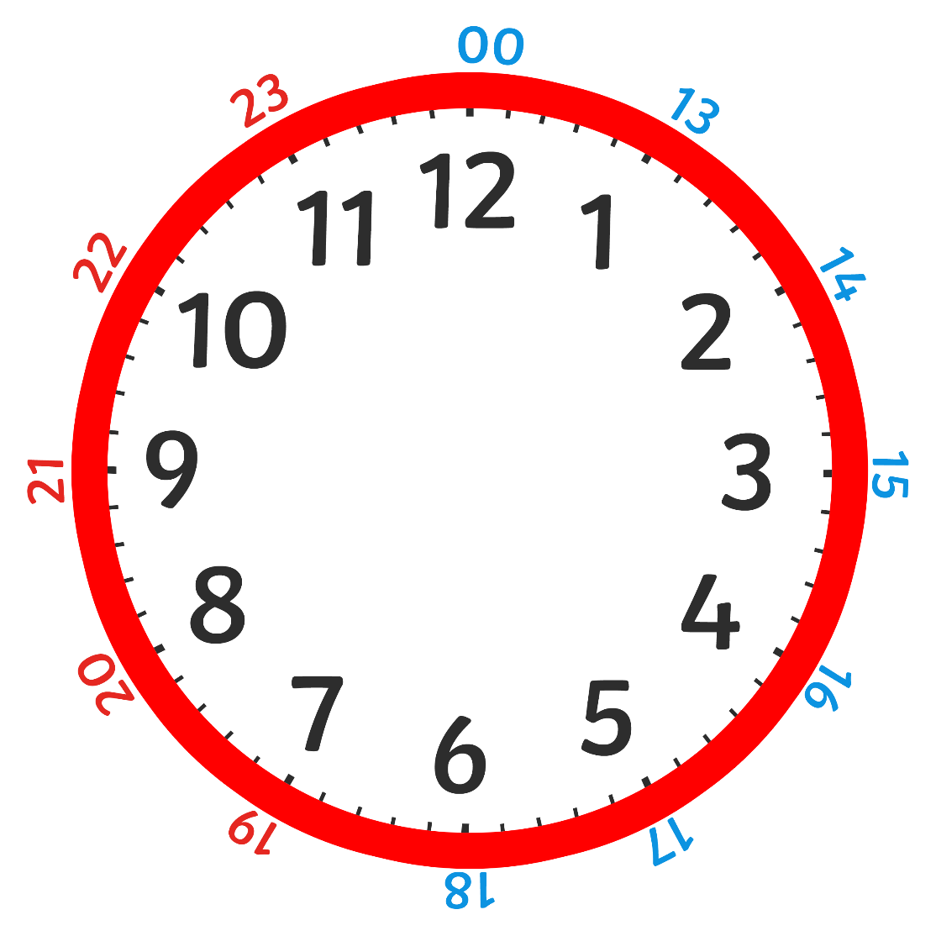
This clock shows 3 o’clock in the afternoon. On a digital 24 hour clock we have to start at 12 and add the amount of hours past 12 that it is. because it is the afternoon.
1
5
0
0
We would do 12+3= 15
So we know we are on the 15th hour of the day.

Slide 38

Converting From 12 to 24 Hour Clocks
0
3
3
0
12 hour digital
24 hour digital
1
5
3
0
The time on the analogue clock is half past 3. On a digital 12 hour clock we would write 03:30 p.m.
On a digital 24 hour clock we would start at 12 and add on the hours to show it is in the afternoon. Remember the minutes don’t change.

Slide 39
Converting From 12 to 24 Hour Clocks
0
1
4
5
1
3
4
5
The time on the analogue clock is quarter to 2. On a digital 12 hour clock we would write 01:45.
On a digital 24 hour clock we would start at 12 and add the number of hours past 12 that it is. So it would be 12+1= 13 because it is the 13th hour in the day. Remember the minutes don’t change.

Slide 40
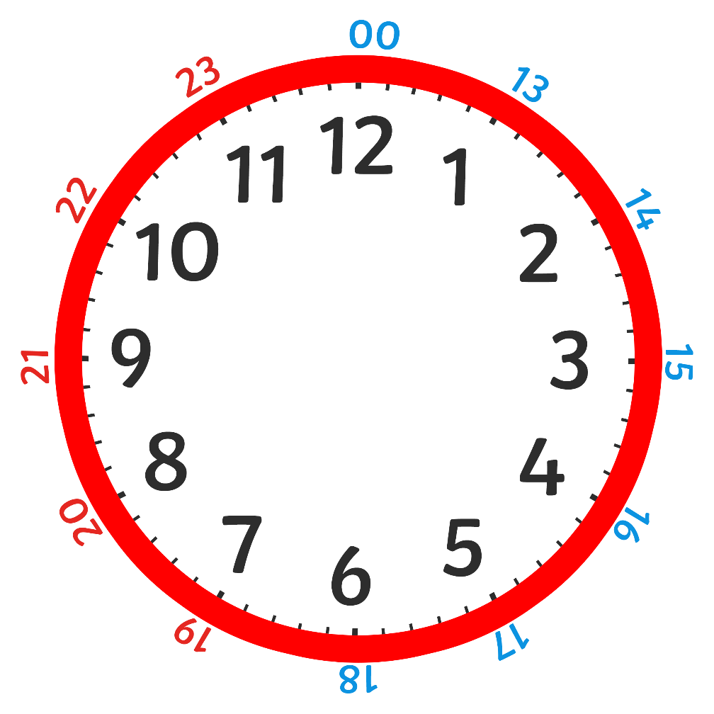
Can you write the time in 24 hours?
0
7
2
5
Remember on a digital 24 hour clock start at 12 and add on the hour that the clock is pointing to.
So we would do 12+7=
Remember the minutes stay the same.

Slide 41
How did you do?
0
7
2
5
1 9 2 5

Slide 42

Can you write the time in 24 hours?
0
3
5
0
Remember on a digital 24 hour clock start at 12 and add on the hour that the clock is pointing to.
So we would do 12+3=
Remember the minutes stay the same.

Slide 43
Can you write the time in 24 hours?
0
3
5
0
1 5 5 0

Slide 44
Converting from 24 hours back to 12. All you do is start from 12 and count on until you get to the hour number. So 12+3=15 therefore the hour hand is 3.
0 3 5 0
1 5 5 0

Slide 45
Converting from 24 hours back to 12. All you do is start from 12 and count on until you get to the hour number.
1 7 1 0

Slide 46
Converting from 24 hours back to 12. All you do is start from 12 and count on until you get to the hour number.
0 5 1 0
1 7 1 0

Slide 47
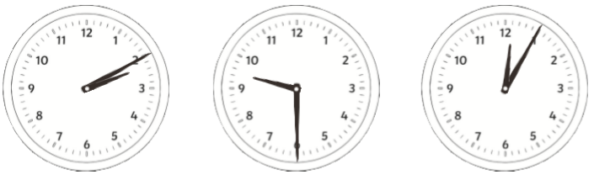
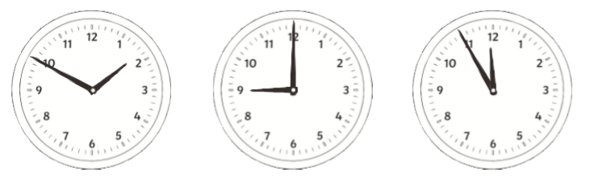
Write the 24 hour digital time

Slide 48
Write the 24 hour digital time in 12 hour digital
  Example: 15:23 = 03:23
  22:45=
  13:22=
  17:30=
  15:40=
  22:20=

Slide 49
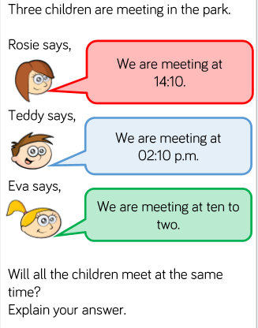
Complete the challenge

Slide 50
04.03.2021
L.O To be able to solve problems
Go to Times Tables Rock Stars to warm up your number brain before you start your maths activity.
Subject: Maths

Slide 51
Pre-recorded Teaching
Access the online teaching video below that will support you to complete the work in this lesson. This video will act as a support but all of the work can still be successfully understood & completed using paper-based versions of this pack. If you need further support to understand / complete work then please contact school via e-mail or telephone.
Play Video
You can also copy and paste this link if you would prefer:
https://classroom.thenational.academy/lessons/applying-knowledge-of-time-to-solve-problems-ccuk4r?activity=video&step=2&view=1

Slide 52
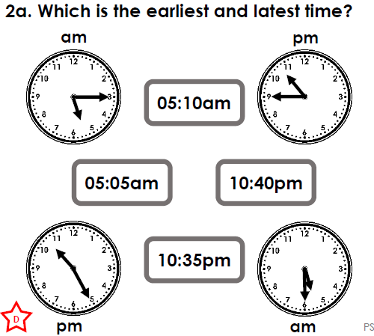
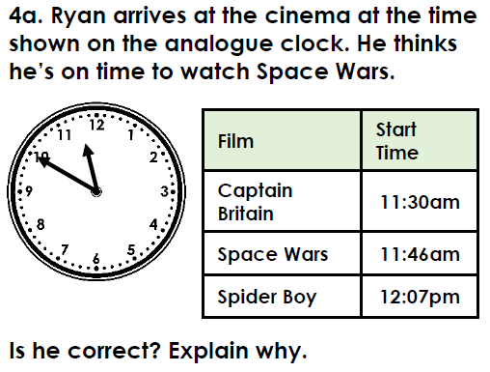
Complete the problem solving questions

Slide 53
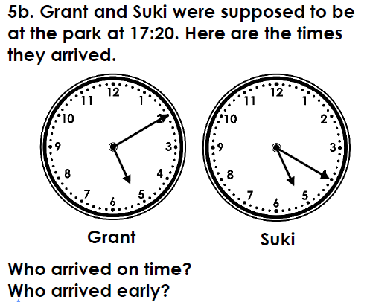
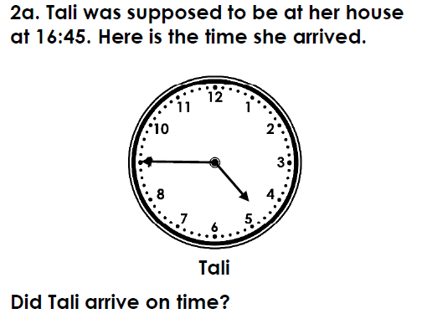
Complete the challenges

Slide 54
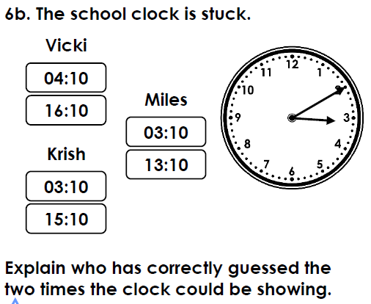
Complete the challenge

