Slide 1
Date: Monday 25th January 2021
LO: To be able to spell words ending –tious and –cious.
Subject: Reading

Slide 2
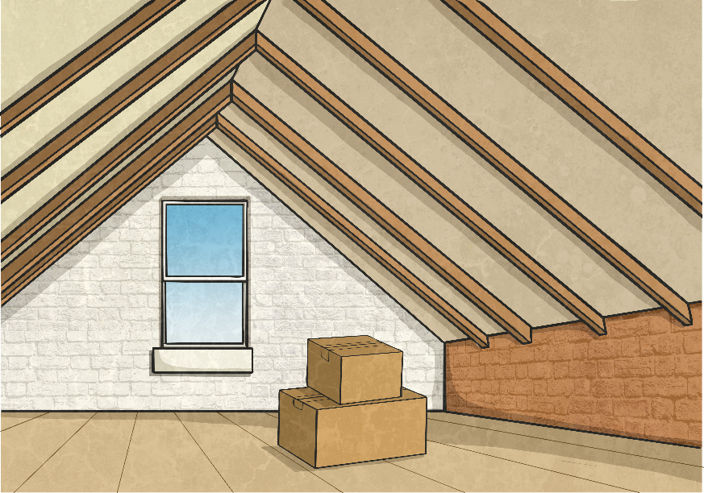
Adding the Suffix -cious
In this picture, we can see a lot of space in the attic.
We could describe the attic as very spacious.
By adding the suffix –cious to the root word, we have turned a noun into an adjective.
space
spacious
(noun)
(adjective)

Slide 3
Rule for Adding the Suffix -cious
If the root word ends in –ce, remove –ce and replace it with –cious.
For example:
grace
grace
gracious
This will change the word from a noun into an adjective.

Slide 4
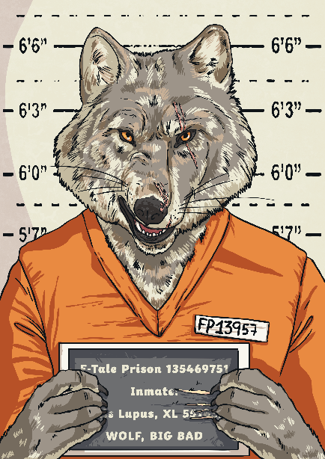
Your Turn: Adding the Suffix -cious
The character we see in this picture has a lot of malice.
How could we add the suffix –cious to turn the noun malice into an adjective to describe this person?
As our root word ends in –ce, we need to remove these letters and add the suffix –cious. This will change the noun into an adjective.
malice
malicious
(noun)
(adjective)

Slide 5
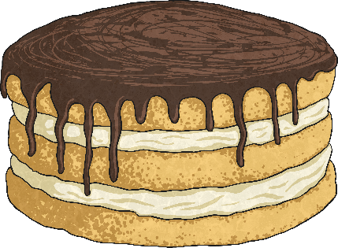
Words Ending in -cious
Sometimes, adjectives end in the suffix –cious which do not follow the rule. Click on each image to find out more.
precious
delicious
ferocious
These words are adjectives. They end in –cious but this has not been added using the rule.

Slide 6
Precious
The word ‘precious’ originally comes from the word for ‘price’, implying that something precious should cost a lot of money.

Slide 7
Delicious
The word ‘delicious’ originally comes from the word for ‘delight’, implying that something delicious is a delight to eat.

Slide 8
Ferocious
The word ‘ferocious’ originally comes from the word for ‘fierce’, meaning that something ferocious is very fierce.

Slide 9
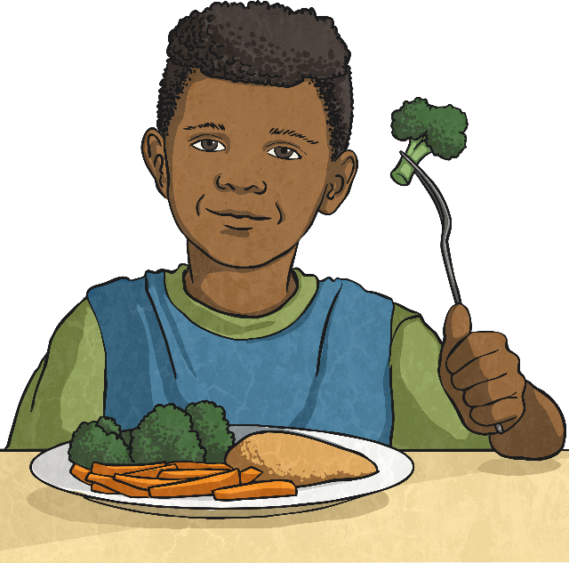
Adding the Suffix -tious
The suffix –tious acts in a similar way to –cious.
In this picture, we can see food that is full of nutrition.
We could describe the food as nutritious.
By adding the suffix -tious, we have turned the noun nutrition into an adjective.
nutrition
nutritious
(noun)
(adjective)

Slide 10
Rule for Adding the Suffix -tious
If the root word ends in –tion, remove –tion and replace it with –tious.
For example:
ambition
ambition
ambitious
This will change the word from a noun into an adjective.

Slide 11
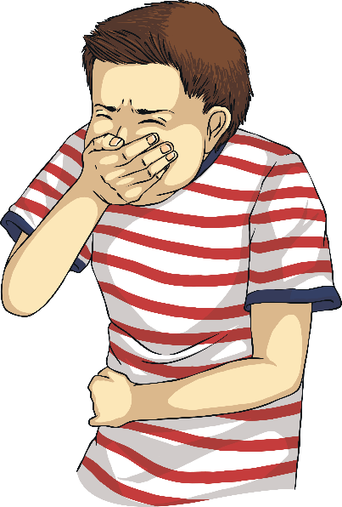
Your Turn: Adding the Suffix -tious
The person we see in picture has got an infection.
How could we add the suffix –tious to turn the noun infection into an adjective to describe this person?
As our root word ends in -tion, we need to remove these letters and add the suffix –tious. This will change the noun into an adjective.
infection
infectious
(noun)
(adjective)

Slide 12
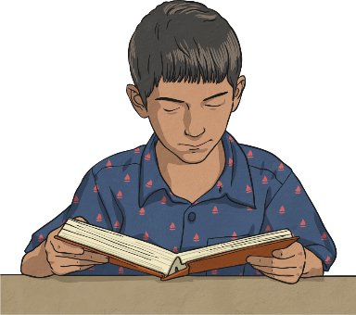
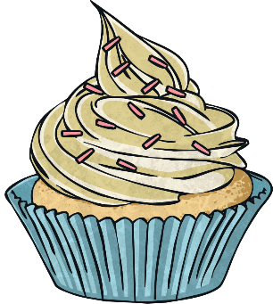
Words Ending in -tious
Sometimes, adjectives end in the suffix –tious which do not follow the rule. Click on each image to find out more.
conscientious
scrumptious
These words are adjectives. They end in –tious but this has not been added using the rule.

Slide 13
Conscientious
The word ‘conscientious’ originally comes from the word for ‘conscience’. As this word ends in -ce, it would normally use –cious not –tious. This is an unusual exception to the rule.

Slide 14
Scrumptious
The word ‘scrumptious’ originally comes from the word for ‘sumptuous’, which implies that things that are scrumptious used to cost a lot of money.

Slide 15
Read, copy, cover, spell this week’s spellings.
Date: Monday 25th January 2021
ferocious
spacious
malicious
gracious
nutritious
ambitious
infectious
cautious

Slide 16
Date: Tuesday 26th January 2021
LO: To be able to retrieve information and explain inferences.
Subject: Reading

Slide 17
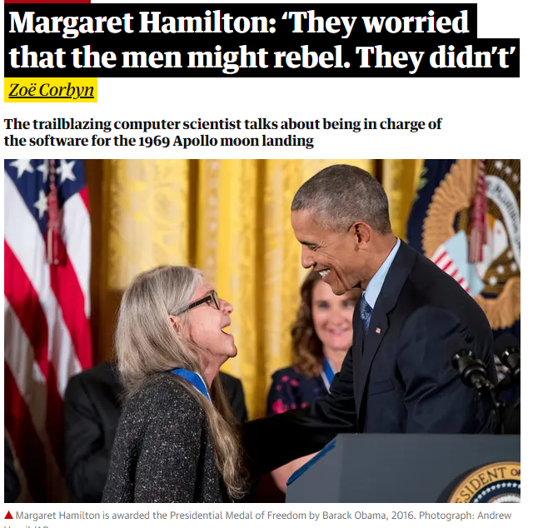
Copy and paste the link below into a web browser and read the article.
https://www.theguardian.com/technology/2019/jul/13/margaret-hamilton-computer-scientist-interview-software-apollo-missions-1969-moon-landing-nasa-women
Alternatively, read through it on the next few pages.

Slide 18
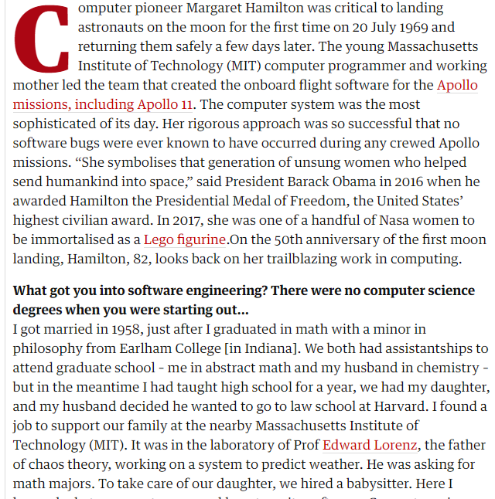

Slide 19
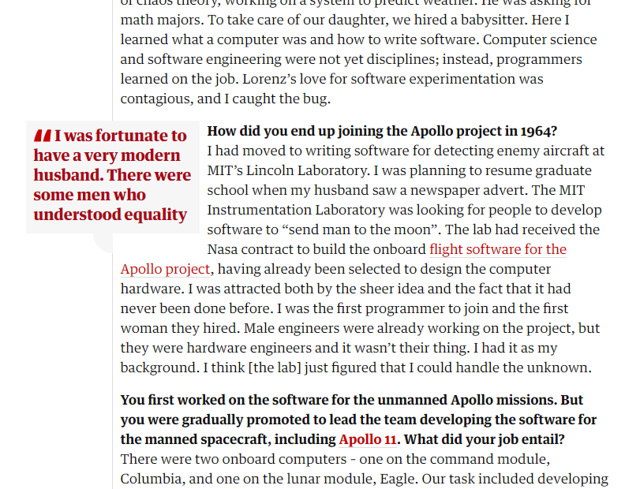

Slide 20
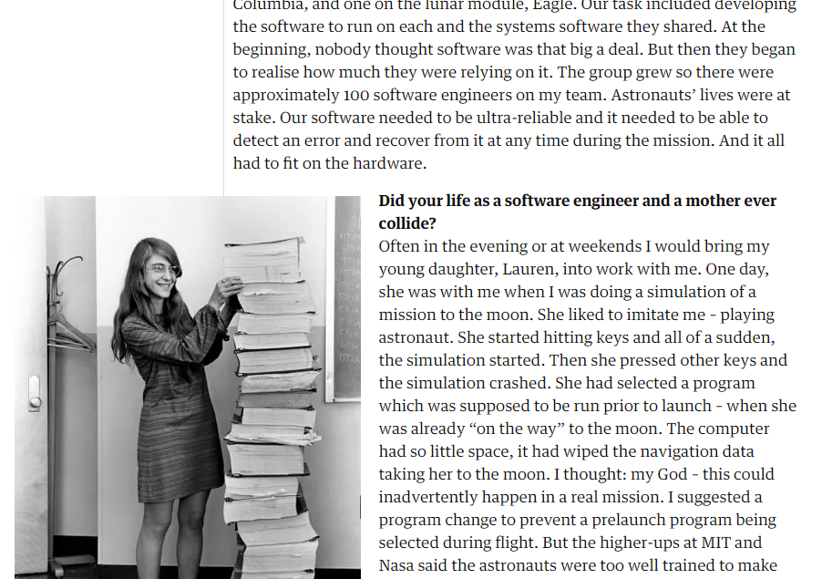

Slide 21
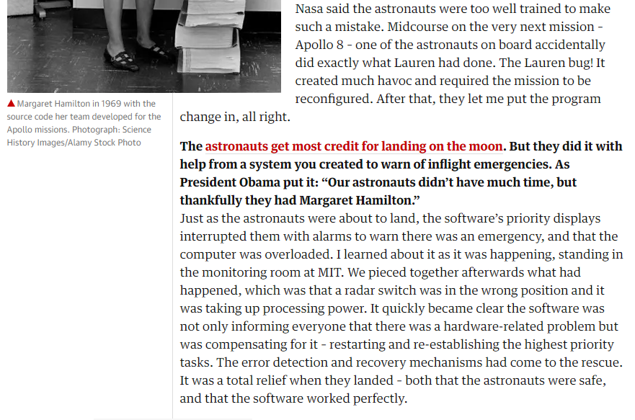

Slide 22
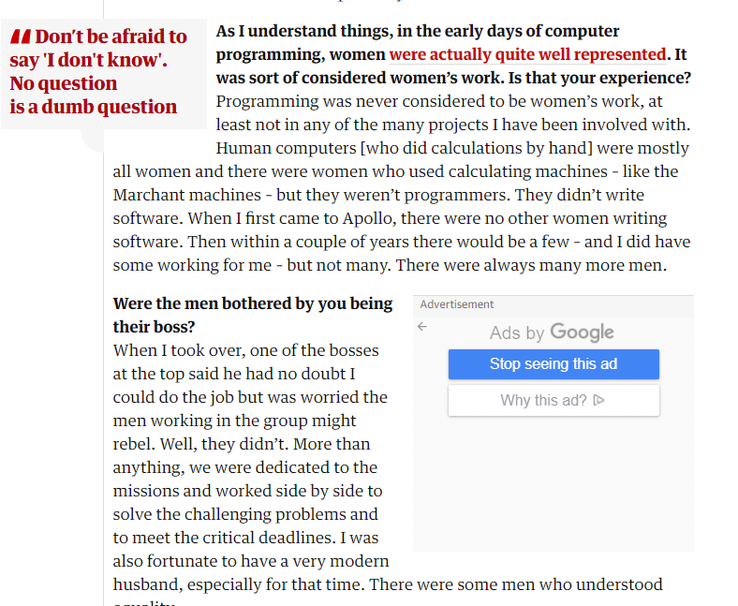

Slide 23
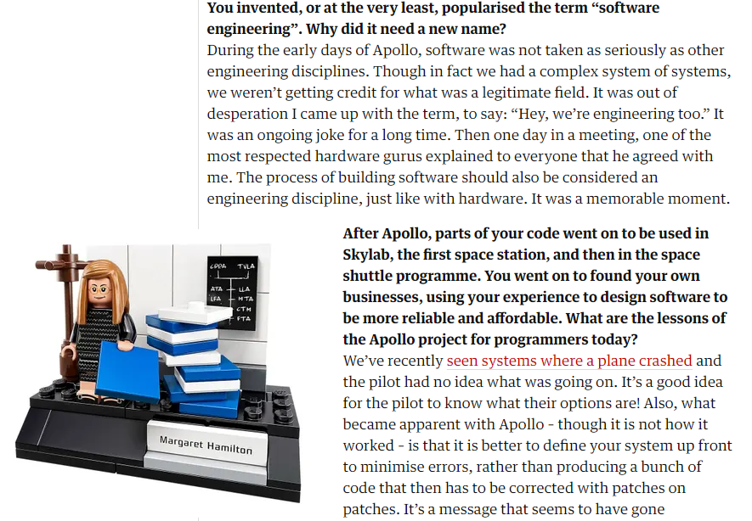

Slide 24
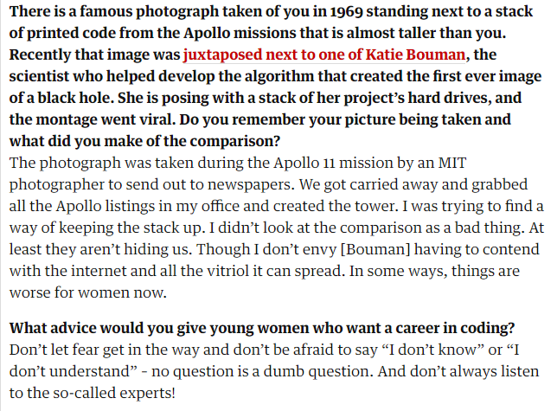

Slide 25
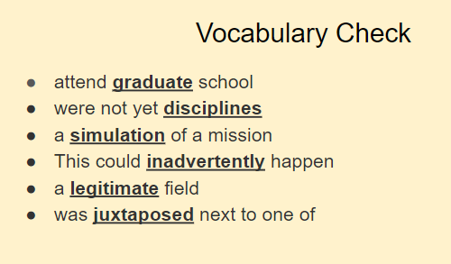
Discuss or think about the meaning of the underlined words. If you are not sure, you could find the words in a dictionary.

Slide 26
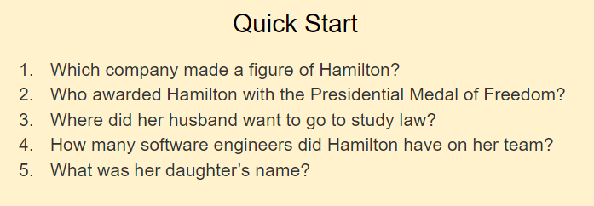
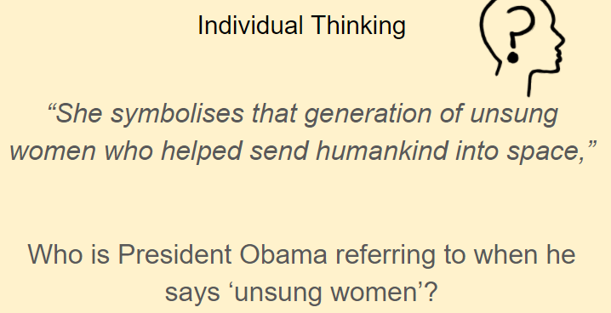
Write your answers down onto a piece of paper.

Slide 27
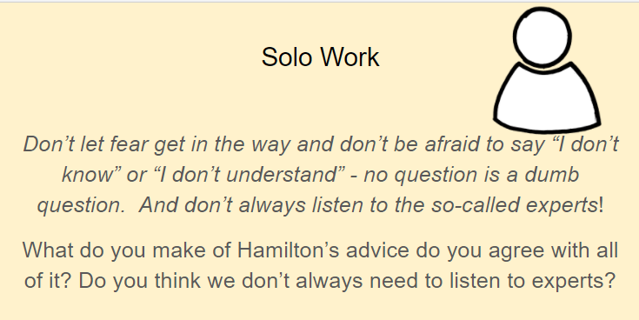
Write your answer down onto a piece of paper.

Slide 28
Date: Wednesday 27th January 2021
LO: To be able to retrieve information and explain inferences.
Subject: Reading

Slide 29
Copy and paste the link below into a web browser and read the article.
https://www.nasa.gov/content/dorothy-vaughan-biography
Alternatively, read through it on the next few pages.

Slide 30
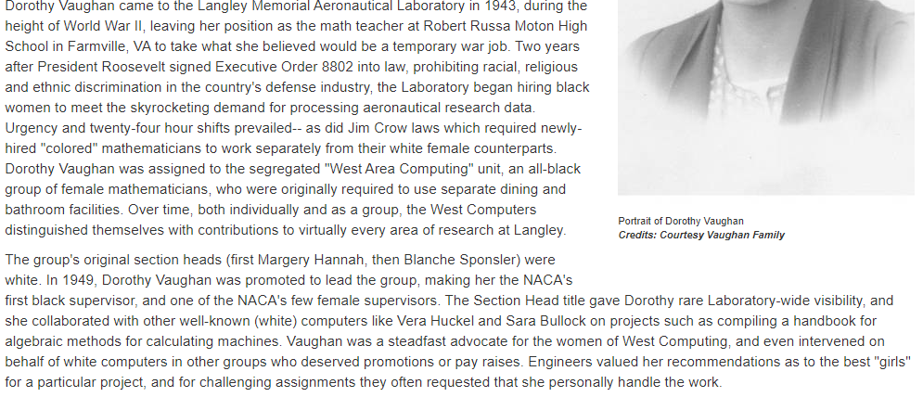

Slide 31
Write your answers down onto a piece of paper.

Slide 32
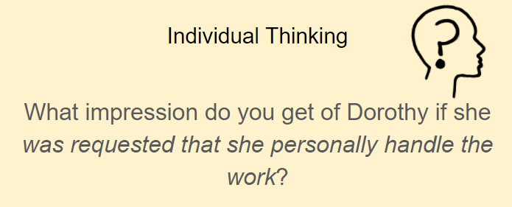
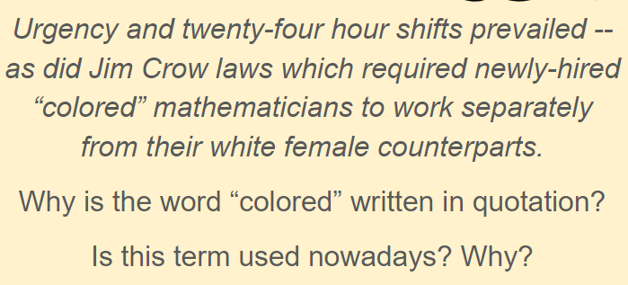

Slide 33
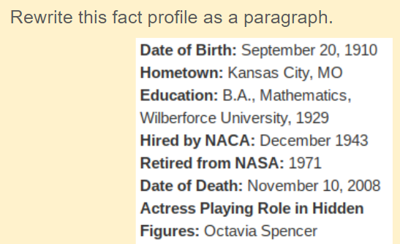

Slide 34
Date: Thursday 28th January 2021
LO: To be able to retrieve information and explain inferences.
Subject: Reading

Slide 35
Copy and paste the link below into a web browser and read the article.
https://issuu.com/nosycrow/docs/thejamiedrakeequation_prelims_hi-re?fbclid=IwAR1Hd7fQhg26uDd80z4LBBeaC8zgpoU79w8UDa9eUivP-bylLpW2PqE2tK8
Alternatively, read through it on the next few pages.

Slide 36
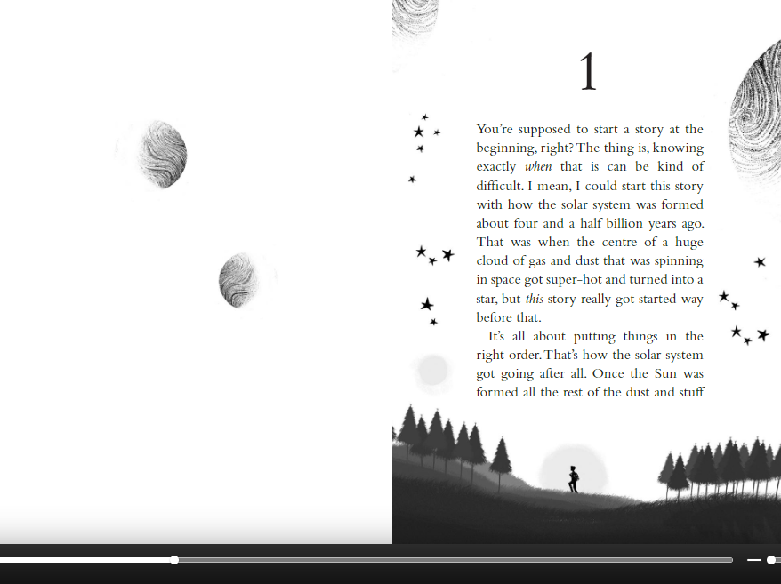

Slide 37
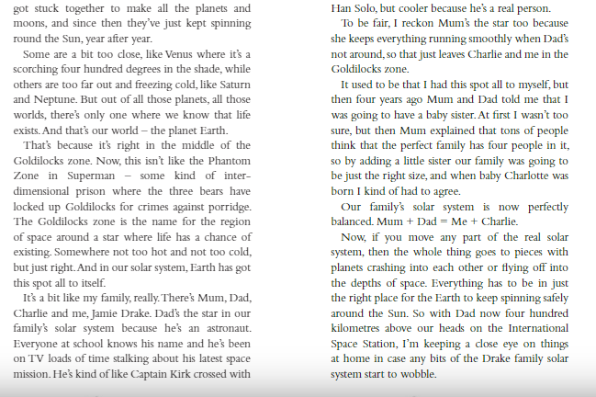

Slide 38
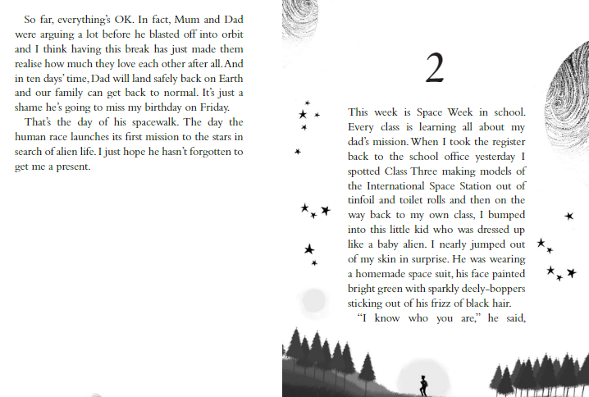

Slide 39
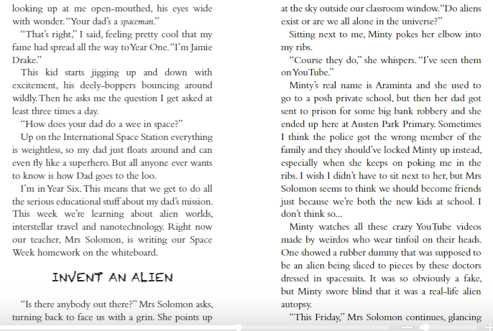

Slide 40
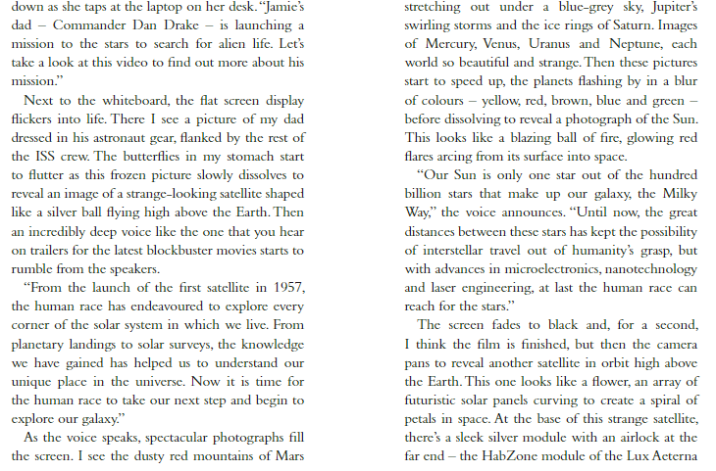

Slide 41
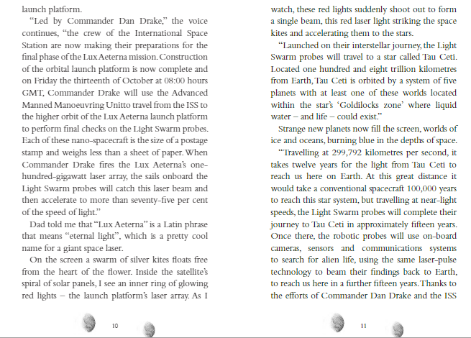

Slide 42
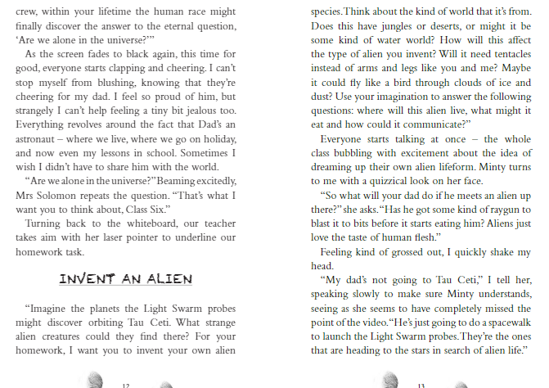

Slide 43
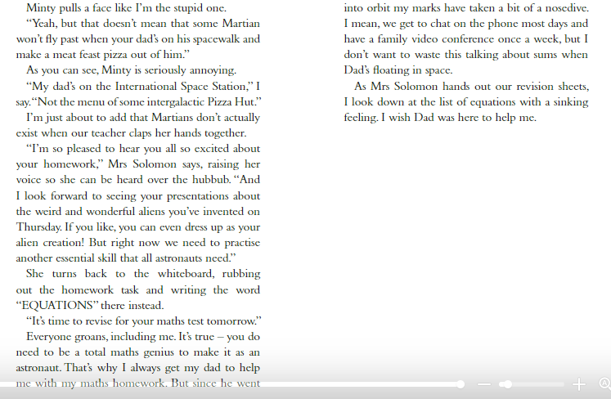

Slide 44
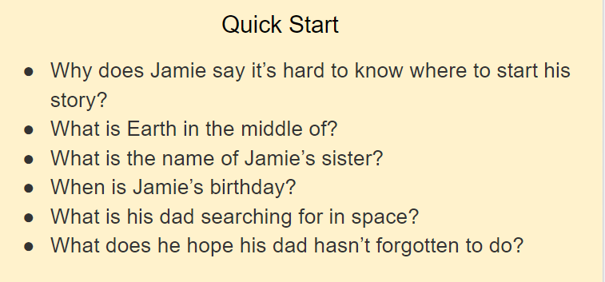
Write your answers down onto a piece of paper.

Slide 45
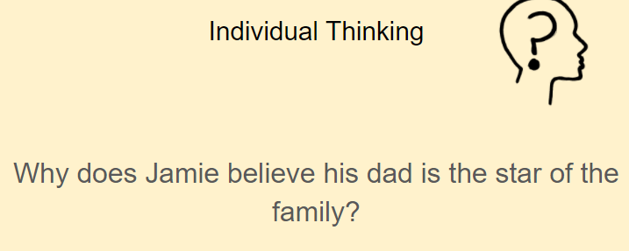

Slide 46
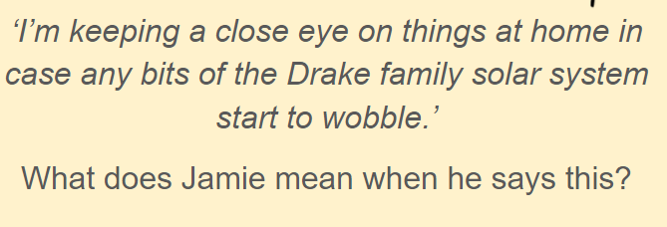
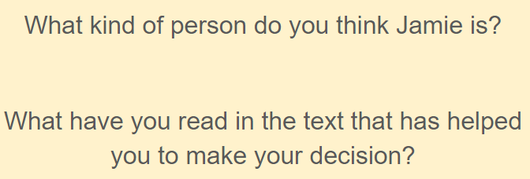
Write your answers down onto a piece of paper.

Slide 47
Date: Friday 29th January 2021
LO: To be able to retrieve information and explain inferences.
Subject: Reading

Slide 49
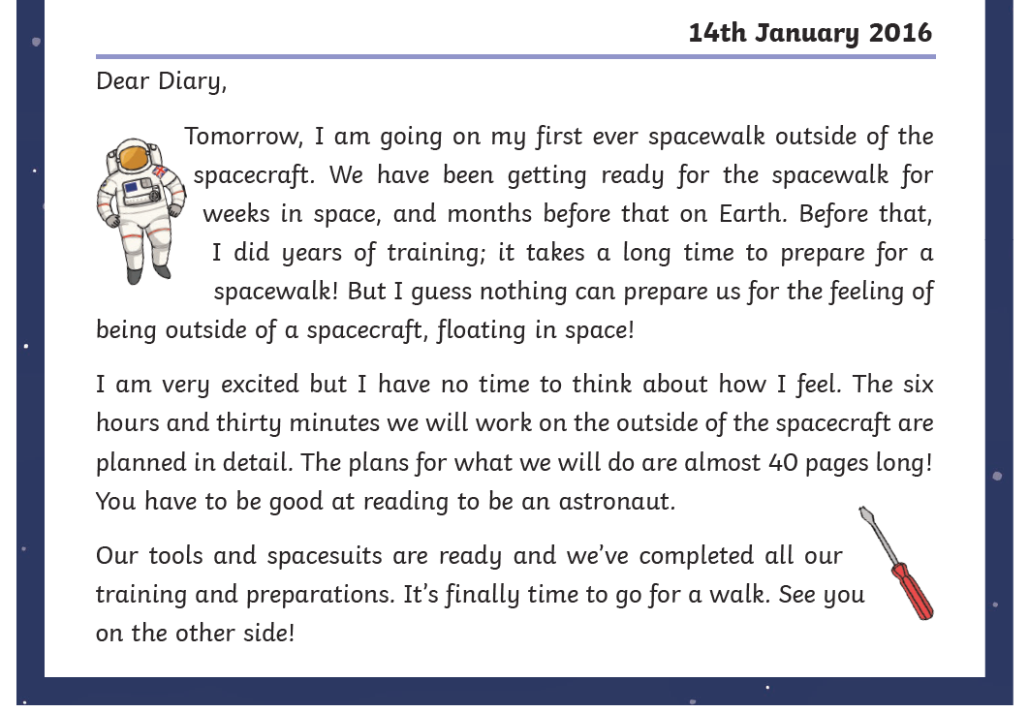

Slide 50
Task: Answer these questions on to a sheet of paper.
Where is the writer settling into their ‘new life’?
Find and write down two activities the writer does on a daily basis.
Which day does the writer not like and explain why.
How do you think the writer might be feeling about their space walk? Give two emotions and explain why they might be feeling this way.
How do we know the work on the space craft is likely to be complicated?
Why do you think the writer states ‘nothing can prepare us for the feeling of being outside a spacecraft, floating in space’?
What do you think the phrase ‘See you on the other side’ means?
Write down 3 features of a diary.

