Slide 1


Date: Monday 1st March 2021
LO: To be able to spell words containing ’sh’ sound spelled ’ch’.
Subject: Reading

Slide 2

Can you spot the similarity in all of these words?
chalet
brochure
machine
chef
chandelier

Slide 3
In the French language, the sh sound is almost always spelt with the letters ch.
There are quite a lot of English words that have been borrowed from the French language and have kept the French spelling.

Slide 4
Of course, not all words with the sh sound spelt ch are from France.
Let’s check out the sh sound.
sh
sh
ti
ci
ch

Slide 5
Now let’s look at words with the sound sh spelt ch.
chef
chalet
chandelier
chute
machine
brochure
moustache
parachute
Some of these words are not used very often. Let’s see their meanings.

Slide 6
definition | words with sh sound spelt ch
something to slide down | chute
a booklet containing information | brochure
a small wooden cabin | chalet
a large hanging light with branches | chandelier

Slide 7
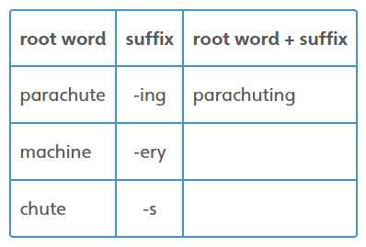
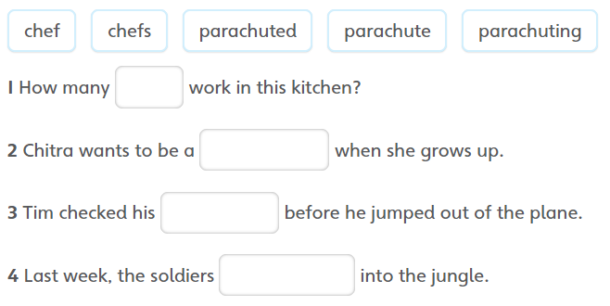
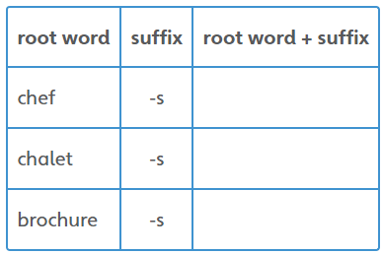
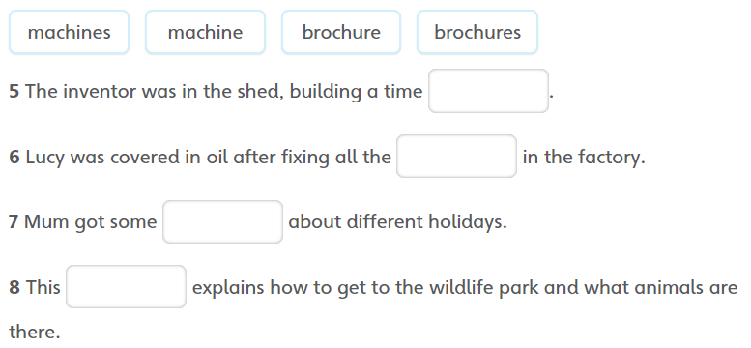

Your task:

Slide 8
End of Lesson

Slide 9
Date: Tuesday 2nd March 2021
LO: To be able to retrieve information and explain inferences.
Subject: Reading

Slide 10
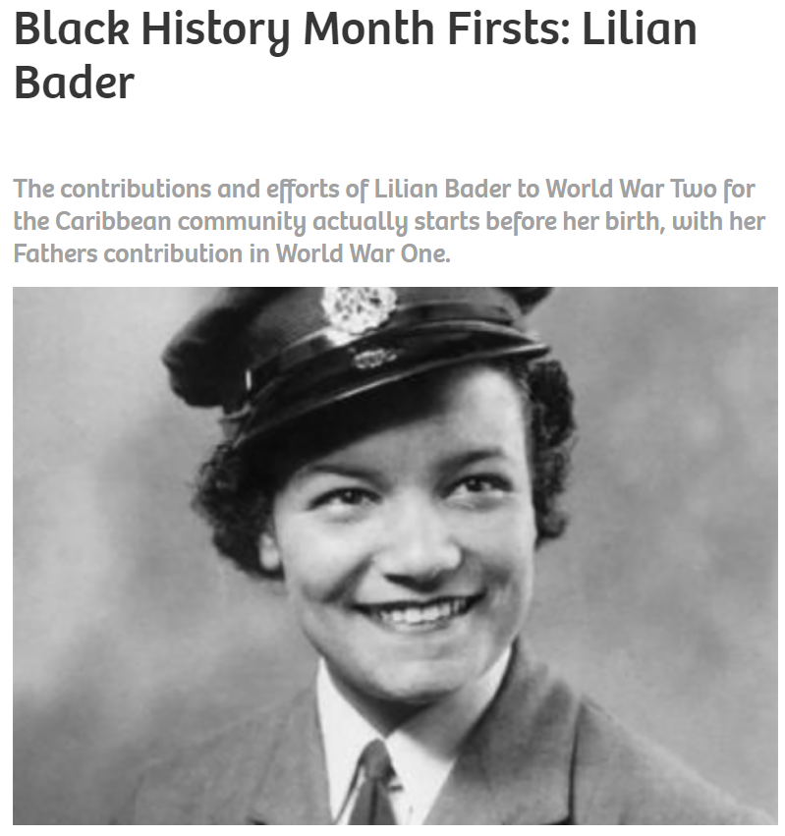
Lilian Bader
https://www.blackhistorymonth.org.uk/article/section/bhm-heroes/black-history-month-firsts-lilian-bader/

Slide 11
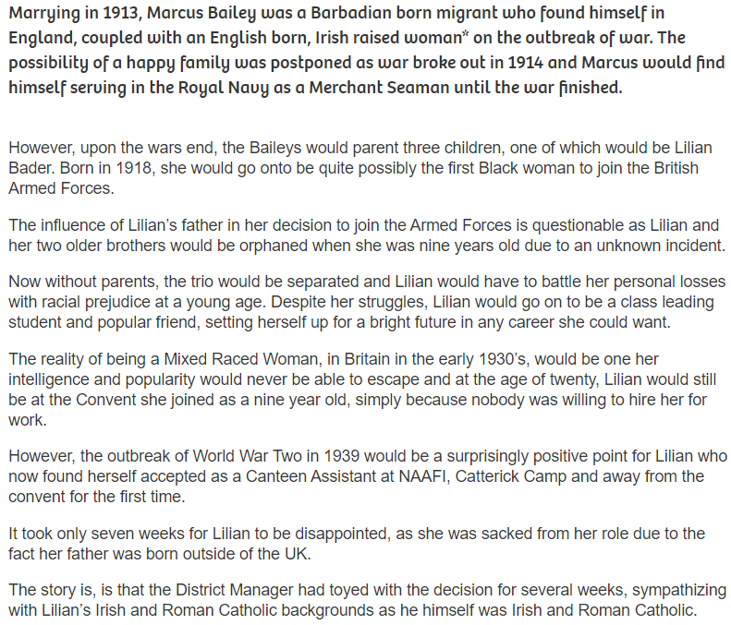

Slide 12
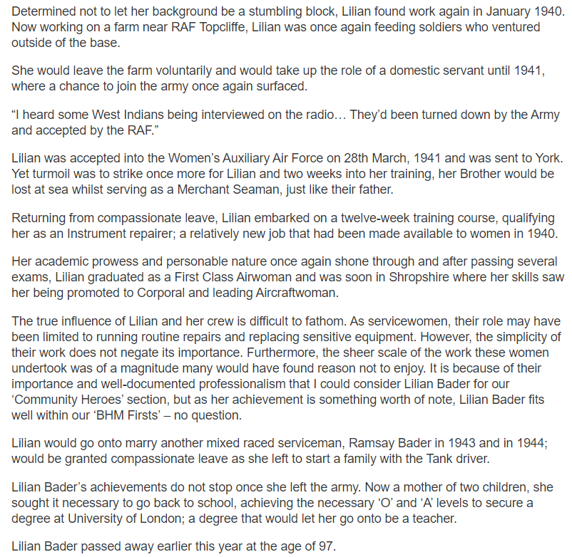
Written by Abdul Rob, on 13/10/2015

Slide 13

Vocabulary Check
a happy family was postponed as war broke out
without parents, the trio would be separated
Yet turmoil was to strike once more
Lilian embarked on a twelve-week training course

Slide 14
Vocabulary Check
Postponed: cause or arrange for (something) to take place at a time later than that first scheduled.
Trio: a set or group of three people or things.
Turmoil: a state of confusion, uncertainty, or disorder
Embarked: go on board a ship or aircraft

Slide 15
Q1. What were Lilian Bader’s challenges in life?
Q1a. Do you think people face the same challenges today?

Slide 16
‘The reality of being a mixed raced woman, in Britain in the early 1930s, would be one her intelligence and popularity would never be able to escape and at the age of twenty Lilian would still be at the convent she joined as a nine year old, simply because nobody was willing to hire her for work.’
Q2. Summarise this paragraph in one sentence.

Slide 17
'Lilian was once again feeding soldiers who ventured outside of the base.’
Q3. Find a synonym for the word ventured.

Slide 18
'...qualifying as an Instrument repairer: a relatively new job that had been made available to women in 1940.’
Q4. Why do you think this job was offered to men only before 1940?

Slide 19
End of Lesson

Slide 20
Date: Wednesday 3rd March 2021
LO: To be able to retrieve information and explain inferences.
Subject: Reading

Slide 21
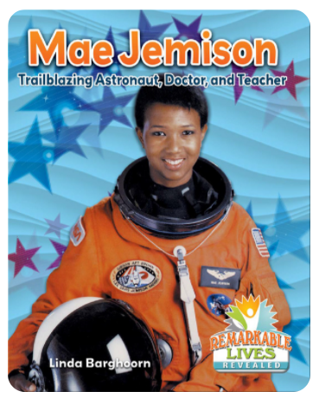
Mae Jemison

Slide 22

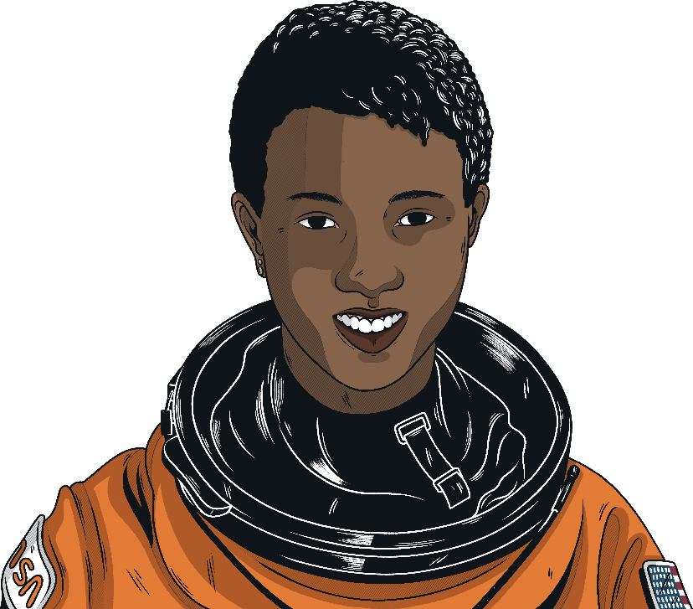

Who is Mae Jemison?
Never limit yourself because of others' limited imagination; never limit others because of your own limited imagination.
Dr Mae Jemison (1956 – present day)
Mae Jemison is a doctor, teacher, inventor and former astronaut.
She lives and works in the United States of America.
Her achievements demonstrate the importance of working hard, having self-belief and setting yourself ambitious goals.
For Mae Jemison, the sky is certainly not the limit!

Slide 23
Early Life
Mae Carol Jemison was born on 17th October 1956 in Decatur, Alabama in the United States of America. Her mother was a teacher and her father was a carpenter and roofer. She was the youngest of three children.
Education was important to her family and, when she was three years old, they moved to the city of Chicago to take advantage of the better schools found there.
At school, Mae Jemison was hard-working and high-achieving. She loved all areas of science and, even at the age of 5, knew that she wanted to be a scientist.
Her uncle was influential in her early life, introducing her to science at every opportunity. She developed a lifelong interest in astronomy.

Slide 24

Education and Early Career
In high school, Mae Jemison became interested in biochemical engineering and at the age of 16, she enrolled at Stanford University to study this subject.
In 1977, she was awarded degrees in chemical engineering and African-American studies.
Think:
Why do you think Mae Jemison chose to become a doctor rather than a dancer?
During her time at university, Jemison devoted time to theatre and dance. Her real passion for dance meant that she would eventually have to choose between being a doctor or a professional dancer.
Having chosen to be a doctor, Mae Jemison went on to attend Cornell University where she gained a doctorate in medicine.
She began work as a general practitioner in a medical centre.
Her real interest lay in international medicine and she worked for two years as a medical officer for the Peace Corps in Liberia and Sierra Leone.
Amongst her other academic achievements, Jemison is also fluent in Russian, Japanese and Swahili.

Slide 25
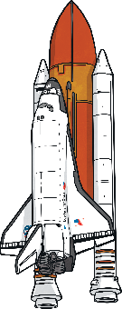
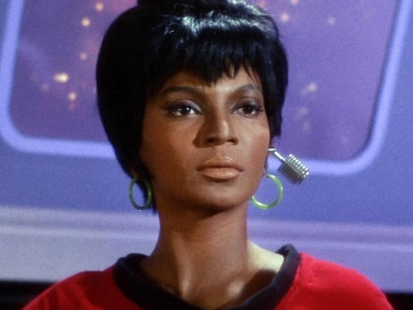
The Race to Space
As a child, Jemison loved reading about space and watching TV shows. One of her favourite shows was Star Trek and Jemison credits the character Lieutenant Uhura with being an early role model. Jemison felt as though she too could be a woman in space.
Later in life, she jumped at the chance to play a role in one of the episodes of Star Trek: The Next Generation.
Think:
What do you think Mae Jemison would have done if she had not been selected as one of the 15 candidates for the astronaut training programme?
Mae Jemison decided to follow her dream of travelling to space.
She applied to be admitted into NASA’s astronaut training programme and in 1987, she became one of only 15 people chosen from more than 2,000 applicants. She was the first Black woman to be admitted.
In September 1992, she also became the first Black woman to go into space, aboard the Endeavour space shuttle.
Mae Jemison spent 8 days in space, alongside 6 other astronauts. She was a mission specialist, carrying out experiments on weightlessness and motion sickness.
Lieutenant Uhura from Star Trek
An interesting fact about Mae Jemison is that she is scared of heights. She never let this fear hold her back though, saying: “It’s a weakness only if it keeps you from doing stuff.”

Slide 26

Retirement?
In March 1993, Mae Jemison retired from NASA. She certainly had no plans to put her feet up and relax. Her drive and determination soon had her looking for new goals.
The thing that I have done throughout my life is to do the best job that I can and to be me.
Today, she runs her own research and development technology company: The Jemison Group.
Her company’s projects focus on improving healthcare and technology in the developing countries of the world.
Mae Jemison is also currently leading the 100 Year Starship Project to ensure that human space travel to another star will happen within 100 years.
Her incredible achievements have led her to have the honour of being inducted into the National Women’s Hall of Fame and the International Space Hall of Fame.

Slide 27
'Her real passion for dance meant that she would eventually have to choose between being a doctor or a professional dancer.’
Q1. What synonym could you replace the word ‘passion’ with?

Slide 28
Q2. Who was a strong influence in Mae’s early life?

Slide 29
As a child, Jemison loved reading about space and watching TV shows. One of her favourite shows was Star Trek and Jemison credits the character Lieutenant Uhura with being an early role model. Jemison felt as though she too could be a woman in space.
Q3. Why do you think the character Lieutenant Uhura was a role model for Mae?

Slide 30
Q4. Why do you think Mae chose to become a doctor instead of a dancer?

Slide 31
Today, she runs her own research and development technology company: The Jemison Group.
Her company’s projects focus on improving healthcare and technology in the developing countries of the world.
Q5. What do you think this tells you about Mae’s personality and values?

Slide 32
End of Lesson

Slide 33
Date: Thursday 4th March 2021
LO: To be able to retrieve information and explain inferences.
Subject: Reading

Slide 34
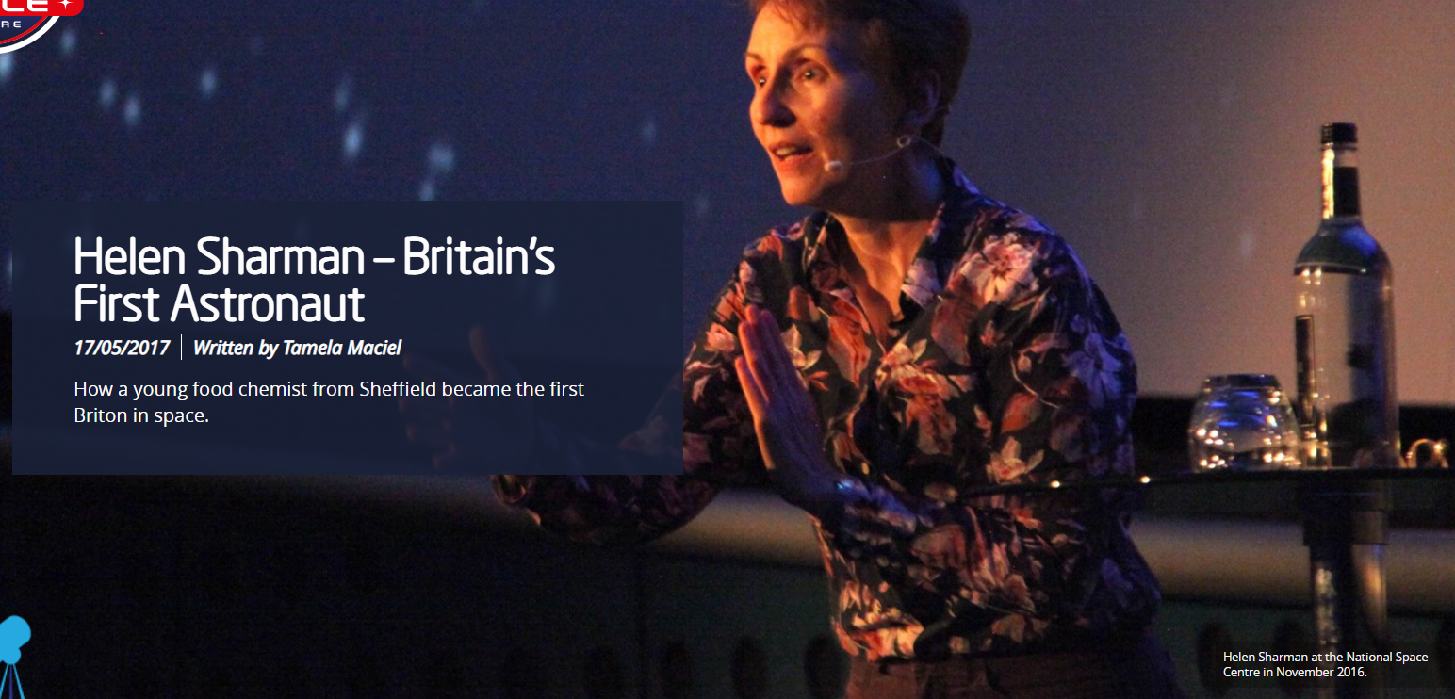

Slide 35
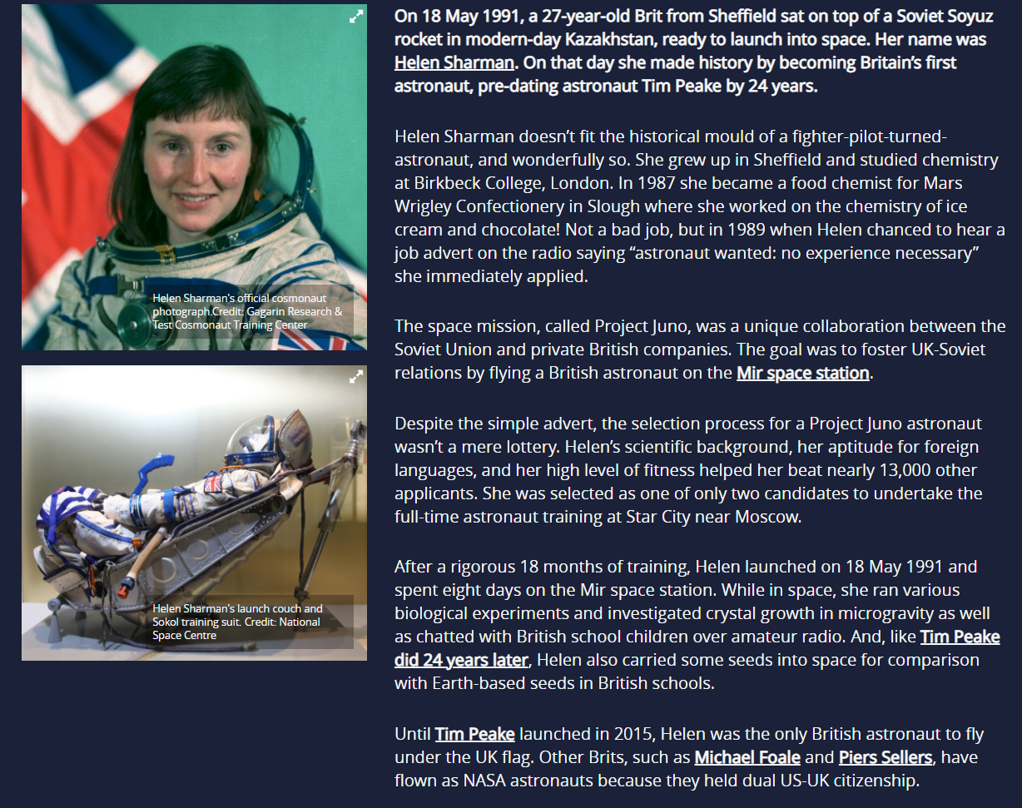

Slide 36
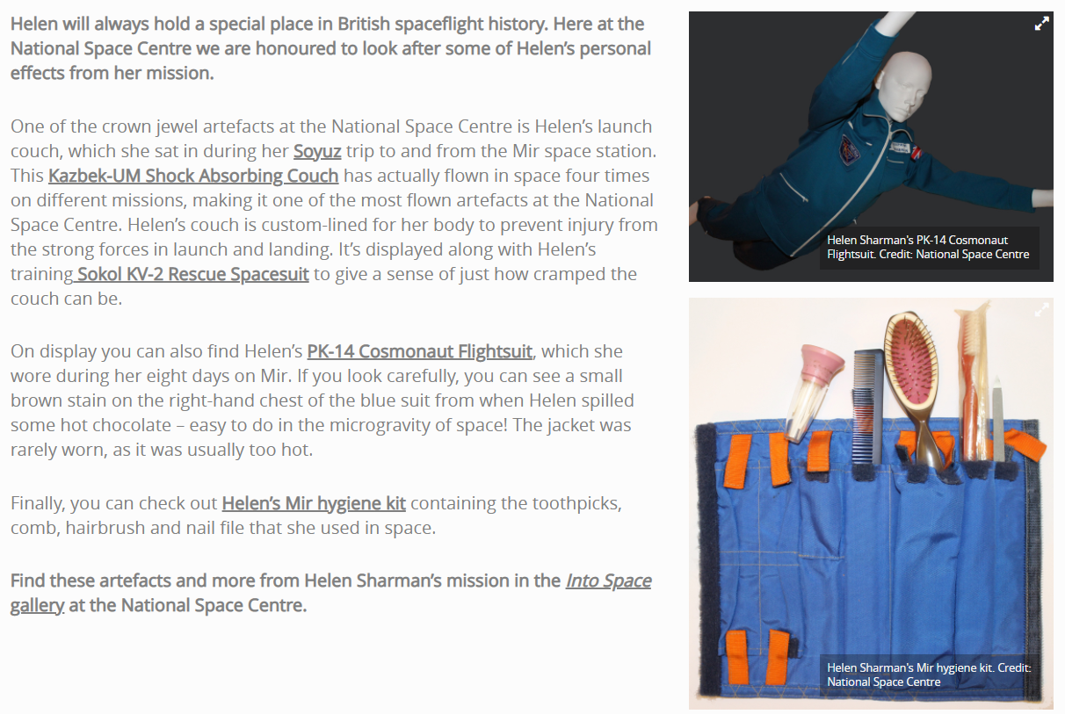

Slide 37
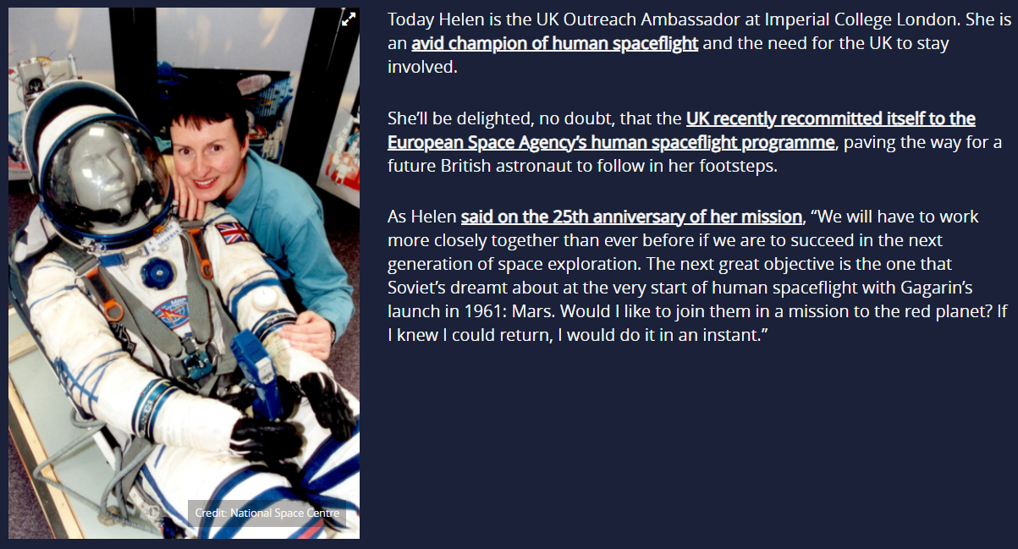

Slide 38
Vocabulary Check
her aptitude for foreign languages
various biological experiments
easy to do in the microgravity of space

Slide 39
Vocabulary Check
Aptitude: a natural ability to do something
Biological: relating to biology or living organisms.
Microgravity: very weak gravity, as in an orbiting spacecraft.

Slide 40
'On that day she made history by becoming Britain’s first astronaut, pre-dating astronaut Tim Peake by 24 years.’
Q1. Why do you think the texts highlights the fact she was before Tim Peake? What does this suggest about Tim Peake?

Slide 41
'After a rigorous 18 months of training, Helen launched on 18 May 1991 and spend eight days on the Mir space station.’
Q2. What type of word is rigorous? What synonym could you replace it with?

Slide 42
Q3. Why is it important to document these events and hold artefacts to show others?
(Think about the impact they have on readers/visitors.)

Slide 43
'One of the crown jewel artefacts at the National Space Centre is Helen’s launch couch, which she sat in during her Soyuz trip to and from the Mir space station.’
Q4. Find and copy a phrase which suggests the importance of the couch.

Slide 44
Q5. If you were to go into space, what objects would you take with you and why?
Do you think your object is worthy of becoming an artefact in a gallery after your trip?

Slide 45
End of Lesson

