Slide 1
Date: Monday 11th January 2020
LO: To be able to spell words ending in –sure or –ture.
Subject: Spelling

Slide 2
Words ending with ‘sure’ make a ‘sh’ sound.
Such as:
Treasure
Measure
Leisure
Enclosure

Slide 3
Words ending with ‘ture’ make a ‘ch’ sound.
Such as:
Adventure
Future
Capture
Picture

Slide 4
3 ways you could complete this task:
Drag the correct RED word ending to complete the spelling.
Write the correct spellings on a piece of paper.
Write the correct spellings Word document.
sure
sure
Pic
Frac
plea
‘ture’ or ‘sure’?
Punc
Clo
Mea
furni
Trea
mix
sure
ture
ture
ture
sure
sure
sure
ture
ture
ture

Slide 5
3 ways you could complete this task:
Drag the correct RED word ending to complete the spelling.
Write the correct spellings on a piece of paper.
Write the correct spellings Word document.
sure
sure
ture
Picture
Fracture
pleasure
‘ture’ or ‘sure’?
Puncture
Closure
Measure
furniture
Treasure
mixture
sure
ture
ture
sure
sure
sure
ture
ture
ture

Slide 6
Exceptions to the rule:
If the root word ends with ‘ch’ an ‘er’ is added.
Teach = teacher
Rich = richer

Slide 7
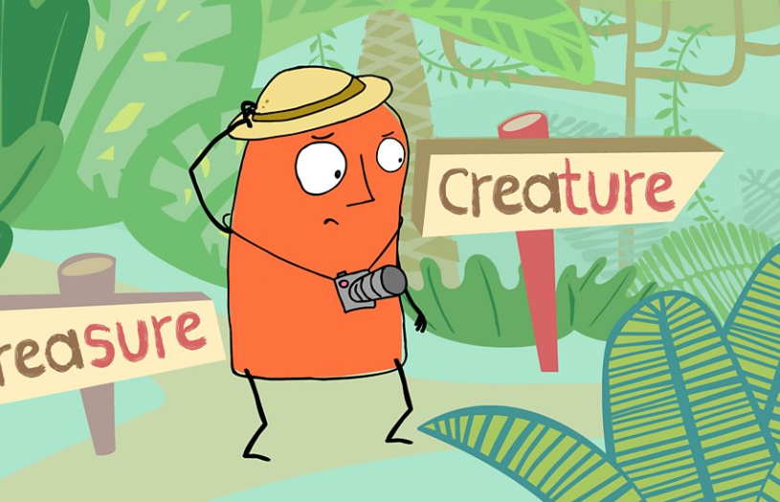
Short Activity
http://www.bbc.co.uk/guides/z3jpk2p
Watch
Activity

