Slide 1

Subject: English
Pack: B

Slide 2
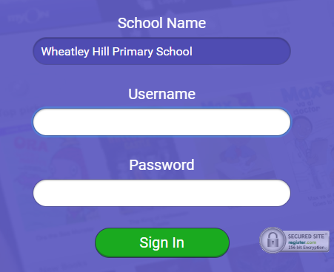
https://www.myon.co.uk/index.html
Remember to use myon for online reading
Example login -
Username
DavidW
Password
password1

Slide 3

Tuesday 22nd June
L.O To be able to make predictions based on a picture
Subject: English

Slide 4
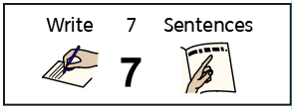




Tuesday 22nd June
What Work? | L.O To be able to make predictions based on a picture
How Much Work?
My work is Finished when...
Next?
6

Slide 5
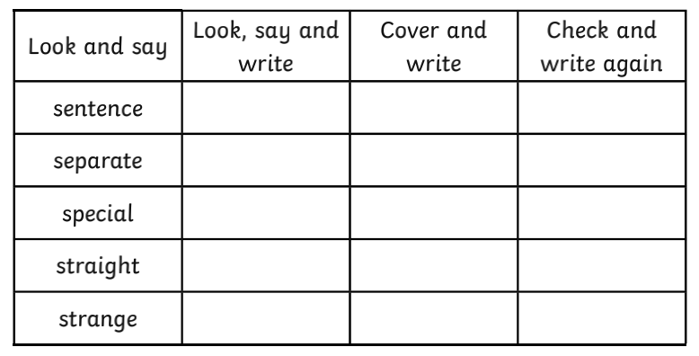

L.O To be able to spell words from the Y3/4 spelling list

Slide 6
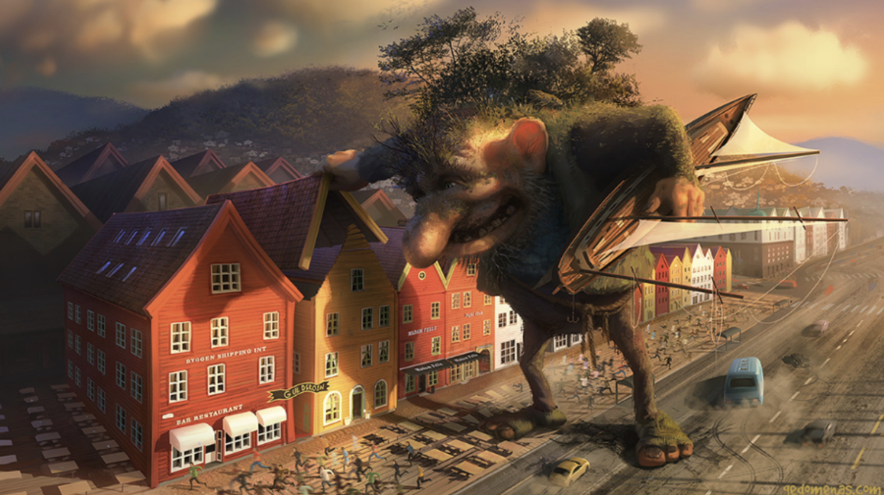

Have a look at this picture and have a think or write down all the things you can see.
The Troll

Slide 7
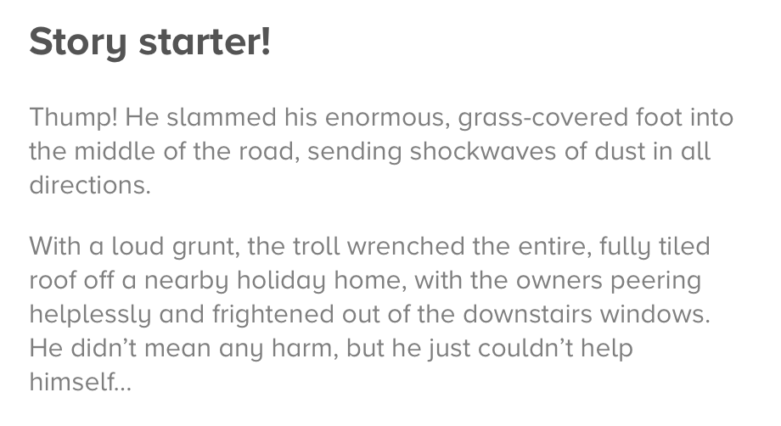

The Troll

Slide 8
Look at clues in the picture and from the writing to answer these questions
Write in full sentences e.g. I think ....... because ......
1. What do you think the troll is thinking?
________________________________________________________________________________________________________________________________________________
2. Do you think he is a mean or a kind troll? Why?
______________________________________________________________________________________________________________________________________________
3. What are the people doing when they have seen the troll?
________________________________________________________________________________________________________________________________________________

Slide 9
Look at clues in the picture and from the writing to answer these questions
4. Where do you think the troll has come from?
________________________________________________________________________________________________________________________________________________
5. What do you think the rope around the troll’s waist is for?
________________________________________________________________________________________________________________________________________________
6. Would you try to catch him or talk to him?
________________________________________________________________________________________________________________________________________________

Slide 10



Tuesday 22nd June
Add an ly opener to this sentence
______________________ , the troll stomped through the quiet holiday village.

Slide 11
Wednesday 23rd June
L.O To be able to use ly openers
Subject: English

Slide 12
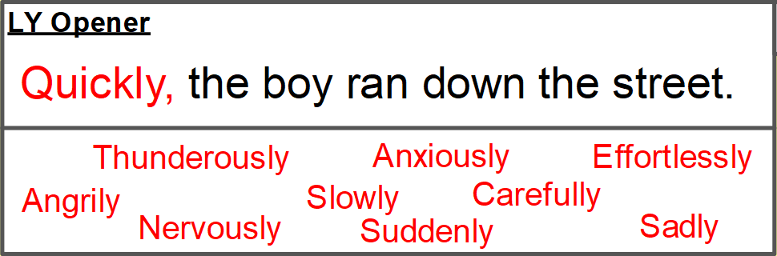
Wednesday 23rd June
What Work? | L.O To be able to use ly openers
How Much Work?
My work is Finished when...
Next?

Slide 13
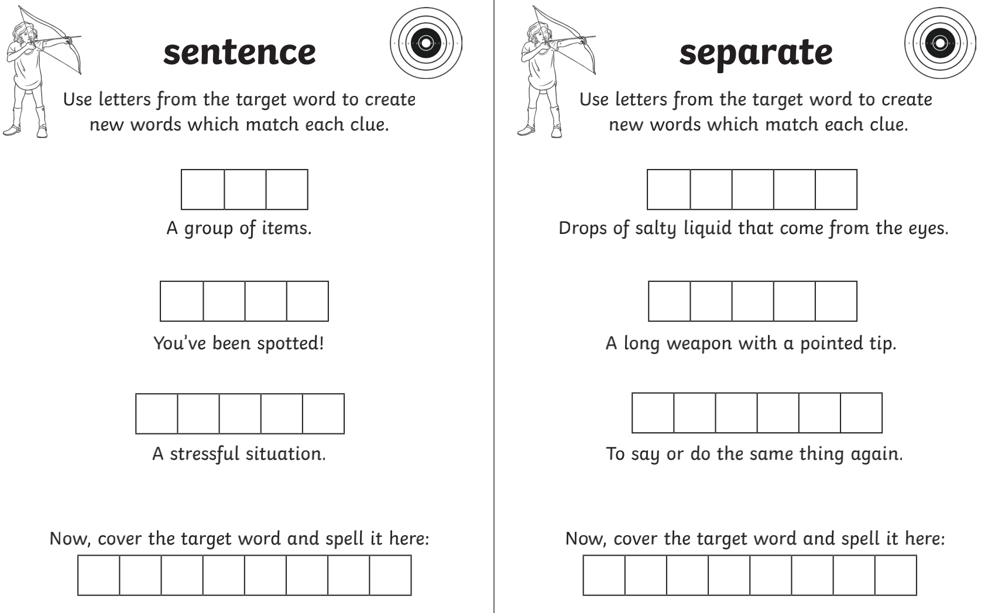
L.O To be able to spell words from the Y3/4 spelling list

Slide 14
Write a list of ly words/ adverbs (words that describe the verb) around the picture of the troll, I'll start you offf :)
Noisily
Curiously
Carelessly
Wildly,
Frantically

Slide 15
LY opners go at the start of the sentences
I know we are really good at these.
They describe the action in the sentence.
E.g.
Curiously, the the troll lifted the tiled roof off the yellow house.
Curiously is the adverb / ly word
Lifted is the verb
He lifted the roof curiously.

Slide 16
Use the ly openers you wrote around the picture to help write the sentences.
The first few have been started for you. Dont forget the commas!
1. ______________________ , the terrified people ran away from the creature.
2. Frantically, the cars _________________________________________________
__________________________________________________
3. ____________________ , the troll grunted at the frightened people.

Slide 17
Now try 4 ly sentences of your own :)
4._____________________________________________________________________________________________________________________________________________
5._____________________________________________________________________________________________________________________________________________
6._____________________________________________________________________________________________________________________________________________
7._____________________________________________________________________________________________________________________________________________

Slide 18
Wednesday 23rd June
Add an expanded noun phrase to describe the troll
Carelessly, the _____________ , _____________ troll stomped through the quiet holiday village.

Slide 19
Thursday 24th June
L.O To be able to write a descriptive paragraph
Subject: English

Slide 20

Thursday 24th June
What Work? | L.O To be able to write a descriptive paragraph
How Much Work?
My work is Finished when...
Next?

Slide 21
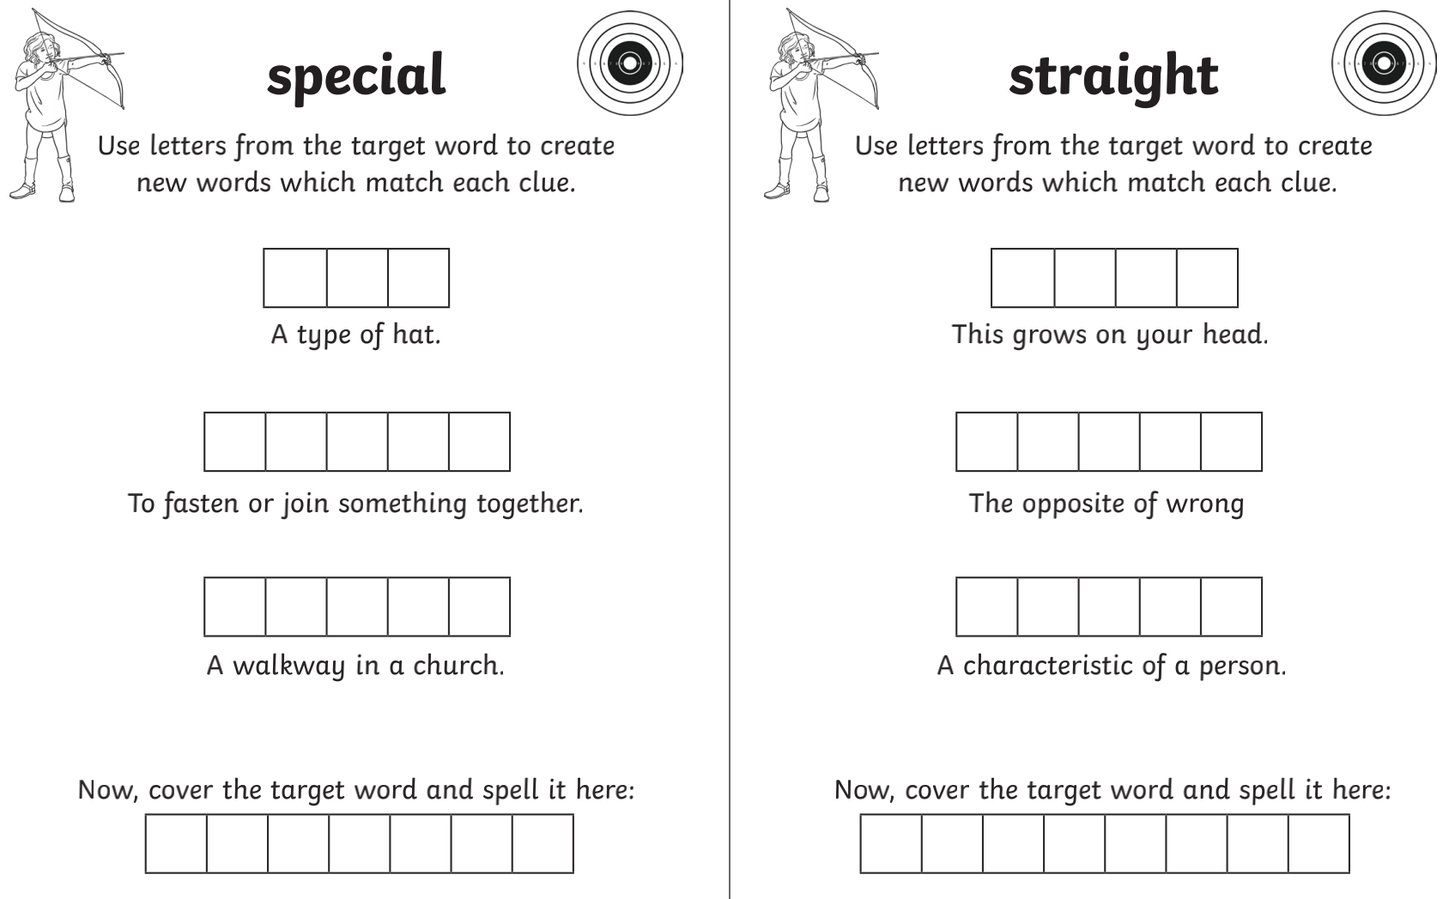
L.O To be able to spell words from the Y3/4 spelling list
t
r

Slide 22
Around the picture add some adjectives (descrubing words to help you. You could describe everything you can see such as the troll, the houses and the sky.
Troll
enormous
curious
nosey
mischievious

Slide 23
Things to include ..
Expanded noun phrase is where you write two
adjectives to describe a noun
adjective, adjective noun
e.g.
enormous, clumsy troll
horrified, scared people
We did ly openers yesterday so these could also be used to make your sentences more interesting.

Slide 24
Here are some sentences to help you describe the picture.
__________________ , the troll lifted up the tiled roof and peered into the house. His ______________ , ______________ eyes gazed inside but there was nothing interesting to be seen. The _____________ , ________________ ship he found in the ocean was much more fascintating. ____________________ , he looked down and saw ______________ , _______________ rpeople running in every direction.

Slide 25
Continue the paragraph independetly. HINT- You could describe what he looks like, what he is thinking or what the people are doing.
_________________________________________________________________________________________________________________________________________________________________________________________________________________________________________________________________________

Slide 26
Thursday 24th June
Add inverted commas to this sentence
Run for your life! cried the terrified people.

Slide 27
Friday 25th June
L.O To be able to make predictions based on a picture
Subject: English

Slide 28
Friday 25th June
What Work? | L.O To be able to make predictions based on a picture
How Much Work?
My work is Finished when...
Next?
6

Slide 29
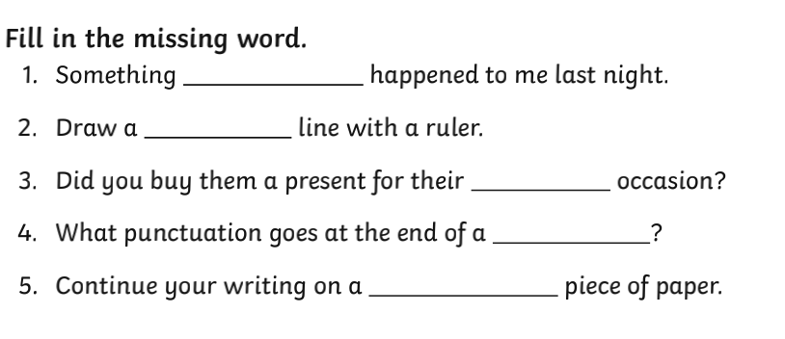
L.O To be able to spell words from the Y3/4 spelling list

Slide 30
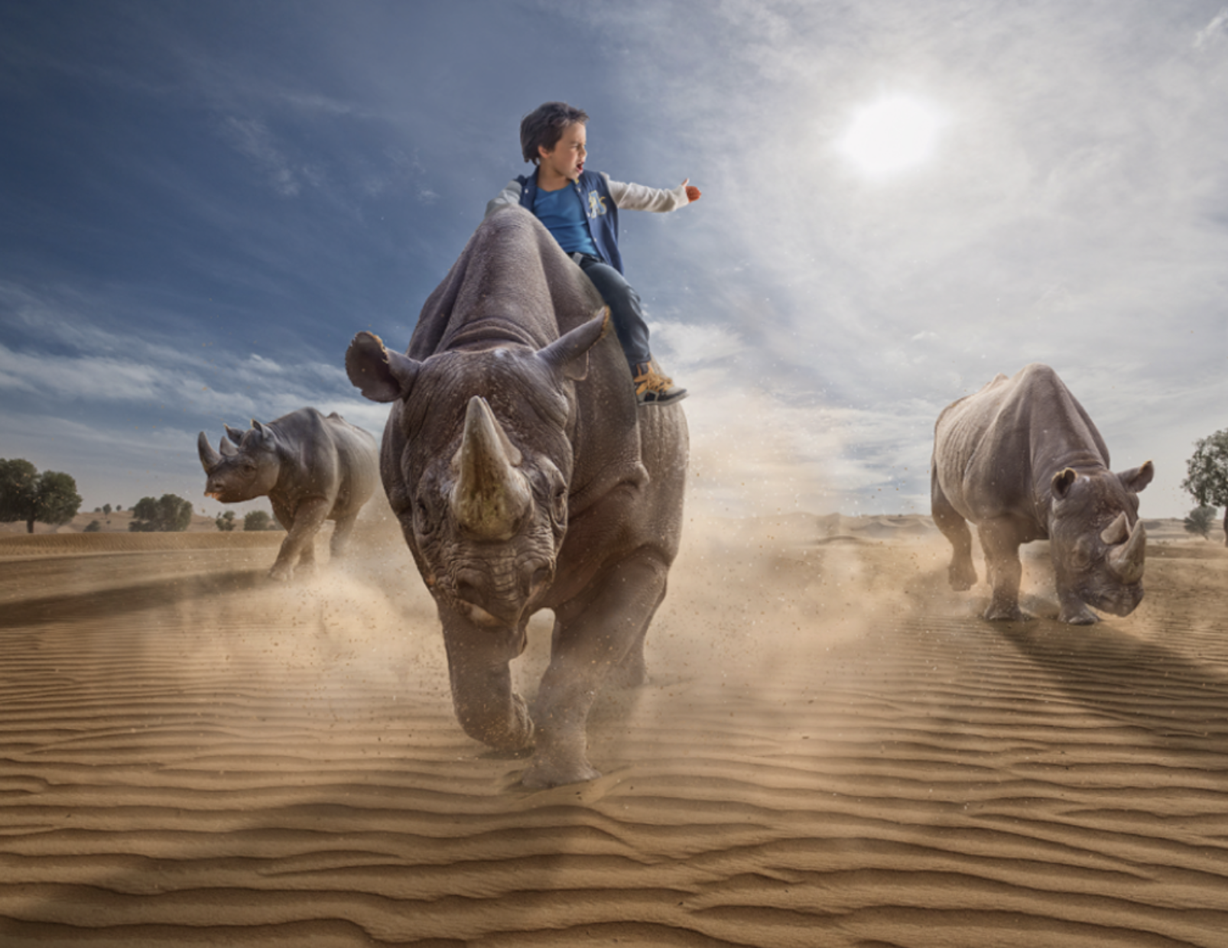
Stampede
Here is a new picture for the next two lessons. Have a look andthink what is happening
in the picture.

Slide 31
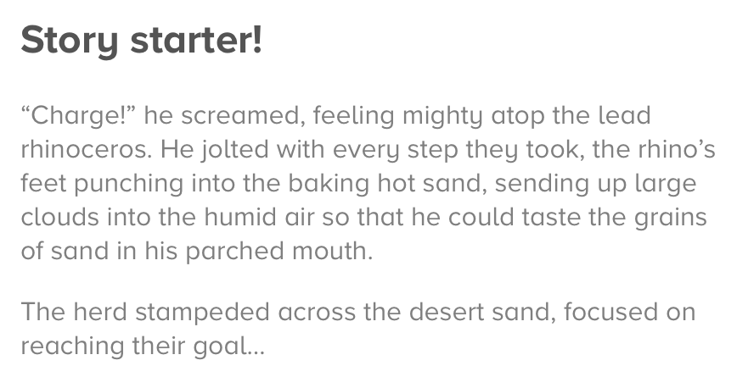
Stampede

Slide 32
Look at clues in the picture and from the writing to answer these questions
Write in full sentences e.g. I think ....... because ......
1. Who is the boy? Where is he from?
________________________________________________________________________________________________________________________________________________
2. What is he doing there?
______________________________________________________________________________________________________________________________________________
3. How has he managed to control the rhinos?
________________________________________________________________________________________________________________________________________________

Slide 33
Look at clues in the picture and from the writing to answer these questions
4. Where are the herd heading? What is their goal?
________________________________________________________________________________________________________________________________________________
5. How do you think the boy is feeling? How would you be feeling if you were him? ________________________________________________________________________________________________________________________________________________
6 . Did you know that rhinos are endangered? Why do you think this is?
________________________________________________________________________________________________________________________________________________

Slide 34
Friday 25th June
Add time opener to this sentence
_____________________ , the herd began their long journey.

Slide 35
Monday 28th June
L.O To be able to use ing openers
Subject: English

Slide 36
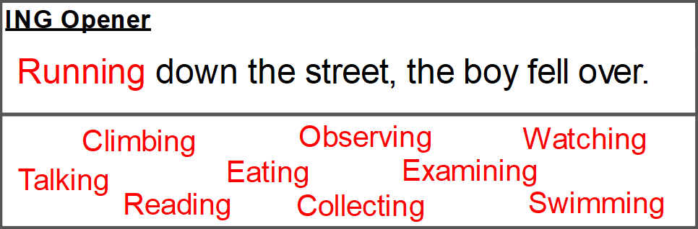
Monday 28th June
What Work? | L.O To be able to use ing openers
How Much Work?
My work is Finished when...
Next?

Slide 37
L.O To be able to spell words from the Y3/4 spelling list
Pick three of these words and write a sentence using each of them.
______________________________________________________________________________________________
______________________________________________________________________________________________
______________________________________________________________________________________________

Slide 38
Write a list of ing words/ verbs (doing) around the picture of the troll, I'll start you offf :)
Running
Stampeding
Charging
Blowing

Slide 39
The ing opener goes at the start of the sentence and is followed by a comma after the full phrase
E.g.
Feeling brave, the boy lifted one arm into the air.
Blowing across the desert, the sand went into the boy's eyes.

Slide 40
Use the ly openers you wrote around the picture to help write the sentences.
The first few have been started for you. Dont forget the commas!
1. Heading across the desert, __________________________________________
_______________________________________________________________________
2. Charging as fast as possible, _________________________________________
_______________________________________________________________________
3. Feeling ________________ , the young boy was ___________________________
______________________________________________________________________ .

Slide 41
Now try 4 ing opener sentences of your own :)
4._____________________________________________________________________________________________________________________________________________
5._____________________________________________________________________________________________________________________________________________
6._____________________________________________________________________________________________________________________________________________
7._____________________________________________________________________________________________________________________________________________

Slide 42
Monday 28th June
Add an apostrophe in the correct place
The boys face was covered in dust and sand from the desert.

