Slide 1

Subject: Maths
Pack: B

Slide 2

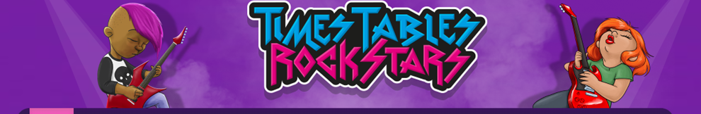

8.2.2021
L.O To be able to recognise money
Go to Times Tables Rock Stars to warm up your number brain before you start your maths activity.
Subject: Maths

Slide 3
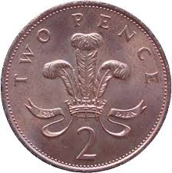
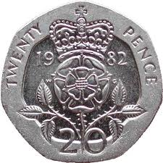
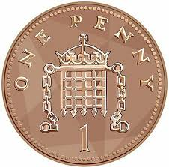
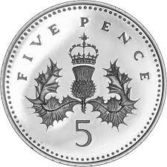
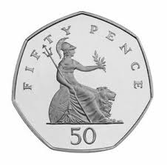
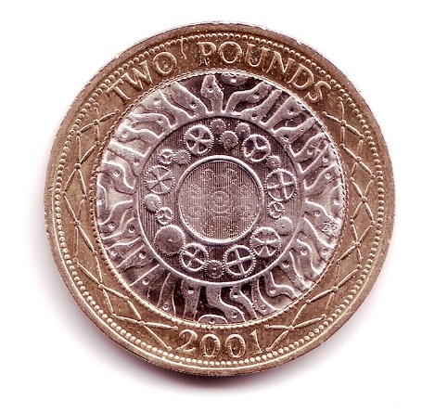
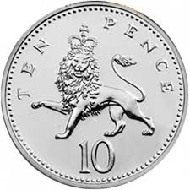
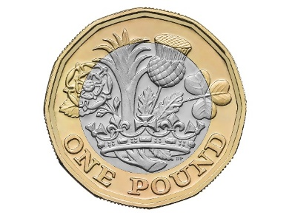

Here are the coins that we use. How many do you recognise?
Do you know how much the coins are worth?
Thinking time?

Slide 4

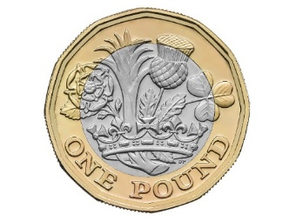
10 pennies is the same as having one 10p coin
Two 10p coins is the same as having a 20p coin
Having ten 10p coins is the same as having a one pound coin

Slide 5

One way to identify a coin is by its colour.
The 1 and 2p coins are an orange/red colour, known as copper.
The 5, 10, 20 and 50p coins are all silver.
Finally, the £1 and £2 coins are gold around the outside, and silver in the middle.
Copper
Silver
Gold and Silver

Slide 6

Try and put these coins in the right section.
Silver
Circle

Slide 7
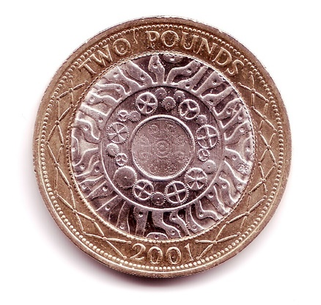
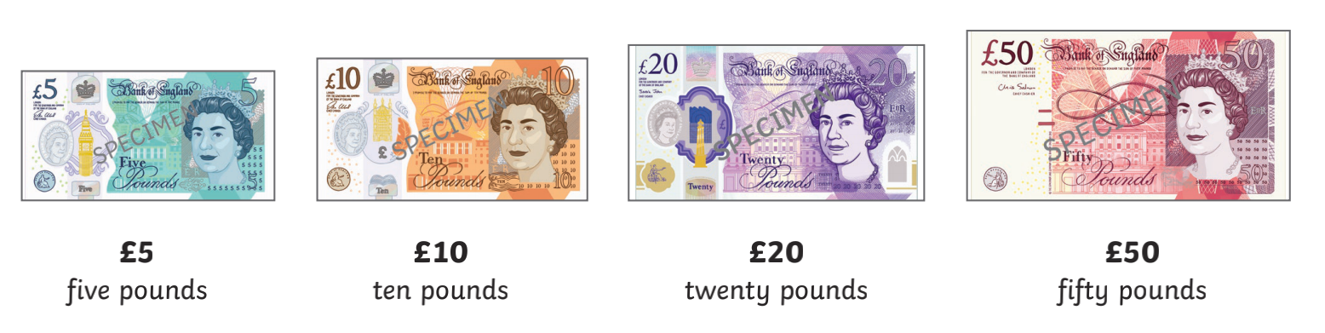
1 pound
2 pounds
The two pound coin is the most valuable coin (which means it is worth the most money.
£1 = 100p £2 = 200p
We also use notes which are larger amounts of money.

Slide 8
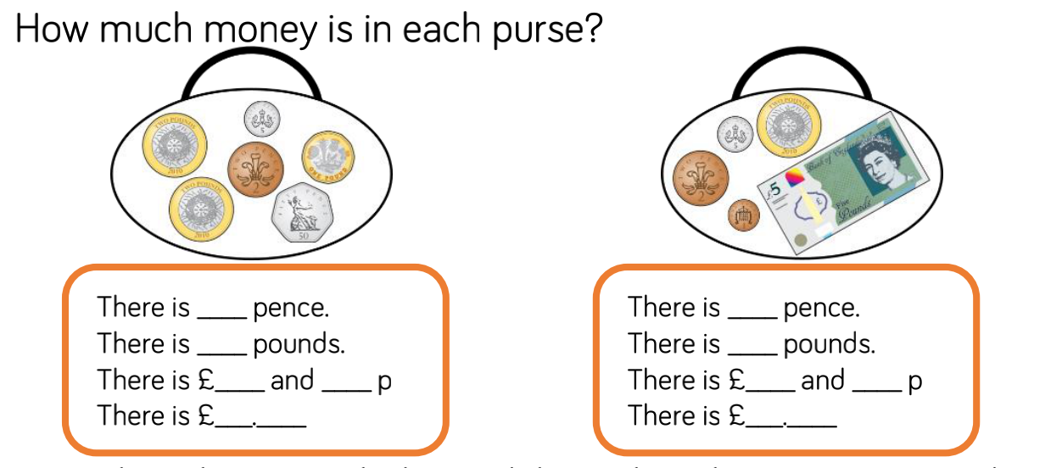
£1 = 100p
money can be written in both pounds and pence.
540p = £5.40 275p = £2.75 482p = £4.82
add the pence and pounds separately

Slide 9
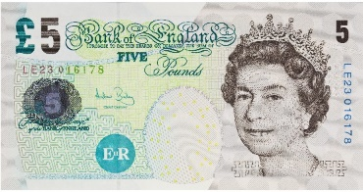
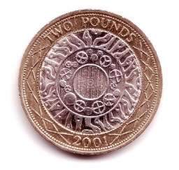
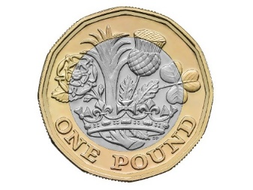
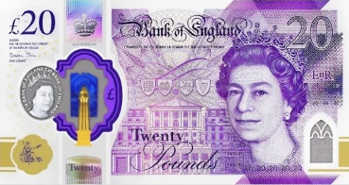
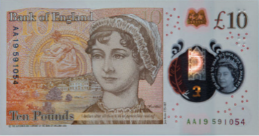

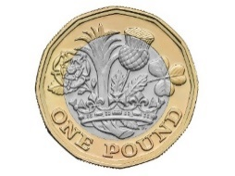
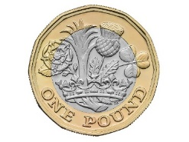
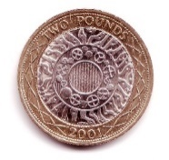
Work out how much money these coins and notes make. e.g. 1. £5.22
6.
7.
8.
9.
10
1.
2.
3.
4
5.

Slide 10
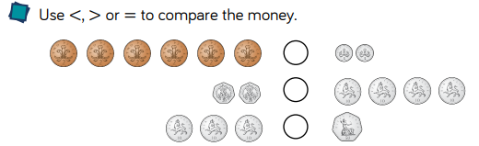
Challenge

Slide 11
9.2.2021
L.O To be able to add amounts of money
Go to Times Tables Rock Stars to warm up your number brain before you start your maths activity.
Subject: Maths

Slide 12
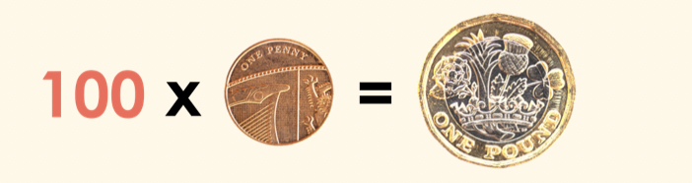
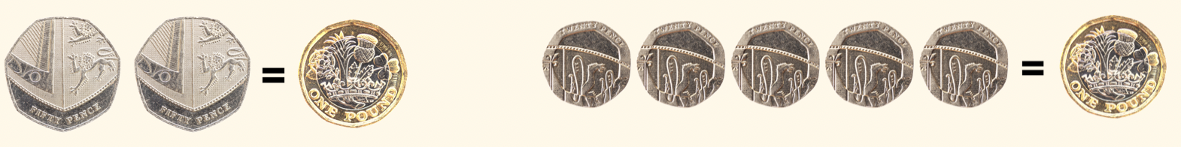
Before we start adding and subtracting amounts of money, we need to be confident in understanding the value of a £
REMEMBER- £1 = 100p
There are different ways we can make £1
50p + 50p = £1 20p x 5 = £1
Can you think of any other ways that we can make £1?

Slide 13
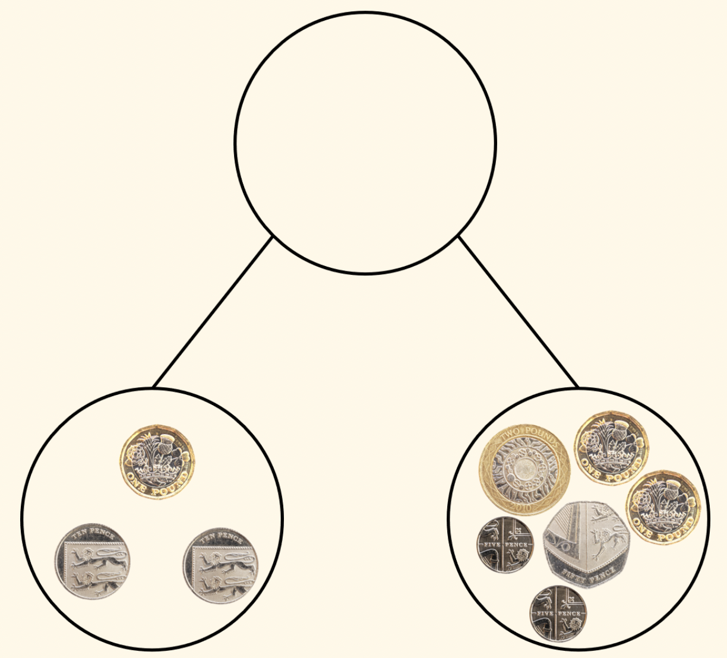
When we are adding and subtract money, it is helpful to work look at the pounds and pence separately
EXAMPLE
£5.80
Here we had the pounds first and then the pence
£1 + £4 = £5
60p + 20p = 80p
£5 + 80p = £5.80
£4.60
£1.20

Slide 14
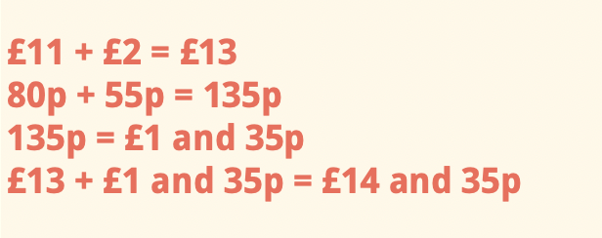
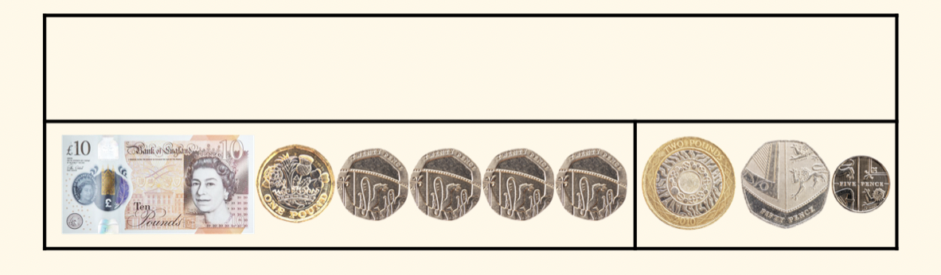
Calculations become more difficult when we have to exchange (when the pence goes over a £)
EXAMPLE
£14.35
£11.80
£2.55
Again we have added the pounds first
But in this example the pence equal higher than £1 (100p)

Slide 15
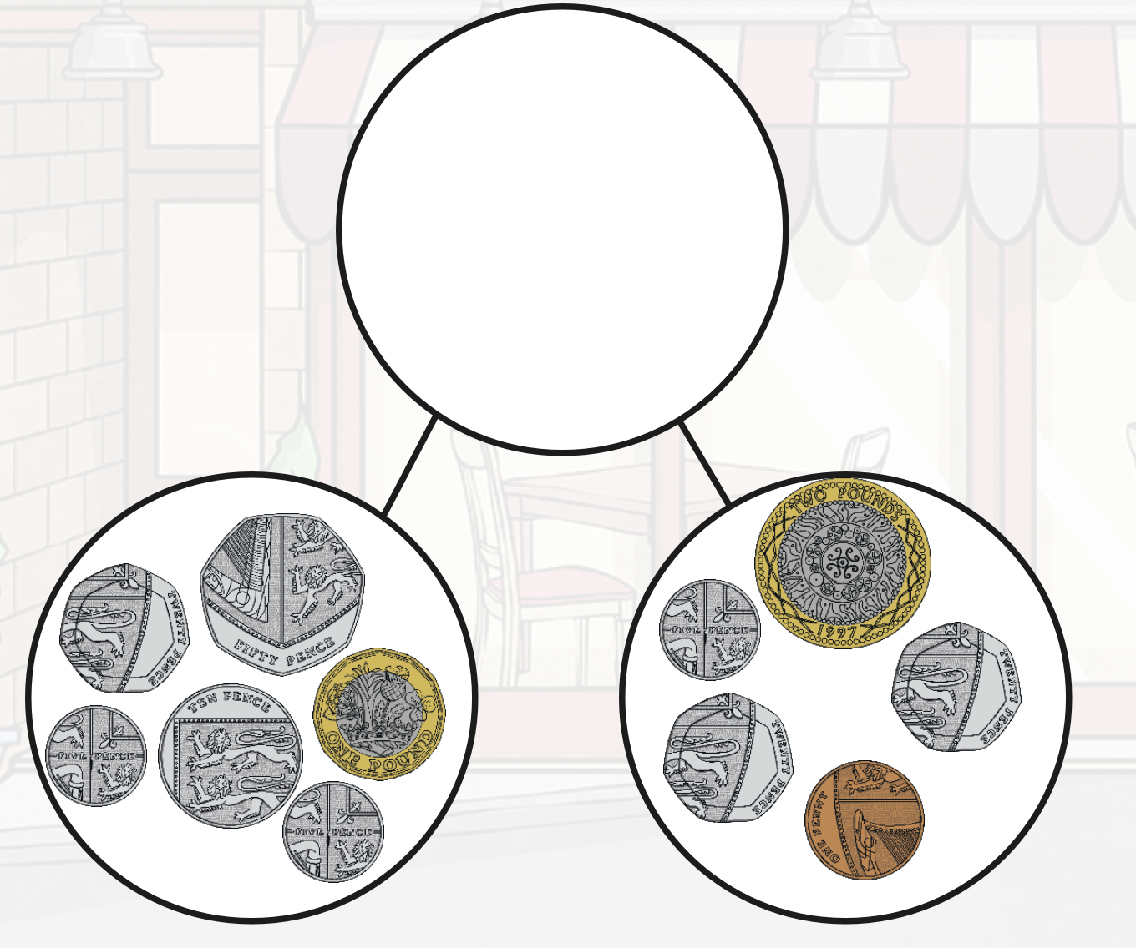
use the examples on the previous slides to help you
work out the 2 amounts
add the pounds first
HINT- you will need to exchange

Slide 16
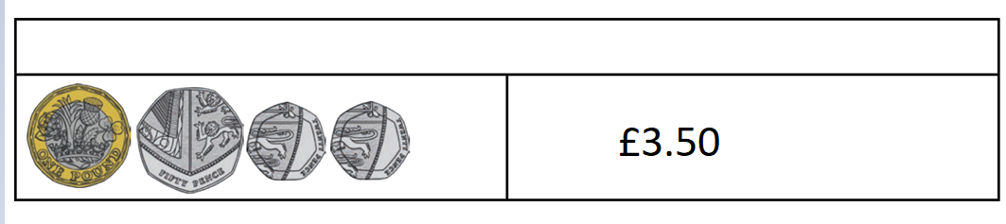
Add the 2 bottom amounts to find the total in this bar model

Slide 17
£2.50 + £3.44 =
£6.30 + £2.35 =
£9.20 + £3.50 =
£10.50 + £5.45 =
£7.60 + £2.60 =
£8.75 + £3.50 =
£9.60 + £5.50 =
£10.85 + £6.40 =
Remember to add the pounds and then the pence
If you have any coins about at home, you could use these to help you
Example
you could use this example to help you out
£2.50 + £3.62
£2 + £3 = £5
50p + 62p = 112p
112p = £1.12
£5 + £1.12 = £6.12
Questions 5-8 require
exchanges

Slide 18
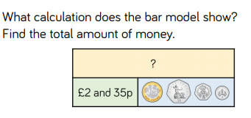
Extension

Slide 19
10.2.2021
L.O To be able to subtract amounts of money
Go to Times Tables Rock Stars to warm up your number brain before you start your maths activity.
Subject: Maths

Slide 20
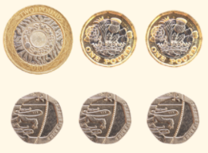
Today we are subtracting amounts of money.
We will work with pounds and pence separately like we did yesterday.
£4.60 - £2.40
£4 - £2 = £2
60p – 40p = 20p
£4.60 - £2.40 = £2.20

Slide 21
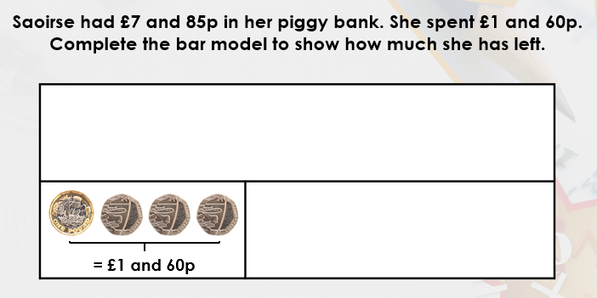
Use the method on the previous slide to work this out.
£ then pence
£7.85

Slide 22
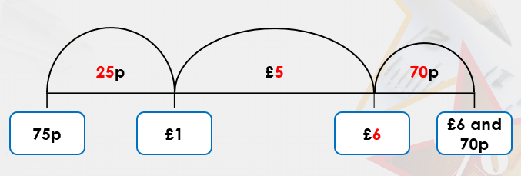
If the sums are not as easy to take away just by taking away pounds and pence,
we can use a number line to help us.
£6.70 – 75p =
In this example we have started at 75p and are counting up to work out the difference
Jump 1- how much to add until you get to the next pound
Jump 2- how much to add until you get to the £6
Jump 3- how much to add until you get to £6.70
Then add the amounts together at the top - £5 + 25p + 70p = £5.95
£6.70 – 75p = £5.95

Slide 23
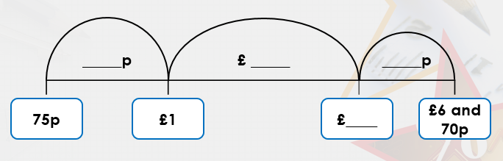
£4.50 - £1.80 =
Have a go using the number line to work out this sum.
I have done the sets at the bottom for you.
£1.80
£2
£4
£4.50

Slide 24
£7.30 - £2.85 =
Now try this one using the same method
£2.85
£7.30

Slide 25
£8.60 - £2.30
£10.50 - £1.35 =
£9.70 - £3.50 =
£12.45 - £6.30 =
You should be able to work the first 4 out by taking away the pounds and then the pence
£7.40 - £2.55 =
£8.25 - £3.60 =
£9.50 - £2.55 =
£10.20 - £3.45 =
These ones are a bit trickier so you could use a number line to help you.
There are some blank number lines on the next slide to help you!

Slide 27
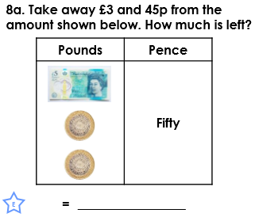
Extension

Slide 28
11.2.2021
L.O To be able to solve problems involving money
Go to Times Tables Rock Stars to warm up your number brain before you start your maths activity.
Subject: Maths

Slide 29
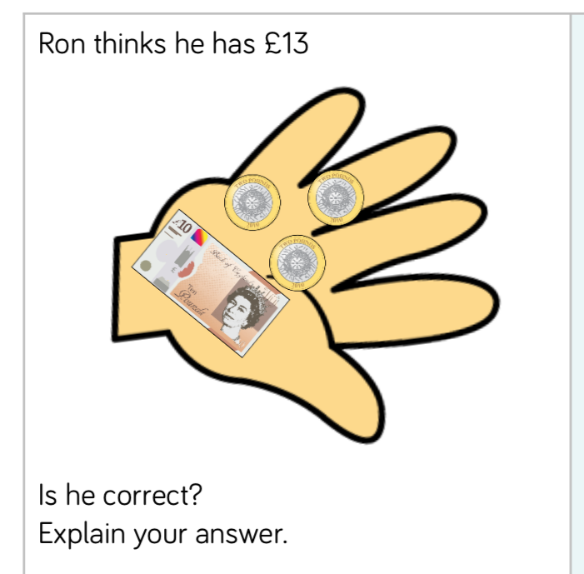
How would you work out this addition problem?
Ron has a £10 pound note, and three £2 coins.
First, I would add the coins together.
£2+£2+£2= £6
Next, I would add the 10 pound note to the £6
£10 + £6 = £16
Ron is wrong, he has £16 not £13

Slide 30
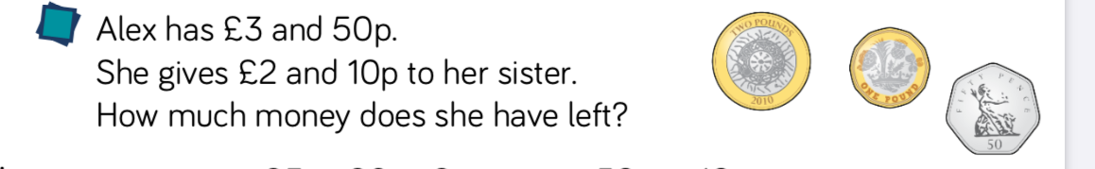
How would you work out this subtraction problem?
£3 – £2 = £1 so Alex has £1
50p – 10p = 40p so Alex has 40 pence
If you put the two answers together you get 1 pound and 40 pence
£1.40

Slide 31
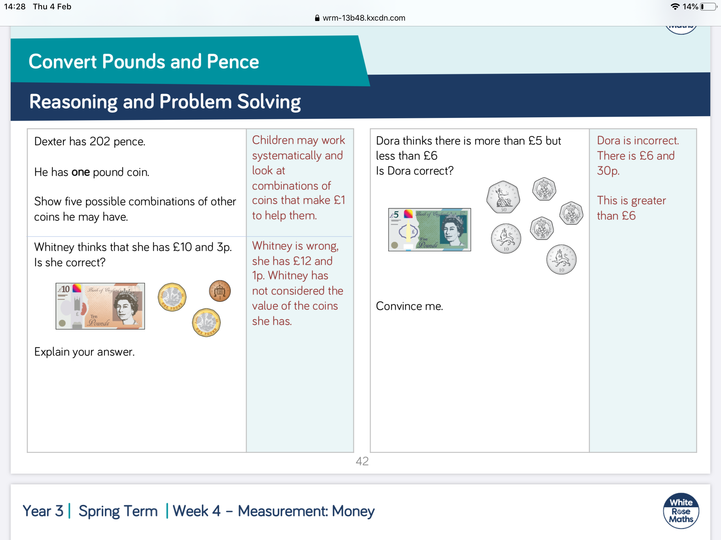
£1+£1= ______
£10+ 1p +_______
Is Whitney correct?
____________________________________________________________________________________
20p+20p+20p = _____
10p+10p= _____
50+_____+______ = _______
Add your answer to the £5 note.
Did you get more than 6 pound?
____________________________________________
____________________________________________

Slide 32
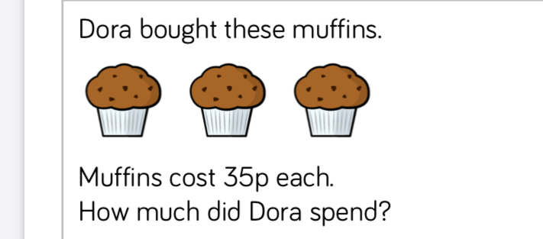
35p x 3 or 35p + 35p + 35p
30 + 30 + 30 = _____
5 + 5 + 5 = _______
Add these two amounts together to get the answer
_____________________________

Slide 33
1. Lewis went to the shop and bought a magazine for £3.80 and some biscuits at £3.50. How much does he spend altogether?
2. Josh bought two footballs for £6.10 each. How much did it cost for both of them?
3. Miss Mitchell bought 3 bags of sweets to fill up Class 4’s sweetie tin. Each bag cost £2.30. How much did Miss Mitchell spend on sweets?
Read through the word problems carefully and work out the answers.
Are you adding or taking away?

Slide 34
4. A child’s ticket to the cinema costs £5.60, whilst an adults costs £8.50. How much more does an adult ticket cost?
5. Hannah went shopping with £10.10, and bought some sunglasses for £7.80. How much money did she have left?
6. Thomas had £12.60. He bought a new pencil case for £4.30. How much does he have left?
Read through the word problems carefully and work out the answers.
For the subtractions, think back to what we did yesterday

Slide 35
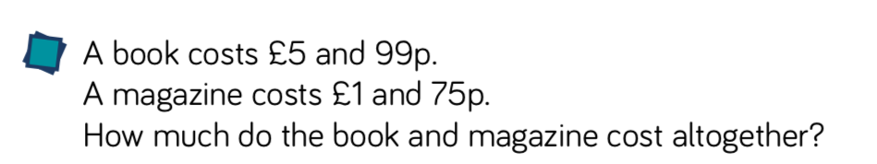
Challenge
Is there an easier way to add 99p?
Clue- we could work it out as an extra £ instead and then take away the penny at the end!

Slide 36
12.2.2021
L.O To be able to recall 4 times table facts
Go to Times Tables Rock Stars to warm up your number brain before you start your maths activity.
Subject: Maths

Slide 37

Pre-recorded Teaching
Access the online teaching video below that will support you to complete the work in this lesson. This video will act as a support but all of the work can still be successfully understood & completed using paper-based versions of this pack. If you need further support to understand / complete work then please contact school via e-mail or telephone.
Play Video
You can also copy and paste this link if you would prefer:
https://teachers.thenational.academy/lessons/recalling-the-4-times-table-cmt64e

Slide 38
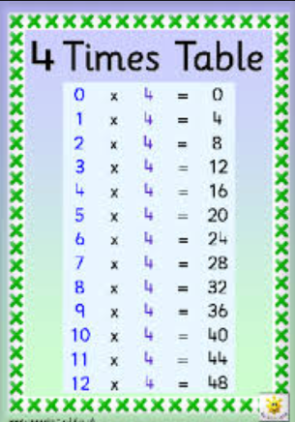
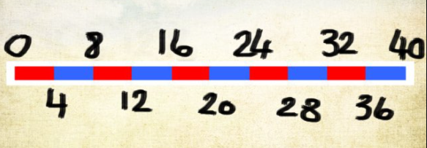
There is also a 4 times table video on the Pathfinders page on our school website
Here is the 4 times table.
Have a go chanting the table to help you remember it!

Slide 39
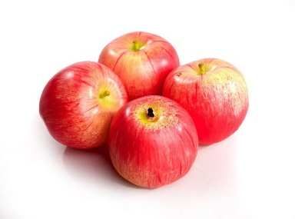

I have 6 packs of apples. In each pack, there are 4 apples. How many apples I have all together.
What numbers do we need to multiply together?
What would the answer be?
___ X 4 = _____

Slide 40
How many groups do we have this time?
There are ___ groups, and each group has 4 apples.
So which numbers do we need to multiply together this time?
___ X ___ = ____

Slide 41
Put in the missing numbers in these number lines.
4 8 12 _____ 20 24 ______ 32 36 _____ 44 ______
______ 40 36 _____ 28 ______ _______ 16 _____
16 _____ _____ ______ 32 ______ _______ ______ _____
36 ______ ______ ______ 20 ______ _______ ______ ____

Slide 42
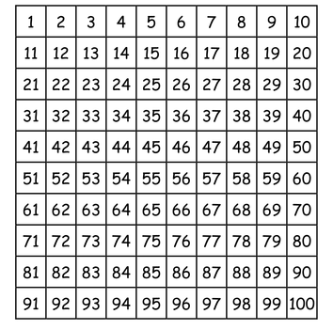
Colour in the squares that are multiples of 4

Slide 43
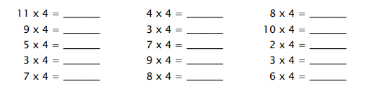

Slide 44
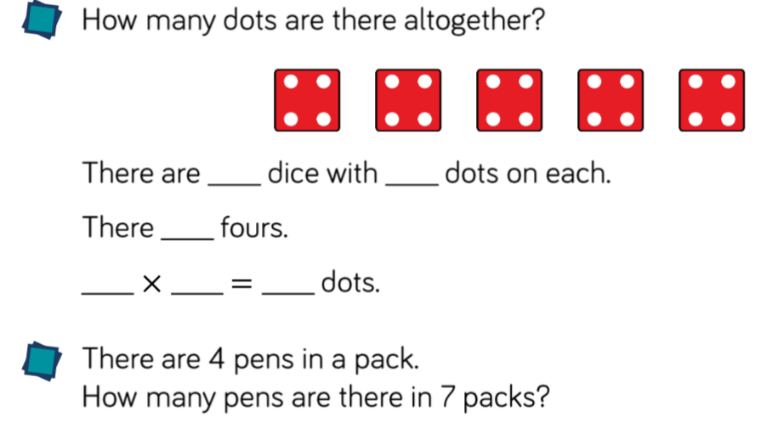
Challenge Time

