Slide 2
Date: Monday 1st February:
L.O To be able to compare the times of the day in different time zones
Subject: Science

Slide 3
Pre-recorded Teaching
Access the online teaching video below that will support you to complete the work in this lesson. This video will act as a support but all of the work can still be successfully understood & completed using paper-based versions of this pack. If you need further support to understand / complete work then please contact school via e-mail or telephone.
Click here
Click here
You can also copy and paste these links if you would prefer:
https://classroom.thenational.academy/lessons/what-is-the-difference-between-night-and-day-0wp2c?step=2&activity=video
https://www.bbc.co.uk/bitesize/clips/zrd9wmn

Slide 4
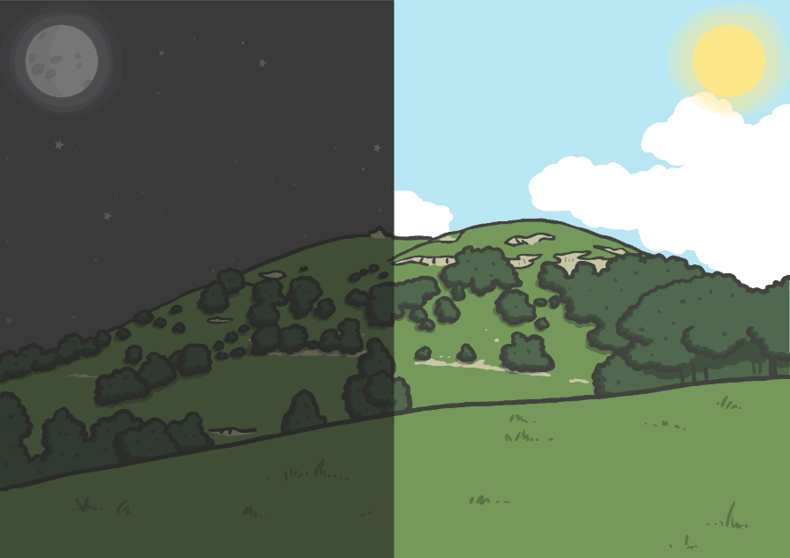
Day and Night- Recap from last week…
The Earth spins on its axis (an imaginary line) and over the course of 24 hours, different parts of the planet are facing towards the Sun and different parts are facing away from it.
When we are facing away from it, it is night time.
When we are facing towards the Sun, it is day time.

Slide 6
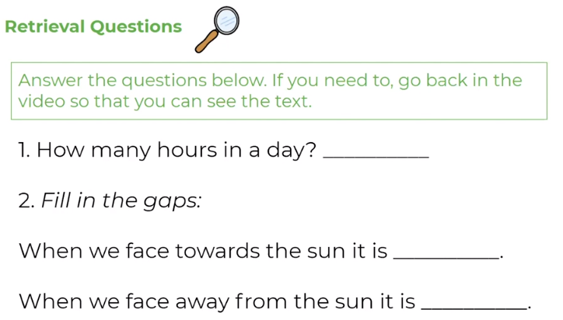
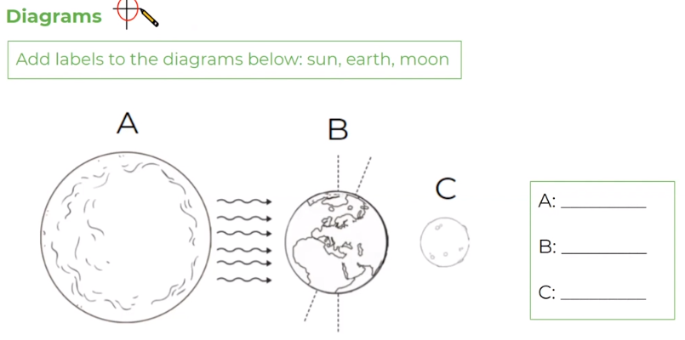

Slide 8
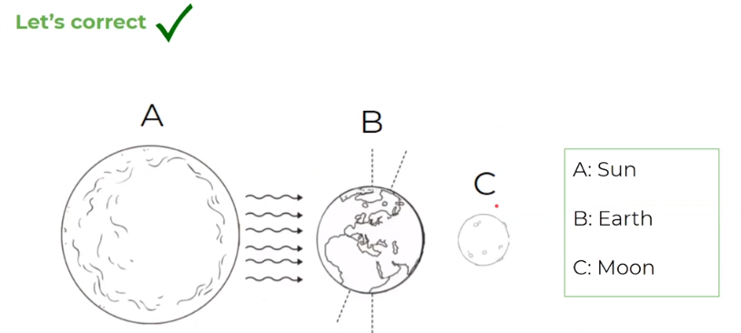
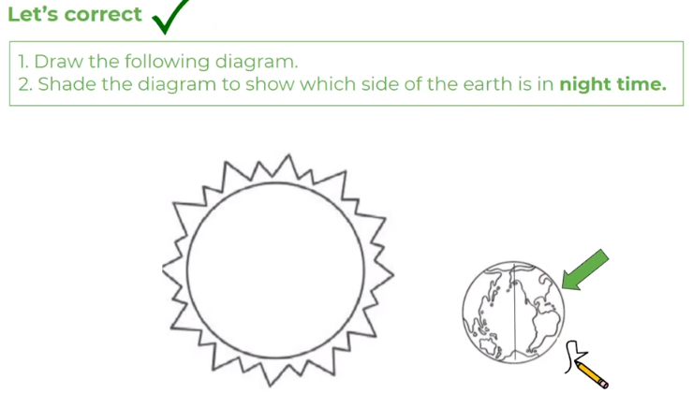

Slide 9
What Time Is It Now?
Time is different depending on where you are in the world. If it is daytime in the UK, it will be night-time in Australia.
Midday (12 noon) is the time when the sun is highest in the sky. The sun is highest in the sky at different times in different places in the world. So for every place in the world to have midday when the Sun is highest, we have to divide the world into time zones.
The Earth is a sphere divided into 360 degrees. The Earth turns 360 degrees in 24 hours. 360 divided by 24 is 15 degrees, so the Earth turns 15 degrees each hour.
The Earth has 24 different times zones- one for each hour in the day.

Slide 10
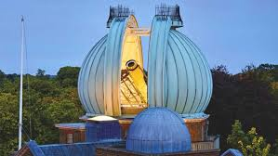
All time zones are measured from a starting point at England’s Greenwich Observatory.
Time at the Greenwich Meridian is known as Greenwich Mean Time (GMT) or Universal Time.
Copy and paste the different links below into a web browser (one at a time) and watch each of the videos.
https://www.bbc.co.uk/bitesize/clips/z9qd7ty
https://www.bbc.co.uk/bitesize/clips/zkynvcw

Slide 11
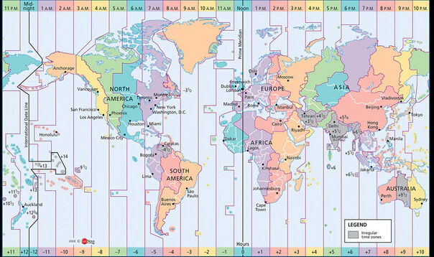
Here is a map of the world to show the different time zones in comparison to the UK.
Use the key along the bottom of the map to help you complete the task on the next slide.

Slide 12
L.O To be able to compare the times of the day in different places
Complete the table or write down your predictions through the different time zones onto paper.
Time at 12pm (Midday) in Wheatley Hill | Predict time in Mexico City | Prediction correct: Yes No | Actual Time: (if prediction wrong)
Time at 12pm (Midday) in Wheatley Hill | Predict time in Istanbul | Prediction correct: Yes No | Actual Time: (if prediction wrong)
Time at 12pm (Midday) in Wheatley Hill | Predict time in Sydney | Prediction correct: Yes No | Actual Time: (if prediction wrong)
Time at 12pm (Midday) in Wheatley Hill | Predict time in Miami | Prediction correct: Yes No | Actual Time: (if prediction wrong)
Time at 12pm (Midday) in Wheatley Hill | Predict time in Tokyo | Prediction correct: Yes No | Actual Time: (if prediction wrong)
Time at 12pm (Midday) in Wheatley Hill | Predict time in San Francisco | Prediction correct: Yes No | Actual Time: (if prediction wrong)
Time at 12pm (Midday) in Wheatley Hill | Predict time in Cape Town | Prediction correct: Yes No | Actual Time: (if prediction wrong)

Slide 13
Check your predictions to the task.
When it is 12pm (noon) in the UK, it would be 10pm at night in Sydney.

Slide 14
Time at 12pm (Midday) in Wheatley Hill | Predict time in Mexico City 6am
Time at 12pm (Midday) in Wheatley Hill | Predict time in Istanbul 3pm
Time at 12pm (Midday) in Wheatley Hill | Predict time in Sydney 10pm
Time at 12pm (Midday) in Wheatley Hill | Predict time in Miami 7am
Time at 12pm (Midday) in Wheatley Hill | Predict time in Tokyo 9pm
Time at 12pm (Midday) in Wheatley Hill | Predict time in San Francisco 4am
Time at 12pm (Midday) in Wheatley Hill | Predict time in Cape Town 2pm
Check over your predictions using these answers.

Slide 15
Date: Tuesday 2nd February:
L.O To be able to explain how the length of a day and temperatures changes throughout a year
Subject: Science

Slide 16
How does the length of a day and temperatures change throughout the year?
Following on from our previous learning about ‘Day and Night’, we are going to look more closely at the changes that happen throughout the year.
At any moment, half of the world is in daytime and half is in night time.
The world is like a ball. We call the top half the Northern hemisphere and the bottom half the Southern hemisphere. The (imaginary) line between them is called the equator.
In the Northern hemisphere, we have summer in June, July and August and winter is in December, January and February.
In summer the days are longer than they are in winter. In London, the longest day is about 16 hours and 39 minutes and the shortest is 7 hours and 45 minutes.
In the Southern hemisphere the seasons are the other way around. When it is summer in Europe, it is winter in Australia. Imagine celebrating Christmas on a long, hot summer day!

Slide 17
The change between day and night is caused by the rotation of the Earth on its axis. ... The changing lengths of days and nights depends on where you are on Earth and the time of year. Also, daylight hours are affected by the tilt of the Earth's axis and its path around the sun.
The Earth's axis is tilted as it travels around the Sun, so some parts of the Earth receive more sunlight each day than others.
This changes during the year because the Earth moves about the Sun, which gives rise to the seasons.
The UK is in the top half (northern hemisphere) of the Earth. When the northern hemisphere is tilted towards the Sun it is summer in the UK.
Six months later the northern hemisphere is tilted away from the Sun and it is winter.
In Spring, the temperature and day length become longer. In Autumn, they are shorter.

Slide 18
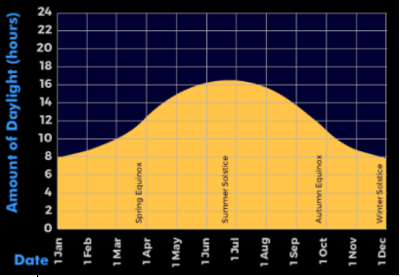
How does day length change through a year? – look at a graph to show the amount of daylight hours and how they change throughout the year.
Notice days are longest in our summertime. Compare spring, summer, autumn and winter, e.g. In July, the UK’s summertime, we enjoy 16 hours of daylight however in December, the UK’s wintertime, we only have 8 hours of daylight.
Answer the following questions:
1. Estimate how many hours of daylight there is in March.
2. Estimate the least amount of hours of daylight and write down which month that it.
3. Estimate the most amount of hours of daylight and write down which month that it.
4. How many more hours of daylight is there between the most and least- use your estimations from question 2 and 3.

Slide 19
Weather and climate
Weather is the way the air and the atmosphere feels. It includes the outside temperature, strength of the wind, and whether it is raining, sunny, hailing, snowing, sleeting, foggy, or cloudy. The weather changes regularly and tends to be different during different seasons and across different countries. We call the general weather trends and the extremes of weather in one place a ‘climate’.
Winters tend to be colder and have more rain, sleet, hail and snow, while summer tends to be warmer and sunnier. Some countries are warm all year round, while others are cold all year round. The UK has what is called a ‘temperate’ climate. A temperate climate is one that is not too extreme.
Some countries, such as Brazil, Kenya and Indonesia experience extreme heat, where temperatures reach over 100 degrees. These countries have the Equator running through them and are closest to the sun. They have a tropical climate. People in these countries try to avoid the hottest parts of the day by staying indoors. Extreme temperatures like these can be very dangerous if people are outside for prolonged periods.
Countries towards the north and south of the earth have a much colder climate. Parts of Russia and Greenland and parts of Canada are in the polar regions and experience a tundra climate. They have long cold winters and their summers are pretty cold too.

Slide 20
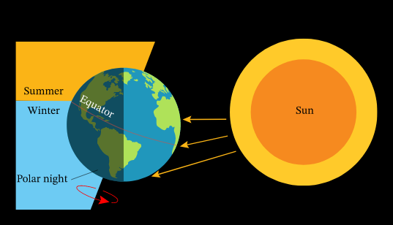
How does the temperature change throughout the year?
Earth rotates on an axis. During the winter, the North Pole is tilted away from the Sun's rays. As Earth travels around the Sun, the tilt of Earth changes. By June, the North Pole is tilted towards the Sun and the days become very long. Earth takes a year to orbit the Sun and it is the tilt which creates the seasons.
The weather in the UK is warmer when we are closer to the sun in the summer, and when warm winds blow warm air in from the south. Temperatures in the UK tend to reach the high 20s and low 30s degrees Celsius at the height of summer.

Slide 21
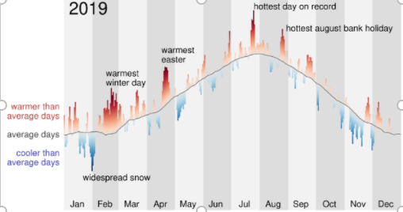
How does air temperature change through a month/year? – look at a line graphs showing how the air temperature changes throughout the year.
Task: In your own words, use the information you have read to explain the changes in temperature throughout the year making links to the orbit and rotation of Earth. Use the graph to estimate different temperatures throughout the year.

Slide 22
Date: Wednesday 3rd February:
L.O To be able to explain how shadows are formed
Subject: Science

Slide 23
Pre-recorded Teaching
Access the online teaching video below that will support you to complete the work in this lesson. This video will act as a support but all of the work can still be successfully understood & completed using paper-based versions of this pack. If you need further support to understand / complete work then please contact school via e-mail or telephone.
Watch video
Watch video
You can also copy and paste this link if you would prefer:
https://teachers.thenational.academy/lessons/how-are-shadows-formed-6wt66d
https://www.bbc.co.uk/bitesize/clips/z8vfb9q

Slide 24
How do we see?

Slide 25
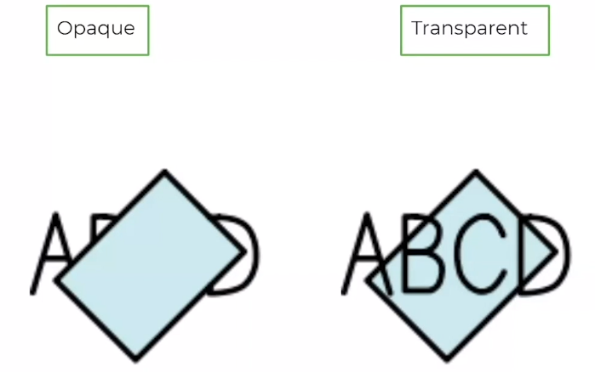
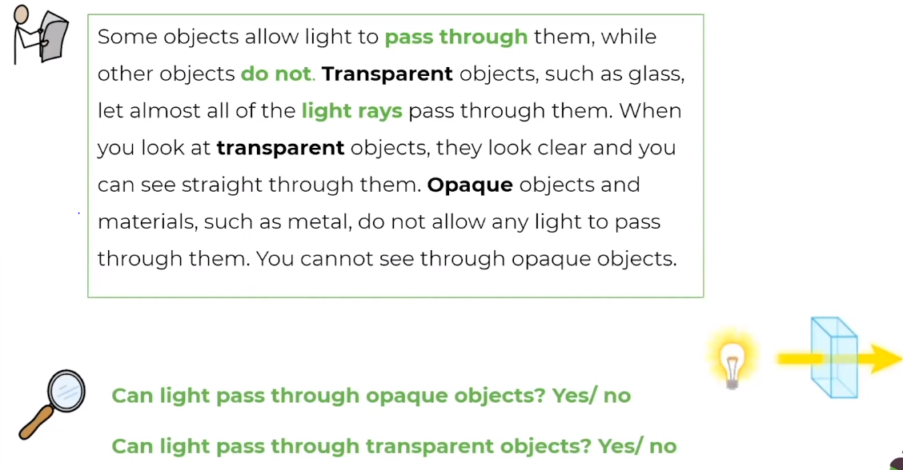

Slide 26
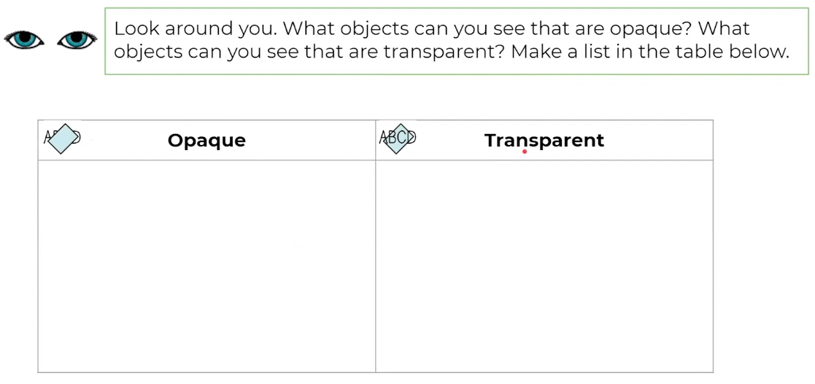

Slide 27
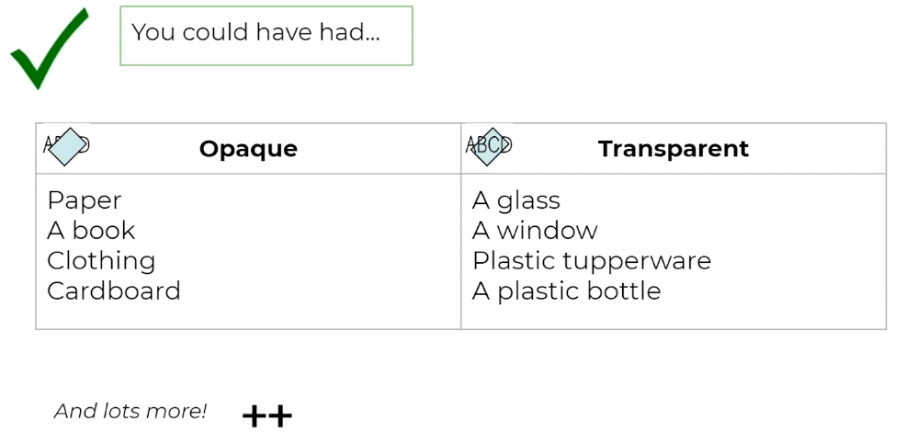

Slide 29
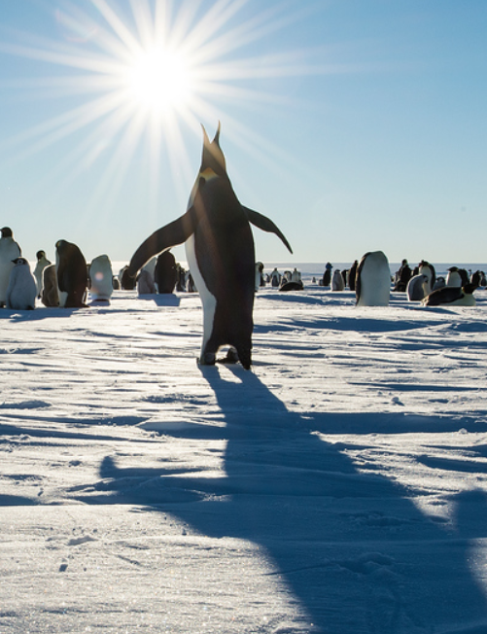
Shadows are formed when light from a source is blocked by an opaque object.
Sunlight that travels towards the Earth takes just over 8 minutes to reach us. When the rays reach Earth, they hit whatever is in their path. If the object they hit is opaque, the light cannot pass through, and a shadow forms.
Task: Go outside and make different shadows using your body or objects. Can you change the size or position of the shadows?

Slide 30
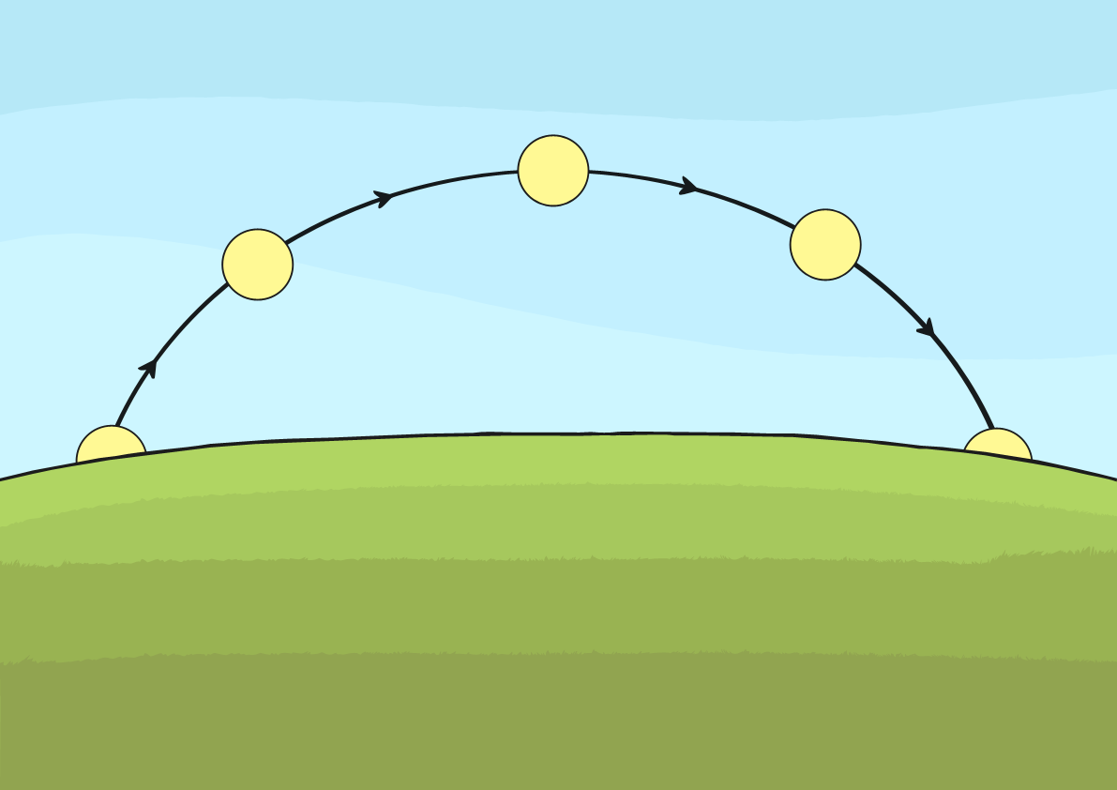
Does the Sun Move?
Have you noticed how shadows change throughout the day?
Why do you think this is?
The Sun stays in the same place in relation to the Earth. It appears to move because of the movements of Earth as it orbits the Sun.
In the morning and late afternoon, shadows are longer. They are shortest at midday as this is when the sun appears to be highest in the sky. This idea of the sun appearing to move during the day is where the traditional stories explaining day and night came from.

Slide 31
When we are outside on a sunny day, we can see how our shadows change throughout the day.
The Sun’s position in the sky affects the length of the shadow.
When the Sun is low on the horizon, the shadows are long.
When the Sun is high in the sky, the shadows are much shorter.
Task: Create a shadow ‘diary’ using an object.
Place an object outside, leave it in the same spot and position, at different points of the day (make sure it is sunny) go outside to check the shadow and use chalk to draw around the shadow. If you don’t have chalk you can observe. What changes happen?

Slide 32
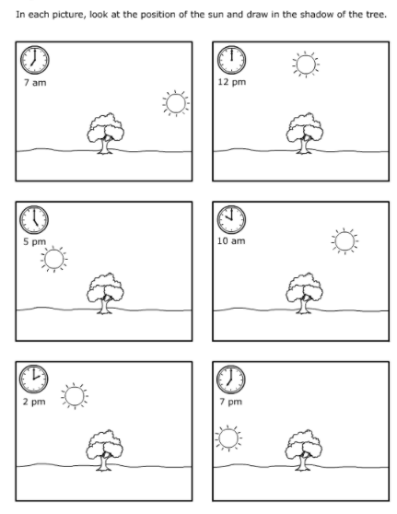
L.O To be able to explain how shadows are formed
Task:
Draw each picture onto a piece of paper if you do not have this sheet.
Look at the position of the sun.
Draw where you think the shadow of the tree would be in relation to the new position of the sun.
Ext: Write a sentence to explain how shadows are formed.

Slide 33
Date: Thursday 4th February:
L.O To be able to order planets from the Sun in French.
Subject: French

Slide 34
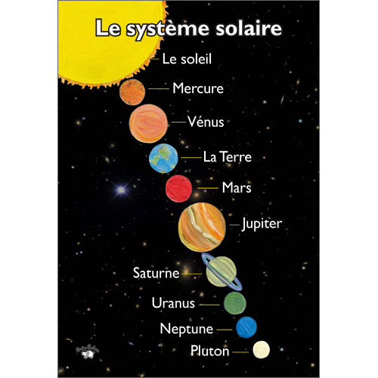
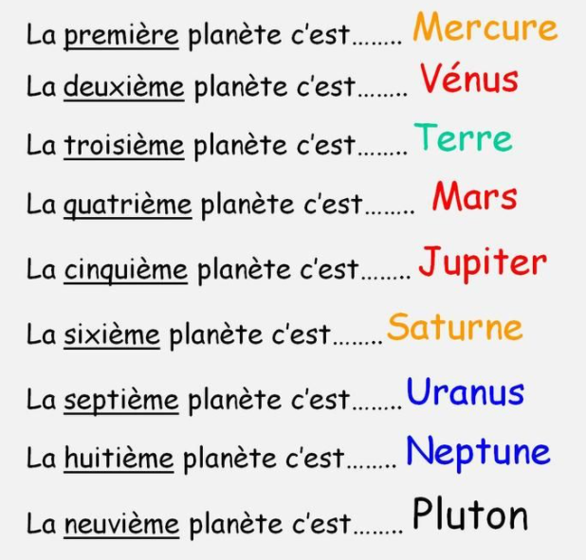
Try saying the French phrases out loud:
Copy and paste the link into a web browser to help with saying the planets in French.
https://www.youtube.com/watch?v=4YArAT9VaUA
What do you notice about the numbers?

Slide 35
Most of the numbers follow a pattern except for number 1.
1
un
1st
première

Slide 36
2
The rest of the numbers follow the pattern by adding ième on the end.
deux
deux
ième
2nd
deuxième

Slide 37
3
trois
3rd
troisième

Slide 38
4
quatre
4th
quatrième

Slide 39
5
cinq
5th
cinquième

Slide 40
6
six
6th
sixième

Slide 41
7
sept
7th
septième

Slide 42
8
huit
8th
huitième

Slide 43
9
neuf
9th
neuvième

Slide 44
10
dix
10th
dixième

Slide 45
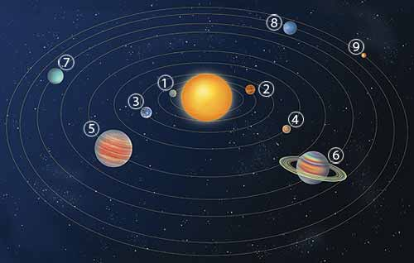
Neptune
Neptune
Uranus
Mercure
La Terre
Vénus
SOLEIL
Mars
Jupiter
Saturne
la Terre Neptune Mars Vénus
Mercure Saturne Jupiter Uranus

Slide 46
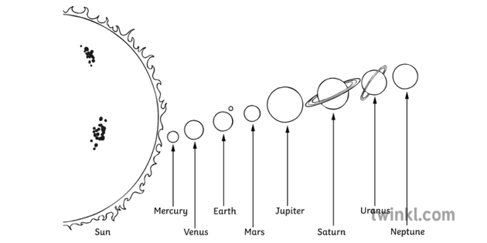
L.O To be able to order planets from the Sun in French.
M V E M J S U N
8th
7th
6th
5th
4th
3rd
Task: Draw the diagram onto a sheet of paper and and label the planets in French.
2nd
1st
Sun

Slide 47
Task: Write out the sentences (onto paper) and fill in the blanks for the position of the planets, or complete onto this page.
Jupiter est la cinquième planète du soleil.
Uranus est la ____________ planète du soleil.
Mars est la ______________ planète du soleil.
Vénus est la _____________ planète du soleil.
Saturne est la ____________ planète du soleil.
Mercure est la ___________ planète du soleil.
La Terre est la ____________ planète du soleil.
Neptune est la ___________ planète du soleil.

Slide 48
Date: Friday 5th February:
L.O To be able to create shadows using sketching techniques.
Subject: Art & Design

Slide 49
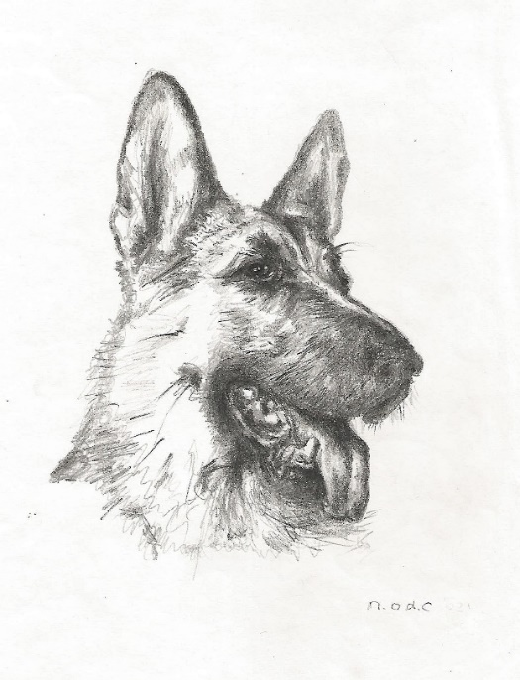
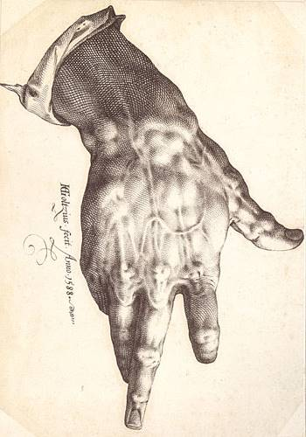
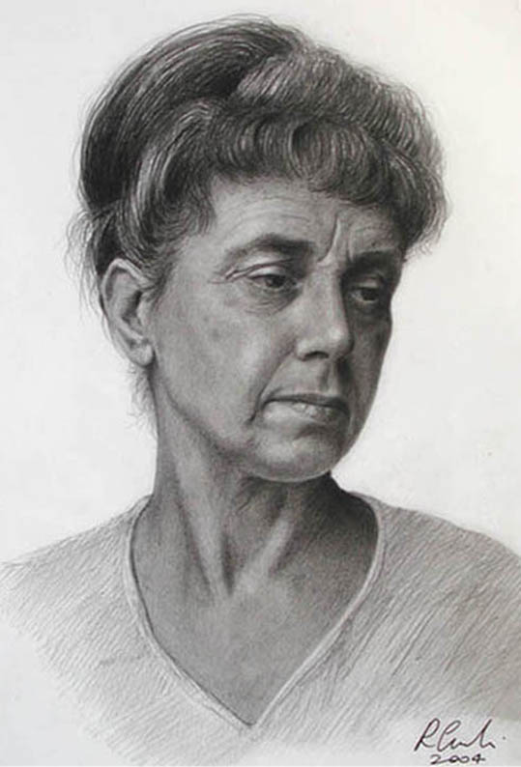
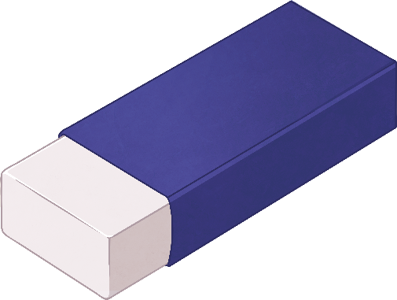
How has the artist made these objects appear 3D?

Slide 50
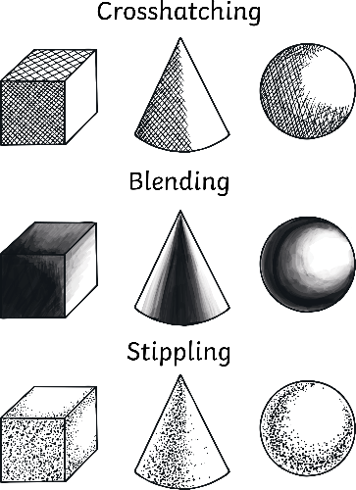
Tonal Shading
You will be experimenting with the following three techniques to create tone:
Cross-hatching
Cross-hatching
Layers of lines are drawn in several directions. The more layers are used, the darker the area becomes.
Blending
Different pressures are used when shading to achieve light, medium and dark tones. Using your finger tip to gently blend and smooth the graphite achieves a smooth blend; a rubber can also be used to blend and add highlights.
Stippling
Layers of dots are built up to give the appearance of light, medium and dark tones within an object or drawing.
Pause for Thought
Why is tone an
important skill to
develop when drawing?

Slide 51
Further Tonal Shading
Now try the further techniques of scumbling and contour-hatching!
Contour-hatching follows the contour, curve or outline of the object you are drawing.
Scumbling, sometimes called controlled scribbling, uses small scribbly loops and curves.
Contour-hatching follows the contour, or curve or outline, of the object. In this case, the hatching is rounded to match the shape of the circle.
Scumbling – tiny, squiggly circular lines – sort of like “controlled scribbling”
Key Terms
Cross-hatching, Blending,
Stippling, Scumbing,
Contour-hatching.
Copy and paste the link below into a web browser and watch the video.
https://www.bbc.co.uk/bitesize/clips/zxyxfg8

Slide 52
If you do not have a paper copy of this task you could copy the images onto a separate piece of paper. Then have a try at copying the techniques (as shown) using a pencil.

Slide 53
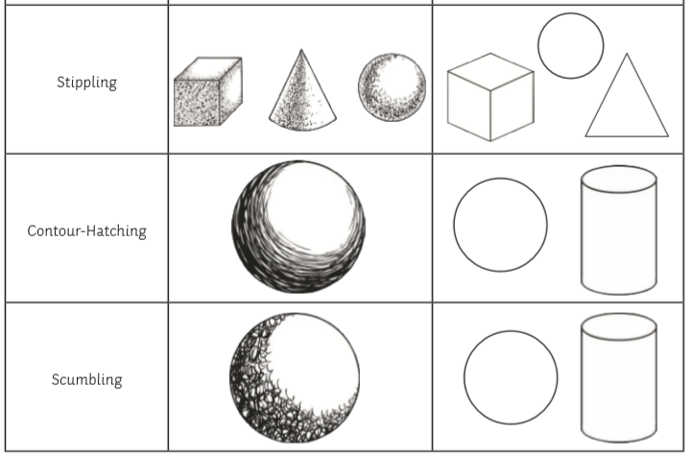

Slide 54
Task 2
Now you have developed some sketching techniques, apply these to creating some fun and interesting shadow art.
The next couple of pages share some different ideas as to how you could do this.
When drawing around the outline of different shadows, try and apply the sketching techniques inside the outlines.

Slide 55
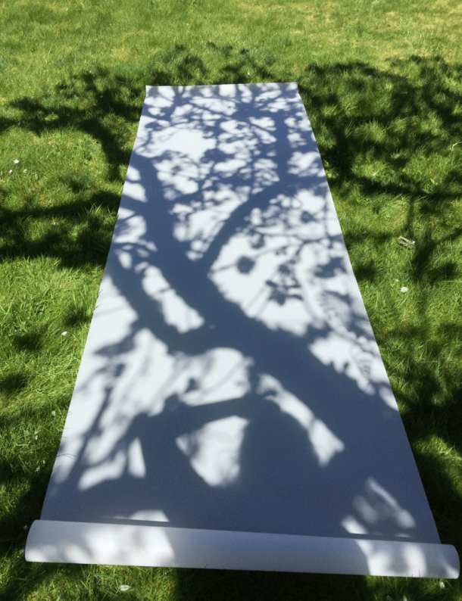
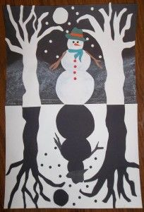
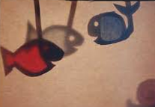
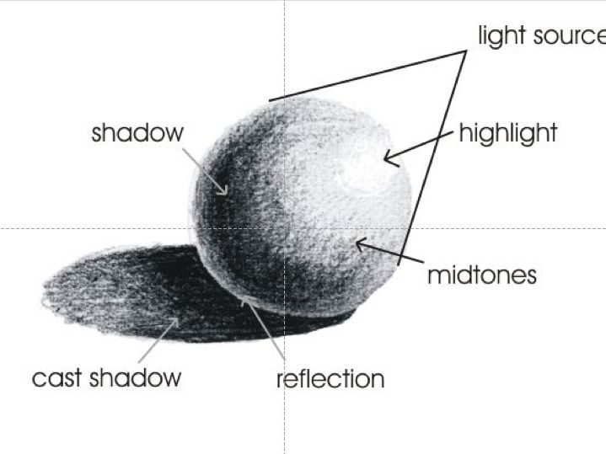
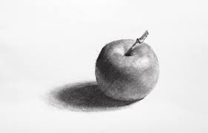
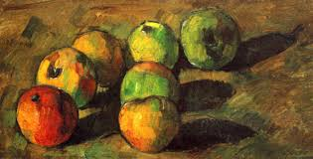
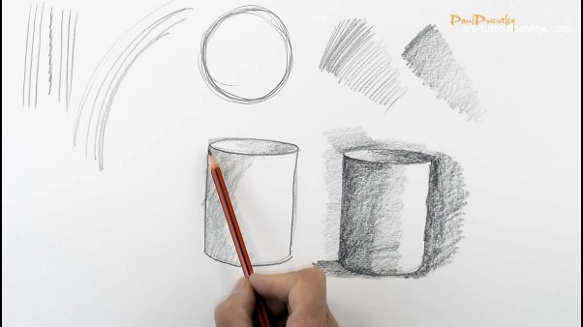
Use some of the ideas provided to create your own shadow art.
If the weather does not allow for this, you could use a light source (such as a torch) to create shadows.
If you don’t have a light source, you could imagine what the shadow would be like- by applying your scientific knowledge or get creative and make it up!
Complete your artwork on paper using pens, pencils, chalks or whatever you have at home.
This task is meant to be enjoyable! Have fun making some interesting shadows! I can’t wait to see them!
You don’t have to complete all the ideas, have a try of a couple of different ones.

