Slide 1
Date: 18.01.2021
LO: To be able to add fractions with different denominators.
Subject: Maths

Slide 2
Times table practise
Spend at least 15mins practising your times tables.
This can be done on TTRS, hit the button or any other times table website.
Copy and paste the following link into a web browser:
https://www.topmarks.co.uk/maths-games/7-11-years/times-tables

Slide 3
Recap
On a piece of paper, compare the fractions given below using the symbols <, > or =.
Use a bar model to help, the first one have been done for you.
$\frac{3}{8}$
$\frac{1}{4}$
$\frac{2}{3}$
$\frac{4}{6}$
$\frac{1}{3}$
$\frac{5}{9}$
$\frac{1}{8}$ | $\frac{1}{8}$ | $\frac{1}{8}$ | $\frac{1}{8}$ | $\frac{1}{8}$ | $\frac{1}{8}$ | $\frac{1}{8}$ | $\frac{1}{8}$
$\frac{1}{4}$ | $\frac{1}{4}$ | $\frac{1}{4}$ | $\frac{1}{4}$
< | Less than
> | Greater than
= | Equal to

Slide 4
Recap
On a piece of paper, compare these fractions.
Use a bar model to help, the first one have been done for you.
$\frac{3}{8}$
$\frac{1}{4}$
$\frac{2}{3}$
$\frac{4}{6}$
$\frac{1}{3}$
$\frac{5}{9}$
>
=
<
$\frac{1}{8}$ | $\frac{1}{8}$ | $\frac{1}{8}$ | $\frac{1}{8}$ | $\frac{1}{8}$ | $\frac{1}{8}$ | $\frac{1}{8}$ | $\frac{1}{8}$
$\frac{1}{3}$ | $\frac{1}{3}$ | $\frac{1}{3}$
$\frac{1}{3}$ | $\frac{1}{3}$ | $\frac{1}{3}$
$\frac{1}{4}$ | $\frac{1}{4}$ | $\frac{1}{4}$ | $\frac{1}{4}$
$\frac{1}{6}$ | $\frac{1}{6}$ | $\frac{1}{6}$ | $\frac{1}{6}$ | $\frac{1}{6}$ | $\frac{1}{6}$
$\frac{1}{9}$ | $\frac{1}{9}$ | $\frac{1}{9}$ | $\frac{1}{9}$ | $\frac{1}{9}$ | $\frac{1}{9}$ | $\frac{1}{9}$ | $\frac{1}{9}$ | $\frac{1}{9}$

Slide 5
Recap
On a piece of paper, complete the following calculations
$\frac{5}{10}+$ $\frac{2}{10}$ =
$\frac{10}{20}+$ $\frac{3}{20}$ =
$\frac{7}{33}+$ $\frac{4}{33}$ =
$\frac{28}{65}+$ $\frac{13}{65}$ =
$\frac{4}{13}+$ $\frac{6}{13}$ =
Remember, when you are adding fractions the denominators must be the same
If the denominator is the same, add the numerators only

Slide 6
Recap
On a piece of paper, complete the following calculations
$\frac{5}{10}+$ $\frac{2}{10}$ = $\frac{7}{10}$
$\frac{10}{20}+$ $\frac{3}{20}$ = $\frac{13}{20}$
$\frac{7}{33}+$ $\frac{4}{33}$ = $\frac{11}{33}$
$\frac{28}{65}+$ $\frac{13}{65}$ = $\frac{41}{65}$
$\frac{4}{13}+$ $\frac{6}{13}$ = $\frac{10}{13}$

Slide 7
$\frac{1}{5}+$ $\frac{1}{10}$ =
Look at this sum
Using a bar model to show $\frac{1}{5}$
$$\frac{1}{5}$$ | $$\frac{1}{5}$$ | $$\frac{1}{5}$$ | $$\frac{1}{5}$$ | $$\frac{1}{5}$$
Using a bar model to show $\frac{1}{10}$
$$\frac{1}{10}$$ | $$\frac{1}{10}$$ | $$\frac{1}{10}$$ | $$\frac{1}{10}$$ | $$\frac{1}{10}$$ | $$\frac{1}{10}$$ | $$\frac{1}{10}$$ | $$\frac{1}{10}$$ | $$\frac{1}{10}$$ | $$\frac{1}{10}$$

Slide 8
Look at this sum
$\frac{1}{5}+$ $\frac{1}{10}$ =
We can see that $\frac{1}{5}$ = $\frac{2}{10}$
$$\frac{1}{5}$$ | $$\frac{1}{5}$$ | $$\frac{1}{5}$$ | $$\frac{1}{5}$$ | $$\frac{1}{5}$$
$$\frac{1}{10}$$ | $$\frac{1}{10}$$ | $$\frac{1}{10}$$ | $$\frac{1}{10}$$ | $$\frac{1}{10}$$ | $$\frac{1}{10}$$ | $$\frac{1}{10}$$ | $$\frac{1}{10}$$ | $$\frac{1}{10}$$ | $$\frac{1}{10}$$
So…
Are the denominators the same?
$\frac{1}{5}+$ $\frac{1}{10}$ = $\frac{2}{10}+$ $\frac{1}{10}$
$\frac{2}{10}+$ $\frac{1}{10}$ = $\frac{3}{10}$
Yes! So now we can add

Slide 9
$\frac{1}{2}+$ $\frac{1}{6}$ =
Look at this sum
Using a bar model to show $\frac{1}{2}$
$$\frac{1}{2}$$ | $$\frac{1}{2}$$
Using a bar model to show $\frac{1}{6}$
$$\frac{1}{6}$$ | $$\frac{1}{6}$$ | $$\frac{1}{6}$$ | $$\frac{1}{6}$$ | $$\frac{1}{6}$$ | $$\frac{1}{6}$$

Slide 10
Look at this sum
$\frac{1}{2}+$ $\frac{1}{6}$ =
Remember to make fractions into their simplest form
We can see that $\frac{1}{2}$ = $\frac{3}{6}$
$$\frac{1}{2}$$ | $$\frac{1}{2}$$
$$\frac{1}{6}$$ | $$\frac{1}{6}$$ | $$\frac{1}{6}$$ | $$\frac{1}{6}$$ | $$\frac{1}{6}$$ | $$\frac{1}{6}$$
So…
Are the denominators the same?
$\frac{1}{2}+$ $\frac{1}{6}$ = $\frac{3}{6}+$ $\frac{1}{6}$
$\frac{3}{6}+$ $\frac{1}{6}$ = $\frac{4}{6}$
$\frac{2}{3}$
Yes! So now we can add
or

Slide 11
$\frac{2}{4}+$ $\frac{1}{8}$ =
Look at this sum
Using a bar model to show $\frac{2}{4}$
$$\frac{1}{4}$$ | $$\frac{1}{4}$$ | $$\frac{1}{4}$$ | $$\frac{1}{4}$$
Using a bar model to show $\frac{1}{8}$
$$\frac{1}{8}$$ | $$\frac{1}{8}$$ | $$\frac{1}{8}$$ | $$\frac{1}{8}$$ | $$\frac{1}{8}$$ | $$\frac{1}{8}$$ | $$\frac{1}{8}$$ | $$\frac{1}{8}$$

Slide 12
Look at this sum
$\frac{2}{4}+$ $\frac{1}{8}$ =
We can see that $\frac{2}{4}$ = $\frac{4}{8}$
$$\frac{1}{4}$$ | $$\frac{1}{4}$$ | $$\frac{1}{4}$$ | $$\frac{1}{4}$$
$$\frac{1}{8}$$ | $$\frac{1}{8}$$ | $$\frac{1}{8}$$ | $$\frac{1}{8}$$ | $$\frac{1}{8}$$ | $$\frac{1}{8}$$ | $$\frac{1}{8}$$ | $$\frac{1}{8}$$
So…
Are the denominators the same?
$\frac{2}{4}+$ $\frac{1}{8}$ = $\frac{4}{8}+$ $\frac{1}{8}$
$\frac{4}{8}+$ $\frac{1}{8}$ = $\frac{5}{8}$
Yes! So now we can add

Slide 13
Example:
The rules for adding fractions…
When adding fractions, the denominators MUST be the same.
Work out what you need to multiply the smaller denominator by to get the bigger denominator.
Whatever you do to the bottom you must do to the top!
Multiply BOTH the numerator and the denominator of the first fraction, by this number
Now add the new fraction created to the other fraction. You can do this because the denominators are now the same.
$\frac{5}{6}+$ $\frac{1}{12}$ =
Is 6 a factor of 12? Yes
What do you do to 6 to make 12? x2
x2
$\frac{5}{6}=$ $\frac{10}{12}$
x2
$\frac{5}{6}+$ $\frac{1}{12}$ = $\frac{10}{12}+$ $\frac{1}{12}$ = $\frac{11}{12}$

Slide 14
Look at this sum
$\frac{1}{5}+$ $\frac{1}{10}$ =
$$\frac{1}{5}$$ | $$\frac{1}{5}$$ | $$\frac{1}{5}$$ | $$\frac{1}{5}$$ | $$\frac{1}{5}$$
$$\frac{1}{10}$$ | $$\frac{1}{10}$$ | $$\frac{1}{10}$$ | $$\frac{1}{10}$$ | $$\frac{1}{10}$$ | $$\frac{1}{10}$$ | $$\frac{1}{10}$$ | $$\frac{1}{10}$$ | $$\frac{1}{10}$$ | $$\frac{1}{10}$$
Without using the bar model, we can think…
We must make the denominators the same.
Which fraction has a smaller denominator? $\frac{1}{5}$
Is 5 a factor of 10? Yes
What do we do to 5 to get 10? x2
Now we need to multiply the numerator and denominator by 2.
Now we can add the fractions because the denominators are the same.
x2
$\frac{1}{5}=$ $\frac{2}{10}$
$\frac{2}{10}+$ $\frac{1}{10}$ = $\frac{3}{10}$
x2

Slide 15
Look at this sum
$\frac{2}{4}+$ $\frac{1}{8}$ =
$$\frac{1}{4}$$ | $$\frac{1}{4}$$ | $$\frac{1}{4}$$ | $$\frac{1}{4}$$
$$\frac{1}{8}$$ | $$\frac{1}{8}$$ | $$\frac{1}{8}$$ | $$\frac{1}{8}$$ | $$\frac{1}{8}$$ | $$\frac{1}{8}$$ | $$\frac{1}{8}$$ | $$\frac{1}{8}$$
Without using the bar model, we can think…
We must make the denominators the same.
Which fraction has a smaller denominator? $\frac{2}{4}$
Is 4 a factor of 8? Yes
What do we do to 4 to get 8? x2
Now we need to multiply the numerator and denominator by 2.
Now we can add the fractions because the denominators are the same.
x2
$\frac{2}{4}=$ $\frac{4}{8}$
$\frac{4}{8}+$ $\frac{1}{8}$ = $\frac{5}{8}$
x2

Slide 16
Now try and work out these examples on your own
$\frac{1}{4}+$ $\frac{1}{12}$ =
$\frac{2}{7}+$ $\frac{4}{21}$ =
$\frac{1}{3}+$ $\frac{5}{18}$ =
$\frac{3}{10}+$ $\frac{1}{40}$ =
Remember to think…
We must make the denominators the same.
Which fraction has a smaller denominator?
Is the smaller denominator a factor of the bigger?
What do we do to smaller denominator to get to the bigger?
Now we need to multiply the numerator and denominator.
Now we can add the fractions because the denominators are the same.

Slide 17
Now try and work out these examples on your own
$\frac{1}{4}+$ $\frac{1}{12}$ = $\frac{4}{12}$
$\frac{2}{7}+$ $\frac{4}{21}$ = $\frac{10}{21}$
$\frac{1}{3}+$ $\frac{5}{18}$ = $\frac{11}{18}$
$\frac{3}{10}+$ $\frac{1}{40}$ = $\frac{13}{40}$
$$\frac{1}{3}$$
or
Remember to make fractions into their simplest form
Remember to think…
We must make the denominators the same.
Which fraction has a smaller denominator?
Is the smaller denominator a factor of the bigger?
What do we do to smaller denominator to get to the bigger?
Now we need to multiply the numerator and denominator.
Now we can add the fractions because the denominators are the same.

Slide 18
What if the smaller denominator is not a factor of the bigger?
Example:
$\frac{1}{2}+$ $\frac{2}{5}$ =
We need to find a common multiple between the denominators.
Write out the timetables for the denominators until we spot a common multiple.
Now we need to multiply the fractions to make the denominators the same.
Now we can add the fractions together because the denominators are the same.
2.
1x2= 2
2x2= 4
2x3= 6
2x4= 8
2x5= 10
1x5= 5
2x5=10
x5
x2
3.
$\frac{1}{2}=$ $\frac{5}{10}$
$\frac{2}{5}=$ $\frac{4}{10}$
x5
x2
4.
$\frac{1}{2}+$ $\frac{2}{5}$ = $\frac{5}{10}+$ $\frac{4}{10}$ = $\frac{9}{10}$

Slide 19
What if the smaller denominator is not a factor of the bigger?
1.
2.
3.
x5
x2
4.
1x2= 2
2x2= 4
2x3= 6
2x4= 8
2x5= 10
1x5= 5
2x5=10
$\frac{1}{2}=$ $\frac{5}{10}$
$\frac{2}{5}=$ $\frac{4}{10}$
$\frac{5}{10}+$ $\frac{4}{10}$ = $\frac{9}{10}$
$\frac{1}{2}+$ $\frac{2}{5}$ =
x5
x2
We need to find a common multiple between 2 and 5.
Write out the 2 and 5 timetables until we spot a common multiple. 10 is the common multiple so 10 will be the denominator for both fractions.
Now we need to multiply the fractions to make the denominators 10. Remember, whatever we do to the denominator we need to do the same to the numerator.
Now we can add the fractions together because the denominators are the same.

Slide 20
Try this one on your own
$\frac{1}{3}+$ $\frac{2}{7}$ =
We need to find a common multiple between 3 and 7.
Write out the 3 and 7 timetables until we spot a common multiple.
Now we need to multiply the fractions to make the denominators the same.
Now we can add the fractions together because the denominators are the same.

Slide 21
Answer
$\frac{1}{3}+$ $\frac{2}{7}$ = $\frac{13}{21}$
1x3= 3
2x3= 6
3x3= 9
4x3=12
5x3=15
6x3=18
7x3=21
1x7= 7
2x7=14
3x7=21
x7
x3
$\frac{1}{3}$
$\frac{7}{21}$
$\frac{2}{7}$
$\frac{6}{21}$
$\frac{7}{21}$
$\frac{6}{21}$
$\frac{13}{21}$
=
=
+
=
x7
x3
We need to find a common multiple between 3 and 7.
Write out the 3 and 7 timetables until we spot a common multiple.
Now we need to multiply the fractions to make the denominators the same.
Now we can add the fractions together because the denominators are the same.

Slide 22
Another way you can find a common multiple is to multiply both dominators together
$\frac{1}{3}+$ $\frac{2}{7}$ =
3x7 = 21
x7
x3
$\frac{1}{3}$
$\frac{7}{21}$
$\frac{2}{7}$
$\frac{6}{21}$
=
=
x7
x3
$\frac{7}{21}$
$\frac{6}{21}$
$\frac{13}{21}$
+
=

Slide 23
Another way you can find a common multiple is to multiply both dominators together
3x7 = 21
However, this might give you a big number.
Therefore, finding a common multiple through timetables is sometimes easier.
e.g.
x7
x3
$\frac{1}{3}$
$\frac{7}{21}$
$\frac{2}{7}$
$\frac{6}{21}$
=
$\frac{1}{6}+$ $\frac{1}{8}$
=
1x6= 6
2x6=12
3x6=18
4x6=24
1x8=8
2x8=16
3x8=24
6x8= 48
x7
x3
x4
x3
$\frac{1}{6}$
=
$\frac{4}{24}$
$\frac{1}{8}$
$\frac{3}{24}$
$\frac{4}{24}$
+
$\frac{3}{24}$
=
$\frac{7}{24}$
=
$\frac{7}{21}$
$\frac{6}{21}$
$\frac{13}{21}$
x4
+
x3
=

Slide 24
Now try and work out these examples on your own
$\frac{1}{6}+$ $\frac{1}{5}$ =
$\frac{2}{9}+$ $\frac{1}{7}$ =
$\frac{1}{4}+$ $\frac{2}{3}$ =
We need to find a common multiple between the denominators.
Write out the timetables for the denominators until we spot a common multiple.
Now we need to multiply the fractions to make the denominators the same.
Now we can add the fractions together because the denominators are the same.

Slide 25
Now try and work out these examples on your own
$\frac{1}{6}+$ $\frac{1}{5}$ = $\frac{11}{30}$
$\frac{2}{9}+$ $\frac{1}{7}$ = $\frac{23}{63}$
$\frac{1}{4}+$ $\frac{2}{3}$ = $\frac{11}{12}$
We need to find a common multiple between the denominators.
Write out the timetables for the denominators until we spot a common multiple.
Now we need to multiply the fractions to make the denominators the same.
Now we can add the fractions together because the denominators are the same.

Slide 26
End of Lesson

Slide 27
Date: 19.01.2021
LO: To be able to subtract fractions with different denominators.
Subject: Maths

Slide 28
Times table practise
Spend at least 15mins practising your times tables.
This can be done on TTRS, hit the button or any other times table website.
Copy and paste the following link into a web browser:
https://www.topmarks.co.uk/maths-games/7-11-years/times-tables

Slide 29
Recap
On a piece of paper, use your knowledge from yesterday to subtract these fractions.
$\frac{3}{8}$
$\frac{1}{4}$
$\frac{5}{8}$
-
=
$\frac{2}{3}$
$\frac{4}{6}$
$\frac{8}{6}$
-
=
$\frac{1}{3}$
$\frac{5}{9}$
$\frac{8}{9}$
-
=

Slide 30
Recap
On a piece of paper, use your knowledge from yesterday to subtract these fractions.
$\frac{3}{8}$
$\frac{1}{4}$
-
$\frac{2}{3}$
$\frac{4}{6}$
-
$\frac{1}{3}$
$\frac{5}{9}$
-

Slide 31
$\frac{2}{5}$ - $\frac{3}{10}$ =
Look at this calculation
Using a bar model to show $\frac{1}{5}$
$$\frac{1}{5}$$ | $$\frac{1}{5}$$ | $$\frac{1}{5}$$ | $$\frac{1}{5}$$ | $$\frac{1}{5}$$
Using a bar model to show $\frac{1}{10}$
$$\frac{1}{10}$$ | $$\frac{1}{10}$$ | $$\frac{1}{10}$$ | $$\frac{1}{10}$$ | $$\frac{1}{10}$$ | $$\frac{1}{10}$$ | $$\frac{1}{10}$$ | $$\frac{1}{10}$$ | $$\frac{1}{10}$$ | $$\frac{1}{10}$$

Slide 32
$\frac{2}{5}$ - $\frac{3}{10}$ =
Look at this calculation
We can see that $\frac{2}{5}$ = $\frac{4}{10}$
$$\frac{1}{5}$$ | $$\frac{1}{5}$$ | $$\frac{1}{5}$$ | $$\frac{1}{5}$$ | $$\frac{1}{5}$$
$$\frac{1}{10}$$ | $$\frac{1}{10}$$ | $$\frac{1}{10}$$ | $$\frac{1}{10}$$ | $$\frac{1}{10}$$ | $$\frac{1}{10}$$ | $$\frac{1}{10}$$ | $$\frac{1}{10}$$ | $$\frac{1}{10}$$ | $$\frac{1}{10}$$
So…
Are the denominators the same?
$\frac{2}{5}−$ $\frac{3}{10}$ = $\frac{4}{10} −$ $\frac{3}{10}$
$\frac{4}{10}−$ $\frac{3}{10}$ = $\frac{1}{10}$
Yes! So now we can subtract

Slide 33
$\frac{1}{2}−$ $\frac{2}{6}$ =
Look at this calculation
Using a bar model to show $\frac{1}{2}$
$$\frac{1}{2}$$ | $$\frac{1}{2}$$
Using a bar model to show $\frac{1}{6}$
$$\frac{1}{6}$$ | $$\frac{1}{6}$$ | $$\frac{1}{6}$$ | $$\frac{1}{6}$$ | $$\frac{1}{6}$$ | $$\frac{1}{6}$$

Slide 34
Look at this calculation
$\frac{1}{2}−$ $\frac{2}{6}$ =
We can see that $\frac{1}{2}$ = $\frac{3}{6}$
$$\frac{1}{2}$$ | $$\frac{1}{2}$$
$$\frac{1}{6}$$ | $$\frac{1}{6}$$ | $$\frac{1}{6}$$ | $$\frac{1}{6}$$ | $$\frac{1}{6}$$ | $$\frac{1}{6}$$
So…
Are the denominators the same?
$\frac{1}{2}−$ $\frac{2}{6}$ = $\frac{3}{6}−$ $\frac{2}{6}$
$\frac{3}{6}−$ $\frac{2}{6}$ = $\frac{1}{6}$
Yes! So now we can subtract

Slide 35
$\frac{3}{4}−$ $\frac{3}{8}$ =
Look at this calculation
Using a bar model to show $\frac{2}{4}$
$$\frac{1}{4}$$ | $$\frac{1}{4}$$ | $$\frac{1}{4}$$ | $$\frac{1}{4}$$
Using a bar model to show $\frac{1}{8}$
$$\frac{1}{8}$$ | $$\frac{1}{8}$$ | $$\frac{1}{8}$$ | $$\frac{1}{8}$$ | $$\frac{1}{8}$$ | $$\frac{1}{8}$$ | $$\frac{1}{8}$$ | $$\frac{1}{8}$$

Slide 36
Look at this calculation
$\frac{3}{4}−$ $\frac{3}{8}$ =
We can see that $\frac{3}{4}$ = $\frac{6}{8}$
$$\frac{1}{4}$$ | $$\frac{1}{4}$$ | $$\frac{1}{4}$$ | $$\frac{1}{4}$$
$$\frac{1}{8}$$ | $$\frac{1}{8}$$ | $$\frac{1}{8}$$ | $$\frac{1}{8}$$ | $$\frac{1}{8}$$ | $$\frac{1}{8}$$ | $$\frac{1}{8}$$ | $$\frac{1}{8}$$
So…
Are the denominators the same?
$\frac{3}{4}−$ $\frac{3}{8}$ = $\frac{6}{8}−$ $\frac{3}{8}$
$\frac{6}{8}−$ $\frac{3}{8}$ = $\frac{3}{8}$
Yes! So now we can subtract

Slide 37
The rules for subtracting fractions
When subtracting fractions, the denominators MUST be the same.
Work out what you need to multiply the smaller denominator by to get the bigger denominator.
Whatever you do to the bottom you must do to the top! Multiply BOTH the numerator and the denominator by this number
Now subtract using the new fraction. You can do this because the denominators are now the same.
Example:
$\frac{5}{6}−$ $\frac{1}{12}$ =
Is 6 a factor of 12? Yes
What do you do to 6 to make 12? x2
x2
$\frac{5}{6}=$ $\frac{10}{12}$
x2
$\frac{5}{6}−$ $\frac{1}{12}$ = $\frac{10}{12}−$ $\frac{1}{12}$ = $\frac{9}{12}$

Slide 38
Look at this calculation
$\frac{3}{5}−$ $\frac{2}{10}$ =
$$\frac{1}{5}$$ | $$\frac{1}{5}$$ | $$\frac{1}{5}$$ | $$\frac{1}{5}$$ | $$\frac{1}{5}$$
$$\frac{1}{10}$$ | $$\frac{1}{10}$$ | $$\frac{1}{10}$$ | $$\frac{1}{10}$$ | $$\frac{1}{10}$$ | $$\frac{1}{10}$$ | $$\frac{1}{10}$$ | $$\frac{1}{10}$$ | $$\frac{1}{10}$$ | $$\frac{1}{10}$$
Let’s think…
We must make the denominators the same.
Which fraction has a smaller denominator? $\frac{3}{5}$
Is 5 a factor of 10? Yes
What do we do to 5 to get 10? x2
Now we need to multiply the numerator and denominator by 2.
Now we can subtract the fractions because the denominators are the same.
x2
$\frac{3}{5}=$ $\frac{6}{10}$
$\frac{6}{10}−$ $\frac{2}{10}$ = $\frac{4}{10}$
x2

Slide 39
Now try and work out these examples on your own
$\frac{1}{4}−$ $\frac{1}{12}$ =
$\frac{2}{7}−$ $\frac{4}{21}$ =
$\frac{2}{3}−$ $\frac{5}{18}$ =
$\frac{3}{10}−$ $\frac{1}{40}$ =
Remember to think…
We must make the denominators the same.
Which fraction has a smaller denominator?
Is the smaller denominator a factor of the bigger?
What do we do to smaller denominator to get to the bigger?
Now we need to multiply the numerator and denominator.
Now we can subtract the fractions because the denominators are the same.

Slide 40
Answers
$\frac{1}{4}−$ $\frac{1}{12}$ =
$\frac{2}{7}−$ $\frac{4}{21}$ =
$\frac{2}{3}−$ $\frac{5}{18}$ =
$\frac{3}{10}−$ $\frac{1}{40}$ =
$\frac{3}{12}−$ $\frac{1}{12}$ = $\frac{2}{12}$
$\frac{6}{21}−$ $\frac{4}{21}$ = $\frac{2}{21}$
$\frac{12}{18}−$ $\frac{5}{18}$ = $\frac{7}{18}$
$\frac{12}{40}−$ $\frac{1}{40}$ = $\frac{11}{40}$

Slide 41
What if the smaller denominator is not a factor of the bigger?
Example:
$\frac{1}{2}−$ $\frac{1}{5}$ =
We need to find a common multiple between the denominators.
Write out the timetables for the denominators until we spot a common multiple.
Now we need to multiply the fractions to make the denominators the same.
Now we can subtract the fractions together because the denominators are the same.
2.
1x2= 2
2x2= 4
2x3= 6
2x4= 8
2x5= 10
1x5= 5
2x5=10
x5
x2
3.
$\frac{1}{2}=$ $\frac{5}{10}$
$\frac{1}{5}=$ $\frac{2}{10}$
x5
x2
4.
$\frac{1}{2}−$ $\frac{1}{5}$ = $\frac{5}{10}−$ $\frac{2}{10}$ = $\frac{3}{10}$

Slide 42
What if the smaller denominator is not a factor of the bigger?
1.
2.
3.
x5
x2
4.
1x2= 2
2x2= 4
2x3= 6
2x4= 8
2x5= 10
1x5= 5
2x5=10
$\frac{1}{2}=$ $\frac{5}{10}$
$\frac{1}{5}=$ $\frac{2}{10}$
$\frac{5}{10}−$ $\frac{2}{10}$ = $\frac{3}{10}$
$\frac{1}{2}−$ $\frac{1}{5}$ =
x5
x2
We need to find a common multiple between 2 and 5.
Write out the 2 and 5 timetables until we spot a common multiple. 10 is the common multiple so 10 will be the denominator for both fractions.
Now we need to multiply the fractions to make the denominators 10. Remember, whatever we do to the denominator we need to do the same to the numerator.
Now we can subtract the fractions together because the denominators are the same.

Slide 43
Try this one on your own
$\frac{1}{3}−$ $\frac{2}{7}$ =
We need to find a common multiple between 3 and 7.
Write out the 3 and 7 timetables until we spot a common multiple.
Now we need to multiply the fractions to make the denominators the same.
Now we can subtract the fractions because the denominators are the same.

Slide 44
Answer
$\frac{1}{3}−$ $\frac{2}{7}$ = $\frac{1}{21}$
1x3= 3
2x3= 6
3x3= 9
4x3=12
5x3=15
6x3=18
7x3=21
1x7= 7
2x7=14
3x7=21
x7
x3
$\frac{1}{3}$
$\frac{7}{21}$
$\frac{2}{7}$
$\frac{6}{21}$
$\frac{7}{21}$
$\frac{6}{21}$
$\frac{1}{21}$
=
=
-
=
x7
x3
We need to find a common multiple between 3 and 7.
Write out the 3 and 7 timetables until we spot a common multiple.
Now we need to multiply the fractions to make the denominators the same.
Now we can subtract the fractions because the denominators are the same.

Slide 45
Another way you can find a common multiple is to multiply both dominators together
$\frac{1}{3}−$ $\frac{2}{7}$ =
3x7 = 21
x7
x3
$\frac{1}{3}$
$\frac{7}{21}$
$\frac{2}{7}$
$\frac{6}{21}$
=
=
x7
x3
$\frac{7}{21}$
$\frac{6}{21}$
$\frac{1}{21}$
-
=

Slide 46
Another way you can find a common multiple is to multiply both dominators together
3x7 = 21
However, this might give you a big number.
Therefore, finding a common multiple through timetables is sometimes easier.
e.g.
x7
x3
$\frac{1}{3}$
$\frac{7}{21}$
$\frac{2}{7}$
$\frac{6}{21}$
=
$\frac{1}{6}−$ $\frac{1}{8}$
=
1x6= 6
2x6=12
3x6=18
4x6=24
1x8=8
2x8=16
3x8=24
6x8= 48
x7
x3
x4
x3
$\frac{1}{6}$
=
$\frac{4}{24}$
$\frac{1}{8}$
$\frac{3}{24}$
$\frac{4}{24}$
-
$\frac{3}{24}$
=
$\frac{1}{24}$
=
$\frac{7}{21}$
$\frac{6}{21}$
$\frac{13}{21}$
x4
-
x3
=

Slide 47
Now try and work out these examples on your own
$\frac{3}{5}−$ $\frac{2}{6}$ =
$\frac{5}{9}−$ $\frac{3}{7}$ =
$\frac{3}{4}−$ $\frac{2}{3}$ =
We need to find a common multiple between the denominators.
Write out the timetables for the denominators until we spot a common multiple.
Now we need to multiply the fractions to make the denominators the same.
Now we can subtract the fractions because the denominators are the same.

Slide 48
Now try and work out these examples on your own
$\frac{3}{5}−$ $\frac{2}{6}$ =
$\frac{5}{9}−$ $\frac{3}{7}$ =
$\frac{3}{4}−$ $\frac{2}{3}$ =
$\frac{18}{30}−$ $\frac{10}{30}$ = $\frac{8}{30}$
$\frac{35}{63}−$ $\frac{27}{63}$ = $\frac{8}{63}$
$\frac{9}{12}−$ $\frac{8}{12}$ = $\frac{1}{12}$
We need to find a common multiple between the denominators.
Write out the timetables for the denominators until we spot a common multiple.
Now we need to multiply the fractions to make the denominators the same.
Now we can subtract the fractions because the denominators are the same.

Slide 49
End of Lesson

Slide 50
Date: 20.01.21
L.O: To be able to identify properties of 3D shapes
Subject: Maths

Slide 51
Times table practise
Spend at least 15mins practising your times tables.
This can be done on TTRS, hit the button or any other times table website.
Copy and paste the following link into a web browser:
https://www.topmarks.co.uk/maths-games/7-11-years/times-tables

Slide 52
Mental Starter: Identify the prime numbers
Remember:
Prime numbers are special numbers, greater than 1, that have exactly two factors, themselves and 1.
19 is a prime number. It can only be divided by 1 and 19.
9 is not a prime number. It can be divided by 3 as well as 1 and 9.
Task: Write down or highlight the prime numbers on/ from the 100 square.

Slide 53
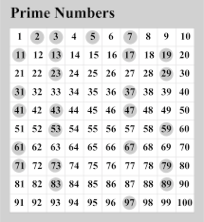
Check your answers.
Look over any numbers you might have missed out or wrote down incorrectly.

Slide 54
Properties of 3D shapes include; faces, edges and vertices.
A face is a flat or curved surface on a 3D shape.
An edge is where two faces meet.
A vertex is a corner where edges meet. The plural is vertices.

Slide 55
Properties of 3D shapes include; faces, edges and vertices.
A face is a flat or curved surface on a 3D shape.
An edge is where two faces meet.
A vertex is a corner where edges meet. The plural is vertices.
?
?
?
?
?
?
?
?
?
?
?
?
?
?
?
?
?
?
?
?
?
?
?
?

Slide 56
A face is a flat or curved surface on a 3D shape.
An edge is where two faces meet.
A vertex is a corner where edges meet. The plural is vertices.
Task 1:
Take a look at the 3D shapes.
Beginning with the cone, can you work out how many faces, edges and vertices each shape has?
Record your answers in a list or use the table on the next slide.
1
2
3
4
?
?
?
?
?
?
?
?
?
?
?
?
5
6
7
8
?
?
?
?
?
?
?
?
?
?
?
?

Slide 57
Shape | Faces | Edges | Vertices
Cone
Sphere
Tetrahedron
Cuboid
Cylinder
Cube
Triangular Prism
Square-based Pyramid

Slide 58
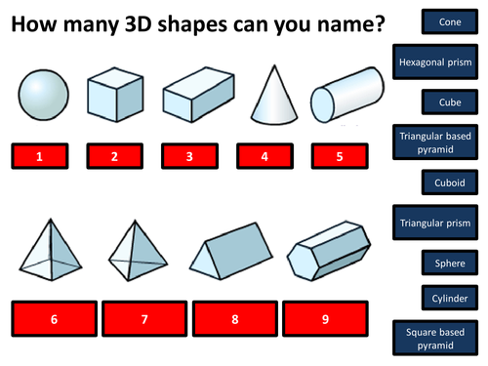
Task 2:
Match the name to the shapes.
You can write them under the shape
or
Write the shape number then the name of the shape.

Slide 59
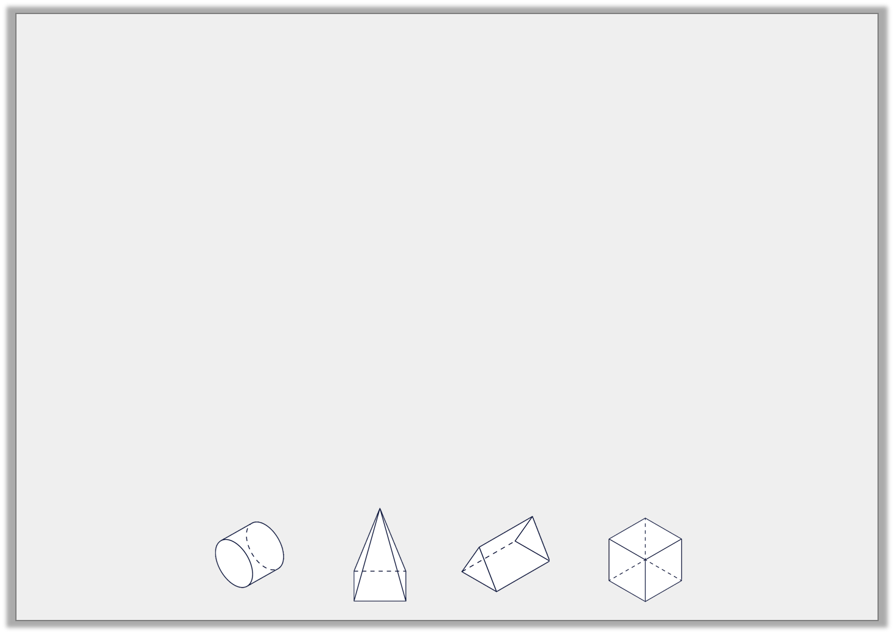
Complete the chart using your knowledge of 3D shapes.
Extension:
Complete the table.
Name | Image | Properties
 |  | 6 faces, 12 edges and 8 vertices
Cylinder
 |  | 5 faces, 9 edges and 6 vertices
1.
2.
3.
4.
3.
4.
1.
2.

Slide 60
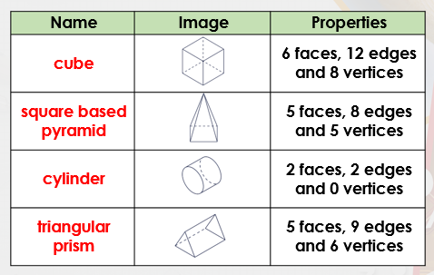
Answers:
4
9
2
7
3
8
1
5
6
Did you correctly match the shapes?
If so, well done!
If you didn’t, can you recap the shapes to ensure you know each name.

Slide 61
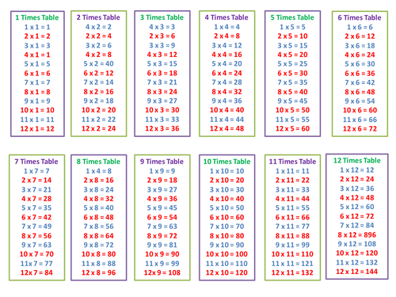
Times table practise
Now you have finished your written job, please spend at least 15mins practising your times tables.
This can be done on TTRS, hit the button or any other times table website.
Copy and paste the following link into a web browser:
https://www.topmarks.co.uk/maths-games/7-11-years/times-tables
Alternatively, you can use the help sheet to support you.

Slide 62
End of Lesson

Slide 63
Date: 21.01.21
L.O: To be able to identify 3D shapes using 2D representations
Subject: Maths

Slide 64
Times table practise
Spend at least 15mins practising your times tables.
This can be done on TTRS, hit the button or any other times table website.
Copy and paste the following link into a web browser:
https://www.topmarks.co.uk/maths-games/7-11-years/times-tables

Slide 65
Mental Starter: Squared numbers
Remember: A square number is a number multiplied by itself. This can also be called 'a number squared'. The symbol for squared is ².
2² = 2 x 2 = 4
3² = 3 x 3 = 9
Write down the answers to these numbers when squared.
4²
5²
6²
7²
8²

Slide 66
Answers:
Write down the answers to these numbers when squared.
4 x 4 = 16
5 x 5 = 25
6 x 6 = 36
7 x 7 = 49
8 x 8 = 64
Did you get the questions correct?
If so, well done!
If you didn’t, can you find your mistake and see how you went wrong?
Re-try the question.

Slide 67
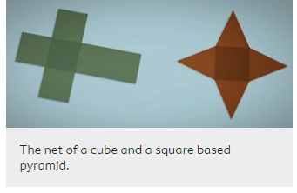
Nets of shapes
The net of a 3D shape is what it looks like if it is opened out flat. A net can be folded up to make a 3D shape.
There may be several possible nets for one 3D shape.
Copy and paste the link below into a web browser page. Watch the video to find out more about nets of shapes.
https://www.bbc.co.uk/bitesize/topics/zt7xk2p/articles/z247tv4

Slide 69
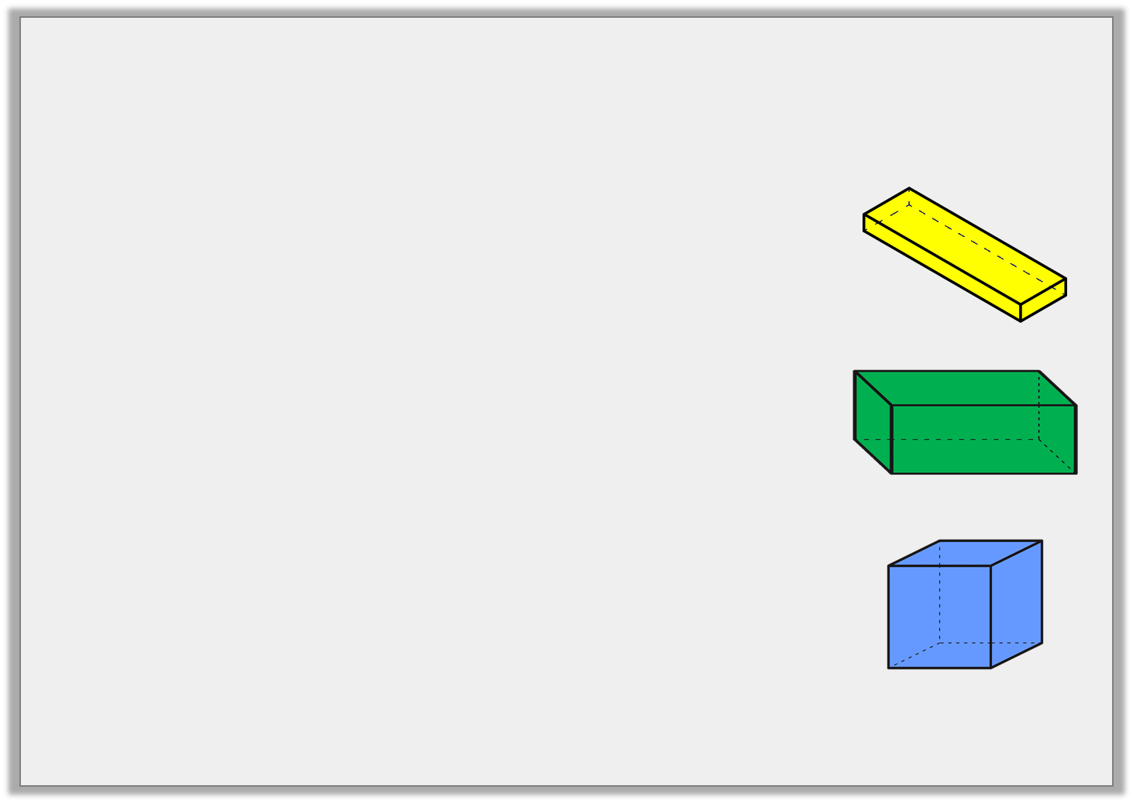
Try this:
Match the net to the correct 3D shape.

Slide 70
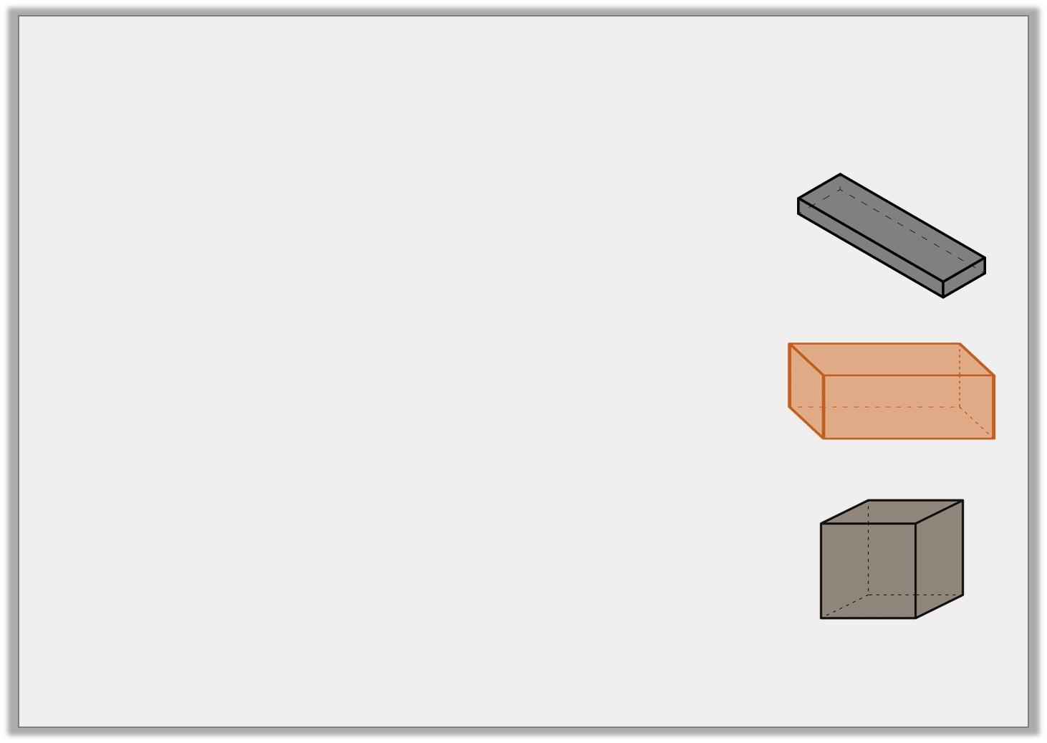
Answer:
Match the net to the correct 3D shape.

Slide 71
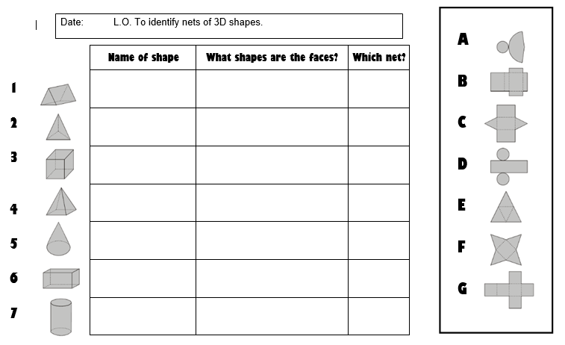
Task 1: Match the nets to the shapes. You can write on the sheet or write the number of the shapes with the number of the matching net. Extension: Write the name of the 3D shape and the 2D shape of each face.
You could have a try at making the different nets to create the 3D shapes.

Slide 72
Answers:
Did you get the questions correct?
If so, well done!
If you didn’t, can you find your mistake and see how you went wrong?
Re-try the question.
Triangular prism Triangles, rectangles C
Triangle based Triangles E
Pyramid
Cube Squares G
Square based Squares, triangles F
Pyramid
Cone Circle, semi- circle A
Cuboid Squares, rectangle B
Cylinder Circles, rectangle D

Slide 73
Task 2:
Put a tick on the square which is trhe base of this open topped cube.

Slide 74
Task 2:
Answer

Slide 75
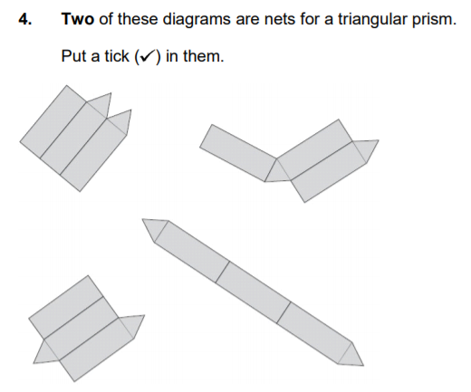
Task 3:
Either, put a tick in the nets which would make a triangular prism
Or
Write the numbers of the nets which make a triangular prism
1.
2.
3.
3.

Slide 76
Task 3:
Answers
1.
2.
√
3.
3.
√

Slide 77
Extension:

Slide 78
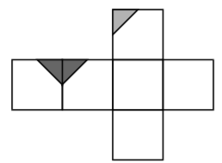
Extension:
Answer

Slide 79
Times table practise
Now you have finished your written job, please spend at least 15mins practising your times tables.
This can be done on TTRS, hit the button or any other times table website.
Copy and paste the following link into a web browser:
https://www.topmarks.co.uk/maths-games/7-11-years/times-tables
Alternatively, you can use the help sheet to support you.

Slide 80
End of Lesson

Slide 81
Date: 22.01.21
L.O: To be able to reason about 3D shapes.
Subject: Maths

Slide 82
Times table practise
Spend at least 15mins practising your times tables.
This can be done on TTRS, hit the button or any other times table website.
Copy and paste the following link into a web browser:
https://www.topmarks.co.uk/maths-games/7-11-years/times-tables

Slide 83
22.01.21 Mental Starter: Cubed numbers
A cube number is a number multiplied by itself 3 times. This can also be called 'a number cubed'. The symbol for cubed is ³.
Eg. 2³ = 2 × 2 (=4) × 2 = 8
Try these:
3³ = 3x 3 =____ then x 3=
4³
5³

Slide 84
Answers:
Did you get the questions correct?
If so, well done!
If you didn’t, can you find your mistake and see how you went wrong?
Re-try the question.
3³ = 3 x 3 = 9 x 3 = 27
4³ = 4 x 4 = 16 x 4 = 64
5³ = 5 x 5 = 25 x 5 = 125

Slide 85
Recap:
True or False?
One or more the nets will make a closed cube?

Slide 86
Answers
True or False?
False, none of the nets make a closed cube

Slide 87
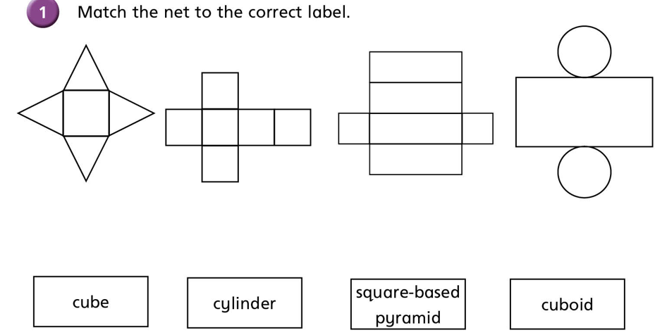
Recap:
Match the net to the name of the 3D shape

Slide 88
Answers
Match the net to the name of the 3D shape

Slide 89
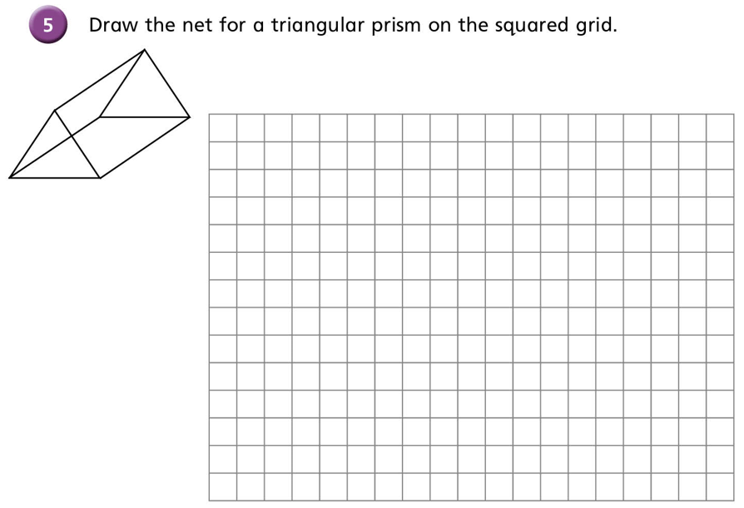
Task 1:
Using the drawing tool on this powerpoint,
Or
If you have access to squared paper…
Have a go at drawing a net for a triangular prism.

Slide 90
Task 1:
Possible answer

Slide 91
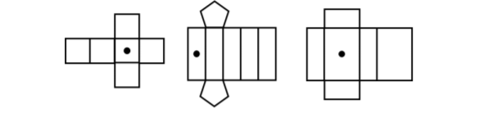
Task 2:
Draw another dot on the nets so the dots are on opposite faces, when the 3D shape is constructed.

Slide 92
Task 2:
Answers

Slide 93
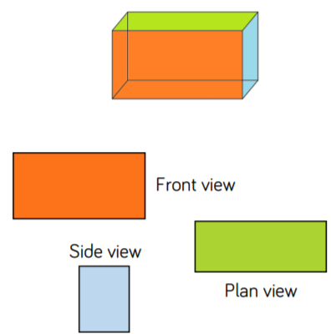
Task 3:
Using different 3D solids in your household (tin of beans, food box, etc.), can you represent each of your shapes from different angles.
An example of a cuboid has been done for yout.

Slide 94
End of Lesson

