Slide 1
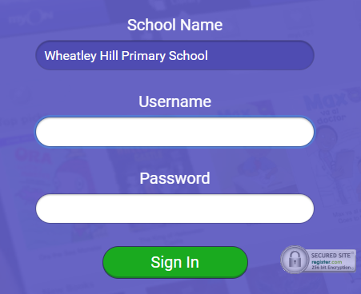
https://www.myon.co.uk/index.html
Remember to use myon for online reading
Example login -
Username
DavidW
Password
password1

Slide 2



Monday 11th – Friday 15th January
L.O To be able to spell words from the Year 3/4 list
There is a spelling activity at the start of each day’s lesson ☺
Subject: English

Slide 3
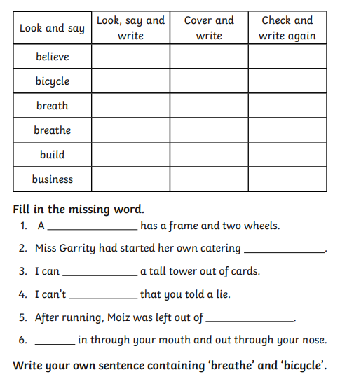
Try and practise your spellings every day ☺
https://cdn.oxfordowl.co.uk/2016/03/04/14/54/32/679/19038_content/index.html
Spelling game

Slide 4
Monday 11th January
L.O To be able to answer questions based on a text
Subject: English

Slide 5
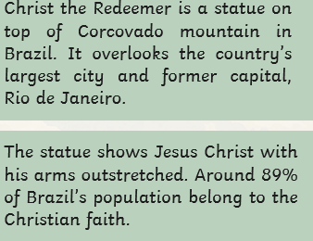
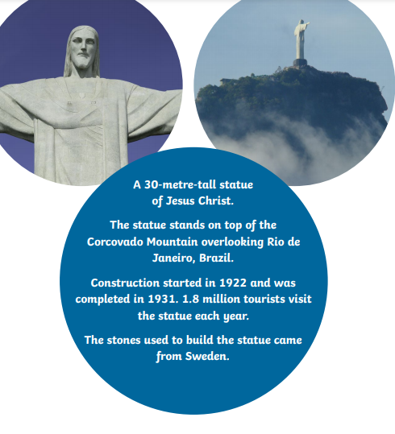
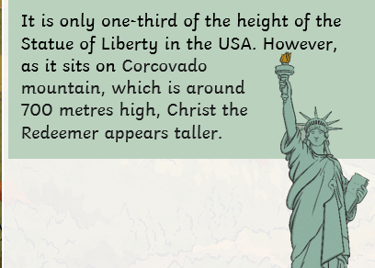
Christ the Redeemer
Read through the information on this page

Slide 6
Answer the questions in full sentences, e.g. Christ the Redeemer shows Jesus with his arms outstretched.
Where is Christ the Redeemer? ____________________________________________________________________
How many tourists visit it each year? __________________________________________________________________
How tall is Christ the Redeemer and why does it appear taller than it is? _________________________________________________________________________________________________________________________________
Why is Christ the Redeemer such a popular statue in Brazil? _____________________________________________________________________________________________________________________________________

Slide 7
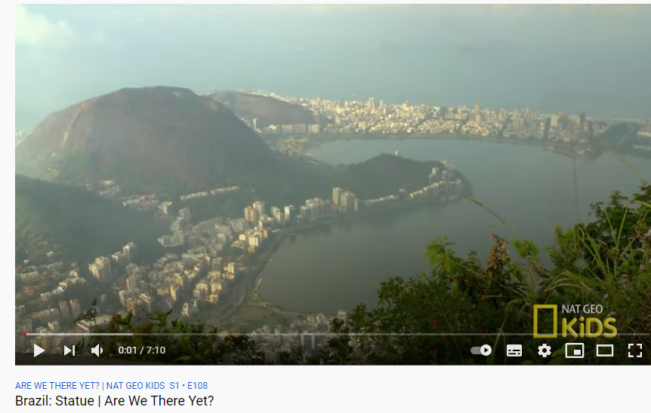
When was it built and where did the stones come from?
_________________________________________________________________________________________________________________________
6. Would you like to visit Christ the Redeemer? Explain your answer
_________________________________________________________________________________________________________________________
Watch this video for more information!
https://www.youtube.com/watch?v=WvZpgvoXB1M

Slide 8
Date: Tuesday 12th January
L.O To be able to write descriptive sentences
Subject: English

Slide 9
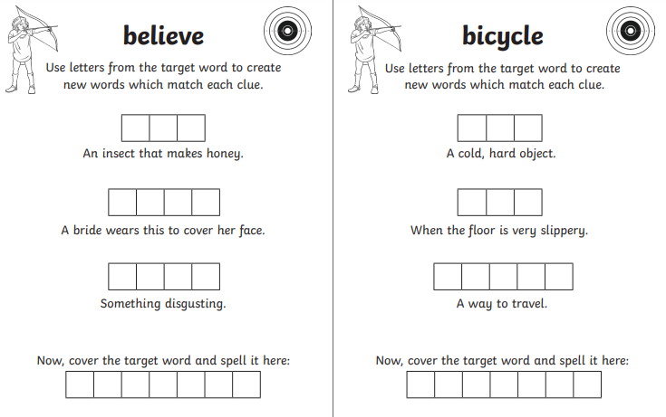

Slide 10
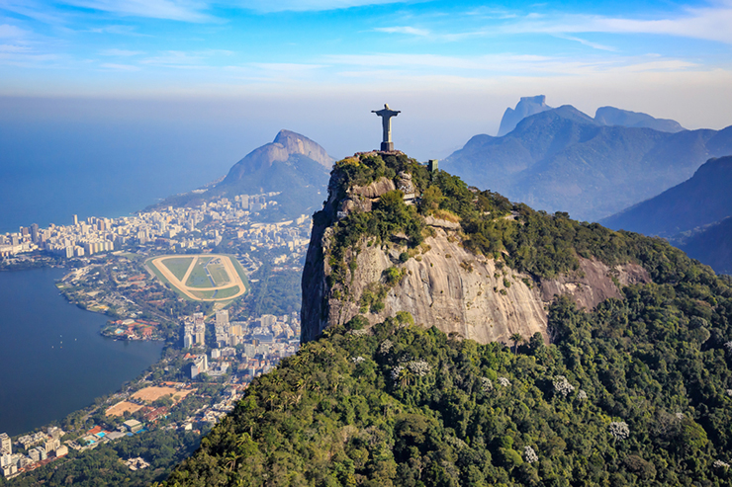
List everything you can see in the picture
Christ the Redeemer
City
Houses
_____________
_____________
_____________
_____________
_____________
_____________
_____________
_____________
_____________
_____________
_____________
_____________
Rio de Janeiro (Brazil)

Slide 11
Now think of adjectives to describe what you can see
______________ , _____________ statue
______________, ______________ city
_____________ , _______________ mountains
_____________ , _______________ ocean
_____________ , _______________ sky
_____________ , _______________ views
Rio de Janeiro (Brazil)
Adjectives are describing words

Slide 12
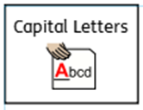
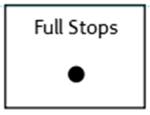


Use the adjectives you have came up with to write descriptive sentences
Don’t forget:
Christ the Redeemer is a _______________, _______________ statue, standing on the _______________, _____________ mountain.
The _______________, _______________ sky looks beautiful above the _______________,
_______________ city.

Slide 13
Use the adjectives you have came up with to write descriptive sentences
Don’t forget:
Rio de Janeiro (Brazil)
Now try 3 sentences of your own
Remember commas between your adjectives!
________________________________________________________________________________________________________________________________________________________________________________________________________________________________________________________________________________________________________________________________________________________________________________________________________________________________________________________________________

Slide 14
Date: Wednesday 13th January
L.O To be able to use prepositional openers
Subject: English

Slide 15
____________________________________________________________________________________________________________________________________________________________________________________

Slide 16
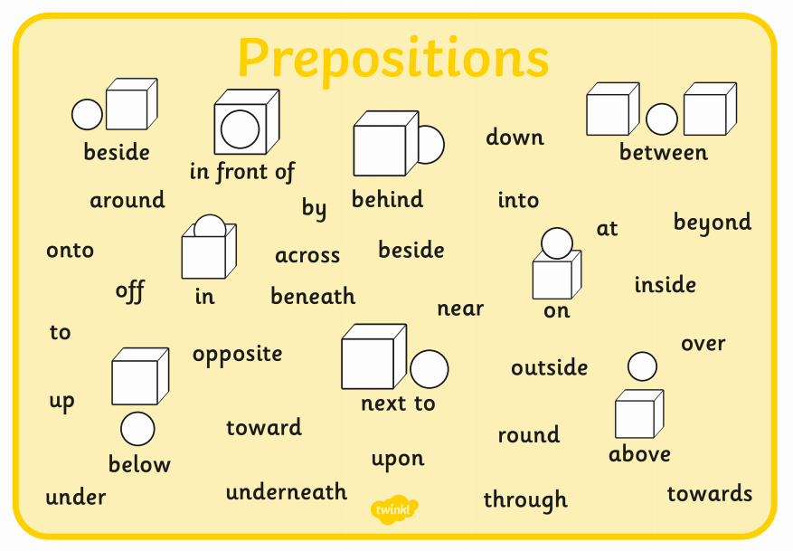
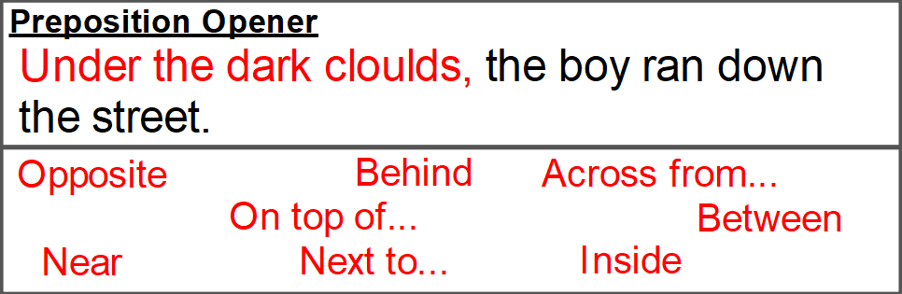
A preposition is a word that tells you where or when something is in relation to something else.

Slide 17
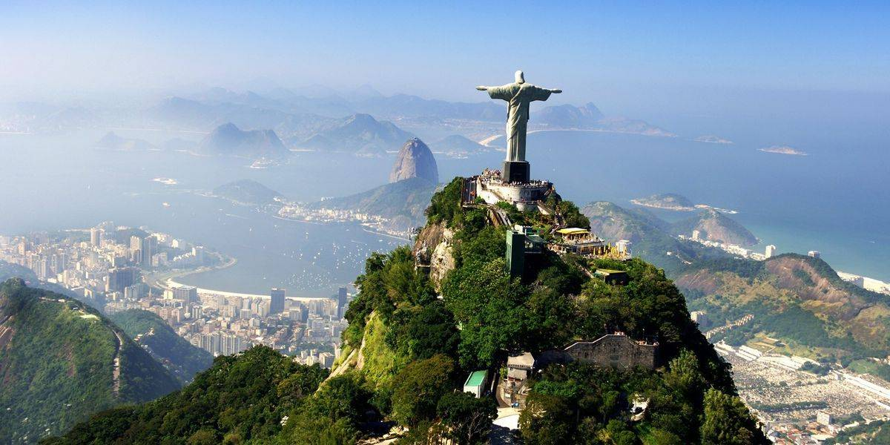
Imagine you are Christ the Redeemer and are looking out over the city.
Think about what you can see.
Remember- if you are the statue you will be writing in
First person – ‘I can see’
Make a list of prepositional phrases to go at the start of sentences.
Remember to add a comma after the full phrase.
Above my head,
Down below,
In front of me,
Next to the ocean,
_______________
_______________
_______________
_______________
_______________
_______________

Slide 18
Don’t forget:
Above my head, birds are peacefully flying in the _________________, _____________________ sky.
Next to the ocean, I can see ____________________________________________________________________________________________________________________________________________________________________________.
Down below, there are _____________________________________________________________________________________________________________________________________________________________________________.

Slide 19
Don’t forget:
Now try 3 sentences of your own
Remember commas after the prepositional phrase ☺
________________________________________________________________________________________________________________________________________________________________________________________________________________________________________________________________________________________________________________________________________________________________________________________________________________________________________________________________________

Slide 20
Thursday 14th January
L.O To be able to use extend sentences with conjunctions
Subject: English

Slide 21
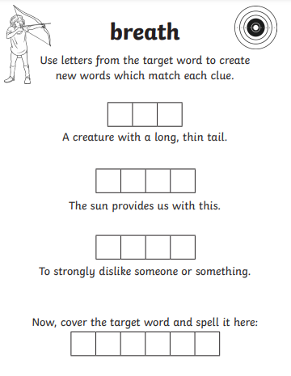
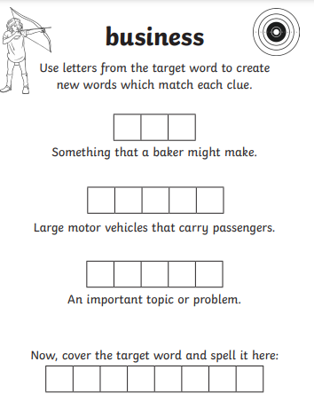

Slide 22

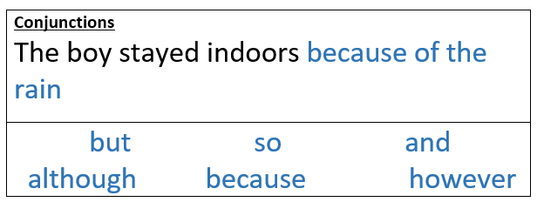
Follow the link for more information and some games
https://www.bbc.co.uk/bitesize/topics/zwwp8mn/articles/zqk37p3#:~:text=A%20conjunction%20is%20a%20word,information%20to%20the%20main%20clause.

Slide 23
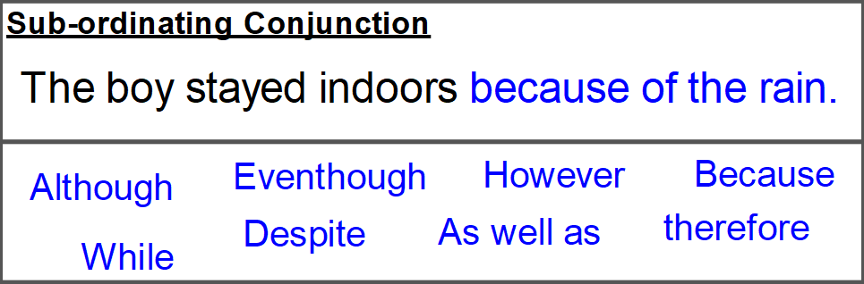
Finish these sentences
Christ the Redeemer is an important statue because _______________________________________________________________________________________________________________________.
The weather in South America is usually hot, however ______________________________________________________________________________________________________________________.
3. The beaches in Brazil are very beautiful, therefore _______________________________________________________________________________________________________________________.

Slide 24
5. There are lots of wealthy areas in Brazil, even though _______________________________________________________________________________________________________________________.
Challenge-
Write 2 sentence of your own containing conjunctions. Can you use one that we haven’t used yet - although, while, as well as
________________________________________________________________________________________________________________________________________________________________________________________________________________________________________________________________________________________________________________________________________________________

Slide 25
Friday 15th January
L.O To be able to write a descriptive paragraph
Subject: English

Slide 26
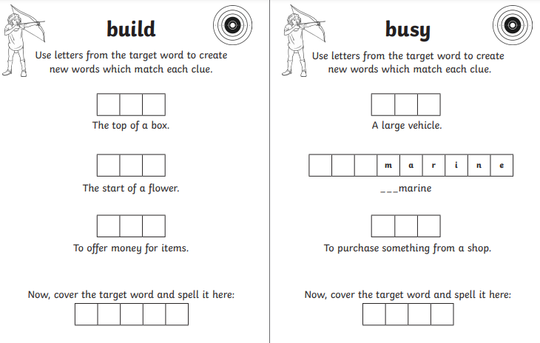

Slide 27
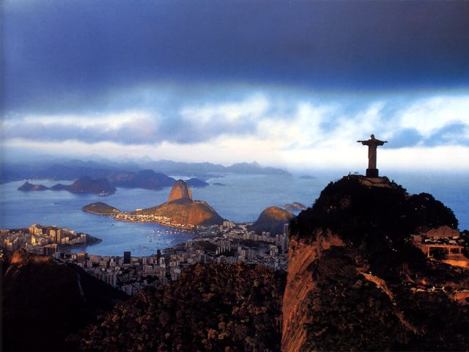
Think of everything we have learnt this week
List any adjectives / openers that could help you describe this picture
________________________________________________________________________________________________________________________________________________________________________________________________
________________________________________________________________________________________________________________________________________________________________________________________________

Slide 28
The famous statue is standing on the __________ , __________ mountains and the sun has set after a glorious, __________ day. Down below, golden lights are illuminating the ______________ city therefore, _____________________________________________________________________________________________________________________________________________________________________________________________________________________________________________________________________________________________________________________________________________________________________________________________________________________________________________________________________________________________________________________________________________________________________________________________________________________________________________________________________________________________________________________________________________

Slide 29

Well done everyone!
Hope you are all ok ☺

