Slide 1
11.1.21 Mental Starter: x10, x100, x1000
Remember:
When x 10 each digit moves 1 place value to the left, a 0 will be added to the ones column
When x100 each digit moves 2 places value to the left, a 0 will be added to the tens and ones column
When x1000 each digit moves 3 place value to the left, a 0 will be added to the hundreds, tens and ones column
Eg. 25
X10= 250 x100= 2500 x1000= 25,000
Multiply the numbers below by 10, 100 or 1000 and write your answers down onto your paper or you can say the numbers out loud.
Complete at least 5 calculations
68 89 91
142 234 578

Slide 2
Date: 11.1.21
L.O: To be able to x using formal methods
Subject: Maths

Slide 3
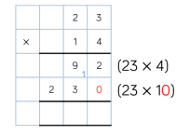
Using the column method for x
Set the question in the formal method
Remember to start the process of multiplication with the units
Multiply ones eg. 3 by 4
Write the answer down correctly – including any carrying
Multiply tens eg. 20 by 4
Add anything that you have carried from the previous multiplication.
Multiply number by tens of the digit eg. 23x10
Drop a zero as we are now multiplying with 10s
Multiply 3 by 10
Write the answer correctly
Multiply 20 by 10
Write the answer down
Add the two answers up together correctly
+
1
3 2 2

Slide 4
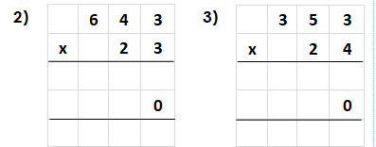
Now try these…
Use the method explained (on the previous slide) to complete these questions.
Either write them on to paper or complete on this.
1
1

Slide 5
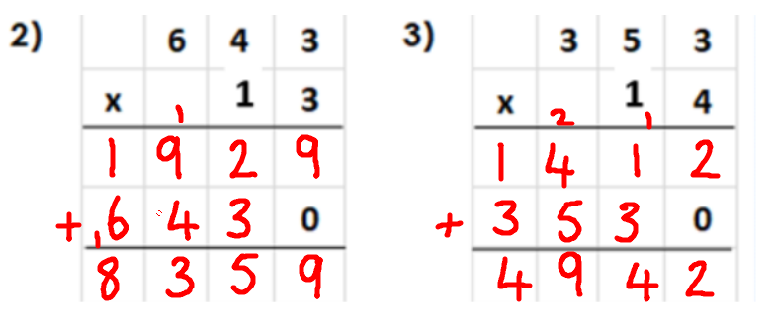
Answers
Did you get the calculations correct?
If so, well done!
If you didn’t, can you find your mistake and see where you went wrong?
Re-try the calculation.

Slide 6
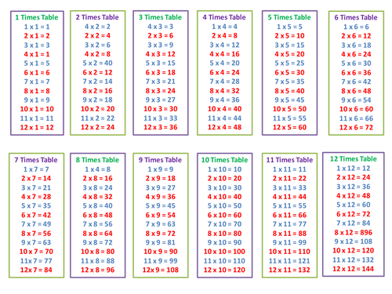
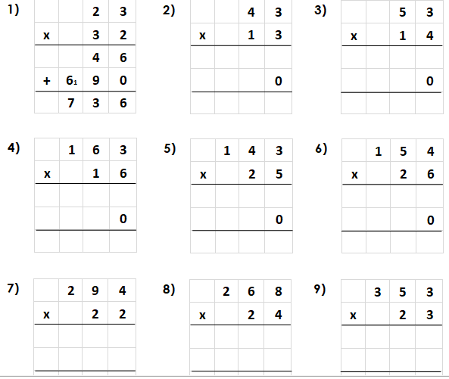
Complete the calculations below on to a piece of paper or onto the calculations. You can use a times table sheet to help you (if needed).
Take care to x the numbers. Remember to + on any carry overs from the previous column.

Slide 7
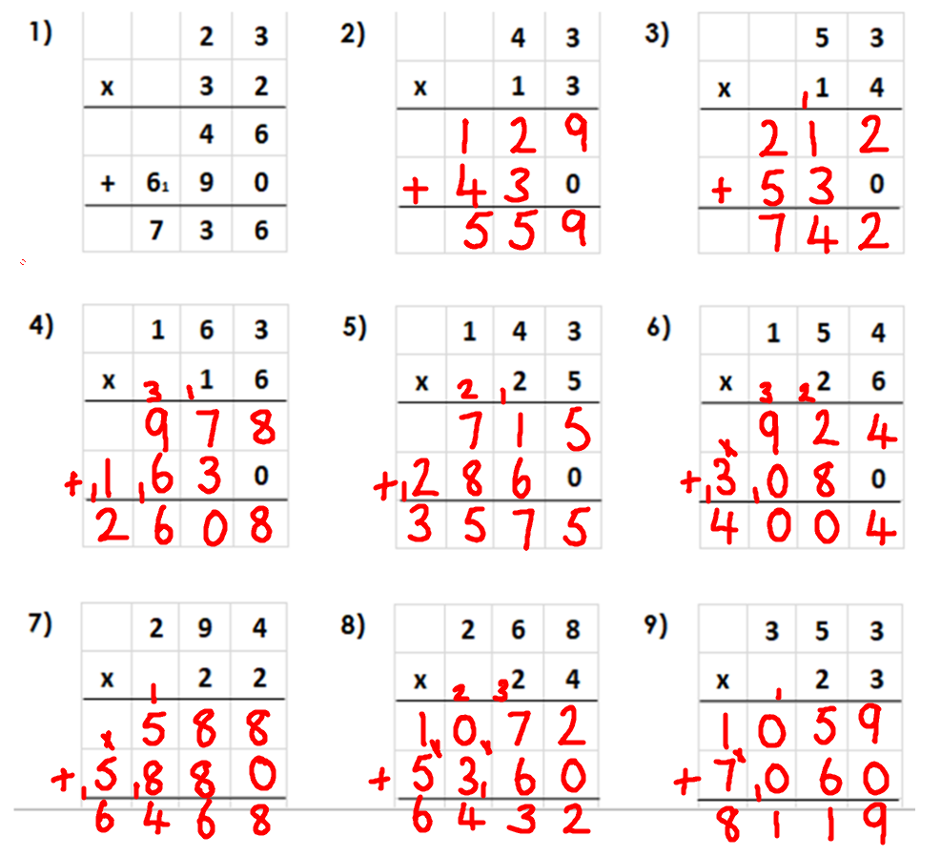
Answers
Did you get it correct?
If so, well done!
If you didn’t, can you find your mistake and see where you went wrong?
Re-try the calculation.

Slide 8
Times table practise
Now you have finished your written job, please spend at least 15mins practising your times tables.
This can be done on TTRS, hit the button or any other times table website.
Copy and paste the following link into a web browser:
https://www.topmarks.co.uk/maths-games/7-11-years/times-tables
Alternatively, you can use the help sheet to support you.

Slide 9
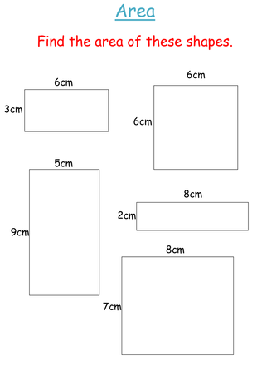
12.1.21 Mental Starter: Area of shapes
Calculate the area of these rectangles and write down your answers on paper or in the middle of the shapes.
1.
2.
Remember area= length x width
1. 6cm x 3cm = 18cm
3.
4.
5.

Slide 10
Answers
Did you get it correct?
If so, well done!
If you didn’t, can you find your mistake and see where you went wrong?
Re-try the calculation.
3cm x 6cm = 18cm
6cm x 6cm = 36cm
5cm x 9cm= 45cm
2cm x 9cm= 18cm
8cm x 7cm= 56cm

Slide 11
Date: 12.1.21
L.O: To be able to x using formal methods
Subject: Maths

Slide 12
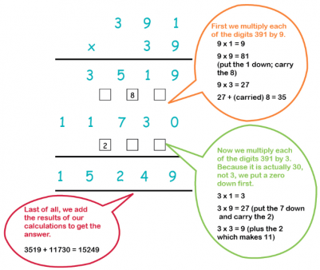
Recap method used yesterday
Set the question in the formal method
Remember to start the process of multiplication with the units
Multiply ones eg. 3 by 4
Write the answer down correctly – including any carrying
Multiply tens eg. 20 by 4
Add anything that you have carried from the previous multiplication.
Multiply number by tens of the digit eg. 23x10
Drop a zero as we are now multiplying with 10s
Multiply 3 by 10
Write the answer correctly
Multiply 20 by 10
Write the answer down
Add the two answers up together correctly

Slide 13
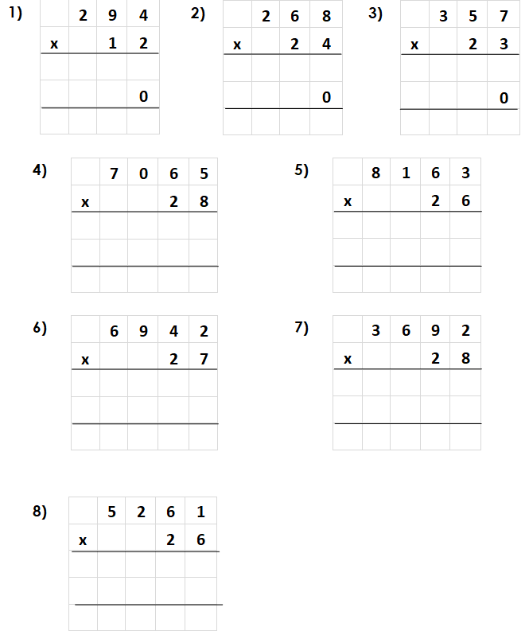
Complete the calculations below on to a piece of paper or into the calculations. You can use a times table sheet to help you (if needed).
Take care to x the numbers. Remember to + on any carry overs from the previous column.

Slide 14
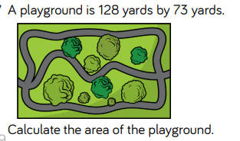
Write down the calculation for the question on to your paper or complete it in the box provided.
Extension: Use the column x method to solve these calculations

Slide 15
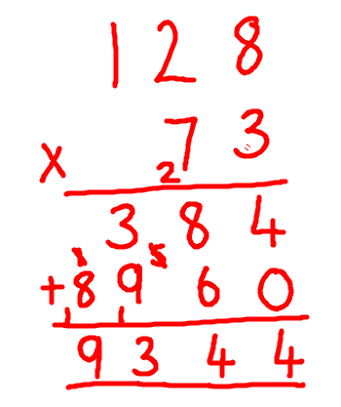
Answers:
Did you get it correct?
If so, well done!
If you didn’t, can you find your mistake and see where you went wrong?
Re-try the calculation.

Slide 16
Times table practise
Now you have finished your written job, please spend at least 15mins practising your times tables.
This can be done on TTRS, hit the button or any other times table website.
Copy and paste the following link into a web browser:
https://www.topmarks.co.uk/maths-games/7-11-years/times-tables
Alternatively, you can use the help sheet to support you.

Slide 17
13.1.21 Mental Starter- ÷10 and 100
Copy the numbers down and divide each by 10 and 100
1. 1200
2. 3300
3. 56700
4. 83100
Remember when dividing numbers, our answer gets smaller.
When dividing by 10, digits move one place value to the right (get smaller)
When dividing by 100, digits move two places to the right.
Eg. 2500 ÷ 10 = 250
2500 ÷ 100 = 25

Slide 18
Answers
÷ 10 ÷ 100
1. 1200 120 12
2. 3300 330 33
3. 56700 5670 567
4. 83100 8310 831
Did you get it correct?
If so, well done!
If you didn’t, can you find your mistake and see where you went wrong?
Re-try the calculation.

Slide 19
Date: 13.1.21
L.O: To be able to divide using formal methods
Subject: Maths

Slide 20
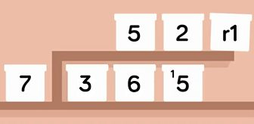
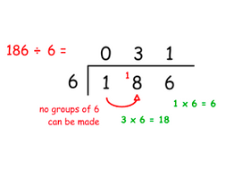
Short division method
Copy and paste the link below into a web browser.
https://www.bbc.co.uk/bitesize/topics/z36tyrd/articles/zgxdfcw
Watch the video and look over the information to remind you of the method for short division. (We have covered this in class!)
Short division will sometimes give an answer with a remainder (r), which you can round up or round down.
To find the answer to 365 ÷ 7 see if 3 (the hundreds) can be divided by 7.
It cannot, so add the tens digit. 36 ÷ 7 = 5 r 1.
Write down the 5 and carry over the 1 so 5 becomes 15.
15 ÷ 7 = 2 r 1.
Write those numbers down. The answer is 52 r 1.

Slide 21
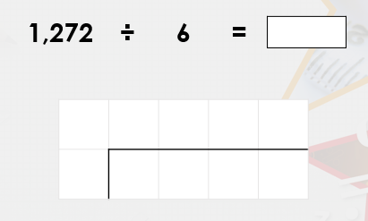
Copy this calculation down, or in the box below, and have a try to calculate the answer using the method described on the last slide. The answer is on the next slide for you to check against.

Slide 22
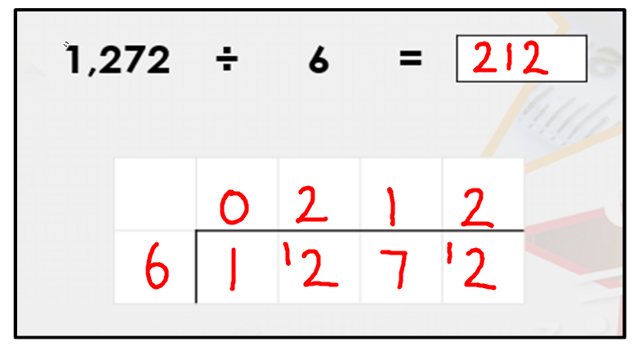
Did you get it correct?
If so, well done!
If you didn’t, can you find your mistake and see where you went wrong?
Re-try the calculation.

Slide 23
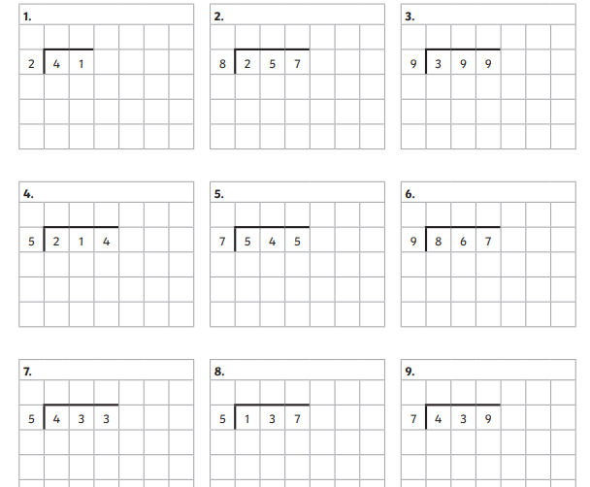
Complete the calculations below, either on the sheet or copy them onto paper. Carefully work out the answers. You can use the times table sheet to help you, but try to do it without.

Slide 24
Extension:
Complete the problem on the sheet or on a piece of paper.
Write down the calculation and solve it.
Write a sentence to explain who is wrong and why.

Slide 25
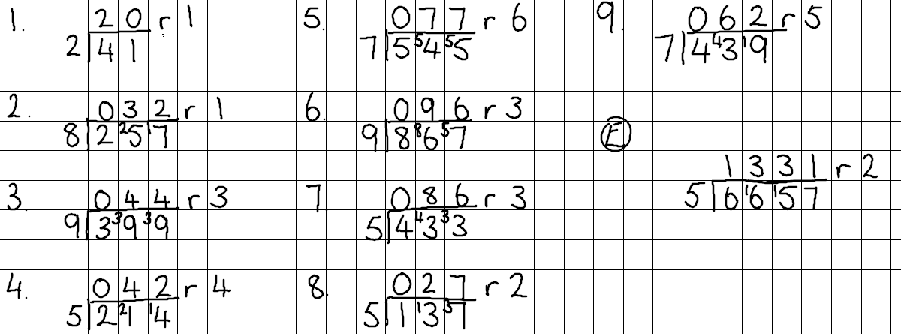
Answers
Did you get it correct?
If so, well done!
If you didn’t, can you find your mistake and see where you went wrong?
Re-try the calculation.
Extension:
Ben is correct because Josh’s remainder is the same as the divisor

Slide 26
Times table practise
Now you have finished your written job, please spend at least 15mins practising your times tables.
This can be done on TTRS, hit the button or any other times table website.
Copy and paste the following link into a web browser:
https://www.topmarks.co.uk/maths-games/7-11-years/times-tables
Alternatively, you can use the help sheet to support you.

Slide 27
Mental Starter: 14.1.21 Copy the numbers into the correct table or say out loud which number would go in which table.

Slide 28
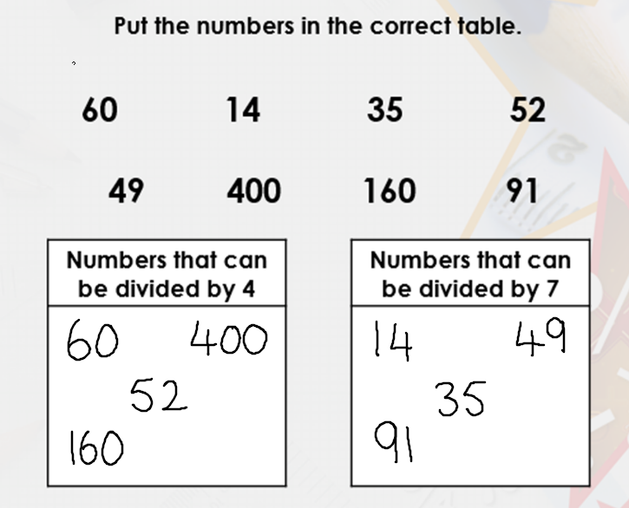
Answers:
Did you get it correct?
If so, well done!
If you didn’t, can you find your mistake and see where you went wrong?
Re-try the calculation.

Slide 29
Date: 14.1.21
L.O: To be able to divide using formal methods
Subject: Maths

Slide 30
Following on from the method we used last lesson, lets try:
256÷12=
Work through the calculation yourself and compare each answer to what is wrote.
200 ÷ 12 = 000 so the 200 is carried over making 50, 250
250 ÷ 12= 20 times with a remainder of 10, which is carried over making 6, 16
16 ÷ 12 = 1 r 4 ( as 4 are left over)
The answer to the calculation is 21 r 4

Slide 31
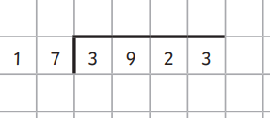
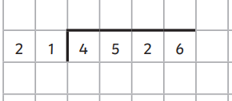
Now have a try of these, either complete the calculations onto the sheet or copy them up and work out the answer using the method on the previous slide:
1.
3.
5.
2.
4.
6.
These are quite tricky, if you are finding them too difficult then please have a look at the next slide and try the calculations shown.

Slide 32
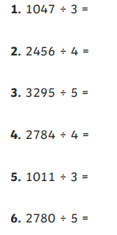
Try these if you were struggling with the previous questions.
Remember to use the short division method shown this week.
As shown in the example:
Copy out the calculations onto paper and complete.

Slide 33
Answers
Did you get it correct?
If so, well done!
If you didn’t, can you find your mistake and see where you went wrong?
Re-try the calculation.

Slide 34
Extension
Write the calculation down to solve this problem:

Slide 35
Answer

Slide 36
Times table practise
Now you have finished your written job, please spend at least 15mins practising your times tables.
This can be done on TTRS, hit the button or any other times table website.
Copy and paste the following link into a web browser:
https://www.topmarks.co.uk/maths-games/7-11-years/times-tables
Alternatively, you can use the help sheet to support you.

Slide 37
15.1.21 Mental starter
Complete the sequences (copy them down onto paper if needed) and fill in the missing numbers:
-10, ____, -6 , _____, -2 , 0 , 2 , 4, _____
_____, -20 , -15, _____, -5 , _____, 5 , 10, _____
_____, _____, 0 , 7, _____, 21, _____
Clue: Calculate the difference between a pair of numbers together.
Use times table knowledge to identify patterns.

Slide 38
Answers:
-10, -8 , -6 , -4 , -2 , 0 , 2 , 4, 6
-25 , -20 , -15, -10 , -5 , 0 , 5 , 10, 15
-14 , -7 , 0 , 7, 14 , 21, 28
Did you get them correct?
Can you spot any errors you made? (If you made them!)

Slide 39
Date: 15.1.21
L.O: To be able to solve ÷ and x problems using formal methods
Subject: Maths

Slide 40
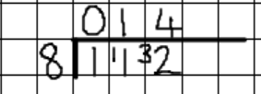
Solving mixed x and division word problems
114 pages
12 copies
1 1 4
X 1 2
2 2 8
+1 1 4 0
1 3 6 8 pages
112 chairs between
8 class rooms
14 chairs each
Think about what is happening in the question to help you decide upon which operation to use. Will the answer be a larger or smaller number?

Slide 41
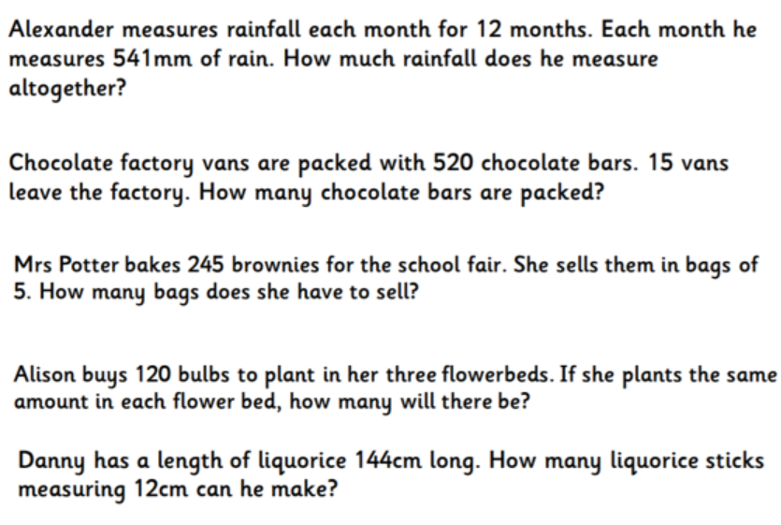
1.
2.
3.
4.
5.
Read through the problems carefully
Underline or write down the key information
Decide what calculation needs to be done
Write down the calculation
Work out the answer
Check over your working
Complete the calculations on a sheet of paper.

Slide 42
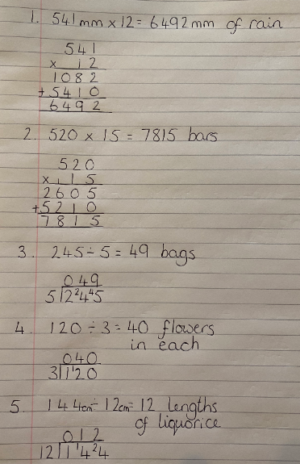
Answers
Did you get it correct?
If so, well done!
If you didn’t, can you find your mistake and see where you went wrong?
Re-try the calculation.

Slide 43
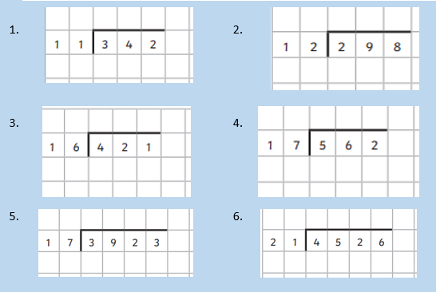
If you did the easier option last lesson, have another try of the tricky calculations.

Slide 44
Answers
Did you get it correct?
If so, well done!
If you didn’t, can you find your mistake and see where you went wrong?
Re-try the calculation.

Slide 45
Times table practise
Now you have finished your written job, please spend at least 15mins practising your times tables.
This can be done on TTRS, hit the button or any other times table website.
Copy and paste the following link into a web browser:
https://www.topmarks.co.uk/maths-games/7-11-years/times-tables
Alternatively, you can use the help sheet to support you.

