Slide 1
Subject: Topic
Pack: A and B

Slide 2
Date: Monday 1st March 2021
LO To be able to describe what objects you would use in a mine
Subject: History

Slide 3
Life was hard working in the mines. It was also very dangerous.
Today we are going to look at some of the objects that would have been used when people were working down the mine.
Watch this video from 52 minutes to see what it would have been like at Wheatley Hill Pit.
https://www.youtube.com/watch?v=96KMAYYlIPo&feature=youtu.be

Slide 4
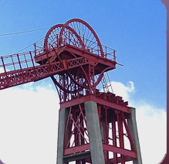
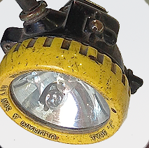
Headstocks
Headstocks have come to symbolise coal mining communities and coal production. Collieries established between the war years employed steam winding engines to drive the wheels that were held high up the lattice-steel frameworks. These towering structures with their attendant pit chimneys and sprawling workshops came to dominate the local landscape.
Cap Lamp
The cap lamp or more accurately ‘Electric Safety Lamp’ is powered by a battery carried on the miner’s belt and a cable running up to the lamp. The lamp may be slotted onto the front of the miner’s helmet by means of a clip or can be detached and used as a flashlight for performing tasks underground.

Slide 5
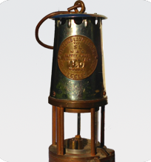
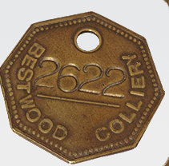
Flame Safety Lamp or Davy Lamp
In the early days, miners used candles, flaming torches and
oil lanterns to light their way. As mines got deeper, this type of lighting presented enormous dangers due to the presence of methane gas which is potentially explosive in high concentrations when exposed to a naked flame.
Motties
Brass ‘motties’ or ‘checks’ were used for pay identification and more importantly as a means of a safety check when miners went underground. In the event of an underground incident such as an accident, fire or inrush of water, motties would be used to identify which miners were in that area of the pit.

Slide 6
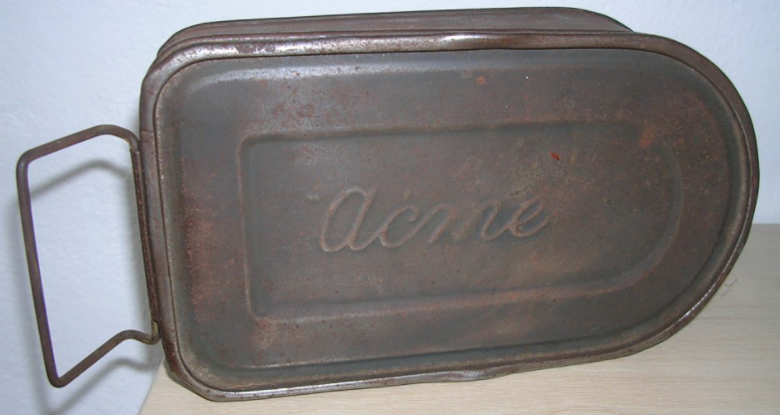
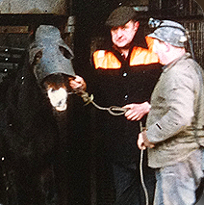
Snap Tin
A colloquialism for ‘lunch’ in the East Midlands and parts of Yorkshire is ‘snap’. Possibly a reference to the specially-shaped, waterproof ‘snap tins’ that miners used to take their food underground. (Miners in the North East refer to their lunch as ‘bait’). Down the mine, tea breaks were not taken at a specific time as they are in other industries, but twenty minutes could be taken at an agreed time for water and a sandwiches.
Pit pony
Wheatley Hill had 72 pit ponies working when it was at it’s best. When it closed it only had 12 ponies left.
In the days before mechanisation, pit ponies were stabled underground and were used to transport materials in and coal out of the mine. The men, boys and ponies who worked together during this period endured terrible working conditions.

Slide 7
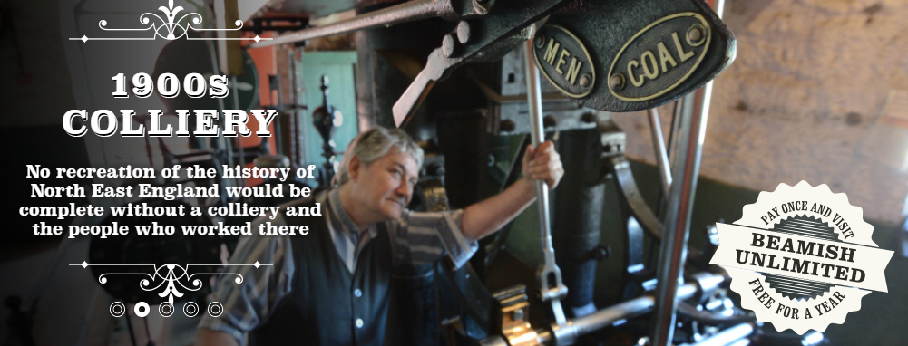
Beamish is a Museum in County Durham where you can visit a 1900s Colliery Coal Mine however at the moment it is not open.
We are going to take a look at how the objects you have been learning about would have been used.

Slide 8
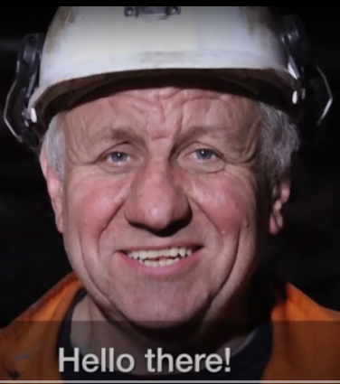
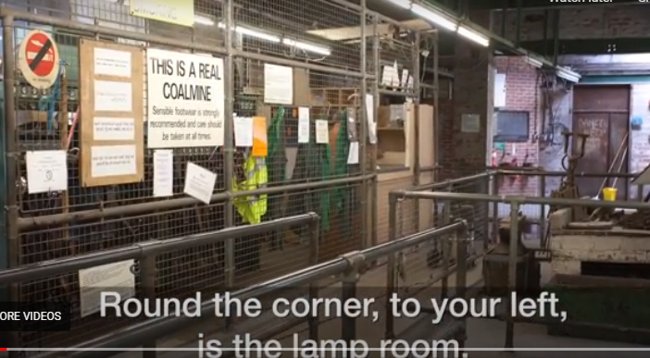
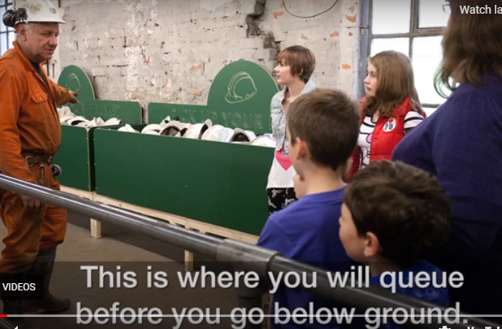
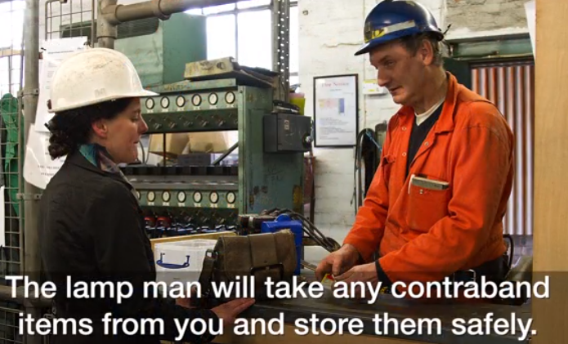
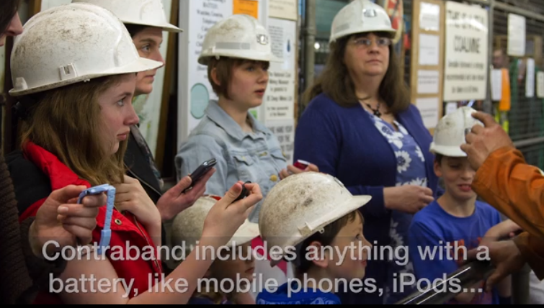
Lets go underground!
https://www.ncm.org.uk/learning/available-later/the-underground-experience
Watch this slideshow or follow the pictures to see
what it will be like to visit a mine.
In the lamp room, you would choose a hard hat that fits snuggly on your head.

Slide 9
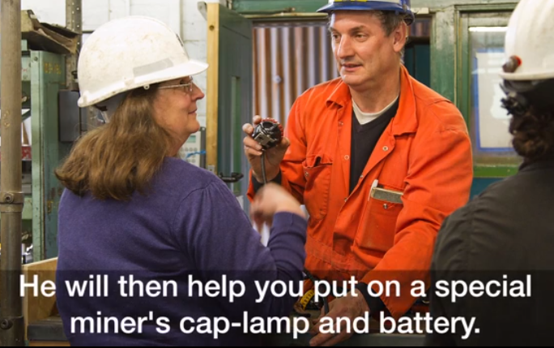
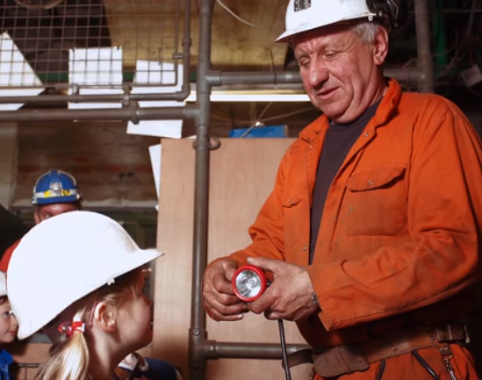
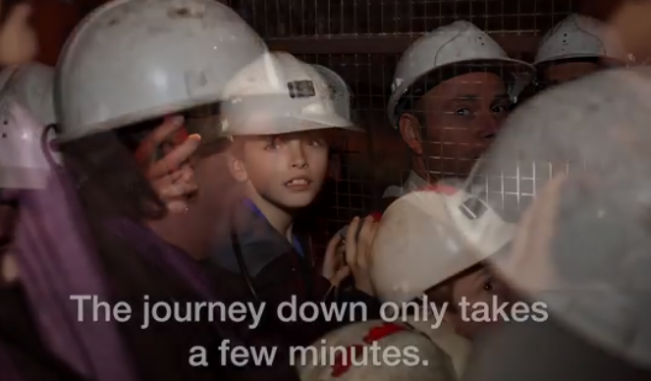
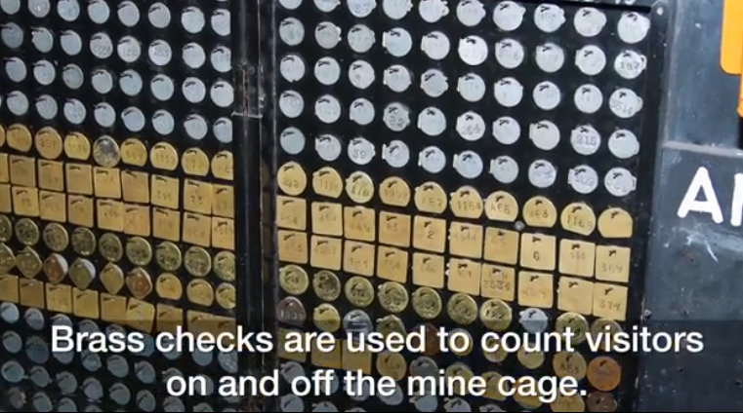

Slide 10
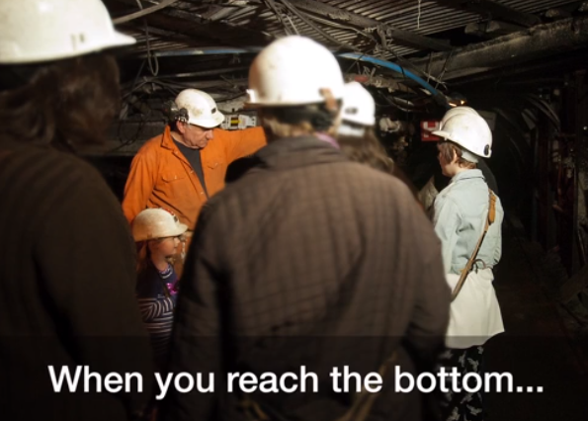
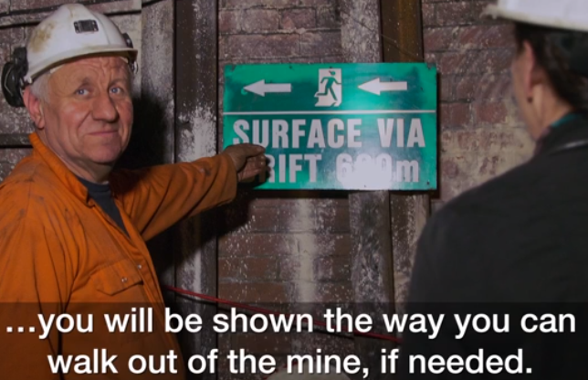
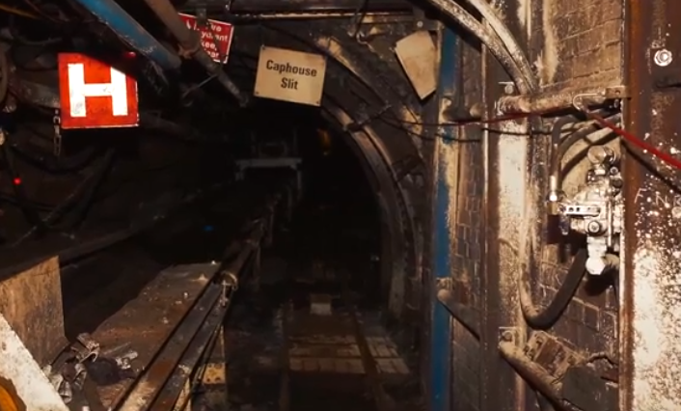
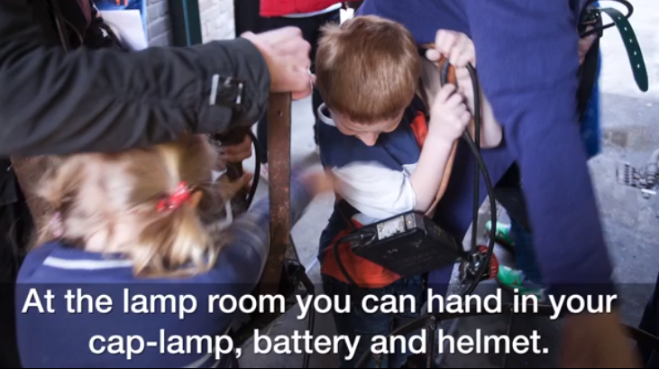
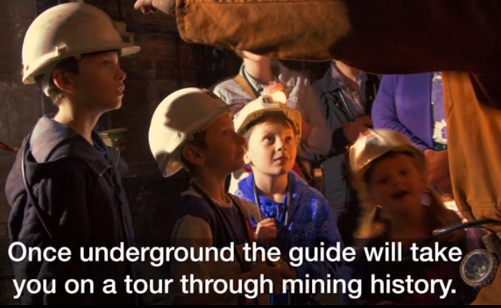
Would you like to go underground?

Slide 11
Complete these sentences using the information you have found out about each object.
Collieries had steam winding engines to ________________ ________________________________________________
The cap lamp can be put on a miner’s_________________ or
_______________ to help them perform tasks _________________ .
It can also be used as a _____________________ and is very
important because ________________________________________
This is a ______________ ______________ . The miners would use it _________________________________________________

Slide 12
Pit ponies were used ____________________________
_____________________________________________
Working conditions were _________________________
The Flame Safety Lamp was also called a _____________ _________. When mines got deeper this lamp was dangerous
because ____________________________________________.
Motties were used to ________________________________
__________________________________________________
If a mottie was not returned at the end of the shift, ________
__________________________________________________

Slide 13
End of lesson

Slide 14
Date: Tuesday 2nd March 2021
L.O To be able to identify patterns between the volume of a sound and the vibrations made.
Subject: Science

Slide 15
Pre-recorded Teaching
Access the online teaching video below that will support you to complete the work in this lesson. This video will act as a support but all of the work can still be successfully understood & completed using paper-based versions of this pack. If you need further support to understand / complete work then please contact school via e-mail or telephone.
Play Video
You can also copy and paste this link if you would prefer:
https://teachers.thenational.academy/lessons/what-do-we-mean-by-amplitude-of-sound-c8tp8e

Slide 16
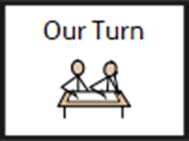
What can you remember from our lessons on sound?

Slide 17
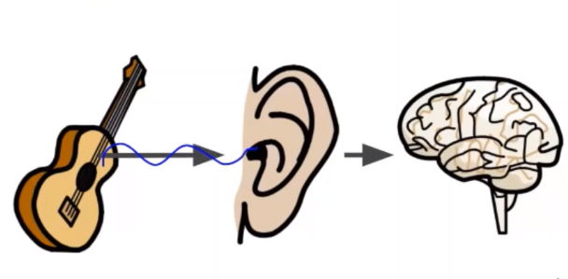
Waves enter our ears.
Then tiny messages are sent to our brain to help us remember the sound.
When we strum a guitar, it vibrates the air around it and sends invisible waves through the air.

Slide 18
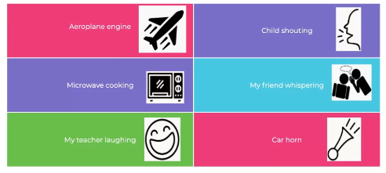
Today we are going to be looking at amplitude.
Look at the different sounds and decide whether they would be a loud or quiet sound?
Talk to your partner or adult at home.

Slide 19
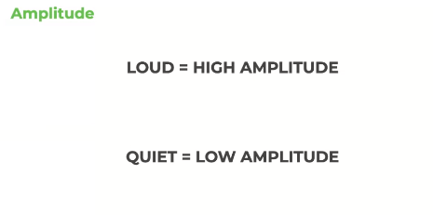
Amplitude is the size of the waves.
A loud sound has a high amplitude.
A quiet sound has a low amplitude.

Slide 20
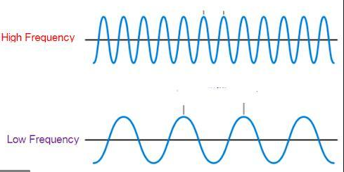
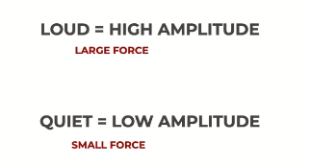
Amplitude is the size of the waves.
The waves of frequency will be high.
The waves of frequency will be low.
Amplitude is measured in decibels.
You need to apply a very large force
to make a loud sound.
You need to apply a very small force
to make a quiet sound.

Slide 21
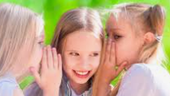
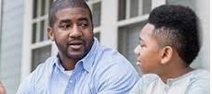
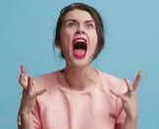
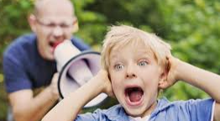
Amplitude (how loud or quiet a sound is) is measured in decibels.
15dB is not very loud. It is quiet like a whisper.
Talking
Shouting!
This is how we write decibels.
150dB would be so loud it could burst your ear drum!
Sounds over 150 dB could seriously damage your ears.

Slide 22
Decibels
Complete these sentences.
The louder the sound is the ___________________ the amplitude.
To make a loud sound, you need to use _________________ force.
A whisper has a sound with a _______________ amplitude.
Amplitude (sound) is measured in ________________________.
decibels higher low more

Slide 23
Sort these sounds into high or low sounds.
12dB
6dB
200dB
96dB
Talk to a partner or adult about your choices.

Slide 24
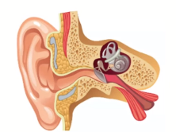
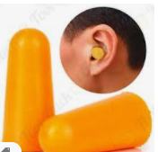
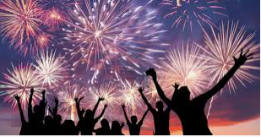
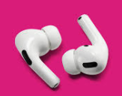
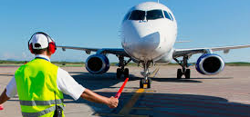
Sounds that are very loud could seriously damage your ears.
It is important to protect your ears so they don’t get hurt.
You could stand further away from the sound and that will also help protect your ears.
Ear defenders help protect against very loud sounds.
Earplugs can help block out loud to medium sounds.
If you listen to really loud music in your headphones, you could damage the inside of your ear and you can not repair it.

Slide 25
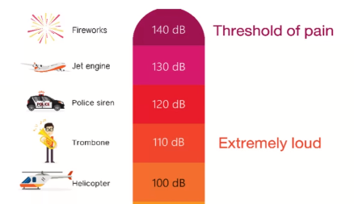
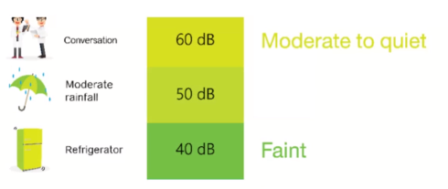
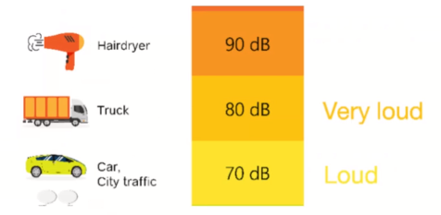
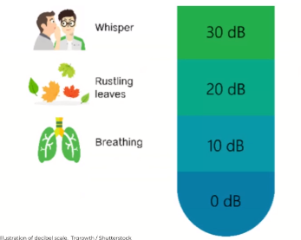
You should never stand very close to a firework.

Slide 26
Complete the questions below by adding in the missing information.
Use the slide on the last page to help.
What makes the sound
Sound in decibels (dB)
Amplitude
Ref
Refrigerator
80dB
J
Jet engine
00
10 dB

Slide 27
Complete the questions below by adding in the missing information.
Use the slide on the last page to help.
What makes the sound
Sound in decibels (dB)
Amplitude
Ref
Helicopter
140dB
J
Moderate rain
00
20 dB

Slide 28
End of lesson

Slide 29
Date: Wednesday 3rd March 2021
LO: To be able to understand the purpose of online adverts and digital footprints
Subject: ICT

Slide 30
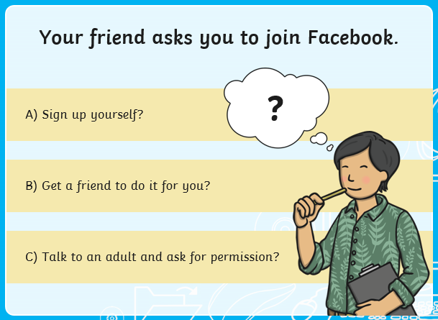
Before we start our task, lets recap our understanding about keeping safe online by having a go at the following quiz. Check your answers at the end.

Slide 32
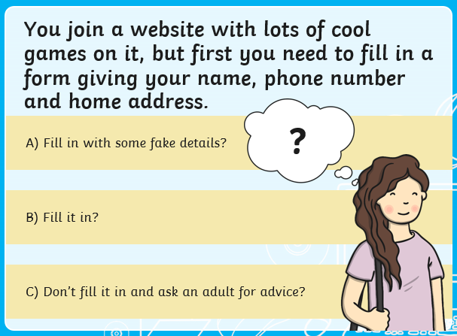

Slide 33
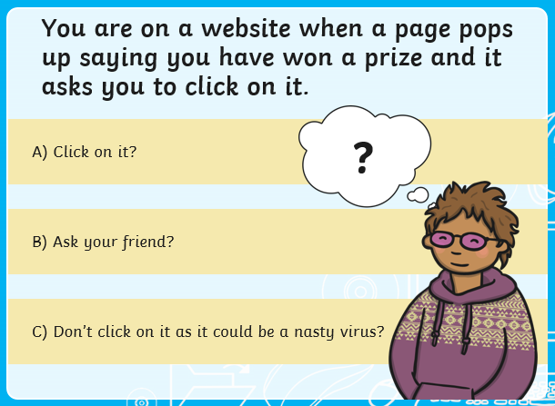

Slide 34
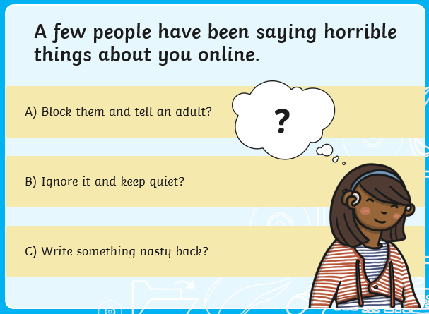

Slide 35
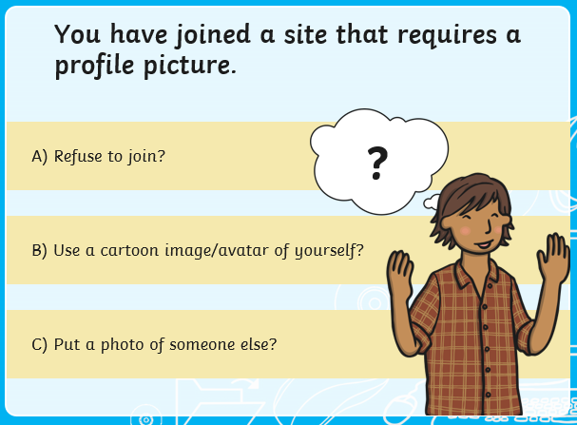

Slide 36
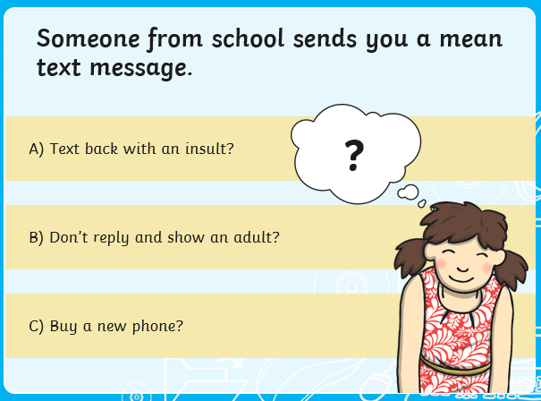

Slide 37
Answers
Question 1 C
Question 2 B
Question 3 C
Question 4 D
Question 5 A
Question 6 B
Question 7 B

Slide 38
Last time we looked at how to keep safe whilst using the internet, today we are going to look at online adverts and their purpose.
If you need help to read any of the information, ask a grown up to help you.

Slide 39
What is online advertising?
Online advertising helps you to inform and persuade people to buy a product. Similar to adverts on T.V, they can be in the form of videos as well as just displaying images of the product.

Slide 40
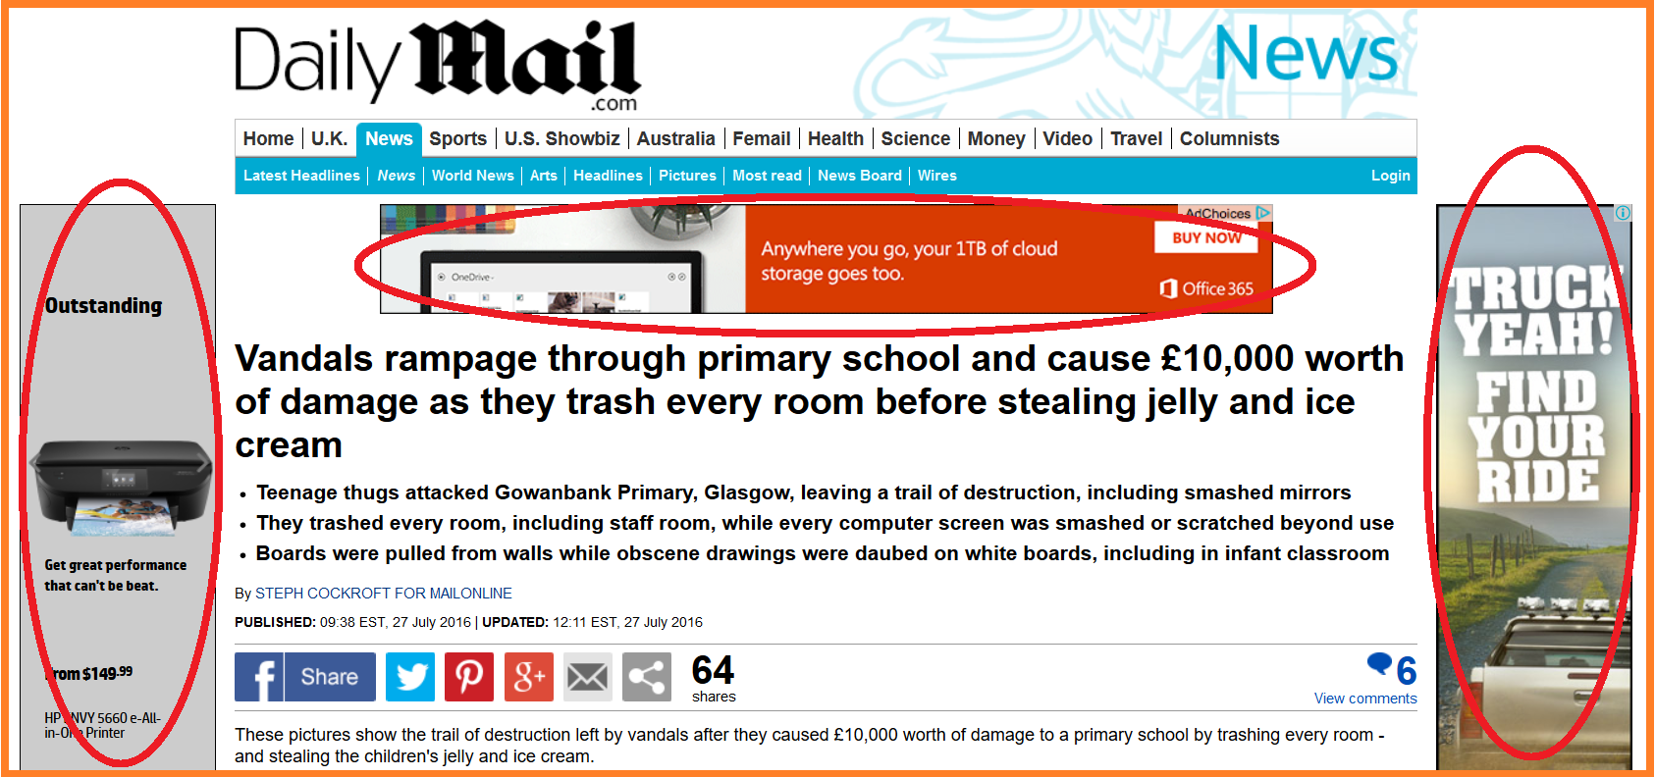
Whilst browsing websites, advertisements often appear at the sides, bottom or top of the page. They usually try to grab your attention with pictures and catchy headings, encouraging you to click on the link to buy.
Advertisements

Slide 41
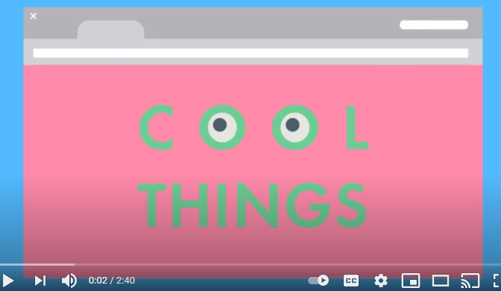
Advertising
The following video can be used to gather further information about online advertising if you would like to know a little bit more but does not need to be watched to complete the task..
https://www.youtube.com/watch?v=zQptrlOFMDw

Slide 42
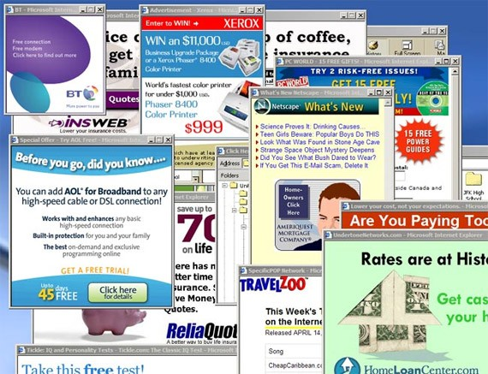
As well as advertisements, you may find other pop up boxes appear on your screen telling you that you have won something.
Do you think it’s a good idea to click on pop ups when they appear? (If you are in school talk with your partner, at home share your ideas with a grown up or sibling.)
REMEMBER: You should NOT click on any pop ups. Many can be fake and lead to you having to enter your personal information or even contain a virus that can harm your computer.

Slide 43
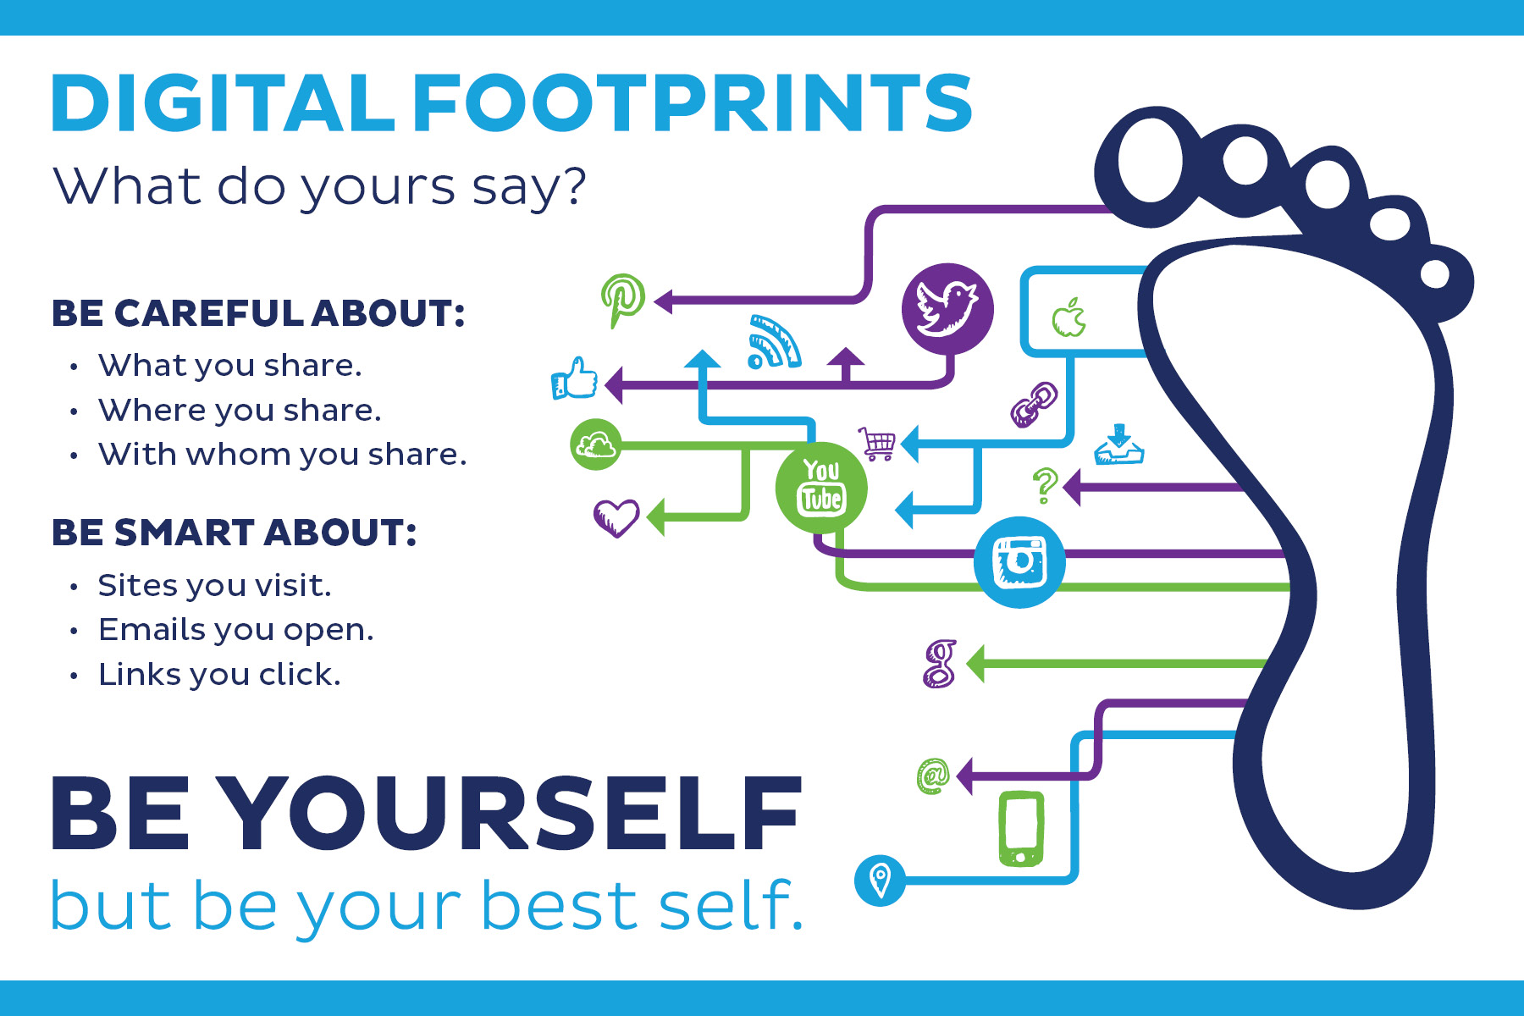
Digital footprint
A digital footprint is a trail of data you create while using the Internet. It includes the websites you visit, emails you send, and information you submit to online services. Advertisers then use this information to send you adverts and products based on your searches.

Slide 44
Digital footprint
The following video can be used to gather further information about digital footprints if you would like to know a little bit more but does not need to be watched to complete the task.
https://www.bbc.co.uk/programmes/p06z2lvy

Slide 45
Task:
Using the words below to complete the following sentences.
Online advertisers try to _______________ you to buy their products. Whilst browsing the ____________, advertisements often appear at the sides, bottom or top of the page. A _________ footprint is a trail of __________ you create while using the Internet.
digital internet persuade data

Slide 46
Task:
Complete your own digital footprint by adding all the ways you use the internet, including any websites you visit regularly. You can write them or draw logos to represent them.
Examples: You tube, Times table Rock stars, Netflix, BBC Bitesize.
Netflix
You tube
BBC Bite size
Hit the button

Slide 50
Using the following website to explore how you can keep safe online.
https://www.thinkuknow.co.uk/

Slide 51
End of lesson

Slide 52
Thursday 4th March 2021
L.O To be able to recognise classroom objects.
Subject: French

Slide 53
Today we will be looking at objects that we have in our classroom.
In French we would say…
Les objets de la classe

Slide 54
un livre | un stylo | un crayon
book | pen | pencil
un taille-crayon | une gomme | des ciseaux
pencil sharpener | rubber | scissors
une règle | un bâton de colle | une trousse
ruler | glue stick | pencil case
Make sure you read these carefully and say them out loud.

Slide 55
On the next slides I will ask you to pass me a classroom object.
‘Pass me’ in French is
Passe-moi
Choose the correct object by circling it.
Work with a partner or an adult at home if you can.

Slide 56
Question 1
Passe-moi
une règle

Slide 57
Question 2
Passe-moi
une stylo

Slide 58
Question 3
Passe-moi
un bâton de colle

Slide 59
Question 4
Passe-moi
une gomme

Slide 60
Question 5
Passe-moi
des ciseaux
Check your answers on the next slide.

Slide 61
Answers
Q3
un bâton de colle
glue stick
une règle
ruler
Q1
une gomme
rubber
Q4
Q2
un stylo
pen
Q5
des ciseaux
scissors

Slide 62
Task
______________________ | ______________________ | ______________________
scissors | ruler | glue stick
______________________ | ______________________ | ______________________
pencil sharpener | rubber | book
______________________ | ______________________ | ______________________
pen | pencil | pencil case
Draw pictures of the classroom objects, writing their names in French on the lines underneath.
The first one has been done for you.
les ciseaux

Slide 63
End of lesson

Slide 64
Date: Friday 5th March 2021
L.O To be able to identify your own feelings
Subject: PSHE

Slide 65
We are looking forward to seeing you all back at school on Monday.
It is normal to have mixed emotions about returning to school after a long break.
Excited
Enthusiastic
You might be feeling….
Happy
Relieved
Sad
Nervous

Slide 66
Look at the ‘Feeling blob tree’ and colour in one blob person which you think might show how you are feeling.
It would be good to talk to someone about about how you are feeling.

Slide 67
We want you to feel happy and relaxed about coming back to
school so you can concentrate on your work.
Spend some time today doing activities that you enjoy.
Play a game
Go for a walk
Read a book

Slide 68
We want you to feel happy and relaxed about coming back to
school so you can concentrate on your work.
Spend some time today doing activities that you enjoy.
Ride your bike or scooter
Watch a film
Make a cake

Slide 69
Have a lovely weekend
See you Monday

