Slide 1
Subject: Topic
Pack: A and B

Slide 2
Date: Monday 22nd February 2021
LO To be able to explain what mining is and how it changed Wheatley Hill
Subject: History

Slide 3
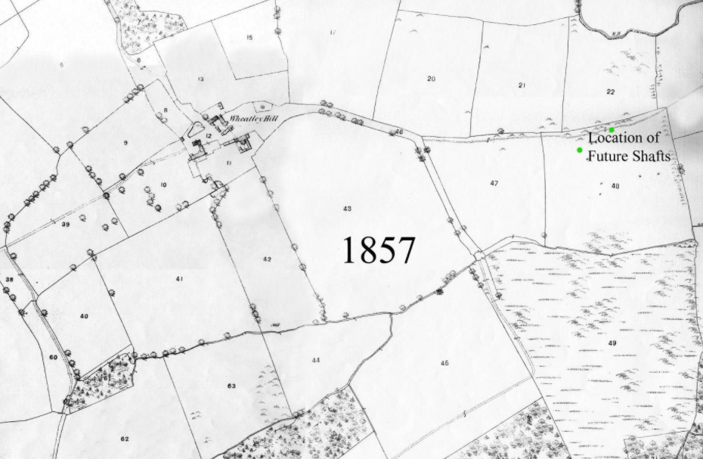
Wheatley Hill is an old mining pit village.
It looked very differently in the past.
This map is called a primary source.
It is an actual map of Wheatley Hill from 164 years ago.

Slide 4
There is not a lot to see on this map.
Can you see the fields?
Can you see the trees?
Can you see the boundary lines?
What can you not see?

Slide 5
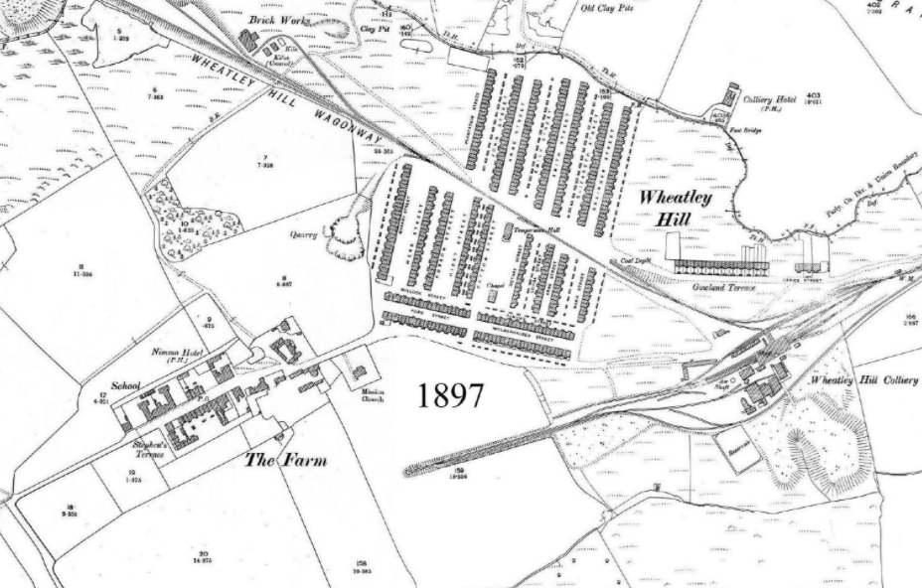
Here is another map of Wheatley Hill. This was taken 40 years after the
first one.
Look at how much Wheatley Hill changed.

Slide 6
What changes can you see?
Look at the little red dots I have put on the map. They will help you identify some changes.

Slide 7
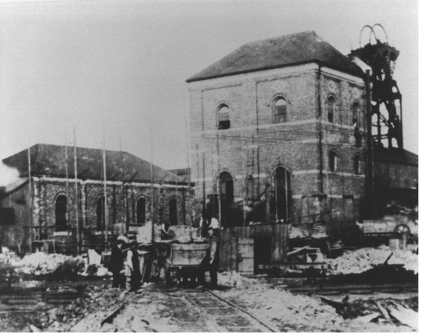
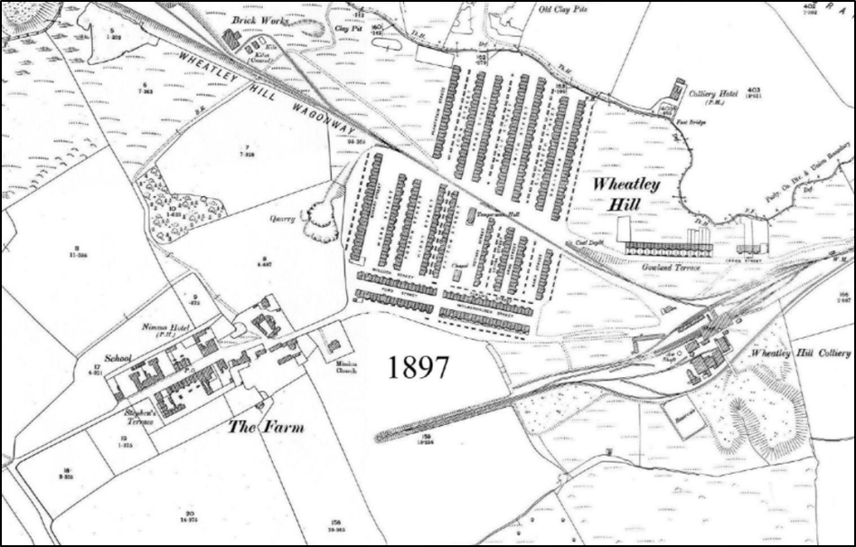
One of the biggest changes was the
opening of the Colliery Pit.
This a picture of Wheatley Hill
Colliery Pit in 1890.
The pit was opened twenty-one years
earlier in 1869.

Slide 8
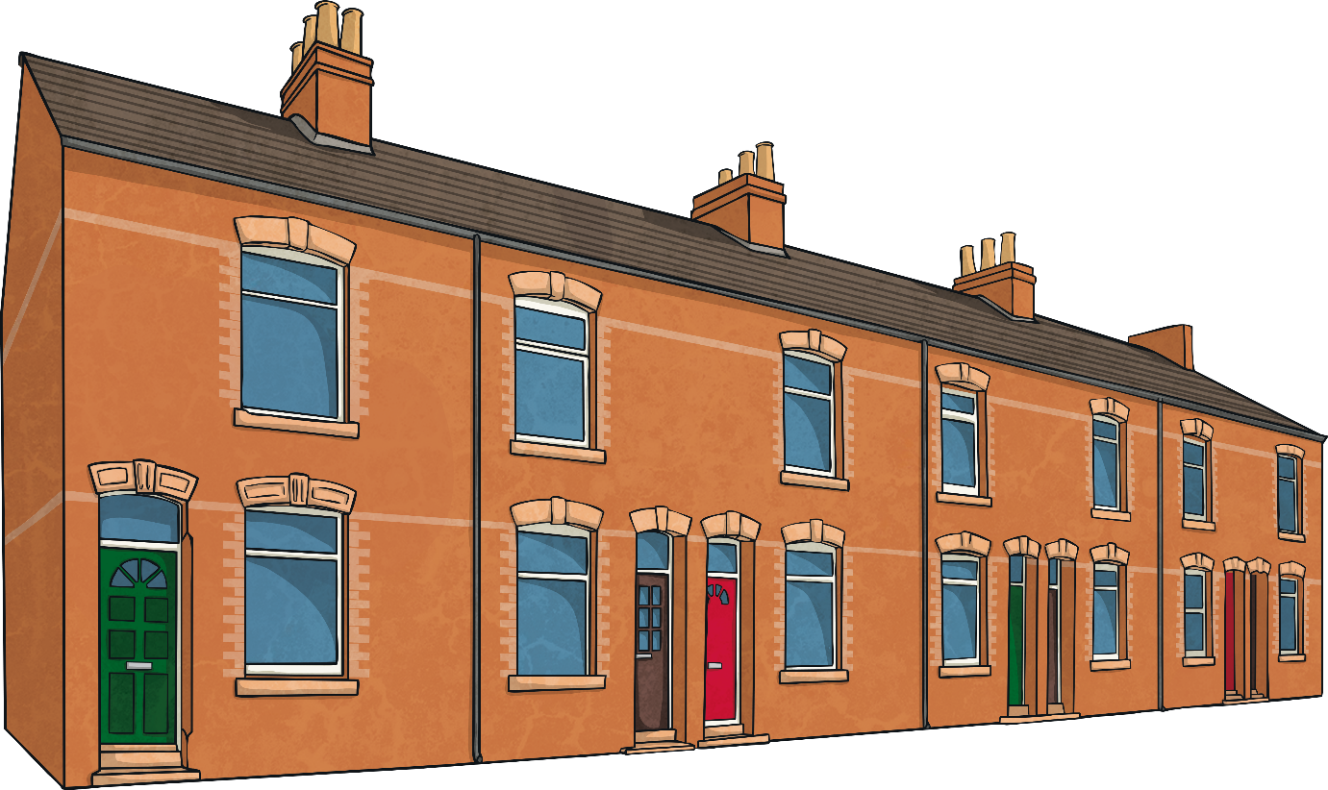
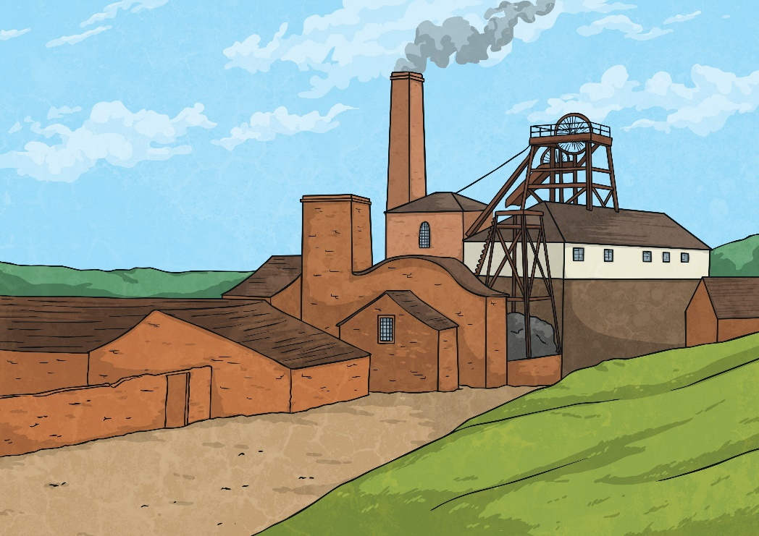
Coal was an important material to fuel the copper, ironworks and railway industries. Another important purpose of coal was to heat buildings as well as to cook food.
Many people moved to be closer to the coal pits. As a result, mass housing was built hurriedly.
Wheatley Hill grew rapidly as people moved to work in the coal mine.

Slide 9
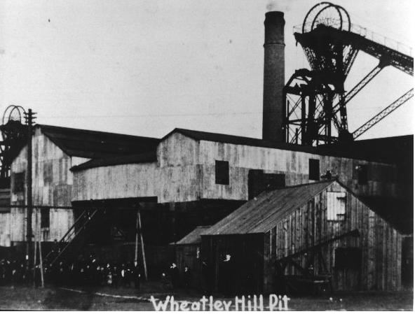
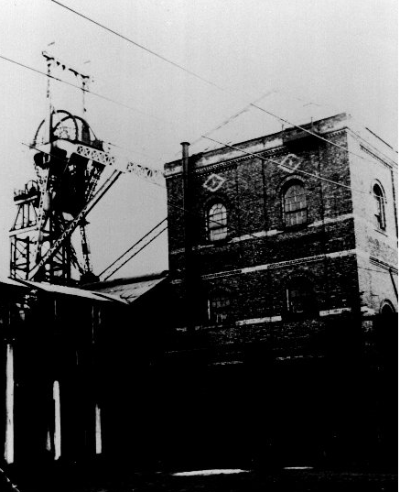
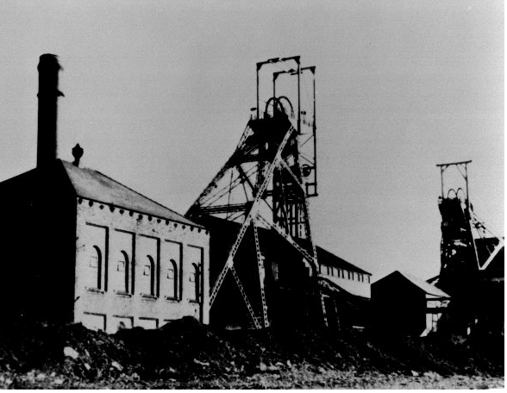
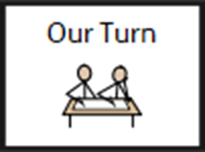
Order the different pictures of the pit. Use the dates to help you.
1890
1910
1950
1968
You can label the pictures 1-4 with 1 being the earliest picture.

Slide 10
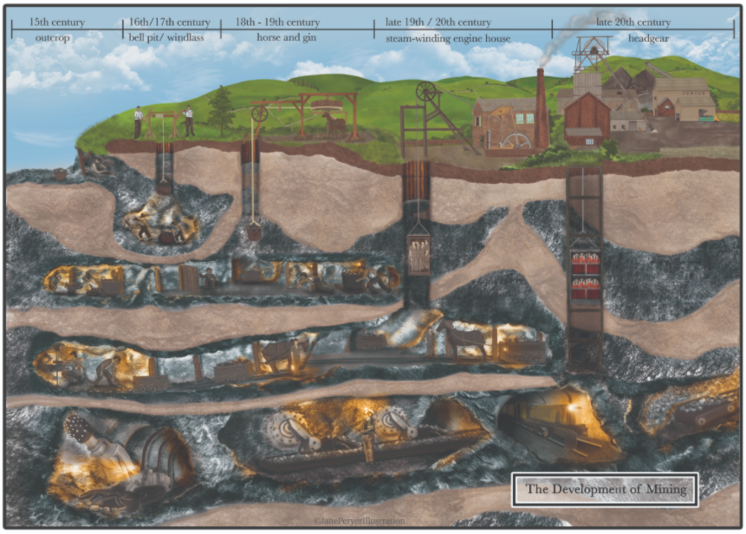
Mining changed over the different centuries .
Mining looked like this in Wheatley Hill.
Look at the timeline across the top of the image for the dates and how coal was mined.

Slide 11
Mines used a shaft to get to the layers of coal beneath the surface. Miners, equipment and coal are transported underground along horizontal tunnels called roadways then coal is mined out on the return to the shaft.
Headstock
Engine house
Screening shed
Colliery houses
Cleaned and sorted coal.
Do you think it would have been easy working in the pit?

Slide 12
Look at these two maps. Write down what you can see in each map.
_____________________________
_____________________________
_______________________
_______________________
________________________________________________________________________________________________________________________________

Slide 13
Label the image of Wheatley Hill Colliery Pit.
Use the information on the previous slide to help.
1968

Slide 14
End of lesson

Slide 15
Date: Tuesday 23rd February
L.O To be able to identify how sounds are made and how we hear them
Subject: Science

Slide 16
Pre-recorded Teaching
Access the online teaching video below that will support you to complete the work in this lesson. This video will act as a support but all of the work can still be successfully understood & completed using paper-based versions of this pack. If you need further support to understand / complete work then please contact school via e-mail or telephone.
Play Video
You can also copy and paste this link if you would prefer:
https://teachers.thenational.academy/lessons/what-is-sound-chh30r?from_query=sound

Slide 17
How is sound created?
Sounds are made when objects vibrate. These vibrations make any other particles touching the object vibrate as well which get ‘pushed’ through the air. These are called sound waves. Our ears are designed to sense these air vibrations and tell our brain what type of sound we are hearing.
This means that if an object is making a sound it is vibrating. Sometimes you can see the vibrations for example when you pluck a guitar.

Slide 18
How is sound created?
Sounds are made when objects _________________
These vibrations make any _______________ touching the object
vibrate as well, which get ‘pushed’ through the______________
3. The vibrations are sensed by our ____________ which tell our
brain the type of sound we are hearing.
air ear particles vibrate

Slide 19
How are different sounds made?
Sounds come in all different volumes. What makes a sound loud or quiet? The volume depends on how strong the vibration is. The stronger the vibration the louder the sound. If you clapped your hands really softly, you will hear a quiet sound. If you clap them hard together, you will create a louder sound because the vibrations are stronger.
When you move further away from the source of a sound, it gets quieter. When you watch T.V and go into another room, it will be much quieter than if you were sitting right in front of it.

Slide 20
How does sound travel?
Sound can travel through solids, liquids and gases.
Soundwaves can travel through solid forms such as bricks and glass which is why you might hear noise outside of the class or school.
In liquid forms, such as under water, particles are closer together so vibrations and soundwaves move quicker.
In gas forms, such as air, sound travels through vibrating particles.

Slide 21
How do you prevent sound?
If there is a sound you want to stop, you need to block the particles from vibrating. You can do this through solid objects, such as closing a door to stop the sound on the other side making it through. You can also use soft objects, such as ear muffs, as they prevent most of the the vibrations from reaching your ears.
You can try blocking the vibrations yourself. Say something outload. Now say the same thing, but this time cover your mouth. Was it quieter? That’s because your hand (a solid object) is blocking the vibrations in the air.

Slide 22
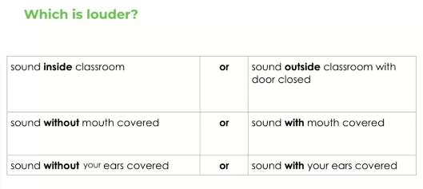
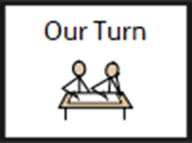
How do you prevent sound?
Discuss this with a friend or an adult

Slide 23
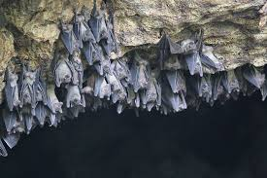
How do animals use sound?
When particles vibrate so quickly, it creates ultrasonic sound. When this happens, sounds are created that humans can’t hear but other animals who have sensitive hearing can. For example, dog whistles create a sound that humans cannot hear but dogs can.
Rats and mice use ultrasonic sound to communicate so they can talk without animals such as cats being able to hear them.
Bats use sound to forage and feed. They send out sound waves to the walls of the cave. When the sound reaches back to their ears, they build a detailed map of everything around them which makes it easier to find food.
Forage means to search for food

Slide 24
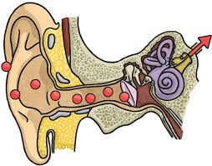
How do we hear sound?
While the particles are vibrating, they will eventually make their way towards your ears and are funnelled into a small spot.
Vibrating particles are small enough to get in to your ear and travel down the ear canal. They travel all the way down until they hit the ear drum. Then they vibrate the ear drum through some small bones which goes all the way to the cochlea. This is the part of the body that tells your brain the kind of sound you have heard.

Slide 25
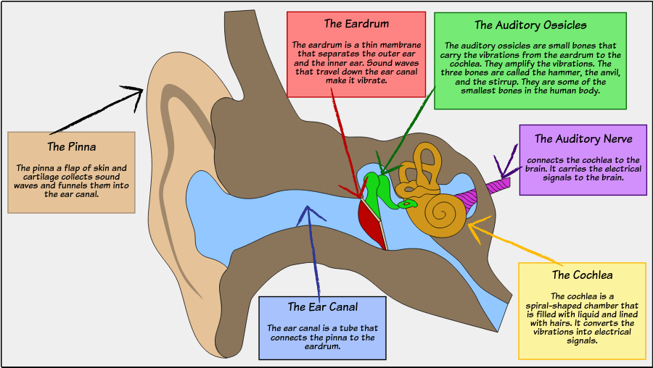
Parts of the ear
Can you see where the cochlea is?

Slide 26
How do we hear sounds?
When vibrating particles reach our ears, they travel down our
ear canal until it reaches our ______ __________
2. It is our ____________ that sends signals to our brain to tell us what
sound we can hear.
3. Animals can communicate, hunt and feed because of ______________ sound.
Cochlea Ultrasonic ear drums

Slide 27
Label the parts of the ears. The ear parts are listed below the picture.

Slide 28
Finish these sentences.
Sound is made when__________________________________________
When the vibrations are stronger _______________________________
Animals use sound to _________________________________________
When vibrating particles enters our ears, it travels through your _____
___________ and vibrates our _______ __________
5. The cochlea sends signals _______________________________

Slide 29
End of lesson

Slide 30
Date: Wednesday 24th February 2021
LO: To be able to learn about Christian worship and beliefs
Subject: R.E

Slide 31
Pre-recorded Teaching
Access the online teaching video below that will support you to complete the work in this lesson. This video will act as a support but all of the work can still be successfully understood & completed using paper-based versions of this pack. If you need further support to understand / complete work then please contact school via e-mail or telephone.
Play Video
You can also copy and paste this link if you would prefer:
https://classroom.thenational.academy/lessons/where-do-christians-worship-71k64t?activity=video&step=2

Slide 32
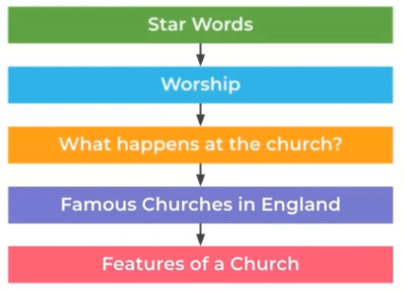
What are we going to look at today?
Key words

Slide 33
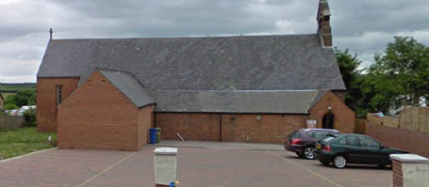
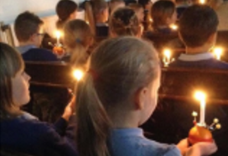
Both Year 3 and 4 have experienced visiting our local church in Wheatley Hill to celebrate Christingle.

Slide 34
What is worship? Worship can be defined in many ways but is mostly when people communicate with God in order to praise, to give thanks, say sorry and to ask God for help. Although many Christians prefer to gather together in churches, they can worship anywhere. In our school, our local vicar Jayne, celebrates ‘Open the book’ with us and shares stories about Jesus and God.

Slide 35
Where can Christians worship?

Slide 36
People can go to church anytime but many gather together on a Sunday in particular. Sunday is also known as the Sabbath Day or Holy Day. On this day, Christians believe that it is a day for rest and worship.

Slide 40
(you-ca-rist)
Eucharist is the taking of wine and bread at the church. It is also known as the Lord’s Supper (last supper) or taking Communion. It allows Christians to remember that Jesus died for their sins.

Slide 42
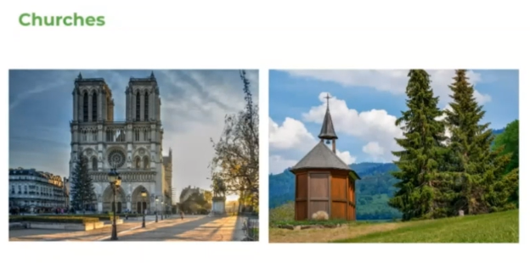
Churches can come in different sizes and styles. Larger churches are know as Cathedrals, such as Durham Cathedral.

Slide 43
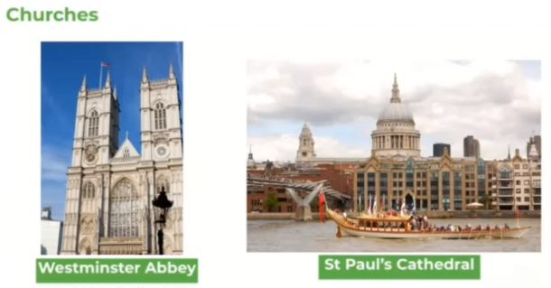
These are two examples of well know churches in England.
Do you recognise any of them or know where they are?
You can find them both in London. Below is web link if you would like to take a closer look inside of Westminster Abbey.
https://www.westminster-abbey.org/learning/virtual-tours

Slide 44
This is a floor plan of a church and as you can see they are built to look like crosses when looked at from the sky.

Slide 46
The nave is the part of the church where people sit.

Slide 48
The pulpit is a raised booth where the priest performs his sermons (teachings).

Slide 50
A font is a special bowl, which is filled with Holy water for baptisms.

Slide 52
A lectern holds the Bible for people to read from it aloud.

Slide 54
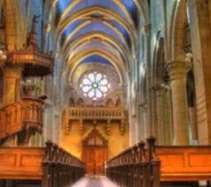
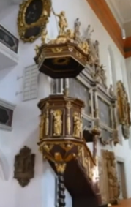
Your task
Using the information from the power point or video, name the item and write down what it is used for.
Nave
The nave is in the middle of the church and is where people sit.

Slide 55
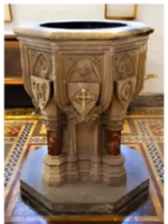
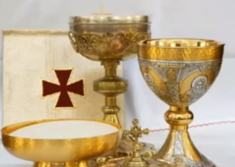
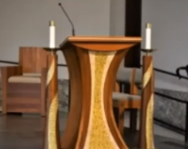

Slide 56
End of lesson

Slide 57
Thursday 25th February 2021
L.O To be able to count from 1-20.
Subject: French

Slide 58
Today, we will be counting from 1-20.
1 sept
2 dix
3 quatre
4 neuf
5 un
6 huit
7 deux
8 cinq
9 trois
10 six
We have already learned how to count from 1-10, let’s refresh our memory.
Match the numbers to the correct numbers in French. The first one has been done for you.
Get help from a partner or ask an adult at home if you can.
Click or copy and paste the following link to watch the video again:
https://www.youtube.com/watch?v=lsc3qLMaCu8

Slide 59
Watch the video using the link below to help you pronounce the numbers 11-20 in French.
Click or copy and paste the following link:
https://www.youtube.com/watch?v=UsEz58BblMY

Slide 60
Let’s have another look at the numbers 11-20.
Number | French Word | Phonetic Pronunciation
11 | onze | onz
12 | douze | dooz
13 | treize | trez
14 | quatorze | kah-tohrz
15 | quinze | cans
16 | seize | sez
17 | dix-sept | deese-set
18 | dix-huit | deese-wheet
19 | dix-neuf | deese-nurf
20 | vingt | vahn
Use the table to help you pronounce the numbers 11-20. Make sure you say them all out loud.
This column shows you how to pronounce the French word correctly.
This column shows the correct French spelling of each number from 11 to 20.

Slide 61
Notice how some of the numbers from 1-10 are similar to numbers 11-20.
Numbers 1-10 |  | Numbers 11-20
1 | un | onze | 11
2 | deux | douze | 12
3 | trois | treize | 13
4 | quatre | quatorze | 14
5 | cinq | quinze | 15
6 | six | seize | 16
7 | sept | dix-sept | 17
8 | huit | dix-huit | 18
9 | neuf | dix-neuf | 19
10 | dix | vingt | 20
This might help you remember the numbers 11-20 more easily.

Slide 62
Numbers 1-10 |  | Numbers 11-20
1 | un | onze | 11
2 | deux | douze | 12
3 | trois | treize | 13
4 | quatre | quatorze | 14
5 | cinq | quinze | 15
6 | six | seize | 16
7 | sept | dix-sept | 17
8 | huit | dix-huit | 18
9 | neuf | dix-neuf | 19
10 | dix | vingt | 20
For example,
7 is sept and,
17 is dix-sept.

Slide 63
Work with a partner or an adult at home if you can.
Test yourself to see if you can remember the numbers that are missing from the next slide.
Remember, some numbers might be similar to those from 1 – 10.

Slide 64
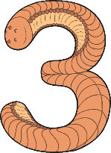
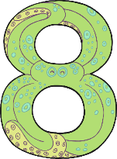
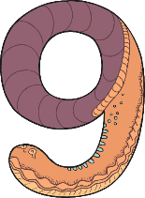
onze | douze | _____________ | _____________ | quinze
_____________ | dix-sept | _____________ | _____________ | vingt

Slide 65
Answers
onze | douze | _____________ | _____________ | quinze
treize
quatorze
_____________ | dix-sept | _____________ | _____________ | vingt
seize
dix-huit
dix-neuf

Slide 66
Task
Look at the picture on the next slide then answer the following questions in French.
Write your answers underneath. The first one has been completed for you.
1. What number is on the bus?
vingt
The number _____________ is on the bus.
2. How many apples are on the tree?
There are ___________ apples on the tree.
3. How many animals are in the pond?
4. How many spots on the dog?
5. How many flowers can you spot?

Slide 67
You can colour in the picture when you have answered all of the questions.

Slide 68
End of lesson

Slide 69
Date: Friday 26th February 2021
L.O To be able to make different sounds
Subject: Science

Slide 70
Pre-recorded Teaching
Access the online teaching video below that will support you to complete the work in this lesson. This video will act as a support but all of the work can still be successfully understood & completed using paper-based versions of this pack. If you need further support to understand / complete work then please contact school via e-mail or telephone.
Play Video
You can also copy and paste this link if you would prefer:
https://teachers.thenational.academy/lessons/how-are-different-sounds-produced-6nj3et

Slide 71
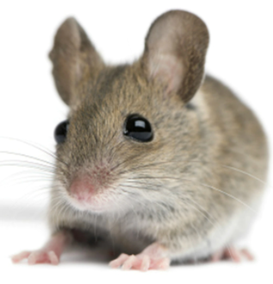
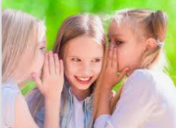
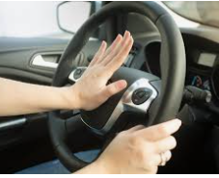
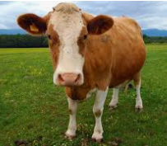
All sounds are made by making vibrations through the air.
The vibrations come from different objects are very different.
Sometimes they sound high pitched like a mouse’s squeak or low like a cow’s moo.
Sometimes they are very quiet like a whisper or very loud like a car horn.

Slide 72
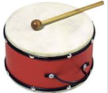
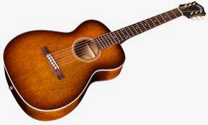
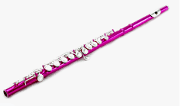
Every time there is a kind of sound, vibrations travel through the air. This means that, to create a sound, all we need to do is create vibrations in the air. We can do this by striking something (like a ), plucking it (like a ) or blowing through it (like a ).

Slide 73
What are three ways can a sound be created?
S ______________________
P ______________________
B ______________________

Slide 74
Remember, a high pitched sound is a high sound like a mouse’s squeak.

Slide 75
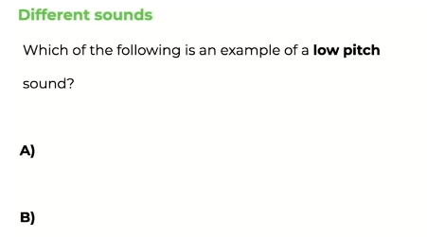
Remember, a low pitched sound is a low sound like a cow’s moo.

Slide 76
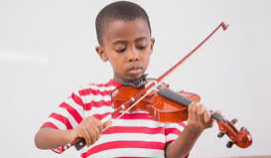
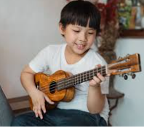
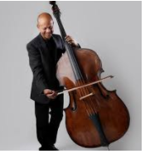
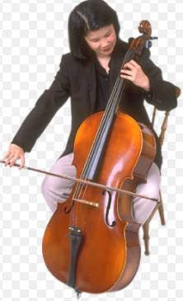
Different instruments create different sounds.
Violin
The larger the instrument the lower the pitch. The smaller the instrument the higher the pitch.
Cello
Ukulele
Double Bass

Slide 77
Label these instruments as high pitched or low pitched.
Violin
Cello
Ukulele
Double Bass

Slide 78
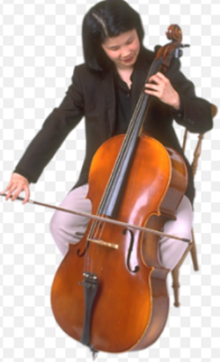
Well done if you labelled the instruments like this.
High pitched
Low pitched

Slide 79
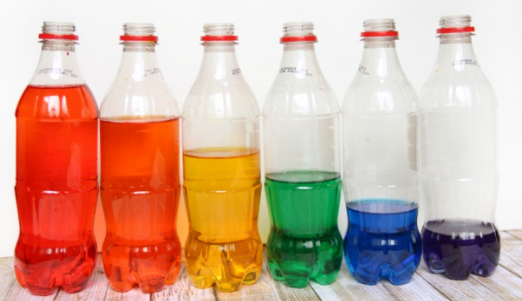
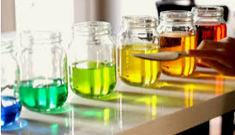
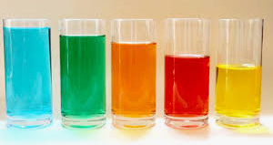
Lets investigate
You will need:
4-6 water bottles/jars/glasses that are all the
same size and made out of plastic or glass.
Water
A wooden spoon, pencil or stick
Food colouring is optional to change water colour
You are going to make your own ‘Water bottle xylophone’

Slide 80
Follow these instructions to make your own ‘water bottle xylophone.’
1. Open and clean out each of the jars/ bottles/glasses and line them up in a row.
2. Fill the glasses with different amount of water, trying not to fill any jars more than halfway. Each jar is a different note to your xylophone - it’s easier to play if the notes are in order. Sort the jars in order of how much water is in each jar.
You can watch a short video here
3. If you’d like to add some extra flair, you can use a few drops of food colouring in each jar so they vary by colour.
4. Now you’re ready to play! Use a wooden
spoon as a beater to tap against the side of a
glass to play a note. Can you play a tune?
https://www.bbc.co.uk/teach/bring-the-noise/found-sounds/z4rcbdm

Slide 81
When you tap a jar with the spoon it vibrates, making that clinking sound. The faster something vibrates, the higher the ‘pitch’ of the sound it makes. Adding water to the jar makes the jar vibrate more slowly, lowering the pitch of the sound.
For xylophones and glockenspiels, it’s the length of the bars that are hit that changes the pitch. The shorter bars vibrate faster, and make a higher pitched note.

Slide 82
Draw a diagram of what your ‘xylophone’ looks like.
Add labels to your diagram. Use the word bank below to help.
water jars bottles glasses spoon pencil stick food colouring

Slide 83
What did you notice?
The container that had the most amount of water ___________________
_______________________________________________________________
2. The container with least amount of water ___________________________
_______________________________________________________________
3. To create a high pitch sound you need ______________ water.
4. To create a low pitch sound you need _______________ water.

Slide 84
End of lesson
End of lesson

