Slide 1
Monday 11th January 2021
L.O To be able to compare to different regions in Brazil
Subject: Geography

Slide 2
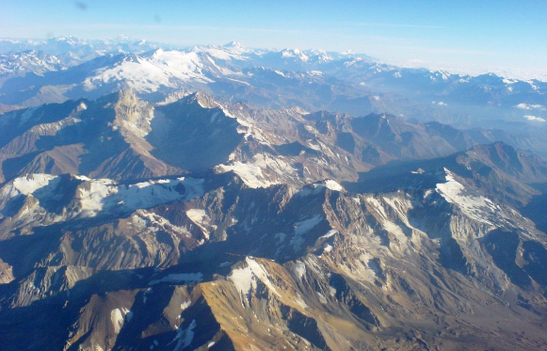
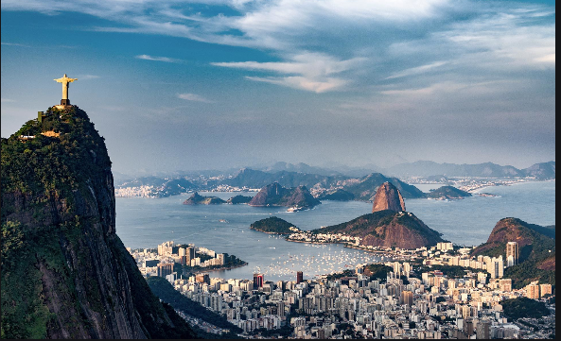
The Andes Mountains Rio de Janeiro
What differences can you see between the two regions?

Slide 3
The Andes Rio de Janeiro
Here are some that I thought of…..
Looks warmer
Looks cold
Has statues
Snow on top
Looks busy
Looks dangerous
Next to the sea
Mountains
Looks like people don’t live here
Populated by people
Tall buildings

Slide 4
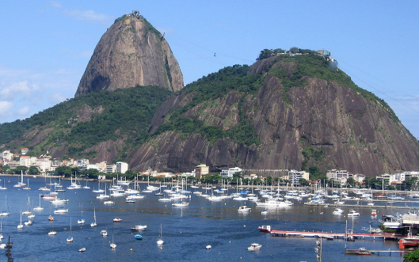
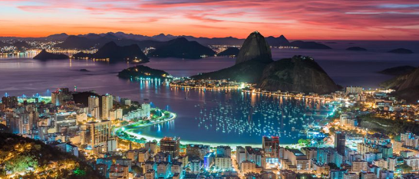
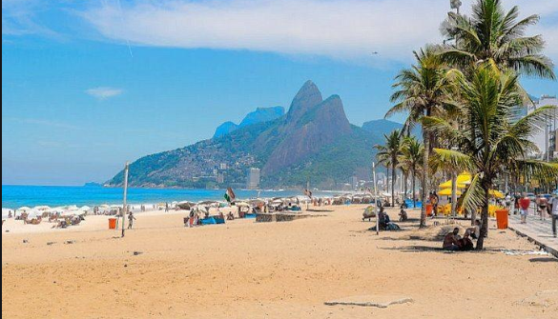
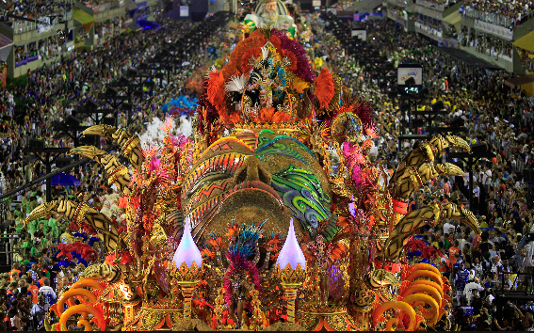
Rio de Janeiro
It’s the second largest city in Brazil
It has beautiful beaches
It attracts a lot of tourism
The have a yearly festival called carnival where lively parades last all day and night
They have many landmarks including Christ the Redeemer and Sugar Loaf

Slide 5
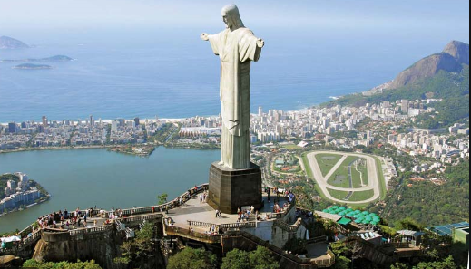
Christ the Redeemer
The statue of Christ the Redeemer is a religious statue which can be found on the top of Corcovodo Mountain. It is a 30 metre tall statue of Jesus Christ with his arms stretched out embracing the city and has been there since 1931.

Slide 6
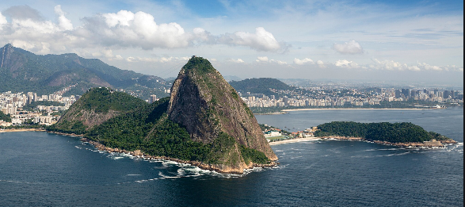
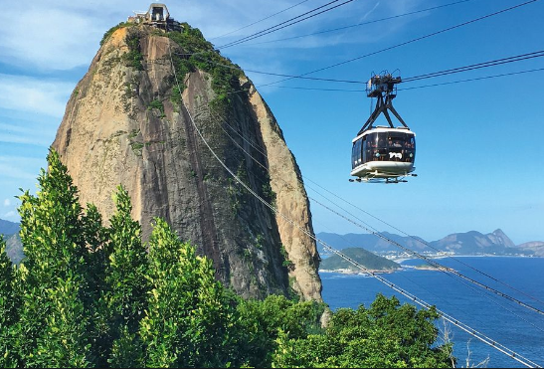
Sugarloaf Mountain in Guanabara Bay
Sugarloaf Mountain is one of the world’s most famous natural landmarks. The name comes from the mountain’s resemblance to a sugarloaf. The top can be reached by cable cars and an amazing view across the city and bay can be seen from there.

Slide 7
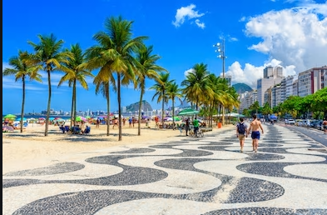
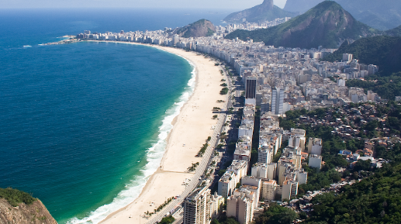
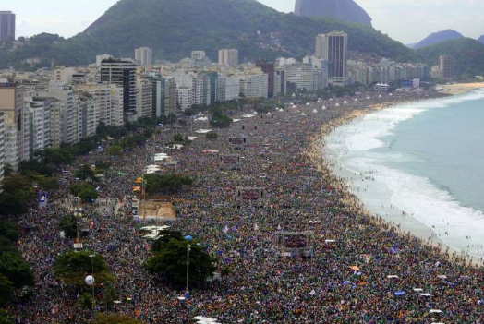
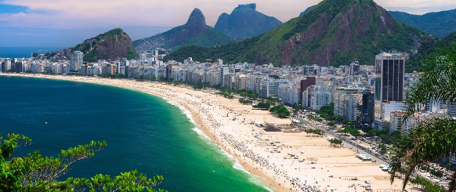
Copacabana Beach
Located in Rio de Janeiro Copacabana Beach is one of the most famous and most beautiful beaches in the world.
It is 4km long.
It attracts many tourist
It has lots of bars and restaurants
Photo courtesy of GovBa (@flickr.com) - granted under creative commons licence - attribution

Slide 8
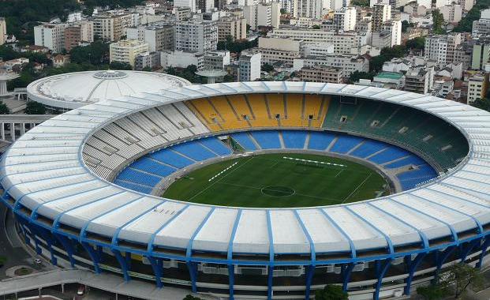
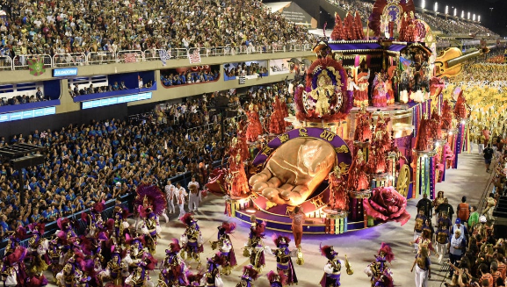
Maracana Stadium Carnival
Football fans may like to visit this famous football stadium. It was named after the Rio Marcana, a river in Rio de Janeiro and many famous footballers have played here.
Rio de Janeiro is famous for its carnival. Even though carnivals are celebrated all around the country, Rio is known as the capital of carnival. The carnival lasts for three days. During that time, Rio is filled with dancing, music, singing and lots of street parades showcasing colourful costumed dancers performing the samba.
Photo courtesy of Around the rings1992 (@flickr.com) - granted under creative commons licence - attribution

Slide 9
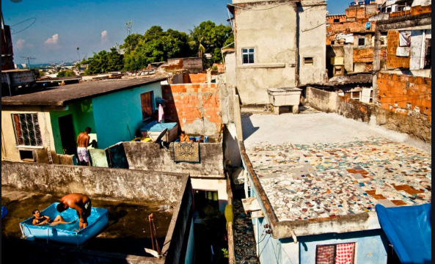
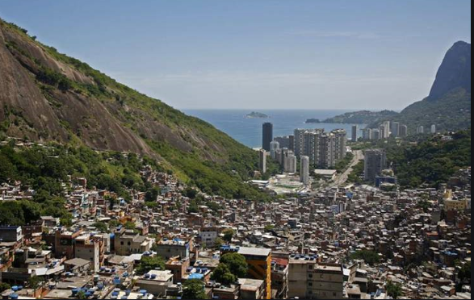
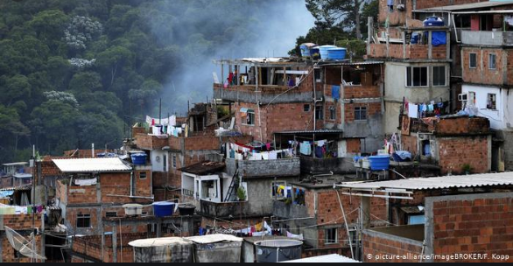
Favelas
There are many poor people living in Rio de Janeiro. These people often live in places known as favelas which is a slum/ shantytown which is located on the outskirts of the city.
They are very dangerous areas with high rates of crime including murder and theft.

Slide 10
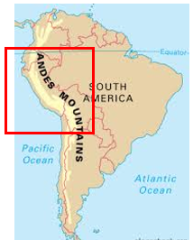
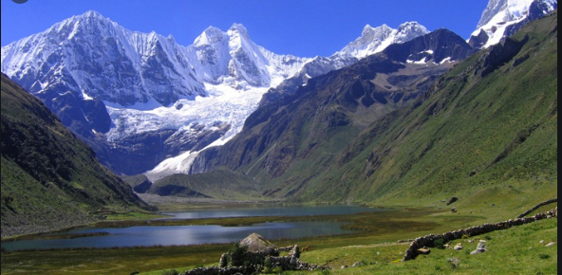
The Andes Mountains
It is the longest mountain range in the world
The Andes is about 5,500 miles long and 200 miles wide
Few people live in the mountains but those that do are farmers

Slide 11
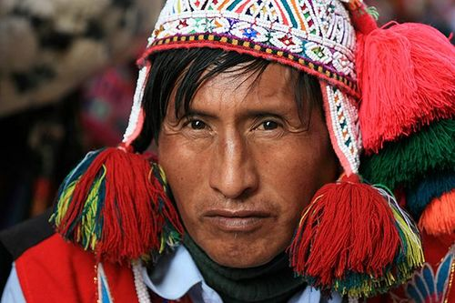
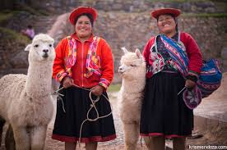
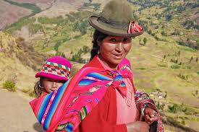
People who live in the Andes Mountains
The Quechua people live high in the Andes Mountains in South America.
The Quechua people live high in the Andes mountains where the soil is poor and not good for growing crops.
It is always cold in the mountains and it can also be dry and very windy.
This makes life difficult.

Slide 12
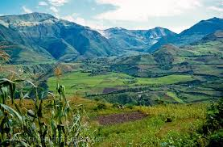
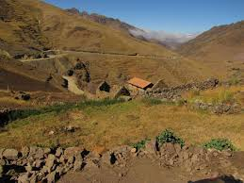
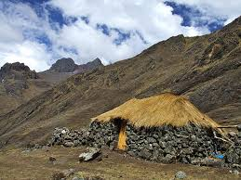
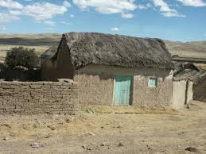

Slide 13
Life in the Andes
Quechua homes are made of stone, or bricks made of mud, with a roof of dried grass. They are very small with no electricity or running water.
They cook over a fire and have to search for wood to burn as there are very few trees. They also use dried llama droppings as fuel.

Slide 14
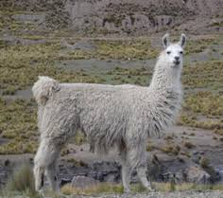
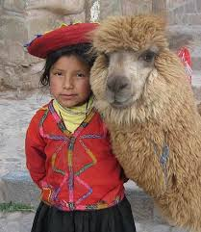
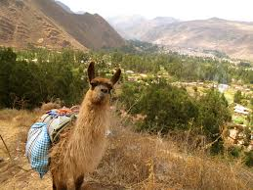
Lifestyle
The Quechua love their llamas and look after them very well
Each year the llamas are sheared because their fleece is very valuable.
The Quechua travel into the city to sell their fleeces at the market. This is almost all the money they can earn.
Sometimes they exchange the fleeces for other things they need.

Slide 15
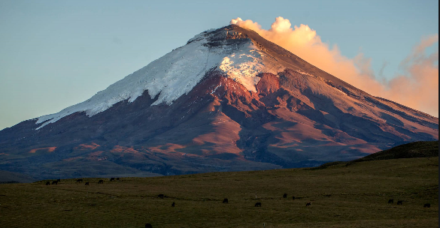
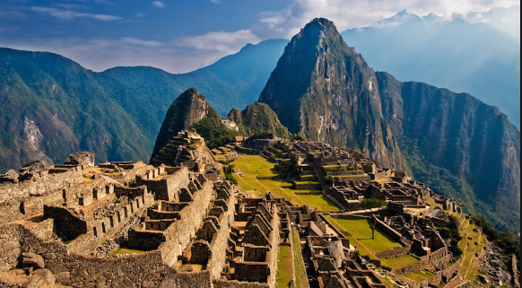
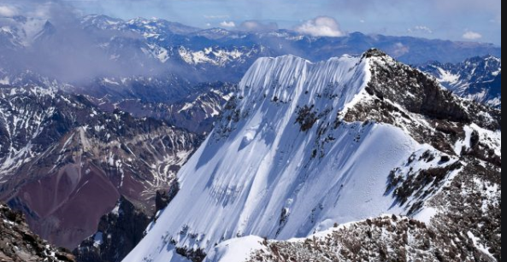
Tourism
The Andes mountains are considered a paradise to hikers.
It attracts many visitors every year
Many love to go trekking for days into the hills to see the stunning views, the old ruins, the volcanoes and climb mountains

Slide 16
Your challenge….
Thinking about everything you have learned about Rio de Janeiro and the Andes, you need to create a poster for the place you would prefer to live in.
Can you include the good points about this place and why it is better than the other?

Slide 17
Tuesday 12th January 2021
L.O To be able to compare to compare life in Rio de Janeiro and the Lake District
Subject: Geography

Slide 18
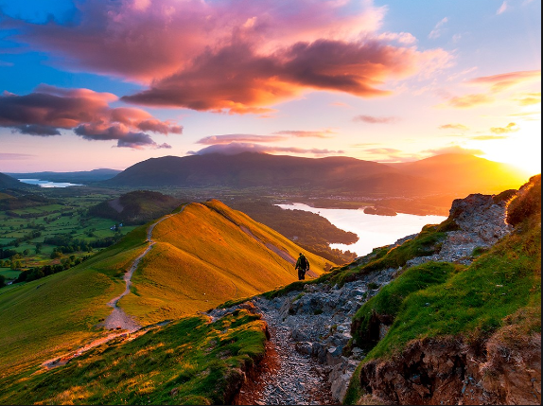
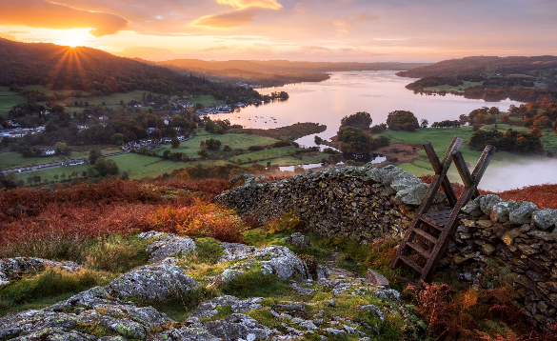
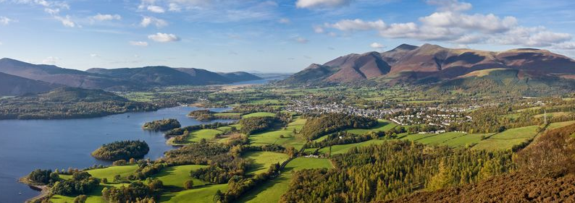
The Lake District
A mountainous region in England
A popular holiday destination
Rural
Famous for its lakes, forests and mountains
Has more than 100 mountain peaks
Five hundred million years ago it was an area of volcanoes and bubbling lava which
Click on the link to learn more https://www.bbc.co.uk/bitesize/topics/z3fycdm/articles/zvys8xs

Slide 19
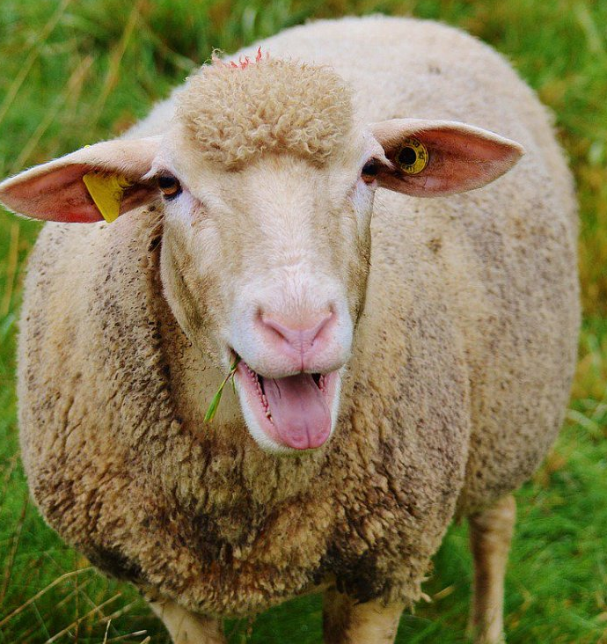
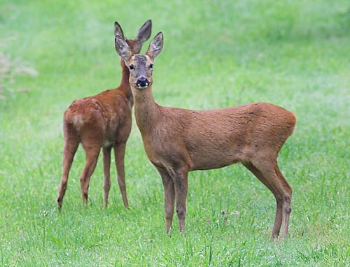
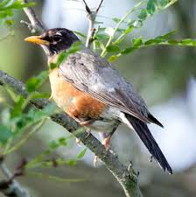
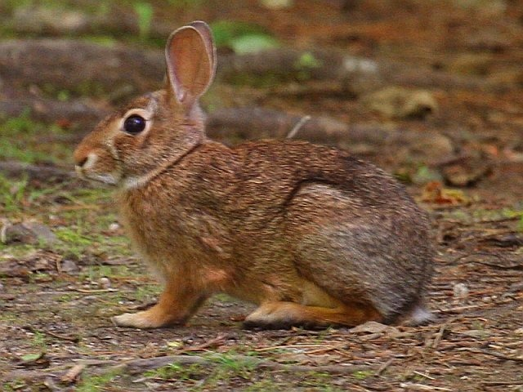
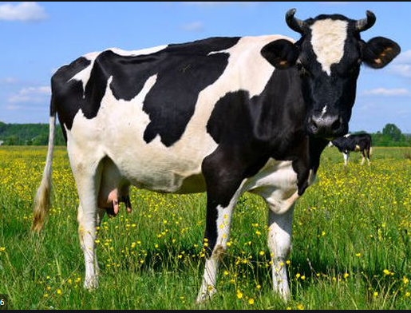
Animals found in the Lake District

Slide 20
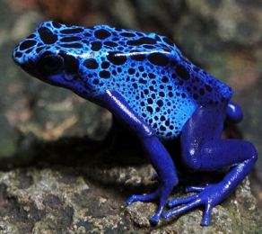
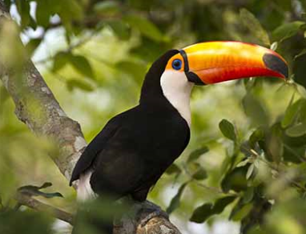
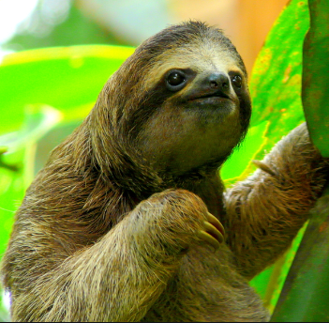
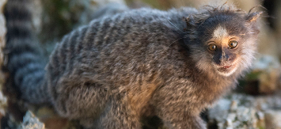
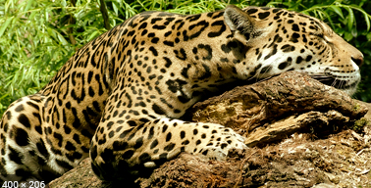
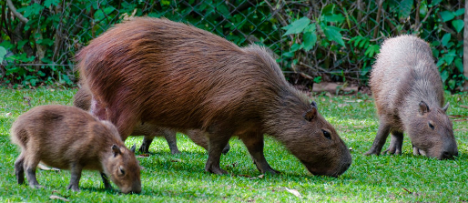
Animals found in Rio de Janeiro

Slide 21
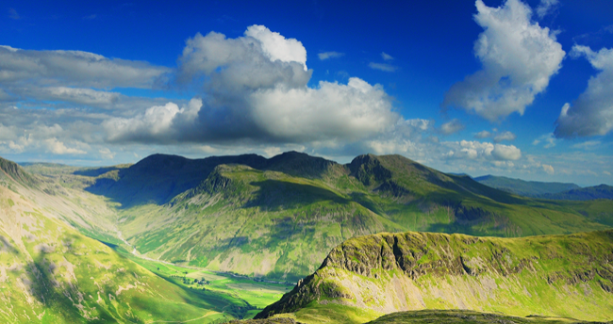
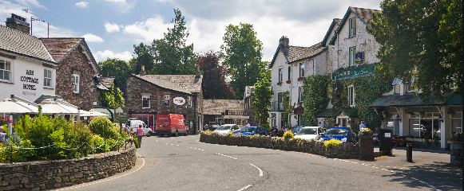
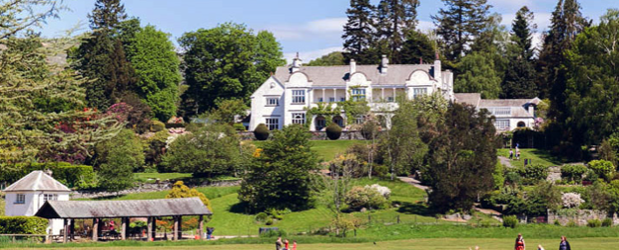
Popular places in the Lake District
Scafell Pike - (England's highest mountain)
Grasmere – (A village which attracts a lot of tourism )
Brokhole – Outdoor attraction with a range of activities including zip-lines and archery
Ullswater – Popular lake with views of the mountains

Slide 22
Popular places in Rio de Janeiro
Copacabana beach – popular tourist destination
Christ the Redeemer – Famous statue
Sugarloaf Mountain – best known landmark
Marcana Stadium – Brazil’s largest football stadium

Slide 23
Life in the Lake District
Small rural primary schools
They all live in small towns and villages
Farming is a core part of the Lake District’s economy
They have milder winters and cooler summers than most of the UK

Slide 24
Life in Rio de Janeiro
They have large international schools
There is a strong contrast between rich and poor people in Rio. The wealthy live in the city centres and surrounding areas in villas whilst the poor live in the suburbs in self-built homes called favelas.
Finance, manufacturing, trade and tourism form a large part of Rio’s economy

Slide 25
Using the information you have learned and any additional facts you know, your challenge is to complete the table below.

Slide 26
Wednesday 13th January 2021
L.O To be able to use a map to identify major cities across the world
Subject: Geography

Slide 27
Capital cities
There are 195 capital cities in the world. Can you guess what city it is and which country it is in by the picture?

Slide 28
How did you do?
London - England
Berlin – Germany
Paris - France
Rome – Italy
Moscow – Russia

Slide 29
Our challenge
Today you need to use a map to locate these capital cities and write them on the map. Once you have finished choose three more of your own
Paris
London
Moscow
Rome
Brussels
Canberra
Ottawa
Brasilia

Slide 31
Thursday 14th January 2021
L.O To be able to research a capital city and create a fact file
Subject: Geography

Slide 32
London
Country – England
Population – 8.982 million people live in London
Currency – pound sterling
Language – English
Someone famous from London – Queen Elizabeth
Famous landmarks in London – Big Ben, Buckingham Palace, Tower of London
Interesting facts about London – over half of London underground runs above the ground and it has more Indian restaurants than Mumbai

Slide 33
Your challenge
Using the internet to help, you need to complete the fact file about a capital city of your choice. Once you have finished, use this information to create a poster about your chosen city.
Country –
Population –
Currency –
Language –
Someone famous -
Famous landmarks -
Interesting facts -

Slide 34
Friday 15th January 2021
L.O To be able to draw a landscape
Subject: Art & Design

Slide 35
Choose one of the landscapes and sketch it. Can you choose different colours/paints to shade it in?
The Lake District The Andes Mountains

