Slide 1



Date: Monday 28th June 2021
LO: To be able to spell homophones and near-homophones.
Subject: English

Slide 2
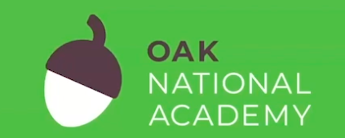
Follow the link to watch the Oak National Academy lesson investigating homophones.
https://classroom.thenational.academy/lessons/to-investigate-homophones-6wuk6c?step=1&activity=video

Slide 3

What are homophones?
Homophones are…
A) words that have the same spelling and sound the same.
B) words that sound exactly the same when pronounced.
C) words that have the same meaning, or similar meanings.
D) naming words.

Slide 4
What are homophones?
The correct answer is...
B) words that sound exactly the same when pronounced.
Homophones are…

Slide 5
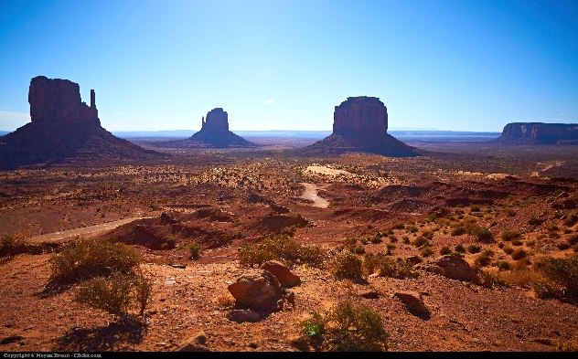
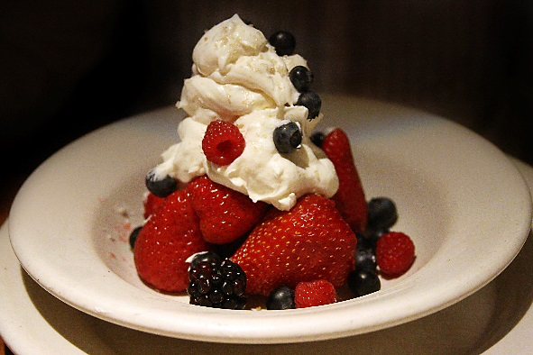
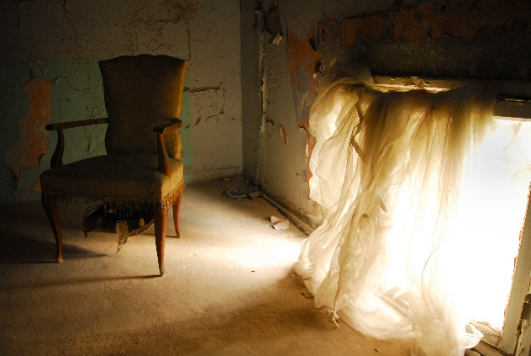
Homophones
Homophones (different words that sound exactly the same when pronounced) and near homophones (different words that sound almost the same when pronounced) can be really tricky to spell, because it can be tricky to remember which words needs which spelling.
For example:
desert
dessert
desert (verb: to abandon)
Are there homophones that you get confused with?

Slide 6
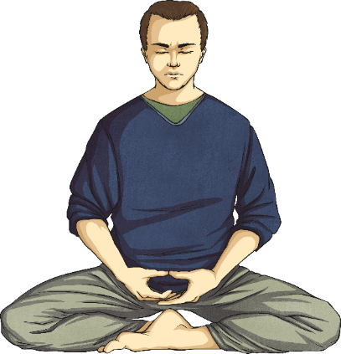
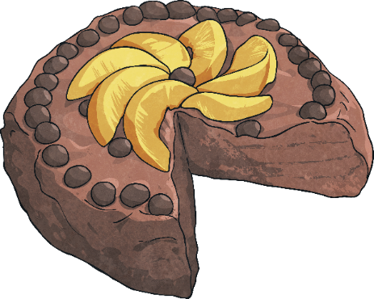
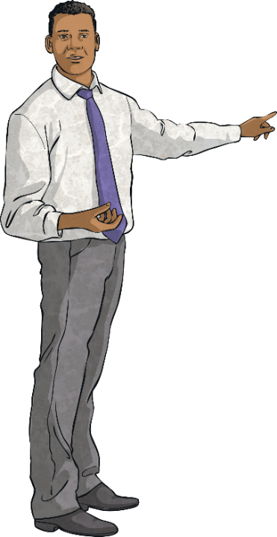
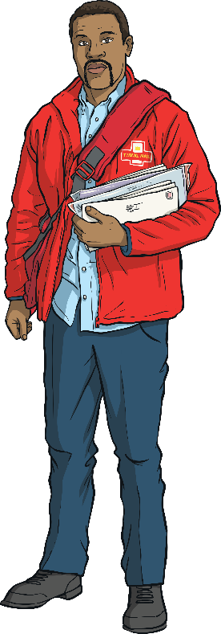
Here are some examples…
piece
peace
male
mail
I just want some peace and quiet.
I just want one piece of cake.
The postman delivered the mail.
We have a new male teacher.

Slide 7
'Their', 'they're' and 'there' are homophones that often confuse people.
there
their
they’re
refers to a place,
eg "I'm going to hide over there."
means it belongs to them,
eg "I ate their sweets."
is short for 'they are’
eg "They are going to be cross."

Slide 8
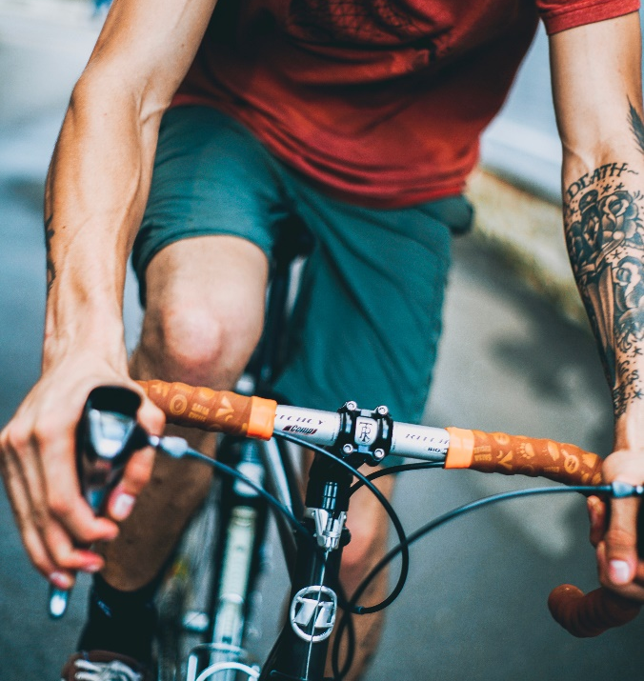
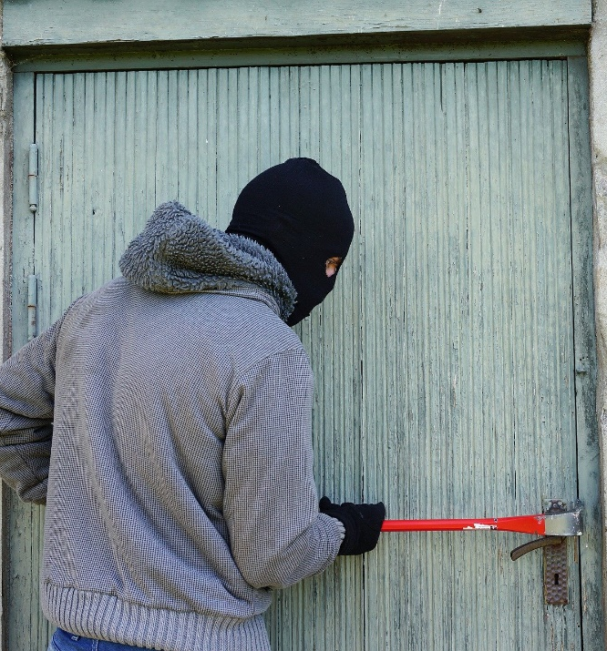

Fill in the spaces by choosing the correct homophone.
brake
break
The cyclist gripped his to slow down.
The burglar tried to in to the house.

Slide 9
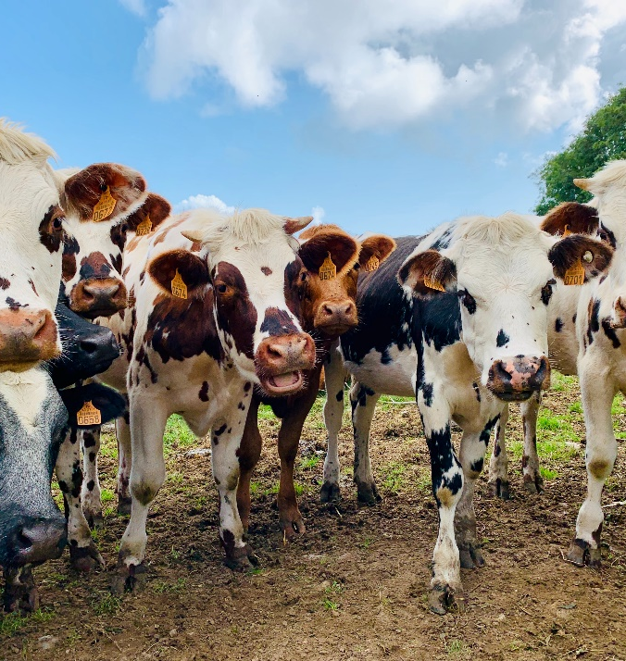
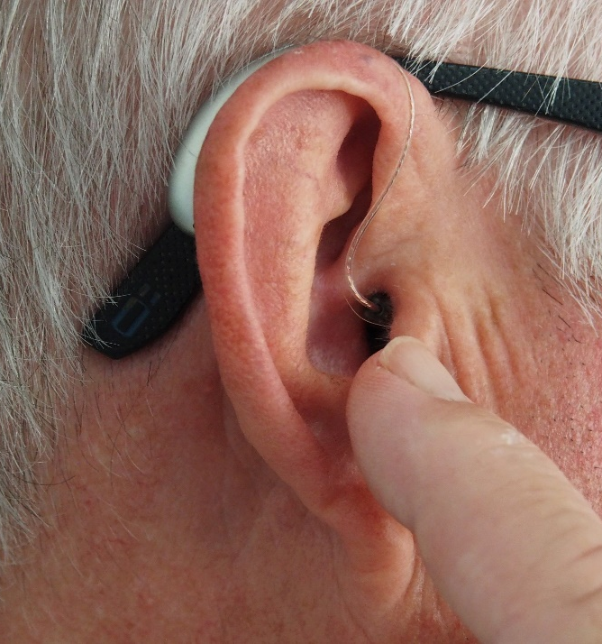
Fill in the spaces by choosing the correct homophone.
herd
heard
The farmer had a of cows.
The man a strange noise.

Slide 10
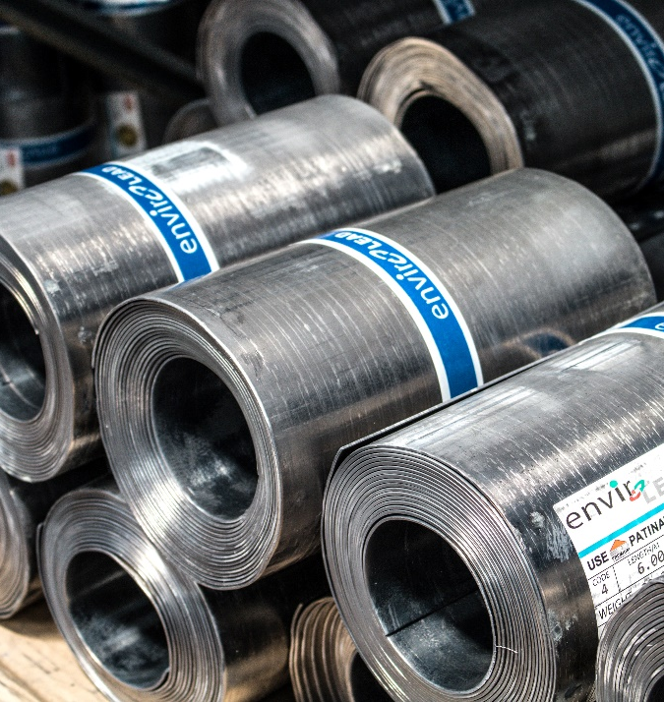
Fill in the spaces by choosing the correct homophone.
steel
steal
The bars were very strong.
The burglar attempted to the TV.

Slide 11
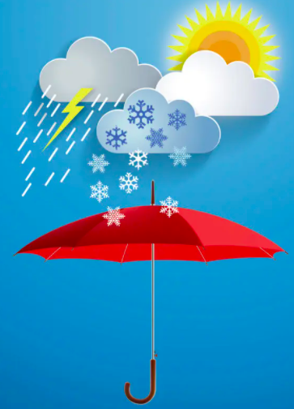
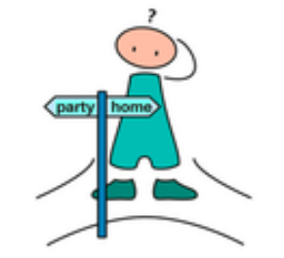
Fill in the spaces by choosing the correct homophone.
whether
weather
The is beautiful today.
I don’t know to go to the party or stay home.

Slide 12
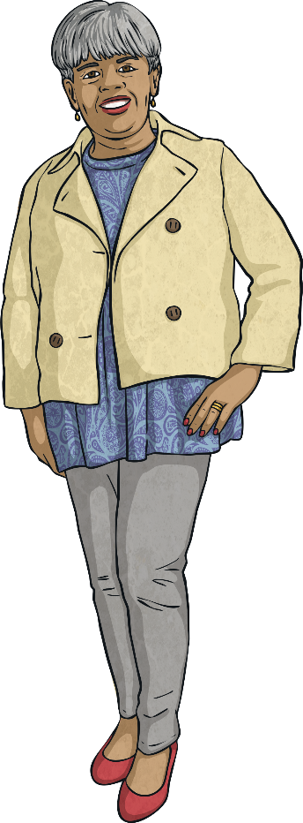
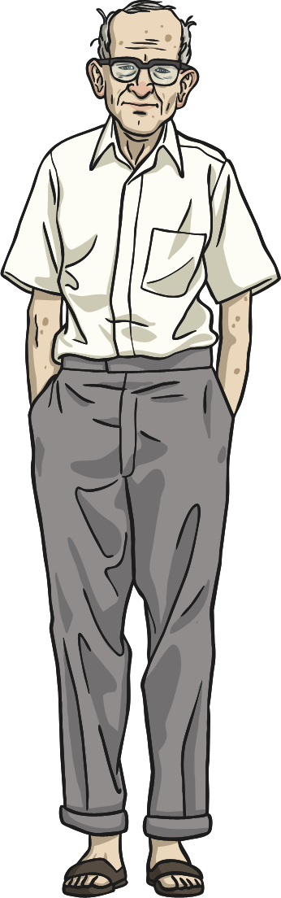

This conversation between Frank and Sheila is full of homophones. Can you spot them and change them to the correct spelling? Re-write this conversation with the correct spellings on the next slide.
Meat me buy the sign outside.
Have you scene the whether?
I can barely sea threw the missed.
Just weight over their by the mane doors.
What do I do if it’s reigning?
If it reins, meat me over hear buy the shop.
Grate. I won’t be long.
Hint: there are 16 homophones altogether.

Slide 13
______________________________________________________________________________________________________________________________________________________________________________________________________________________________________________________________________________________________________________________________________________________________________________________________________________________________________________________________________________________________________________________________________________________________________
Sheila:
Frank:
Sheila:
Frank:
Sheila:
Frank:

Slide 14
Extend
Choose a set of homophones and write a sentence for each.
________________________________________________________________________________________________________________________________________________________________________________________________________________________________________________________________________________________________________________________________________________________________________________________________________________________________________________________
there
their
they’re
whether
weather
two
too
to
blew
blue
hear
here

Slide 15

Reading time
Now that you have finished your main task, please enjoy some reading time.
You can read to yourself, an adult or sibling.
This can be done by logging on to your myON account, picking a book or magazine and enjoying at least 15 minutes reading time.
https://www.myon.co.uk/login/index.html
Remember that your login is your first name and first letter of your surname then password:
harryp
password1
Please email trailblazerspupils@gmail.com if you have any login issues.

Slide 16
End of lesson

Slide 17
Date: Tuesday 29th June 2021
LO: To be able to correctly punctuate sentences using hyphens.
Subject: English

Slide 18
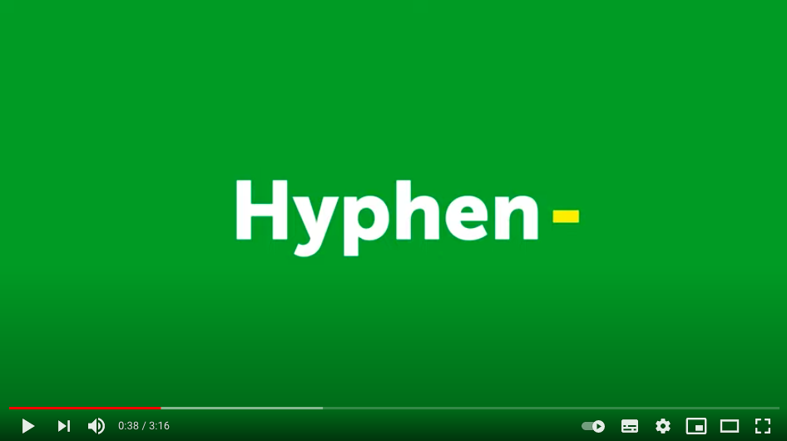
Follow the link below to watch the video about hyphens.
https://www.youtube.com/watch?v=1F7wFwdcfKg

Slide 19

What is a hyphen?
A hyphen is a punctuation mark that looks like a little horizontal line.
Hyphens join together words or parts of words.
This is a hyphen.
-
E.g. small-scale, re-formed.
Hyphens are very useful as they can help to clarify the meaning of a word or phrase and avoid ambiguity in writing. Look at the example below:
Paula decided to resign from her job.
Steve re-signed his contract.

Slide 20
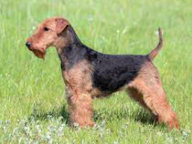
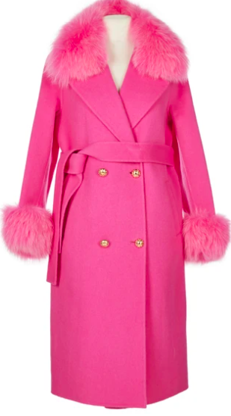
Creating a Compound Adjective
Hyphens can be used to link two separate words into a compound adjective before a noun.
The terrier padded across the room on its bear-like paws.
Georgina hung her hot-pink coat on the hook.

Slide 21
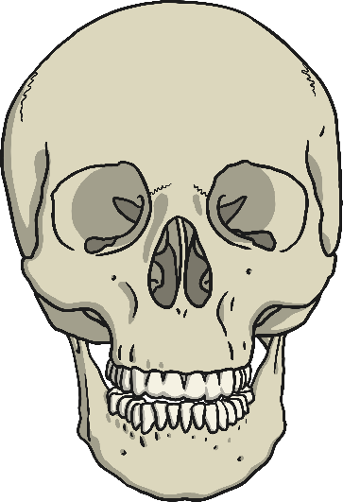

Joining two nouns
Hyphens can be used to join together two nouns of equal importance to create a new noun or adjective.
Dan hung up a skeleton-head garland on Halloween.
(This creates an adjective.)
The student-teacher taught the children about hyphens.
(This creates a new noun.)

Slide 22
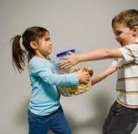

Avoiding Awkward Letters or Sound Combinations
Hyphens can be used to avoid combining letters and sounds which could be awkward to say or write without a hyphen.
The children seemed incapable of co-operating with each other.
The policeman called for help to de-escalate the situation.
Hyphens are often used in this way to join prefixes to words when the prefix ends and the word starts with a vowel.

Slide 23

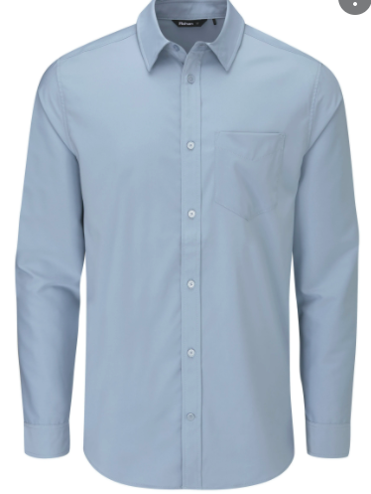
Clarifying a Word Meaning
Hyphens can be used to ensure that the meaning of a word is clear. In these examples the words could mean different things without the hyphens.
Bill requested that the email be re-sent.
Dad decided to re-press his shirt as it was still creased.

Slide 24
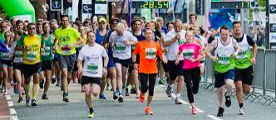
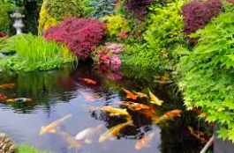
In Numbers
Hyphens should be used to join the tens and units in written numbers 21 – 99.
Sam came first in the marathon in which one hundred and twenty-seven people raced.
There are thirty-two known species of fish in our school pond.

Slide 25
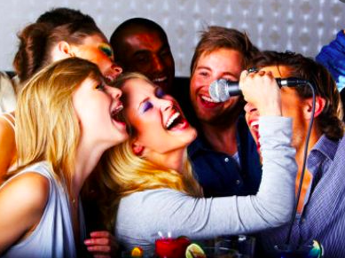

Create Informal Words/Phrases
Hyphens can be used in informal phases to link words which go together to create a unit of meaning.
The song became a bit of a
free-for-all with everyone singing at once.
The man is an out-and-out thief.

Slide 26
Hyphens can be used to avoid ambiguity in sentences. That means they help to make the meaning of the sentence clear.
There was a man eating shark in the bay.
Read these two sentences.
There was a man-eating shark in the bay.
The hyphen in the second sentence helps to make the meaning clear as it creates a compound adjective to describe the shark. This means there is a shark in the bay that eats people.
The first sentence is ambiguous (it isn’t very clear). This could mean a man was eating a shark for his lunch.

Slide 27
Choose the appropriate word to complete these sentences.
Our teacher asked me to research / re-search my drawer to find my missing homework.
It is important to recycle / re-cycle as much as possible.
Mrs Cook said that she was going to remark / re-mark the tests
because the scores all seemed quite low.
Marek is an excellent goalkeeper because he has quick reflexes / re-flexes.

Slide 28
Answers…
Our teacher asked me to research / re-search my drawer to find my missing homework.
It is important to recycle / re-cycle as much as possible.
Mrs Cook said that she was going to remark / re-mark the tests
because the scores all seemed quite low.
Marek is an excellent goalkeeper because he has quick
reflexes / re-flexes.

Slide 29
Task:
Punctuate the sentences below using a hyphen.
Jason wore his lime green shirt for the photoshoot.
The chocolate ice cream is absolutely delicious.
The nasty-looking villain spotted his next victim in the heaving crowd.
There are two hundred and fifty three people in this school.
Mr Dobbs and Mr Trotter are co-owners of ‘Dobbs and Trotter Cars Ltd’
Children’s clothes are usually tax free.
Brad Stephens is an excellent footballer, I’m glad he has resigned at our club.
E: write a sentence of your own using a hyphen.

Slide 30
Reading time
Now that you have finished your main task, please enjoy some reading time.
You can read to yourself, an adult or sibling.
This can be done by logging on to your myON account, picking a book or magazine and enjoying at least 15 minutes reading time.
https://www.myon.co.uk/login/index.html
Remember that your login is your first name and first letter of your surname then password:
harryp
password1
Please email trailblazerspupils@gmail.com if you have any login issues.

Slide 31
End of lesson

Slide 32
Date: Wednesday 30th June 2021
LO: To be able to identify synonyms and antonyms.
Subject: English

Slide 33
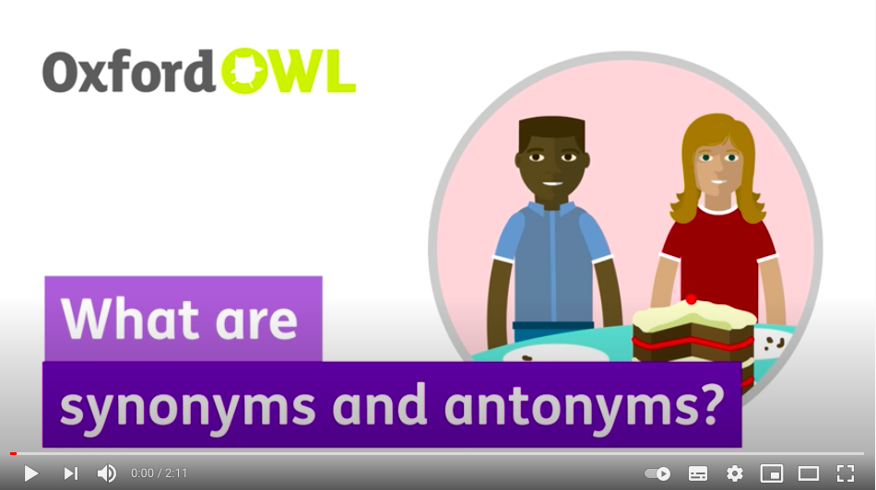
Follow the link to watch the Oxford Owl video on synonyms and antonyms.
https://www.youtube.com/watch?v=F_kvS4KYrqM

Slide 34
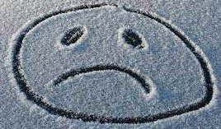

What are synonyms and antonyms?
A synonym is a word that has the same (or nearly the same) meaning as another word in the same language.
An antonym is a word which has the opposite meaning of another word.
sad
unhappy
happy
sad

Slide 35
Here are some synonyms for…
dark
old
dim
gloomy
dusky
overcast
pitch black
indistinct
aged
worn
antique
vintage
ancient
Some antonyms could be…
old
dark
young
modern
recent
light
bright

Slide 36

Synonyms
Write down as many synonyms for the word nice as you can think of.

Slide 37
Synonyms
Here are some words you could have chosen.
likeable
compassionate
kindly
genial
amiable
pleasant

Slide 38
Antonyms
Write down as many antonyms for the word happy as you can think of.

Slide 39
Antonyms
Here are some words you could have chosen.
forlorn
melancholy
gloomy
sorrowful
sad
mournful

Slide 40
Synonyms
Draw a line to match each word below with a synonym.
One has been done for you.
courageous
tranquil
monotonous
peculiar
vile
serene
tedious
weird
repulsive
heroic

Slide 41
Synonyms
Draw a line to match each word below with a synonym.
One has been done for you.
courageous
tranquil
monotonous
peculiar
vile
serene
tedious
weird
repulsive
heroic

Slide 42
Antonyms
Re-write these sentences replacing the bold words with an antonym.
1. The coach went too fast on the motorway.
_______________________________________________________
2. I need to decrease the amount of water I drink.
_______________________________________________________

Slide 43
Antonyms
Re-write these sentences replacing the bold words with an antonym.
1. The coach went too fast on the motorway.
The coach went far too slowly on the motorway.
2. I need to decrease the amount of water I drink.
I need to increase the amount of water I drink.

Slide 44
Task:
Read the sentences. Find a different synonym to the one given in brackets.
The group had a (wonderful) ________________ time on holiday, they never wanted to return home.
The service at the restaurant was (appalling) ________________, we had to complain to the manager.
When Jessica met up with her friends they (laughed) _________________ all day.
Now, re-write the sentences below replacing the bold words with an antonym.
4. The bus leaves in five minutes.
__________________________________________________________________________
5. The trip to the zoo was successful; nobody got eaten this year.
__________________________________________________________________________
6. Justin’s main course was disgusting and his dessert was revolting; he didn’t leave a tip.
__________________________________________________________________________

Slide 45
Reading time
Now that you have finished your main task, please enjoy some reading time.
You can read to yourself, an adult or sibling.
This can be done by logging on to your myON account, picking a book or magazine and enjoying at least 15 minutes reading time.
https://www.myon.co.uk/login/index.html
Remember that your login is your first name and first letter of your surname then password:
harryp
password1
Please email trailblazerspupils@gmail.com if you have any login issues.

Slide 46
End of lesson

Slide 47
Date: Thursday 1st July 2021
LO: To be able to use pronouns appropriately.
Subject: English

Slide 48
Follow the link to watch the Oak National Academy lesson exploring pronouns.
https://classroom.thenational.academy/lessons/to-explore-pronouns-cmvkjr?activity=video&step=1

Slide 49
What is a pronoun?
Pronouns are words used to replace a noun. Without pronouns, spoken and written English would be very repetitive.
See the different types of pronouns on the following slides...

Slide 50
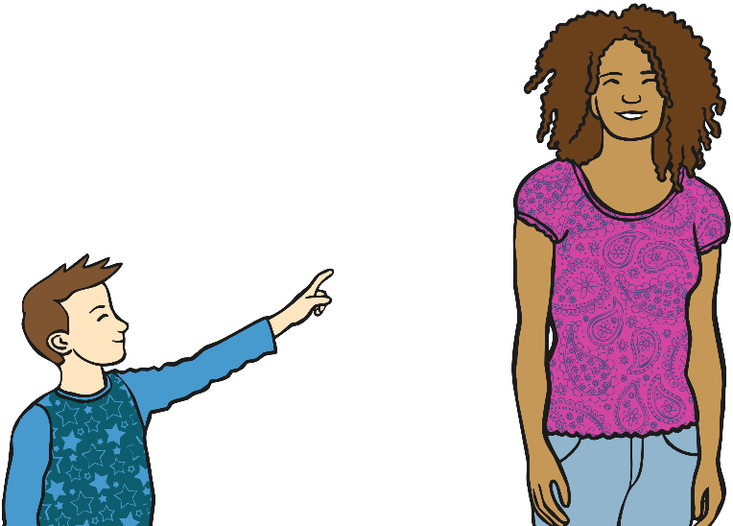
Personal Pronouns
Personal pronouns represent people, places and things. They refer back to either the object or subject of the sentence. Personal pronouns often signal whether the noun they refer back to is singular or plural and its gender.
He pointed at her. She giggled at him.
them
it
we
him
you
she
you
I
they
he
me
us

Slide 51
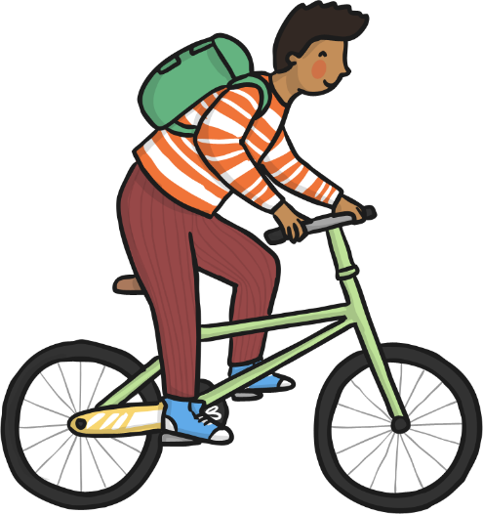
Possessive Pronouns
Possessive pronouns show you the ownership of something. There are not to be confused with possessive apostrophe words. They don’t need an apostrophe.
The bike was his.
yours
its
theirs
mine
hers
his
ours

Slide 52
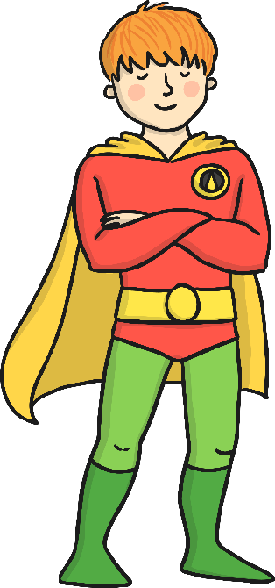

Relative Pronouns
Relative pronouns are the first words used in a relative clause.
that
who
whom
which
whose
Jim, who was dressed as a superhero, was going to a fancy dress party.
The lion held the mouse, which made him nervous.

Slide 53
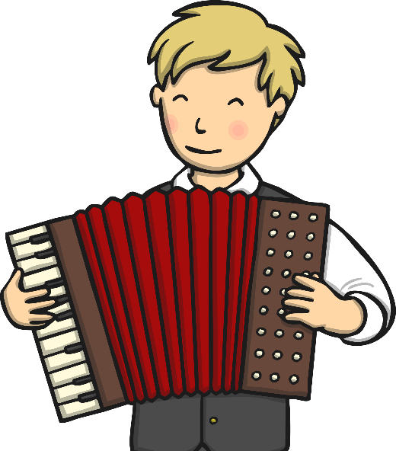
Reflexive Pronouns
Reflexive pronouns reflect back on an earlier noun or pronoun.
myself
themselves
herself
yourself
himself
ourselves
He taught himself to play the accordion.
‘Himself’ refers back to the pronoun ‘he’.

Slide 54

Interrogative Pronouns
Interrogative pronouns are used to ask questions when there is an unknown subject or object.
what
who
which
whose
whom
Who was that?
Whose are those?

Slide 55
Underline six pronouns in the following passage.
Bob and Bert went shopping for a camping equipment. They bought a tent for themselves. It came with free sleeping bags. Bob gave his to someone else because he already had one.

Slide 56
Answers…
Bob and Bert went shopping for a camping equipment. They bought a tent for themselves. It came with free sleeping bags. Bob gave his to someone else because he already had one.

Slide 57
Put a circle around all of the pronouns in the box. Underline all of the nouns.
me
costume
yours
mine
crying
Hassan
leggings
them
Ash
it
classroom
singing
dominoes
they
her
him

Slide 58
Answers…
me
costume
yours
mine
crying
Hassan
leggings
them
Ash
it
classroom
singing
dominoes
they
her
him

Slide 59
Task:
Re-write the sentences, replacing the underlines nouns with the correct pronouns.
Sara played Scrabble, even though Sara doesn’t really like Scrabble.
_________________________________________________________________________
2. Some Australian spiders are venomous, so be careful not to approach the spiders.
_________________________________________________________________________
For each sentence, underline the noun and circle the pronoun that it has been replaced with. The first one has been completed for you.
3. I tried to tie my lace, but they ended up looking like balls of spaghetti.
4. I put my hands over my face to stop it twitching.
5. Sam dislikes anything to do with music, almost as much as he dislikes running in P.E.
6. He fished my cap from underneath the trolley and plonked it back on my head.
7. “I’ll come help you,” said Helen. She lifted me up and patted my back reassuringly.

Slide 60
Task:
Extend the sentence using a relative pronoun within a relative clause.
Example
Relative Pronouns
Who
Which
That
Whose
Whom
The boy looked around nervously.
The boy, who was very shy, looked around nervously.
Extend the sentence using a relative pronoun within a relative clause.
The house was standing at the very top of the hill.
______________________________________________________________________________________________________________

Slide 61
Reading time
Now that you have finished your main task, please enjoy some reading time.
You can read to yourself, an adult or sibling.
This can be done by logging on to your myON account, picking a book or magazine and enjoying at least 15 minutes reading time.
https://www.myon.co.uk/login/index.html
Remember that your login is your first name and first letter of your surname then password:
harryp
password1
Please email trailblazerspupils@gmail.com if you have any login issues.

Slide 62
End of lesson

Slide 63
Date: Friday 2nd July 2021
LO: To be able to use possessive pronouns appropriately.
Subject: English

Slide 64
Follow the link to watch the Oak National Academy lesson exploring pronouns.
https://classroom.thenational.academy/lessons/to-explore-pronouns-cmvkjr?activity=video&step=1

Slide 65
Yesterday we learnt about different pronouns.
Remember, a pronoun is a word used to replace a noun.
For example,
Carrie enjoyed going to the park.
She enjoyed going to the park.
Can you think of anymore pronouns?

Slide 66
In this lesson we will be focusing on possessive pronouns.
Can you remember what possessive pronouns are?

Slide 67
Possessive pronouns show you the ownership of something. There are not to be confused with possessive apostrophe words. They don’t need an apostrophe.
The bike was his.
yours
its
theirs
mine
hers
his
ours
Instead of:
The bike was Simon’s.

Slide 68
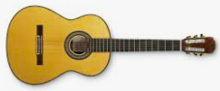
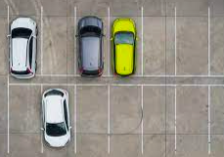
Remember, possessive pronouns show ownership and replace possessive noun phrases, such as:
The guitar is hers.
“The parking space is ours!” screamed Gina.
This is much quicker to say than…
“The parking space is mine, John, Kelly, Martin and Fay’s!” screamed Gina.

Slide 69
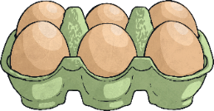
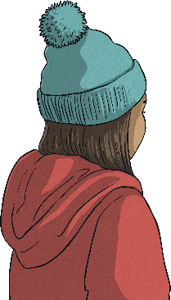

Read the sentences below and spot the possessive pronouns.
“Those eggs are ours. You need to collect them,” said Anita.
“Is the bobble hat mine or yours?” asked Charlotte.
He signed all of his forms and handed them in at the desk.
The responsibility is yours to make sure that you are lining up correctly.
Could you spot any other types of pronouns?

Slide 70
Read the sentences below and spot the possessive pronouns.
“Those eggs are ours. You need to collect them,” said Anita.
“Is the bobble hat mine or yours?” asked Charlotte.
He signed all of his forms and handed them in at the desk.
The responsibility is yours to make sure that you are lining up correctly.
Could you spot any other types of pronouns?

Slide 71
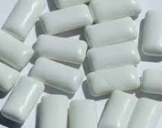

Read the sentences below and add in the possessive pronouns. Will more than one option fit?
“The chewing gum is _______ not __________,” lied Hannah.
“This group is _______. __________ is over there,” snapped Bradley.

Slide 72
Possessive pronouns you could have used…
“The chewing gum is _______ not __________,” lied Hannah.
his
yours
“This group is _______. __________ is over there,” snapped Bradley.
mine
Hers
Did you use different ones?

Slide 73
Task:
Underline all of the possessive pronouns in the following sentences.
His hair was longer than hers.
I saw that her dog was smaller than theirs.
Someone asked, "Is that dog yours?"
I replied, "Yes, he's mine.”
His ribbon was big and its colour was blue.
yours mine
its his
hers ours
theirs
Fill in the blank with the proper possessive pronouns.
6. I paid for my scarf, so it is ____________________.
Pick any of these desserts. The choice is ____________________.
The math book belongs to Ralph. It is _________________.
All my brothers love video games. Playing them is a favourite pastime of ______________.
We bought this game together, so it is _______________.

Slide 74
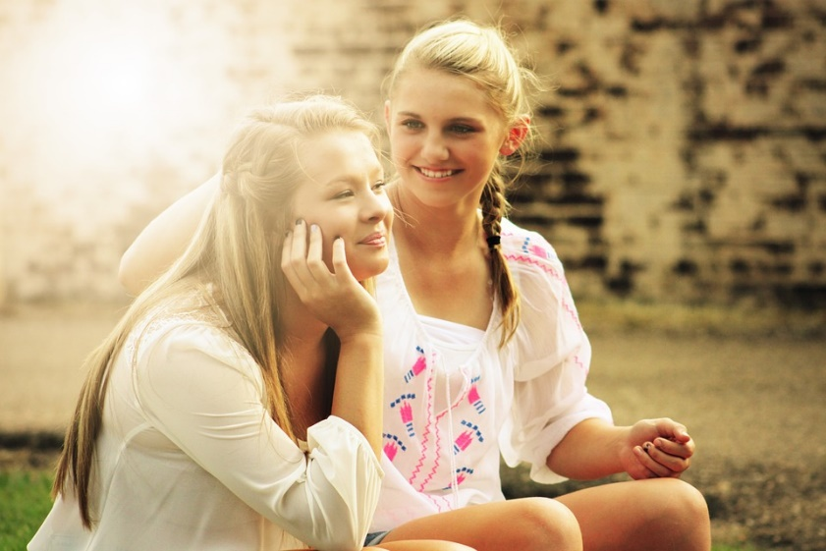
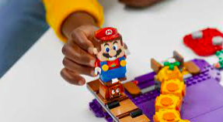
Extend:
Write a sentence for each of the following pictures. Make sure your sentence includes a possessive pronoun.
____________________________________________________________________________________________________________________
yours
mine
its
his
hers
ours
theirs
____________________________________________________________________________________________________________________

Slide 75
Reading time
Now that you have finished your main task, please enjoy some reading time.
You can read to yourself, an adult or sibling.
This can be done by logging on to your myON account, picking a book or magazine and enjoying at least 15 minutes reading time.
https://www.myon.co.uk/login/index.html
Remember that your login is your first name and first letter of your surname then password:
harryp
password1
Please email trailblazerspupils@gmail.com if you have any login issues.

Slide 76
End of lesson

