Slide 1
25.01.2021
LO To be able to add and subtract 1s mentally.
Go to Times Tables Rock Stars to warm up your number brain before you start your maths activity.
Subject: Maths

Slide 2
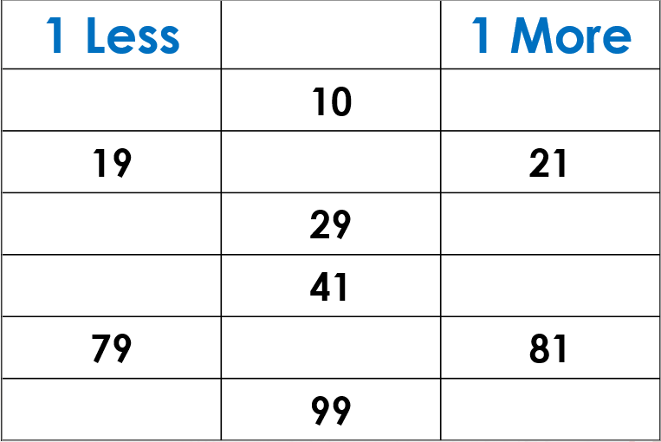
Fill in the missing numbers

Slide 3
Fill in the missing blanks below

Slide 4
Complete the number sentences
1. Continue the pattern 22=29-7, 22=28-6
2. Four hundred and sixty four add two is _____________
3. Three hundred and eleven subtract one is _____________
4. Six hundred and thirty five add three is _____________
5. Seven hundred and twenty six subtract five is _____________
6. Five hundred seventy seven add four is _____________
7. Three hundred and forty five subtract eight is _____________
8. Nine hundred and twenty eight add four is _____________
9. Two hundred and sixty six add seven is _____________

Slide 5
Try this challenge
Jane is given a problem.
I have 376 beads. I use
7 and then add pack of 9.
How many does she have in total?

Slide 6
26.01.2021
LO To be able to add and subtract 10s mentally
Go to Times Tables Rock Stars to warm up your number brain before you start your maths activity.
Subject: Maths

Slide 7
Fill in the missing numbers
10
10

Slide 8
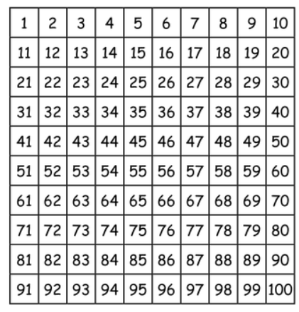
Adding 10
Use the number square to help you mentally solve the calculations
Fifty seven add ten
Forty four subtract ten
Eighty three subtract two tens
Seventy three add 3 tens

Slide 9
How did you do?
Use the number square to help you mentally solve the calculations
Fifty seven add ten is sixty seven
Forty four subtract ten thirty four
Eighty three subtract two tens sixty three
twenty three add 3 tens fifty three

Slide 10
Complete the number sentences
Three hundred and forty five add ten
Seven hundred and twenty six add three tens
Two hundred and thirty four subtract two tens
Five hundred and eighty three subtract four tens
Nine hundred and thirty six add 5 tens
Three hundred and forty two add five tens

Slide 11
Try this challenge
Insert the correct symbols in the boxes below
396 |  | 4 tens |  | twenty | = | 416

Slide 12
27.01.2021
LO To be able to add and subtract 100s mentally.
Go to Times Tables Rock Stars to warm up your number brain before you start your maths activity.
Subject: Maths

Slide 13
Fill in the missing numbers
100
100
654
785
274
250
654

Slide 14
Find the missing number
158 +__________= 358
258+__________=658
365+___________=765
965- __________=265
745- __________ = 545
852- __________=352

Slide 15
How did you do?
158 + 200= 358
258 + 400=658
365 + 400=765
965 - 700=265
745 - 200= 545
852 - 500=352

Slide 16
Complete the bar models
845
245
545
145
625 | 300
245 | 500

Slide 17
Complete the number sentences
Five hundred and eighty four add three hundred is
Four hundred and twenty two add five hundred is
Two hundred and eleven add six hundred is
Nine hundred and fifty six subtract four hundred is
Eight hundred and thirty five subtract four hundred is
Seven hundred and seventy seven subtract six hundred is

Slide 18
Try this challenge

Slide 19
28.01.2021
LO To be able to solve problems
Go to Times Tables Rock Stars to warm up your number brain before you start your maths activity.
Subject: Maths

Slide 20
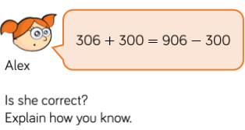
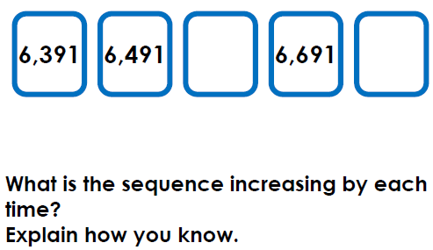
Solve the word problems

Slide 21
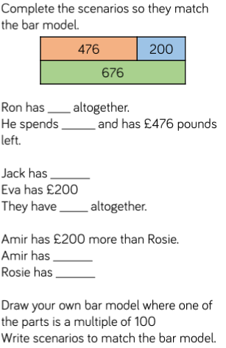
Solve the word problems

Slide 22
Solve the word problems

Slide 23
29.01.2021
LO To be able to practise the 3 times table
Go to Times Tables Rock Stars to warm up your number brain before you start your maths activity.
Subject: Maths

Slide 24
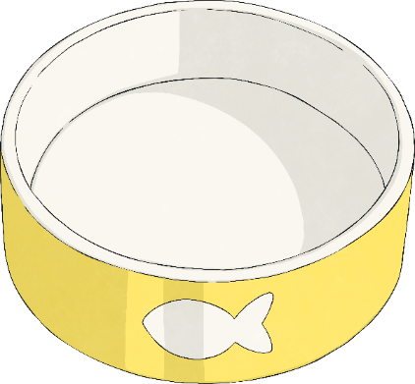
Complete the sentences about the picture below
There were treats altogether.
They were shared between bowls.
Now there are treats in each bowl.
÷ = .
or ÷ = .
There are lots of treats.
There are treats in total.
× = .
or × = .
3
12

Slide 25
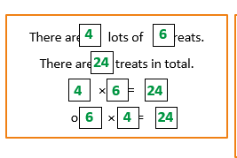
How did you do?
4
3
12
12
4
3
4
3
12
12
3
4
3
4
12
12
3
4

Slide 26
Fill in the missing numbers
0 3 6 _____ _____ 15 _____ _____ 24 _____ 30 _____ _____
36 _____ 30 _____ _____ 21 _____15 _____ _____ _____ _____ _____
15 _____ _____ 24 _____ _____ _____
27 _____ _____18 _____ _____ _____ _____ _____ _____
Click on this link to help you https://teachers.thenational.academy/lessons/recalling-the-3-times-table-c8tp4d?from_query=3+time

Slide 27
Colour in the squares that are multiples of 3

Slide 28
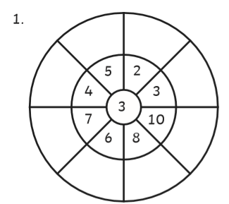
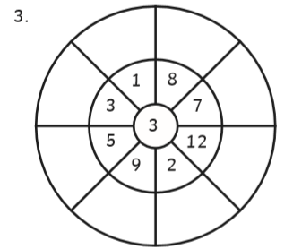
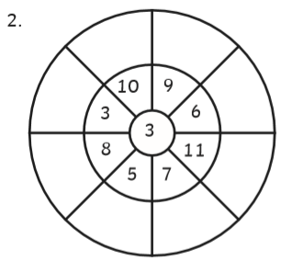
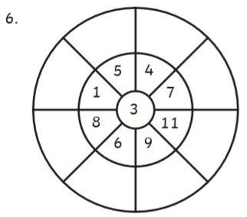
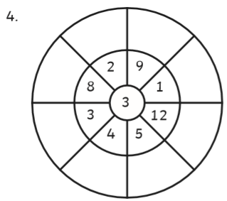
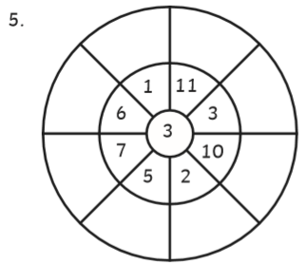
Complete the multiplication wheels
2x3=6
6

