Slide 1
Subject: English

Slide 2
Date: Monday 28th June 2021
LO: To be able to use apostrophes for possession.
Subject: English

Slide 3
Pre-recorded Teaching
Access the online teaching video below that will support you to complete the work in this lesson. This video will act as a support but all of the work can still be successfully understood & completed using the powerpoint. If you need further support to understand / complete work then please contact school via e-mail or telephone.
Play Video
You can also copy and paste this link if you would prefer:
https://www.youtube.com/watch?v=zNFPnVz7JB4

Slide 4
Apostrophes can be used to show possession.
Possession means that something belongs to something else.
A noun belongs to a another noun.
The boy’s house was bombed.
A noun is a person, place or thing.

Slide 5
Let’s look at some examples:
Ghandi’s letter did not convince Hitler.
The soldier’s weapon was ready to use.
The child’s father went to fight.
What do these sentences tell us about possession?
The letter belongs to Ghandi.
The weapon belongs to the soldier.
The father belongs to the child.

Slide 6
Write the sentence and place the apostrophe in the correct place.
The trains whistle signalled it was ready to leave.
The air raid sirens scream warned the citizens.
The girls tears cascaded from her eyes.

Slide 7
Check if you wrote them correctly.
The train’s whistle signalled it was ready to leave.
The air raid siren’s scream warned the citizens.
The girl’s tears cascaded from her eyes.

Slide 8
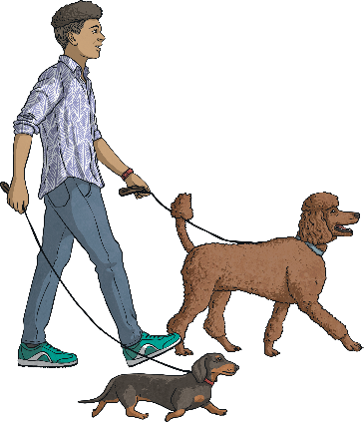
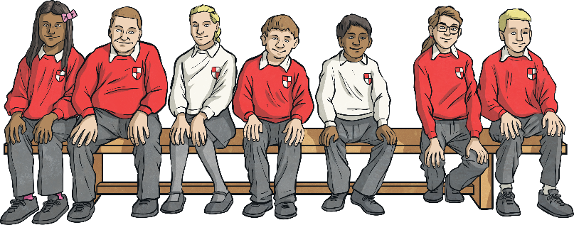
What is plural possession?
Apostrophes can be used to show that something belongs to someone or something. This is called possession. When we are talking about more than one thing, we call this plural.
The dogs’ leads were too long.
The children’s lunch was delayed.
If the noun is plural and ends with an s, we just attach the apostrophe to it without an additional s.
If the noun is plural and does not end with s, we add ’s to the end.

Slide 9
What will we see?

Slide 11
What will we see?
The monkeys’ bananas were ripe.
The monkey’s bananas were ripe.

Slide 12
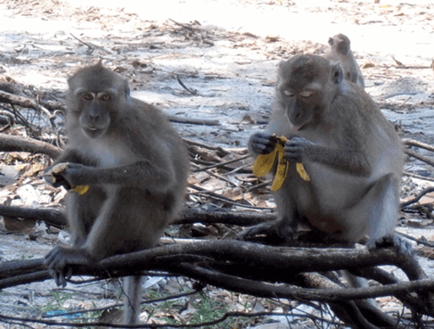
The monkeys’ bananas were ripe.
The monkeys’ bananas were ripe.

Slide 13
Plural Possession
Now it is your turn. Read the singular form of the noun, make the noun plural and then show where the apostrophe would need to be to show plural possession.
Singular | Plural | Plural Possession
kitten
actress
baby
knife
child
volcano
kittens
kittens’
actresses
actresses’
babies
babies’
knives
knives’
children
children’s
volcanoes
volcanoes’

Slide 14
Task 1
Re-write these sentences using apostrophes to show possession.
Example: A weapon belonging to the soldier, becomes… The soldier’s weapon
1.The propellers belonging to the plane began to spin.
2.The bombs belonging to Germany began to fall.
3.The rations belonging to the family were very basic.
4.The bravery belonging to the man helped him to fight.
5.The wing belonging to the plane was shot at.

Slide 15
End of Lesson

Slide 16
Date: Tuesday 29th June 2021
LO: To be able to use apostrophe for contraction.
Subject: English

Slide 17
Pre-recorded Teaching
Access the online teaching video below that will support you to complete the work in this lesson. This video will act as a support but all of the work can still be successfully understood & completed using the powerpoint. If you need further support to understand / complete work then please contact school via e-mail or telephone.
Play Video
You can also copy and paste this link if you would prefer:
https://www.youtube.com/watch?v=OyI8xH2CXsw

Slide 18
What is an apostrophe?
’

Slide 19
Why is it used?
An apostrophe is used for two reasons;
To contract two words, to make one.
For example: do not = don’t
An apostrophe is also used to show possession.
For example: Darcy’s pencil

Slide 20
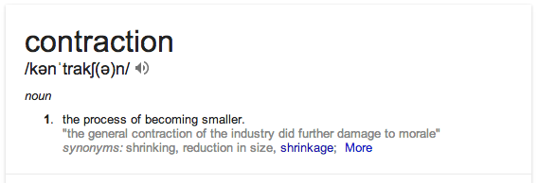
What does contraction mean?
We make two words smaller by omitting (missing out) some letters
There are about 100 in the English language
How many can you think of?

Slide 21
Original form | Contracted form
it is | it’s
She is | she’s
who is | who’s
I am | I’m
you are | you’re
they are | They’re
I have | I’ve
we have | we’ve
would have | would’ve
he had | he’d
I will | I’ll
you will | you’ll
is not | isn’t
cannot | can’t
did not | didn’t

Slide 22
Apostrophes can be used to show missing letters.
I can not come to the party.
I can’t come to the party.
Can not becomes can’t.
The apostrophe shows that there are letters missing.

Slide 23
What do these words become when you shorten them?
have not
they will
shall not
I have
you are
haven’t
they’ll
shan’t
I’ve
you’re

Slide 24
Write the words with the missing apostrophes, on your white board…
I cant believe it!
That wasnt right.
Id better be off.
Youre working hard

Slide 25
Apostrophes for contraction
How many do you know?
A B C D E F G H I
J K L M N O P Q R
S T U V W X Y Z

Slide 26
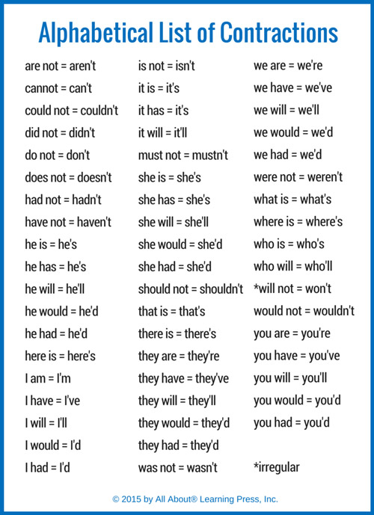

Slide 27
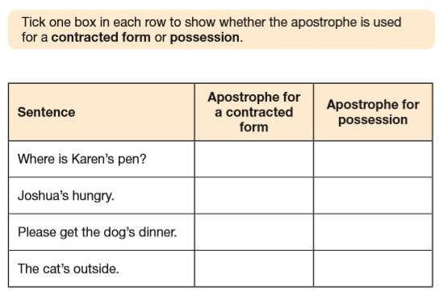

Slide 28
Task:
Write a contraction to replace the words that could be contracted in each sentence.
Some people think it is not, but I think football is coming home.
This summer, spectators can not travel to Japan, to watch the Olympics.
When Alyssa Carson completes her training, she will be the youngest astronaut to go into space.
Tyrannosaurs used to live in the Arctic, that is according to new research by Patrick Druckenmiller.
I would like to get my hands on one of the new £50 notes, featuring Alan Turing.
After England win the Euros, there will be a huge celebration!

Slide 29
End of Lesson

Slide 30
Date: Wednesday 30th June 2021
LO: To be able to use colons and semi-colons in a list.
Subject: English

Slide 31
Pre-recorded Teaching
Access the online teaching video below that will support you to complete the work in this lesson. This video will act as a support but all of the work can still be successfully understood & completed using the powerpoint. If you need further support to understand / complete work then please contact school via e-mail or telephone.
Play Video
You can also copy and paste this link if you would prefer:
https://www.youtube.com/watch?v=ymgszCIoHbA

Slide 32
Can you name these punctuation marks?
: ; , Colon Semi –colon Comma

Slide 33
Using a full sentence, write these items in a list.
What punctuation will I need?

Slide 34
Does it look like this?
For my lesson, I need a black pen, a ruler and a book.

Slide 35
Time to up-level!
For an English lesson, I need: a black pen; a ruler; and a book.
We can use a colon ( : ) to introduce a list, like this…
We can use semi colons ( ; ) to separate items in a list, like this…
Write a sentence and tell me more information about each item (Add an adjective)

Slide 36
Time to up-level!
For an English lesson, I need: a black pen, to write with; a ruler, to underline neatly; and a book, to write down all of my amazing ideas.
Tell me more information about each item

Slide 37
Task – Using colons and semi-colons, can you create;
1 x list about the animals you might see at a zoo
1 x list about the equipment a firefighter would need
1 x list about things you might see at a sporting event
1 x list about what you would need for a trip to the beach
1 x list about the items you bought in the supermarket

Slide 38
End of Lesson

Slide 39
Date: Thursday 1st July 2021
LO: To be able to use bullet points in a list.
Subject: English

Slide 40
Pre-recorded Teaching
Access the online teaching video below that will support you to complete the work in this lesson. This video will act as a support but all of the work can still be successfully understood & completed using the powerpoint. If you need further support to understand / complete work then please contact school via e-mail or telephone.
Play Video
You can also copy and paste this link if you would prefer:
https://www.youtube.com/watch?v=50CJv1vp5yo

Slide 41
Where do you find bullet points?
Bullet points are little markers at the start of a line which are used to separate items in a list. For example, you might be listing names in a class or team. In addition, it could be a shopping list, notes taken from a presentation, a list of questions or the resources needed for your science investigation.
Buy:
butter;
milk;
bread;
tea bags;
Sausages;
frozen peas.
Netball team
Jamie D
Stefano
Alex
Katie W
Kodi
Maia
Izzie
Elephants
biggest land mammals
Weigh more than a car
African bigger than Asian
trunk are their nose
tusks are very long teeth

Slide 42
Why use bullet points?
Bullet points, like numbered lists, help to break down a set of key ideas or items so that the reader can see them all easily. We use bullets instead of numbers when the items in the list don’t need to go in any particular order.
Let’s try again…
We can see bullet points in lots of places, such as:
shopping lists;
names in a class or team;
presentation notes;
survey questions;
science resources list.
An introduction phrase or title for the list is often called the stem.
Make sure each point is clearly different from the others.
Bullet points should all be the same in one list.

Slide 43
Punctuating Bullet Points
Why do we need punctuation in a bullet point list? Aren’t the bullet points the punctuation?
Well, no – they’re just a way of laying out your information more clearly for the reader.
However, the information on some bullet point lists needs to follow specific punctuation rules.
Let’s take a look…

Slide 44
Listing Facts
You could put some individual facts about a topic into a bullet point fact box, for example in a report.
Facts are usually given as statements in a sentence. And what does a statement sentence always need?
That’s right – capital letter and full stop.
Fascinating Space Facts
Because of Mars’s lower gravity, you would weigh less there than you do on Earth.
Venus spins in the opposite direction to the other planets.
Uranus takes 84 Earth years to orbit the sun.

Slide 45
Listing Questions
A bullet point list is a good way to organise a set of questions you want to ask – tick them off as you go through.
Questions are typically in sentences, so they need a
capital letter and question mark.
Questions for Queen Victoria
How many children do you have?
Which is your favourite palace?
Do you like riding in your carriage?
Have you got any pets?
Why have you got a smaller crown than the kings and queens before you?

Slide 46
Listing Proper Nouns
When you make a list of names, for example people in a team or countries of the world, each name must have a capital letter at the start.
Six largest countries in the world:
Russia;
Canada;
USA;
China;
Brazil;
Australia.
Netball team
Jamie D
Stefano
Alex
Katie W
Kodi
Maia
Izzie

Slide 47
Listing things or items
A bullet point list is a really clear way to show a set of resources or equipment needed.
These items are usually just words or phrases, so they don’t need sentence punctuation.
stem
If your list has a stem followed by a colon, each item needs a semi-colon except the last, which has a full stop.
You will need:
tea bags;
milk;
water;
kettle;
mug;
teaspoon;
sugar.
colon
Football tournament
blow-up goalposts
footballs
cones
whistles
stopwatches
You don’t have to use : and ; in your list of items. The most important thing is to be consistent. Stick to one style only in each list.
semi-colon
full stop

Slide 48
My turn
I’ll write a list about my favourite films.
The most important thing is to be consistent. Stick to one style only in each list.

Slide 49
My turn
I’ll write a list about my favourite films.
My favourite films are:
Frozen,
Mission Impossible,
The Greatest Showman,
The Grinch.
The most important thing is to be consistent. Stick to one style only in each list.

Slide 50
Our turn
We’ll write a list about what equipment we need to be ready to work.
The most important thing is to be consistent. Stick to one style only in each list.

Slide 51
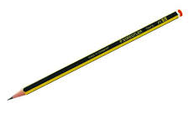
Your turn. Use these items to begin your list.
To be ready to work, I need:
The most important thing is to be consistent. Stick to one style only in each list.

Slide 52
To be ready to work, I need:
A pen,
A ruler,
Exercise book,
An eraser,
A pencil.

Slide 53
Task
1 x bulleted list about your favorite foods
1 x bulleted list about what you would need for a trip to the beach
1 x bulleted list about your teachers
1 x bulleted list about a topic of your choice

Slide 54
End of Lesson

Slide 55
Date: Friday 2nd July 2021
LO: To be able to use bullet points in a list.
Subject: English

Slide 56
Pre-recorded Teaching
Access the online teaching video below that will support you to complete the work in this lesson. This video will act as a support but all of the work can still be successfully understood & completed using the powerpoint. If you need further support to understand / complete work then please contact school via e-mail or telephone.
Play Video
You can also copy and paste this link if you would prefer:
https://www.youtube.com/watch?v=RPqxNqO8u-A

Slide 58
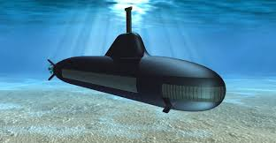
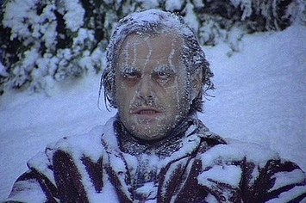
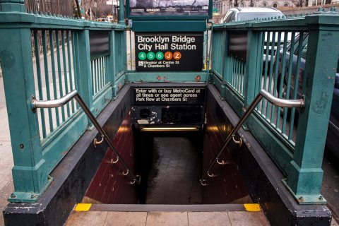
submarine- an boat that floats under the water
subway- a train that runs under the ground
subzero- below freezing temperature
What do these words have in common?

Slide 59
They all have the prefix ‘sub’
What does sub mean?
It means under or below

Slide 61
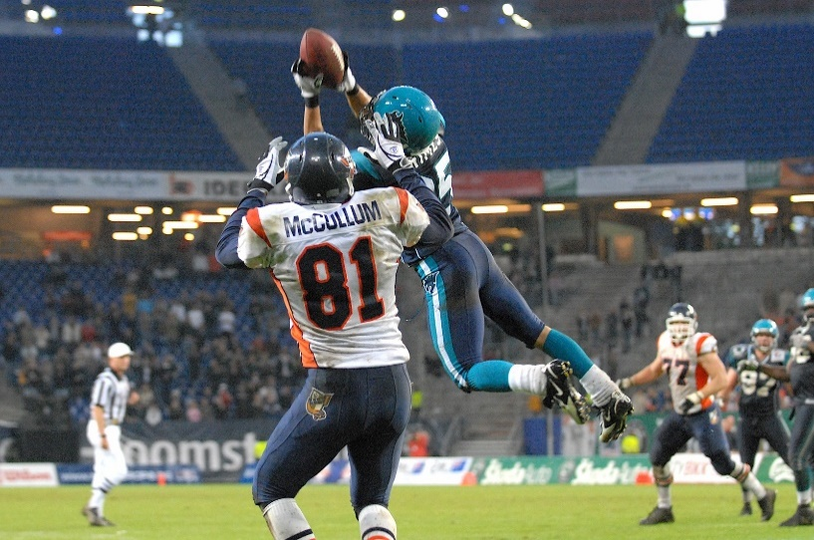
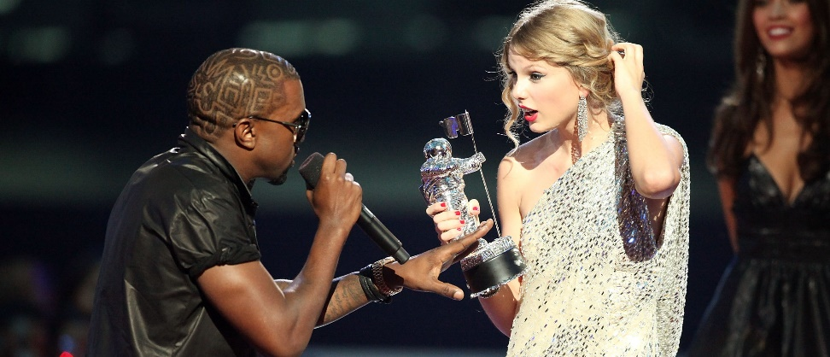
Internet - a communication system that connects computers and database all over the world
Interrupt - to stop or cause to cease, in the middle of something
Intercept - When you intercept something, you stop or interrupt it from getting to where it was going.
What do these words have in common?

Slide 62
They all have the prefix ‘inter’
What does ‘inter’ mean?
It means between or together

Slide 63
or together

Slide 64
This week’s spellings
Subway
Subtitle
Submarine
Submerge
Subordinate
Intercept
Interfere
Interrupt
International
Interval

Slide 65
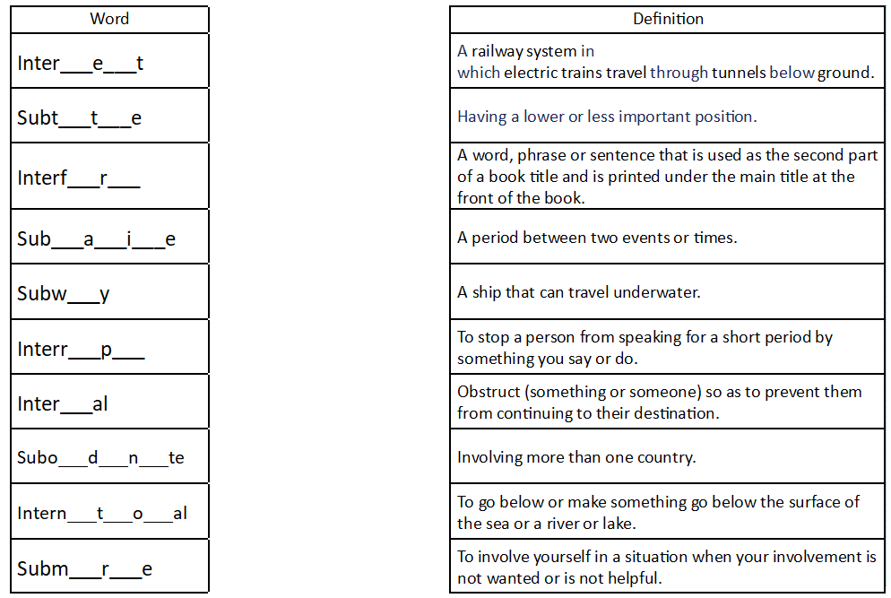
Task: Add in the missing letters from the words, like the example below.
Then, match the word to it’s definition.
c
p
c

Slide 66
Extension: Choose 3 words and write a sentence for each word.
Subway
Subtitle
Submarine
Submerge
Subordinate
Intercept
Interfere
Interrupt
International
Interval

Slide 67
Answers

Slide 68
End of Lesson

