Slide 1
Subject: English
Pack: C

Slide 2
Date: Monday 21st June 2021
L.O. To be able to follow instructions to make a ham and cheese sandwich.
Subject: English

Slide 3
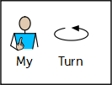
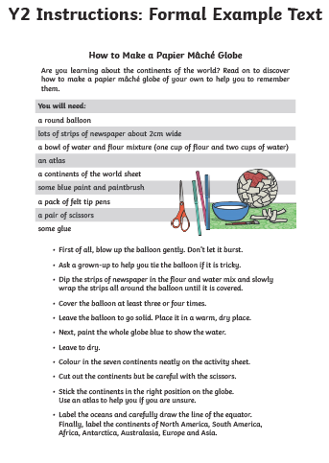
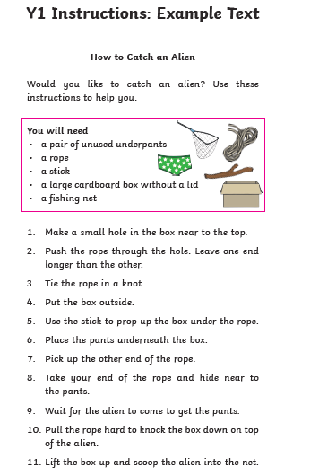
Instructions
This week we are going to be focusing on instructions!
What are instructions?
Instructions tell you how to make something step by step.
Here are some examples

Slide 4
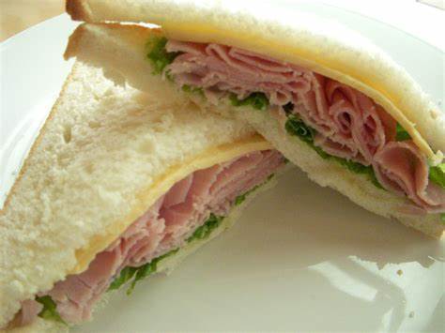
How to make a ham & cheese sandwich
Your job is to follow the instructions to make a delicious ham, cheese and lettuce sandwich.

Slide 5
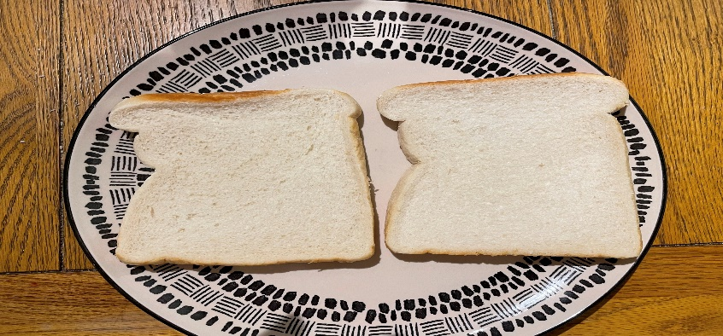
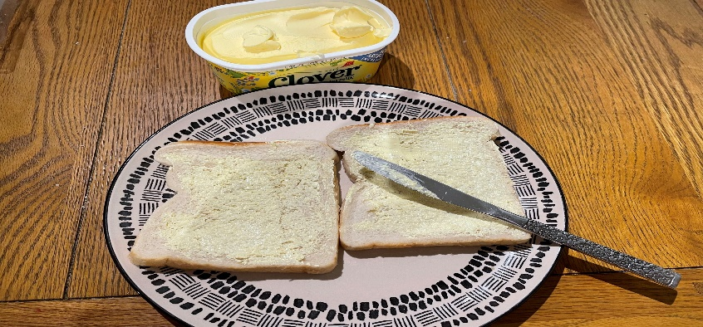
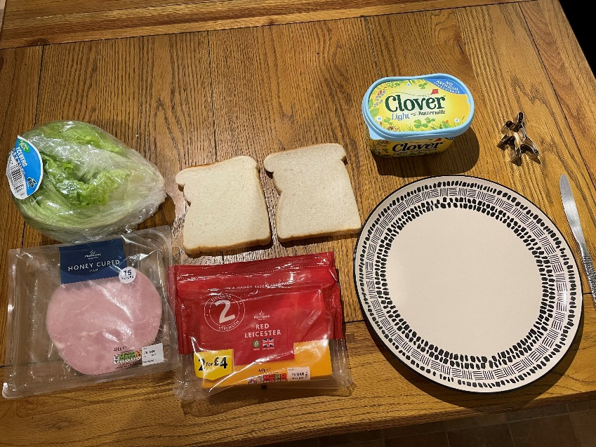
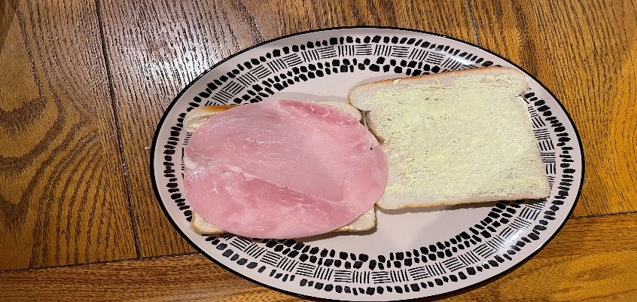
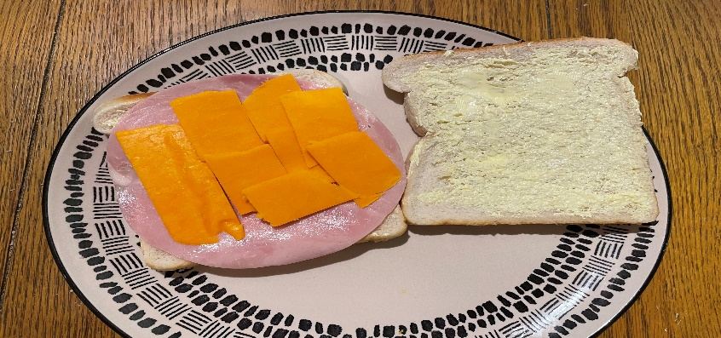
How to make a ham & cheese sandwich
First we need to read the instructions to find out what we will need and what we have to do.
First, put your two slices of bread onto the plate.
You will need:
2 slices of bread
Butter or margarine
Ham
Cheese
Lettuce
1 plate
1 knife
Animal shaped cutter (Optional)
Secondly, spread the butter or margarine onto one side of each slice of bread.
Then, place one slice of ham onto the buttered side of one of the slices of bread.
Next, cut the cheese into four or five small slices and place the cheese on top of the ham.
Continued on the next slide

Slide 6
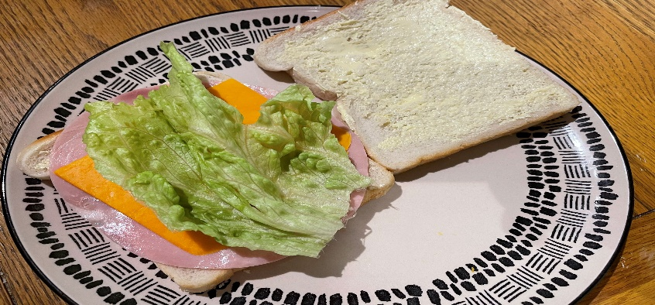
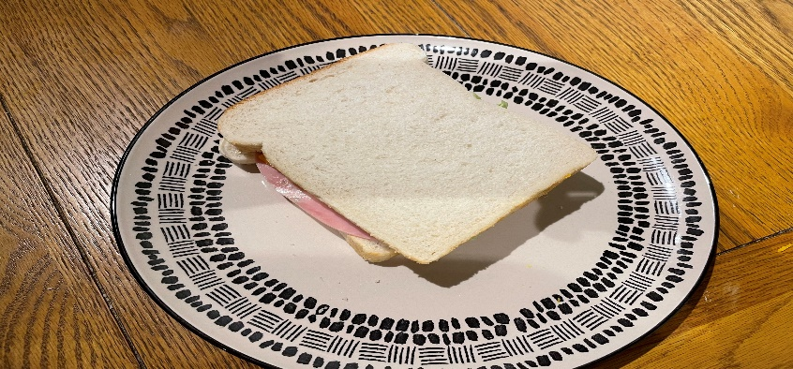
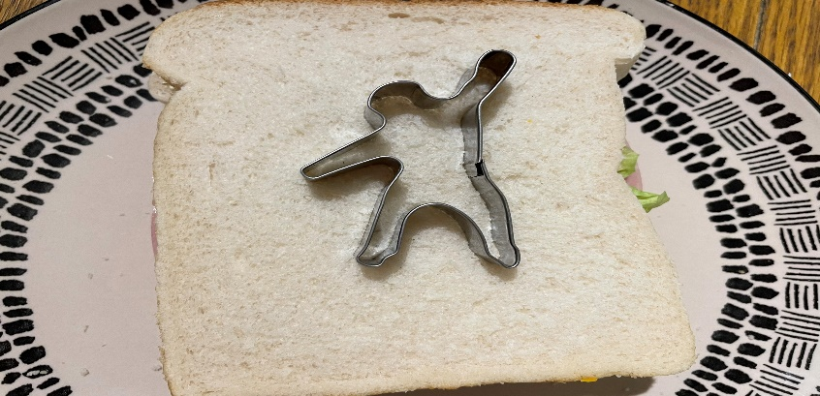
How to make a ham & cheese sandwich
After that, peel off one lettuce leaf and put the lettuce on top of the ham and cheese.
Next, place the other slice of bread on top of the sandwich with the buttered side on top of the lettuce.
*Optional – cut your sandwich into the shape of a rainforest animal using a special cutter or your knife.
Finally, enjoy your delicious ham and cheese sandwich.

Slide 7
How to make a ham & cheese sandwich
Now it's your turn!
On the next two slides you will find another copy of the instructions. Make sure you follow the instructions carefully and tick off each step once you have completed the instruction.
You might find it useful to take photos of you doing each stage of the instructions. This will help with your writing later in the week.
If you don’t have any of the ingredients you can miss out that step or use an alternative filling. For example, if you don’t have ham you could just make a cheese sandwich. Or you could swap the ham to chicken.

Slide 8
How to make a ham & cheese sandwich
Follow the instructions and tick off each step once you have completed that instruction.
First, put your two slices of bread onto the plate.
You will need:
2 slices of bread
Butter or margarine
Ham
Cheese
Lettuce
1 plate
1 knife
Animal shaped cutter (Optional)
Secondly, spread the butter or margarine onto one side of each slice of bread.
Then, place one slice of ham onto the buttered side of one of the slices of bread.
Next, cut the cheese into four or five small slices and place the cheese on top of the ham.
Continued on the next slide

Slide 9
How to make a ham & cheese sandwich
After that, peel off one lettuce leaf and put the lettuce on top of the ham and cheese.
Next, place the other slice of bread on top of the sandwich with the buttered side on top of the lettuce.
*Optional – cut your sandwich into the shape of a rainforest animal using a special cutter or your knife.
Finally, enjoy your delicious ham and cheese sandwich.

Slide 10
How to make a ham & cheese sandwich
Now for the best part – eating the sandwich! We hope you enjoy your delicious sandwich.
We would love to see photos of you making your sandwich and your finished product!

Slide 11
Well done for all of your hard work! We can’t wait to see your completed work.
Could any completed work / photographic evidence of completed work please be sent to pathfinderspupils@gmail.com
Thank you!

Slide 12
Date: Tuesday 22nd June 2021
L.O. To be able to find features of instructions.
Subject: English

Slide 13
How to make a ham & cheese sandwich
Let's re read the instructions to get them back in our head.
First, put your two slices of bread onto the plate.
You will need:
2 slices of bread
Butter or margarine
Ham
Cheese
Lettuce
1 plate
1 knife
Animal shaped cutter (Optional)
Secondly, spread the butter or margarine onto one side of each slice of bread.
Then, place one slice of ham onto the buttered side of one of the slices of bread.
Next, cut the cheese into four or five small slices and place the cheese on top of the ham.
Continued on the next slide

Slide 14
How to make a ham & cheese sandwich
After that, peel off one lettuce leaf and put the lettuce on top of the ham and cheese.
Next, place the other slice of bread on top of the sandwich with the buttered side on top of the lettuce.
*Optional – cut your sandwich into the shape of a rainforest animal using a special cutter or your knife.
Finally, enjoy your delicious ham and cheese sandwich.

Slide 15
Features of instructions …
Use the key below to help you find the features!
On the next two slides you will find my instructions on how to make a ham, cheese and lettuce sandwich. Use the key to highlight/underline the key features in the correct colour.
Key:
Title
Time openers
Imperative verbs
Pictures
Top Tips:
Imperative verbs are ‘bossy’ doing words.
Time openers are words or phrases used to tell you when to do something.

Slide 16
How to make a ham & cheese sandwich
First, put your two slices of bread onto the plate.
You will need:
2 slices of bread
Butter or margarine
Ham
Cheese
Lettuce
1 plate
1 knife
Animal shaped cutter (Optional)
Secondly, spread the butter or margarine onto one side of each slice of bread.
Then, place one slice of ham onto the buttered side of one of the slices of bread.
Next, cut the cheese into four or five small slices and place the cheese on top of the ham.
Continued on the next slide

Slide 17
How to make a ham & cheese sandwich
After that, peel off one lettuce leaf and put the lettuce on top of the ham and cheese.
Next, place the other slice of bread on top of the sandwich with the buttered side on top of the lettuce.
*Optional – cut your sandwich into the shape of a rainforest animal using a special cutter or your knife.
Finally, enjoy your delicious ham and cheese sandwich.

Slide 18
Well done for all of your hard work! We can’t wait to see your completed work.
Could any completed work / photographic evidence of completed work please be sent to pathfinderspupils@gmail.com
Thank you!

Slide 19
Date: Wednesday 23rd June 2021
L.O. To be able to use time openers.
Subject: English

Slide 20
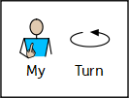
Instructions
Instructions have two key features:
1. Time openers
2. Imperative verbs
Over the next few slides we are going to find out what time openers and imperative verbs are and how to use them in our writing.

Slide 21
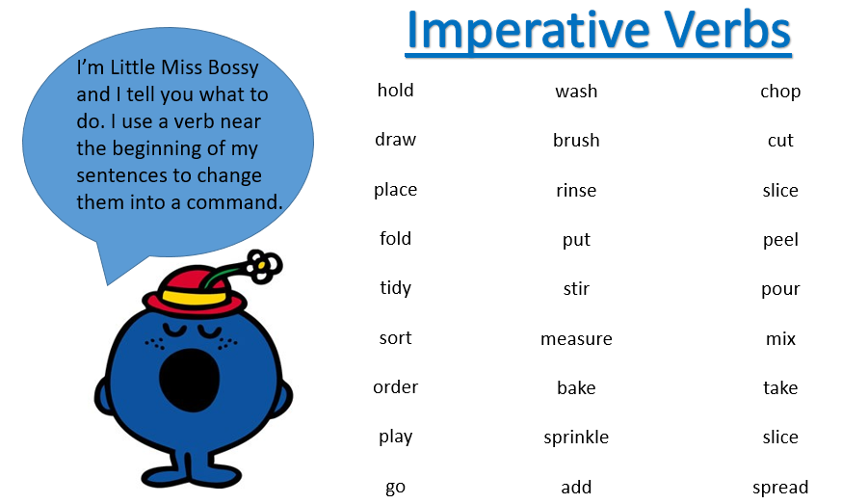
Imperative verbs
What are verbs?
Verbs are doing words – they are used to describe an action for example run, jump, cut or wipe.
What are imperative verbs?
Imperative verbs are still doing words but they are used to tell somebody else what to do.
Sometimes people call imperative verbs ‘bossy words’ because they tell people what to do!

Slide 22
Read the verbs
jump
eat
run
clap
draw
Verbs
paint
cut
sing
laugh
cry
These words are all actions that people can do.

Slide 23
Imperative verbs
Can you do the actions to represent these verbs?

Slide 24
Fill in the missing verbs
Choose from these verbs:

Slide 25
Fill in the missing verbs - answers
Spread
Choose from these verbs:
Put
Cut

Slide 26
Time openers
What are time openers?
Time openers are words or phrases which tell you when to do something or when something happened.
When writing instructions, you usually start each step with a time opener so that the person following the instruction knows clearly when to do each step of the instructions.

Slide 27
Read the time openers
Secondly
First
Next
Finally
Examples of time openers
Later
Then
Before
After

Slide 28
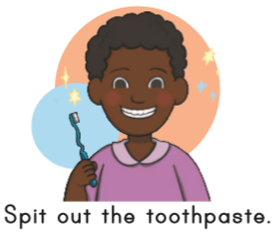
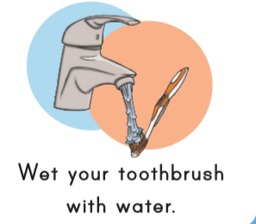
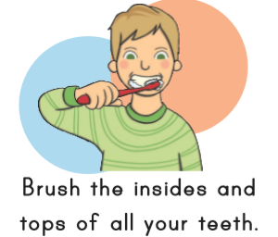
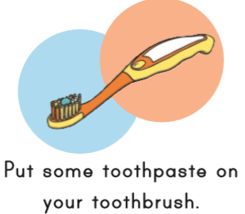
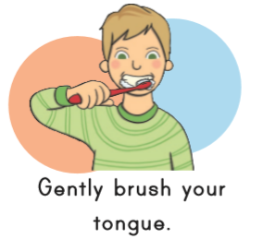
Order the instructions
Below are some instructions for how to brush your teeth. Read each step and put them in the correct order.
You can cut the pictures out and order them or you can drag the picture into the boxes below using the mouse on your computer.

Slide 29
Order the instructions
The instructions are now in the correct order.
Your job now is to match the picture to the correct time opener.
Finally
First
Then
Next
Secondly
Clue: two of the openers can be used in any order.

Slide 30
Order the instructions - answers
The instructions are now in the correct order.
Your job now is to match the picture to the correct time opener.
Finally
First
Then
Next
Secondly
Next and then could have been used in any order. However, first, secondly and finally could only be used for one step.

Slide 31
Fill in the missing time openers
_____________ put the toothpaste onto your tooth brush.
_____________ brush the insides and tops of all teeth.
Choose from these two time openers:
First
Then

Slide 32
Fill in the missing time openers and verbs
Now you need to fill in both the time opener and the verb, I have done one to help you!
First put some toothpaste on your tooth brush.
Time opener
Imperative verb
Your turn
_____________ ____________ your tongue.
_____________ ____________ the toothpaste out.

Slide 33
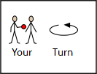
Write the instructions
Using the instructions we have just ordered, write 4 instructions on how to brush your teeth. Remember every step must have a time opener and an imperative verb.
You can use the word banks for help
Time openers:
First
Next
Then
After that
Finally
Before
Imperative verbs:
Brush
Turn
Wash
Rinse
Scrub

Slide 34
Well done for all of your hard work! We can’t wait to see your completed work.
Could any completed work / photographic evidence of completed work please be sent to pathfinderspupils@gmail.com
Thank you!

Slide 35
Date: Thursday 24th June 2021
L.O. To be able to write instruction on how to make a ham, cheese and lettuce sandwich.
Subject: English

Slide 36
How to make a ham & cheese sandwich
Let's re read my instructions to get them back in my head.
First, put your two slices of bread onto the plate.
You will need:
2 slices of bread
Butter or margarine
Ham
Cheese
Lettuce
1 plate
1 knife
Animal shaped cutter (Optional)
Secondly, spread the butter or margarine onto one side of each slice of bread.
Then, place one slice of ham onto the buttered side of one of the slices of bread.
Next, cut the cheese into four or five small slices and place the cheese on top of the ham.
Continued on the next slide

Slide 37
How to make a ham & cheese sandwich
After that, peel off one lettuce leaf and put the lettuce on top of the ham and cheese.
Next, place the other slice of bread on top of the sandwich with the buttered side on top of the lettuce.
*Optional – cut your sandwich into the shape of a rainforest animal using a special cutter or your knife.
Finally, enjoy your delicious ham and cheese sandwich.

Slide 38
Write your instructions
Today you are going to write instructions to tell people how to make a ham, cheese and lettuce sandwich.
Your instructions must include:
A title
Pictures (can be drawn or photos)
Time openers
Imperative verbs
At least 6 steps
Remember:
Imperative verbs are ‘bossy’ doing words.
Time openers are words or phrases used to tell you when to do something.
You can use the template on the next slide to type your instructions or you can write them neatly on a piece of paper.
Don’t forget:
This piece of writing should take approximately 45 minutes
You will also find my pictures on slide 40 which you can cut and stick onto your instructions. Or you could draw your own.

Slide 41
Pictures to cut and stick onto your instructions
Don’t forget you can draw your own pictures or use photographs you took of your own sandwich!

Slide 42
Well done for all of your hard work! We can’t wait to see your completed work.
Could any completed work / photographic evidence of completed work please be sent to pathfinderspupils@gmail.com
Thank you!

Slide 43
Date: Friday 25th June 2021
L.O. To be able to read and spell words with the ‘s’ sound spelt ‘c’.
Subject: English

Slide 44
‘s’ – sound spelt as ‘c’
The spelling rule we are focusing on today is ‘s’ but it is spelt ‘c’.
When a ‘c’ comes before e, i or y it sounds like ‘s’ but we spell it with ‘c’
Click on the links or copy and paste the links into your internet browser to watch the spelling videos.
The 's' sound spelt c before e, i and y – YouTube
Spelling video /s/ sound spelt c before 'e', 'i' and 'y' - YouTube
Soft c / Sounds like 's' / Phonics Song - YouTube

Slide 45
Read the words
Remember ‘c’ before e, i or y sounds like ‘s’.
ice
cell
pace
race
city
space
fancy
rice
circle
nice
circus
mercy
cinema
Now write the words on a piece of paper and underline the ‘c’ sound which sounds like ‘s’ .

Slide 46
Match the picture to the correct word
race
space
ice
rice
city

Slide 47
Match the picture to the correct word - answers
race
space
ice
rice
city

Slide 48
Word | 1st try | 2nd try | 3rd try
ice
race
nice
space
city
rice
circle
circus
Practice writing the words on a piece of paper or type into the table on your computer.

Slide 49
‘s’ sound spelt ‘c’
Now pick 3 ‘s’ words spelt ‘c’ and write a sentence including each word.
ice
city
nice
space
race
rice
circus
circle

Slide 50
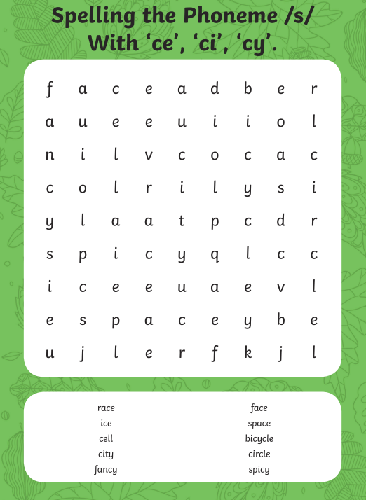
Word Search

Slide 51
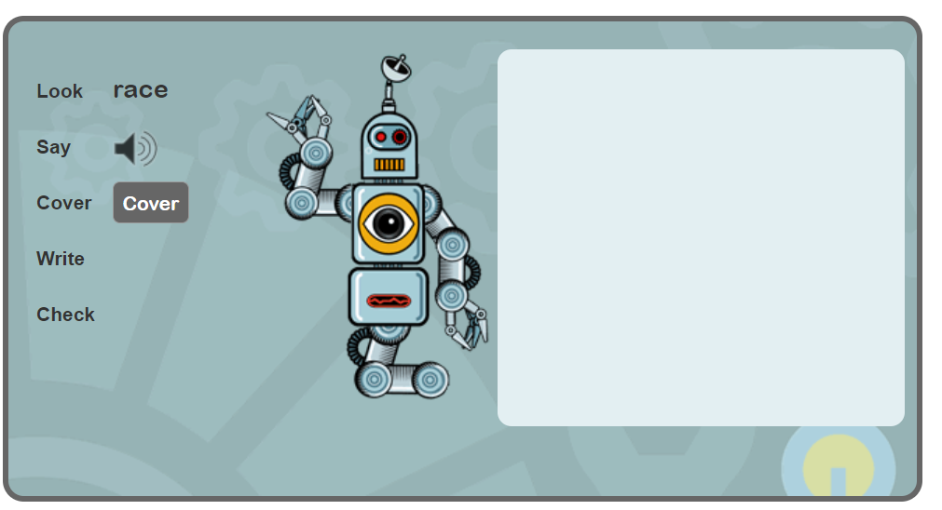
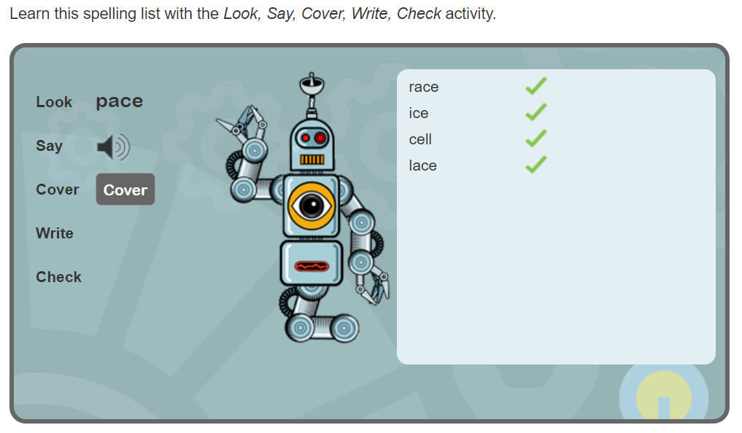
Spelling game
Use the link to play the game and practice spelling the ‘s’ sound but spelt ‘c’ words
Learn spelling activity: /s/ sound spelt c before e,i, and y (spellzone.com)

Slide 52
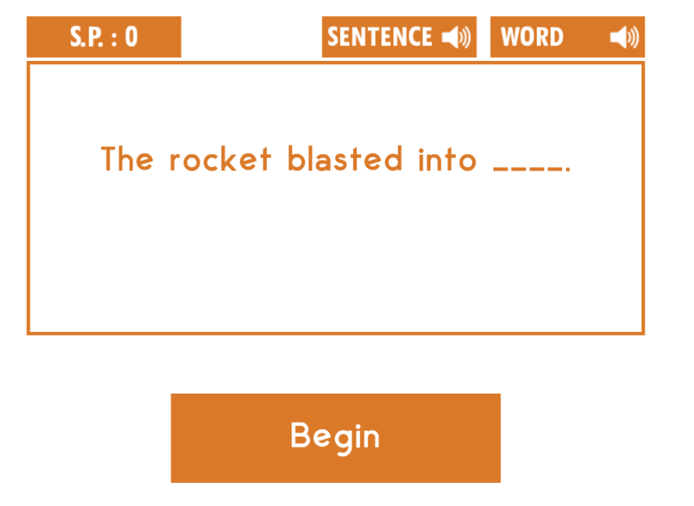
Spelling game
Use the link to play the game and practice spelling the ‘s’ sound but spelt ‘c’ words
https://spellingframe.co.uk/spelling-rule/81/4-The-s-sound-spelt-c-before-e-i-and-y

Slide 53
Well done for all of your hard work! We can’t wait to see your completed work.
Could any completed work / photographic evidence of completed work please be sent to pathfinderspupils@gmail.com
Thank you!

