Slide 1


Date: Monday 18th January 2021
LO: To be able to apply the spelling rules for adding the suffixes –ible and –able.
Subject: Reading

Slide 2
They're both common spelling patterns for adjectives and usually sound the same.
When we add –ible or –able, we change a verb to an adjective.
They mean 'able to' or 'fit for' - acceptable, understandable, responsible

Slide 3
The following words mean 'able to be' -
available: able to be used or obtained
audible: able to be heard
breakable: able to be broken
visible: able to be seen

Slide 4
Which one is correct?
understandible or understandable
terrable or terrible
dependible or dependable

Slide 5
Which one is correct?
understandible or understandable
terrable or terrible
dependible or dependable

Slide 6
There are more words ending in -able (about 900)
There are far fewer ending in -ible
(less than 200).

Slide 7
A general rule is that if you take away the suffix (able) you are usually left with a root word:
understandable = understand + able
enjoyable = enjoy + able
comfortable = comfort + able
dependable = depend + able

Slide 8
What happens if they word ends with y?
Example: rely or justify
We ‘drop’ the y and add an i.
justify - justifiable
rely - reliable

Slide 9
If the root word ends in 'e' then usually we drop the ‘e‘.
value + able = valuable
desire + able = desirable
move + able = movable
believe + able = believable
excite + able = excitable

Slide 10
As a general rule we aren't left with a root word when we take away the ‘ible’
terrible = terr ×
horrible = horr ×
Visible = vis ×
But there are always exceptions - look at these:
corrupt +ible = corruptible
destruct + ible = destructible
convert + ible = convertible
digest + ible = digestible
access + ible accessible

Slide 11
We also drop the 'e' with ible:
collapse + ible = collapsible
response + ible = responsible
sense + ible = sensible
reduce + ible = reducible

Slide 12
Fill in the blanks using your knowledge of this week’s spelling rule.
1. That chair looks (comfort) _____________________.
2. The restaurant was (horr) _____________ and the service was (terror) ___________.
3. I went to see an (incred) ____________film last night.
4. I really had an (enjoy) _____________ evening.
5. The weather was so (change) ____________ yesterday.
6. I hope this isn't (imposs) _____________.
7. The job advert says you need to be (rely) __________, (sense) ___________, and (flex) ____________.
8. The pay is quite (reason) _____________.
9. I'm quite (knowledge) ____________ about spelling now.
10. Her new puppy is very (excite) _____________ and totally (adore) _____________.

Slide 13
Date: Tuesday 19th January 2021
LO: To be able to retrieve information and explain inferences.
Subject: Reading

Slide 14
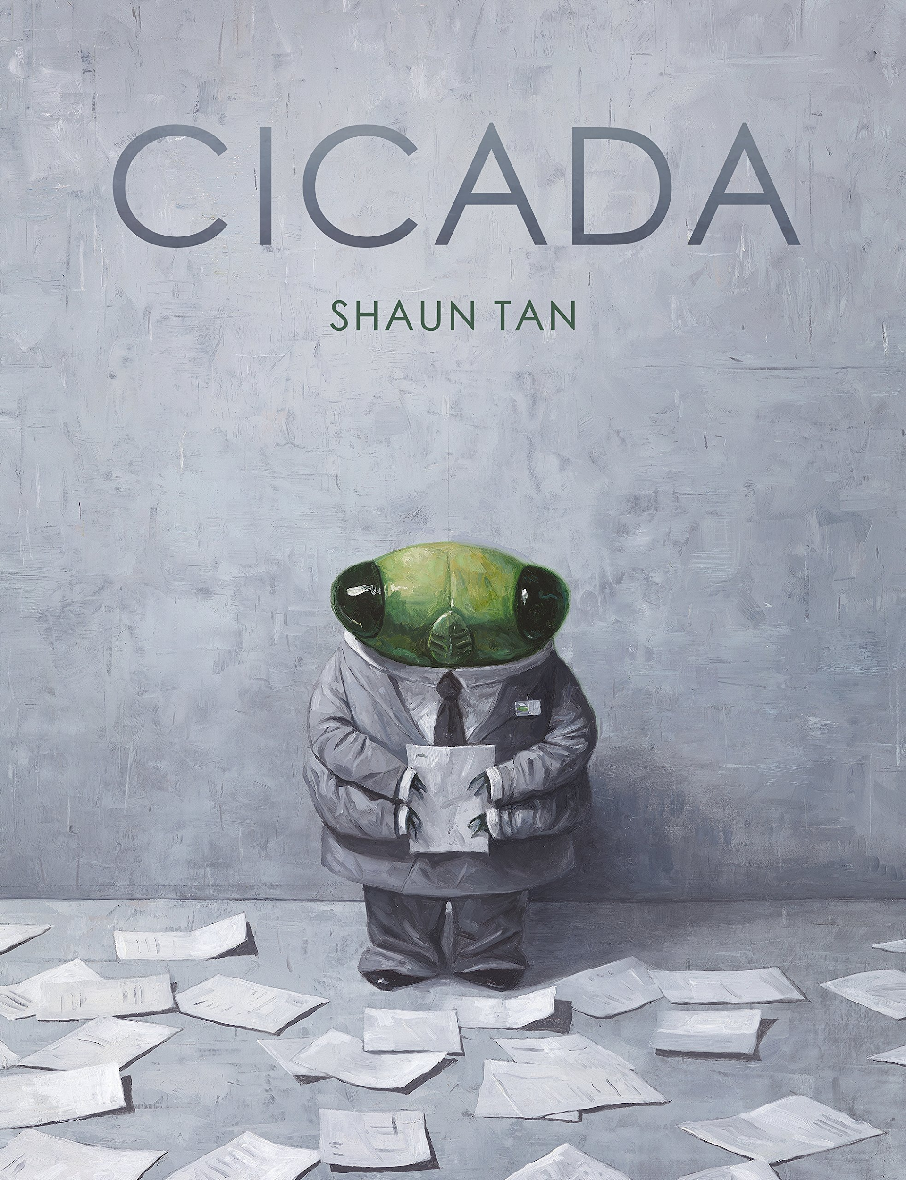
Cicada
Please watch and read along with the following clip: https://www.youtube.com/watch?v=eXTpwN8T7ig

Slide 15
Retrieval
What was Cicada’s job?
Where was Cicada not allowed to go?
How long had he worked for the company?
What did he do each evening?
Where did Cicada live?
What does Cicada do when he thinks about humans?

Slide 16
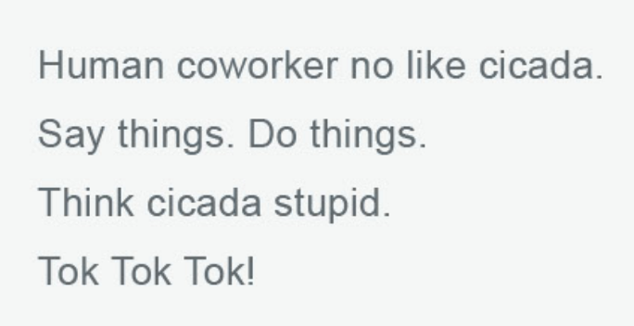
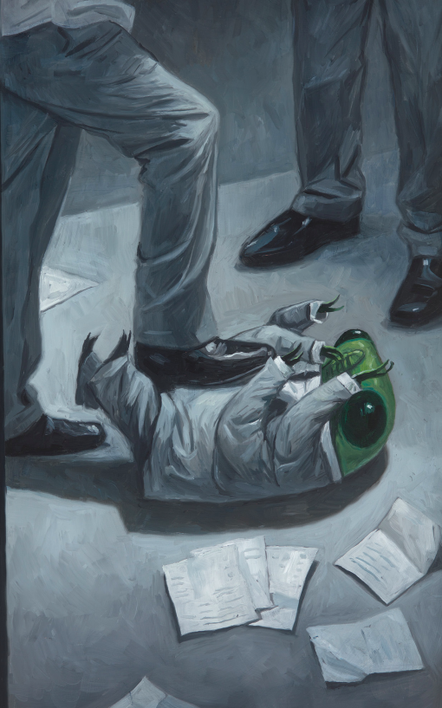
Vocabulary
Which words best describes the actions of his co-workers?

Slide 17

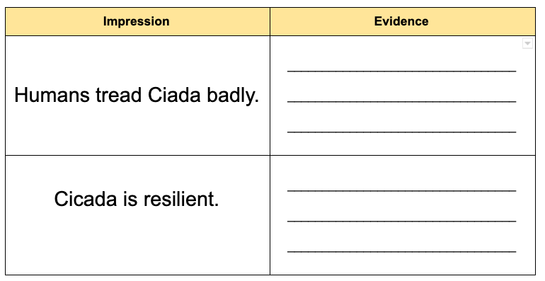
Explain
I get two impressions from the text.
Find evidence to justify my impressions.

Slide 18
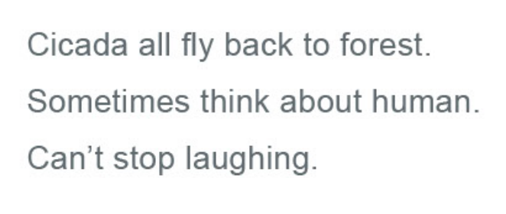
Explain
Explain why you think Cicada is laughing.

Slide 19
Date: Wednesday 20th January 2021
LO: To be able to retrieve information and explain inferences.
Subject: Reading

Slide 20
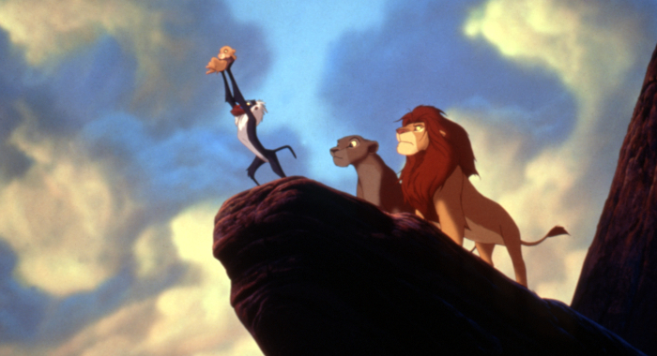
Circle of Life
https://www.azlyrics.com/lyrics/eltonjohn/circleoflife.html

Slide 21
Retrieval
Who wrote the song?
What does the song tell us that we must find in life?
What does the song tell us that we will first experience in life?
How can we get through our troubles?
What must we not take?

Slide 22
Vocabulary
unwinding
Stampede
wayside

Slide 23
Infer
‘There's more to be seen
Than can ever be seen
More to do than can ever be done.’
What does this extract imply about the lyricist’s expectations of life?

Slide 24
Explain
‘It’s a leap of faith’
Explain what this
phrase means.
Can you given an example from your own lives?

Slide 25
Date: Thursday 21st January 2021
LO: To be able to retrieve information and explain inferences.
Subject: Reading

Slide 26
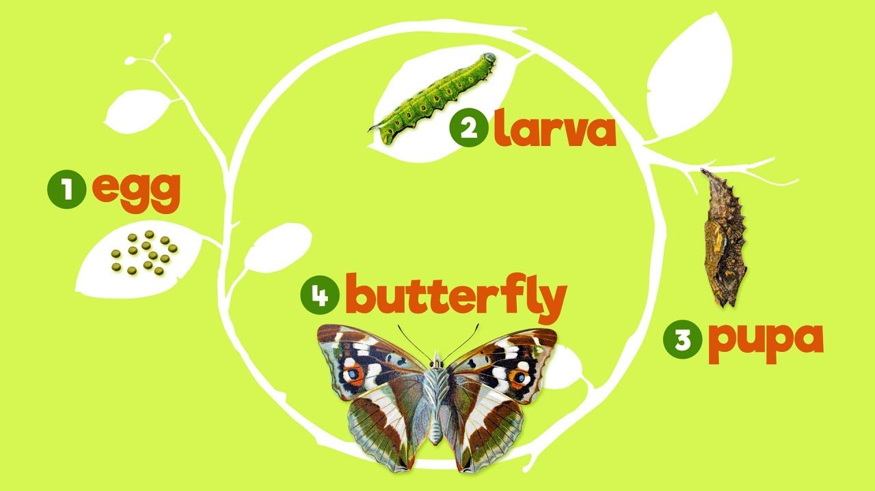
Life Cycle of a Butterfly
https://ansp.org/exhibits/online-exhibits/butterflies/lifecycle/

Slide 27
Retrieval
(Answer these questions in your head or tell an adult)
In what year did Henry V become king?
When do butterflies lay their eggs?
What must caterpillars do once they’ve hatched?
How long can a caterpillar grow?
What is the third stage of the cycle? Give both names.
Explain the job/role of a hatched butterfly.

Slide 28

Vocabulary Check
incomplete metamorphosis - a short rule by King or Queen
suspended - to hang
special cells - the smallest unit of life

Slide 29
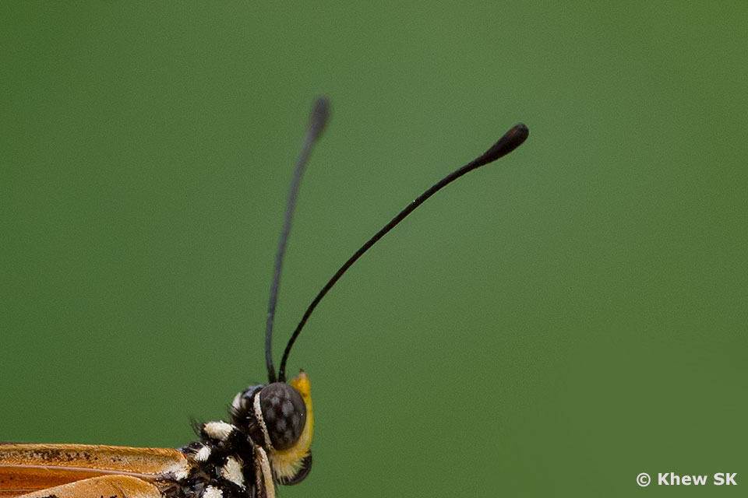
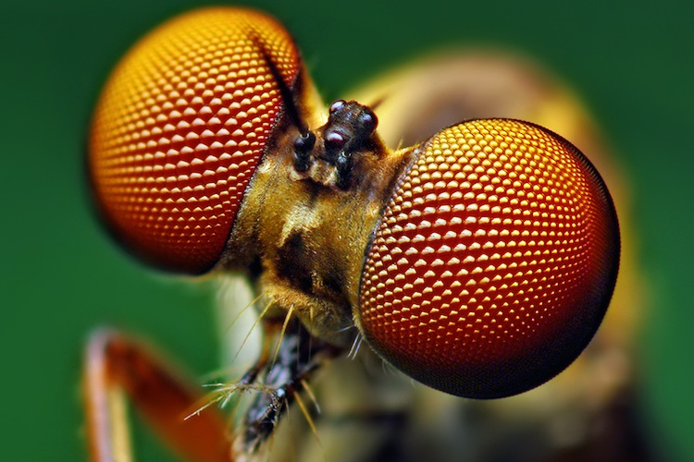
Vocabulary
larva antennae
compound eyes
hibernate

Slide 30
Explain
How is the life cycle of a butterfly different from the life cycle of a dragonfly?

Slide 31
Infer
‘The pupa may suspended under a branch, hidden in leaves or buried underground.’
Why would they not lay their eggs in obvious places?

Slide 32
Explain
Based on what you know about the life cycle of a butterfly, which stage do you think is the most important?
Write your answer in full sentences using evidence from the text to justify your answer.

Slide 33

Explain
‘As they grow, they undergo one seriously terrific transformation.’
Do you agree with this?
Explain your opinion and include evidence from the
text to support your answer.

