Slide 1


Subject: Maths
Pack: B

Slide 2


Date: 01.02.2021
LO: To be able to describe the position of a shape in the first quadrant.
Subject: Maths

Slide 3
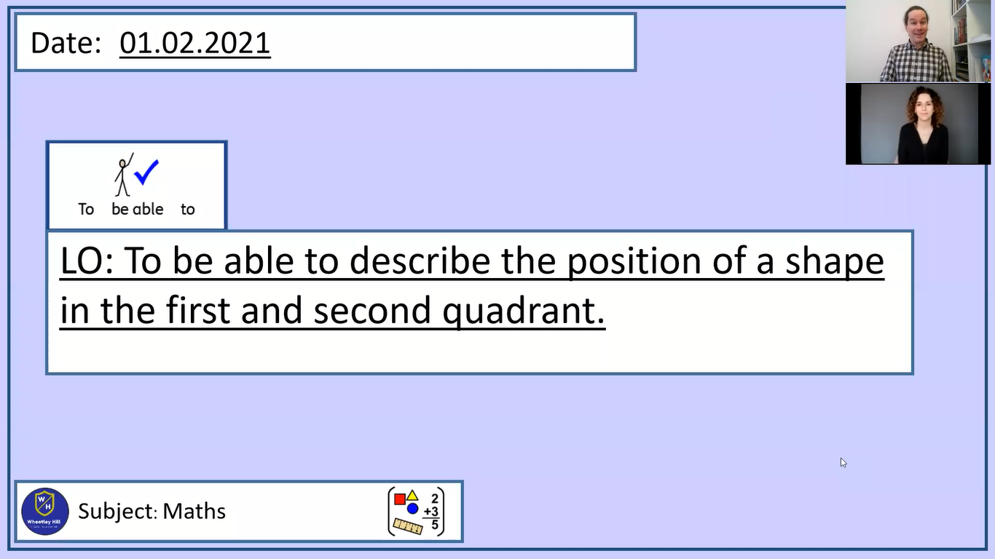
Pre-recorded Teaching
Mr. Herdman’s online teaching video is on our school website. It will support you to complete the work in this lesson. This video will act as a support but all of the work can still be successfully understood & completed using paper-based versions of this pack. If you need further support to understand / complete work then please contact school via e-mail or telephone.
You can also copy and paste this link if you would prefer:
https://www.whprimary.com/copy-4-of-covid19

Slide 4

Times table practise
Spend at least 15mins practising your times tables.
This can be done on TTRS, hit the button or any other times table website.
Use the Times Tables Rock Stars app or website.
Alternatively, copy and paste the following link into a web browser:
https://www.topmarks.co.uk/maths-games/7-11-years/times-tables

Slide 5

Horizontal and Vertical lines
Horizonal
Vertical
y-axis
x-axis
Notes:
Before we start, I am going to explain what x and y axis are, and doing this, I will quickly recap a lesson that you all probably have learnt before.
x-axis are horizontal, which is a straight line that goes from left to right or right to left, and a tip for you, horizontal sounds like horizon, which is a landscape, which should help you remember the direction of a horizonal. Horizon lies on the ground.
y-axis are vertical, which is a straight line that goes from top to bottom or bottom to top.

Slide 6
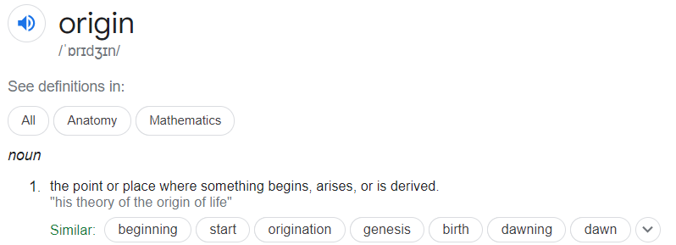
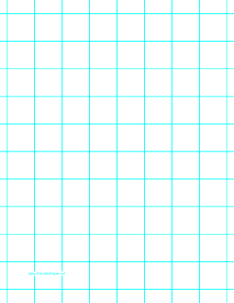
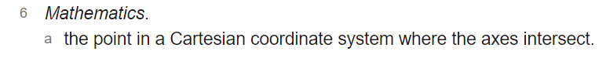
A coordinate system
10
y-axis
9
8
7
6
5
Origin
4
3
2
1
x-axis
0
3
4
5
9
10
1
2
6
7
8
Notes:
A cartesian coordinate system is a coordinate system that we are going to use today. This is a 10 by 10 grid cartesian coordinate system.
Outside of a cartesian coordinate system, coordinates is used in mapping to chart the landscape.
In a cartesian coordinate system, coordinates are a set of values that shows an exact position on a grid. The horizontal line are called x-axis, and the vertical line are called a y-axis.
The origin is the starting point. The origin is the point where the planes meet, and the value of coordinates are normally defied as zero. Here is a definition of Origin from a dictionary. Axes refers to the two line, x-axis and y-axis and the word, intersect means a place where two things meet.
I have explained the basics of a cartesian coordinate system, now we are going to use coordinates to plot and discover shapes, let’s move on.

Slide 7
How to plot a coordinate?
y-axis
10
I am going to explain how to plot a coordinate.
Firstly, we are going to focus on the x-axis.
Starting from the origin of the x-axis (0), read along the x-axis to the number 7.
Secondly, from the origin of the y-axis, read along to the number 3.
At this point, mark the coordinate with a cross.
How do you write down the coordinate?
It is written (7, 3)
9
8
7
6
5
4
3
2
1
x-axis
0
1
2
3
4
5
6
7
8
9
10

Slide 8

Yet more coordinates!
y-axis
10
We have marked the coordinate (7, 3) but how do we mark the coordinate (2, 3) on the grid?
Now, we are going to try and mark two further coordinates together.
Together we are going to plot these coordinates;
(7, 8) – be careful as the yellow cross plotted on the grid is what happens if you start with the y-axis.
(2, 8) – be careful as the yellow cross plotted on the grid is what happens if you start with the y-axis.
Now connect the marked coordinates using a ruler, can anyone confirm what shape is visible on the grid?
Answer: a square!
9
8
7
6
5
4
3
2
1
0
x-axis
0
1
2
3
4
5
6
7
8
9
10

Slide 9
Plotting these coordinates
10
9
Plot these following vertices on the grid.
A vertex, or in plural form, vertices, shows the point of where two lines meet on a grid.
(3, 5)
(4, 4)
(0, 2)
(4, 0)
8
7
6
y-axis
5
4
3
2
1
0
1
2
3
4
5
6
7
8
9
10
x-axis

Slide 10
Plotting these coordinates - answer
Plotting these coordinates
10
9
What are the coordinates of the vertices of the rectangle?
( , )
( , )
( , )
( , )
8
7
(0, 2)
(0, 3)
(4, 3)
(4, 2)
6
y-axis
5
4
3
2
1
0
1
2
3
4
5
6
7
8
9
10
x-axis

Slide 11
Recap
Remember to start with the x-axis first every time, which is the horizonal plane at the bottom, before moving on the y-axis, which the vertical plane from the left.
Always start from the origin of the planes, can anyone write down the coordinate of the origin of the planes?
Answer - (0, 0).

Slide 12

Task 1
Using the blank cartesian coordinate system in the next slide, to draw these shapes.
A rectangle
A square
A triangle

Slide 13
Task 1
10
9
8
7
6
y-axis
5
4
3
2
1
0
1
2
3
4
5
6
7
8
9
10
x-axis

Slide 14
Task 2
y-axis
Mr Herdman is now asking you to draw a rectangle on the grid.
Can you draw a rectangle on the grid and give Mr Herdman the coordinates used to plot four vertices of the rectangle.
Vertex A = ( , )
Vertex B = ( , )
Vertex C = ( , )
Vertex D = ( , )
5
4
3
2
1
0
x-axis
0
1
2
3
4
5

Slide 15
Task 3
y-axis
(2,5)
Mr Herdman has plotted two vertices of a square, labelled (5, 2) and (2, 5) on the grid.
What are the coordinates of vertices A and B?
Vertex A =
Vertex B =
B
5
4
3
2
A
(5,2)
1
0
x-axis
0
1
2
3
4
5

Slide 16
Task 3 - answers
y-axis
(2,5)
Mr Herdman has plotted two vertices of a square, labelled (5, 2) and (2, 5) on the grid.
What are the coordinates of vertices A and B?
Vertex A =
Vertex B =
B
5
4
3
2
A
(5,2)
(2, 2)
(5, 5)
1
0
x-axis
0
1
2
3
4
5

Slide 17
Task 4
y-axis
Mr Herdman has plotted three vertices of a rectangle, labelled (1, 1), (3, 1) and (3, 5) on the grid.
Mr Herdman estimates that the final vertex of the rectangle, marked D on the grid, is (5, 1).
Can you decipher whether if Mr Herdman is correct?
Vertex D =
D
5
4
3
2
1
0
x-axis
0
1
2
3
4
5

Slide 18
Task 4 - answer
y-axis
Mr Herdman has plotted three vertices of a rectangle, labelled (1, 1), (3, 1) and (3, 5) on the grid.
Mr Herdman estimates that the final vertex of the rectangle, marked D on the grid, is (5, 1).
Can you decipher whether if Mr Herdman is correct?
Vertex D =
D
5
4
3
2
(1, 5)
1
0
x-axis
0
1
2
3
4
5

Slide 19
Task 5
Mr Herdman has drawn a square, but he has somehow forgotten to draw a grid.
Mr Herdman reveals the first two coordinates of the two vertices.
Use the cartesian coordinate system in the next slide.
What are the coordinates of vertices A and B?
Vertex A = ( , )
Vertex B = ( , )
(6, 10)
B
A
(10, 6)

Slide 20
Task 5
10
9
8
7
6
y-axis
5
4
3
2
1
0
1
2
3
4
5
6
7
8
9
10
x-axis

Slide 21
Task 5 - answers
Vertex A = (6, 6)
Vertex B = (10, 10)
(10, 10)
(6, 10)
B
A
(10, 6)
(6, 6)

Slide 22
Grey Box Challenge 1
Mr Herdman would like you to answer these questions.
What is an origin? ________________________________________________________________________________________________________________________________________________________________________
What is a vertex?
________________________________________________________________________________________________________________________________________________________________________
Mr Herdman thinks this line is a vertical line. Is Mr Herdman correct? (circle one) Yes No

Slide 23
Grey Box Challenge 1 = answers
Mr Herdman would like you to answer these questions.
What is an origin?
The origin is the starting point. The origin is the point where the planes meet, and the value of coordinates are normally defied as zero
What is a vertex?
Vertex is used to show a point where two lines meet.
Mr Herdman thinks this line is a vertical line. Is Mr Herdman correct? (circle one) Yes No

Slide 24
End of lesson.

Slide 25
Date: 02.02.2021
LO: To be able to describe the position of a shape in all 4 quadrants.
Subject: Maths

Slide 26
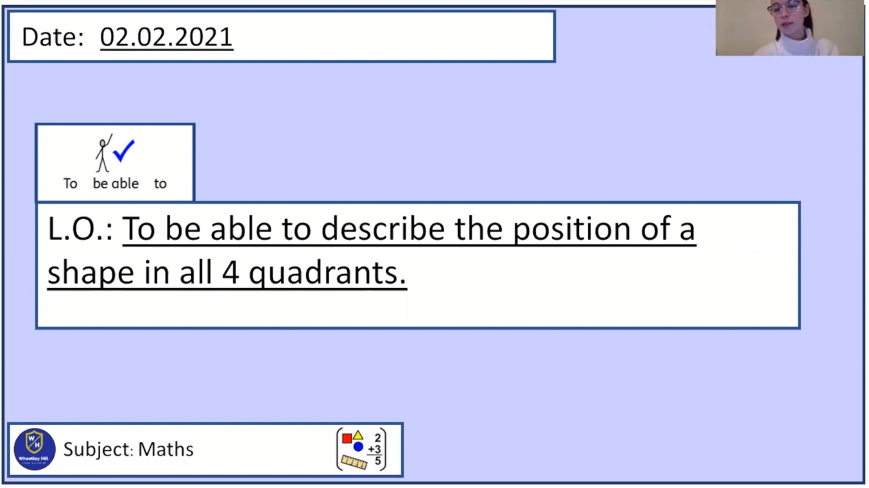
Pre-recorded Teaching
Miss Umbleby’s online teaching video is on our school website. It will support you to complete the work in this lesson. This video will act as a support but all of the work can still be successfully understood & completed using paper-based versions of this pack. If you need further support to understand / complete work then please contact school via e-mail or telephone.
You can also copy and paste this link if you would prefer:
https://www.whprimary.com/copy-4-of-covid19

Slide 27
Times table practise
Spend at least 15mins practising your times tables.
This can be done on TTRS, hit the button or any other times table website.
Use the Times Tables Rock Stars app or website.
Alternatively, copy and paste the following link into a web browser:
https://www.topmarks.co.uk/maths-games/7-11-years/times-tables

Slide 28
Recap
x
y
( , )
When we write coordinates, we go along the corridor and up the stairs.
We always write the number on the x axis first and then the number on the y axis.

Slide 29
Recap
Can you describe the position of these shapes using coordinates?
y
y
10
9
A
8
7
6
5
4
A
D
3
2
B
C
1
B
C
x
0
x
1
2
3
4
5
6
7
8
9
10
A ( , )
B ( , )
C ( , )
A ( , )
B ( , )
C ( , )
D ( , )

Slide 30
Recap
Can you describe the position of these shapes using coordinates?
y
y
10
9
A
8
7
6
5
4
A
D
3
2
B
C
1
B
C
x
0
x
1
2
3
4
5
6
7
8
9
10
A ( 6 , 8 )
B ( 3 , 2 )
C ( 9 , 2 )
A ( 1 , 4 )
B ( 1 , 1 )
C ( 6 , 1 )
D ( 6 , 4 )

Slide 31
The four quadrants.
y
2nd quadrant
1st quadrant
3rd quadrant
4th quadrant

Slide 32
The first quadrant.
y
A
We should now be confident to know that
A ( 2 , 3 )

Slide 33
The second quadrant.
y
Let's have a look at the second quadrant.
Remember we go along the corridor and up the stairs.
Along the x axis, point B is negative 3.
Along the y axis, point B is 2.
So, the coordinates of point B are .
B
(-3 , 2)
When points are in the second quadrant x is negative. This is shown by putting a – in front of the number.

Slide 34
Write the coordinates of points A to C
y
5
4
A
B
3
2
C
A ( , )
B ( , )
C ( , )
1
x
-5
-4
-3
-2
-1
0
1
2
3
4
5
-1
-2
-3
-4
-5

Slide 35
Write the coordinates of points A to C
y
5
4
A
B
3
2
C
A ( -5 , 3 )
B ( -2 , 2 )
C ( -4 , 1 )
1
x
-5
-4
-3
-2
-1
0
1
2
3
4
5
-1
-2
-3
-4
-5

Slide 36
The third quadrant.
y
Let's have a look at the third quadrant.
We go along the corridor and this time we go down the stairs.
Along the x axis, point C is negative 4.
Along the y axis, point C is negative 3.
So, the coordinates for point C are .
(-4 , -3)
When points are in the third quadrant both x and y are negative. This is shown by putting a – in front of both numbers.
C

Slide 37
Write the coordinates of points A to C
y
5
4
3
2
A ( , )
B ( , )
C ( , )
1
x
-5
-4
-3
-2
-1
0
1
2
3
4
5
-1
A
-2
B
-3
C
-4
-5

Slide 38
Write the coordinates of points A to C
y
5
4
3
2
A ( -4 , -2 )
B ( -1 , -3 )
C ( -3 , -4 )
1
x
-5
-4
-3
-2
-1
0
1
2
3
4
5
-1
A
-2
B
-3
C
-4
-5

Slide 39
The fourth quadrant.
y
Let's have a look at the fourth quadrant.
We go along the corridor and this time we go down the stairs.
Along the x axis, point D is 1.
Along the y axis, point D is negative 4.
So, the coordinates for point D are .
(1 , -4)
When points are in the fourth quadrant y is negative. This is shown by putting a – in front of the number.
D

Slide 40
Write the coordinates of points A to C
y
5
4
3
2
A ( , )
B ( , )
C ( , )
1
x
-5
-4
-3
-2
-1
0
1
2
3
4
5
-1
A
-2
B
-3
-4
C
-5

Slide 41
Write the coordinates of points A to C
y
5
4
3
2
A ( 1 , -2 )
B ( 4 , -3 )
C ( 3 , -5 )
1
x
-5
-4
-3
-2
-1
0
1
2
3
4
5
-1
A
-2
B
-3
-4
C
-5

Slide 42
y
2nd quadrant
1st quadrant
Negative x
Positive x
Positive y
Positive y
3rd quadrant
4th quadrant
Negative x
Positive x
Negative y
Negative y

Slide 43
Write the coordinates of points A to G
y
5
A ( , )
B ( , )
C ( , )
D ( , )
E ( , )
F ( , )
G ( , )
A
4
3
G
2
B
1
F
x
-5
-4
-3
-2
-1
0
1
2
3
4
5
-1
C
-2
D
-3
E
-4
-5

Slide 44
Write the coordinates of points A to G
y
5
A ( -4 , 4 )
B ( -3 , 1 )
C ( -5 , -1 )
D ( -2 , -3 )
E ( 3 , -4 )
F ( 4 , 0 )
G ( 1 , 2 )
A
4
3
G
2
B
1
F
x
-5
-4
-3
-2
-1
0
1
2
3
4
5
-1
C
-2
D
-3
E
-4
-5

Slide 45
Ways to complete this task:
Use insert → shapes to plot the coordinates onto this grid.
Print this grid and plot the coordinates by drawing on it.
Draw a grid that looks like the one on the left and plot the coordinates by drawing on it.
TASK: plot these co-ordinates on the grid.
y
(-1,2)
(-3,4)
(2, 3)
(4,-2)
Remember we go along the corridor and up/down the stairs.

Slide 46
y
Can you plot these co-ordinates on the graph?
(-1,2)
(-3,-4)
(2, 3)
(4,-2)

Slide 47
Ways to complete this task:
Use insert → shapes to plot the coordinates onto this grid.
Print this grid and plot the coordinates by drawing on it.
Draw a grid that looks like the one on the left and plot the coordinates by drawing on it.
y
Task: Draw a shape using the co-ordinates
(-2,2)
(-4,2)
(-2,-3)
(-4,-2)
What is the name of the shape?
Remember we go along the corridor and up/down the stairs.

Slide 48
y
Draw a shape using the co-ordinates
(-2,2)
(-4,2)
(-2,-3)
(-4,-3)
What is the name of the shape?
Rectangle

Slide 49
y
A
What are the coordinates for each vertex of the triangle?
A ( , )
B ( , )
C ( , )
B
C
Remember we go along the corridor and up the stairs.

Slide 50
y
A
Can you write the coordinates for each vertex of the triangle?
A ( -3 , 4 )
B ( -4 , 1 )
C ( -1 , 1 )
B
C

Slide 51

Name and write the coordinates for these 4 shapes.
y
Name:
A
B
C
Name:
H
I
J
K
A
L
O
C
M
N
B
H
K
Name:
D
E
F
G
Name:
L
M
N
O
D
G
E
F
I
J

Slide 52
Name and write the coordinates for these 4 shapes.
Name: Right Angled Triangle
A
B
C
Name: Rectangle
H
I
J
K
-5 4
3 -1
-5 1
3 -4
-1 1
5 -4
5 -1
Name: Square
D
E
F
G
Name: Parallelogram
L
M
N
O
-4 -2
2 4
-4 -4
1 1
-2 -4
4 1
-2 -2
5 4

Slide 53
End of lesson.

Slide 54
Date: 03.02.2021
LO: To be able to represent the position of a shape, after a translation.
Subject: Maths

Slide 55
Times table practise
Spend at least 15mins practising your times tables.
This can be done on TTRS, hit the button or any other times table website.
Use the Times Tables Rock Stars app or website.
Alternatively, copy and paste the following link into a web browser:
https://www.topmarks.co.uk/maths-games/7-11-years/times-tables

Slide 56

Pre-recorded Teaching
Access the online teaching video below that will support you to complete the work in this lesson. This video will act as a support but all of the work can still be successfully understood & completed using paper-based versions of this pack. If you need further support to understand / complete work then please contact school via e-mail or telephone.
Play Video
Please fast forward to 8:00mins into the video for the relevant content.
You can also copy and paste this link if you would prefer:
https://classroom.thenational.academy/lessons/to-describe-movement-between-positions-as-translations-of-a-given-unit-leftright-or-updown-1-65h36t?step=2&activity=video

Slide 57
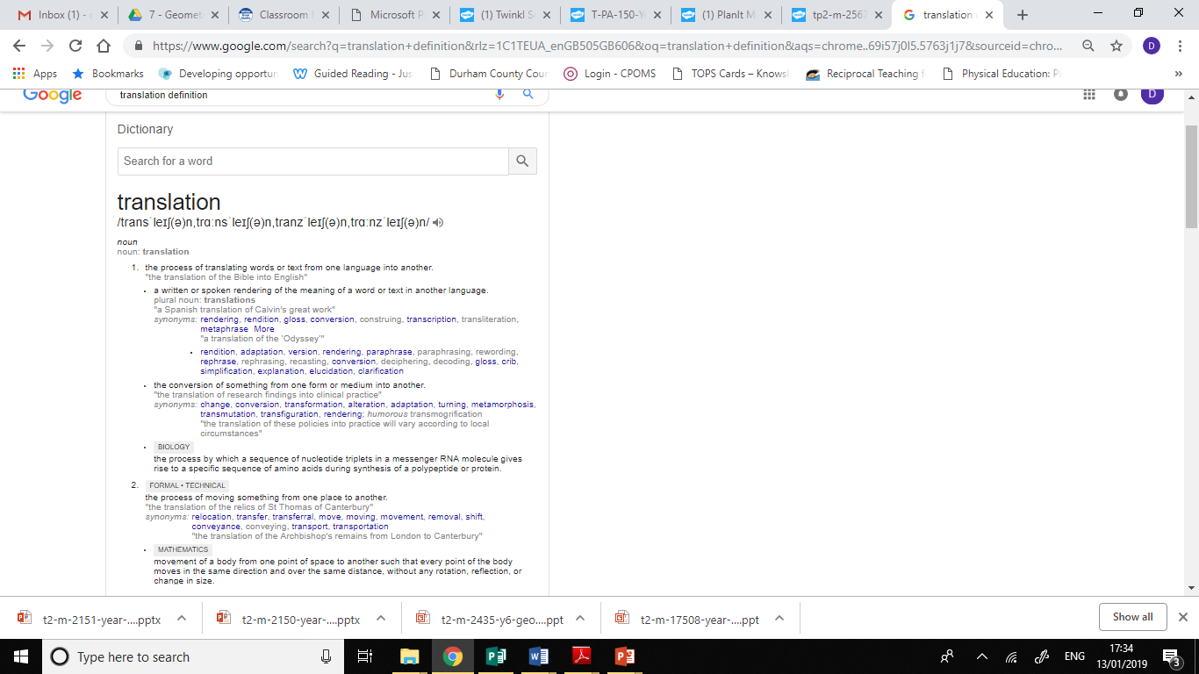
What does translation mean?

Slide 58
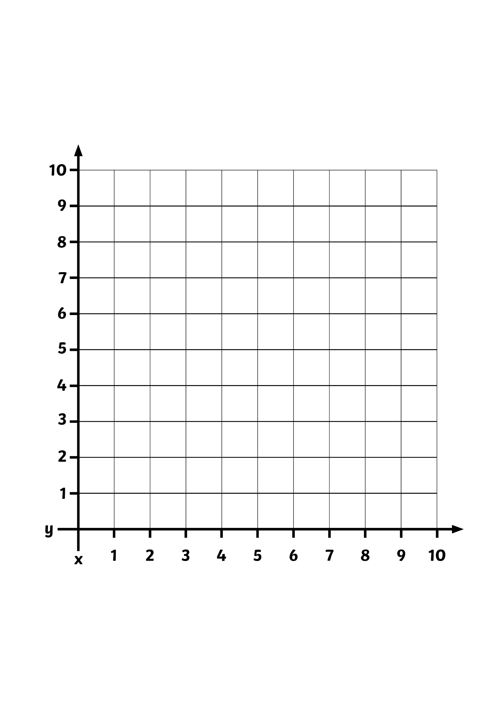

What is a Translation?
A translation is when a shape moves from one position to another without being rotated or flipped.
On this grid, rectangle A has been moved to position B.
B
A
x
y

Slide 59
What Is a Translation?
This is not a translation because the shape has
been rotated.
B
A
x
y

Slide 60

Translating Shapes
Is this a translation?
B
A
Yes
This is a translation.
x
y

Slide 61
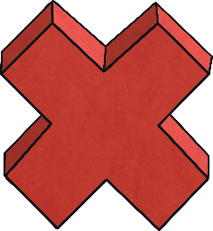
Translating Shapes
Is this a translation?
B
No
This is not a translation because the shape has been rotated.
A
x
y

Slide 62
Translating Shapes
Is this a translation?
B
No
This is not a translation because the shape has been rotated.
A
x
y

Slide 63
So, how do we translate?
This point represents the top left hand corner of the rectangle
To translate a shape, we must pick one of the shape’s vertices (corners).
We have chosen the top left hand corner on this rectangle.
I want to move this rectangle 5 squares to the right and 2 squares up.
2 squares up
5 squares to the right
B
A
We always move along the x-axis first, then then the y-axis.
x
y

Slide 64
So, how do we translate?
To translate a shape, we must pick one of the shape’s vertices (corners).
We have chosen the bottom left-hand corner on this triangle.
I want to move this triangle 5 squares to the left and 4 squares down.
A
4 squares down
B
5 squares to the left
We always move along the x-axis first, then then the y-axis.
x
y
This point represents the top left hand corner of the triangle

Slide 65
So, how do we translate?
This time, I would like to translate the triangle to another point on the coordinate grid.
I would like to move the bottom left-hand vertex from (1,1) to (4,6).
How far to the right and how many squares up do I need to translate?
B
Hopefully, you said 3 squares to the right and 5 squares up
A
x
y

Slide 66
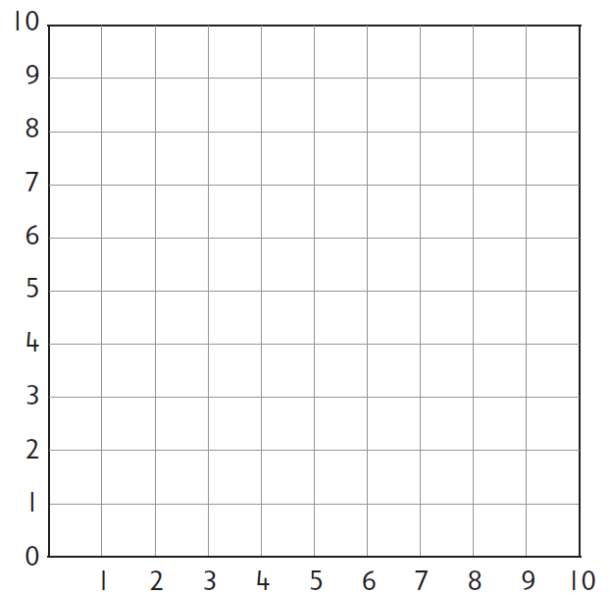
Task 1:
The triangle is translated and one of its vertices ends up at A.
A has translated to (6,7)
A
A
Show the position of the shape, following a translation.

Slide 67
Task 1 answer:
A has translated to (6,7)
A
A
Point A has translate 3 squares to the right and 1 square up.

Slide 68
Task 2 :
The square is translated and one of its vertices ends up at A.
What are the coordinates of the vertex?
A
A
Show the position of the shape, following a translation.

Slide 69
Task 2 answer:
The square is translated and one of its vertices ends up at A.
What are the coordinates of the vertex?
A
A
The square has been translated 6 squares to the left and 2 squares up.

Slide 70
Task 3:
The rectangle is translated 3 squares to the left and 3 squares down.
A
What is the coordinate of A?
Can you show where the rectangle has been translated to?

Slide 71
Task 3 answer:
The rectangle is translated 3 squares to the left and 3 squares down.
A
What is the coordinate of A?
A
The vertex ‘A’ has moved from the coordinate (8,8) to the coordinate (5,5).

Slide 72
We will now look at translating across the first and second quadrant.
After translation A is at (-2,8)
The rectangle has translated 6 squares to the left and 3 squares up
y-axis
10
9
A
8
Before translation A is at (4,5)
7
6
5
A
4
3
2
1
x-axis
-10
-9
-8
-7
-6
-5
-4
-3
-2
-1
0
1
2
3
4
5
6
7
8
9
10

Slide 73
We will now look at translating across the first and second quadrant.
If you placed it here - well done!
y-axis
10
9
Can you translate this rectangle from its current position, to (-8,7)?
8
A
7
6
It translated 17 squares left and 2 squares up.
A
5
4
3
2
1
x-axis
-10
-9
-8
-7
-6
-5
-4
-3
-2
-1
0
1
2
3
4
5
6
7
8
9
10

Slide 74
We will now look at translating across the first and second quadrant.
I want to translate this right-angled triangle 9 squares to the right and 1 square down.
At which coordinate do you think A will be at, after translation?
y-axis
10
9
8
7
If you said A translated to (1,4), you were correct!
6
A
5
A
4
3
2
1
x-axis
-10
-9
-8
-7
-6
-5
-4
-3
-2
-1
0
1
2
3
4
5
6
7
8
9
10

Slide 75
Task 4:
Can you describe the points which A, B and C are at and record them.
y-axis
10
9
8
A
7
6
5
C
B
4
3
2
1
x-axis
-10
-9
-8
-7
-6
-5
-4
-3
-2
-1
0
1
2
3
4
5
6
7
8
9
10
Now, can you translate the rectangle by moving each point to the following coordinates:
C 12 squares left and 4 squares down:
A to (7,3):
B to (-6,5):

Slide 76
Task 4 answers:
Can you describe the points which A, B and C are at and record them.
y-axis
10
9
8
A
7
6
B
5
C
B
4
3
A
2
C
1
x-axis
-10
-9
-8
-7
-6
-5
-4
-3
-2
-1
0
1
2
3
4
5
6
7
8
9
10
Now, can you translate the rectangle by moving each point to the following coordinates:
C 12 squares left and 4 squares down:
A to (7,3):
B to (-6,5):

Slide 77
End of Lesson

Slide 78
Date: 04.02.2021
LO: To be able to represent the position of a shape, after a translation.
Subject: Maths

Slide 79
Times table practise
Spend at least 15mins practising your times tables.
This can be done on TTRS, hit the button or any other times table website.
Use the Times Tables Rock Stars app or website.
Alternatively, copy and paste the following link into a web browser:
https://www.topmarks.co.uk/maths-games/7-11-years/times-tables

Slide 80

Pre-recorded Teaching
Access the online teaching video below that will support you to complete the work in this lesson. This video will act as a support but all of the work can still be successfully understood & completed using paper-based versions of this pack. If you need further support to understand / complete work then please contact school via e-mail or telephone.
Play Video
Please select the ‘translation’ video.
You can also copy and paste this link if you would prefer:
https://whiterosemaths.com/homelearning/year-6/week-13-geometry-position-direction/

Slide 81
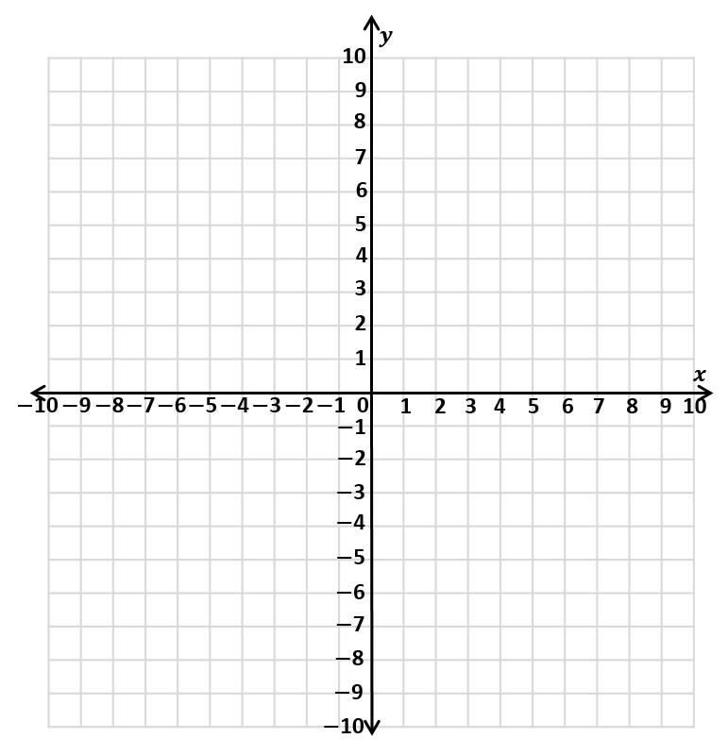
Recap
We are going to recap the learning you did on Tuesday about coordinates in all 4 quadrants.

Slide 82
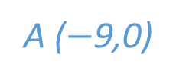

Recap
1) What are the coordinates
of point A and B.
2) Plot the coordinate
(0,$−$4)
3) Plot the coordinate
($−$3,$−$7 )
4) Which quadrants are the points in?
B
A ($−$9,0)
B (3,5)
A
1st quadrant
3rd quadrant

Slide 83
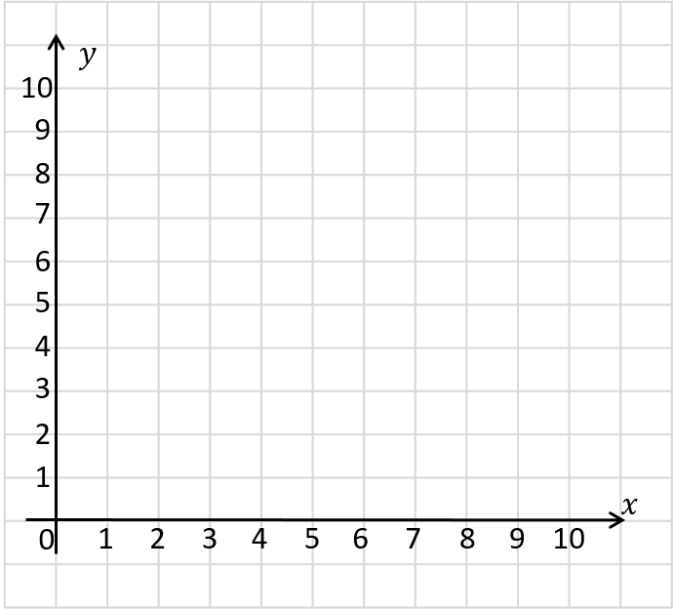
Recap
2 up
4 right
The point has been translated 4 right and 2 up.

Slide 84
Recap
3 right
3 down
Can you describe the translation?

Slide 85
Can you describe the translations?
A
B
A
B
5 right
1 down
B
C
C
2 left
3 down
B
A
5 left
1 up

Slide 86

We are now going to look at new learning: translating within all four quadrants.
y
5
4
3
The coordinates of the black point on shape A are (-4,-1).
We are going to move the triangle 5 squares right and 5 squares up.
2
1
x
-5
-4
-3
-2
-1
0
1
2
3
4
5
-1
-2
A
B
-3
-4
-5

Slide 87
We are now going to look at new learning: translating within all four quadrants.
7 right
A
We are going to look at the translation of triangle A to triangle B?
6 down
B

Slide 88
We’re now going to translate the triangle 9 squares to the left, then 11 squares up
B
A

Slide 89
We’re now going to translate the triangle 9 squares to the right, then 6 squares up
B
A

Slide 90
How Has This Shape Been Translated From A to B?
y
5
The black point on the triangle has translated to (1,-4)
4
3
B
How many squares left or right and how many squares up or down has the triangle moved?
2
A
1
(3 squares left, 5 squares down)
x
-5
-4
-3
-2
-1
0
1
2
3
4
5
-1
-2
-3
-4
-5

Slide 91
How Has This Shape Been Translated From A to B?
y
5
The shape has been translated 3 squares to the right and
4 squares down.
4
A
B
3
What are he coordinates of the black point on shape A and shape B?
2
1
(-4,2)
x
-5
-4
-3
-2
-1
0
1
2
3
4
5
-1
(-1,-2)
-2
-3
-4
-5

Slide 92
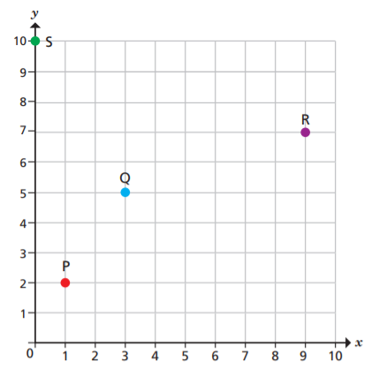
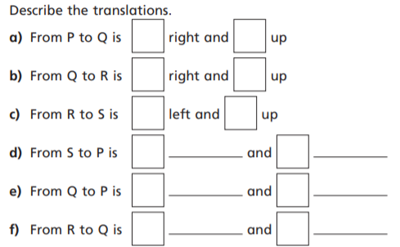
Task 1:

Slide 93
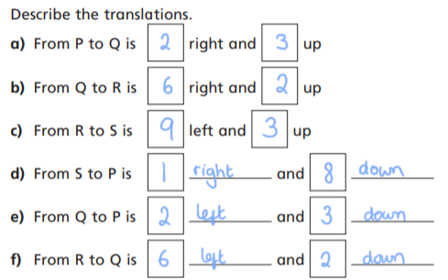
Task 1 answers:

Slide 94
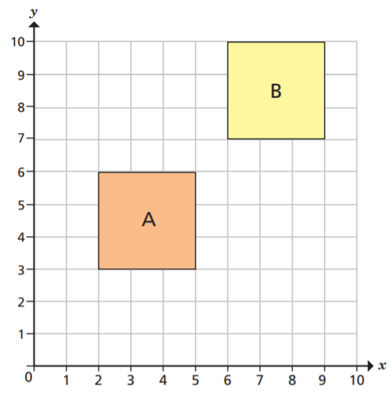
Task 2:
“The translation from A to B is 1 right and 1 up.”
Do you agree?
Explain your answer.

Slide 95
Task 2 answers:
“The translation from A to B is 1 right and 1 up.”
Do you agree?
Explain your answer.
No. The corners closest to each other have been translated, instead of the corresponding corners.

Slide 96
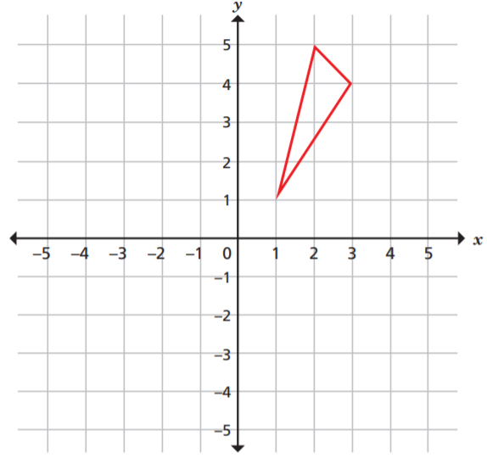
Task 3: Translate the triangle 6 left.

Slide 97
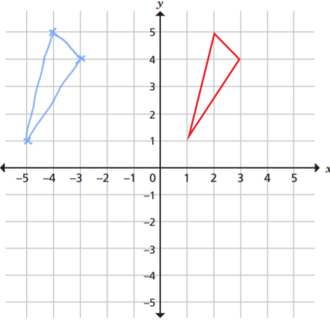
Task 3 answer:

Slide 98
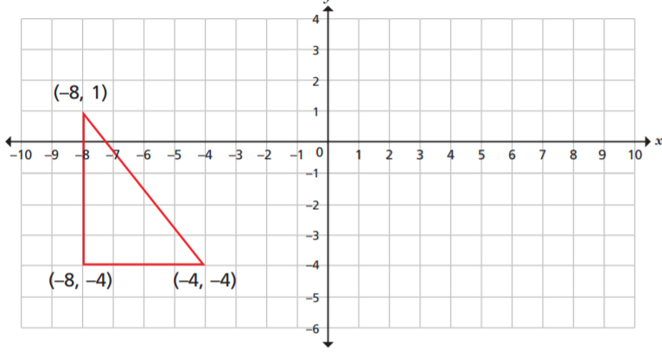
Task 4: Translate the triangle 9 right and 1 down.

Slide 99
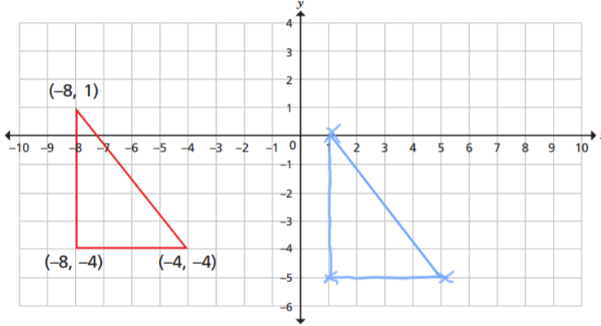
Task 4 answer:

Slide 100
End of Lesson

Slide 101
Date: 05.02.2021
LO: To be able to represent the position of a shape, after a reflection.
Subject: Maths

Slide 102
Times table practise
Spend at least 15mins practising your times tables.
This can be done on TTRS, hit the button or any other times table website.
Use the Times Tables Rock Stars app or website.
Alternatively, copy and paste the following link into a web browser:
https://www.topmarks.co.uk/maths-games/7-11-years/times-tables

Slide 103
Pre-recorded Teaching
Access the online teaching video below that will support you to complete the work in this lesson. This video will act as a support but all of the work can still be successfully understood & completed using paper-based versions of this pack. If you need further support to understand / complete work then please contact school via e-mail or telephone.
Play Video
You can also copy and paste this link if you would prefer:
https://classroom.thenational.academy/lessons/reflecting-simple-shapes-6mu3ec?step=2&activity=video

Slide 104
Recap
1) Translate shape A
2 left and 4 down.
2) Write the coordinates
of each vertex of the
translated shape.
3) Describe the translation
from shape A to C.
A
C

Slide 105
1) Translate shape A
2 left and 4 down.
2) Write the coordinates
of each vertex of the
translated shape.
3) Describe the translation
from shape A to C.
A
C
(0,2) (5,2) (0,5) (5,5)
9 left and 11 down.

Slide 106
Reflections

Slide 107

What’s changed?
What’s stayed the same?
The boy looks the same, however his image has been ‘flipped’ in the mirror.
He has his right hand out, but in the mirror, it looks like his left hand

Slide 108


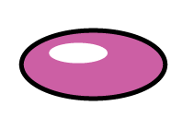
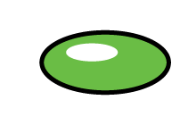


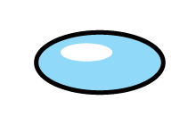
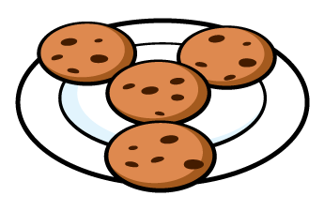
Which images are reflections? Which images are not?

Slide 109
Which images are reflections? Which images are not?

Slide 110
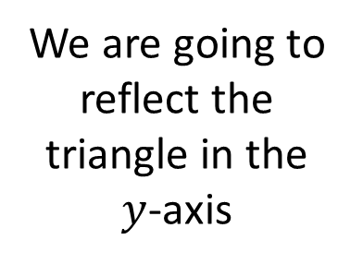
2 away
We are going to reflect the triangle in the $y$-axis
5 away
You can see that each point is reflected the same distance from the mirror line.
This is unlike translation, where the shape does not change!
The y-axis is the vertical line, here.
In this case, this is the mirror line

Slide 111
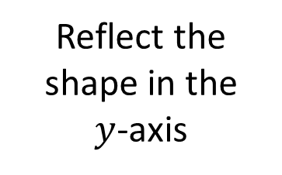
2 away
5 away
Reflect the shape in the
$y$-axis
6 away
3 away
We count how many squares each point of the shape is away from the mirror line.
We then plot that point the same distance on the other side of the mirror line.

Slide 112
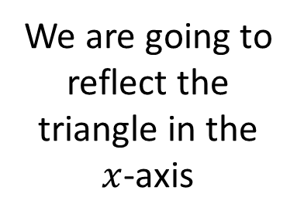
6 away
We are going to reflect the triangle in the $x$-axis
2 away
This time, the mirror line is the x-axis (horizontal line).

Slide 113
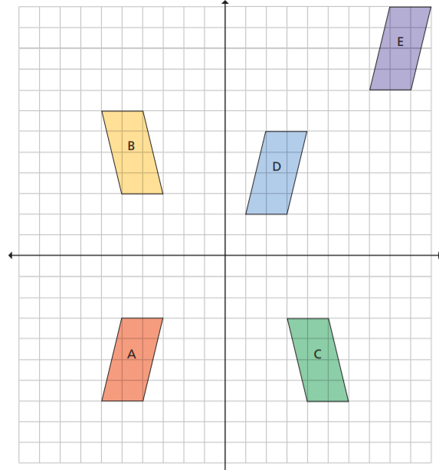
Task 1: Five parallelograms are shown on the coordinate grid.
Circle the shapes that are reflections of shape A.

Slide 114
Task 1 answers:

Slide 115
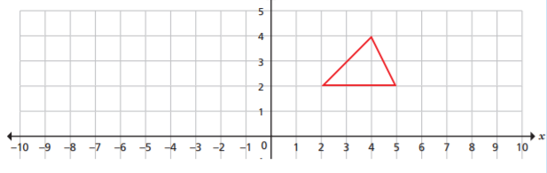
Task 2: Reflect the triangle in the y-axis

Slide 116
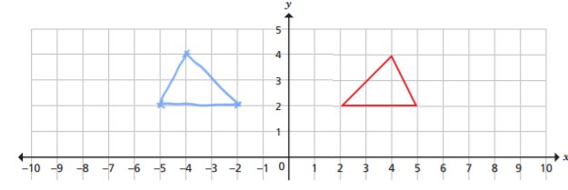
Task 2 answers: Reflect the triangle in the y-axis

Slide 117
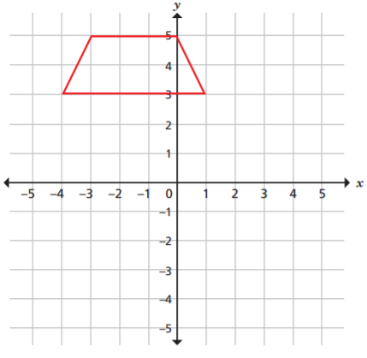
Task 3: Reflect the shape in the x-axis

Slide 118
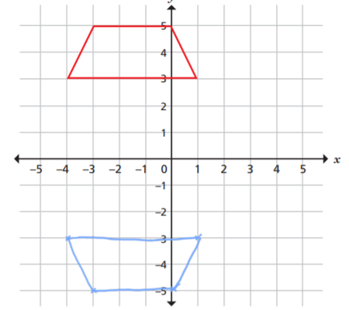
Task 3 answer:

Slide 119
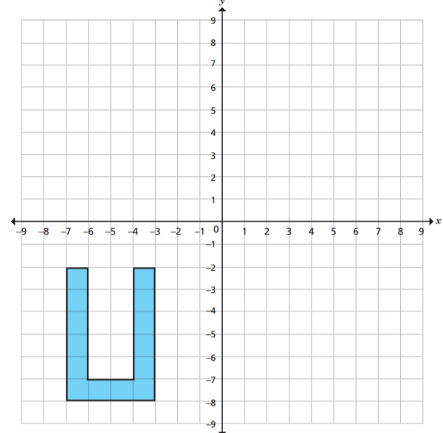
Task 4: Translate the shape in the x-axis.

Slide 120
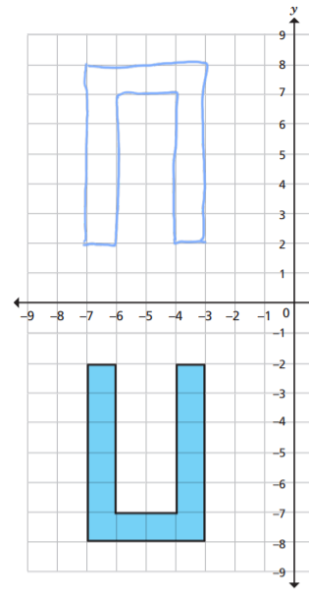
Task 4 answer:

Slide 121
End of Lesson

