Slide 1


Monday 25th January 2021
LO To be able to investigate artefacts.
Subject: History

Slide 2
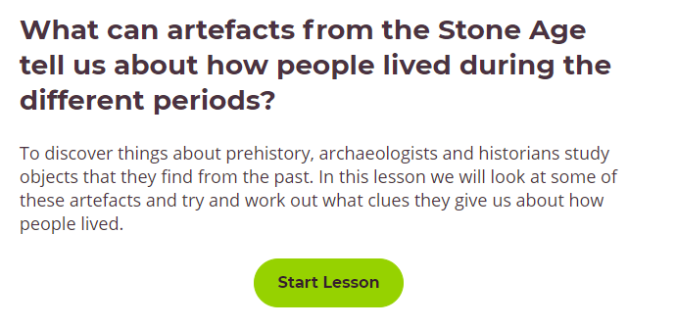
Click on the link to watch an online lesson about the Stone Age.
https://classroom.thenational.academy/lessons/what-can-artefacts-from-the-stone-age-tell-us-about-how-people-lived-during-the-different-periods-6wtk8c

Slide 3
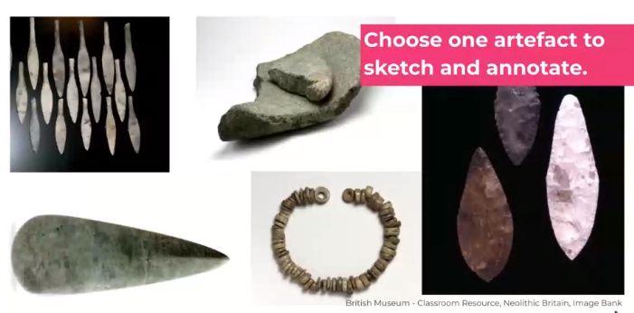
Label each artefact from the online lesson. How many can you remember?

Slide 4
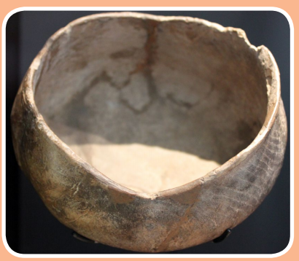
We are going to be archaeologists and look closer at some more artefacts.
For each one complete the sentences with your ideas.
1
What do you think this artefact is?
I think this artefact is a ____________________.
2. What is it made from?
I think it is made from ____________________.
3. How would it have been used?
It would have been used for ______________________.

Slide 5
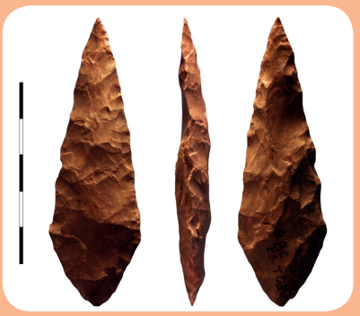
Use the sentences starters from the previous page to write your answers
to the questions.
2
What do you think this artefact is?
____________________________________________________________________________________________________________
2. What is it made from?
____________________________________________________________________________________________________________
3. How would it have been used?
____________________________________________________________________________________________________________

Slide 6
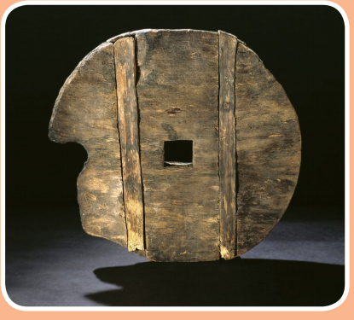
Use the sentences starters from the previous page to write your answers
to the questions.
3
What do you think this artefact is?
____________________________________________________________________________________________________________
2. What is it made from?
____________________________________________________________________________________________________________
3. How would it have been used?
____________________________________________________________________________________________________________

Slide 7
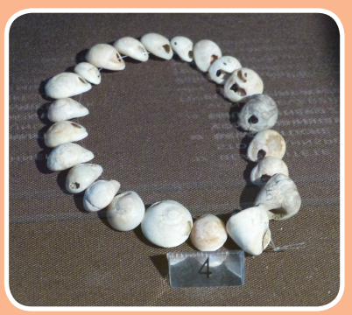
Use the sentences starters from the previous page to write your answers
to the questions.
4
What do you think this artefact is?
____________________________________________________________________________________________________________
2. What is it made from?
____________________________________________________________________________________________________________
3. How would it have been used?
____________________________________________________________________________________________________________

Slide 8
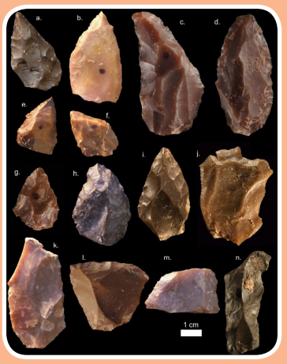
Use the sentences starters from the previous page to write your answers
to the questions.
5
What do you think this artefact is?
____________________________________________________________________________________________________________
2. What is it made from?
____________________________________________________________________________________________________________
3. How would it have been used?
____________________________________________________________________________________________________________

Slide 9
Answer sheet
Wooden bowl – dated around 3,700BC. May have been used for cooking, eating or making items such as candles.
Spear heads – stones that have been formed into sharp heads. Some believe they could have also been used as knives.
3. Chariot wheel – made from maple and oak wood. Dated around 2,700BC
Snail shell necklace – made from Nerite snail shells with man-made holes. Believed to be dated 25,000BC
Stone tools – an assortment of Stone Age tools found in Morocco.
Believed to be 300,000 years old.

Slide 10
Tuesday 26th January 2021
LO To be able to sort food from the Stone Age.
Subject: History

Slide 11
Life in the Palaeolithic era could be tough.
There was a constant search for food which meant moving around, hunting and gathering.
Over time, farming techniques developed which meant people settled in one place. Today we are going to be thinking about what life would have been like for the early
hunter-gatherers.

Slide 12
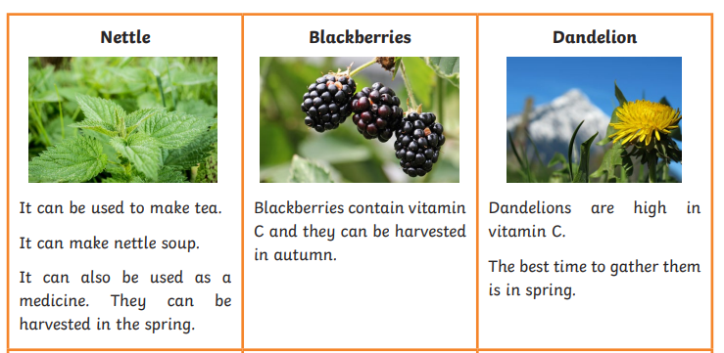
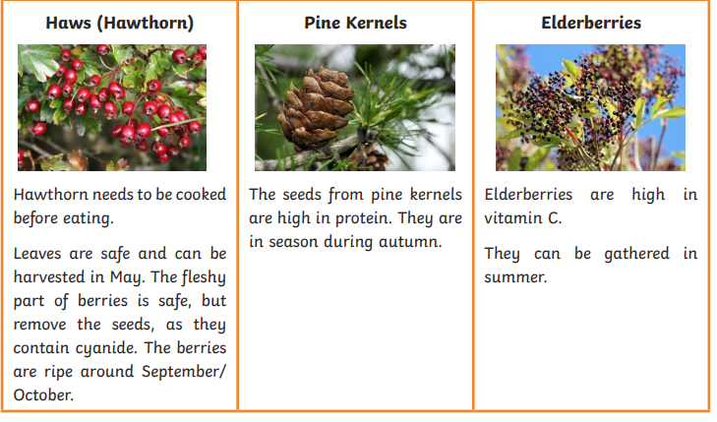
Cut out the cards and ask your adult helper to hide them around the house or even in the garden.
You will need to become a gatherer to find enough cards to make a meal.
Watch out for the poisonous food!

Slide 13
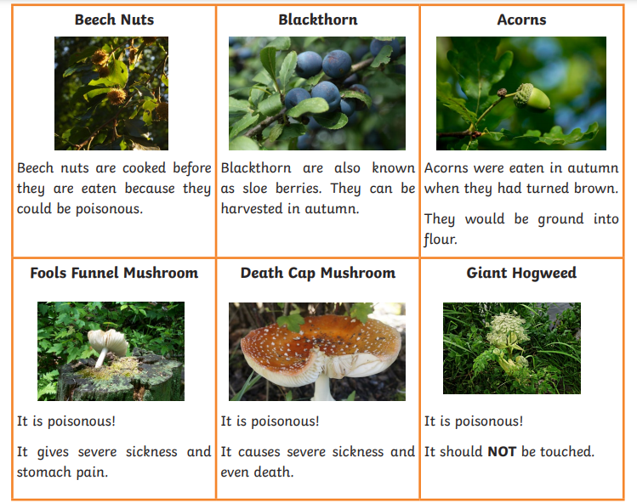

Slide 14
Stone Age Survival – Seasons Wheel
Task: Draw, stick or write the names of the food you gathered on to the
correct season on the plate on the next slide.
In which seasons were you able to gather the greatest variety of food?
___________________________________________________________
___________________________________________________________
What would you need to do with the food to help you have enough for all year?
____________________________________________________________
____________________________________________________________

Slide 15
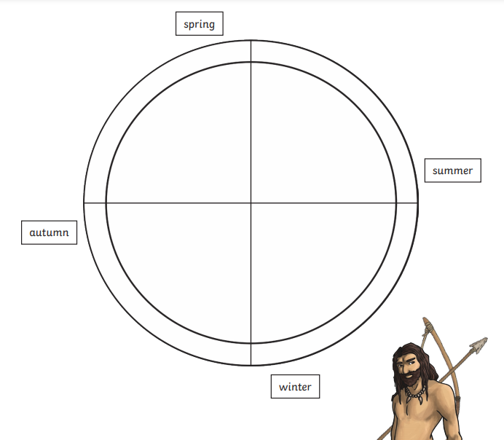

Slide 16
People living in the Stone Age were also good at hunting for their food. They could hunt animals all year.
When do you think it would be easiest to hunt for animals?
_____________________________________________________________________________________
_____________________________________________________________________________________
2. When would it be most difficult?
_________________________________________________________________________
_________________________________________________________________________
3. Do you think the animals would migrate (move away) and would
this be a problem for stone-age hunter-gatherers?
_____________________________________________________________________________________
_____________________________________________________________________________________

Slide 17

Thursday 28th January 2021
LO To be able to understand the importance of rules, laws, rights and responsibilities
Subject: PSHE

Slide 18

Video about laws, rights and responsibilities
https://www.youtube.com/watch?v=TyP09S0UEzA
Video about rights and responsibilities
https://www.youtube.com/watch?v=vL8539Zp9a8

Slide 19
Think about the following questions..
Why do we have laws and rules?
What would happen if we didn’t have laws or rules?
What happens when we break laws?

Slide 20
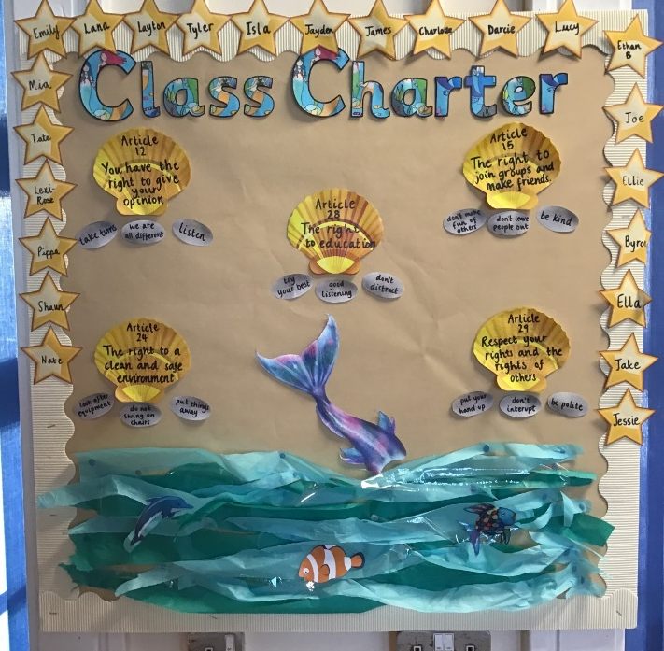
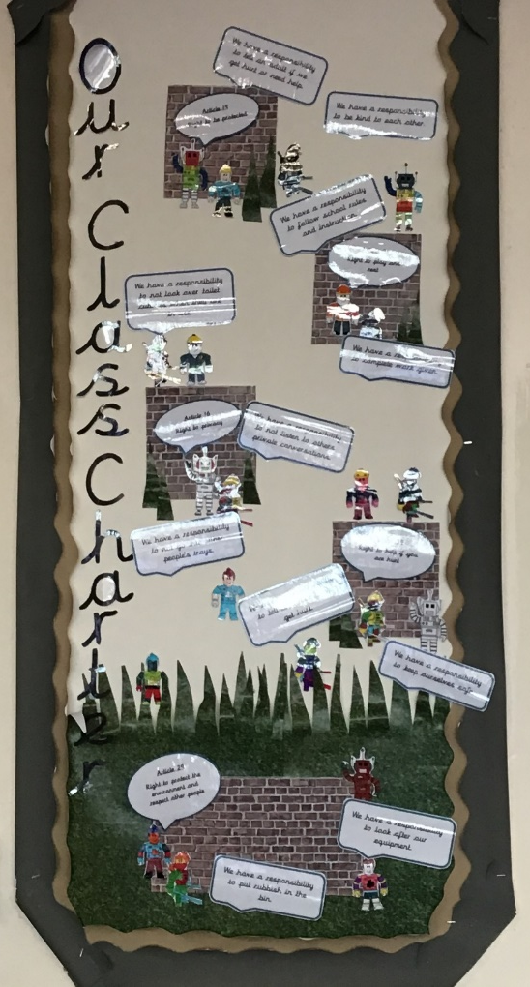
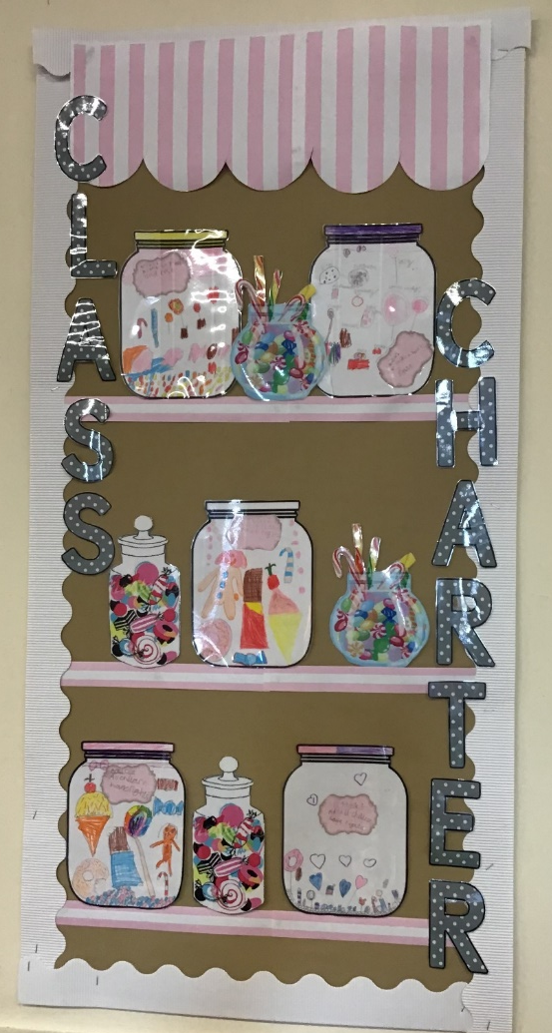
Class Charter
In September, each class created a class charter displaying their 5 most important rights. Alongside these rights, the children decided what their responsibilities were to make sure these rights were fulfilled.

Slide 21

Rights and Responsibilities
Example
Right
Responsibility
It is your responsibility is to tell some one if you are hurt.
On the next slide are some of your rights. Write down one example of your responsibility beside each right.

Slide 22



It is my responsibility to ____________________ ____________________________________________________________
Think about if you want people to listen to you sharing things, what do they want you to do?
It is my responsibility to _______________ ____________________________________________________________
Think about if you don’t want people to go into your tray or bags, what must you not do?
It is my responsibility to _______________ ____________________________________________________________
What must you do to keep the environment clean?

Slide 23






Last week we looked at belonging to a community or a group. Can you create a poster on how to keep yourself and others safe whilst taking part in a group.
Example
Swimming
RUles
If you need help with what group to use, here are some ideas:
Football
Dancing
Swimming
Tig
Classroom
School
Climbing frame
It must include:
At least 4 points on how keep everyone safe
Pictures/drawings
Title
How to keep safe in the water

Slide 24
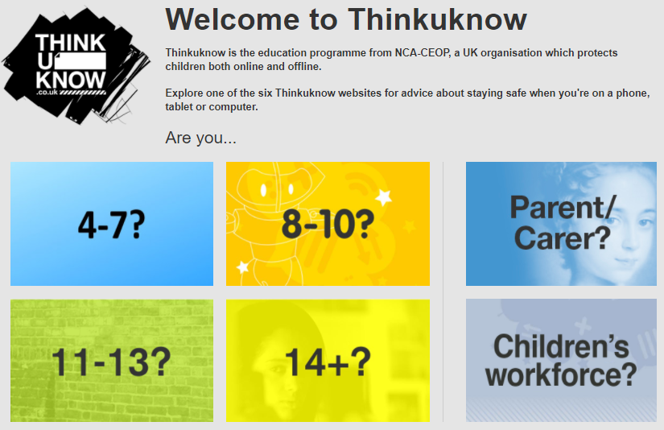
How to keep safe online…
Try the following link about keeping safe online.
https://www.thinkuknow.co.uk/
Write down 5 facts you know about how to keep safe online.
________________________________________________________________________________________________________________________________________________________________________________________________________________________________________________________________________________________________________________________________________________________________________________________________________________________________________________________________________________________________________________________________________________________________________________________________

Slide 25

Friday 29th January 2021
L.O To be able to ask somebody how they are and respond.
Subject: French

Slide 26
Watch the video below to help you pronounce the greetings and introductions.
https://www.bbc.co.uk/teach/supermovers/ks1--ks2-mfl-french-greetings-with-ben-shires/zdpdvk7

Slide 27
On the next slide practise asking ‘how are you?’ and responding in French.

Slide 28
How are you?
English French
How are you?
Comment ça va?
I’m good
Ça va bien
I’m not good
Ça va mal
I’m ok
Pas mal
So-so
Comme-çi comme-ça
Thank you
Merci

Slide 29
On the following slides practise asking ‘how are you?’ and responding.
Test yourself to see if you can remember what each of the phrases mean. Use the pictures to help you!

Slide 30

Bonjour!
What other greetings could we use?

Slide 31

?
?
?
?
Comment ça va?

Slide 32
Ça va bien

Slide 33
?
?
?
?
Comment ça va?

Slide 34
Ça va mal

Slide 35
?
?
?
?
Comment ça va?

Slide 36

Pas mal

Slide 37
?
?
?
?
Comment ça va?

Slide 38

Comme-çi comme-ça!

Slide 39

?
?
?
?
Can you remember how to say thank you in French?
Merci

Slide 40
Task
Copy out each of the phrases below, filling in the missing letters.
The first one has been done for you.
_________________________________________________________________________________________________________________________________________________________________________________________________________________________________________________________________________________________________________________________________________________________________________________________________________________________________________________________________________________________________________________________________________________________________________________________________________________________________________________________________________________________________________________
Friday 29th January 2021
L.O To be able to ask somebody how they are and respond.
Pas m _ _
a l
2. Com _ _ _ t ça _ _?
3. _ a va _ _ l
4. Ça va b _ _ n, mer _ _
5. Co _ _ e-ç _ _ _ _ me-ç _

Slide 41
Extend
Now, have a go at writing a simple conversation of your own.
Choose a greeting, ‘how are you?’ and a response to make your conversation.
Copy the example on the following slide and then make up your own underneath.

Slide 42
Remember you can add ‘merci’ to your response to say thank you.
________________________________________________________________________________________________________________________________________________________________________________________________________________________________________________________________________________________________________________________________________________________________________________________________________________________________________
6. Salut!
Comment ça va?
Ça va bien, merci.
7. Greeting
‘How are you?’
Response
1
2
3
Greeting
‘How are you?’
Response
Salut
Ça va bien
Bonjour
Ça va mal
Bon après-midi
Comment ça va?
Pas mal
Bonsoir
Bonne nuit
Comme-çi comme-ça

Slide 43
Friday 29th January 2021
LO To be able to make cave drawings.
Subject: Art

Slide 44
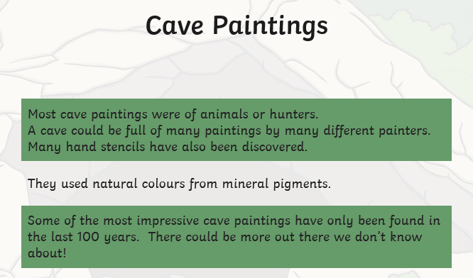

Slide 45
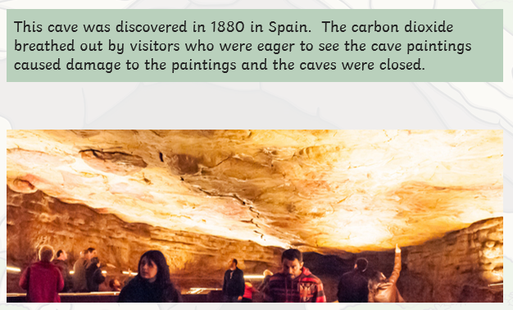
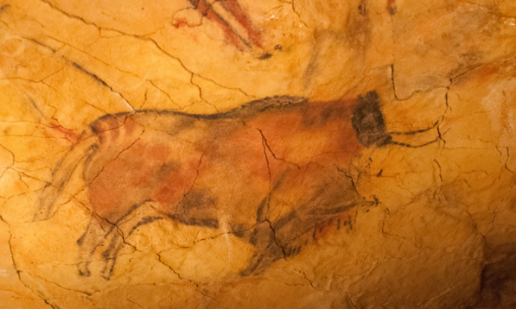
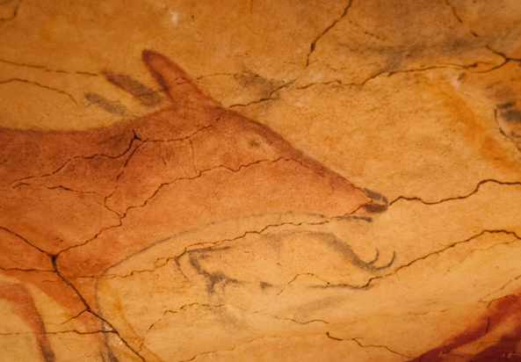
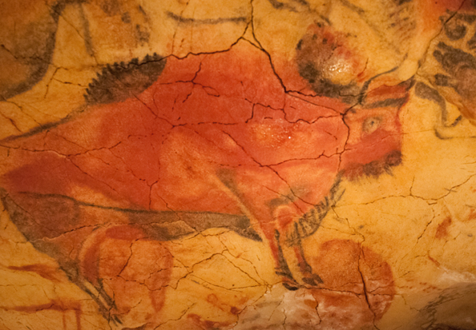
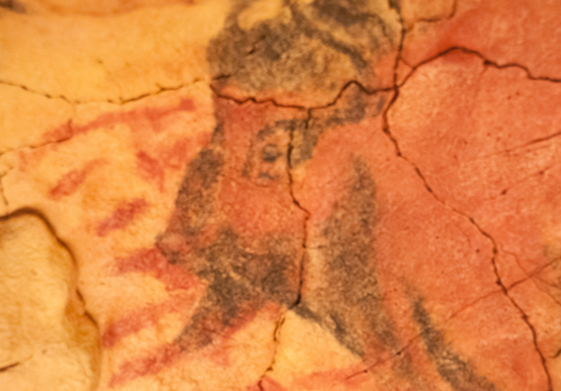

Slide 46
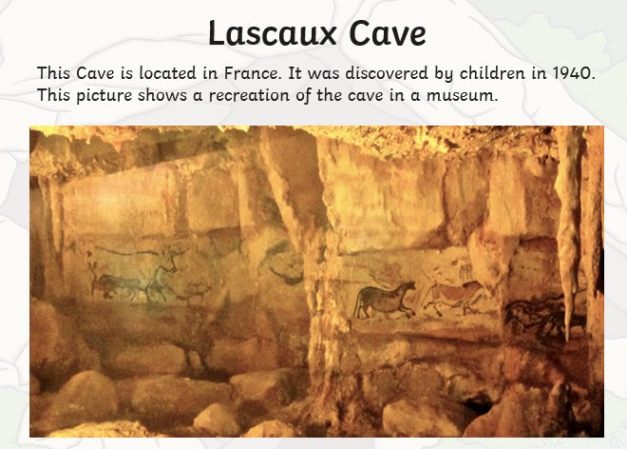
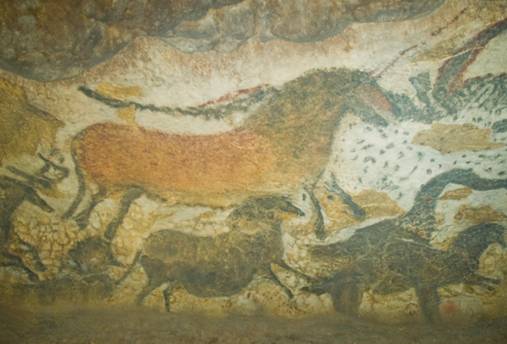
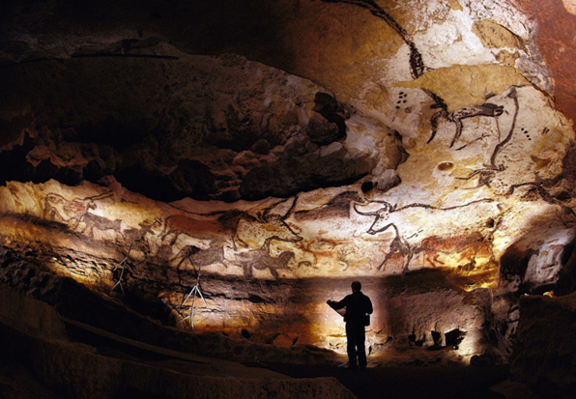
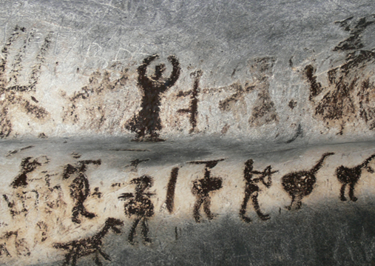

Slide 47
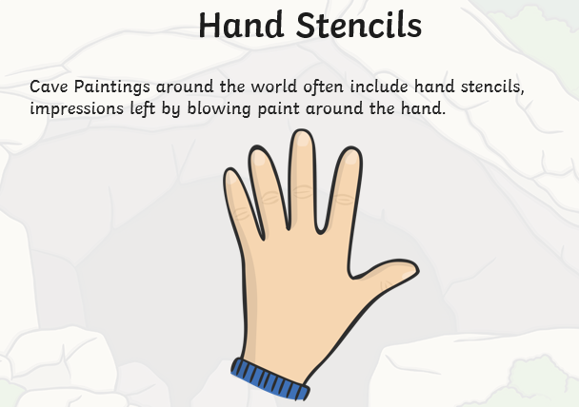
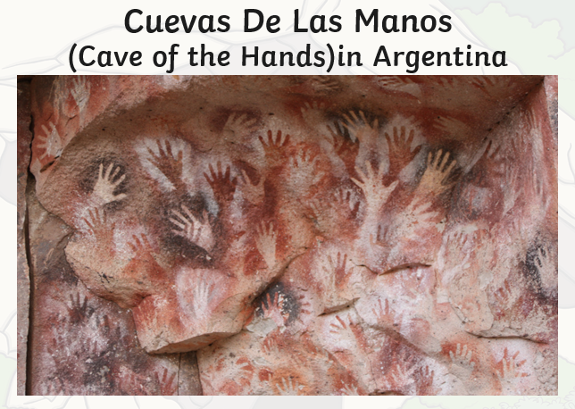
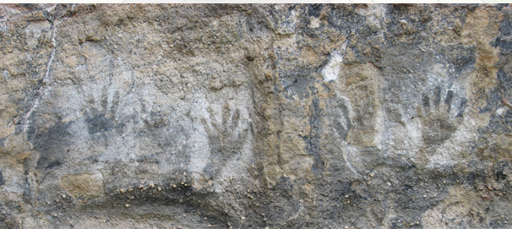
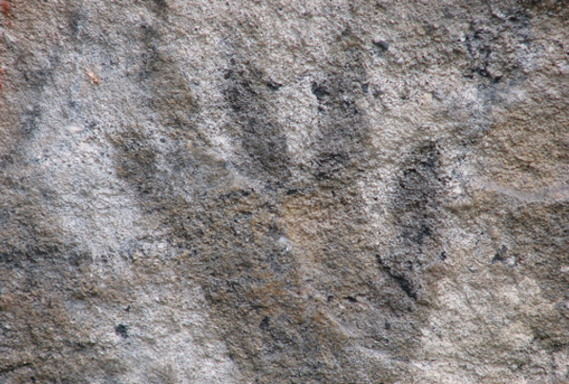

Slide 48
You are going to paint your own cave drawings.
The colours in the paintings were made from mineral pigments, so you will need to use natural colours, such as red, black and white.
The cave walls were often uneven so you might want to crumple your paper to make it feel
like you are writing on a rough wall.
You can use paints, chalks, coloured pencils or crayons.
Instructions
Crumple your paper.
Use the paints or chalks to draw an animal and a hunter. Use the pictures to give you some ideas.
Draw around your hand to make an outline of your hand.

Slide 49

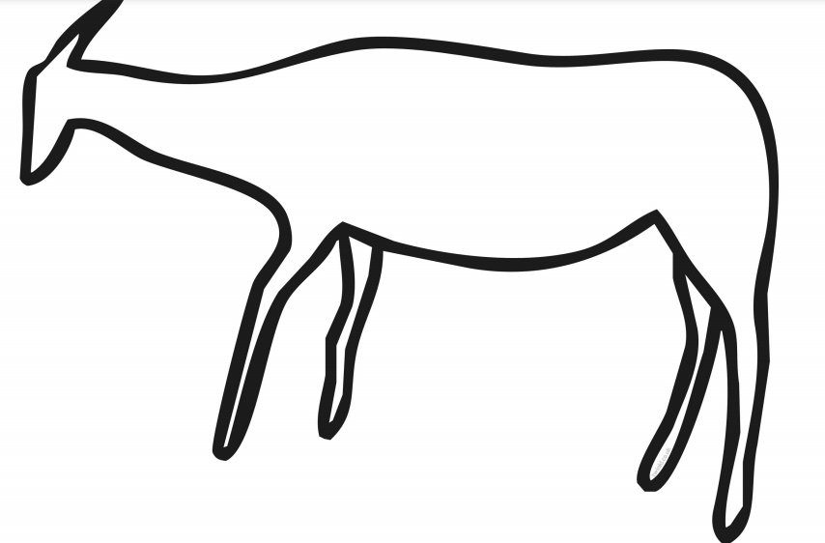

You could cut and stick these animals
or use them as template to draw over.

Slide 50


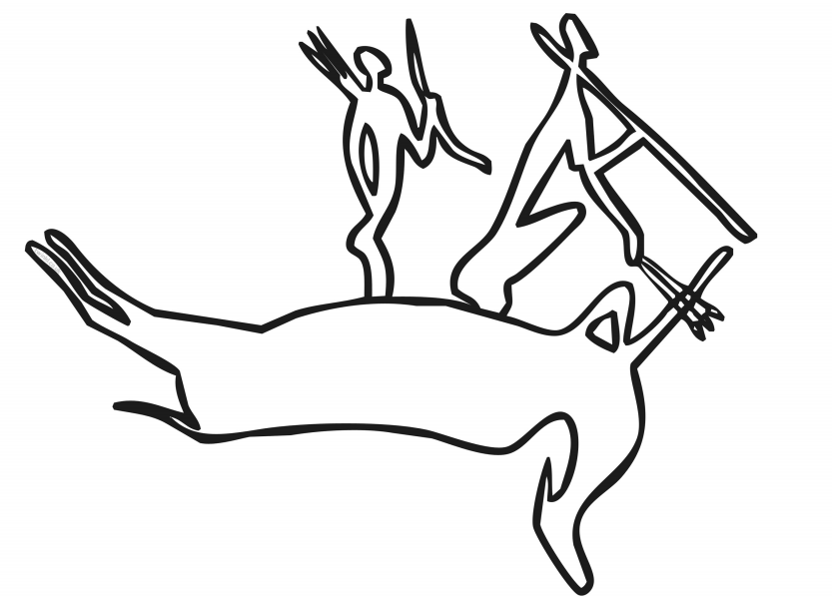
You could cut and stick these
hunter images or use them
as a template to draw around.

